Slide 1


Slide 2
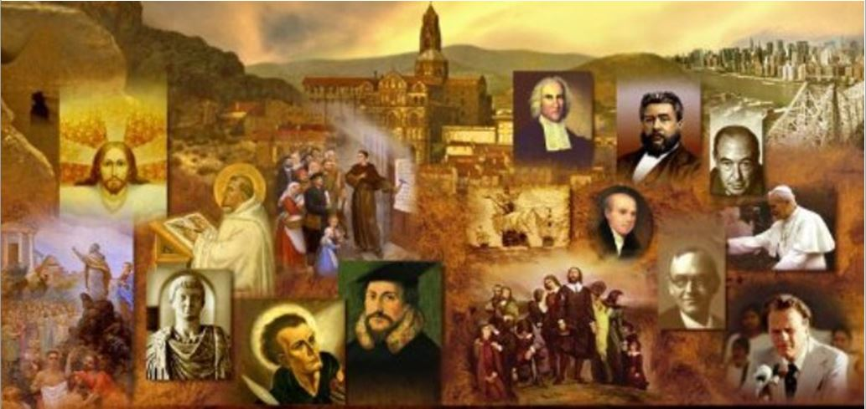
Review
At the turn of the century, after the apostles had died, the Church, for the most part, looked to the scriptures as its source of divine revelation.
But in the latter half of the second century (c.165–170), a new group emerged that rekindled interest in prophetic and charismatic gifts.
Name the group and tell from what region it seems to have emerged.
Montanism emerged from Phrygia in Asia Minor
Who were the three principle individuals who seem to have started the group and what name did they give to their movement?
Montanism was started by an enigmatic individual named Montanus along with two prophetesses: Priscilla and Maximilla.
They referred to themselves as “The New Prophesy”

Slide 3
Review
What were the three features or behaviors that we said characterized the Montanists:
Prophetic utterances.
Ecstatic experiences.
Apocalyptic fervor.
Montanus claimed to be the mouthpiece of God himself.
What passage of scripture did Montanus say had promised and foretold his spiritual abilities?
He claimed that he was the Paraclete (Greek word for “Helper”) or manifestation of the Holy Spirit promised in John 14:16 and 16:12-13.
Besides claiming divine revelation, what were the Montanists also known for and why did it cause serious concern among the Orthodox churches?
Montanists were known for their ecstatic experiences and trance-like states.
The Orthodox churches maintained that in instances of true prophecy described in Scripture, this is not how prophets behaved.

Slide 4
Review
Although the Montanists referred to their movement as “the New Prophecy”, the Montanist prophets did not offer any new doctrinal revelations.
What was the primary subject of their revelations?
Their main “prophetic” message was the nearness of the second coming of Christ
In the light of this imminent return of the Lord, Montanists taught a severe moral code.
What were some of their distinctive moral teachings?
An absolute ban on second marriages in all circumstances
An obligation to frequent fasting
The veiling of virgins
“Serious” sins committed after one’s baptism cannot be forgiven.
Christians must never seek to escape persecution and martyrdom but embrace them eagerly.

Slide 5
Review
Who was the well known orthodox leader who embraced Montanism thus giving it some credibility in the eyes of the other orthodox leaders?
Tertullian
The Montanist movement was not condemned with the same degree of swiftness and clarity as other divergent groups (such as the Gnostics or Marcionites).
But what did the orthodox churches finally decide concerning Montanism?
According to Eusebius, the churches in Asia assembled together to discuss the New Prophecy and “tested the recent utterances, pronounced them profane, and rejected the heresy – then at last the Montanists were driven out of the church and excommunicated”.

Slide 6
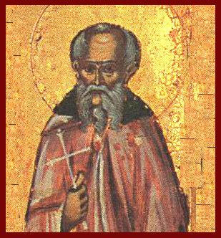
Melito of Sardis
https://alchetron.com/Melito-of-Sardis#-

Slide 7
*Melito of Sardis
Melito served as the bishop of Sardis in Asia Minor,
In his own day Melito was a famous writer of many books
He was active in the period AD 170–180.
Tertullian, the great African theologian, admired Melito’s writings.
Sadly, almost all Melito’s writings have been lost to us.
Melito wrote an apology addressed to Marcus Aurelius.
We also owe to Melito the first known Christian list of books contained in the Old Testament.
He made a special trip to Palestine to seek information about the Hebrew Scriptures; his list corresponds with the Jewish and Protestant Old Testament of today and omits the Apocrypha.
* Needham, Nick. 2,000 Years of Christ's Power Vol. 1: The Age of the Early Church Fathers

Slide 8
*Melito of Sardis
Melito also wrote a commentary on the Book of Revelation.
The loss of this and of his books “On the Church" and “On the Lord’s Day" are perhaps to be regretted most.
One of the fragments of Melito that has been preserved is one from a work entitled “On Faith”, which contains a remarkable Christological creed, an eloquent expansion of the Regula Fidei (Rule of Faith).
*Schaff, Philip. History Of The Christian Church (The Complete Eight Volumes In One) . Kindle Edition.

Slide 9
*Excerpt from On Faith by Melito of Sardis
Our Lord Jesus Christ is Perfect Reason;
The Word of God;
Who was begotten before the light;
Who was Creator with the Father;
Who was the Fashioner of man;
Who was all things in all;
Patriarch among the patriarchs,
Law in the law,
Chief Priest among the priests,
King among the kings,
Prophet among the prophets,
Archangel among the angels;
*Schaff, Philip. History Of The Christian Church (The Complete Eight Volumes In One) . Kindle Edition.

Slide 10
*Excerpt from On Faith by Melito of Sardis
He piloted Noah,
Guided Abraham,
Was bound with Isaac,
Exiled with Jacob,
Was Captain with Moses;
He foretold his own sufferings
in David and the prophets;
He was incarnate in the Virgin;
Worshipped by the Magi;
*Schaff, Philip. History Of The Christian Church (The Complete Eight Volumes In One) . Kindle Edition.

Slide 11
*Excerpt from On Faith by Melito of Sardis
He healed the lame,
Gave sight to the blind,
Was rejected by the people,
Condemned by Pilate,
Hanged upon the tree,
Buried in the earth,
Rose from the dead and appeared to the apostles,
Ascended to heaven;
*Schaff, Philip. History Of The Christian Church (The Complete Eight Volumes In One) . Kindle Edition.

Slide 12
*Excerpt from On Faith by Melito of Sardis
He is the Rest of the departed,
The Recoverer of the lost,
The Light of the blind,
The Refuge of the afflicted,
The Bridegroom of the Church,
The Charioteer of the cherubim,
The Captain of angels;
God who is of God,
The Son of the Father,
The King for ever and ever.
*Schaff, Philip. History Of The Christian Church (The Complete Eight Volumes In One) . Kindle Edition.

Slide 13
*Melito of Sardis
In his book, The Forgotten Trinity, James White includes his translation of a sermon that Melito preached on the Passover around AD 180.
Remember, this sermon was preached approximately 145 years prior to the Council of Nicaea, 130 years prior to Constantine's battle at the Milvian Bridge (where he allegedly saw the sign of the cross in the sky and the phrase, "in this sign, conquer").
James White comments: “As you read these words, rejoice, as I rejoice, at the thought of this ancient believer and the fact that he reveled in the truth about the God-man Jesus Christ just as we do today. Oh that we had more preaching like this in our land today!"
* Based on notes taken from James White’s 2016 Church History Series; Lesson 18 – Melito of Sardis

Slide 14
*Excerpt from a Passover Sermon by Melito of Sardis
And so he was lifted up upon a tree and an inscription was attached indicating who was being killed.
Who was it?
It is a grievous thing to tell, but a most fearful thing to refrain from telling.
But listen, as you tremble before him on whose account the earth trembled!
He who hung the earth in place is hanged.
He who fixed the heavens in place is fixed in place.
He who made all things fast is made fast on a tree.
The Sovereign is insulted.
God is murdered.
The King of Israel is destroyed by an Israelite hand.
* Based on notes taken from James White’s 2016 Church History Series; Lesson 18 – Melito of Sardis

Slide 15
*Excerpt from a Passover Sermon by Melito of Sardis
This is the One who made the heavens and the earth,
And formed mankind in the beginning,
The One proclaimed by the Law and the Prophets,
The One enfleshed in a virgin,
The One hanged on a tree,
The One buried in the earth,
The One raised from the dead and who went up into the heights of heaven,
The One sitting at the right hand of the Father,
The One having all authority to judge and save,
Through Whom the Father made the things which exist from the beginning of time.
* Based on notes taken from James White’s 2016 Church History Series; Lesson 18 – Melito of Sardis

Slide 16
*Excerpt from a Passover Sermon by Melito of Sardis
This One is "the Alpha and the Omega,"
This One is "the Beginning and the End"
The beginning indescribable and the end incomprehensible.
This One is the Christ.
This One is the King.
This One is Jesus.
This One is the Leader.
This One is the Lord.
This One is the One who rose from the dead.
This One is the One sitting on the right hand of the Father.
He bears the Father and is borne by the Father.
“To him be the glory and the power forever. Amen.”
* Based on notes taken from James White’s 2016 Church History Series; Lesson 18 – Melito of Sardis

Slide 17
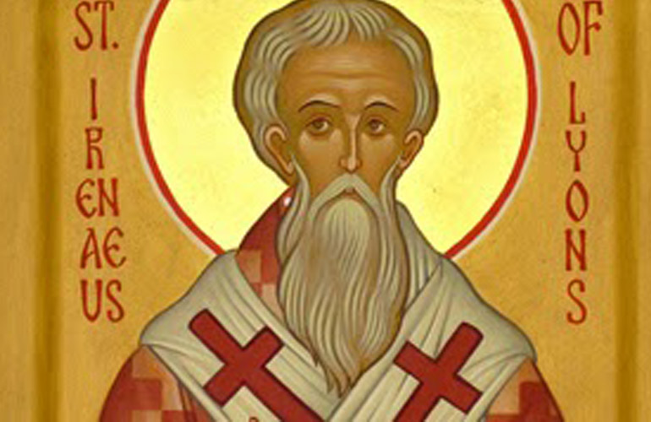
Irenaeus of Lyons
https://www.livingfaith.in/news/st-irenaeus-of-lyons/1415

Slide 18
*Irenaeus of Lyons
Irenaeus was a native of Asia Minor— probably Smyrna— where he was born around the year 130.¹
As a boy Irenaeus was taught by the bishop of Smyrna, Polycarp, who as a young man had known the apostle John. ²
Polycarp’s chief delight in his old age was to recount all the conversations he had had with John. ²
Through bishop Polycarp, then, Irenaeus and the apostle John were closely linked: John taught Polycarp, Polycarp taught Irenaeus. ²
¹ Gonzalez, Justo L.. The Story of Christianity: Volume 1: The Early Church to the Dawn of the Reformation (p. 84).
² Needham, Nick. 2,000 Years of Christ's Power Vol. 1: The Age of the Early Church Fathers

Slide 19
*Irenaeus of Lyons
Irenaeus moved to Lyons in southern France as a young man.
Lyons was the capital of Roman France; founded by the Romans in 43 BC.
By Irenaeus’s time Lyons had become a large prosperous city, thronged by merchants from every part of the Empire.
The churches of southern France had been planted by Christians from Asia Minor, so a bond existed between Irenaeus’s homeland and Lyons.
The bishop of the church in Lyons at this point, a man called Pothinus, was himself a native of Asia Minor, and Irenaeus became one of his presbyters.
* Needham, Nick. 2,000 Years of Christ's Power Vol. 1: The Age of the Early Church Fathers

Slide 20
*Irenaeus of Lyons
In AD 177, a storm of fierce persecution swept over the churches in Lyons; and in that persecution many Christians perished, including bishop Pothinus.
Irenaeus was probably away in Rome at the time, and so escaped the ordeal.
When he returned to Lyons he was elected bishop in place of the martyred Pothinus.
Irenaeus remained bishop of Lyons until his own death in about AD 200.
* Needham, Nick. 2,000 Years of Christ's Power Vol. 1: The Age of the Early Church Fathers

Slide 21
*Irenaeus of Lyons
Irenaeus was above all a pastor.
He was not particularly interested in philosophical speculation nor in delving into mysteries hitherto unsolved, but rather in leading his flock in Christian life and faith.
Therefore, in his writings he did not seek to rise in great speculative flights, but simply to refute heresy and instruct believers.
* Gonzalez, Justo L.. The Story of Christianity: Volume 1: The Early Church to the Dawn of the Reformation (p. 84).

Slide 22
*Irenaeus of Lyons
Irenaeus stands out as the most important Church father of the 2nd century.
This is because he wrote against the Gnostics a lengthy book usually known as Against Heresies (its longer title is A Refutation and Overthrow of Knowledge Falsely So-called).
The book has survived, mostly in a Latin translation, and come down to us today completely intact.
It is priceless for what it tells us about the beliefs of Christians in the 2nd century and about the Gnostic movement.
Irenaeus also wrote a smaller work against the Gnostics called Proof of the Apostolic Preaching.
* Needham, Nick. 2,000 Years of Christ's Power Vol. 1: The Age of the Early Church Fathers

Slide 23
*Irenaeus of Lyons
We learn several things about Irenaeus from his anti-Gnostic writings.
He was well educated, and knew both Greek philosophy and Greek poetry.
He had a thorough knowledge of the Old Testament, and was familiar with most of the documents which we know as the New Testament (Hebrews, James, 2 Peter and Jude are the only books Irenaeus does not mention).
He displays an astonishing knowledge of the various Gnostic sects and their teachings.
* Needham, Nick. 2,000 Years of Christ's Power Vol. 1: The Age of the Early Church Fathers

Slide 24
*Irenaeus of Lyons
There may have been a personal factor in Irenaeus’s anti-Gnostic crusade: he had a friend called Florinus with whom he had grown up in Smyrna, both having been taught by Polycarp.
In adult life, Florinus had renounced orthodox Christianity and become a follower of the great Gnostic leader Valentinus.
Irenaeus addressed a long letter to Florinus, pleading with him to return to the true faith (unsuccessfully, as far as we know), and Valentinus is the Gnostic teacher whom Irenaeus chiefly attacks in his work, Against Heresies.
* Needham, Nick. 2,000 Years of Christ's Power Vol. 1: The Age of the Early Church Fathers

Slide 25
*Irenaeus’ Arguments Against Gnosticism
Irenaeus gave detailed descriptions of the doctrines of the various Gnostic sects.
Irenaeus believed that simply giving a accurate description of the Gnostic teachings would show how ridiculous, unreasonable, and unworthy of belief they were.
He argued against the Gnostics’ claim that they had a special secret knowledge passed on from Jesus and the apostles.
He pointed out that none of the Gnostic sects agreed with each other about what this secret knowledge was!
* Needham, Nick. 2,000 Years of Christ's Power Vol. 1: The Age of the Early Church Fathers

Slide 26
*Irenaeus’ Arguments Against Gnosticism
On top of this, Irenaeus also employed a persuasive counter-argument, namely that orthodox theology had been reliably passed down from bishop to bishop, all the way from the apostles to his own day.¹
Irenaeus argued that there were many churches which the apostles had actually founded or where the apostles had ministered. Yet none of these apostolic churches knew anything about a so-called secret knowledge.²
On the contrary, they all taught the same orthodox gospel – a gospel which contradicted Gnostic beliefs.²
¹ Kruger, Michael J.. Christianity at the Crossroads: How the Second Century Shaped the Future of the Church (p. 83).
² Needham, Nick. 2,000 Years of Christ's Power Vol. 1: The Age of the Early Church Fathers

Slide 27
*Irenaeus’ Arguments Against Gnosticism
Irenaeus’ argument was later distorted by the Roman Catholics to teach a doctrine that they call apostolic succession, in which they say that God, starting with Peter, had established in the church at Rome a succession of bishops (or “popes”) who had apostolic authority. ¹
But Irenaeus was not saying that these subsequent bishops were apostles, or bore the authority of the apostles, but rather that they preserved the traditions and teachings of the apostles. ²
¹ Needham, Nick. 2,000 Years of Christ's Power Vol. 1: The Age of the Early Church Fathers
² Kruger, Michael J.. Christianity at the Crossroads: How the Second Century Shaped the Future of the Church (p. 83).

Slide 28
*Irenaeus’ Arguments Against Gnosticism
But Irenaeus’ list of a succession of “bishops” in the church at Rome starting with the supposed appointment of the Linus (cf. 2 Tim. 4:21) as the first bishop of Rome by Peter and Paul does have one problem: almost all of our early historical evidence indicates that the church at Rome started with a plurality of elders and continued as such until at least the end of the first century.
We see this from:
All the scriptural examples where the Apostle Paul appoints a plurality of elders in each church (Acts 14:23; 20:17)
1 Clement, which was sent out from the church at Rome at the end of the first century, suggests, as do a number of documents written at that time (e.g. The Didache), that a plurality of “bishops” in each church was the norm at that time.
* Kruger, Michael J.. Christianity at the Crossroads: How the Second Century Shaped the Future of the Church (p. 83).

Slide 29
*Irenaeus’ Arguments Against Gnosticism
But Irenaeus also demonstrated by careful argument from the Bible that Gnostic teachers were in error.
For example, Irenaeus, arguing from the Bible, shows that the God of the Old Testament, and the God of the New Testament, are the same God, and that the Creator of the universe is not some inferior “Demiurge” but the heavenly Father of Jesus Christ.
Irenaeus also argued that salvation did not come through any “secret knowledge”, but through the life and death of Christ.
Taking his cue from Romans 5, Irenaeus interpreted Christ as the “Second Adam”, who by His perfect obedience had reversed and cancelled the disobedience of the first Adam.
* Needham, Nick. 2,000 Years of Christ's Power Vol. 1: The Age of the Early Church Fathers

Slide 30
*Irenaeus’ Arguments Against Gnosticism
Thus Jesus’ obedience by his crucifixion on a tree renewed and reversed what had been done by Adam’s disobedience in connection with a tree.
Here was a great panorama of religious history in which mankind, struck down by the disaster of the Fall, gradually moved forward toward reconciliation with God. “What we lost in Adam, we might regain in Christ, namely the image and likeness of God.”
Even so, the advance had been slow. Not everything had been revealed at once.
Irenaeus set human progress in the framework of four successive “covenants”:
From Adam to Noah,
From Noah to Moses
From Moses to the coming of Christ
And finally the New Covenant of Jesus Christ.
* Frend, W. H. C.. The Early Church – From the Beginnings to 461 (SCM Classics); p. 69

Slide 31
*Irenaeus’ Arguments Against Gnosticism
Each had been valid for its own time, and now, the Holy Spirit was continually renewing the Church.
These arguments enabled Irenaeus to explain the reason for the obviously lower standards of conduct portrayed in patriarchal times compared with the demands of Christian life.
Thus, in Irenaeus Gnostic and Marcionite dualism found itself confronted by an orthodox theory of progressive revelation based on traditional Hellenistic-Jewish and Christian arguments.
Instead of Christ “suddenly appearing” (as the Gnostics taught) , his ministry was the climax of a long process of human development stretching back to the beginning of time.
Irenaeus also affirmed, against Gnostic Docetism, that Christ really took on human flesh, became a real man, really died and really rose again.
* Frend, W. H. C.. The Early Church – From the Beginnings to 461 (SCM Classics); p. 69

