Slide 1


Slide 2
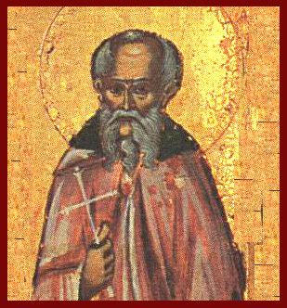
Modern Day
Melito of Sardis?
“That’s My King!” – Dr. S. M. Lockridge
https://alchetron.com/Melito-of-Sardis#-

Slide 3
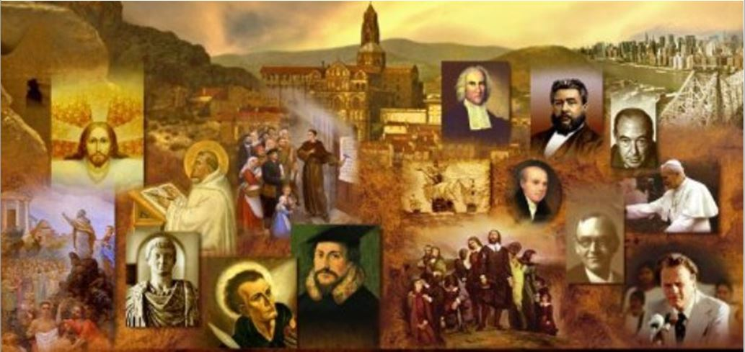
Review
What was Irenaeus’ connection to the Apostle John?
  As a boy Irenaeus was taught by the bishop of Smyrna, Polycarp, who as a young man had known the apostle John.
Does this mean that the Apostle John would have agreed with everything that Irenaeus taught?
  No.
Through what unusual circumstance did Irenaeus end becoming the bishop of Lyons, France?
  In AD 177, Pothinus, the Bishop of Lyons and many other Christians in Lyons were martyred.
  Irenaeus was away on business in Rome at the time, and so escaped the ordeal.
  When he returned to Lyons he was elected bishop in place of the martyred Pothinus.

Slide 4
Review
Irenaeus stands out as the most important Church father of the 2nd century.
Among his accomplishments, he wrote a couple of lengthy books refuting the Gnostics.
What did I suggest may have been a personal factor in Irenaeus’s anti-Gnostic crusade?
  Irenaeus had a friend called Florinus with whom he had grown up in Smyrna, both having been taught by Polycarp.
  In adult life, Florinus had renounced orthodox Christianity and become a follower of the great Gnostic leader Valentinus.
Irenaeus believed that just giving an accurate description of the Gnostic teachings would do what?
  Show how ridiculous, unreasonable, and unworthy of belief they were.

Slide 5
Review
Irenaeus argued that in churches that had been established by the apostles, orthodox theology (which contradicted Gnosticism) had been reliably passed down from bishop to bishop, all the way from the apostles to his own day.
How was Irenaeus’ argument was later distorted by the Roman Catholics to teach a doctrine that they call apostolic succession?
  Roman Catholics say that God, starting with Peter, had established in the church at Rome a succession of bishops (or “popes”) who had apostolic authority. ¹
  But Irenaeus was not saying that these subsequent bishops were apostles, or bore the authority of the apostles, but rather that they preserved the traditions and teachings of the apostles.

Slide 6
Review
Irenaeus’ list of a succession of “bishops” in the church at Rome starting with the supposed appointment of Linus (cf. 2 Tim. 4:21) as the first bishop of Rome by Peter and Paul does have one problem. What is it?
  Almost all of our early historical evidence indicates that the church at Rome started with a plurality of elders and continued as such until at least the end of the first century

Slide 7
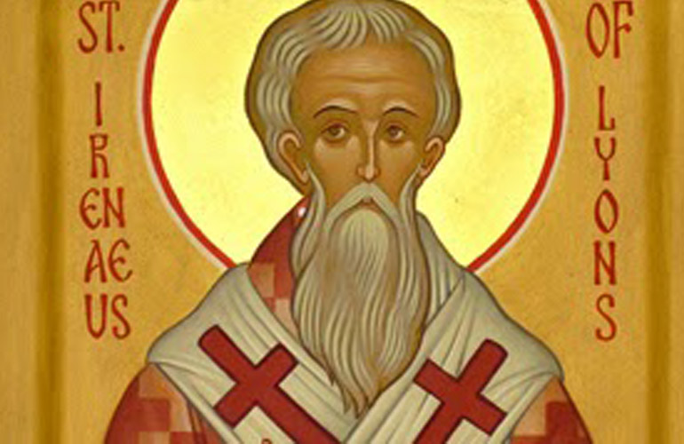
Irenaeus of Lyons
(continued)
https://www.livingfaith.in/news/st-irenaeus-of-lyons/1415

Slide 8
*Effects of Irenaeus’ Response to Gnosticism
The response of Irenaeus and the early Church to Gnosticism had a great effect on the way the Christian faith developed in the patristic age:
It prompted the Church to place a strong emphasis on apostolic tradition – the teaching of the apostles which had been handed down in those churches where the apostles themselves had been active.
We can see this stress on apostolic tradition in three areas:
  The Basic Teachings of the Apostles (aka the Rule of Faith)
  The Churches Founded by the Apostles
  The Inspired Writings of the Apostles (i.e. the New Testament)
* Needham, Nick. 2,000 Years of Christ's Power Vol. 1: The Age of the Early Church Fathers

Slide 9
*The Basic Teachings of the Apostles
In order to refute the false doctrines of the Gnostics, the Church pointed to the basic teachings of the Apostles, or what came to be known as the rule of faith (Latin: regula fidei).
The rule of faith was basically a summary of what the early church fathers believed to be the essential, orthodox apostolic teachings.
Each church had its own version of this “rule of faith”, but they all taught more or less the same thing.
The version used in the Roman church developed into what has become well known in the Western world as the Apostles’ Creed.
* Needham, Nick. 2,000 Years of Christ's Power Vol. 1: The Age of the Early Church Fathers

Slide 10
*The Apostles’ Creed
I believe in God,
the Father Almighty,
Creator of heaven and earth.
And in Jesus Christ,
His only Son,
our Lord,
Who was conceived by the Holy Spirit,
born of the Virgin Mary,
suffered under Pontius Pilate,
was crucified,
died and was buried.
* Needham, Nick. 2,000 Years of Christ's Power Vol. 1: The Age of the Early Church Fathers

Slide 11
*The Apostles’ Creed
On the third day He rose again.
He ascended into heaven
and is seated at the right hand of God the Father Almighty,
from where He will come again
to judge the living and the dead.
I believe in the Holy Spirit,
the holy Catholic Church,
the forgiveness of sins,
the resurrection of the dead,
and the life everlasting.
* Needham, Nick. 2,000 Years of Christ's Power Vol. 1: The Age of the Early Church Fathers

Slide 12
*The Churches Founded by the Apostles
There was also an emphasis on the churches which the apostles themselves had founded, or with which they had been historically connected.
These churches, it was argued, were the guardians of the true apostolic faith, and yet none of them knew anything of the so-called “secret knowledge” of the Gnostics.
Yet if the apostles had passed some “secret knowledge” on to the churches (as the Gnostics claimed), surely it would have been to the leaders of these churches that the apostles would have revealed this knowledge.
* Needham, Nick. 2,000 Years of Christ's Power Vol. 1: The Age of the Early Church Fathers

Slide 13
*The Churches Founded by the Apostles
This emphasis on apostolic churches was the main reason why the Roman church and its bishop became so important in the Western half of the Empire.
There were a good number of apostolic churches in the East; but only one church in the West could claim to have any connection with the ministry of the apostles – the church in Rome, where Paul (and possibly Peter) had taught.
* Needham, Nick. 2,000 Years of Christ's Power Vol. 1: The Age of the Early Church Fathers

Slide 14
*The Churches Founded by the Apostles
Christians in the West, therefore, tended to look to Rome for spiritual leadership.
And throughout the doctrinal controversies of the early Church period, the Roman church had a remarkable record for being on the right, orthodox side.
We see here the beginnings of the process by which the bishop of Rome eventually came to dominate all the other bishops and churches in the West.
The process took four or five centuries to develop.
In Irenaeus’s day, the bishop of Rome was simply the “first among equals”, entitled to a position of paramount respect, but not yet an absolute ruler of the Western Church.
* Needham, Nick. 2,000 Years of Christ's Power Vol. 1: The Age of the Early Church Fathers

Slide 15
*The Inspired Writings of the Apostles
There was a deep concern to preserve the writings of the apostles the New Testament Scriptures, and to make sure that the Church accepted only genuine apostolic Scriptures.
On one hand, the early Church had to guard against Marcion throwing out authentic Scriptures, and the other hand the Gnostics adding their own false teachings to Scriptures.
The criterion by which the Church judged and accepted a writing as authoritative was its connection with the apostles.
If it had been written or dictated by an apostle (e.g. Paul, John, Peter, Matthew), or by someone under apostolic direction (e.g. Mark, who wrote under Peter’s direction, and Luke, who wrote under Paul’s), it was regarded as “Scripture”.
* Needham, Nick. 2,000 Years of Christ's Power Vol. 1: The Age of the Early Church Fathers

Slide 16
*The Inspired Writings of the Apostles
The idea developed of seeing the collected writings of the apostles as a “New Testament” alongside the Old.
We see in the Muratorian Canon (AD 180) and other writings of the time, that most of the books in our present-day New Testament were accepted in Irenaeus’s time; debate lasted for several centuries, however, over Hebrews, James, 2 Peter, Jude, 2 and 3 John, and Revelation.
By the 4th century the Church had reached a consensus that these books, too, were genuine Scripture.
In the East, the 39th Festal Letter of Athanasius, bishop of Alexandria, written in AD 367, contained an authoritative list of New Testament books, corresponding to the New Testament we know today.
In the West, a Church council at Carthage in AD 397 agreed on the same list of authentic New Testament books. This list was called the “canon” of the New Testament, from the Greek word for “rule” or “standard”.
* Needham, Nick. 2,000 Years of Christ's Power Vol. 1: The Age of the Early Church Fathers

Slide 17
*The Catholic Church
The Church acquired a new name for itself from the Gnostic controversy. It called itself the Catholic Church – as in the Apostles’ Creed, “I believe in the holy Catholic church.”
It is essential not to confuse Catholic with Roman Catholic.
We give the title “Roman Catholic” to that branch of the Western Church which, in the 16th century, rejected the Protestant Reformation.
It was only at that point in history that what we today think of as “Roman Catholicism” really came into being, as Rome defined its theology and practice much more clearly in opposition to Protestant views.
* Needham, Nick. 2,000 Years of Christ's Power Vol. 1: The Age of the Early Church Fathers

Slide 18
*The Catholic Church
In contrast to this later term “Roman Catholic”, the early Church in both East and West called itself simply “Catholic”.
The word comes from the Greek katholikos, which means “universal” or “throughout the world”.
By calling itself Catholic, the early Church was setting itself apart from Gnosticism.
The different Gnostic sects had no unity – they all taught conflicting doctrines; but the true Church, founded on the faith of the apostles, taught the same doctrines “throughout the world”.
So the early Christians called themselves “Catholics” to express the unity of their common faith, and to distinguish themselves from Gnostics and other deviant groups.
* Needham, Nick. 2,000 Years of Christ's Power Vol. 1: The Age of the Early Church Fathers

Slide 19
*The Catholic Church
The result of the Gnostic controversy was that the early Church developed a number of special features:
  An emphasis on orthodoxy
  An emphasis on unity
  Tightly controlled church organization
  Church discipline
  The importance of standing in the line of apostolic tradition (which later developed into the doctrine of “apostolic succession”).
These features gave the early Church its unique identity as the Catholic Church.
* Needham, Nick. 2,000 Years of Christ's Power Vol. 1: The Age of the Early Church Fathers

Slide 20
*Irenaeus and the Quartodeciman Controversy
In one of our earlier classes, we briefly discussed the fact that in the middle of the second century, a controversy known as Quartodeciman controversy arose concerning the observation of Easter.
The churches of Asia Minor observed Easter on the precise day of the Passover, the fourteenth of Nisan (in the Hebrew calendar), which does not necessarily always fall on a Sunday.
But the churches of Palestine, Alexandria and Rome always observed Easter on a Sunday, the one that fell just after the fourteenth of Nisan.
* Kruger, Michael J.. Christianity at the Crossroads: How the Second Century Shaped the Future of the Church (p. 93).

Slide 21
*Irenaeus and the Quartodeciman Controversy
Their disagreement was not addressed by one church (or one bishop) declaring authority over another, but by each trying to “persuade” the other.
Although neither was successful, they maintained a peaceful and respectful relationship.
The controversy flared up again at the end of the second century.
According to Eusebius, a number of meetings were called by bishops in various locales – e.g., Jerusalem, Rome, Corinth – all of which declared that Easter should be celebrated on Sunday.
In response, Polycrates, bishop of Ephesus, called together a number of bishops in Asia who reaffirmed the Quartodeciman practice, citing a great lineage of prior individuals who shared that view.
* Kruger, Michael J.. Christianity at the Crossroads: How the Second Century Shaped the Future of the Church (p. 93).

Slide 22
*Irenaeus and the Quartodeciman Controversy
Victor, the bishop of Rome, was frustrated by this response and “tried to cut off” all the Asian churches from fellowship and sent them letters announcing their “absolute excommunication”.
However, Victor was sharply rebuked by Irenaeus and a number of his fellow bishops for making such a move and disturbing the peace of the Church.
As a result, Victor’s bid to excommunicate the other churches failed.
* Kruger, Michael J.. Christianity at the Crossroads: How the Second Century Shaped the Future of the Church (p. 93).

Slide 23
*Irenaeus on the Quartodeciman Controversy
Irenaeus wrote to Victor saying:
  When the blessed Polycarp [who was Bishop of Smyrna – an Asian Church] visited [Anicetus, Bishop of Rome] they made peace immediately, having no wish to quarrel on this point. Anicetus could not persuade Polycarp to observe [Easter on Sunday], since he had always done so with John, our Lord’s disciple, and the other apostles whom he knew. Nor did Polycarp persuade Anicetus to observe (Easter on the 14th of Nisan), who said he was bound to the practice of the presbyters before him. Nevertheless, they communed with each other, and in church Anicetus yielded the consecration of the Eucharist to Polycarp, obviously out of respect. They parted from each other in peace, and in peace the whole church was maintained both by those who observed and those who did not.
*As cited and summarized by Eusebius in The Church History; Translation by Paul Maier; p. 181

Slide 24
*Irenaeus on the Quartodeciman Controversy
This controversy shows two important things:
  The problem of breaking fellowship with other believers over issues which are not definitional to the faith:
    Victor was trying to make the issue of when to celebrate Easter an issue over which to break fellowship.
    Churches in our day do things like that. For example, churches that try to make eschatology an essential issue.
    We need to be careful about doing this.
  By their response to Victor, bishop of Rome, it is clear that the bishops in the late third century did not regard the bishop of Rome as an infallible pope – though the Roman Catholic Church in our day will try to claim that he was.
*Based on notes taken from James White’s 2016 Church History Series; Lesson 19 – Irenaeus (Part 2)

Slide 25
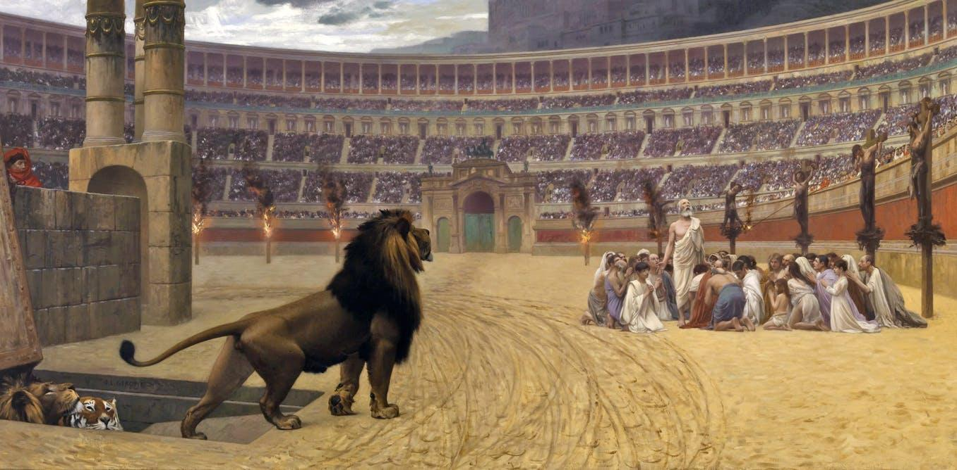
A Further Look at Christian Persecution
https://www.sutori.com/story/world-religions-christianity-7ba5

