Slide 1


Slide 2
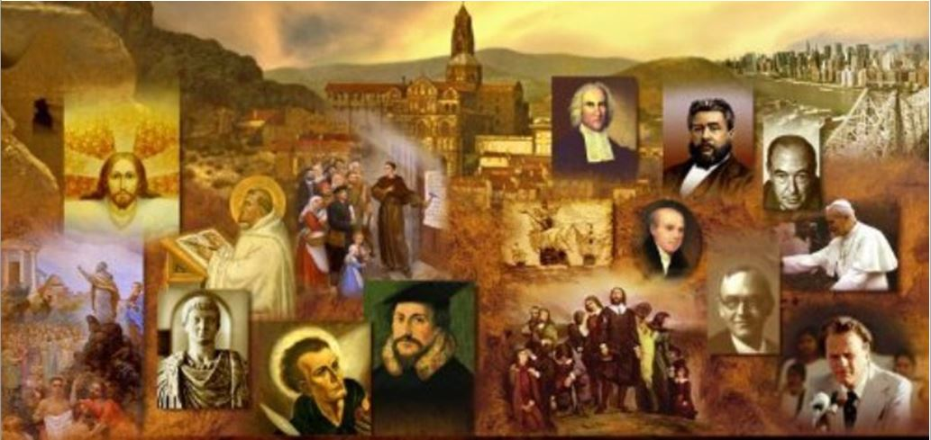
Review
Why should it not come as a surprise to us that Christians throughout time and throughout the world have often suffered terrible persecution?
  Jesus warned us that we would be persecuted (John 15:20).
As we look at the church from AD 30 – AD 313, we see that persecution is not constant everywhere throughout the empire – rather it comes and goes in spurts and tends to occur in particular local areas, for the most part.
Who was the first Roman Emperor to persecute Christians and what was he like as an emperor?
  The First major Roman persecutor was Nero who reigned from AD 54-68.
  Nero, in a word, was insane. He killed a number of significant individuals (including Peter and Paul), a number of those around him, and eventually, himself (at age 32)

Slide 3
Review
According to Irenaeus, what significant NT event occurred near the end of Domitian’s reign (hint: Domitian reigned from AD 81-96)?
  The NT book of Revelation was written by the Apostle John
The persecuting emperor, Marcus Aurelius who reigned from AD 161-180, was played Richard Harris in what recent movie?
  Gladiator (2000) (though the film contains numerous historical inaccuracies).
During the reign of Septimius Severus (AD 193-211), what did Tertullian say about the blood of the Christian martyrs?
  It was the seed of the church.

Slide 4
Review
Origin’s father Leonidas died a martyr in AD 202 (during the reign of Septimius Severus), Origin wanted to be martyred along with his father. How did Origen’s mother prevent him from leaving the house to join his father in martyrdom?
  By hiding all his clothes!
Empire-wide persecution began under Decius, AD 249-251.
What is the Latin term for the signed and witnessed certificate Decius required everyone in the Empire (except Jews, who were exempted) to obtain in order to prove they had performed a sacrifice to the gods in the presence of a Roman magistrate.
  A libellus.

Slide 5
Review
Diocletian AD 284-305 was the final persecuting emperor and the most fierce.
Galerius, who ruled as a co-regent under Diocletian, was rabidly anti-Christian. What unusual request did Galerius make of the Christian community near the end of his life?
  Galerius, having fallen ill, rescinded the persecution and asked Christians to pray for his health!
The Emperor Constantine came to power in AD 306.
What official edict did Constantine issue that ended all official Christian persecution? And in what year?
  In AD 313 Constantine issued the Edict of Toleration (sometimes referred to as the “Peace of the Church”).

Slide 6
Review
Last week, in the latter portion of our class, we looked at a period of intense persecution.
Where and (approximately) when did that persecution take place?
  Lyons and Vienne, Gaul (modern day France) near the end of the second century.
Describe some of the individuals who you remember suffered during that time?
  Blandina – a slave girl, who was severely beaten.
  Pothinus, the 92 year old Bishop of Lyons, who was succeeded by Irenaeus.
  Ponticus, a lad of about fifteen
  Sanctus, the deacon from Vienne
  Attalus, who had always been a pillar among the Christians in Pergamum
How did it make you feel last week as listened to these detailed accounts of persecution?

Slide 7
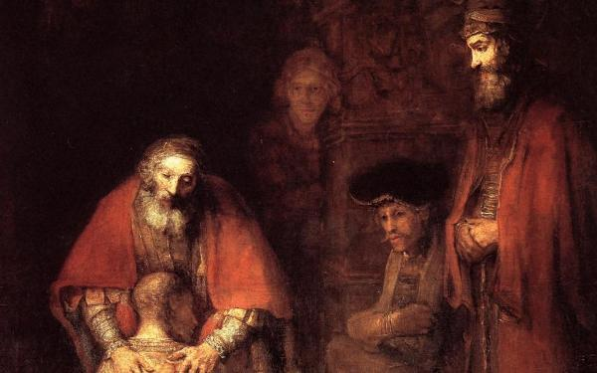
Response to Persecution
https://en.wikipedia.org/wiki/The_Return_of_the_Prodigal_Son_(Rembrandt)

Slide 8
*Response to Persecution
The persecution that the church endured for the first 300 years of church history gave rise to a number of doctrinal disputes.
These disputes caused much dissention and difficulty within the early church.
The issue wasn’t so much how to respond to persecution, but how to respond to those who “lapsed” under persecution.
It was pretty much a given that as a Christian you were not to cooperate with the Romans when they exercised inappropriate authority.
But what do you do with the people who gave in during the persecution and then, when the persecution lets up, want to come back?
*Based on notes taken from James White’s 2016 Church History Series; Lesson 15 – Response to Persecution

Slide 9
*Response to Persecution
There was also disagreement in the early church as to the proper response to persecution:
  There were those who sought out persecution.
  But church leaders generally advised against seeking out persecution.
  They pointed out that Jesus had instructed his disciples that if they persecute you in one city, go to another (Mat. 10:11-14).
  These church leaders argued that persecution was not something that a person should be seeking – a Christian should not seek to lose his life.
  Of course, they looked up to those who remained faithful while being tortured and/or put to death against their will. But in their view, martyrdom is not something we should be seeking for ourselves.
*Based on notes taken from James White’s 2016 Church History Series; Lesson 15 – Response to Persecution

Slide 10
*Response to Persecution
Cyprian, who was bishop of Carthage (AD 248 – 258) during a time of persecution, believed it was his duty to flee to a secure place with other leaders of the church, and continue guiding the flock through an extensive correspondence.
As was to be expected, many interpreted this decision as an act of cowardice.
For instance, the clergy of the church of Rome who had lost their bishop in the persecution, wrote to Cyprian questioning his decision to flee.
* Gonzalez, Justo L.. The Story of Christianity: Volume 1: The Early Church to the Dawn of the Reformation p. 103

Slide 11
*Response to Persecution
Cyprian insisted that he had fled for the good of his flock, and not out of cowardice.
Indeed, his valor and conviction were amply proven a few years later, when he gave his life as a martyr.
But in the meantime, his own authority was questioned, and there were many who claimed that the “confessors” of Carthage (i.e. those who had previously suffered for their faith) had more authority than he did, particularly when it came to the question of the restoration of the lapsed.
* Gonzalez, Justo L.. The Story of Christianity: Volume 1: The Early Church to the Dawn of the Reformation p. 103

Slide 12
*Response to Persecution
Many of those who had sought martyrdom, felt that fleeing was a compromising act. They felt like they were the strong believers.
On the other hand, those who fled from persecution, viewed those who sought martyrdom as foolish and overly zealous.
The ones who did flee would often flee to the catacombs – a series of underground burial places. The catacombs stretched over 350 miles and contained as many as 4 million graves.
*Based on notes taken from James White’s 2016 Church History Series; Lesson 15 – Response to Persecution

Slide 13
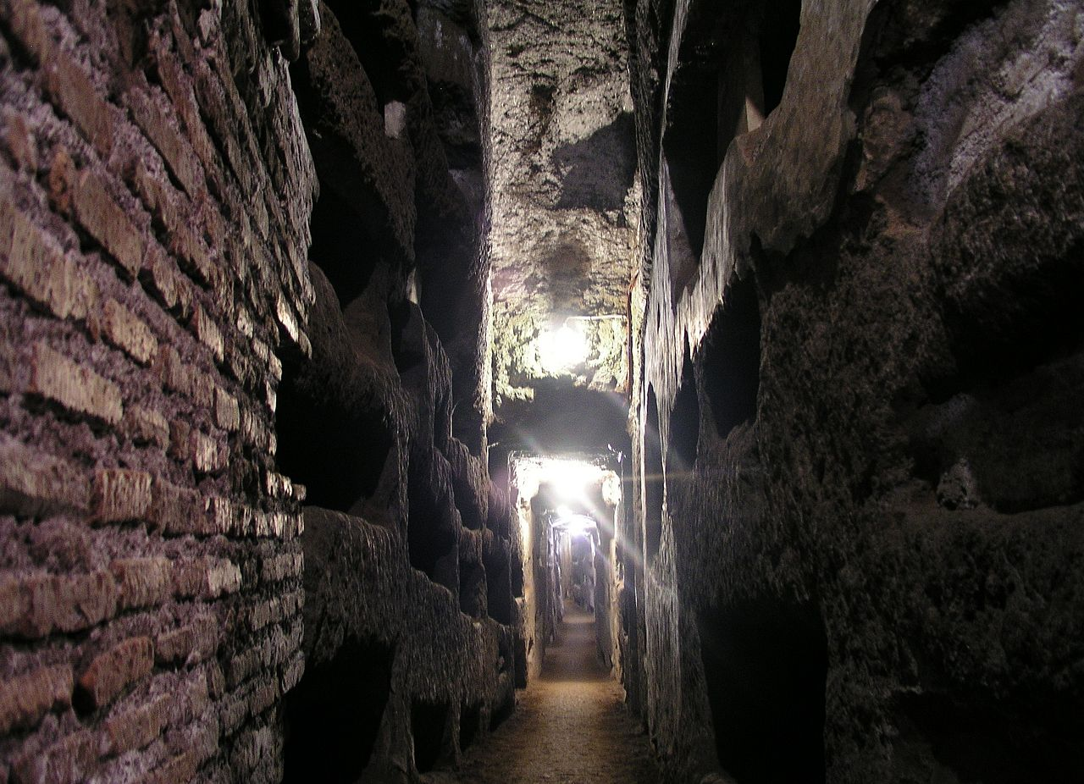
Catacombs
https://en.wikipedia.org/wiki/Catacombs_of_Rome#/media/File:Rom,_Domitilla-Katakomben_2.jpg

Slide 14
*Response to Persecution
But how was the early church going to deal with lapsed believers who want to return to the church?
By the end of the 300 years of persecution, three groups of the “lapsed” were identified in the church:
  The Sacrificati – those who had made sacrifice to the emperor
  The Libellatici – those who obtained a libellus saying that they had offered the sacrifice. They would often get this by bribes.
  The Traditores – Those who surrendered sacred books to the authorities. Some had offered secular books, pretending they were the scriptures that the authorities were seeking to destroy.
The church struggled greatly with what to do with those in the last two categories. Public penance was a common practice.
If you lapsed, you would never be allowed into a leadership position.
*Based on notes taken from James White’s 2016 Church History Series; Lesson 15 – Response to Persecution

Slide 15
*Response to Persecution
Some, known as “confessors”, who had suffered for their faith, were given positions of authority in the church.
The “confessors” were most likely to favor letting the lapsed back into the church.
Some required that those returning do some kind of penance; others said they should never be allowed back into the church.
The controversy produced a number of schisms in the early churches.
*Based on notes taken from James White’s 2016 Church History Series; Lesson 15 – Response to Persecution

Slide 16
*Schism in Rome
An example of one of these schisms occurred in AD 251, when a man named Cornelius was elected bishop of Rome (by the populace of the church – as was the case up until AD 1059).
After becoming bishop, Cornelius offered penance and re-admission to the lapsed.
One of the leading clergy in the city, a man named Novatian, rejected Cornelius’ action and split from his authority and insisted that there could be no re-admission of the lapsed into the church.
This became known as the Novatianist Controversy. It was very troubling at the time that something like this could happen in Rome.
*Based on notes taken from James White’s 2016 Church History Series; Lesson 15 – Response to Persecution

Slide 17
*Schism In North Africa
Another schism in the church that resulted from persecution occurred in Carthage, North Africa.
*Based on notes taken from James White’s 2016 Church History Series; Lesson 15 – Response to Persecution

Slide 18
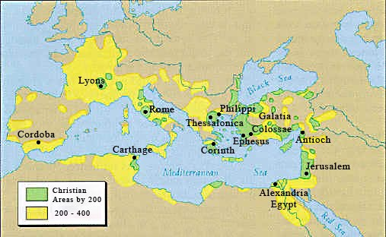
*Schism In North Africa
https://romeprojetlogan.weebly.com/christianity.html

Slide 19
*Schism In North Africa
Another schism in the church that resulted from persecution occurred in Carthage, North Africa.
Cyprian, who I mentioned earlier had served as Bishop of Carthage (AD 248 – 258), taught something known as Ex opere operantis (literally, “from the work of the doer”) – a teaching that the spiritual state of a person performing a spiritual act is vital to the blessing and recognition of that act by God.
So, by this teaching, if someone had been baptized by someone who was later discovered to be an apostate, their baptism could no longer be considered valid.
*Based on notes taken from James White’s 2016 Church History Series; Lesson 15 – Response to Persecution

Slide 20
*Schism In North Africa
In teaching Ex opere operantis, Cyprian was in disagreement with Stephen, who was the Bishop of Rome at the time.
Stephen held to an opposing view known as Ex opere operato (literally “from the work worked”) – a teaching that a person receives the blessing of God by the function of the spiritual act itself, regardless of the spiritual state of the one performing it.
So, by this teaching, if a person was baptized by someone who was later discovered to be an apostate, that person’s baptism would still be considered valid.
*Based on notes taken from James White’s 2016 Church History Series; Lesson 15 – Response to Persecution

Slide 21
*Schism In North Africa
A number years later, after Cyprian had passed from the scene (being martyred in AD 258), his teaching of Ex opere operantis came back to haunt the church at Carthage.
In AD 311, the very important bishopric of Carthage became vacant and a man named Caecilian was elected to fill the position.
Some of those within the church who held to teaching of Ex opere operantis claimed that one of the men laying hands on Caecilian (during his ordination) was an apostate, a Traditor, and therefore they believed that Caecilian’s ordination should be considered null and void.
Furthermore, they insisted that since Caecilian was not really a bishop, all those whom he had ordained were also false ministers, whose sacraments had no validity!
*Based on notes taken from James White’s 2016 Church History Series; Lesson 15 – Response to Persecution

Slide 22
*Schism In North Africa
Those who did not recognize Caecilian’s ordination as valid ordained their own bishop whose successor in AD 316 was named Donatist.
This became known as the Donatist controversy.
The Donatists eventually came to view themselves as the “pure ones”.
It’s hard for us to understand how radical it was at this time for a group to break off from the Catholic (universal) church.
*Based on notes taken from James White’s 2016 Church History Series; Lesson 15 – Response to Persecution

Slide 23
*Schism In North Africa
140 years later, Augustine would still be fighting this very issue.
The Donatists who split off, eventually grew to a point that they could have a meeting of their bishops and have 700 bishops in attendance. So they were a big group.
The Donatists basically all disappeared once the Muslims took over.
*Based on notes taken from James White’s 2016 Church History Series; Lesson 15 – Response to Persecution

Slide 24
*Some Questions to Ponder
Should a Christian seek martyrdom, or were the early church leaders right – that you should avoid martyrdom if you can?
What is the proper response to a so-called brother who walks away from the faith, perhaps in a situation of great pressure or temptation, but then, years later, decides he wants to come back to the church?
Is the validity of one’s baptism in any way contingent upon the spiritual state of the one who baptized them?
*Based on notes taken from James White’s 2016 Church History Series; Lesson 15 – Response to Persecution

Slide 25
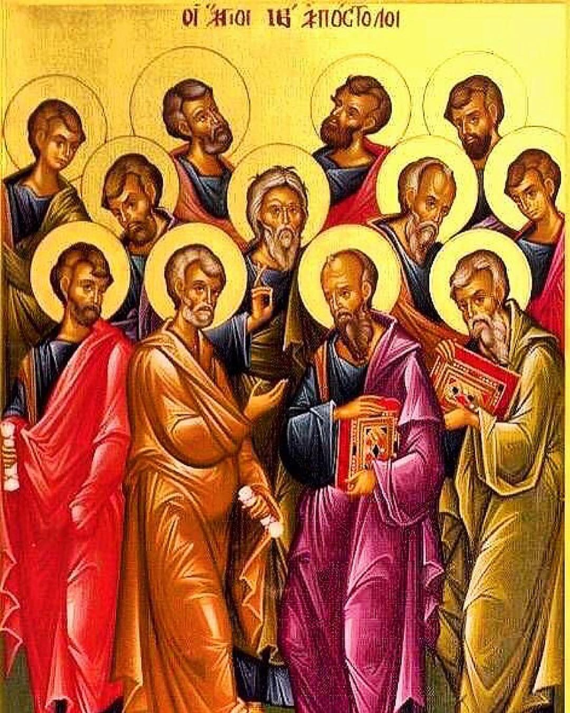
The Third Century Church Fathers
http://www.instahu.com/p/1907459568511173538_8613825243

