Slide 1
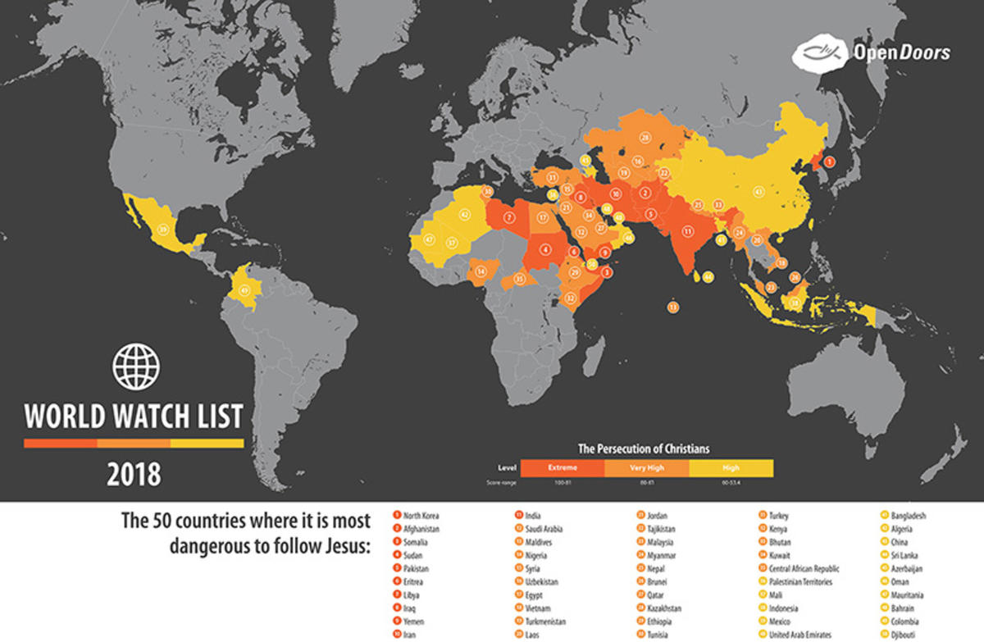

Slide 2
TRAVEL BACK TO
1620s

Slide 3
YOUR ARE A PILGRIM LIVING IN
NEW PLYMOUTH
COLONY, MA

Slide 4
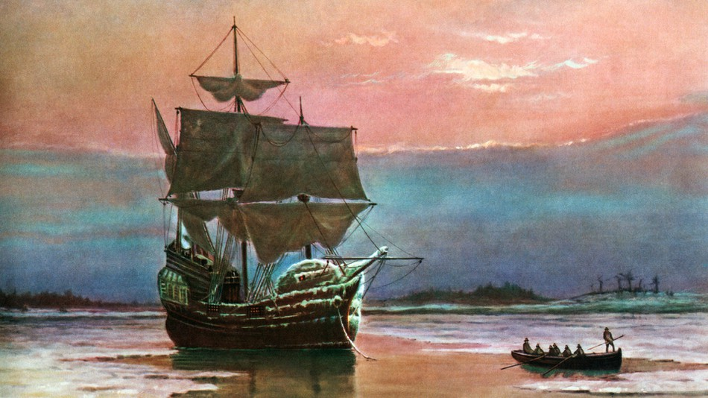
Notes:
66 days; 2,750 miles

Slide 5
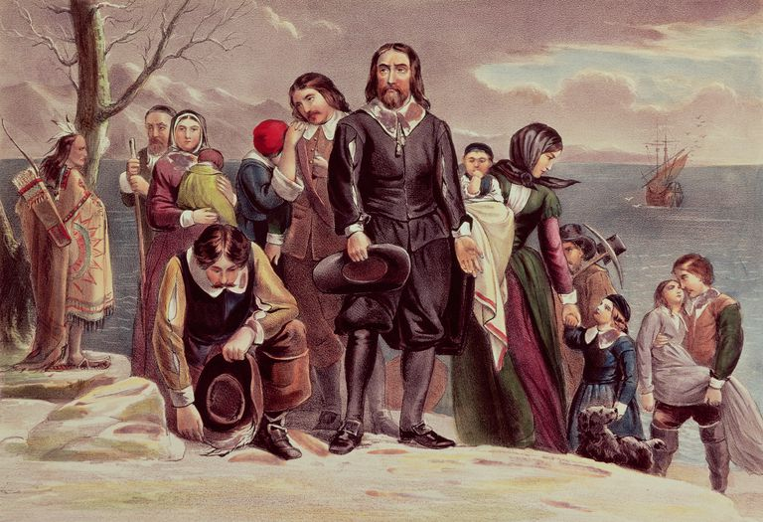

Slide 6
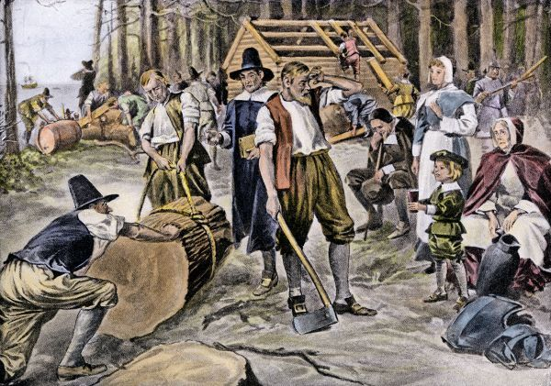

Slide 7
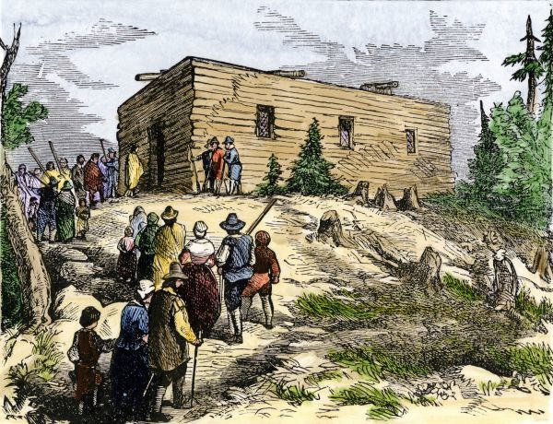

Slide 8
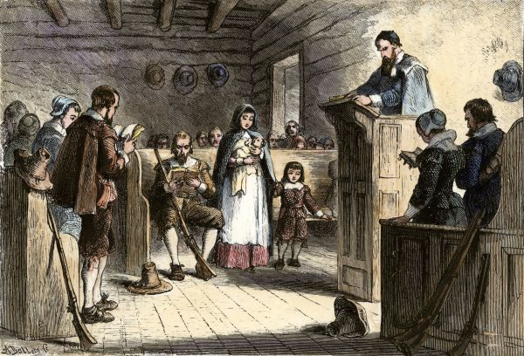

Slide 9
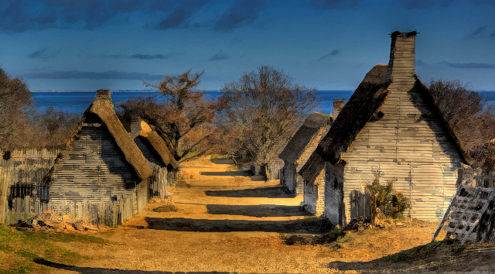

Slide 10
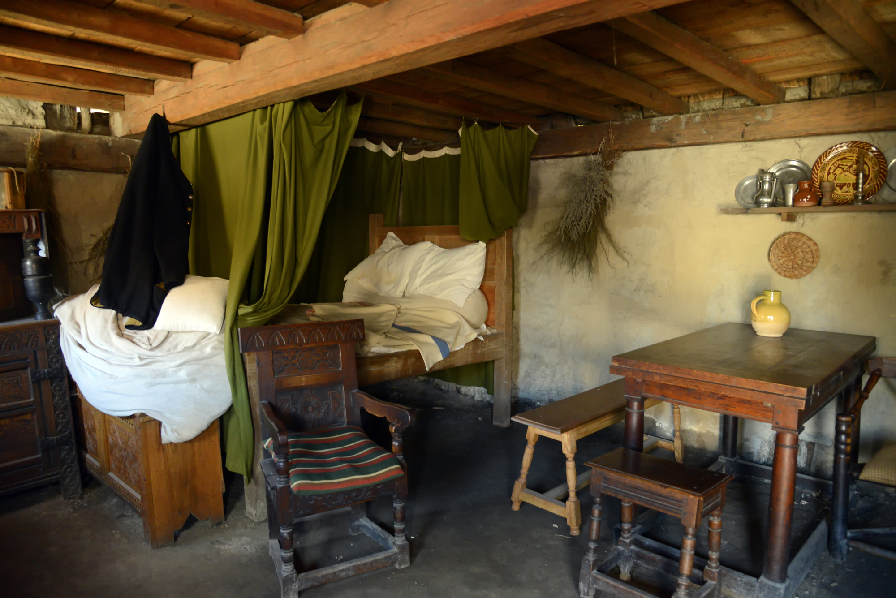

Slide 11
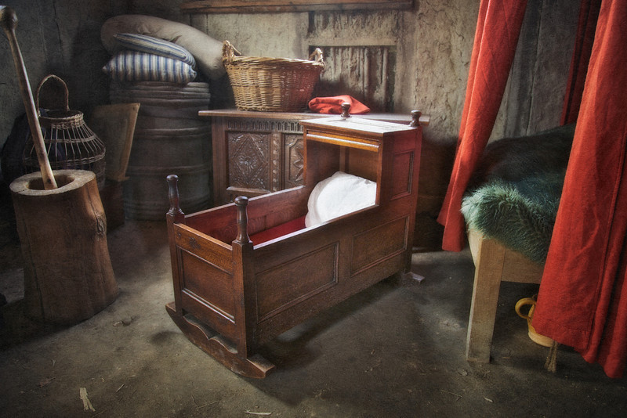

Slide 12
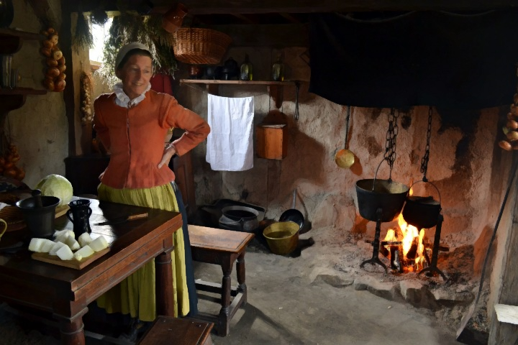
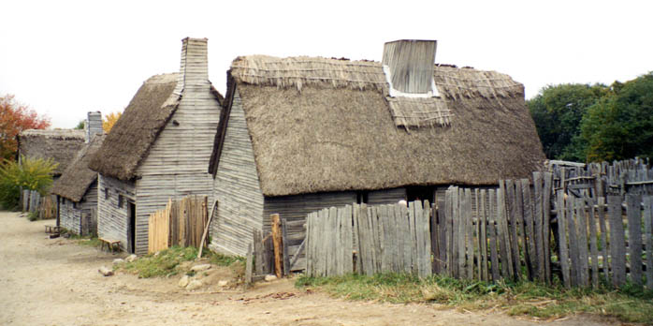

Slide 13

Notes:
You own two books. A copy of the Bible, and a copy of John Foxe’s Book of Martyrs (also known as…)

Slide 14
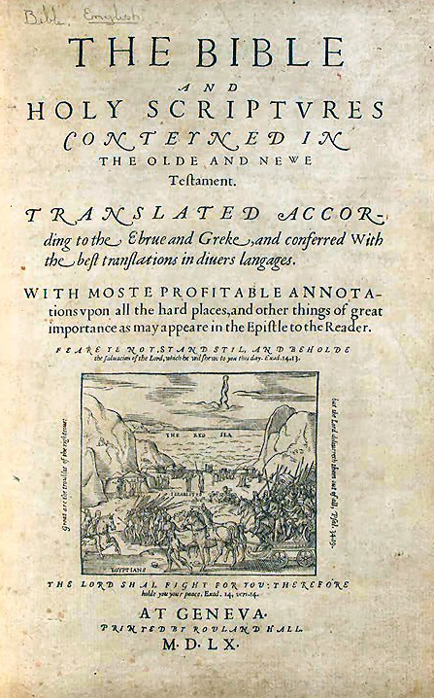
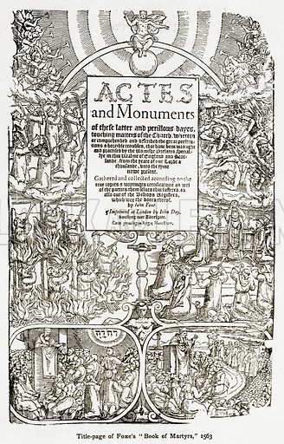

Slide 15
WHAT INFLUENCE DO YOU IMAGINE THESE TWO BOOKS COULD HAVE IN YOUR LIFE IF THEY WERE ALL YOU OWNED?
THE INFLUENCE THE BIBLE WOULD
HAVE ON US SHOULD BE OBVIOUS…

Slide 16
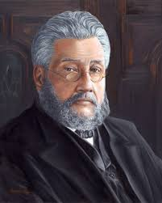
Charles Spurgeon on the sufficiency of knowing
our Bibles…
“In case the famine of books should be sore in the land, there is one book which you all have, and that is your Bible; and a [Christian] with his Bible is like David with his sling and stone, fully equipped for the fray. No man may say that he has no well to draw from while the Scriptures are within reach. In the Bible we have a perfect library, and he who studies it thoroughly will be a better scholar than if he had devoured the Alexandrian Library entire. To understand the Bible should be our ambition; we should be familiar with it, as familiar as the housewife with her needle, the merchant with his ledger, the mariner with his ship….”

Slide 17
BUT WHAT INFLUENCE WOULD OUR LIMITATION TO JOHN FOXES’ BOOK OF MARTYRS HAVE ON US?
THIS SCENARIO IS HARD TO IMAGINE SINCE OUR HABIT IS TO READ BROADLY, BUT SHALLOWLY…

Slide 18
Charles Spurgeon on the effect of too many books…
“A student will find that his mental constitution is more affected by one book thoroughly mastered than by twenty books which he has merely skimmed, lapping at them, as the classic proverb puts it ‘as the dogs drink of Nilus.’ Little learning and much pride come of hasty reading. Books may be piled on the brain till it cannot work. Some men are disabled from thinking by their putting meditation away for the sake of much reading. They gorge themselves with book-matter, and become mentally dyspeptic…

Slide 19
“…there is very much sound sense in the remark of a writer in the Quarterly Review many years back. "Give us the one dear book, cheaply picked from the stall by the price of the dinner, thumbed and dog-eared, cracked in the back and broken in the corner, noted on the fly-leaf and scrawled on the margin, sullied and scorched, torn and worn, smoothed in the pocket and grimed on the hearth, damped by the grass and dusted among the cinders, over which you have dreamed in the grove and dozed before the embers, but read again, again, and again, from cover to cover. It is by this one book, and its three or four single successors, that more real cultivation has been imparted than by all the myriads which bear down the mile-long, bulging, bending shelves of the Bodleian."

Slide 20
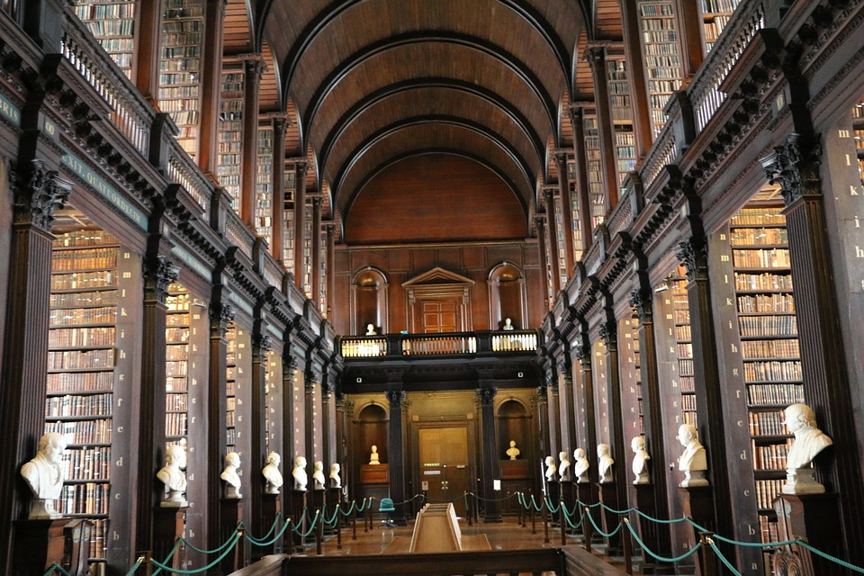
The Bodleian Libraries
Oxford University, England

Slide 21
AGAIN, WHAT INFLUENCE WOULD OUR LIMITATION TO JOHN FOXES’ BOOK OF MARTYRS (I.E. A HISTORY OF THE PERSECUTED CHURCH) HAVE ON US?

Slide 22
"When one recollects that until the appearance of the Pilgrim's Progress* the common people had almost no other reading matter except the Bible and Foxe's Book of Martyrs, we can understand the deep impression that this book produced; and how it served to mold the national character. Those who could read for themselves learned the full details of all the atrocities performed on the Protestant reformers; the illiterate could see the rude illustrations of the various instruments of torture, the rack, the gridiron, the boiling oil, and then the holy ones breathing out their souls amid the flames...”
-- Douglas Campbell,
"The Puritan in Holland,
England, and America"
* After 1678, the three most common household books are the Bible, Foxe’s Book of Martyrs, and Pilgrim’s Progress.

Slide 23
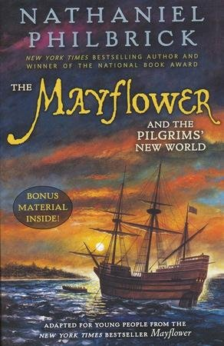
Speaking of William Bradford’s childhood:
“Lonely and intelligent, he looked to the Bible for consolation and guidance. For a boy in need of instruction, the Geneva Bible, translated in the previous century…was just the thing. There was also John Foxe’s Book of Martyrs, an account of the Protestants killed by Queen Elizabeth’s Catholic predecessor on the throne, “Bloody Mary”...This had a deep and lasting influence on Bradford, and as Foxe made horrifyingly clear, to be a godly Englishman sometimes required a person to make the ultimate sacrifice.”
…or, to go to extreme lengths to worship God.

Slide 24
EXCERPTS FROM
FOXE’S BOOK OF MARTYRS

Slide 25
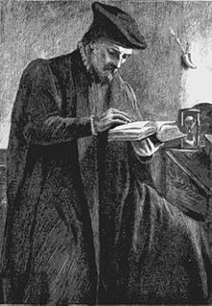
Thomas Bilney, professor of civil law at Cambridge, was brought before the bishop of London, and several other bishops, in the Chapter house, Westminster, and being several times threatened with the stake and flames, he was weak enough to recant; but he repented severely afterward. For this he was brought before the bishop a second time, and condemned to death. Before he went to the stake he confessed his adherence to those opinions which Luther held; and, when at it, he smiled, and said, "I have had many storms in this world, but now my vessel will soon be on shore in heaven. "He stood unmoved in the flames, crying out, "Jesus, I believe"; and these were the last words he was heard to utter.

Slide 26
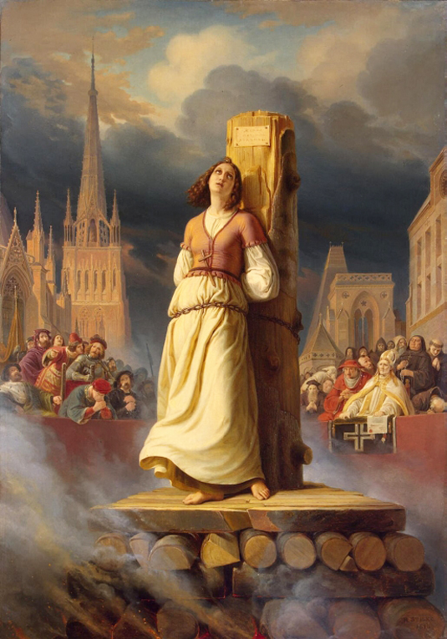
Wendelinuta, a pious Protestant widow, was apprehended on account of her religion, when several monks, unsuccessfully, endeavored to persuade her to recant. As they could not prevail, a Roman Catholic lady of her acquaintance desired to be admitted to the dungeon in which she was confined, and promised to exert herself strenuously towards inducing the prisoner to abjure the reformed religion. When she was admitted to the dungeon, she did her utmost to perform the task she had undertaken; but finding her endeavors ineffectual, she said, "Dear Wendelinuta, if you will not embrace our faith, at least keep the things which you profess secret within your own bosom, and strive to prolong your life” …

Slide 27
…to which the widow replied, "Madam, you know not what you say; for with the heart we believe to righteousness, but with the tongue confession is made unto salvation." As she positively refused to recant, her goods were confiscated, and she was condemned to be burnt. At the place of execution a monk held a cross to her, and bade her kiss and worship God. To which she answered, "I worship no wooden god, but the eternal God who is in heaven." She was then executed, but through the before-mentioned Roman Catholic lady, the favor was granted that she should be strangeled before fire was put to the fagots.

Slide 28
ILLUSTRATIONS
FROM FOXE’S BOOK OF MARTYRS:
(AN AID FOR THE YOUNG & ILLETERATE)

Slide 29
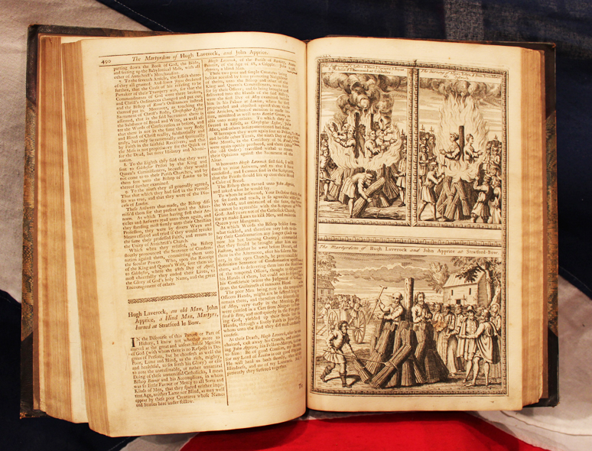

Slide 30
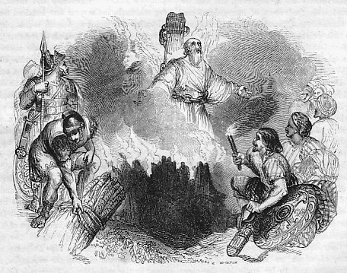
The Martyrdom of Polycarp

Slide 31
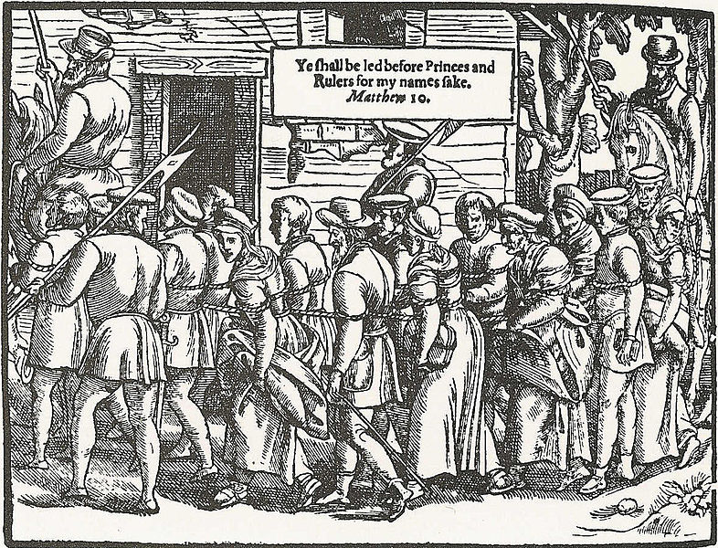
Peasants Bound by Ropes and Taken to Trial in London

Slide 32
SPECIFICALLY…HOW WOULD/SHOULD A CHRISTIAN BE INFLUENCED BY A CONCENTRATED STUDY OF THE PERSECUTED CHURCH?

Slide 33
1
A study of the persecuted church brings us to terms with the realities of Christian persecution.

Slide 34
CHRISTIAN PERSECUTION
IS AN AGELESS ISSUE

Slide 35
John 15:20 “Remember the word that I said to you: ‘A servant is not greater than his mater.’ If they persecuted me, they will also persecute you.’”

Slide 36
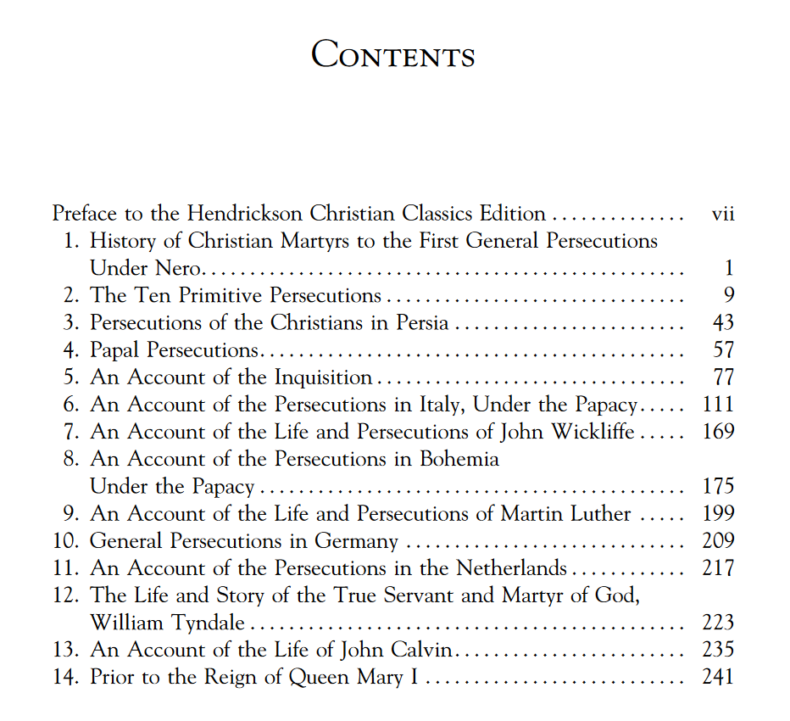
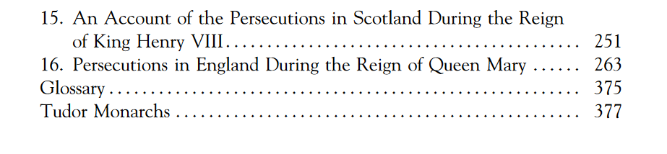

Slide 37
CHRISTIAN PERSECUTION
IS AN GLOAL ISSUE

Slide 38
I Peter 5:9 “Resist him, firm in your faith, knowing that the same kinds of suffering are being experienced by your brotherhood throughout the world.”

Slide 40
2
A study of the persecuted church confronts us with the relevance of Protestant thinking* and its foundations in the Gospel.
Notes:
Unfortunately, the catholic persecution of protestant was replaced by a protestant (church of England) persecution of protestants.

Slide 42
A study of Christian persecution raises the question, “Why are Christian’s persecuted?”
Whether at the hands of Emperors or Popes, the answer usually* lies with the claims of the Gospel.

Slide 43
“Persecution is, as Calvin said, a contention against God…Specifically, persecution is a retaliatory action against the righteousness of God in Christ, who is proclaimed and represented by his followers. The reasons Christians have always faced persecution and the reason they will suffer until Christ’s return is simple: Jesus Christ is the Son of God who has established the kingdom of God and now reigns in righteousness over heaven and earth. Jesus is at root the ultimate provocateur of Christian persecution. The world despised and rejected Jesus when he first walked the earth, and the world…remains hostile to him still.”
Gregory Cochran,
“Christian Persecution
as Explained by Jesus”

Slide 44
3
A study of the persecuted church gives us a greater appreciation for, and conviction to defend, the dissemination of God’s Word.

Slide 46
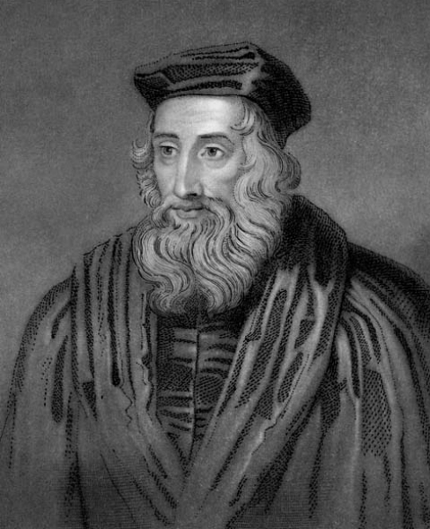
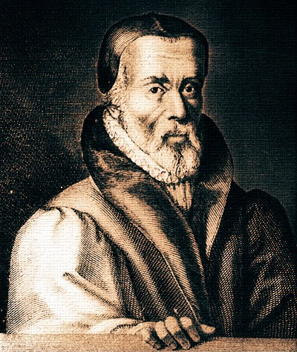

Slide 47
John Wycliffe is best known for being the first to translate the Bible from Latin into English. He believed everyone should have the Bible in his own language. In 1377, his first English Bible was printed by hand because there were no printing presses at that time. It was against the law to read Wycliffe’s Bible but many people risked everything to have one for themselves.
Famous Quote:
“Forasmuch as the Bible contains Christ, that is all that is necessary for salvation. It is necessary for ALL men, not for priests alone.”

Slide 48
William Tyndale, known by many as ‘The Father of the English Bible’, was the first person to translate the Bible from the original Hebrew and Greek into English. His translation was accurate and easy to read. I n fact, some say that up to 90% of the King James Bible of 1611 is based on William Tyndale’s translation.
Famous Quote:
In reply to a local priest who said “We are better to be without God’s laws than the Pope’s,” Tyndale angrily replied, “If God spare my life, ere many years pass, I will cause a boy that driveth the plow to know more of the Scripture than thou dost.”

Slide 49
4
A study of the persecuted church prepares us to better endure and/or respond to contemporary trials.

Slide 51
Consider the account of
Mary and Elizabeth…

Slide 52
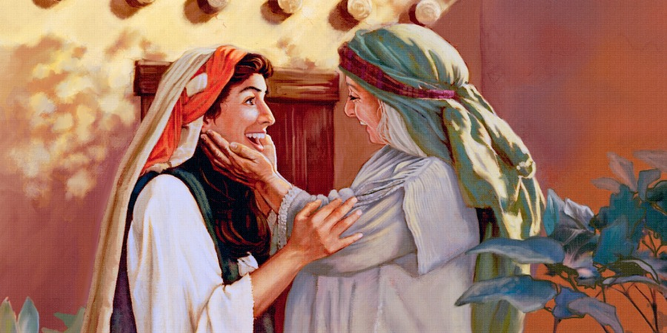
…not this Mary and Elizabeth

Slide 53
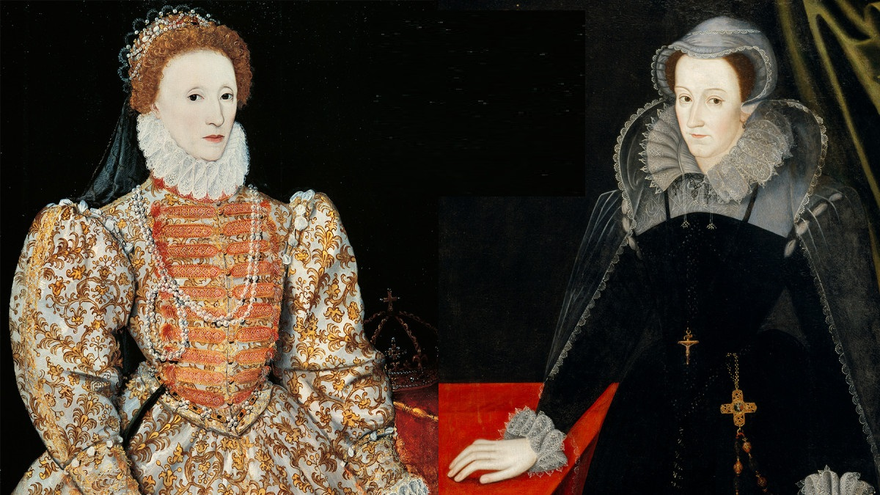
Elizabeth I of England
1533 - 1603
Mary, Queen of Scots
1542 - 1587

Slide 54
“Queen Elizabeth of England and Mary, Queen of Scots were two of the greatest, most legendary rivals in recorded history—although they never met. In one castle was Elizabeth (a Protestant), the childless “virgin” queen: bawdy, brilliant and cynical. In the other, Mary (a Catholic): feminine, charming, romantic and reckless…”
Earning the nickname “Bloody Mary,” Mary of Scots violently persecuted her Protestant opponents having hundreds of “dissenters” burned at the stake.

Slide 55
Mary of Scots reigned
from 1542 to 1567
Foxes Book of Martyrs
was published 1563!

Slide 56
An abbreviated timeline.

Slide 57
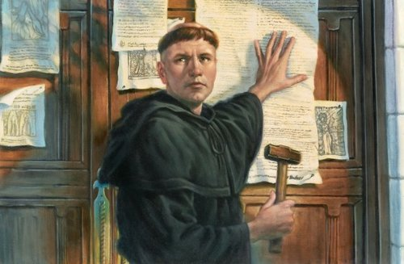
1517
Martin Luther Posts 95 Theses
Notes:
The launch of the Protestant Reformation

Slide 58
1530s to 1600s
Mary and Elizabeth

Slide 59
1620
Mayflower sails to New World
Notes:
The colonization of the New World. (Jamestown founded in 1607)

Slide 60
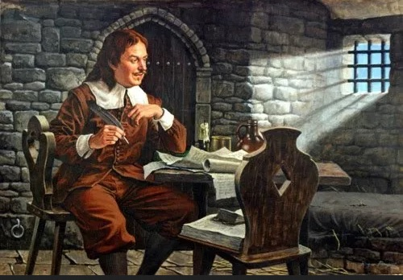
1678
Pilgrim’s Progress Written

Slide 61
“…Take a people just awakening to a new intellectual and religious life; let several generations of them, from childhood to old age, pore over such a book, and its stories become traditions as individual and almost as potent as songs and customs on a nation's life."
-- Douglas Campbell,
"The Puritan in Holland,
England, and America"

Slide 62
FAST-FORWARD TO
TODAY

Slide 63
"After the Bible itself, no book so profoundly influenced early Protestant sentiment as the Book of Martyrs. Even in our own time it is still a living force. It is more than a record of persecution. It is an arsenal of controversy, a storehouse of romance, as well as a source of edification."
-- James Miller Dodds,
“English Prose"

Slide 64
I Peter 4:12 “Beloved, do not be surprised at the fiery trial when it comes upon you to test you, as though something strange were happening to you.

Slide 65
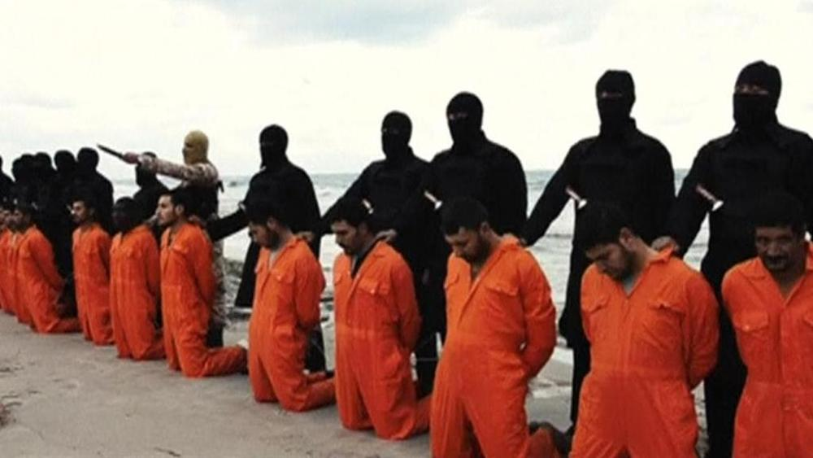
20 Christian Egyptians Martyred in 2017

