Slide 1


Slide 2
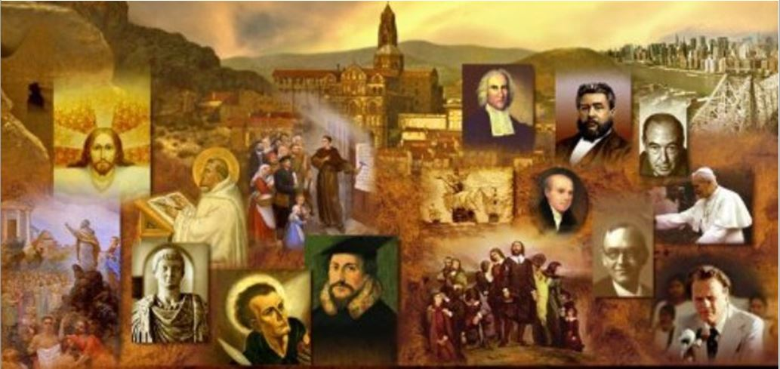
Review
We saw last time that in the early church there were some who actually sought out persecution.
What did the earlier church leaders advise concerning seeking out persecution and what scripture did they offer in support of their advice?
  The church leaders generally advised against seeking out persecution.
  They pointed out that Jesus had instructed his disciples that if they persecute you in one city, go to another (Mat. 10:11-14).
Cyprian, bishop of Carthage during a time of persecution, believed it was his duty to flee to a secure place while guiding the flock through an extensive correspondence.
Although many considered Cyprian’s behavior to be cowardly, what later event in Cyprian’s life proved otherwise?
  Cyprian’s valor and conviction were amply proven a few years later, when he gave his life as a martyr

Slide 3
Review
By the end of the 300 years of persecution, what three groups of the “lapsed” were identified in the church (give a brief definition of each and as a bonus give the Latin terms):
  The Sacrificati – those who had made sacrifice to the emperor
  The Libellatici – those who obtained a libellus saying that they had offered the sacrifice. They would often get this by bribes.
  The Traditores – Those who surrendered sacred books to the authorities. Some had offered secular books, pretending they were the scriptures that the authorities were seeking to destroy.
What are some of the ways that lapsed believers were treated by the early church?
  Some were forbidden to become members
  Some were made to do penance
  As a rule, none were ever allowed to serve as leaders

Slide 4
Review
While serving as bishop of Rome (AD 251 – 253), Cornelius offered penance and re-admission to the lapsed.
One of the leading clergy in the city rejected Cornelius’ action and split from his authority. What was his name?
  Novatian
Cyprian, Bishop of Carthage (AD 248 – 258), taught something known as Ex opere operantis (literally, “from the work of the doer”) – Give a brief explanation of what this means.
  The spiritual state of a person performing a spiritual act is vital to the blessing and recognition of that act by God.
Stephen, bishop of Rome, held to an opposing view known as Ex opere operato (literally “from the work worked”). Explain what this means and how it contrasts with the above teaching.
  A person receives the blessing of God by the function of the spiritual act itself, regardless of the spiritual state of the one performing it.

Slide 5
Review
In AD 311, some of those in the church at Carthage who held to teaching of Ex opere operantis claimed that one of the men laying hands on their bishop, Caecilian (during his ordination) was an apostate, a Traditor, and therefore they believed that Caecilian’s ordination should be considered null and void.
Those who did not recognize Caecilian’s ordination as valid ordained their own bishop. What was the successor this this bishop’s name and what large Christian movement grew out of these events?
  The successor’s name was Donatist.
  This became known as the Donatist controversy.

Slide 6
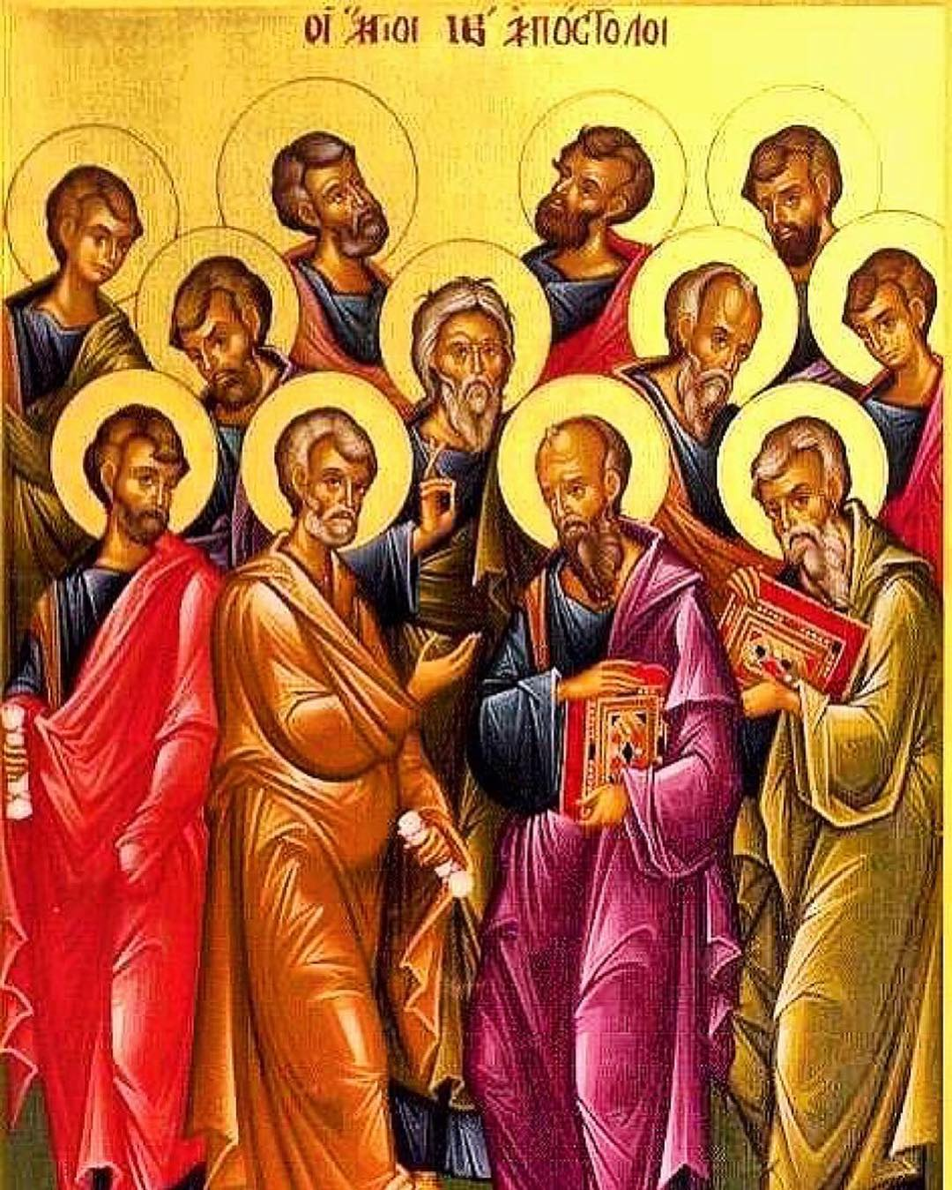
The Third Century Church Fathers
http://www.instahu.com/p/1907459568511173538_8613825243

Slide 7
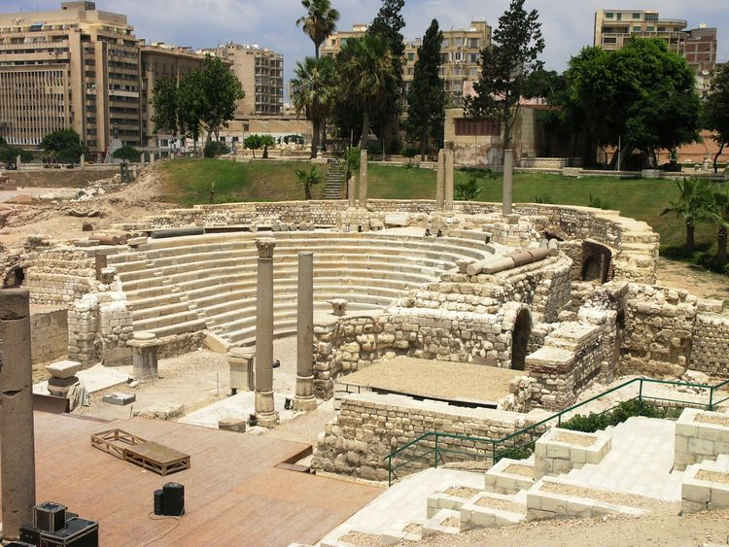
The Church in Alexandria:
Clement and Origen
https://www.ancient.eu/image/5436/roman-theatre-alexandria/

Slide 8
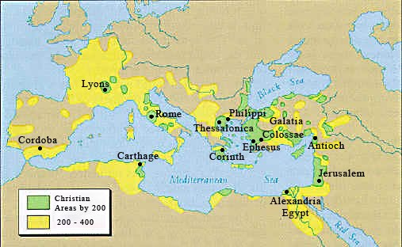
*Alexandria
https://romeprojetlogan.weebly.com/christianity.html

Slide 9
*Alexandria
The Egyptian city of Alexandria was, after Rome, the greatest city in the Roman Empire.
If Rome was the Empire’s legal and administrative capital, Alexandria acted as its intellectual and cultural capital, as well as being one of its most important trading ports.
It was the liveliest center of artistic, scientific and philosophical activity in the Greek and Roman world.
A deeply Hellenistic community, it also had a vast Jewish population.
Religious movements and ideas of every variety met and circulated in Alexandria, influenced each other, and were influenced by Greek philosophy.
* Needham, Nick. 2,000 Years of Christ's Power Vol. 1: The Age of the Early Church Fathers

Slide 10
*Alexandria
We do not know anything about the beginnings of Christianity in Alexandria, although the New Testament says that Apollos came from there (Acts 18: 24).
Probably the Christian faith spread to Alexandria through the evangelism of Hellenistic Jews.
The Gnostic movement also had strong Alexandrian roots: the influential Gnostic leaders Basilides and Valentinus both came from the Egyptian capital.
* Needham, Nick. 2,000 Years of Christ's Power Vol. 1: The Age of the Early Church Fathers

Slide 11
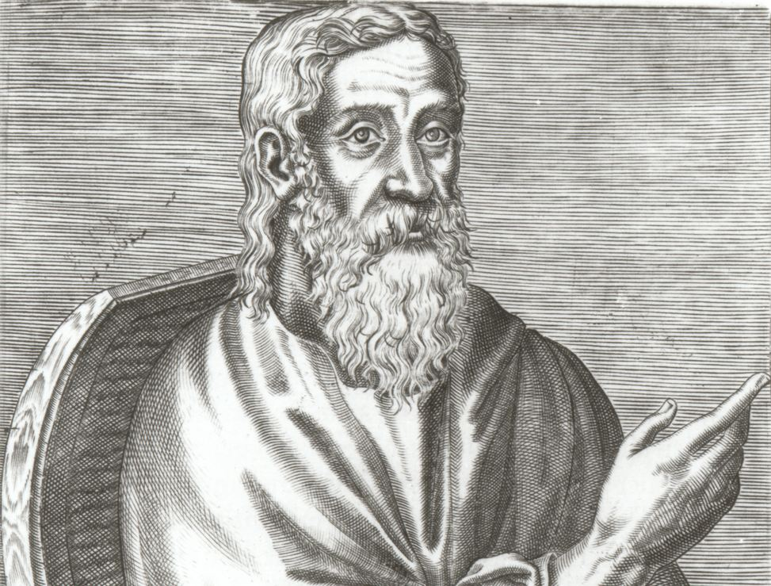
Clement of Alexandria
http://myocn.net/faith-seeking-understanding-part-ii-clement-alexandria/

Slide 12
*Clement of Alexandria
Clement was born around AD 150 in Athens, a city that had long been famous for its philosophers.
His parents were pagans; but young Clement was converted in unknown circumstances, and then undertook a vast search for a teacher who could give him deeper instruction in the Christian faith.
After extensive travels, he found in Alexandria a teacher named Pantaenus who satisfied his thirst for knowledge.
*Gonzalez, Justo L.. The Story of Christianity: Volume 1: The Early Church to the Dawn of the Reformation p. 86

Slide 13
*Clement of Alexandria
Clement remained in Alexandria, and when his teacher died Clement took his place as the main Christian instructor in Alexandria.
In 202, when Septimius Severus was emperor, persecution broke out, and Clement had to leave the city.
He then traveled along the Eastern Mediterranean— particularly Syria and Asia Minor— until his death in 215.
Clement was not a pastor (like his contemporary Irenaeus, for example), but rather a thinker and a searcher.
And his goal was not so much to expound the traditional faith of the church— although he did hold that faith— as to help those in quest of deeper truth, and to convince pagan intellectuals that Christianity was not the absurd superstition that some claimed it was.
*Gonzalez, Justo L.. The Story of Christianity: Volume 1: The Early Church to the Dawn of the Reformation p. 86-7

Slide 14
*Clement of Alexandria
Three main writings of Clement have come down to us:
  Exhortation to the Greeks
  Instructor
  Miscellanies
* Galli, Mark. 131 Christians Everyone Should Know (p. 53). B&H Publishing Group

Slide 15
*Clement of Alexandria
Exhortation to the Greeks
This work was a defense of Christianity which criticized Pagan religion and sought to convert the reader to Christ.
Like Justin Martyr, Clement presented Christ as the eternal Logos who is educating the whole human race, Jew and Gentile, into a true knowledge of God.
* Needham, Nick. 2,000 Years of Christ's Power Vol. 1: The Age of the Early Church Fathers

Slide 16
*Clement of Alexandria
Instructor
This was a sequel to the Exhortation to the Greeks, a handbook of instruction for the new convert.
Its concern was with how the Christian should conduct himself in the world.
Clement examined every area of life – food and drink, the home, marriage, recreation, music, dancing – and stated how the Christian should behave in each area.
He recommended a simple lifestyle, midway between luxury and poverty.
* Needham, Nick. 2,000 Years of Christ's Power Vol. 1: The Age of the Early Church Fathers

Slide 17
*Clement of Alexandria
Miscellanies
This is a strange book, in which Clement seems deliberately to wander about over a great variety of themes.
In the course of his wanderings, Clement offered his ideal of the perfect Christian.
He taught that faith – believing what the Bible says – was only the first step in the Christian life.
After this first step of faith came knowledge (Clement used the Greek word gnosis): a growing spiritual knowledge of God which transformed the human mind into God’s likeness.
Clement described the Christian as the “true Gnostic”. Gnostics claimed a special knowledge of spiritual truth, but Clement taught that only the Orthodox (Catholic) Christian really possessed it.
* Needham, Nick. 2,000 Years of Christ's Power Vol. 1: The Age of the Early Church Fathers

Slide 18
*Clement of Alexandria
Miscellanies
Sharing Justin Martyr’s view of Christ as the Logos, Clement also shared Justin Martyr’s high regard for Greek philosophy.
Clement argued that philosophy had prepared the Greeks to receive Christ, just as the Old Testament Law had prepared the Jews to receive Christ!
According to Clement, the Logos has always been at work among all peoples, leading them by different paths towards the knowledge of the one true Creator God.
* Needham, Nick. 2,000 Years of Christ's Power Vol. 1: The Age of the Early Church Fathers

Slide 19
*Clement of Alexandria
Clement’s positive approach to Greek philosophy involved him in some controversial ideas.
When he contrasted simple faith with advanced spiritual knowledge, “faith” often appeared to mean “orthodox Christianity”, while “knowledge” meant “Greek philosophical knowledge”.
Clement freely used both Platonic and Stoic ideas and writings in his discussions of the Christian view of life.
* Needham, Nick. 2,000 Years of Christ's Power Vol. 1: The Age of the Early Church Fathers

Slide 20
*Clement of Alexandria
Even in opposing the Gnostics, Clement seems to have absorbed some of their attitudes.
For instance, Clement defended the goodness of marriage against Gnostic criticism, but he still could not believe that the ideal Christian husband and wife would ever have sex for enjoyment, rather than for the “pure” purpose of producing offspring.
This was a view repeated by many of the early Church fathers, perhaps most notably, Augustine of Hippo.
* Needham, Nick. 2,000 Years of Christ's Power Vol. 1: The Age of the Early Church Fathers

Slide 21
*Clement of Alexandria
Clement’s importance does not lie so much in the manner in which he understands one doctrine or another, but rather in that his thought is characteristic of an entire atmosphere and tradition that developed in Alexandria and that would be of great significance for the subsequent course of theology.
Later in this study, when discussing Origen, we will see the next step in the development of that theological tradition.
It is also interesting to note that Clement is the author of the oldest Christian hymn whose authorship is known— a hymn whose translation by Lowell Mason in 1831, now commonly sung, begins “Shepherd of tender youth, guiding in love and truth.”
*Gonzalez, Justo L.. The Story of Christianity: Volume 1: The Early Church to the Dawn of the Reformation p. 88

Slide 22
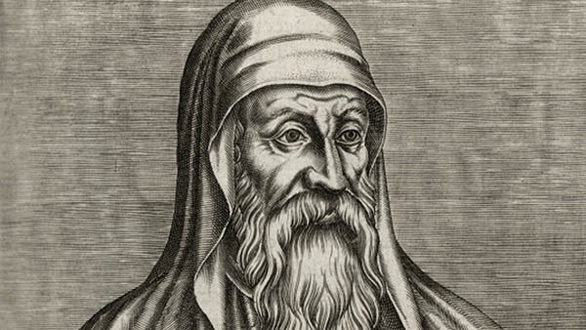
Origen of Alexandria
http://myocn.net/faith-seeking-understanding-part-ii-clement-alexandria/

