Slide 1


Slide 2
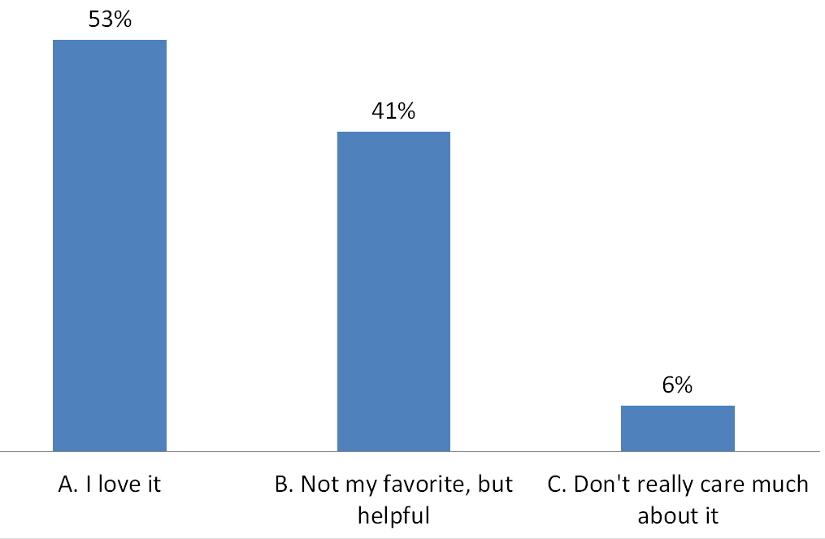
Results from Last Week’s Survey
Question # 1 – Attitude Towards the Subject of Church History

Slide 3
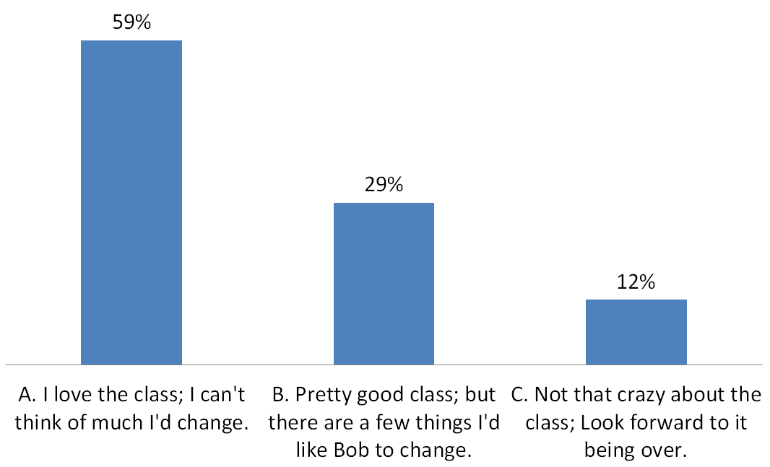
Results from Last Week’s Survey
Question # 2 – General Feeling About Bob’s History Class So Far

Slide 4
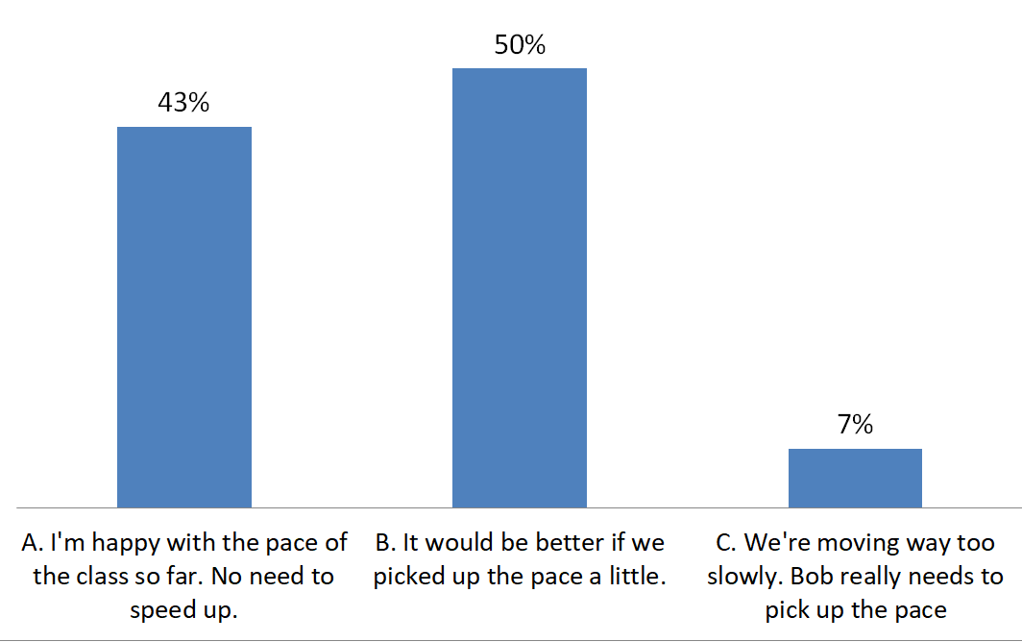
Results from Last Week’s Survey
Question # 3 – How Do You Feel About the Pace of the Class So Far?

Slide 5
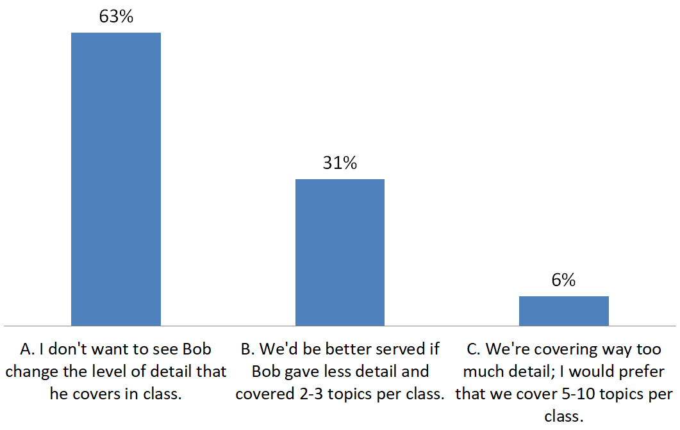
Results from Last Week’s Survey
Question # 4 – What Do You Think About the Level of Detail That Bob Gives in Class?

Slide 6
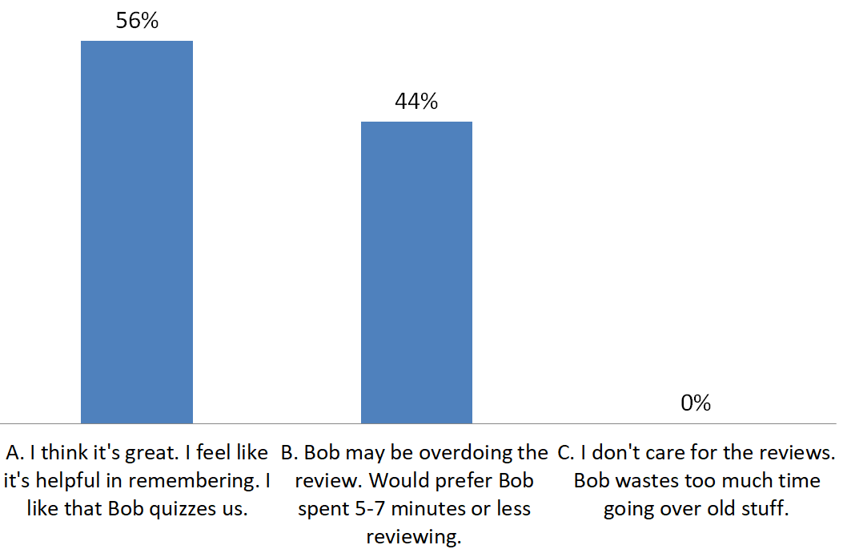
Results from Last Week’s Survey
Question # 5 – What Do You Think About the Amount of Time Bob Spends Reviewing?

Slide 7
Results from Last Week’s Survey
Question # 6 – Things You Like About the Class?
The topic of Church History
Bob and His Style of Teaching
  Energetic and Passionate about the Topic
  Well Prepared and Thorough
The Use of PowerPoint and the Graphics
The comparisons between past controversies with controversies in our own day.
Bob’s Interaction with the Class

Slide 8
Results from Last Week’s Survey
Question # 7 – Things You Don’t Like About the Class?
Hard to Keep Up in Class While Taking Notes.
The print on the screen is sometimes too small and hard to read.
The Long Reviews
Class is Sometimes a Little Too “Fact Based” – Not Enough Practical Application Made in Class.
Not Always Enough Time Allowed at the End of Class for Discussion.
It’s sometimes difficult to follow some of the more complex aspects of the class:
  The Latin and Greek Terms
  Referring to the Century (1st, 2nd, 3rd, etc.) rather than the year
  Sometimes the more nuanced ideas are hard to follow

Slide 9
Results from Last Week’s Survey
Question # 8 – Things Bob could start doing to improve the class
Provide Handouts with Each Class:
  Outline of the Class
  A sheet with blanks to fill in
Provide more graphics and timelines showing the big picture of where we are in history.
Slow Down
Give less detail but cover more people (or topics) in a lesson.
More Focus on Practical Application
More time spent discussing and wrestling with a particular topic - whatever topics get the class fired up.
Provide Snacks for Class

Slide 10
Results from Last Week’s Survey
Question # 9 – Things Bob could stop doing to improve the class
Less review and less detail with more of an overview approach.
Fewer questions on "note taker" level. Questions should be where we all think and are benefitted.
Constant clearing of the throat.

Slide 11
My Takeaways from Last Week’s Survey
I plan to start making handouts available at the beginning of each class.
I plan to shorten the amount of time I spend reviewing to about 5-7 minutes, while still trying to cover the main ideas from the previous week.
I plan to make a regular practice of showing some “big picture” timelines to remind the class of what we’ve covered and show how this weeks class fits into the big picture.
I plan to try to cover 2-3 topics (or individuals) per class in an effort to speed things up a little.
At the end of each class, I will ask for a volunteer to bring a snack for the class on the following week. ☺
I will set aside the last ten minutes (or so) of each class for a discussion time where we can, as a class, further explore the ideas taught in class and how we might apply them to our lives today.

Slide 12
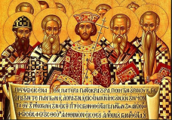


Overview of Church History
From the Cross to Nicaea
Roman Persecution
Jewish
Persecution
Marcus Aurelius
Septimius Severus
Diocletian
Domitian
Hadrian
Maximin
Valerian
Nero
Trajan
Decius
54
81
98
117
161
193
235
249
253
284
â
â
â
â
â
â
â
â
â
â
68
96
117
138
180
211
238
251
260
305
Martyrdom of
Peter & Paul
Death of
Apostle John
Rise of Gnosticism
Rise of Montanism
Novatianist Controversy
Constantine
Edict of Toleration
Council of Nicaea
Marcion
First Century
Second Century
Third Century
Fourth Century
AD 1
33
68
100
130
140
165
200
251
300
313
325
The Apostolic Fathers
95 to 140
1 Clement 70-140
The Didache 100
Ignatius of Antioch 107
Letter of Barnabas 120
Papias 130
Letter to Diognetus 100-150
Shepherd of Hermas 150
Polycarp 156

Slide 13
Overview of Church History
From the Cross to Nicaea
Roman Persecution
Jewish
Persecution
Marcus Aurelius
Septimius Severus
Diocletian
Domitian
Hadrian
Maximin
Valerian
Nero
Trajan
Decius
54
81
98
117
161
193
235
249
253
284
â
â
â
â
â
â
â
â
â
â
68
96
117
138
180
211
238
251
260
305
Martyrdom of
Peter & Paul
Death of
Apostle John
Rise of Gnosticism
Rise of Montanism
Novatianist Controversy
Constantine
Edict of Toleration
Council of Nicaea
Marcion
First Century
Second Century
Third Century
Fourth Century
AD 1
33
68
100
130
140
165
200
251
300
313
325
The Apostolic Fathers
95 to 140
Second Century Apologists
Justin Martyr 103–165
Tertullian 155-225
Melito of Sardis 170-180
Irenaeus of Lyons 130-202

Slide 14
Overview of Church History
From the Cross to Nicaea
Roman Persecution
Jewish
Persecution
Marcus Aurelius
Septimius Severus
Diocletian
Domitian
Hadrian
Maximin
Valerian
Nero
Trajan
Decius
54
81
98
117
161
193
235
249
253
284
â
â
â
â
â
â
â
â
â
â
68
96
117
138
180
211
238
251
260
305
Martyrdom of
Peter & Paul
Death of
Apostle John
Rise of Gnosticism
Rise of Montanism
Novatianist Controversy
Constantine
Edict of Toleration
Council of Nicaea
Marcion
First Century
Second Century
Third Century
Fourth Century
AD 1
33
68
100
130
140
165
200
251
300
313
325
The Apostolic Fathers
95 to 140
Second Century Apologists
Third Century Church Fathers
Clement of Alexandria 150-215
Origen of Alexandria 185-254
Hippolytus 170-236
Cyprian 200-258

Slide 15
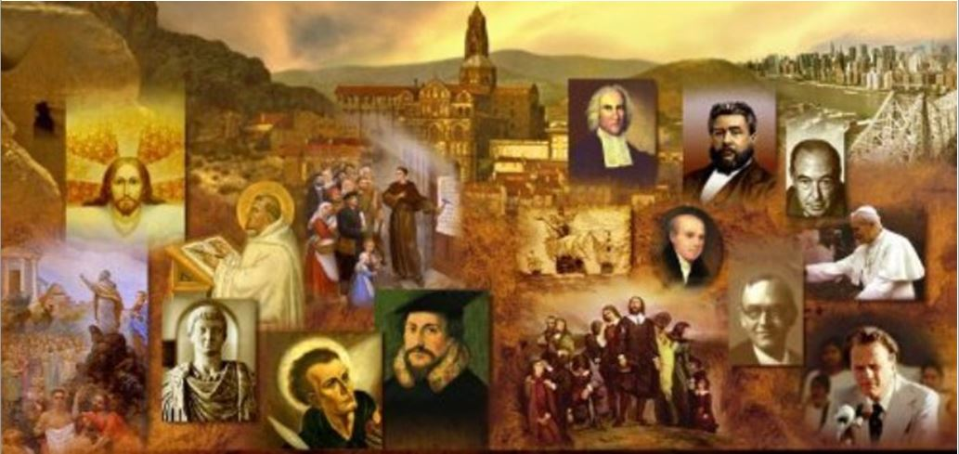
Review
The Egyptian city of Alexandria was, after Rome, the greatest city in the Roman Empire.
What was the ancient city of Alexandria known for?
  It was the cultural center of artistic, scientific and philosophical activity in the Greek and Roman world.
Clement was born to pagan parents in around AD 150 in Athens, a city that had long been famous for its philosophers.
Where did Clement end up settling after his conversion?
  Alexandria

Slide 16
Review
Clement shared Justin Martyr’s high regard for Greek philosophy and freely used both Platonic and Stoic ideas and writings in his discussions of the Christian view of life.
What parallel did Clement draw between Greek Philosophy and Greeks and the Old Testament Law and the Jews?
  Clement argued that philosophy had prepared the Greeks to receive Christ, just as the Old Testament Law had prepared the Jews to receive Christ!

Slide 17
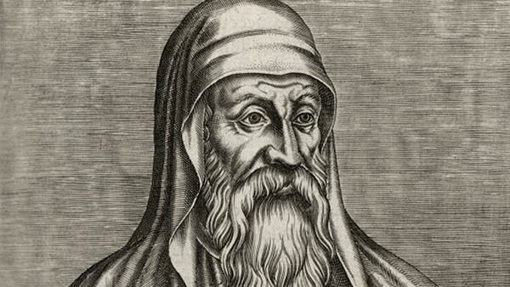
Origen of Alexandria
http://myocn.net/faith-seeking-understanding-part-ii-clement-alexandria/

Slide 18
*Origen of Alexandria
Origen was born in AD 185 and he died in AD 253.
His father, Leonides, was martyred during the same persecution (under Septimius Severus) that caused Clement to flee Alexandria in AD 202.
Origen wanted to die with his father, but his mother saved his life by hiding his clothes so he couldn’t leave the house. He was 17 at the time.
At 18 years of age he was chosen to take Clement’s place in leading the Alexandrian School.
His fame spread widely. His works fill 600 volumes.
He had a scribe with him day and night who wrote down everything. He addressed a wide breadth of topics.
*Based on notes taken from James White’s 2016 Church History Series; Lesson 20 – Alexandrian School

Slide 19
*Origen of Alexandria
He was an ascetic, wore a slave collar all his life.
He owned one coat, no shoes. Never drank wine, ate sparingly, slept on the floor, and spent much of the night in prayer.
He is most famous for the fact that as a youth he emasculated himself. Later in life he repented of that.
This is part of the reason why he is not considered a “saint” by the Roman Catholics.
He was ordained a presbyter by bishops outside of Alexandria.
The bishop of Alexander, Demetrius, convened a council against Origen and had him condemned and excommunicated.
So Origen went to Caesarea and founded another school which soon rivaled the school in Alexandria!
*Based on notes taken from James White’s 2016 Church History Series; Lesson 20 – Alexandrian School

Slide 20
*Origen of Alexandria
Towards the end of his life Origen was invited to return to Alexandria after Demetrius’ death, but he ended up getting caught up in the Decian persecution - the beginning of empire wide persecution that started in the 250s.
And although Origin was eventually released, the torture he underwent while in prison eventually resulted in his death.
Origen is vitally important in the discussion of a number of aspects of early church history.
Today, in places like Westminster Theological Seminary, there are entire courses offered solely on Origen. He does stand as a giant in many ways.
*Based on notes taken from James White’s 2016 Church History Series; Lesson 20 – Alexandrian School

Slide 21
*Origen of Alexandria
There are only two well-known early church fathers who knew both biblical languages well: Jerome and Origen.
Origen recognized there were variations in the text in his day.
He wrote something very important called the Hexapla – a six-columned edition of the Old Testament comparing six textual streams of information.
Modern Greek texts will footnote Origen as “Or”.
Origen’s asceticism had a huge effect on his students, which they then spread to others.
But Origen’s largest area of influence is in the area of exegesis (or the lack thereof). Origen introduced the allegorical method of interpretation.
*Based on notes taken from James White’s 2016 Church History Series; Lesson 20 – Alexandrian School

Slide 22
*Origen of Alexandria
In allegorical interpretation there are three “senses” to every biblical text:
  The Literal Sense – Origen considered this the least important – though we believe the opposite. He thought since anybody could know this interpretation, it wasn’t all that special. He thought there ought to be a spiritual aspect to the text that an unbeliever wouldn’t be able to see.
  The Moral Sense – He considered this a little more important.
  The Spiritual or Allegorical Sense – He considered this most important. There are some scriptures that are very susceptible to allegorical interpretation. Parables are an example of this. Allegorical interpretations will yield hundreds of possible interpretations. The other is apocalyptic literature (like the book of Revelation).
*Based on notes taken from James White’s 2016 Church History Series; Lesson 22 – Allegorical School

Slide 23
*Origen of Alexandria
After Origen, especially during the Medieval Period, the OT was considered a book of allegorical stories.
It’s difficult to underestimate the negative affect that this method of interpretation had on the church. People could find anything they wanted in the Bible when using the allegorical method.
Origen himself:
  Did not believe in the resurrection of material bodies.
  Believed in the pre-existence of the human soul.
  Believed that redemption would be extended to all beings including fallen angels - There was in the early church a fairly widespread movement of universalism.
*Based on notes taken from James White’s 2016 Church History Series; Lesson 22 – Allegorical School

Slide 24
*Origen of Alexandria
You cannot ignore Origin – his impact was great, both positively and negatively.
We can’t ignore somebody just because they were really off in some area.
*Based on notes taken from James White’s 2016 Church History Series; Lesson 22 – Allegorical School

Slide 25
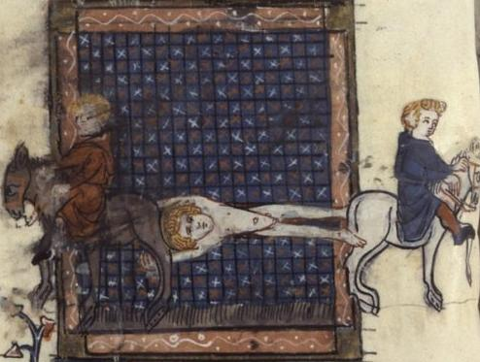
Hippolytus of Rome
https://en.wikipedia.org/wiki/Hippolytus_of_Rome#/media/File:Hippolytus_martyrdom.jpg

Slide 26
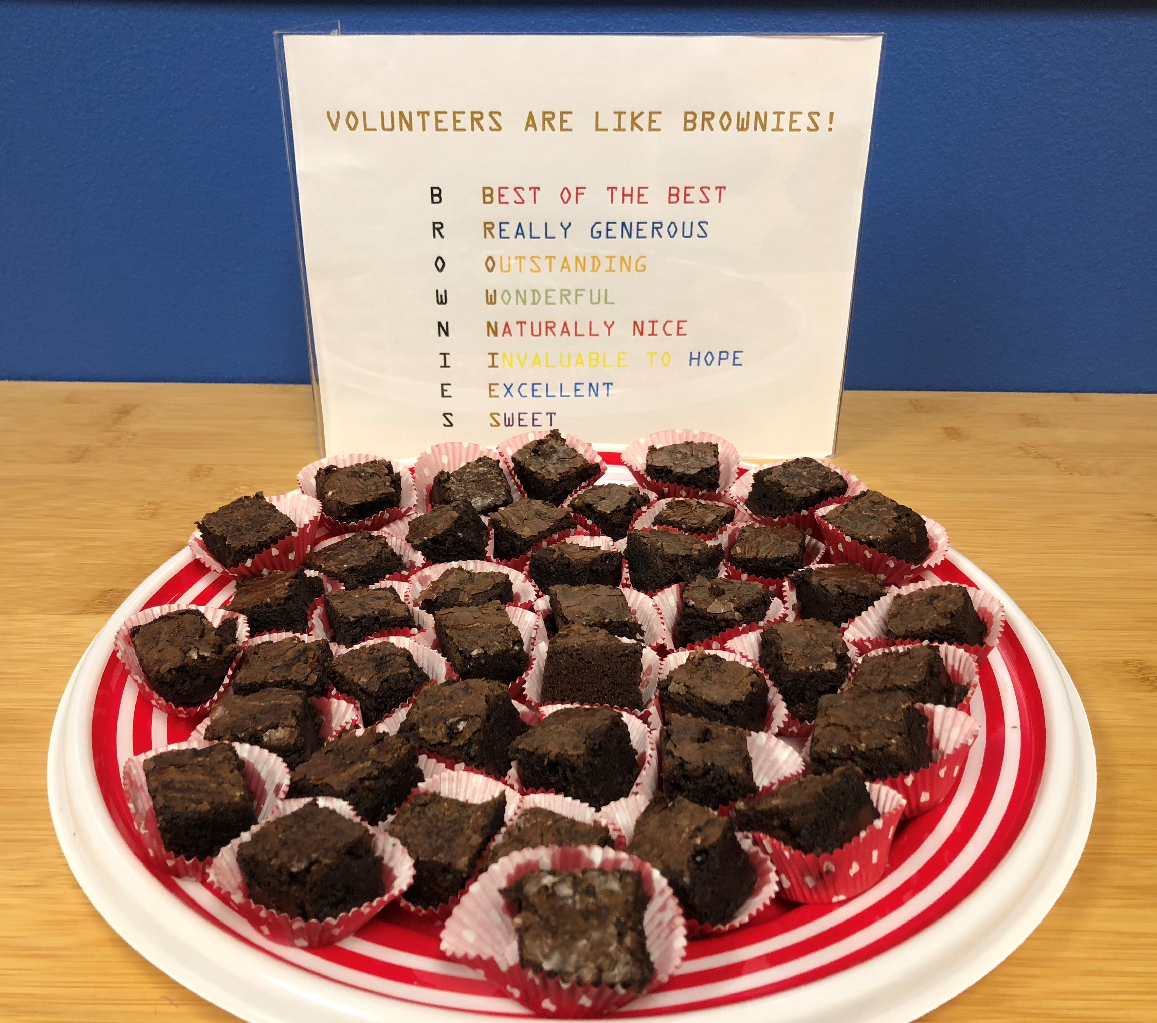
https://www.hopehelps.org/volunteer-appreciation-week-2018/

Slide 27

Class Discussion Time
https://www.weareteachers.com/moving-beyond-classroom-discussions/

Slide 28
*Class Discussion Time
As you heard me summarize the results of last week’s survey and my response to it, what are some additional thoughts that you have?
We saw that Clement of Alexandria, who was born in Athens and ended up in Alexandria (two cities that were known for their focus on Greek philosophy), often mixed Greek philosophy with his theology.
In what ways do you think the cultural ideas where we live tends to end up finding their way into our theology?
In relation to Origen I stated that we can’t ignore somebody just because they were really off in some area (of their thinking or theology).
Can you think of a practical application of this principle that you could make in our day?
Do you have a topic or question that you would like to see us to discuss?

