Slide 1


Slide 2
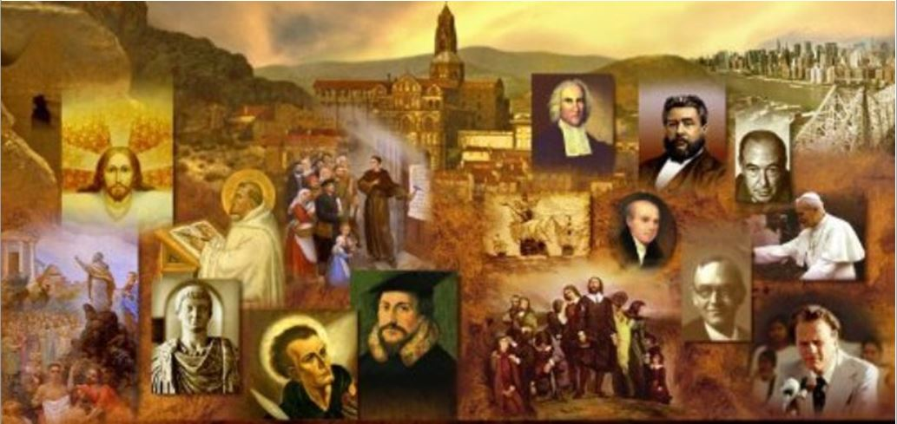
Review
What are some of the most impressive things that you remember about Origen?
  He was willing to be martyred as a Christian along with his Father at the age of 17
  At 18 years of age he was chosen to take Clement’s place in leading the Alexandrian School.
  He had a scribe with him day and night who wrote down everything he said; consequently, today his extant works fill 600 volumes.
  He owned one coat, no shoes. Never drank wine, ate sparingly, slept on the floor, and spent much of the night in prayer.
  When the bishop of Alexandria had Origen condemned and excommunicated, Origen went to Caesarea and founded another school which soon rivaled the school in Alexandria!
  Today, in places like Westminster Theological Seminary, there are entire courses offered solely on Origen.
  He was one of only two well-known early church fathers who knew both biblical languages well.

Slide 3
Review
But unfortunately, Origen’s largest area of influence on subsequent generations is in the area of exegesis (or the lack thereof). Origen introduced the allegorical method of interpretation.
According to the allegorical method of interpretation what are the three “senses” to be found in every biblical text?
  The Literal Sense – Origen considered this the least important – though we believe the opposite.
  The Moral Sense – He considered this a little more important.
  The Spiritual or Allegorical Sense – He considered this most important.
What is the problem with the allegorical method of interpretation?
  It’s not tied to anything objective in the biblical text, and so someone using this method can say anything they want and claim they got it from the text, when, in reality, they just made it up!

Slide 4
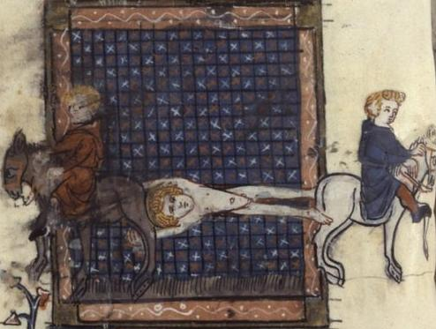
Hippolytus of Rome
https://en.wikipedia.org/wiki/Hippolytus_of_Rome#/media/File:Hippolytus_martyrdom.jpg

Slide 5
*Hippolytus of Rome
This famous person has lived three lives:
  A real one in the third century as an opponent of the Roman bishops of his day
  A fictitious one in the middle ages as a canonized Roman Catholic “saint”
  A literary one in the nineteenth century after the discovery of his long lost works against heresies.
Hippolytus was undoubtedly one of the most learned and eminent scholars and theologians of his time.
During the middle ages, the Roman Catholic church considered him a “saint” and a martyr.
* Schaff, Philip. History Of The Christian Church (The Complete Eight Volumes In One). Kindle Edition.

Slide 6
*Hippolytus of Rome
But when Books 4-10 of one of Hippolytus’ most famous works, “Refutation of all Heresies”, was discovered and published in 1851, it became clear that, in his day, Hippolytus had vigorously opposed a number of the Roman bishops whom the Roman Catholics now claim were early “popes”!
Until this publication was made available in 1851, it was difficult to obtain any definite facts concerning Hippolytus of Rome and his life because there were so many conflicting statements made about him by early historical writers.
But with this relatively recent discovery, it is now possible to clear up many of the ambiguities that once existed concerning the life of Hippolytus.
* The Complete Works of St. Hippolytus (9 Books). Kindle Edition. Introduction by J.P. Kirsch
.

Slide 7
*Hippolytus of Rome
Hippolytus (c. 170–235 AD) served as presbyter in the Church of Rome under Bishop Zephyrinus (199–217 AD) and was probably one of the most important Christian theologians in the third century.
There is some evidence that Hippolytus might have been a disciple of Irenaeus.
It is also thought that Origen once heard a sermon by Hippolytus when he went to Rome about the year 212.
Hippolytus came into conflict with Bishop Zephyrinus, along with many others in the church of Rome at the time, for their “modalistic” views of the Father and the Son.
Modalism (also known as “Sabellianism”) is a heresy that is still taught by some in our day, which denies that there is any real personal distinction between Father, Son and Holy Spirit – that they are all the same person who simply acted out three different roles or “manifestations”.
* The Complete Works of St. Hippolytus (9 Books). Kindle Edition. Introduction by J.P. Kirsch
.

Slide 8
*Hippolytus of Rome
Because Bishop Zephyrinus failed to understand the gravity of the Modalists’ heretical views, he declined to make a decision on the issue.
For this Hippolytus strongly criticized him, saying he was an incompetent man, unworthy to rule the Church of Rome and was merely a puppet in the hands of an ambitious and intriguing deacon in the church named Callistus.
Consequently, when Zephyrinus died and Callistus was elected bishop (217-218), Hippolytus immediately left the communion of the Roman Church and had himself elected bishop by those who followed him.
* The Complete Works of St. Hippolytus (9 Books). Kindle Edition. Introduction by J.P. Kirsch
.

Slide 9
*Hippolytus of Rome
Hippolytus began referring to himself and those who left the church with him as the true Catholic Church and followers of the Apostles, while referring to Bishop Callistus and the Romans who stayed in his church as members of “the School of Callistus”.
Hippolytus accused Callistus not only of falling into the heresy of Sabellius; but also of being too lax on sin, because Callistus had granted absolution to members of the Roman church who had committed grave sins, such as adultery.
Callistus and his Roman congregation, on the other hand, considered Hippolytus to be guilty of “excessive rigorism”.
* The Complete Works of St. Hippolytus (9 Books). Kindle Edition. Introduction by J.P. Kirsch
.

Slide 10
*Hippolytus of Rome
Hippolytus continued his opposition to the Roman bishops throughout the ministries of the two immediate successors of Callistus:
  Bishop Urban (222-230)
  Bishop Pontian (230-35)
In 235 both Hippolytus and Bishop Pontian ended up being exiled to the mines of Sardinia during the persecution of Christians by the Roman emperor Maximinus.
There Hippolytus became reconciled with Pontian and exhorted his supporters to unite with Rome.
Before dying as martyrs, both Hippolytus and Pontian resigned as bishops in order to allow for a successor named Anterus to become bishop of Rome (235–236), thus ending the schism.
Fabian, the subsequent Bishop of Rome (236–250), had Hippolytus’ corpse brought to Rome for solemn burial in 236, an indication that, before his death, Hippolytus had been reconciled to the church at Rome.
* The Complete Works of St. Hippolytus (9 Books). Kindle Edition. Introduction by J.P. Kirsch
.

Slide 11
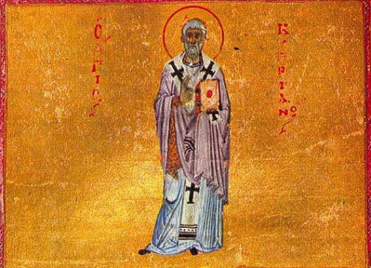
Cyprian of
Carthage
https://www.stcyprianoca.org/

Slide 12
*Cyprian of Carthage
Cyprian was born in about 200, probably in Carthage. Upper class and rich, he was a famous lawyer and a professor of rhetoric (the art of public speaking) prior to his conversion.
Disgusted, however, with the corruption and immorality of Pagan society, Cyprian searched for something purer and nobler, and found the answer in Christ.
Converted in 246, he gave his entire fortune away to the poor.
Within two or three years of becoming a Christian, his outstanding qualities of character, his gentleness, love and peaceable spirit, led to his election as bishop of Carthage.
* Needham, Nick. 2,000 Years of Christ's Power Vol. 1: The Age of the Early Church Fathers . Kindle Edition.

Slide 13
*Cyprian of Carthage
The greatest influence on Cyprian was Tertullian; Cyprian called him “the master” and used to read his writings every day (the Catholic Church had not yet consigned Tertullian to the category of despised heretic).
Cyprian himself had a fairly simple, literal understanding of the Bible, in stark contrast to Origen.
But he interpreted the New Testament in a rather Old Testament way, thinking of presbyters and bishops as priests and the Lord’s supper as a sacrifice.
Cyprian was the first of the early Church fathers to set forth a theological doctrine of holy communion in sacrificial terms, a view which unfortunately became increasingly widespread in later years.
* Needham, Nick. 2,000 Years of Christ's Power Vol. 1: The Age of the Early Church Fathers . Kindle Edition.

Slide 14
*Cyprian of Carthage
However, Cyprian’s main concern was not the doctrine of communion, but Christian unity, best expressed in his book The Unity of the Catholic Church.
Cyprian held that this unity was found in the person and office of the bishop. “Where the bishop is,” he said, “there is the Church.”
To belong to the Catholic Church, therefore, a person had to be in fellowship with the local “apostolic” bishop.
Each bishop was supreme in his own church, Cyprian argued, but all bishops were equal with one another.
* Needham, Nick. 2,000 Years of Christ's Power Vol. 1: The Age of the Early Church Fathers . Kindle Edition.

Slide 15
*Cyprian of Carthage
From Cyprian’s doctrine of the Church, it followed that the sin of schism – leaving the Catholic Church and its “apostolic” bishops – was infinitely serious.
Therefore, in one of Cyprian’s most famous sayings, he stated:
  Whoever stands apart from the Church and is joined to an adulteress [a non-Catholic church] is cut off from the promises given to Christ’s Church; and he who leaves the Church of Christ does not attain to the rewards of Christ, but is an alien and an enemy. You cannot have God as your Father unless you have the Church as your mother. If anyone was able to escape the flood outside of Noah’s ark, then you can escape judgment if you are outside the doors of the Church.
* Needham, Nick. 2,000 Years of Christ's Power Vol. 1: The Age of the Early Church Fathers . Kindle Edition.

Slide 16
*Cyprian of Carthage
The persecution under the emperor Decius raised some serious problems for Cyprian’s understanding of the Church.
Decius had ordered all citizens to offer sacrifice to the gods and to obtain an official certificate stating that they had done this.
Large numbers of Church members had either offered sacrifice, or bribed magistrates to give them a fake certificate.
After the persecution was over, these people wanted to be admitted back into the Church. What should be done with these “lapsed” Christians?
* Needham, Nick. 2,000 Years of Christ's Power Vol. 1: The Age of the Early Church Fathers . Kindle Edition.

Slide 17
*Cyprian of Carthage
Cyprian presided over a local Church council at Carthage in 251 and played a leading part in its decision that the lapsed could be received back into the Church, but only after a period of time during which they would be proving their sincerity by doing “penance” for their sin.
The time period of penance was to vary according to the seriousness involved in each individual case of apostasy.
* Needham, Nick. 2,000 Years of Christ's Power Vol. 1: The Age of the Early Church Fathers . Kindle Edition.

Slide 18
*Cyprian of Carthage
These decisions led to schisms in the Church.
Some Christians in Carthage thought that Cyprian was too strict; led by the presbyter Novatus, they broke away to form a rival church with a softer, more lenient discipline.
The opposite happened in Rome, where the church took the same line as Carthage towards the problem of the lapsed.
Some Roman Christians led by a presbyter named Novatian broke away from the Roman church, forming a new congregation with a far stricter discipline: they would never readmit any lapsed believer.
* Needham, Nick. 2,000 Years of Christ's Power Vol. 1: The Age of the Early Church Fathers . Kindle Edition.

Slide 19
*Cyprian of Carthage
The splits in the Church produced by Decius’s persecution led to even more problems.
What if someone became a Christian in the Novatianist Church, was baptized by Novatianists, and then decided to join the Catholic Church? Should he be re-baptized?
Cyprian said yes. Outside the Catholic Church, no baptism was spiritually effective.
But Stephen, the bishop of Rome, said no. As long as a person had been baptized by water in the name of the Trinity, his baptism was valid. It did not matter that the baptism had been done in a schismatic church.
* Needham, Nick. 2,000 Years of Christ's Power Vol. 1: The Age of the Early Church Fathers . Kindle Edition.

Slide 20
*Cyprian of Carthage
Stephen tried to force his view on the churches of North-West Africa, threatening to excommunicate them all.
The response of Cyprian and the African bishops was robust:
  Let each bishop give his opinion in this matter without judging another, and without separating from the fellowship of those who are not of his opinion. None of us must set himself up as a bishop of bishops, nor force his brother-bishops to obey him by tyrannical terror. Every bishop has full liberty and complete power in his own church. No other bishop can judge him, and he cannot judge any other bishop. Let us all await the judgment of our Lord Jesus Christ, who alone has the power to appoint us as governors in His Church, and who alone can judge our conduct.
* Needham, Nick. 2,000 Years of Christ's Power Vol. 1: The Age of the Early Church Fathers . Kindle Edition.

Slide 21
Cyprian of Carthage
Unfortunately, over time, Cyprian’s insistence on the equality of all bishops gave way, in the West, to a belief in the supremacy of the bishop of Rome.¹
The question of what should be done about those baptized Christians who sinned continued to divide the Western church.²
It was out of that concern that the entire penitential system eventually developed over time.²
Much later, the Protestant Reformation was in large measure a protest against that system.²
¹Needham, Nick. 2,000 Years of Christ's Power Vol. 1: The Age of the Early Church Fathers . Kindle Edition.
²Gonzalez, Justo L.. The Story of Christianity: Volume 1: The Early Church to the Dawn of the Reformation (p. 104)

Slide 22
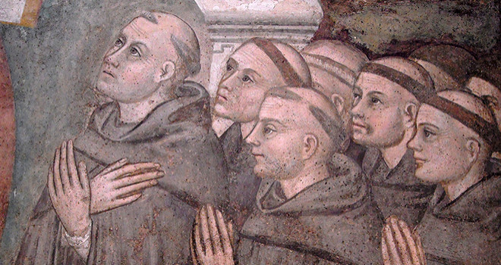
The Development of Monasticism
https://www.crisismagazine.com/2017/monasticism-testifies-gods-reality

Slide 23

https://www.hopehelps.org/volunteer-appreciation-week-2018/

Slide 24

Class Discussion Time
https://www.weareteachers.com/moving-beyond-classroom-discussions/

Slide 25
*Class Discussion Time
The church conflicts brought about by Hippolytus raise a lot of questions about the importance of purity within the local church:
  Is it essential that leaders and members of a church hold to a right view of God in his triune nature?
  Is it important that the members of a local church be held to a high standard of personal purity?
  How is sin to be dealt with within a local church?
Did Cyprian have too high of a view of the role of a bishop within the church when he said that to belong to the Catholic Church, a person had to “be in fellowship with the local apostolic bishop”?
Did Cyprian have too high a view of the church when he taught that a person cannot escape judgment if they do not belong to a sound local church body?
Do you have a topic or question that you would like to see us to discuss?

