Slide 1


Slide 2
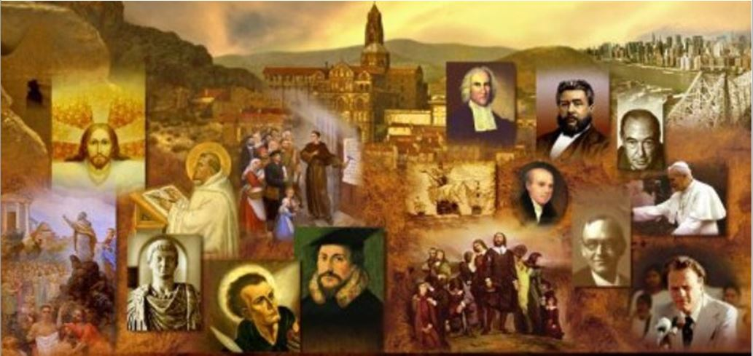
Review
In the spring of 311, with 40,000 soldiers behind him, Constantine rode toward Rome to confront Maxentius, a rival emperor whose numbers were four times his own.
Constantine, up to this point, had been a sun-worshipper.
As the story goes, on the night before his battle with Maxentius, Constantine had a dream. Give a summary of what Constantine dreamed and what happened as a result.
  Constantine had a dream in which the first two letters in the Greek word for Christ appeared one on top of the other in the shape of a cross.
  Constantine is said to have seen or heard the words, “By this sign you will conquer.”
  The following day Constantine had the Chi-Rho sign painted on the shields of his troops.
  Constantine is then said to have prayed to the God of the Christians for victory, and won an amazing and crushing triumph over Maxentius who was killed in battle at the Milvian Bridge.
  He believed that the Christian God had granted him victory, and from then on Constantine acted as the great champion and protector of Christians.

Slide 3
Review
What are some of the aspects of Constantine’s life cited by those who do not believe he was a Christian?
  He ordered the killing of a number of people for purely political reasons, or in a fit of rage – including his son Crispus.
  in his last years, Constantine began favoring the Arian heresy which denied that Christ was God in the flesh.
What are some aspects of Constantine’s life cited by those who believe that he was a Christian?
  Constantine had nothing to gain, either in the political or military sphere, by professing the Christian faith.
  He regularly attended Christian worship
  He listened to the longest sermons without murmuring
  He observed Easter with great solemnity
What city did Constantine found as capital when he conquered the eastern portion of the Empire? Give the original name (given by Constantine), the eventual name, and the modern name?
  “New Rome”
  Constantinople
  Istanbul

Slide 4
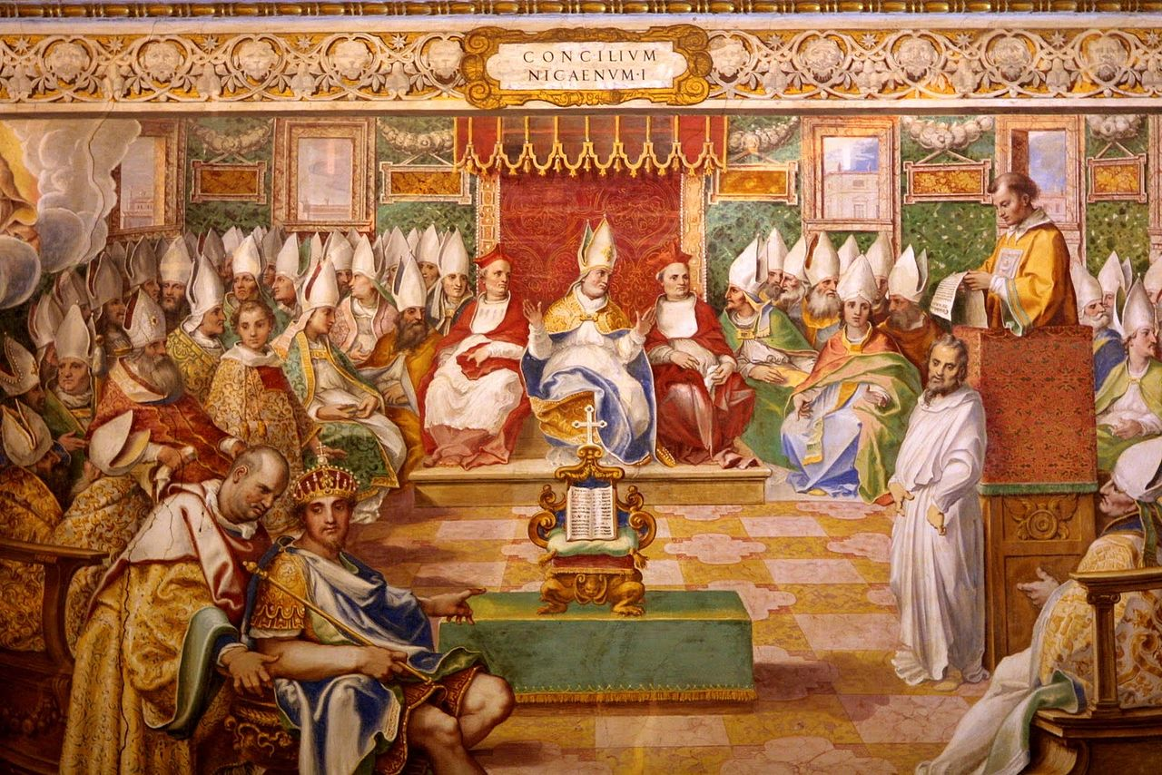
The Council of Nicaea
https://en.wikipedia.org/wiki/First_Council_of_Nicaea#/media/File:Nicea.jpg

Slide 5
*Background to the Council of Nicaea
Except for the apostolic council in Jerusalem recorded in Acts 15, the Council of Nicaea stands above other early councils of the church as far as its scope and its focus.
Luther called it “the most sacred of all councils.”
When it began in AD 325, the fires of persecution had barely cooled. The Roman Empire had been unsuccessful in its attempt to wipe out the Christian faith.
Fourteen years had elapsed since the final persecutions under the Emperor Galerius had ended.
Many of the men who made up the Council of Nicaea bore in their bodies the scars of persecution. They had been willing to suffer for the name of Christ.
* https://www.equip.org/articles/what-really-happened-at-nicea-/

Slide 6
*Background to the Council of Nicaea
The council was called by the Emperor Constantine. So serious was the issue at hand that many leading bishops in the church agreed to participate.
To understand why the first universal council was called, we must go back to around AD 318.
In a suburb just outside of Alexandria, a popular presbyter by the name of Arius began teaching in opposition to Alexander, the bishop of Alexandria.
Specifically, Arius disagreed with Alexander’s teaching that Jesus, the Son of God, had existed eternally.
Instead, Arius insisted that “there was a time when the Son was not.” Christ, according to Arius, must be numbered among the created beings — highly exalted, to be sure, but a creation, nonetheless.
Alexander defended his position and eventually assembled a council of Egyptian bishops which then removed Arius from office for heresy.
* https://www.equip.org/articles/what-really-happened-at-nicea-/

Slide 7
*Background to the Council of Nicaea
Arius, however, was not ready to give up without a fight, so he went to Palestine and gathered support from other Eastern bishops.
He had a ready-made network of contacts, because many of the Middle Eastern clergy had, like Arius himself, studied under the learned Lucian of Antioch, head of the Antiochene school of theology, who had died a martyr in AD 312 during Maximinus’ persecution of the Church.
Arius wrote letters to Lucian’s ex-students who were now presbyters or bishops, addressing them as “Dear fellow pupil of Lucian”.
* Needham, Nick. 2,000 Years of Christ's Power Vol. 1: The Age of the Early Church Fathers

Slide 8
*Background to the Council of Nicaea
Lucian’s views of Christ seem to have been similar to Arius’s; some historians have called Lucian “the father of Arianism”.
Arius’s methods proved very successful in popularizing his cause, with the result that Church leaders throughout the East became caught up in the dispute, and began to take sides either with Arius or with Alexander.
Of the bishops who supported Arius, only a few actually understood and believed Arius’s doctrine that the Son was a created being!
However, many found the controversy deeply confusing, because in some ways Arius seemed to be closer than Alexander was to the traditional Eastern theology, taught by Origen, which said that the Son was inferior to the Father.
* Needham, Nick. 2,000 Years of Christ's Power Vol. 1: The Age of the Early Church Fathers

Slide 9
*Background to the Council of Nicaea
Alexander was, in effect, challenging Origen’s teaching by saying that the Son was equal with the Father in possessing the full divine nature – which, according to Arius, meant a belief in two Gods.
On the other hand, Arius himself was teaching that the Son was a created being, which was certainly not what Origen had said.
So the Eastern Church became increasingly perplexed and divided.
Constantine felt that it was his duty as a Christian emperor to restore unity to his Empire’s divided Church.
* Needham, Nick. 2,000 Years of Christ's Power Vol. 1: The Age of the Early Church Fathers

Slide 10
*Background to the Council of Nicaea
Having consolidated his hold on the Empire, Constantine promoted unity in every way possible.
He recognized that a schism in the Christian church would be just one more destabilizing factor in his empire, and he moved to solve the problem.
While he had encouragement from men like Hosius, bishop of Cordova, and Eusebius of Caesarea, Constantine was the one who officially called for the council.
* https://www.equip.org/articles/what-really-happened-at-nicea-/

Slide 11
*The Participants and Their Views
According to tradition, 318 bishops attended the Council of Nicaea, though most historians believe this number is a bit high.
The vast majority came from the East, with less than a dozen representing the rest of the Empire.
The council was divided into three groups:
  The Arian Group
  The Orthodox Group
  The Middle Group
* https://www.equip.org/articles/what-really-happened-at-nicea-/

Slide 12
*The Participants and Their Views
The Arian Group - Arius was in attendance, at the command of the Emperor, along with a few supporters.
Most notable of these were two Egyptian bishops, Theonas and Secundus, as well as Eusebius of Nicomedia.
This group represented the viewpoint that Christ was of a different substance (Greek: hetero-ousios) than the Father, that is, that He is a creature.
The “Orthodox” Group - was led primarily by Hosius of Cordova and Alexander of Alexandria (accompanied by his brilliant young deacon, and later champion of the Nicene position, Athanasius).
They represented the view that Christ was of the same substance (Greek: homo-ousios) as the Father, that is, that He has eternally shared one essence with the Father and is fully God.
* https://www.equip.org/articles/what-really-happened-at-nicea-/

Slide 13
*The Participants and Their Views
The Middle Group - led by Eusebius of Caesarea (and hence often called the “Eusebian” party), distrusted the term homoousios, primarily because it had been used in the previous century by the modalistic heretic Sabellius and others who wished to teach the error that the Father and the Son were one person.
This middle group agreed with the orthodox party that Jesus was fully God, but they were concerned that the term homoousios could be misunderstood to support the false idea that the Father and Son are one person.
The middle group therefore presented the idea that the Son was of a similar substance (Greek: homoiousios) as the Father.
By this means they hoped to avoid both the error of Arius as well as the perceived danger of Sabellianism found in the term homoousios.
* https://www.equip.org/articles/what-really-happened-at-nicea-/

Slide 14
*The Participants and Their Views
Party/Leaders | View of Christ and the Father
Arian – Arius | of a different substance — heteroousios
Orthodox – Hosius, Alexander, Athanasius | of the same substance — homoousios
Eusebian – Eusebius of Caesarea | of a similar substance — homoiousios
* https://www.equip.org/articles/what-really-happened-at-nicea-/

Slide 15
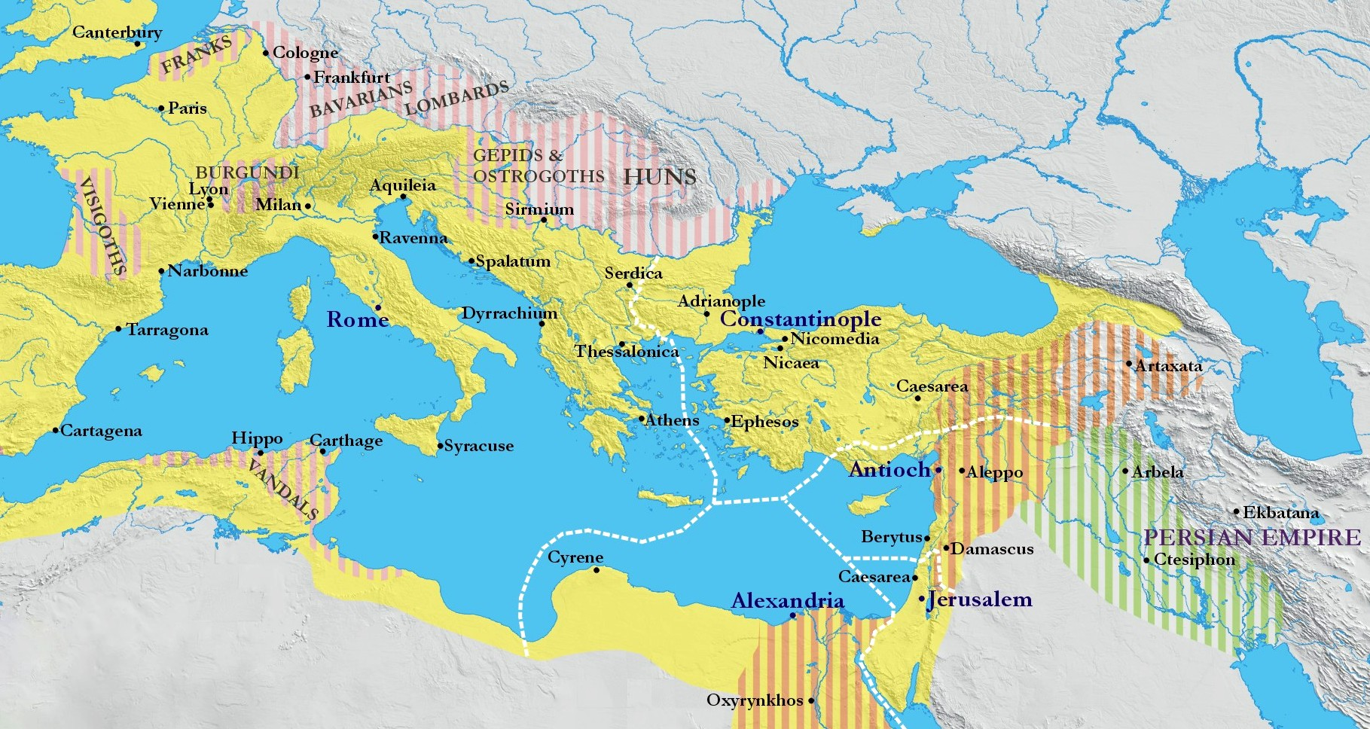
*The Participants and Their Views
* https://kimberlinglutheran.com/wp-content/uploads/2017/10/Nicaea.jpg

Slide 16
*The Participants and Their Views
Often it is alleged (especially by Jehovah’s Witnesses, for example) that Constantine is the one who forced the “same substance” view upon the council.
This is not the case. There is no question that Constantine wanted a unified church after the Council of Nicaea. But he was no theologian, nor did he really care to any degree what basis would be used to forge the unity he desired.
Later events show that he didn’t have any particular stake in the term homoousios and was willing to abandon it, if he saw that doing so would be of benefit to him.
As Schaff rightly points out with reference to the term homoousios, “The word…was not an invention of the council of Nicaea, still less of Constantine, but had previously arisen in theological language, and occurs even in Origen [AD 185-254] and among the Gnostics….”
Constantine is not the source or origin of the term, and the council did not adopt the term at his command.
* https://www.equip.org/articles/what-really-happened-at-nicea-/

Slide 17
*The Decision and the Creed
Athanasius notes that the gathered bishops started off wanting to express their faith in scriptural language alone – and they really tried to do that.
But every time they came up with a statement that was limited solely to biblical terms, the Arians would find a way of “reading” the statement so as to allow for agreement.
Eventually the members of the council were forced to realize that they needed to use an extra-biblical term that would clearly differentiate between a belief in the full deity of Christ and all those positions that would compromise that belief.
Therefore, they settled on the term homoousios as being completely antithetical to the Arian position, and at the same time accurately descriptive of the scriptural truth that Jesus Christ is not a creature, but is fully God, incarnate deity.
* https://www.equip.org/articles/what-really-happened-at-nicea-/

Slide 18
*The Decision and the Creed
The “orthodox” party had to convince the “middle group” that by using the term homoousios they were not in any way attempting to give aid and comfort to the Modalists and Sabellians in the East who continued to teach their errors even in the days of Nicaea.
They were not compromising the existence of three Persons, but were instead safeguarding the full deity of the Persons, and in particular, the Son.
* https://www.equip.org/articles/what-really-happened-at-nicea-/

Slide 19
*The Decision and the Creed
The resulting creed, signed by all but Arius and two bishops, was quite clear in its position:
  We believe…in one Lord Jesus Christ, the Son of God, begotten from the Father, only-begotten, that is, from the substance of the Father, God from God, light from light, true God from true God, begotten, not made, of one substance (homoousios) with the Father, through Whom all things were made….
* https://www.equip.org/articles/what-really-happened-at-nicea-/

Slide 20
*The Decision and the Creed
The creed also contained an “anathema” (i.e., condemnation) for those who rejected these truths, and for the first time, such anathemas carried with them civil repercussions.
Arius and some of his followers were banished, even though for a short time.
This set a precedent that eventually would have tremendous impact on culture and church, but it is also a separate issue from the theological proclamation of the council.
* https://www.equip.org/articles/what-really-happened-at-nicea-/

Slide 21
*The Decision and the Creed
Nicaea did not come up with something “new” in the creed.
Belief in the deity of Christ was as old as the apostles themselves, who enunciated this truth over and over again.
References to the full deity of Christ are abundant in the period prior to the Council of Nicaea:
  Ignatius (died c. 108), the great martyr bishop of Antioch, could easily speak of Jesus Christ as God at the opening of the second century.
  Melito of Sardis (c. 170-180), a much less well-known figure, as you will remember, was tremendously gifted in expressing the ancient faith of the church regarding the deity of Christ
* https://www.equip.org/articles/what-really-happened-at-nicea-/

Slide 22
*The Decision and the Creed
Nicaea was not creating some new doctrine, some new belief, but clearly, explicitly, defining biblical truth against error.
The council had no idea that they, by their gathering together, possessed some kind of sacramental power of defining beliefs: they sought to clarify biblical truth, not to put themselves in the forefront and make themselves a second source of authority.
The relationship between the sufficient Scriptures and the Nicene Bishops should be noted carefully:
  The need for a council (or creed) does not mean that the Scriptures are somehow insufficient; rather, the purpose of a council or creed is to remind one of the truths already clearly taught in Scripture.
  The authority of a council or creed is derived from its fidelity to Scripture – not the other way around.
* https://www.equip.org/articles/what-really-happened-at-nicea-/

Slide 23
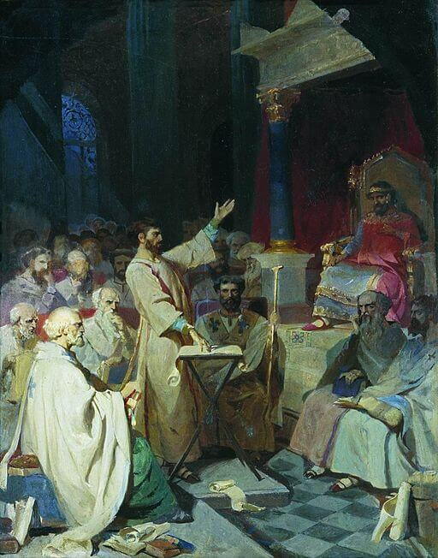
The Rise of Arianism After Nicaea
https://sgwmscog.com/wp-content/uploads/Council-of-Nicea-2-1.jpg

Slide 24

https://www.hopehelps.org/volunteer-appreciation-week-2018/

Slide 25

Class Discussion Time
https://www.weareteachers.com/moving-beyond-classroom-discussions/

Slide 26
*Class Discussion Time
The Council of Nicaea and its Nicene Creed raise some interesting questions about the value and purpose of creeds.
Focusing specifically on the value of creeds in our day:
  There are many well meaning Christians in our day who will argue that creeds are essentially worthless: all you need is the word of God, anything beyond that is superfluous at best, and in many cases harmful because they often introduce man-made ideas into our theology.
  Contrast this with the painful discovery made by the bishops of Nicaea – that without the use of extra-biblical language it is sometimes impossible to expose the errors of heretics.
  What are your thoughts on this issue?
Do you have a topic or question that you would like to see us to discuss?

