Slide 1


Slide 2
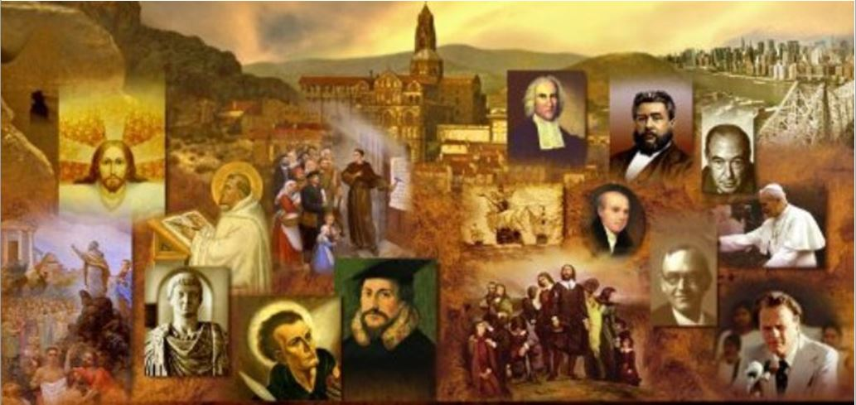
Review
The Council of Nicaea seemed to have settled the Arian controversy and restored unity and peace to the Eastern Church. Was this the case? Explain your answer.
  No! During the six decades between the Council of Nicaea and the Council of Constantinople in 381, Arianism experienced many victories.
  In fact, there were times during those six decades when the majority of bishops were Arian!
Give the name of the Arian leader with a strong influence in Constantine’s court who sought to completely overturn Nicaea (and almost succeeded).
  Eusebius of Nicomedia
Who is the other well-known Eusebius who lived at this time, and what is he known for?
  Eusebius of Caesarea, known as the father of Church history

Slide 3
Review
Give the name of the Alexandrian bishop who almost singlehandedly stood firm for Trinitarian theology against the onslaught of Arianism that took place in the decades following the Council of Nicaea.
  Athanasius
What group was Athanasius in close contact with throughout his life that repeatedly gave him support and asylum, and modeled for him a rigid discipline that he applied to himself?
  The desert monks
How many times was Athanasius removed from his position as bishop over the Arian controversy?
  Five times
What was the Latin saying that described Athanasius’ singlehanded stand against the Arian heresy?
  Athanasius contra mundum: “Athanasius against the world.”

Slide 4

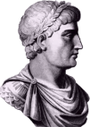

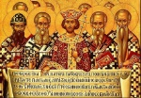
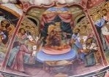
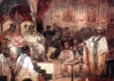
Overview of Church History
From the Cross to Chalcedon
Roman Persecution
Jewish
Persecution
Constantine
AD 306-337
Theodosius I
AD 379-395
Arianism Dominates the Church
381 - Council of Constantinople
313 - Edict of Toleration
325 - Council of Nicaea
Death of
Apostle John
Rise of Gnosticism
Rise of Monasticism
321 – Rise of Arianism
451 - Council of Chalcedon
First Century
Second Century
Third Century
Fourth Century
Fifth Century
AD 1
33
100
130
200
300
400
The Apostolic Fathers
95 to 140
Athanasius
Second Century Apologists
Third Century Church Fathers
Cappadocian Fathers
Chrysostom,
Augustine,
& Jerome

Slide 5
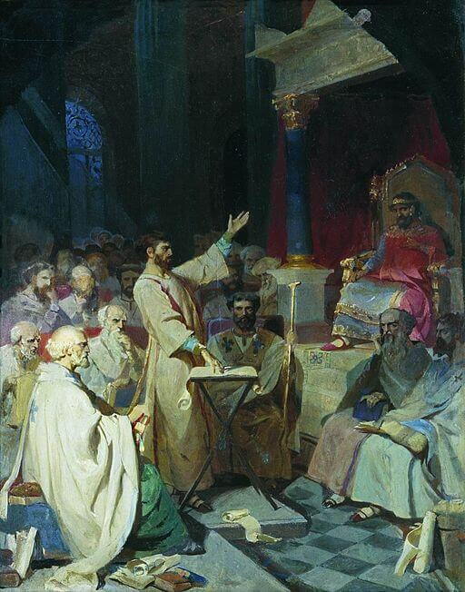
Arian Domination After Nicaea
https://sgwmscog.com/wp-content/uploads/Council-of-Nicea-2-1.jpg

Slide 6
*Arian Domination After Nicaea
Constantine’s son, Constantius was a vain and cruel man who liked to think he was both a great emperor and a great theologian. He was neither.
In matters of theology Constantius was strongly influenced by an inner circle of Arian bishops.
Constantius used all his power as emperor to put fierce pressure on Western Church leaders to accept Arianism, claiming that whatever he, the emperor, believed must certainly be true, otherwise God would not have delivered the world into his hands.
Constantius sent into exile any bishops or presbyters who refused to accept Arianism.
* Needham, Nick. 2,000 Years of Christ's Power Vol. 1: The Age of the Early Church Fathers

Slide 7
*Arian Domination After Nicaea
In AD 356, Constantius exiled the Roman Bishop Liberius to northern Greece and he had the emperor Constantine’s old counsellor, Hosius of Cordova, now 100 years old, imprisoned and tortured.
Both Liberius and Hosius eventually cracked under the inhumane treatment to which Constantius subjected them, and signed an Arian statement of faith – though a year later Hosius renounced it on his deathbed, and confessed afresh his faith in Christ’s deity.
In that same year, Constantius sent troops into Alexandria to arrest Athanasius , but in a hair-raising chase Athanasius escaped, and went into hiding for six years in the Egyptian desert, sheltered by the desert monks.
* Needham, Nick. 2,000 Years of Christ's Power Vol. 1: The Age of the Early Church Fathers

Slide 8
*Arian Domination After Nicaea
By 360, Constantius had terrorized most of the Church in both East and West into accepting Arianism.
Many “Origenist bishops” in the East, who believed Christ was of a similar substance with the Father but who still insisted that the Son was eternal and uncreated like the Father, now found themselves being deposed and exiled right alongside the “Nicene bishops” who held to the more exalted view of Christ given in the Creed of Nicaea (that he was of the same substance as the Father).
These events shocked the Origenists into realizing that they needed to be much clearer and stronger in their views of Christ’s divine nature and so they began to look more favorably at Nicene theology.
In 361, Constantius died. He was replaced by “Julian the Apostate”, nephew of Constantine the Great who had been brought up a Christian, but had become a pagan.
On becoming emperor, Julian allowed all exiled bishops to return to their churches, hoping that this would cause confusion and division among Christians. But the opposite happened.
* Needham, Nick. 2,000 Years of Christ's Power Vol. 1: The Age of the Early Church Fathers

Slide 9
*Arian Domination After Nicaea
Athanasius returned in triumph to Alexandria, a popular hero.
He was now convinced that he and the Origenists, whom Constantius had recently persecuted alongside the Nicenes, were fighting the same essential battle against the Arians.
So in a council in 362, Athanasius suggested an alliance between Nicenes and Origenists, in the hope that the two parties would soon be able to reach doctrinal agreement and concentrate together on defeating the real heretics who taught that the Son was a created being.
“Those who accept the Creed of Nicaea,” Athanasius said, “but have doubts about the word homoousios (“same substance”) , must not be classed as enemies. Let us discuss the issue with them as brothers with brothers. They mean the same thing we mean. All we are arguing about is the use of a word.”
This move towards peace and unity in the Church was not what Julian the Apostate had expected. So he sent Athanasius into exile again.
* Needham, Nick. 2,000 Years of Christ's Power Vol. 1: The Age of the Early Church Fathers

Slide 10
*Arian Domination After Nicaea
In AD 363, Julian was killed fighting the Persians.
In AD 364, Valentinian became emperor, and he placed the East under the authority of his brother Valens
Valens was an Arian, who then began persecuting Nicenes and Origenists alike.
Athanasius had come back from exile after Julian the Apostate’s death, but Valens banished him again.
But Valens’s persecution of both Nicenes and Origenists helped to bring the two parties together in united opposition to Arianism.
Consequently, Valens eventually relented on his policy of oppression, and Athanasius was allowed to return to Alexandria in AD 366.
Athanasius spent his last six years in Alexandria, peacefully carrying out his episcopal duties until he died in AD 373.
* Needham, Nick. 2,000 Years of Christ's Power Vol. 1: The Age of the Early Church Fathers

Slide 11
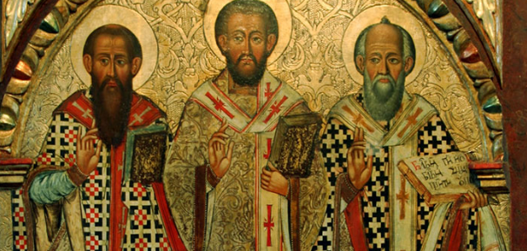
The Cappadocian Fathers
http://www.centerforbaptistrenewal.com/blog/2019/5/6/meet-the-cappadocian-fathers

Slide 12
*The Cappadocian Fathers
As Athanasius passed from the scene God raised up a new generation of Nicene theologians who came to be known as the “Cappadocian fathers”:
  Basil of Caesarea (330-79)
  Gregory of Nyssa (335-94)
  Gregory of Nazianzus (330-90).
All three were natives of the province of Cappadocia in Asia Minor.
* Needham, Nick. 2,000 Years of Christ's Power Vol. 1: The Age of the Early Church Fathers

Slide 13
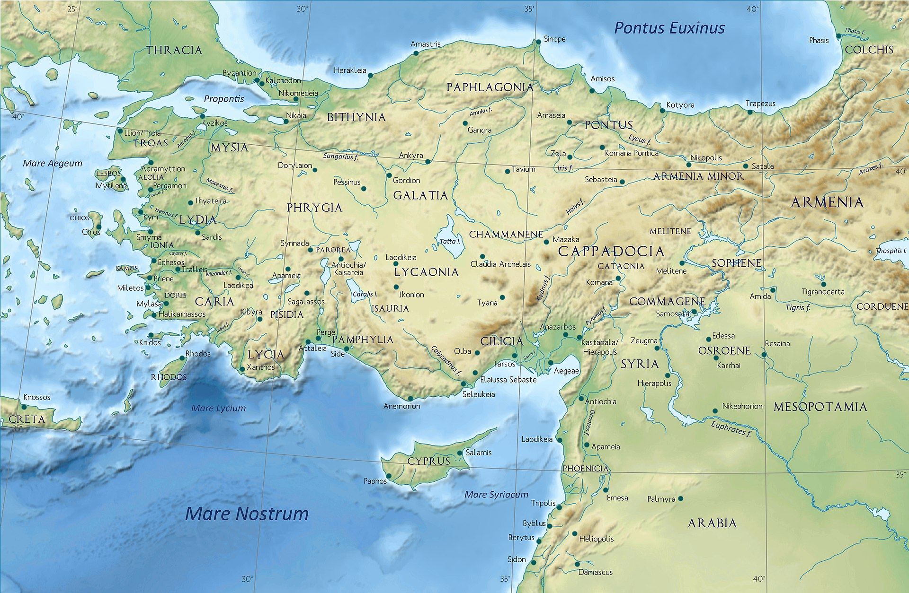
Cappadocia
https://en.wikipedia.org/wiki/Cappadocia#/media/File:Asia_Minor_in_the_Greco-Roman_period_-_general_map_-_regions_and_main_settlements.jpg

Slide 14
*The Cappadocian Fathers
Basil and Gregory of Nyssa were brothers, born into a wealthy Christian family.
In his youth Basil went to study in Caesarea, the capital city of Cappadocia, where he met and became the intimate lifelong friend of Gregory of Nazianzus.
In their warm and devoted love for each other, Basil and Gregory were the “David and Jonathan” of the patristic age (cf. 1 Sam. 18:1; 2 Sam. 1:26).
They both immersed their minds in all the riches of Pagan culture and philosophy in Athens, the cradle of European thought, but without wandering in the slightest from their Christian beliefs and commitment.
Both were baptized in about AD 358 – clear examples of individuals raised as Christians in believing families, but baptized only in their maturity (which was the prevailing 4th century custom).
* Needham, Nick. 2,000 Years of Christ's Power Vol. 1: The Age of the Early Church Fathers

Slide 15
*The Cappadocian Fathers
Basil then lived the life of a hermit in Cappadocia for several years. But in AD 364 Eusebius, the bishop of Caesarea, persuaded him to accept ordination as a presbyter and help him in his battle with the Arians in the Caesarean church.
On Eusebius’s death in 370, the church elected Basil as its new bishop.
In the conflict against Arianism, Basil proved a hugely effective practical church leader, organizer and administrator, as well as a superb preacher.
He was also wrote an important treatise On the Holy Spirit in AD 375, in which he argued for the Spirit’s full deity.
Many have praised Basil’s sermons and treatises as the clearest, most beautiful Christian writings in Greek from the entire patristic period.
* Needham, Nick. 2,000 Years of Christ's Power Vol. 1: The Age of the Early Church Fathers

Slide 16
*The Cappadocian Fathers
Meanwhile, in AD 362, Basil’s best friend Gregory of Nazianzus became a presbyter in his home church of Nazianzus, where his father was bishop.
Gregory was not fond of the battles that often came as a result of being in church leadership; he was a sensitive, inward-looking person, who preferred writing poetry in solitude to the vicious cut-throat fighting often required when doing battle with Arians in the public arena of Church politics and theological debate.
Despite his distaste for church political battles, Gregory briefly served as bishop (AD 379-81) in a small congregation in the Eastern capital, Constantinople, at a time when Arianism reigned supreme.
Here Gregory’s Five Theological Orations brilliantly summed up the Nicene doctrine of the Trinity, refuted Arianism, and attracted large numbers to Gregory’s church, winning them over to the Nicene faith.
* Needham, Nick. 2,000 Years of Christ's Power Vol. 1: The Age of the Early Church Fathers

Slide 17
*The Cappadocian Fathers
We can catch a flavor of the wild theological atmosphere of Constantinople during the Arian controversy from a description given by Gregory of Nyssa:
  If you ask a person to give you some small change for a large coin, his response is to philosophize about what distinguishes the Father from the Son. If you ask about the price of a loaf, the shopkeeper’s response is that the Father is greater and the Son is inferior. If you ask a bath attendant whether your bath is ready, you will have to rest satisfied with the attendant’s response that the Son has been generated out of nothing.
Gregory of Nazianzus’s Orations earned him the title “Gregory the Theologian” in the Eastern Church.
Together with John Chrysostom, Gregory was the Eastern Church’s most eloquent preacher in the age of the early Church fathers.
* Needham, Nick. 2,000 Years of Christ's Power Vol. 1: The Age of the Early Church Fathers

Slide 18
*The Cappadocian Fathers
Basil’s brother, the gentle Gregory of Nyssa, was bishop of Nyssa, a town near Caesarea.
The Eastern Church soon came to recognize him as one of their outstanding theologians and teachers on the spiritual life.
His fame as an opponent of Arianism was so great that the assembled fathers of the Council of Constantinople asked Gregory to deliver the opening address.
The Cappadocian fathers rank alongside Athanasius as the outstanding Eastern theologians of the 4th century. Their writings and personal influence brought about a final union between the Nicene and Origenist parties.
* Needham, Nick. 2,000 Years of Christ's Power Vol. 1: The Age of the Early Church Fathers

Slide 19
*The Cappadocian Fathers
The Cappadocian Fathers also settled another dispute about whether the Holy Spirit was God.
It is not surprising, after decades of controversy over whether Christ was God, that some Christians should now start arguing about the status of the Holy Spirit.
Some who opposed the Arians, and accepted the deity of Christ, nevertheless denied the deity of the Spirit. They were called “Macedonians”, after one of their leaders, Macedonius, who was for a time bishop of Constantinople.
Athanasius had already argued in AD 358 that the Holy Spirit must be recognized as God alongside Father and Son.
The Cappadocian Fathers carried on this argument, strengthened it, and laid the basis for extending the term homoousios to the Holy Spirit – He too was “of the same essence” as the Father.
* Needham, Nick. 2,000 Years of Christ's Power Vol. 1: The Age of the Early Church Fathers

Slide 20
*The Cappadocian Fathers
So what had started as a dispute about the status of Christ finally became a search for a full doctrine of the Trinity.
The Cappadocian Fathers created the following formula for expressing this doctrine: God is three hypostases in one ousia – that is, in English, God is three persons existing eternally in one single being or nature.
In other words, God is not three separate beings or realities; God the Father possesses one divine nature, one single reality of “Godness”, which He shares completely with the Son and with the Holy Spirit.
Father, Son and Spirit are therefore each fully and equally God, because they each fully and equally possess the one divine essence or nature.
* Needham, Nick. 2,000 Years of Christ's Power Vol. 1: The Age of the Early Church Fathers

Slide 21
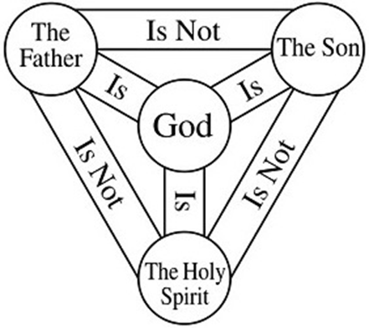
The Trinity

Slide 22
*The Cappadocian Fathers
Nicenes and Origenists rallied together around this Cappadocian formula of three persons in one being.
The Origenists gave up saying that the Son was inferior to the Father in His divine nature; the Nicenes distanced themselves conclusively from the Sabellian heresy, to which some of them had been inclined. At last they could present a united front against the Arians.
* Needham, Nick. 2,000 Years of Christ's Power Vol. 1: The Age of the Early Church Fathers

Slide 23
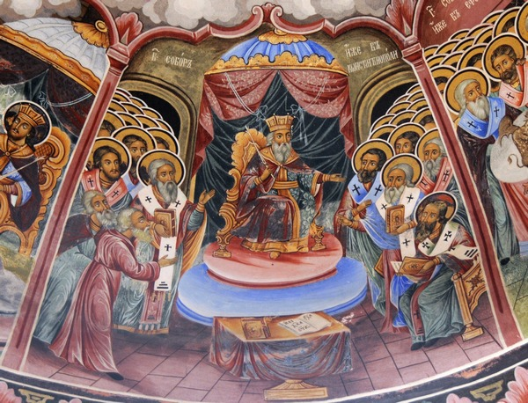
The Council of Constantinople (AD 381)
https://www.livius.org/pictures/bulgaria/rila-monastery/the-first-council-of-constantinople-381/

Slide 24
*The Council of Constantinople
The Arian emperor Valens died fighting the Goths in AD 378.
The West had had a Nicene emperor since AD 375 named Gratian.
Gratian now appointed a new Nicene emperor for the East, a Spanish soldier called Theodosius.
Theodosius gave Arianism its death-blow by issuing an edict in AD 380, which recognized Nicene believers as the only ones legally entitled to use the name “Catholic” (which gave the Nicenes legal possession of all church buildings).
In AD 381 Theodosius summoned an ecumenical Council at Constantinople.
The Council of Constantinople produced a new revised form of the Creed of Nicaea, known as the Nicene Creed, which reaffirmed and extended the teaching of the Council of Nicaea in AD 325.
* Needham, Nick. 2,000 Years of Christ's Power Vol. 1: The Age of the Early Church Fathers

Slide 25
*The Council of Constantinople
The Nicene Creed confirmed the doctrines of the Council of Nicaea (including the word homoousios).
It also extended Nicaea’s belief in the deity of the Son to include the Holy Spirit as well, ascribing deity to the Spirit by calling Him “the Lord and the life-giver” and stating that He “is worshipped and glorified” together with Father and Son.
The Nicene Creed became so highly prized over the next 100 years that by the end of the 5th century, Eastern churches had started reciting it in their worship as a public declaration of their faith.
Western churches began using the Creed in worship towards the end of the 6th century.
* Needham, Nick. 2,000 Years of Christ's Power Vol. 1: The Age of the Early Church Fathers

Slide 26
*The Council of Constantinople
The Council of Constantinople brought an end to Arianism within the Church, although it lived on for several centuries among some of the Germanic tribes.
But the belief of the Church was, from now on, to be a strong and solid faith in the Trinity, Father, Son and Holy Spirit, one God in three persons.
* Needham, Nick. 2,000 Years of Christ's Power Vol. 1: The Age of the Early Church Fathers

Slide 27
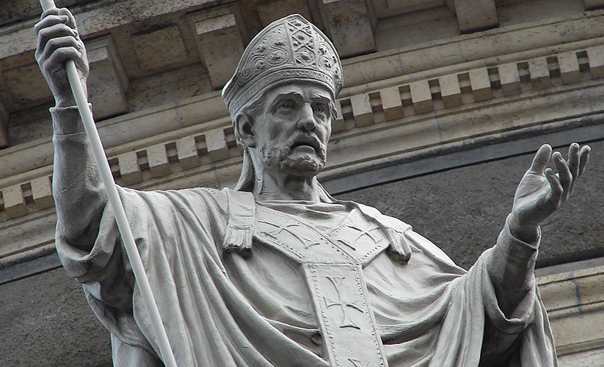
John Chrysostom
https://www.franciscanmedia.org/saint-john-chrysostom/

Slide 28

https://www.hopehelps.org/volunteer-appreciation-week-2018/

Slide 29

Class Discussion Time
https://www.weareteachers.com/moving-beyond-classroom-discussions/

Slide 30
*Class Discussion Time
The Arian persecution caused two previously opposing groups, Origenists and the Nicenes, to become allies and ultimately come to a genuine agreement over what they believed. Do you see a possibility of something like this happening with opposing groups in our day?
Do you relate to Gregory of Nazianzus’ distaste for the kind of political battles that sometimes have to take place within a local church in order to preserve biblical orthodoxy and defend biblical truth? Are those battles sometimes necessary? (see 1 Cor. 11:19)
As you can see, the early church fought a long and difficult battle to establish the doctrine of the trinity. Do you think we take the doctrine of the trinity too much for granted in our day?
Do you have a topic or question that you would like to see us to discuss?

