Slide 1


Slide 2
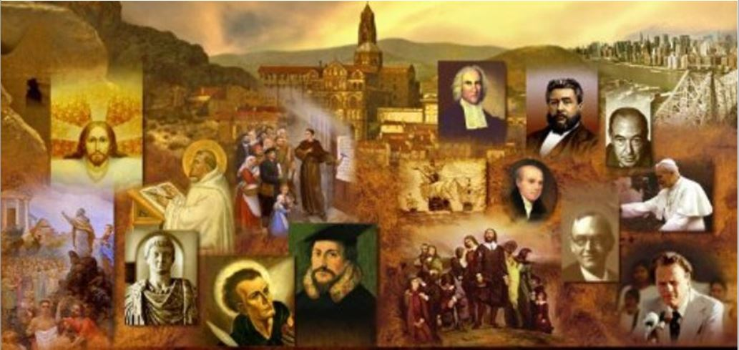
Review
By AD 360, Constantius, son of Constantine, had terrorized most of the Church in both East and West into accepting Arianism.
Why were the “Origenist bishops” called that and what did they believe about Christ?
  They were called that because they followed Origen's teachings about Christ – that he was in some sense less than the Father.
  They believed Christ was of a similar (rather than the same) substance with the Father, but they did still that the Son was eternal and uncreated like the Father.
How were the Origenist bishops treated by the Arians?
  They were deposed and exiled right alongside the “Nicene bishops” who held to the more exalted view of Christ given in the Creed of Nicaea (that he was of the same substance as the Father).
What effect did the Arian persecution of both the Origenist and Nicene bishops have on the relationship between the two groups?
  It helped to bring the two parties together in united opposition to Arianism.

Slide 3
Review
As Athanasius passed from the scene God raised up three more Nicene theologians. What did the three of them come to be known as and why were they called that?
  They came to be known as the Cappadocian fathers because they were all natives of the province of Cappadocia in Asia Minor.
The writings and personal influence of the Cappadocian fathers brought about a final agreement between the Nicene and Origenist parties on the full deity of Christ.
What other teachings did Cappadocian fathers help to solidify concerning the trinity?
  That the Holy Spirit was also “of the same essence” as the Father.
  God is three persons existing eternally in one single being or nature.
What Ecumenical Council was called by the Emperor Theodosius in AD 381, and what did it accomplish?
  The Council of Constantinople – this council produced a new revised form of the Creed of Nicaea, known as the Nicene Creed, which reaffirmed and extended the teaching of the Council of Nicaea in AD 325.

Slide 4
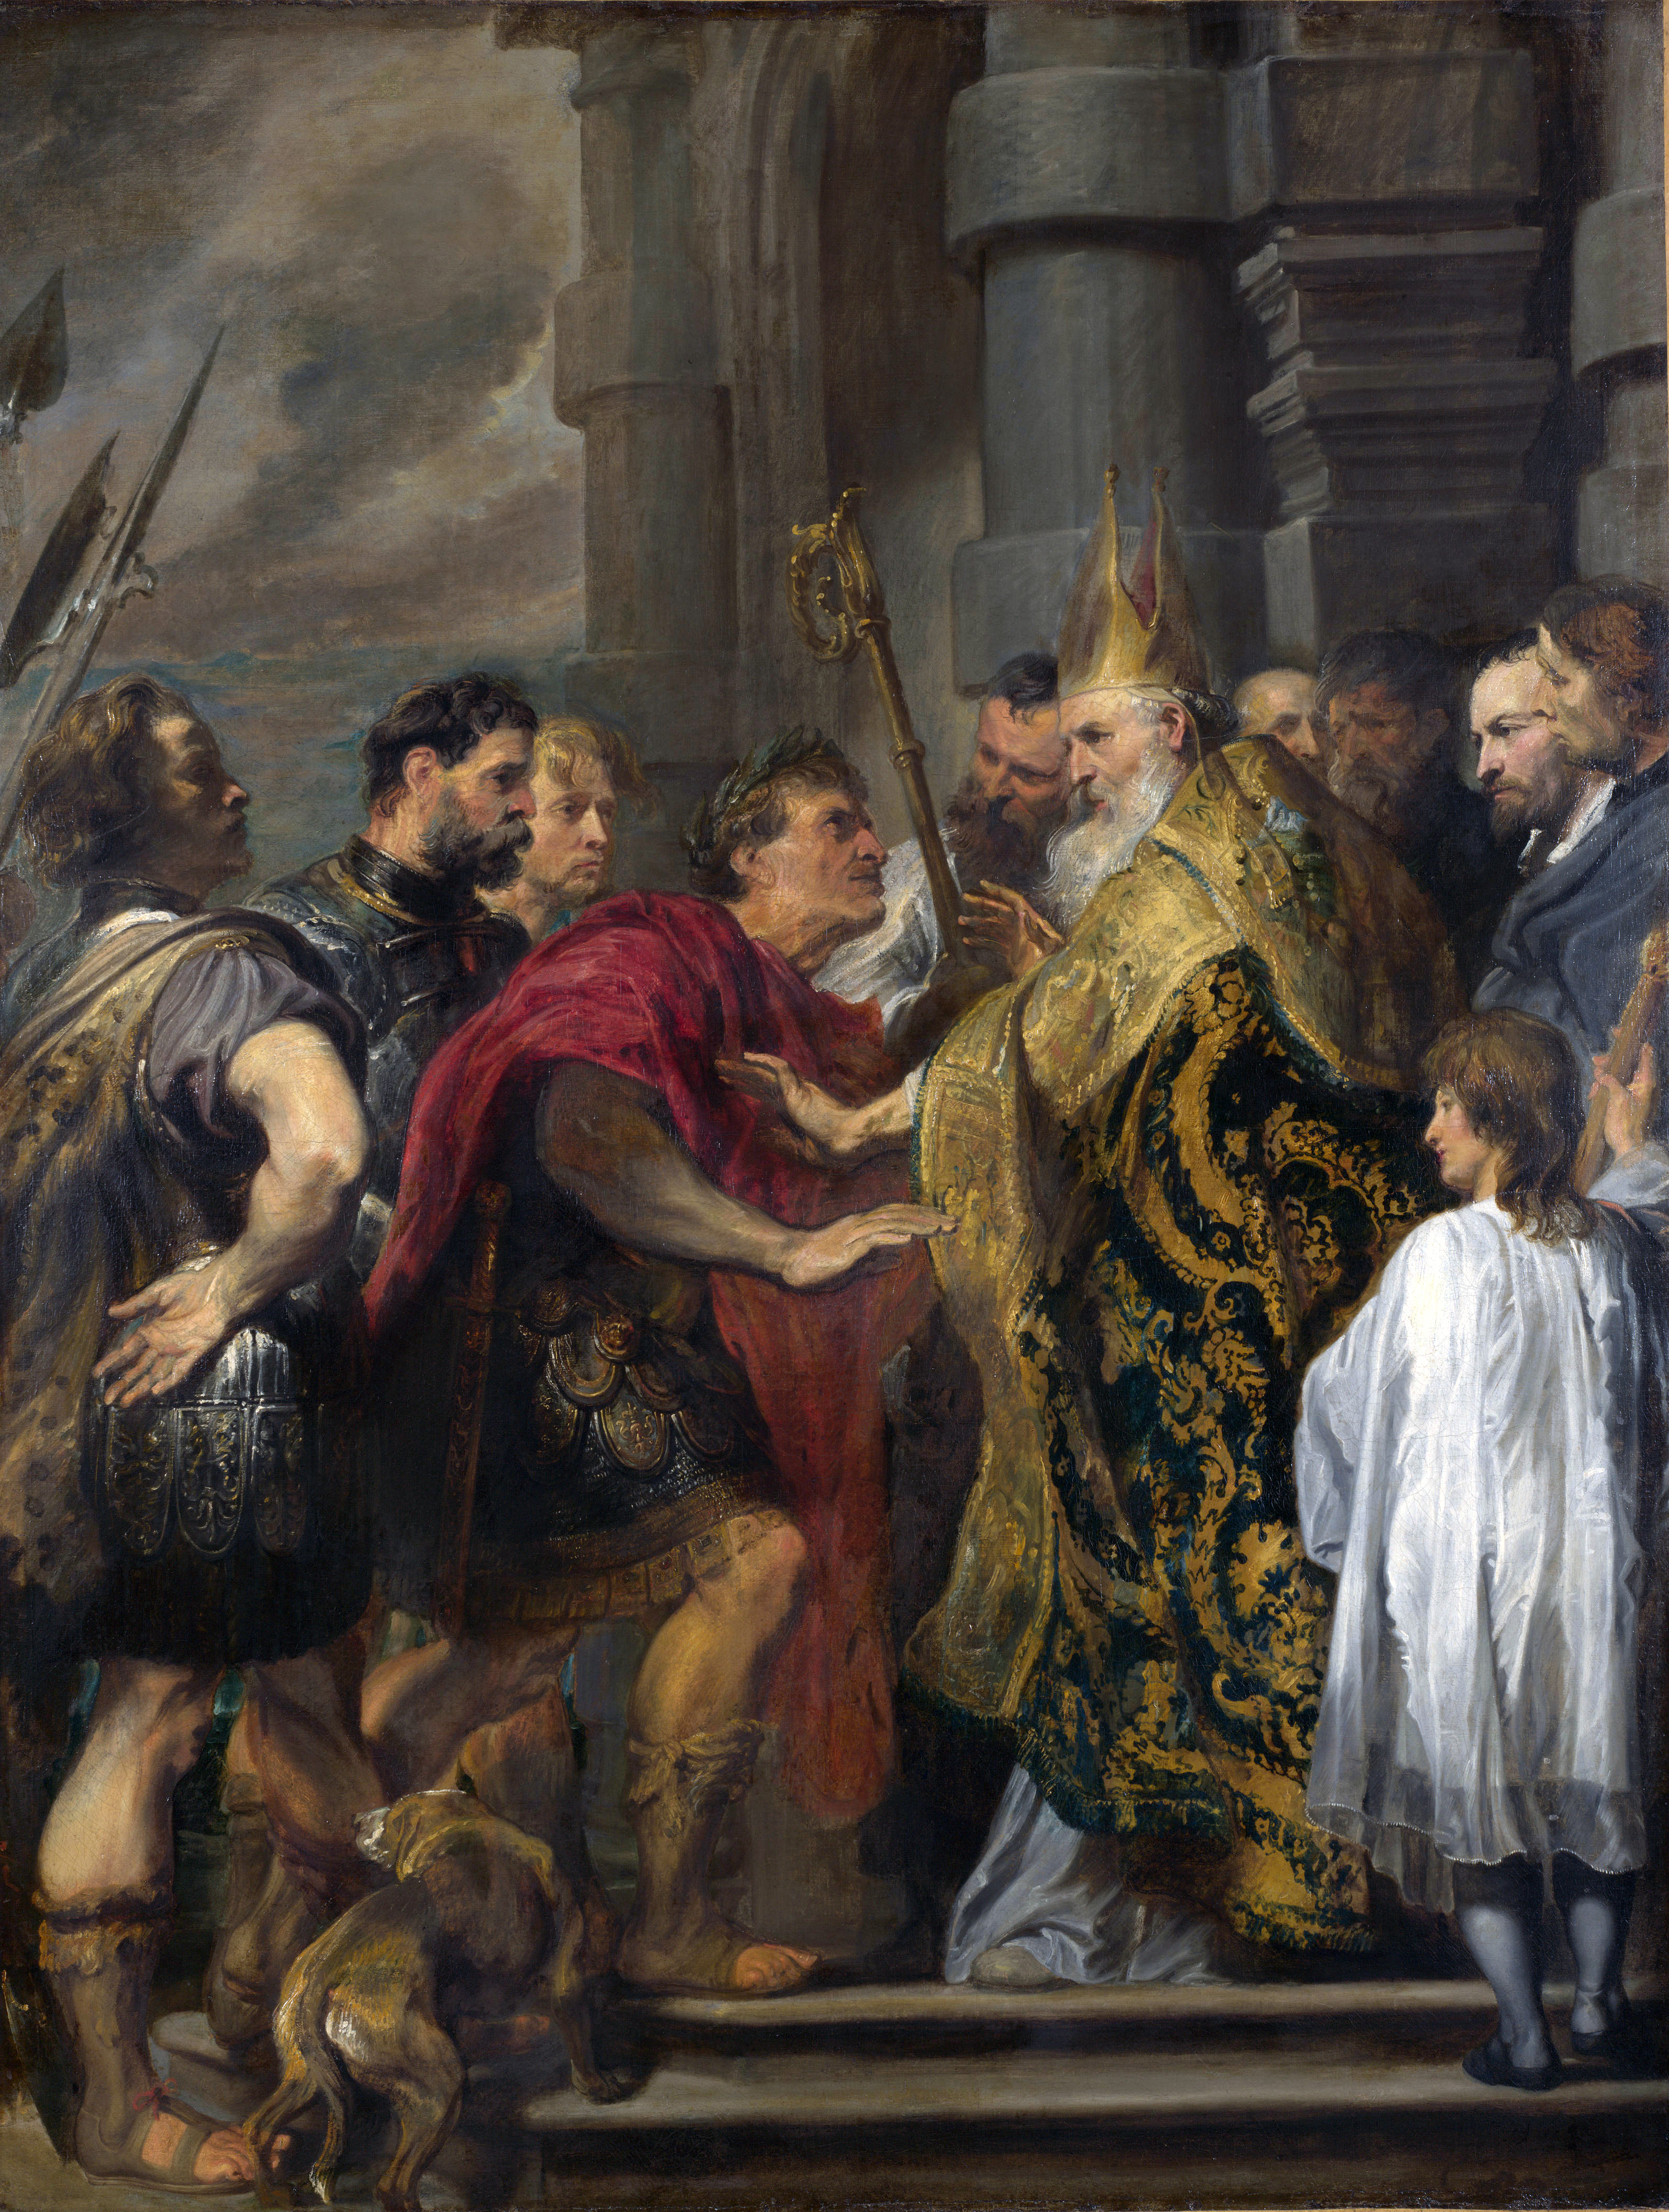
Ambrose of Milan
https://www.franciscanmedia.org/saint-john-chrysostom/

Slide 5
*Ambrose of Milan
After Rome, Milan was the most important city of Italy, and its church enjoyed great prestige.
In AD 374, the death of Auxentius, the bishop of Milan and the West’s leading Arian, threw the Milanese church into a fierce power-struggle between Arians and Trinitarians over who should succeed him as bishop.
Ambrose was provincial governor of Milan at that time, and it was his duty to make sure that the election did not erupt into public disorder and violence.
As he addressed the excited church members, exhorting them to peaceful conduct, a child’s voice suddenly shouted out, “Ambrose for bishop!”
The whole crowd took up the cry, even though Ambrose was not a presbyter – in fact, he was only a layman who had not yet been baptized!
Ambrose was horrified, but he interpreted the event as God’s will and reluctantly submitted.
* Needham, Nick. 2,000 Years of Christ's Power Vol. 1: The Age of the Early Church Fathers

Slide 6
*Ambrose of Milan
As bishop of Milan, Ambrose attained to fame as a magnificent preacher, a resolute enemy of Arianism, and a pioneer hymn-writer.
He introduced into his church in Milan the Eastern practice of congregational singing in worship. Prior to this in Western worship, the psalms had been chanted or sung “responsively”.
Ambrose popularized in Western worship the Eastern practice of singing hymns, i.e. newly written songs of worship, as opposed to the Old Testament psalms and other songs or poetic passages of Scripture set to music (e.g. the Magnificat of Luke 1: 46-55).
Ambrose wrote his own hymns to teach his congregation the orthodox doctrine of Christ during the Arian controversy.
Tradition says he wrote the great Latin hymn, the Te deum; whether or not Ambrose was its real author, it is certainly the greatest hymn of the Western Church from the patristic age.
* Needham, Nick. 2,000 Years of Christ's Power Vol. 1: The Age of the Early Church Fathers

Slide 7
*Ambrose of Milan
When the emperor Theodosius the Great made Milan his Western capital, Ambrose became his close friend and advisor; but Ambrose made it clear that the emperor was not to behave as a ruler in the Church.
Ambrose wrote: “The Church belongs to God, therefore it cannot be assigned to Caesar. The emperor is within the Church, not above it.”
* Needham, Nick. 2,000 Years of Christ's Power Vol. 1: The Age of the Early Church Fathers

Slide 8
*Ambrose of Milan
Ambrose’s view led to a famous confrontation between bishop and emperor in AD 390.
  That year, in the city of Thessalonica, a rioting mob murdered Botherich, the virtuous governor of the province of Illyria, along with several of his officials. The results were explosive.
  Theodosius was normally a wise, generous, far-seeing ruler, admired for his Christian integrity of character; but he had one fatal weakness – he was prone to outbursts of wild fury, which so terrified everyone that even his wife and children would hide from him.
  When Theodosius heard about the murder of Botherich, he lost all self-control, and in a fit of wrath he sent an order to his soldiers to massacre the Thessalonians as a punishment.
  Almost immediately Theodosius recoiled from what he had done, and sent another order cancelling his savage decree.
  But it was too late. The Thessalonian troops, eager to avenge the murder of their beloved governor, had already butchered some 7,000 people.
* Needham, Nick. 2,000 Years of Christ's Power Vol. 1: The Age of the Early Church Fathers

Slide 9
*Ambrose of Milan
When Ambrose heard of this outrage, he boldly excommunicated the emperor and exhorted him to deep, meaningful repentance.
Theodosius turned up at the church in Milan on Sunday, as if nothing had happened, only to find Ambrose barring his way, refusing to let him enter!
The emperor claimed he had repented; Ambrose informed him that words were not enough – his repentance must be as public as his sin had been.
Theodosius submitted and walked through the streets of Milan doing public penance.
He was banned from attending worship for eight months.
* Needham, Nick. 2,000 Years of Christ's Power Vol. 1: The Age of the Early Church Fathers

Slide 10
*Ambrose of Milan
When Ambrose finally allowed him to enter church again, the emperor had to kneel and beg God’s forgiveness before the whole congregation, which he did with passionate sorrow, tears streaming from his eyes.
This was the first time that a bishop had used his spiritual authority to humble an emperor.
Undoubtedly Ambrose’s stern, steely, uncompromising personality also had something to do with the way he was able to face down the awesome Theodosius and compel his submission.
Ambrose’s relationship with Theodosius showed that the Western doctrine of the Church’s independence of the emperor could, in practice, turn into the Church controlling the emperor.
* Needham, Nick. 2,000 Years of Christ's Power Vol. 1: The Age of the Early Church Fathers

Slide 11
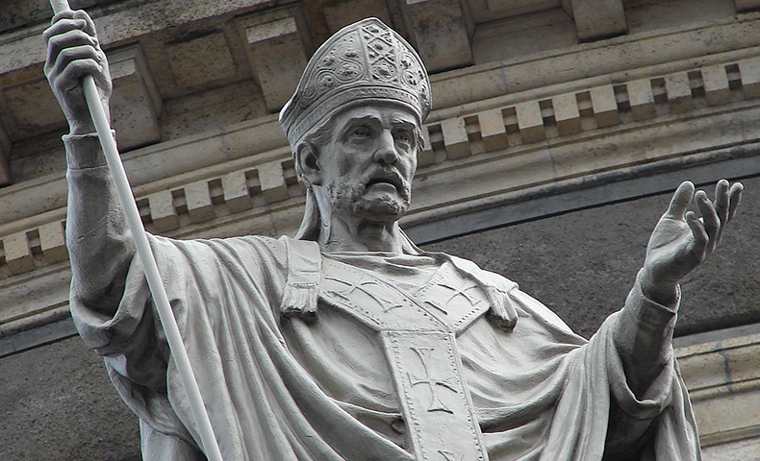
John Chrysostom
https://www.franciscanmedia.org/saint-john-chrysostom/

Slide 12
*John Chrysostom
John Chrysostom was one of the most glorious preachers of the early Church, or indeed of the Church in any age.
He was born in Antioch, probably in the year AD 349 or thereabouts.
As a young man, John at first pursued a career in law, studying under Libanius, an eminent Pagan teacher of rhetoric, who regarded John as his best student.
When Libanius lay dying, his friends asked him who should take his place in Antioch as professor of rhetoric. Libanius replied, “It ought to have been John, had not the Christians stolen him from us.”
Immediately after he finished his school studies under Libanius, John (at the age of eighteen) underwent a radical change of attitude to his life and his future.
Reacting against the prevailing Paganism and secularism of his education, he became passionately devoted to studying the Scriptures.
* Needham, Nick. 2,000 Years of Christ's Power Vol. 1: The Age of the Early Church Fathers

Slide 13
*John Chrysostom
As part of this new personal commitment to a Christian way of life, John now studied under the great Bible interpreter Diodore of Tarsus.
Diodore was very important in shaping John’s approach to the exposition of Scripture.
Two schools of thought dominated the Church at that time.
On the one hand, there were those who favored an allegorical interpretation of Scripture – that is, they tended to downplay its obvious historical meaning, and search for deeper, symbolic meanings.
These interpreters were especially linked with the church in Alexandria, so their method is often called the Alexandrian method of Bible interpretation.
* Needham, Nick. 2,000 Years of Christ's Power Vol. 1: The Age of the Early Church Fathers

Slide 14
*John Chrysostom
Diodore, however, represented the other school of thought; he emphasized the straightforward historical meaning of the text, and was quite scathing about those who departed from this in search of supposedly “deep” symbolic meanings.
John avidly drank in Diodore’s teaching on this, and when he became a preacher he would always follow Diodore’s method, sticking close to the text of Scripture and its obvious sense, through a meticulous scholarly study of the meaning of words and historical backgrounds.
This method of interpretation was especially linked with John’s home city of Antioch, and so is often called the Antiochene method of Bible interpretation.
* Needham, Nick. 2,000 Years of Christ's Power Vol. 1: The Age of the Early Church Fathers

Slide 15
*John Chrysostom
Basil of Caesarea was also a great advocate of this grammatical-historical method, and explained it as follows in his sermon on the days of creation in Genesis:
  I know the principles of “allegory” from the writings of others. Some preachers do not admit the ordinary meaning of the Scriptures. They will not call water “water”, but something else. They interpret a plant or a fish according to the fancy of their own imagination; they change reptiles and wild beasts into something allegorical, just like those who interpret the meaning of dreams according to their own personal ideas. But when I hear the word “grass”, I understand that it means grass! Plants, fish, wild beast domestic animals – I take them all in a literal sense.
* Needham, Nick. 2,000 Years of Christ's Power Vol. 1: The Age of the Early Church Fathers

Slide 16
*John Chrysostom
In AD 372, John decided to leave Antioch altogether, and join with the hermits on nearby Mount Silpios.
There was much resentment in Antioch at John’s refusal to let himself be ordained a bishop (he felt unworthy); and he had other reasons for seeking seclusion among the hermits of Silpios.
Chiefly John found himself increasingly unable to control his sexual desires, and he felt that he must get away from feminine company entirely, and learn from the holy hermits how to be a better, more self-disciplined Christian.
In later life, John looked back with a glow of nostalgia to the time he spent among the hermits, where the whole aim and ideal of life was undistracted, moment-by-moment fellowship with Christ.
Unfortunately John practiced such a severe self-discipline as a hermit (doing without any sleep at all, as far as possible, and eating the most scanty diet) that he permanently damaged his health.
He was ever afterwards troubled by stomach problems, insomnia, and sudden rushes of blood to the head.
* Needham, Nick. 2,000 Years of Christ's Power Vol. 1: The Age of the Early Church Fathers

Slide 17
*John Chrysostom
It was John’s ill-health that probably motivated his eventual abandonment of Mount Silpios and return to Antioch in the year AD 378.
Two years later, John was ordained as a deacon.
John began to make a name for himself as an eloquent spokesman for orthodox Christianity through a stream of brilliant writings.
In AD 386, John was ordained as a presbyter. This meant that John now had access to the pulpit.
So began his great career as a preacher for which he is best remembered today.
Over the next twelve years, John’s preaching in Antioch won a matchless reputation for brilliance.
* Needham, Nick. 2,000 Years of Christ's Power Vol. 1: The Age of the Early Church Fathers

Slide 18
*John Chrysostom
Later, after his death, the Church gave him the nickname Chrysostom, which is Greek for “golden mouth”.
He preached his way verse-by-verse through books of the Bible, and was astonishingly direct and outspoken in denouncing sin among believers, especially the sin of compromising with worldly standards of behavior.
He also made hard-hitting criticisms of the way that rich Christians used or abused their wealth.
Others wrote down Chrysostom’s sermons as he preached them, and many have survived, e.g. his fifty-eight sermons on selected Psalms, ninety sermons on Matthew’s Gospel, and eighty-eight on the Gospel of John.
Most modern students find them to be among the easiest to read and most practically helpful of all the writings of the early Church fathers.
* Needham, Nick. 2,000 Years of Christ's Power Vol. 1: The Age of the Early Church Fathers

Slide 19
*John Chrysostom
In addition to his published sermons, Chrysostom continued to write Christian treatises at Antioch, the most famous of which was On the Priesthood, an exposition of the nature and duties of a Christian pastor.
This work has been reprinted and translated into other languages more often than any of Chrysostom’s other works.
One early Church father said of this treatise: “Everyone who reads this book must feel his heart filled with the fire of God’s love. It sets forth the office of presbyter, its dignity so worthy of our esteem, its problems, and how to fulfil its duties in the most effective way.”
Another interesting production of Chrysostom’s pen at this time was a treatise on how to raise children, which later came to be known as Saint John Chrysostom’s Golden Book On Bringing Up Children.
This is the first known attempt by a Christian writer to set out a comprehensive program for the education of the young.
* Needham, Nick. 2,000 Years of Christ's Power Vol. 1: The Age of the Early Church Fathers

Slide 20
*John Chrysostom
In his sermons, Chrysostom denounced abortion, prostitution, gluttony, the theater, and swearing.
About the love of horse racing, he complained:
  “My sermons are applauded merely from custom, then everyone runs off to [horse racing] again and gives much more applause to the jockeys, showing indeed unrestrained passion for them! There they put their heads together with great attention, and say with mutual rivalry, 'This horse did not run well, this one stumbled,' and one holds to this jockey and another to that. No one thinks any more of my sermons, nor of the holy and awesome mysteries that are accomplished here.”
* Galli, Mark. 131 Christians Everyone Should Know (pp. 84-85). B&H Publishing Group.

Slide 21
*John Chrysostom
Chrysostom’s large bald head, deeply set eyes, and sunken cheeks reminded people of Elisha the prophet.
Though his sermons (which lasted between 30 minutes and two hours) were well attended, he sometimes became discouraged: “My work is like that of a man who is trying to clean a piece of ground into which a muddy stream is constantly flowing.”
At the same time, he said, “Preaching improves me. When I begin to speak, weariness disappears; when I begin to teach, fatigue too disappears.”
* Galli, Mark. 131 Christians Everyone Should Know (pp. 84-85). B&H Publishing Group.

Slide 22
*John Chrysostom
In early AD 398, John was seized by soldiers and transported to the Constantinople, where he was forcibly consecrated as archbishop!
His kidnapping was arranged by a government official who wanted to adorn the church in the capital city with the best orator in Christianity.
Rather than rebelling against the injustice, John accepted it as God's providence. And rather than soften his words for his new and prestigious audience—which now included many from the imperial household—John continued themes he preached in Antioch.
He railed against abuses of wealth and power. Even his lifestyle itself was a scandal: he lived an ascetic life, used his considerable household budget to care for the poor, and built hospitals.
He continued preaching against the great public sins. In a sermon against the theater, for example, he said: “Long after the theater is closed and everyone is gone away, those images [of “shameful women” actresses] still float before your soul, their words, their conduct, their glances, their walk, their positions, their excitation, their unchaste limbs…. And there within you she kindles the Babylonian furnace in which the peace of your home, the purity of your heart, the happiness of your marriage will be burnt up!”
* Galli, Mark. 131 Christians Everyone Should Know (p. 85). B&H Publishing Group.

Slide 23
*John Chrysostom
His lack of tact and political skill made him too many enemies—in the imperial family and among fellow bishops.¹
Eudoxia, the emperor’s wife, resented the bishop’s growing power. Besides, what was being said from the pulpit was not to her liking— it described her too well.²
When Chrysostom described the pomp and the folly of the powerful, she felt the people’s eyes staring at her.²
So the empress made special grants to the church in hopes that Chrysostom would tone down his criticisms.²
But instead he thanked her. And continued preaching.²
¹ Galli, Mark. 131 Christians Everyone Should Know (p. 85). B&H Publishing Group.
² Gonzalez, Justo L.. The Story of Christianity: Volume 1: The Early Church to the Dawn of the Reformation (pp. 228-229).

Slide 24
*John Chrysostom
So one day when Chrysostom had to leave the city in order to attend to some matters in Ephesus, Eudoxia joined Theophilus, bishop of Alexandria, in plotting against the meddling preacher.
Upon his return, Chrysostom found himself the object of a long list of ridiculous charges brought before a small gathering of bishops convened by Theophilus.
He paid no attention to them, but simply went about his preaching and his management of the church.
Theophilus and his partisans found him guilty, and asked the emperor Arcadius to banish him.
Prodded his wife, the weak emperor agreed to that request, and ordered Chrysostom to leave the city.
The situation was tense. The people were indignant.
² Gonzalez, Justo L.. The Story of Christianity: Volume 1: The Early Church to the Dawn of the Reformation (p. 229).

Slide 25
*John Chrysostom
The bishops and other clergy from neighboring towns gathered at the capital, and pledged their support to Chrysostom.
All that Chrysostom would have to have done was to give the order, and the neighboring bishops and clergy would have convened as a synod and condemned Theophilus and his followers.
Such a popular uprising that would have no doubt shaken the very foundations of the empire.
But Chrysostom was a lover of peace, and therefore made ready for exile. Three days after receiving the imperial edict, he bid farewell to his friends and followers and surrendered to the authorities.
² Gonzalez, Justo L.. The Story of Christianity: Volume 1: The Early Church to the Dawn of the Reformation (p. 229).

Slide 26
*John Chrysostom
Chrysostom was sent to a cold and unknown hamlet on the shores of the Black Sea.
The soldiers guarding him, being aware that their charge did not have the good will of the crown, paid no attention to his failing health, and during the journey drove him to exertions well beyond his strength.
Soon the banished bishop became seriously ill. When he perceived that death was near, he asked to be taken to a small church by the roadside.
There he took communion, bid farewell to those around him, and preached his briefest but most eloquent sermon: “In all things, glory to God. Amen.”
*Gonzalez, Justo L.. The Story of Christianity: Volume 1: The Early Church to the Dawn of the Reformation (pp. 230-232).

Slide 27
*John Chrysostom
In Constantinople and elsewhere, people felt that a great injustice and even a sacrilege had been committed.
John’s staunchest supporters refused the authority of the new bishop and of those in communion with him— particularly the patriarchs of Alexandria and of Antioch.
The schism ended only when, thirty-one years after his death, John’s memory was restored, and his body was brought back to Constantinople amid great pomp and celebration.
*Gonzalez, Justo L.. The Story of Christianity: Volume 1: The Early Church to the Dawn of the Reformation (pp. 230-232).

Slide 28
*John Chrysostom
As we compare the lives of Chrysostom and Ambrose, we see an indication of what would be the future course of the churches in the East compared with the West.
Ambrose faced the most powerful emperor of his time, and won.
Chrysostom, on the other hand, was deposed and banished by the weak Arcadius.
From then on, the Latin-speaking church of the West would become increasingly powerful, as it filled the vacuum left by the crumbling empire.
In the Greek-speaking East, on the other hand, the empire would last another thousand years.
Sometimes weak, and sometimes strong, this Eastern offshoot of the old Roman Empire— the Byzantine Empire— would zealously guard its prerogatives over the church.
Theodosius was not the last Western emperor to be humbled by a Latin-speaking bishop. And John Chrysostom was not the last Greek-speaking bishop banished by an Eastern emperor.
*Gonzalez, Justo L.. The Story of Christianity: Volume 1: The Early Church to the Dawn of the Reformation (pp. 230-232).

Slide 29
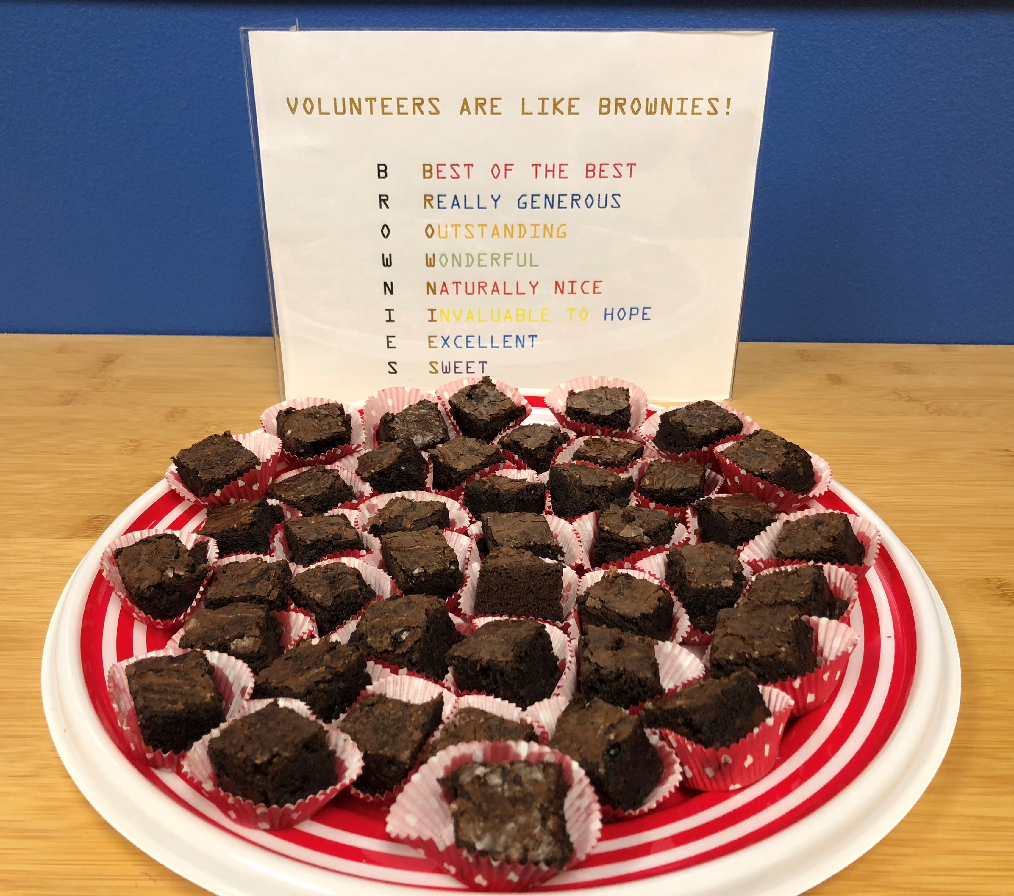
https://www.hopehelps.org/volunteer-appreciation-week-2018/

Slide 30

Class Discussion Time
https://www.weareteachers.com/moving-beyond-classroom-discussions/

Slide 31
*Class Discussion Time
When the emperor Theodosius showed up for church in Milan one Sunday, claiming to have repented of ordering the murder of 7,000 Thessalonians, the bishop Ambrose informed him that words were not enough – he was forced to walk through the streets of Milan doing public penance and barred from church attendance for eight months.
What do you think of Ambrose’s response? Are words not enough to show repentance? Should some kind of penance be required before a sinning church member is allowed back into a church fellowship?
When John Chrysostom found himself increasingly unable to control his sexual desires, and he felt that he must get away from feminine company entirely and joined a monastery for a number of years.
What do you think of this approach to dealing with sin and temptation?
Do you have a topic or question that you would like to see us to discuss?

