Slide 1


Slide 2
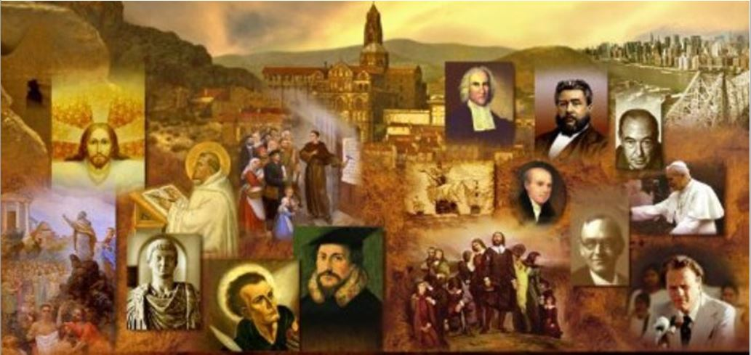
Review
Describe what you can remember went on in a 4th century baptismal ceremony.
They turned to the west and renounced Satan and his works
They turned to the east and professed faith in the Trinity
Anointed with oil - twice
Immersed three times
Clothed in white garments, given lighted tapers
Partook of Communion for the first time
Were given milk and honey
Why did many in the very early church wait as late as possible in life to be baptized?
Because of the widespread belief that baptism could deal only with sins committed before a person was baptized.

Slide 3
Review
According to modern liberal scholars, when (historically) did Christians first begin to believe that Christ died in the place of sinners?
Not until AD 1094, when Anselm wrote Cur Deus Homo (Why the God-Man?)
When was the Epistle to Diognetus ,which gives a very clear explanation of the substitutionary work of Christ, written?
Early in the second century
The scriptures teach that Christ, the one mediator between God and man gave himself as a “ransom for all” (1Tim 2:5-6). Who did Origen teach that Christ paid a ransom to?
Satan
Though there were discussions of Christ’s atonement for sin off and on throughout church history – when did the strongest and clearest church-wide discussions of the atonement first take place historically?
During the Reformation

Slide 4
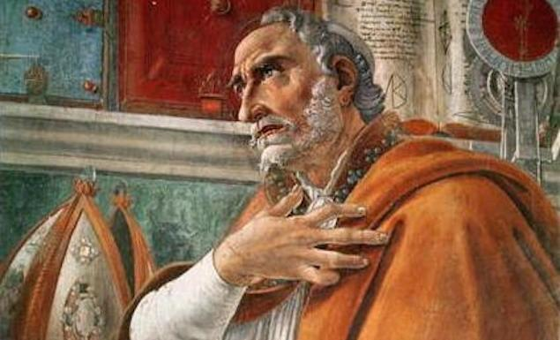
Augustine of Hippo
https://www.theschooloflife.com/thebookoflife/the-great-philosophers-augustine/

Slide 5
*Augustine’s Early Years and Conversion
Augustine was born in AD 354, in Tagaste, North Africa, a little town in a region that we know as Algeria.
His father was an easygoing heathen; his mother, Monica, an eager Christian.
In spite of their limited resources, the couple was determined to give Augustine the best education available. Thus he went to school, first near home and then in the North African capital, Carthage.
* Shelley, Dr. Bruce L.. Church History in Plain Language: Fourth Edition (p. 134)

Slide 6
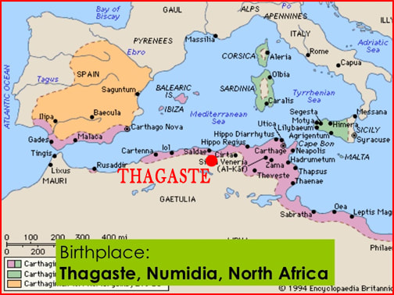
*Augustine’s Early Years and Conversion
https://devotiontoourlady.com/uploads/3/5/2/7/35275079/map-thagaste-03_1_orig.jpg

Slide 7
*Augustine’s Early Years and Conversion
In Carthage, he found sexual temptations irresistible. He fell in love with a girl who gave him a son whom they named Adeodatus.
Augustine and his girlfriend lived together for thirteen years, but throughout this time Augustine felt a sense of guilt and condemnation over his sexual immorality.
This sense of guilt later heightened his feelings of personal depravity and gave him a greater appreciation for God’s rescuing grace.
* Shelley, Dr. Bruce L.. Church History in Plain Language: Fourth Edition (p. 134)

Slide 8
*Augustine’s Early Years and Conversion
Augustine also had a strong interest in learning and philosophy.
At the age of 19, a treatise by Cicero, the Latin author, fell into his hands and convinced him intellectually that he should make truth his life’s search.
The old temptations, however, still assailed him, and like Paul, he felt that two warriors, a higher and a lower, were struggling in him for mastery.
In his conflicts he turned to the Bible, but it had no appeal to him. The Bible, especially the Old Testament, seemed crude and barbarous to him.
* Shelley, Dr. Bruce L.. Church History in Plain Language: Fourth Edition (p. 134)

Slide 9
*Augustine’s Early Years and Conversion
For a time Augustine tried Manicheanism, a persecuted faith in the Roman Empire, but one peculiarly appealing to a man of passion who felt two tendencies at war within him.
Mani, its founder, had taught in Persia and had met there a martyr’s death by crucifixion in AD 277.
Manicheanism taught that the universe as the scene of an eternal conflict between two powers, the one good and the other evil.
Manicheanism taught that these two spiritual forces warred within each of us and that we must free ourselves from the evil within us through prayer and abstinence from life’s pleasures.
* Shelley, Dr. Bruce L.. Church History in Plain Language: Fourth Edition (p. 134-135)

Slide 10
*Augustine’s Early Years and Conversion
Like the Gnostics, the Manicheans held that much of the New Testament is true, but they rejected everything in it that seemed to suggest Christ’s real sufferings, and they discarded the Old Testament altogether.
Augustine remained an eager Manichean for nine years, from AD 374 to 383, but he eventually became dissatisfied with its teachings.
In AD 383 Augustine moved to Rome at the suggestion of his Manichean friends.
* Shelley, Dr. Bruce L.. Church History in Plain Language: Fourth Edition (p. 134-135)

Slide 11
*Augustine’s Early Years and Conversion
Shortly after his arrival in Rome, Augustine secured a professorship in the State University in Milan and moved to the northern city.
His widowed mother and some of his African friends soon joined him. He was now thirty years old, at the summit of a career, with dazzling prospects of success before him.
More than ever, however, he was deeply dissatisfied with his life. He callously separated from his mistress and become engaged to a young woman of wealth and position; but he still could not master his passions.
He found himself in “a whirl of vicious love-making.” Augustine would later write: “There’s nothing so powerful in drawing the spirit of a man downward as the caresses of a woman.” His inner conflicts became almost unbearable.
* Shelley, Dr. Bruce L.. Church History in Plain Language: Fourth Edition (p. 135)

Slide 12
*Augustine’s Early Years and Conversion
While living in Milan, Augustine came under the powerful preaching of Bishop Ambrose.¹
At first, he only went to church to study Ambrose’s preaching style, but before long the message reached his soul. ¹
The eloquence of Ambrose’s sermons, and the way Ambrose made Christianity seem an intelligent and reasonable faith, utterly captivated Augustine’s mind. ²
Ambrose’s method of handling the Old Testament also helped Augustine overcome his problems with the Hebrew Scriptures. ²
When Ambrose came across a difficult Old Testament passage, one that seemed unworthy of God, he said it should not be interpreted literally, but understood in a spiritual or symbolic sense. (This was basically the Alexandrian method of expounding the Bible.) ²
¹ Shelley, Dr. Bruce L.. Church History in Plain Language: Fourth Edition (p. 135)
² Needham, Nick. 2,000 Years of Christ's Power Vol. 1: The Age of the Early Church Fathers

Slide 13
*Augustine’s Early Years and Conversion
The final stimulus to Augustine’s conversion seems to have been the personal example of the monks.
When a friend told him the story of Anthony and the Egyptian hermits— how they withstood the temptations of the world— Augustine felt a burning sense of shame.
How could these unlearned men win such spiritual victories when he, with all his education, knew only defeat?
* Shelley, Dr. Bruce L.. Church History in Plain Language: Fourth Edition (p. 135)

Slide 14
*Augustine’s Early Years and Conversion
Augustine was soon convinced in his mind that the Christian faith was true. However, he had a fierce struggle submitting to it in his heart and will; the attractions of the world and sensual pleasures were still overpoweringly strong.
His conversion finally came when he was meditating in a garden in Milan in AD 386.
Augustine heard a child’s voice mysteriously saying, “Take and read! Take and read!” He had a copy of the New Testament with him, so he picked it up and it fell open at Romans 13: 13-14: “Not in orgies and drunkenness, not in sexual immorality and lust, not in strife and jealousy. But instead clothe yourselves in the Lord Jesus Christ, and make no provision for your sinful nature, to gratify its desires.”
Augustine later wrote of this event in his autobiography: “I did not want or need to read any further. Instantly, as I finished the sentence, the light of faith flooded into my heart, and all the darkness of doubt vanished.”
* Needham, Nick. 2,000 Years of Christ's Power Vol. 1: The Age of the Early Church Fathers

Slide 15
*Augustine’s Early Years and Conversion
On the eve of the following Easter, AD 387, Augustine, along with his son, Adeodatus, were baptized by Ambrose in Milan.
“The unrest of our past life,” he said, “receded from us.”
A few months later, accompanied by his mother, he set out for North Africa, a different man.
On the journey, however, near Rome, his mother died. Shortly after that, he lost his son, adding to the grief he already felt from the death of his mother.
* Shelley, Dr. Bruce L.. Church History in Plain Language: Fourth Edition (p. 135-136)

Slide 16
*Augustine’s Early Years and Conversion
Augustine was now as eager to leave the world as he had once been to plunge into it. But God had other plans.
Augustine’s gifts were too well-known and the need for leadership in the church was too great for him to be left in peace.
Three years later at Hippo, a nearby North African town, Augustine was ordained as bishop by popular demand, but against his will.
He was forty-three years old and for the next thirty-three years, until his death in AD 430, he stood in the center of the storms of his time.
* Shelley, Dr. Bruce L.. Church History in Plain Language: Fourth Edition (p. 135-136)

Slide 17
*Augustine’s Theology and Historical Influence
Augustine’s theology and writing were strongly influenced by two major issues that encountered in his ministry:
Donatism and teachings related to sacraments and the unity of the Catholic Church
Pelagianism and teachings related to our natural ability/inability to have faith and to live the Christian life.
* James White – 2016 Church History Series; Lesson 35 and 36 – Augustine of Hippo

Slide 18
*Augustine’s Theology and Historical Influence
The controversies Augustine faced in his life pulled him in two opposing directions. Over a thousands year later, the Reformers and the Roman Catholic Church could both fairly quote from Augustine against their opponents:
The Roman Catholics could quote Augustine in his anti-Donatist writings: unity of the church, the nature of sacraments, etc.
The Reformers could quote Augustine in his anti-Pelagian writings: salvation, grace.
In his book Tertullian and Augustine, BB Warfield wrote: “The Reformation inwardly considered was just the ultimate triumph of Augustine’s doctrine of grace over Augustine’s doctrine of the Church”.
* James White – 2016 Church History Series; Lesson 35 and 36 – Augustine of Hippo

Slide 19
*Augustine and Donatism
North African Christianity was torn by a passionate conflict between Catholics and a movement called Donatism.
The controversy was long-standing and deep-seated. A bishop of Hippo could scarcely avoid speaking to the issue.
When Augustine stepped into church leadership, Donatism was almost a hundred years old. The movement stood for a holy church, for church discipline, and for the unflinching resistance of unworthy bishops.
The Catholics, said the Donatists, had surrendered all of these by ordaining immoral priests and bishops.
The Donatist name arose from Donatus, an early bishop of Carthage (AD 313– 355) who led the protest against Catholic practices.
* Shelley, Dr. Bruce L.. Church History in Plain Language: Fourth Edition (p. 136-137)

Slide 20
*Augustine and Donatism
Donatist charges centered on the fact that certain Catholic bishops had handed over the Scriptures to be burned during the persecution under Diocletian.
Such an act, the Donatists insisted, was a serious sin of apostasy.
Since the Catholic pastors were ordained by bishops who had sinned so grievously, the Donatists believed they, rather than the Catholics, constituted the true church of Christ.
* Shelley, Dr. Bruce L.. Church History in Plain Language: Fourth Edition (p. 136-137)

Slide 21
*Augustine and Donatism
During Augustine’s time the Donatists were still widespread in North Africa, and in some areas they constituted a majority.
Augustine rejected the Donatist’s view of a pure church. Until the day of judgment, he said, the church must be a mixed multitude. Both good and bad people are in it.
To support this idea he appealed to Jesus’ parable of the wheat and tares (Matt. 13: 24– 30), overlooking the fact that Jesus was not speaking of the church but of the whole world.
* Shelley, Dr. Bruce L.. Church History in Plain Language: Fourth Edition (p. 136-137)

Slide 22
*Augustine and Donatism
Augustine also set forth a different understanding of the sacraments.
The Donatists argued that the validity of the sacrament depends upon the moral standing of the minister. Augustine said no. The sacrament does not belong to the minister but to Christ.
The priest’s acts are really God’s because He is the one who placed the sacraments in the hands of the properly ordained minister.
All that is required of the priest is his awareness that he administers God’s grace for the whole church.
Such a view makes the priest the channel for grace to the members of the church.
Thus Augustine added his considerable influence to his priestly (sacerdotal) view of the church that reached such unfortunate extremes in medieval Catholicism.
* Shelley, Dr. Bruce L.. Church History in Plain Language: Fourth Edition (p. 136-137)

Slide 23
*Augustine and Donatism
Augustine’s defense of the Catholic Church in the Donatist controversy also led him to support the use of force in the suppression of the rivals.
Initially Augustine was strongly opposed to the use of coercion against his Donatist opponents.
But over time, when he discovered that such coercive measures were often effective, Augustine changed his mind and began to advocate such practices.
What looks like harsh action, he said, may bring the offender to recognize its justice. Had not the Lord himself in the parable said, “Compel people to come in” (Luke 14: 23)?
* Shelley, Dr. Bruce L.. Church History in Plain Language: Fourth Edition (p. 136-137)

Slide 24
*Augustine and Donatism
Modern supporters of religious toleration have often blamed Augustine for this policy of persecution and the negative influence that it had on the Roman Catholic Church during the Spanish Inquisition.
But in fairness to Augustine it must be pointed out that Christian emperors had been using their power to punish religious nonconformists ever since Constantine the Great.
Augustine actually opposed this policy at first, and then simply offered a theological argument to justify an existing practice.
* Needham, Nick. 2,000 Years of Christ's Power Vol. 1: The Age of the Early Church Fathers

Slide 25
*Augustine and Donatism
However, it is true that people used Augustine’s arguments, and the great authority of his name, to justify the persecution of religious nonconformists throughout the Middle Ages and Reformation period in the West.
What most later supporters of persecution failed to notice was that Augustine remained totally opposed to the use of violence or the death penalty against non-Catholics. Fines and banishment were the only penalties Augustine had advocated.
* Needham, Nick. 2,000 Years of Christ's Power Vol. 1: The Age of the Early Church Fathers

Slide 26
Augustine of Hippo
To be continued next week…
https://www.theschooloflife.com/thebookoflife/the-great-philosophers-augustine/

Slide 27

https://www.hopehelps.org/volunteer-appreciation-week-2018/

Slide 28

Class Discussion Time
https://www.weareteachers.com/moving-beyond-classroom-discussions/

Slide 29
*Class Discussion Time
Do you relate to Augustine’s struggle with sin and the sense of appreciation that he had to God for delivering him from his struggles?
Augustine was at first opposed to the use of government power in coercing his opponents to accept his views, but then changed his mind when he saw such methods were effective. Do you see examples in our day (perhaps in your own life!) where people go along with an idea against their better judgment, not because it’s right, but because “it works”.
Augustine’s theological views were affected by the battles that he engaged in his Christian ministry. Have you seen examples in our day (again, perhaps in your own life!) where someone’s views become distorted, even to a point of being in conflict with other closely held views, due to a conflict that they have encountered in their Christian ministry?
Do you have a topic or question that you would like to see us to discuss?

