Slide 1


Slide 2
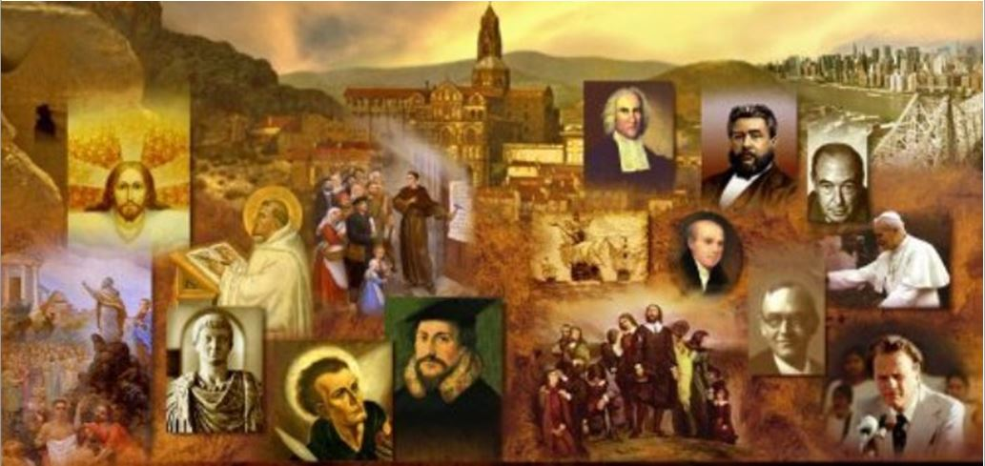
Review
How did Augustine feel about the Bible as an unbeliever?
  The Bible, especially the Old Testament, seemed crude and barbarous to him.
Before becoming a Christian, what religious philosophy did Augustine subscribe to for a period of nine years?
  Manicheanism
What was Augustine’s original reason for visiting Ambrose’s church?
  To study Ambrose’s persuasive preaching style
What was it about Ambrose’s preaching that helped Augustine overcome his distaste for Christianity?
  Ambrose made Christianity seem an intelligent and reasonable faith.
  Ambrose would “spiritualize” OT texts that would otherwise be offensive.
What NT passage did God use to change Augustine’s heart? Give a rough paraphrase of the text.
  Romans 13: 13-14: “Not in orgies and drunkenness, not in sexual immorality and lust, not in strife and jealousy. But instead clothe yourselves in the Lord Jesus Christ, and make no provision for your sinful nature, to gratify its desires.”

Slide 3
Review
What were the two major false belief systems shaped Augustine's theological perspective as he battled them?
  Donatism and Pelagianism
Fill in the blanks of this famous BB Warfield quote: “The Reformation inwardly considered was just the ultimate triumph of Augustine’s doctrine of ______ over Augustine’s doctrine of ______”.
  Grace, the Church
What were the Donatist’s objections to Augustine and the Catholic church?
  The church had allowed men that the Donatist believed had faulty ordinations to serve as bishops
  The church was too lax towards the sinful behavior of its members.
What was Augustine’s objections to the Donatists?
  He believed the Donatists were divisive and were unnecessarily stringent in their requirements for leaders and members.

Slide 4
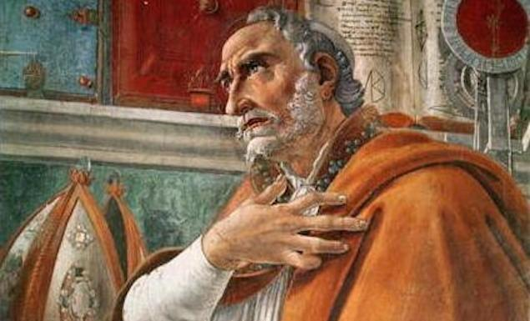
Augustine of Hippo - Part 2
https://www.theschooloflife.com/thebookoflife/the-great-philosophers-augustine/

Slide 5
*Augustine’s Theology and Historical Influence
Augustine’s theology and writing were strongly influenced by two major issues that encountered in his ministry:
  Donatism and teachings related to sacraments and the unity of the Catholic Church
  Pelagianism and teachings related to our natural ability/inability to have faith and to live the Christian life.
* James White – 2016 Church History Series; Lesson 35 and 36 – Augustine of Hippo

Slide 6
*Augustine and Pelagianism
Pelagius was a British monk of cultured mind and blameless character who came to Rome in AD 383.
The worldliness he found among Roman Christians shocked him to the core of his being; most of them, Pelagius felt, viewed Christianity as a set of rituals which offered bliss in the future life, without the slightest hint that it should also influence their moral behavior in the present.
As he viewed the corrupt behavior of his “fellow Christians”, Pelagius came to believe that his God-given role was to hold out his high ascetic ideals of monastic holiness to the Church at large.
Unfortunately, despite his zeal for holy living, Pelagius had a very unorthodox theology – he, in fact held to a false gospel!
Pelagius held that all human beings were born into the world as sinless as Adam was before he fell; the apostasy of Adam had not corrupted humanity’s nature, but had merely set a fatally bad example, which most of Adam’s sons and daughters had freely followed.
* Needham, Nick. 2,000 Years of Christ's Power Vol. 1: The Age of the Early Church Fathers

Slide 7
*Augustine and Pelagianism
However, there were some people (according to Pelagius) who had managed to remain sinless throughout their lives by a proper use of their free-will, e.g. some of the Old Testament saints like Daniel.
In fact, Pelagius thought anyone could become sinlessly perfect if only he tried hard enough.
Pelagius admitted that human beings needed God’s grace in order to be good, but he had his own peculiar definition of grace. For Pelagius “grace” really meant two things:
  God’s gift of natural free-will to all human beings;
  God’s gift of the moral law and the example of Christ, which revealed perfectly how people should live, and supplied strong incentives in the form of eternal rewards and punishments.
Pelagius’s theology therefore made the fruits of human goodness grow almost entirely out of human free-will and effort.
Entry into heaven, in the Pelagian scheme, became a just reward for living a good life on earth, rather than an undeserved gift purchased for helpless sinners by the blood of an all-sufficient Savior.
* Needham, Nick. 2,000 Years of Christ's Power Vol. 1: The Age of the Early Church Fathers

Slide 8
*Augustine and Pelagianism
Augustine recognized that Pelagius’s theology was heretical and was definitely contrary to his own experience.
Augustine sensed profoundly the depth of his own sin and hence the greatness of God’s salvation.
He felt that nothing less than irresistible divine power (grace) could have initially saved him from his sin and only constantly inflowing divine grace could continue to keep him in the Christian life.
In Augustine’s view, Adam’s sin had enormous consequences: his power to please God was gone. In a word, he died— spiritually, and soon physically.
But Adam was not alone in his ruin.
* Shelley, Dr. Bruce L.. Church History in Plain Language: Fourth Edition (p. 137-138)

Slide 9
*Augustine and Pelagianism
Augustine taught that the whole human race was “in Adam” and shared his fall. Mankind became a “mass of corruption,” incapable of earning their own salvation.
Every individual, from earliest infancy to old age, deserves nothing but damnation.
Since man in and of himself can do nothing good, all power to do good must be the free gift of God, that is, grace.
Out of the mass of the fallen race, God chooses some to receive this grace, which comes to them from the work of Christ, and ordinarily through the church and especially through its sacraments.
All who receive baptism receive regenerating grace, which then frees them to serve God, though that service is imperfect even at best, and is maintained only by the constant gift of more grace.
* Shelley, Dr. Bruce L.. Church History in Plain Language: Fourth Edition (p. 137-138)

Slide 10
*Augustine and Pelagianism
Augustine, like Paul, had been “apprehended” by the grace of God. He entered the Christian faith by what seemed to him catastrophes.
The great original catastrophe was his condition at birth, sinful alienation from God. And the only freedom from that catastrophe was a new birth.
Therefore Augustine launched a strenuous literary attack on Pelagianism.
By AD 419 the Pelagians were banished by the Emperor Honorius, and in AD 431 they were condemned by a General Council of the Church meeting at Ephesus.
* Shelley, Dr. Bruce L.. Church History in Plain Language: Fourth Edition (p. 137-138)

Slide 11
*Augustine and Pelagianism
The Pelagian controversy continued to rumble on in various ways until Augustine’s death and even afterwards.
However, the controversy was not a straight fight between Augustinians and Pelagians. A small group of writers arose in southern France, who were known as “Semi-Pelagians”.
Their leader was the great John Cassian, one of the founding fathers of Western monasticism.
* Needham, Nick. 2,000 Years of Christ's Power Vol. 1: The Age of the Early Church Fathers

Slide 12
*Augustine and Pelagianism
The Semi-Pelagians agreed with Augustine that the whole human race had fallen in Adam, and that sinners could not become Christians or do spiritual good without the powerful help of God’s grace.
But they insisted that although a sinner could not save himself, he could at least cry out to God for saving grace, just as a sick person might not be able to heal himself, but he could at least take himself to the doctor.
Conversion was therefore a joint product of the divine and human will working together, a view known as synergism (from the Greek “working together”).
Augustine wrote against the Semi-Pelagians, but treated them with mildness, gentleness and respect.
In Augustine’s view, the Pelagians were blasphemous heretics, but Semi-Pelagians were erring brothers in Christ.
* Needham, Nick. 2,000 Years of Christ's Power Vol. 1: The Age of the Early Church Fathers

Slide 13
*Augustine and Pelagianism
Another well-known semi-Pelagian in Augustine’s day, Vincent of Lerins, argued that a test of true Catholic doctrine was that it had been believed “everywhere, always, by everyone” in the Church.
Augustine’s doctrine of humankind’s helpless slavery to sin and God’s sovereign predestination of some to salvation, Vincent said, failed to pass this test, because until Augustine taught it, it had been believed “nowhere, at no time, by no-one!”
Augustine disagreed: he argued that his view was present in in the writings of earlier fathers, especially Cyprian and Ambrose, but that it was in an undeveloped form.
It was only the rise of Pelagianism, Augustine contended, that was now forcing the Church to think out more clearly the relationship between grace and free-will.
* Needham, Nick. 2,000 Years of Christ's Power Vol. 1: The Age of the Early Church Fathers

Slide 14
*Augustine and Pelagianism
Augustine went on to say: “Why should we need to search into the works of those who, prior to this heresy, were under no obligation to concern themselves with solving this knotty question – which they would undoubtedly have done, if they had been obliged to deal with such matters? Therefore what they thought about the grace of God, they have shortly and swiftly handled in some parts of their writings [since there was no one was raising questions about those issues in their day]. But they dealt at length with those matters in which they refuted the enemies of the Church [in their day]…”
* Needham, Nick. 2,000 Years of Christ's Power Vol. 1: The Age of the Early Church Fathers

Slide 15
*Augustine and Pelagianism
The Western Church broadly accepted Augustine’s doctrines of sin and salvation, with some modifications.
Most of the great Western theologians of the Middle Ages were “Augustinians” in their basic understanding of human sin and divine grace.
So were the Protestant Reformers of the 16th century.
The East, by contrast, followed the Semi-Pelagian “synergist” outlook which John Cassian had championed in France.
Because of Augustine’s view of the Catholic Church, he held that the grace which saved the elect was channeled through the one true Church and its sacraments. If anyone lived and died outside the Catholic Church, that showed he was not one of the elect.
This was the type of Augustinianism which prevailed in the Middle Ages in the West.
* Needham, Nick. 2,000 Years of Christ's Power Vol. 1: The Age of the Early Church Fathers

Slide 16
*Augustine and Pelagianism
Later, the Protestant Reformers rejected Augustine’s doctrine of the Church, and taught that the Holy Spirit bestowed grace on the elect by creating personal faith in the gospel, written or preached.
In this way the Reformers “liberated God’s grace” from its confinement in one exclusive Church.
The Protestant Reformation has often been called “the triumph of Augustine’s doctrine of grace over Augustine’s doctrine of the Church”.
* Needham, Nick. 2,000 Years of Christ's Power Vol. 1: The Age of the Early Church Fathers

Slide 17
*Augustine and The City of God
In AD 410, the Visigoths shocked the Roman world by invading Rome.
The pagans of that day blamed the disaster on the fact that Rome had turned to Christianity and abandoned its traditional gods.
Responding to this charge, Augustine wrote what soon became a very popular book, The City of God, in which he developed a Christian view of world-history.
The human race, he said, had always been divided into two spiritual communities:
  “The City of the World” – made up of those who were controlled by a supreme love of self and earthly things
  “The City of God” – made up of those who were controlled by a supreme love of God and eternal things.
The two cities were mingled with each other here on earth, but they would be finally separated into their opposite destinies when Christ returned.
* Needham, Nick. 2,000 Years of Christ's Power Vol. 1: The Age of the Early Church Fathers

Slide 18
*Augustine and The City of God
The city of God existed and was nurtured within the Catholic Church, although the Church contained tares as well as wheat.
The city of the world found its most obvious expression in the state.
By this teaching, Augustine strengthened the Western sense of the profound difference, even tension, between Church and state.
The city of the world could never provide true peace and security; sinful human passions and conflicts always disturbed it.
While they were here on earth, Augustine argued, not even the members of God’s city were exempt from the changing fortunes and calamities of earthly life (such as the fall of Rome).
* Needham, Nick. 2,000 Years of Christ's Power Vol. 1: The Age of the Early Church Fathers

Slide 19
*Augustine and The City of God
Human beings could find enduring happiness only by looking beyond this sin-cursed life, and fixing their hearts on what was spiritual and eternal through faith in Jesus Christ.
Augustine died in 430, while Hippo was under siege from an invading Germanic army of Vandals. However, his theology lived on in the Western Church.
Augustine is the Christian thinker who has had, by far, the greatest influence on the beliefs, practices and spirituality of Western Christianity.
* Needham, Nick. 2,000 Years of Christ's Power Vol. 1: The Age of the Early Church Fathers

Slide 20
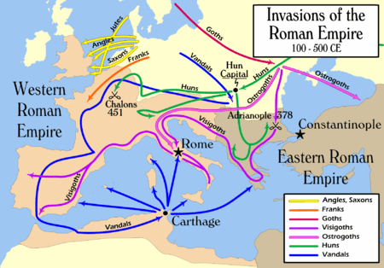
*Augustine and The City of God
https://ipfs.io/ipfs/QmXoypizjW3WknFiJnKLwHCnL72vedxjQkDDP1mXWo6uco/I/m/Invasions_of_the_Roman_Empire_1.png

Slide 21
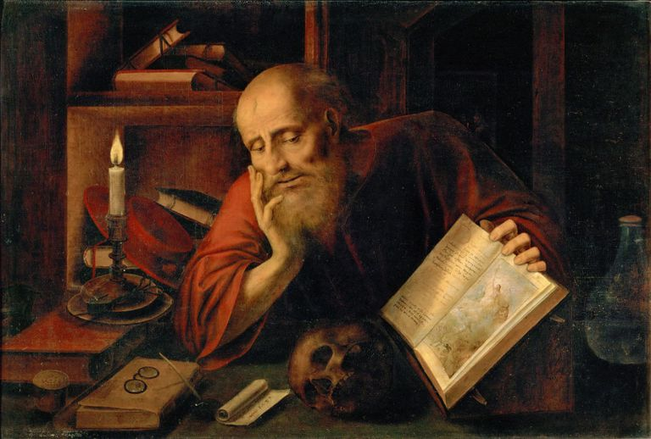
Jerome
https://www.thoughtco.com/saint-jerome-profile-1789037

Slide 22

https://www.hopehelps.org/volunteer-appreciation-week-2018/

Slide 23

Class Discussion Time
https://www.weareteachers.com/moving-beyond-classroom-discussions/

Slide 24
*Class Discussion Time
Both the theological groups opposing Augustine (Donatists and Pelagians) were appalled by the moral laxity found among professing “believers” in the church. Is this an issue in our day? Can we really expect professing believers to be morally pure? How should this be addressed biblically?
When it comes to the issue of our ability/inability to please God in and of ourselves, who are the Pelagians, Semi-Pelagians, and Augustinians of our day?
What do you think of Vincent of Lerins’ test of a true doctrine was that it has to have been believed “everywhere, always, by everyone” throughout church history?
Do you have a topic or question that you would like to see us to discuss?

