Slide 1


Slide 2
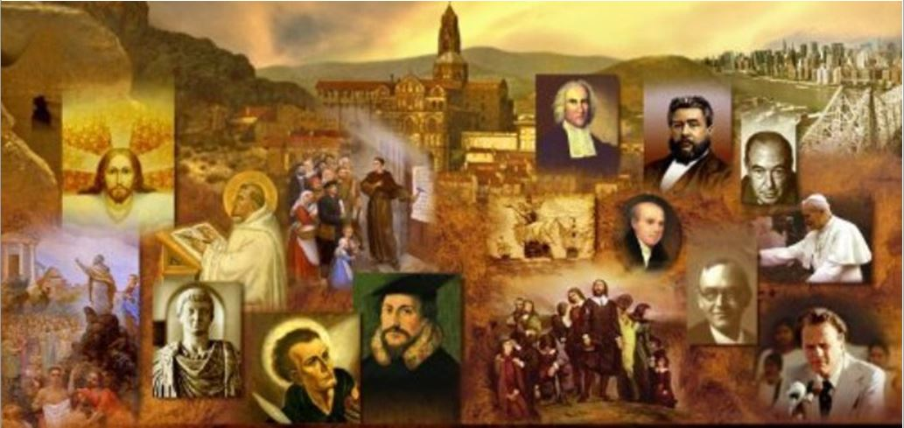
Review
What did Pelagius find among Roman Christians that shocked him to the core of his being?
  He felt that most of them viewed Christianity as a set of rituals which offered bliss in the future life, without the slightest hint that it should also influence their moral behavior in the present.
In what way did Pelagius believe that Adam’s sin affected the rest of humanity? Contrast this with Augustine’s view of Adam’s sin.
  Pelagius believed that Adam set a fatally bad example, which most of Adam’s sons and daughters had freely followed.
  Augustine believed taught that the whole human race was “in Adam” and shared in his fall. Consequently, every individual, from earliest infancy to old age, deserves nothing but damnation.
By what means did Pelagius believe that some people could remain sinless throughout their lives?
  By a proper use of their free-will

Slide 3
Review
How did Augustine believe that men were saved?
  Since man in and of himself can do nothing good, all power to do good must be the free gift of God, that is, grace.
  God chooses some to receive this grace, which comes to them from the work of Christ, and ordinarily through the church and especially through its sacraments.
What did the Semi-Pelagians believe concerning salvation?
  A sinner could not save himself, but he could cry out to God for saving grace, like a sick person might take himself to the doctor. Conversion therefore was a joint product of the divine and human will working together, a view known as synergism.
What event occurred in AD 410 that shocked the Roman world?
  The Visigoths invaded Rome
What did the pagans of that day claim was the cause of the Roman invasion and how did Augustine counter their claim?
  They blamed the disaster on the fact that Rome had turned to Christianity and abandoned its traditional gods.
  Augustine wrote The City of God, in which he developed a Christian view of world-history.

Slide 4
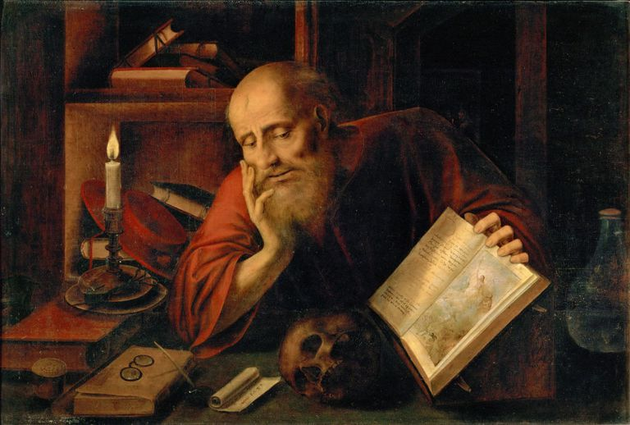
Jerome
https://www.thoughtco.com/saint-jerome-profile-1789037

Slide 5
*Jerome’s Early Years
Eusebius Hieronymus Sophronius, thankfully known as Jerome, was probably the greatest Christian scholar in the world by his mid-30s.
One of the great figures in the history of Bible translation, he spent three decades creating a Latin version that would be the standard for more than a millennium.
Jerome was also an extreme ascetic with a nasty disposition who showered his opponents with sarcasm and invective.
Jerome was born in AD 340 to wealthy Christian parents in Stridon, Dalmatia (near modern Ljubljana, Slovenia), and educated in Rome, where he studied grammar, rhetoric, and philosophy. There he was baptized at age 19.
* Galli, Mark. 131 Christians Everyone Should Know (p. 337). B&H Publishing Group.

Slide 6
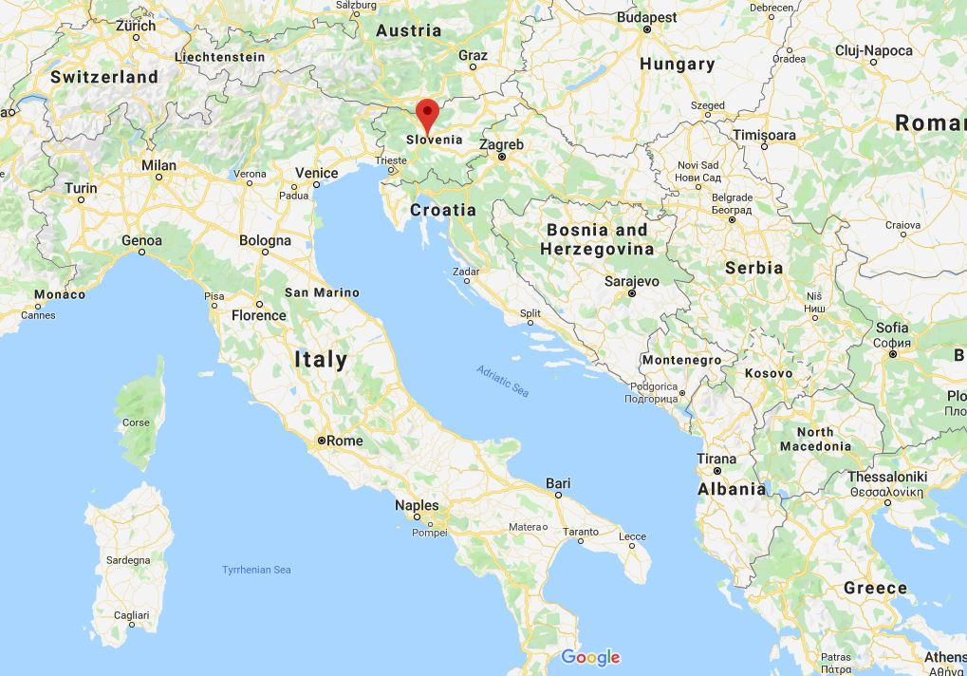
Jerome’s Birth Place

Slide 7
*Jerome’s Early Years
Jerome was an ardent admirer of classical learning, but, as a Christian, he felt that this love for pagan learning was sinful.
His inner turmoil on this score peaked when, during a serious illness, he dreamed that he was at the final judgment and was asked: “Who are you?” “I am a Christian,” Jerome answered. But the judge retorted: “You lie. You are a Ciceronian.”
After that experience, Jerome resolved to devote himself fully to the study of scripture and of Christian literature. But he never ceased reading and imitating the style of the classical pagan authors.
* Gonzalez, Justo L.. The Story of Christianity: Volume 1: The Early Church to the Dawn of the Reformation (pp. 233-236).

Slide 8
*Jerome’s Early Years
Jerome also struggled inwardly with sexual lusts.
By living the monastic life, he had hoped to be rid of that burden. But even there he was plagued by memories of Roman banquets and dancing girls.
He sought to suppress such thoughts by punishing his body, and living an austere life.
He was unkempt, and even came to affirm that, having been washed by Christ, there was no need to ever wash again.
And yet, even that did not suffice.
Finally, in order to fill his mind with something that would take the place of the pleasures of Rome, he decided to study Hebrew.
That language, with its strange alphabet and grammar, seemed barbaric to him. But he told himself that, since the Old Testament was written in it, it must be divine.
* Gonzalez, Justo L.. The Story of Christianity: Volume 1: The Early Church to the Dawn of the Reformation (p. 236).

Slide 9
*Jerome’s Early Years
Eventually Jerome conceded that he was not made for the life of a hermit and returned to civilization.
He returned to Rome, where Bishop Damasus, a good judge of human nature, made him his private secretary and encouraged him to engage in further study and writing.
It was also Damasus who first suggested to him the project that would eventually occupy most of his time, and would become his greatest monument: a new translation of scripture into Latin.
Although Jerome did some work on this project while in Rome, he pursued it most actively later in his life.
* Gonzalez, Justo L.. The Story of Christianity: Volume 1: The Early Church to the Dawn of the Reformation (p. 236).

Slide 10
*Jerome’s Early Years
Meanwhile, Jerome received a great deal of help from a group of rich and devout women who lived in the palace of a widow, Albina.
Besides Albina, the group included the scholarly Paula, who — with her daughter Eustochium— would play a leading role in the rest of Jerome’s life.
Jerome visited that house regularly, for in its women he found devoted disciples, some of whom became accomplished students of Greek and Hebrew.
It was in that company that Jerome felt most free to discuss the scholarly questions that occupied his mind— particularly questions having to do with the text of the Bible.
It’s interesting that Jerome, who never had any close male friends, and who was obsessed with sex, found such solace in this group of women.
Perhaps he felt at ease because they did not dare compete with him.
* Gonzalez, Justo L.. The Story of Christianity: Volume 1: The Early Church to the Dawn of the Reformation (p. 236).

Slide 11
*Jerome’s Early Years
But during his short three-year stint in Rome, Jerome offended the pleasure-loving Romans with his sharp tongue and blunt criticism.
As one historian put it, “He detested most of the Romans and did not apologize for detesting them.”
He mocked the Roman religious leaders for such things as their:
  Lack of charity: “I have not faith and mercy, but such as I have, silver and gold—that I don't give to you either.”
  Vanity: “The only thought of such men is their clothes—Are they pleasantly perfumed? Do their shoes fit smoothly?”
  Pride in their Beards: “If there is any holiness in a beard, nobody is holier than a goat!”
  Ignorance of Scripture: “It is bad enough to teach what you do not know, but even worse...not even to be aware that you do not know”.
* Galli, Mark. 131 Christians Everyone Should Know (pp. 338-339). B&H Publishing Group.

Slide 12
*Jerome’s Early Years
When Bishop Damasus died, in AD 384, Jerome lost his staunchest defender.
Siricius, the new bishop of Rome, had little use for Jerome’s scholarship.
When one of Paula’s daughters died, Jerome’s enemies, whom he had criticized for their comfortable life, claimed that her death was due to the rigors imposed on her by Jerome.
Finally, Jerome decided to leave Rome and go to the Holy Land— or, as he said, “from Babylon to Jerusalem.”
* Gonzalez, Justo L.. The Story of Christianity: Volume 1: The Early Church to the Dawn of the Reformation (p. 236).

Slide 13
*Jerome’s Early Years
By AD 386 both he and Paula (who followed him there) decided to settle in Palestine and devote themselves to the monastic way of life.
Their goal, however, was not the extreme asceticism of the desert monks, but rather a life of moderate austerity, spent mostly in study.
Since Paula was rich, and Jerome was not lacking in means, they founded two monastic houses in Bethlehem, one for women under Paula’s leadership, and another for men under Jerome’s supervision.
He then furthered his education in Hebrew, in order to translate the Bible, while he taught Latin to the children of the neighborhood, and Greek and Hebrew to Paula’s nuns.
* Gonzalez, Justo L.. The Story of Christianity: Volume 1: The Early Church to the Dawn of the Reformation (p. 236).

Slide 14
*Jerome and the Latin Vulgate
While living in Bethlehem, Jerome primarily devoted himself to the work that would be his great literary monument: the translation of the Bible into Latin.
By then there were other Latin translations, but these had been done on the basis of the Septuagint— the ancient translation of the Hebrew text into Greek.
What Jerome then undertook was a direct translation from Hebrew.
After many years of work, interrupted by a voluminous correspondence and by the calamities that shook the Roman world, Jerome completed this enormous task.
Jerome’s version, commonly known as the Vulgate, eventually became the standard Bible of the entire Latin-speaking church.
* Gonzalez, Justo L.. The Story of Christianity: Volume 1: The Early Church to the Dawn of the Reformation (p. 237).

Slide 15
*Jerome and the Latin Vulgate
But at first the Vulgate was not as well received as Jerome had wished.
The new translation, naturally enough, altered the favorite texts of some people, and many demanded to know who had given Jerome authority to tamper with scripture.
Furthermore, many believed the legend that the Septuagint had been the work of independent translators who, upon comparing their work, found themselves in total agreement.
That legend had long been used to argue that the Septuagint was just as inspired as the Hebrew text.
Therefore, when Jerome published a version that disagreed with the Septuagint, there were many who felt that he lacked respect for the inspired Word of God.
* Gonzalez, Justo L.. The Story of Christianity: Volume 1: The Early Church to the Dawn of the Reformation (p. 237).

Slide 16
*Jerome and the Latin Vulgate
Such criticism came not just from ignorant believers, but also from some very learned Christians such as Augustine of Hippo who wrote:
  I pray you not to devote your energies to translating the sacred books to Latin, unless you do as you did earlier in your translation of the book of Job, that is, adding notes that show clearly where your version differs from the Septuagint, whose authority has no equal. . . . Besides, I cannot imagine how, after so long, someone can find in the Hebrew manuscripts anything which so many translators did not see before, especially since they knew Hebrew so well.
* Gonzalez, Justo L.. The Story of Christianity: Volume 1: The Early Church to the Dawn of the Reformation (p. 238).

Slide 17
*Jerome and the Latin Vulgate
As an example of the problems caused by Jerome’s translation, Augustine refers to the way that Jerome translated the name of the plant that provided shade for the prophet Jonah.
The traditional version— based on Greek— called it a gourd. Jerome translated it as ivy. Augustine reports:
  A certain bishop, our brother, ordered that your translation be employed in the church he leads. People were surprised that you translated a passage in Jonah in a very different way than they were used to singing [in church] for generations. There was a riot, particularly since the Greeks claimed that the passage was wrong. . . . So you see the consequences of supporting your translation on manuscripts that cannot be verified by known languages [that is, Greek or Latin, rather than Hebrew].
* Gonzalez, Justo L.. The Story of Christianity: Volume 1: The Early Church to the Dawn of the Reformation (p. 238).

Slide 18
*Jerome and the OT Apocrypha
Jerome’s knowledge of Hebrew also enabled him to grasp another important fact about the Old Testament Scriptures: He realized that the Greek translation of the Old Testament, the Septuagint, contained certain books which were not found in the Hebrew Old Testament.
Jerome argued that Christians must accept as part of the authentic Old Testament only those books which the Jews included in the Hebrew Old Testament, and must reject the extra books in the Septuagint (though, at the insistence of Damascus, he did translate the apocryphal books into Latin)
The Church called these extra books the apocrypha, which is Greek for “hidden things” (this refers to the fact that the apocryphal books were not read out in public worship, because the Church did not consider them to be on the same level as the rest of Scripture).
* Needham, Nick. 2,000 Years of Christ's Power Vol. 1: The Age of the Early Church Fathers

Slide 19
*Jerome and the OT Apocrypha
The Old Testament which Protestants use today is the Hebrew Old Testament as Jerome defined it.
Romans 3:2 says that it is to the Jews that the scriptures were entrusted.
The Jews had one canon and as early as 200 years before Christ they laid up the canonical books in the temple, but the Jews never laid up the apocrypha.
Until AD 1546 when the Roman Catholic Church incorporated the apocryphal books into the canon at the council of Trent (and anathematized anyone who didn’t agree), there was a good deal of uncertainty about whether or not to include the apocryphal books as a part of the canon.
*James White – 2016 Church History Series; Lesson 37 – Jerome

Slide 20
*Jerome and the OT Apocrypha
But generally speaking, the more a writer knew of Judaism, Hebrew and the Old Testament, the less likely they were to believe the apocryphal books were a part of the canon of scripture:
  Melito of Sardis in AD 170 rejected the apocryphal books as scripture because he inquired of the Jews.
  Origen in the early third century – rejected the apocryphal books.
  His student Rufinus in late fourth century - rejected the apocryphal books.
  Jerome - rejected the apocryphal books
  Pope Gregory the Great (late sixth century) commenting on Maccabees (an apocryphal book) says that “this isn’t from scripture.”
  Cardinal Cajetan who interviewed Luther (AD 1519) – rejected the apocryphal books as scripture.
*James White – 2016 Church History Series; Lesson 37 – Jerome

Slide 21
*Jerome’s Last Days
At first glance, Jerome appeared to be an extremely insensitive person whose only concern was his own prestige.
But in truth he was very different than he appeared, and his rigid facade hid a sensitive spirit.
No one knew this as well as did Paula and her daughter, Eustochium.
But his good friend Paula died in AD 404, and Jerome felt alone and desolate.
His grief was all the greater, for he was convinced that it was not only his end that approached, but that of an era.
* Gonzalez, Justo L.. The Story of Christianity: Volume 1: The Early Church to the Dawn of the Reformation (p. 238-240).

Slide 22
*Jerome’s Last Days
A few years later, in AD 410, Rome was taken and sacked by the Goths. The news shook the world.
Jerome heard of it in Bethlehem, and wrote to Paula’s daughter, Eustochium:
  Who could have believed that Rome, built by the conquest of the world, would fall? That the mother of many nations has turned to her grave? . . . My eyes are dim by my advanced age . . . and with the light that I have at night I can no longer read Hebrew books, which are difficult even during the day for the smallness of their letters.
Jerome survived for almost ten more years. They were years of loneliness, pain, and controversy.
Finally, in AD 420, a few months after the death of Eustochium, who had become as a daughter to him, the tired scholar died at the age of 80.
* Gonzalez, Justo L.. The Story of Christianity: Volume 1: The Early Church to the Dawn of the Reformation (p. 238-240).

Slide 23
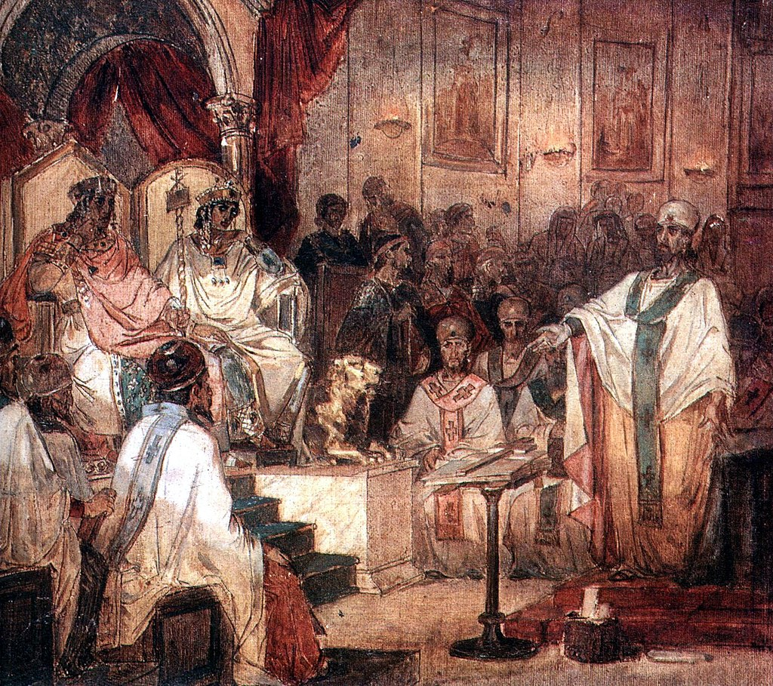
The Council of Chalcedon
https://sgwmscog.com/wp-content/uploads/Council-of-Nicea-2-1.jpg

Slide 24

https://www.hopehelps.org/volunteer-appreciation-week-2018/

Slide 25

Class Discussion Time
https://www.weareteachers.com/moving-beyond-classroom-discussions/

Slide 26
*Class Discussion Time
The Christian community gave Jerome a lot of grief for “changing God’s Word” when, working from the original Hebrew, sometimes came up with a different translation than they had been used to seeing in the Septuagint, the traditional translation of that day.
Ironically, 1100 years later, Erasmus was given grief for changing what was written in the Vulgate, which had by then become the traditional text of the day. Do you see a pattern here? What “traditional” text of our day will sometimes cause these kinds of objections to be raised?
Do you have a topic or question that you would like to see us to discuss?

