Slide 1


Slide 2
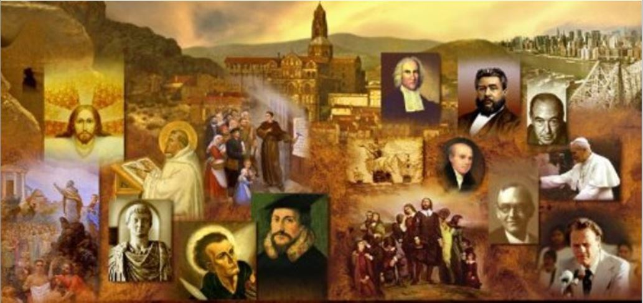
Review
History indicates that Christianity reached the lands east of the Arabian Peninsula very early on.
There are three early accounts that suggest an early movement of the gospel to peoples in the east, two of which are found in scripture. Briefly describe each of the three accounts.
  In Matthew 2 we are told a group of astronomers from Persia came to see Jesus at his birth and returned home afterwards.
  In Acts 2, Men are said to have come to Jerusalem from a number of areas east of Jerusalem to celebrate one of the great annual Jewish feasts, heard Peter preach the gospel, and were converted before returning home.
  An early church tradition says that the first century apostles Andrew and Thomas went east spreading the Christian message as far as India.
Around the time that Paul and Barnabas launched their missionary journeys from Antioch to the Roman Empire, west of Antioch, others (not mentioned in scripture) carried the gospel east to what great empire?
  The Persian Empire

Slide 3
Review
What was the official religion of Persia during those first centuries when Christianity began to also take root there?
  Zoroastrianism
What effect did Constantine’s conversion and advocacy of Christianity in the Roman Empire have on how Persian Emperors began to view Christians living in the Persian Empire?
  The Persian emperors became suspicious of the political loyalties of their Persian Christian subjects and started to persecute them.
What view of Christology took root among most of the early Christians in Persia and beyond?
  Nestorianism
How far east had the Christian Gospel traveled by the end of the 12th century
  To Iraq, Iran, Afganistan, Mongolia, India, China, and possibly even Japan!
What tragic fate befell the vast number of Christians living throughout the East with the rise of the Timurid Empire (AD 1370-1405)?
  Vast numbers of them were killed

Slide 4
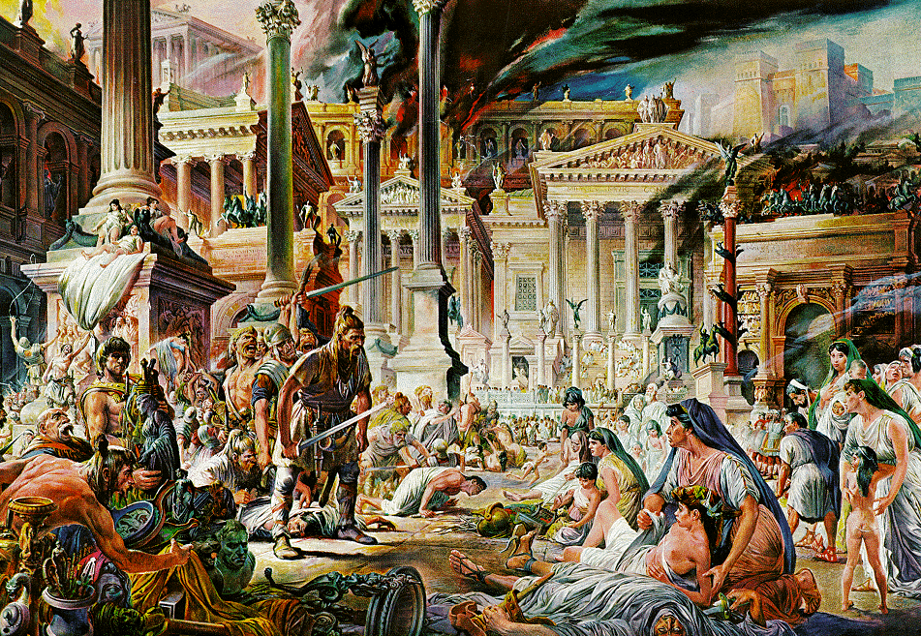
The Fall of Rome
https://www.historyonthenet.com/when-did-the-roman-empire-really-end

Slide 5
*The Fall of Rome
When a Visigothic army besieged and captured Rome early in the 5th century, people at the time viewed the event as nothing less than the “fall of the Roman Empire” in the West.
However, the process by which the Western Empire collapsed had already begun in the 4th century, and was not completed until the 6th.
The Visigoths who sacked Rome in AD 410 were one of various Germanic tribes who lived north of the river Danube, covering a vast area which took in not only modern Germany, but present-day Poland, the Czech Republic, Slovakia, Hungary and south-eastern Russia.
Needham, Nick. 2,000 Years of Christ's Power Vol. 1: The Age of the Early Church Fathers

Slide 6
*The Fall of Rome
From AD 375 onwards, the Germans came under attack from a numerous and fierce migrating people of Asia called the Huns, whose most famous leader history knows simply as Attila the Hun (AD 441-53).
To protect themselves against the Huns, the Germans banded together into large tribal confederacies under a single chieftain or king.
The main confederacies were:
  the Ostrogoths (Eastern Goths),
  Visigoths (Western Goths),
  Franks,
  Vandals,
  Lombards,
  Burgundians,
  Angles, Saxons and Jutes.
Needham, Nick. 2,000 Years of Christ's Power Vol. 1: The Age of the Early Church Fathers

Slide 7
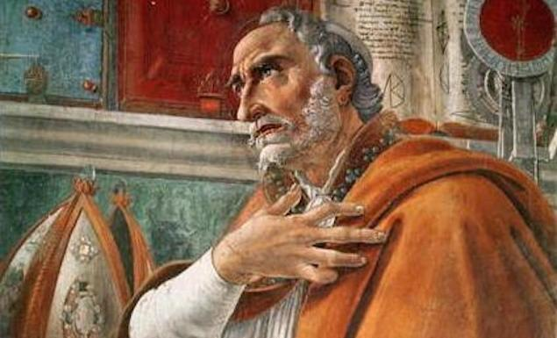
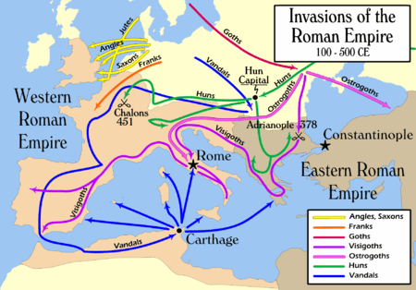
https://ipfs.io/ipfs/QmXoypizjW3WknFiJnKLwHCnL72vedxjQkDDP1mXWo6uco/I/m/Invasions_of_the_Roman_Empire_1.png

Slide 8
*The Fall of Rome
These various Germanic Confederacies sought security from the Huns by crossing over into the Roman Empire.
The Empire was no strange place to them; many Germans already served in the Roman armies, and had adapted to Roman customs.
By the middle of the 4th century, part of the Empire’s civilization which the Germans encountered was the Christian faith.
However, it was Christianity in its Arian form – the heresy that denied the deity of Christ.
Needham, Nick. 2,000 Years of Christ's Power Vol. 1: The Age of the Early Church Fathers

Slide 9
*The Fall of Rome
The Visigoths were the first Germanic group to convert from Paganism to Arianism; an Arian bishop called Ulfilas (AD 311-81) had evangelized many of them, and had translated the Bible into Gothic.
In AD 376 the Visigoths crossed the Danube river into the Empire to escape from the Huns, and settled in the Roman provinces of Moesia and Thrace (present-day Bulgaria and Serbia).
They felt that their settlement in the Empire involved accepting the Empire’s religion, and in AD 376 the Church in the East was officially Arian (it was during the reign of the Arian emperor Valens).
Needham, Nick. 2,000 Years of Christ's Power Vol. 1: The Age of the Early Church Fathers

Slide 10
*The Fall of Rome
The whole Visigothic people therefore embraced Arianism.
The Ostrogoths, Vandals, Lombards and many of the Burgundians also converted from Paganism to Arianism before they migrated into and mastered the Western Empire.
So the religion of most of the Germanic conquerors of the Empire was not Paganism, but Arian Christianity.
The Germans who remained Pagan – the Franks, Angles, Saxons and Jutes – worshipped Wotan (or Wodin) as their chief god, together with other deities such as Thor (god of thunder), Tiwaz (god of war), Freya (goddess of fertility), and Saeter (a water-god).
We derive the names of most our days from these Germanic gods: Tuesday (Tiwaz’s day), Wednesday (Wodin’s day), Thursday (Thor’s day), Friday (Freya’s day), Saturday (Saeter’s day).
Needham, Nick. 2,000 Years of Christ's Power Vol. 1: The Age of the Early Church Fathers

Slide 11
*The Fall of Rome
The first sign that the Empire was in serious trouble from the Germans was when the Visigothic army overthrew the emperor Valens, killing him and crushing his troops in AD 378 at the battle of Adrianople (north-west of Constantinople).
The Visigoths had taken refuge in the Empire only two years previously, but rebelled when the Roman authorities treated them badly.
The emperor Theodosius the Great (AD 379-95) managed to restore order, but he allowed the Visigoths to stay inside the Empire as allies of Rome.
Needham, Nick. 2,000 Years of Christ's Power Vol. 1: The Age of the Early Church Fathers

Slide 12
*The Fall of Rome
After Theodosius’s death, the Visigoths under their new king, Alaric (AD 395-410), became hungry for more territory, and moved into northern Italy.
After several years of fighting, Alaric besieged and captured Rome itself in AD 410.
The vast and ancient city, once the capital of the world, collapsed in flames, as the brutal Visigoths set its buildings on fire and massacred its population, sparing only church buildings.
Rome’s fall sent emotional shock-waves crashing through the entire Empire.
Jerome in Bethlehem said, “My voice is choked, broken with sobs as I dictate this letter. The city that conquered the entire earth has now itself been conquered!”
Needham, Nick. 2,000 Years of Christ's Power Vol. 1: The Age of the Early Church Fathers

Slide 13
*The Fall of Rome
From this point onwards it is customary to refer to the Eastern Roman Empire as the “Byzantine” Empire, after Byzantium, the name of the old town on the site where Constantinople now stood.
The Visigoths then moved out of Italy and by AD 419 had settled in France.
While the Visigoths were ravaging Italy, the Vandals (who had also embraced Arianism) pushed across France in AD 406 and migrated into Spain.
Under pressure from the Visigoths, the Vandals then crossed the straits of Gibraltar into North-West Africa in AD 429, launched a campaign of violent and bloody conquest, destroying towns and cities, slaughtering their Catholic inhabitants.
Needham, Nick. 2,000 Years of Christ's Power Vol. 1: The Age of the Early Church Fathers

Slide 14
https://ipfs.io/ipfs/QmXoypizjW3WknFiJnKLwHCnL72vedxjQkDDP1mXWo6uco/I/m/Invasions_of_the_Roman_Empire_1.png

Slide 15
*The Fall of Rome
The West’s greatest theologian, Augustine of Hippo, died in AD 430 while a Vandal army was besieging his city.
A mighty Vandal kingdom was established on the ruins of Roman North Africa; Vandal ships ruled the Mediterranean Sea.
None of this was good news for the orthodox African Christians who had survived the conquest, because the Vandals persecuted them intensely, sending Catholic bishops to the island of Corsica as slave-labor to cut timber for the Vandal fleets.
The control and defense of Italy was now in the hands of a Roman army which was in fact made up entirely of Germans.
The Western emperors had ceased to have any real authority; they were merely puppet kings, set up and toppled by the German generals.
Needham, Nick. 2,000 Years of Christ's Power Vol. 1: The Age of the Early Church Fathers

Slide 16
*The Fall of Rome
In AD 452, Attila the Hun advanced on Rome.
A sudden raid over the Alps brought him into northern Italy, where he met with little resistance.
The weakened Roman army kept out of range and the population fled.
In spite of pestilence and mutiny, Attila drove his horses and men on.
At a fordable spot on the Po River, Attila met an embassy from Rome, the usual peace delegation.
He was about to send them away when he heard that Bishop Leo was there as emissary for the Roman emperor.
Shelley, Dr. Bruce L.. Church History in Plain Language: Fourth Edition (pp. 141-142)

Slide 17
*The Fall of Rome
Leo was commissioned to negotiate with one of the mighty men of the panic-stricken world in the hope of avoiding chaos – to save what could be saved.
The Roman emperor was doing nothing to preserve the ancient capital of the empire and its surrounding territories from devastation.
So Bishop Leo, now acting in the name of the emperor, sat facing Attila alone.
Man to man, the contest seemed unequal: on one side, a ruthless conqueror; on the other, a church bishop.
Shelley, Dr. Bruce L.. Church History in Plain Language: Fourth Edition (pp. 141-142)

Slide 18
*The Fall of Rome
Long before the arrival of the embassy from Rome, Attila had probably made up his mind about further military thrusts.
Epidemics in his army added to widespread famine were forcing him to break off the advance.
But nobody knew it. So he willingly granted an interview to the imperial envoy, and in the course of it he granted the pope’s plea that the capital should be spared.
He even promised to withdraw from Italy, and he kept his word.
The bishop of Rome had assumed a new role and staked a fresh claim on the future.
Shelley, Dr. Bruce L.. Church History in Plain Language: Fourth Edition (pp. 141-142)

Slide 19
*The Fall of Rome
In AD 476, the last of the Western emperors, Romulus Augustulus, was deposed; thus the last remnants of the Roman Empire vanished in the West.
However, even though the Germanic tribes had overthrown the Roman political system in Western Europe, they continued to think of themselves as citizens of the Roman Empire, and professed their loyalty to the emperor – that is, the Byzantine emperor in distant Constantinople.
The Christian city of Constantinople, after all, was the “New Rome”, and real political power in the Empire had rested in Constantinople ever since Constantine the Great had transferred the seat of imperial government there in AD 330.
Of course, it also suited the political and territorial ambitions of the Germanic kings to have their “emperor” in far-off Constantinople rather than in nearby Rome.
Needham, Nick. 2,000 Years of Christ's Power Vol. 1: The Age of the Early Church Fathers

Slide 20
*The Fall of Rome
After many tribal movements and conflicts, the Visigoths finally settled in Spain, the Ostrogoths in Italy, the Franks and Burgundians in France, the Vandals in North-West Africa, and the Angles, Saxons and Jutes in Britain.
Of these new Germanic kingdoms, the Visigoths, Ostrogoths, Vandals, and most of the Burgundians, were Arians, while the Franks, Angles, Saxons and Jutes remained Pagan.
However, in AD 496 a crucial event happened which was to transform the religious destiny of the new West.
The Frankish king Clovis (AD 481-511) had married a Burgundian princess called Clotilda in AD 493; and Clotilda was a Catholic (not an Arian, but a believer in the Trinity).
Clotilda tried to persuade her husband to become a Christian. Clovis resisted. However, in AD 496 he found himself in serious military trouble fighting another Germanic tribe.
Needham, Nick. 2,000 Years of Christ's Power Vol. 1: The Age of the Early Church Fathers

Slide 21
*The Fall of Rome
In his desperation, Clovis prayed to the Lord about Whom his wife had so often told him, promising that he would become a Christian if Christ gave him victory in battle:
  “O Jesus Christ Clotilda holds that You are the Son of the living God. You graciously pour out Your assistance on people in trouble, and victory comes to people who put their trust in You. In faith I cry for Your glorious aid. If You will hand me victory over those who attack me, and I get proof of the miracles tasted by those committed to Your name (as they say), then I will exercise faith in You and submit to baptism. I have cried to my own gods to help me, but it is painfully obvious they are not going to help me. So I cannot credit them with any power. They do not intervene to rescue people who trust in them. So I now cry out to You. I long to believe in You, especially that I may escape my foes.”
Needham, Nick. 2,000 Years of Christ's Power Vol. 1: The Age of the Early Church Fathers

Slide 22
*The Fall of Rome
Victory came and Clovis kept his promise, accepting baptism into the Catholic faith.
The tribe followed the religious allegiance of its chief: the Franks became the first Catholic kingdom among the new Western nations.
Catholics praised Clovis as a new Constantine who had led his people out of Pagan darkness into the light of orthodox Christianity.
The Catholic Church soon became the richest and most powerful institution in Frankish society.
Needham, Nick. 2,000 Years of Christ's Power Vol. 1: The Age of the Early Church Fathers

Slide 23
*The Fall of Rome
For our knowledge of early Frankish Christianity, we are indebted to bishop Gregory of Tours (AD 538-94), whose History of the Franks tells the story of the Frankish people up to AD 591.
In AD 573, by the unanimous voice of clergy and people, Gregory was elected bishop of Tours.
He became a high-ranking political counsellor to four successive Frankish kings, as well as a vibrantly energetic and active Church leader; the people of Tours adored Gregory for his sanctity and his fearless advocacy of justice for the poor and oppressed.
His History of the Franks makes it painfully clear that most of the Frankish people had embraced the Christian faith in a rather shallow and external way.
Gregory and his fellow bishops had a hard time trying to convince their Frankish flocks that being a Christian involved a break with Pagan customs and a change of moral lifestyle.
Needham, Nick. 2,000 Years of Christ's Power Vol. 1: The Age of the Early Church Fathers

Slide 24
*The Fall of Rome
Most of the new Germanic kingdoms in continental Europe and Africa, however, were not Pagan but Arian.
It took many years of patient, laborious evangelism and teaching by native Catholics to win over their new German masters to the Catholic faith.
The Vandals in North-West Africa, and the Ostrogoths in Italy, never did abandon their Arianism.
The Byzantine emperor Justinian the Great (527-65) destroyed the intolerant Arian kingdoms of the Ostrogoths in Italy and the Vandals in North-West Africa.
His successful Italian and African military campaigns were the last great attempt by the Eastern Empire to bring the West back under imperial control.
Needham, Nick. 2,000 Years of Christ's Power Vol. 1: The Age of the Early Church Fathers

Slide 25
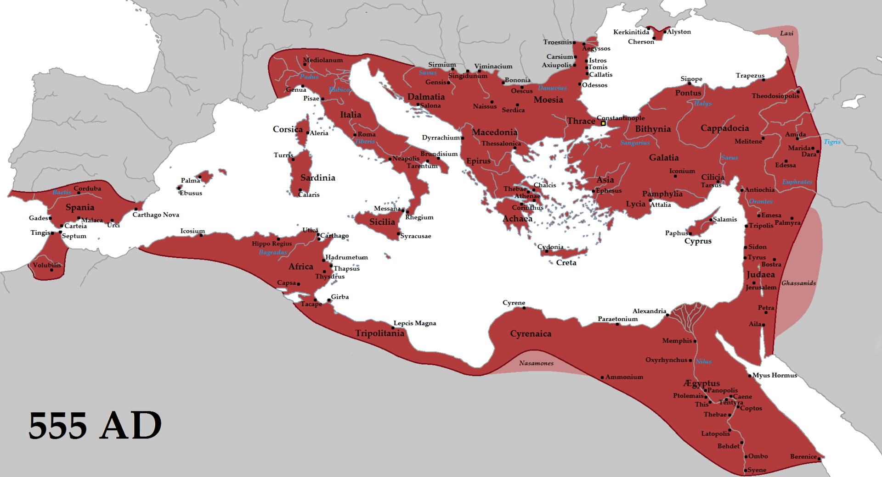
The empire in 555 under Justinian the Great, at its greatest extent since the fall of the Western Roman Empire (its vassals in pink)
https://en.wikipedia.org/wiki/Byzantine_Empire#/media/File:Justinian555AD.png

Slide 26
*The Fall of Rome
However, Justinian’s victories did not survive his own death. Italy, which had been liberated from the Ostrogoths, suffered invasion and conquest by the Arian Lombards.
After the conversion of Clovis and the Franks to Catholicism in AD 496, the Burgundians soon abandoned Arianism, accepting the Catholic faith in AD 517 and becoming part of the Frankish kingdom in AD 532.
The Visigothic king of Spain accepted Catholicism in AD 587, and his people followed him into the new faith.
In Italy, the fortunes of Arianism and Catholicism swung back and forth from one Lombard king to another.
The final decision for Catholicism came with king Liutprand (AD 712-44), probably the greatest of the Lombard monarchs.
Needham, Nick. 2,000 Years of Christ's Power Vol. 1: The Age of the Early Church Fathers

Slide 27
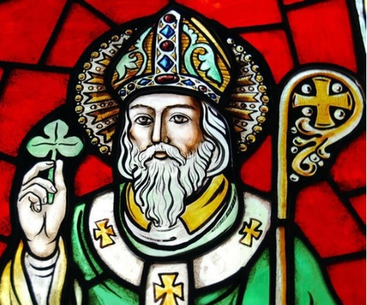
Saint Patrick
https://www.al.com/life/2019/03/who-was-st-patrick-did-he-teach-the-trinity-with-clover.html

Slide 28

https://www.hopehelps.org/volunteer-appreciation-week-2018/

Slide 29

Class Discussion Time
https://www.weareteachers.com/moving-beyond-classroom-discussions/

Slide 30
*Class Discussion Time
The Frankish king Clovis is an example of someone who, in desperation, tries to make a “deal” with God, promising to do something for God (in this case, to become a Christian) if God will deliver them from their desperate circumstance – and God, for his own sovereign purposes, chooses to grant their request.
History is filled with people trying to make this kind of bargain with God.
Can you share a personal example of a time when you or someone you know tried to make a bargain like this with God? What was the outcome?
Do you think that trying to bargain with God in this way is a good thing – something that God would want us to do?
Does the fact that God often brings good out of such a request prove that God approves of approaching Him in this way?
Do you have a topic or question that you would like to see us to discuss?

