Slide 1


Slide 2
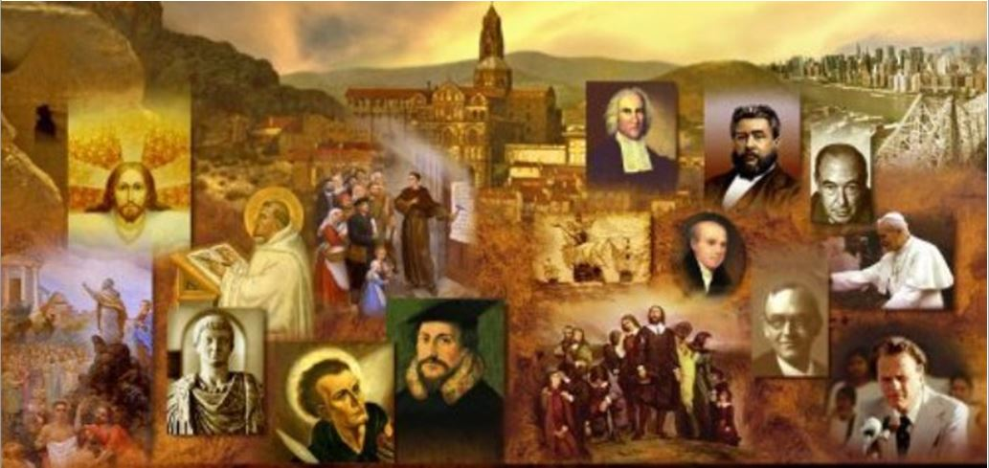
Review
From AD 375 onwards, the Germanic tribes north of the Danube River came under attack from a numerous and fierce migrating people of Asia. What were these people called and who was their (famous) leader?
  The Huns, whose famous leader was Attila the Hun
To protect themselves against the Huns, the Germans banded together into large tribal confederacies. How many of the Germanic confederacies can you name?
  the Ostrogoths (Eastern Goths),
  Visigoths (Western Goths),
  Franks,
  Vandals,
  Lombards,
  Burgundians,
  Angles, Saxons and Jutes
These various Germanic Confederacies sought security from the Huns by crossing over into the Roman Empire.
Some of the Germanic conquerors of the Empire were Pagan, but what was the religion of most of the Germanic invaders?
  Arian Christianity

Slide 3
Review
What well-known church Father lost his life when the Vandals, under pressure from the Visigoths, crossed the straits of Gibraltar into North-West Africa launched a campaign of violent and bloody conquest, destroying towns and cities – including Carthage.
  Augustine
In AD 452, when Attila the Hun advanced on Rome, who did the emperor send to meet with him to negotiate a settlement?
  Leo, Bishop of Rome
Though the Germanic tribes had overthrown the Roman political system in Western Europe, they continued to think of themselves as citizens of what political entity?
  Citizens of the Roman Empire
What did the Frankish king Clovis ask God to do for him before he would become a Christian?
  Give him victory in battle

Slide 4
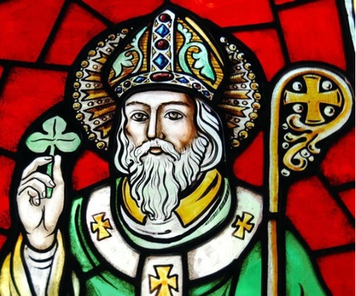
Saint Patrick
https://www.al.com/life/2019/03/who-was-st-patrick-did-he-teach-the-trinity-with-clover.html

Slide 5
*Saint Patrick
Patrick is remembered today as :
  The saint who drove the snakes out of Ireland (not true)
  The teacher who used the shamrock to explain the Trinity (doubtful)
  The namesake of annual parades in New York and Boston
What is less well-known is that Patrick was a humble missionary (this “saint” regularly referred to himself as “a sinner”) of enormous courage.
When he evangelized Ireland, he set in motion a series of events that impacted all of Europe.
It all started when he was carried off into slavery by Irish raiders in around AD 430.
Galli, Mark. 131 Christians Everyone Should Know (p. 229). B&H Publishing Group.

Slide 6
*Saint Patrick
A 16-year-old Romanized Briton, Patrick was sold to a cruel warrior chief whose opponents' heads sat atop sharp poles around his palisade in Northern Ireland.
While Patrick minded his master's pigs in the nearby hills, he lived like an animal himself, enduring long bouts of hunger, thirst, and isolation.
A nominal Christian to this point, he now turned to the Christian God of his fathers for comfort.
He later wrote of that time in his autobiography: “I would pray constantly during the daylight hours. The love of God and the fear of Him surrounded me more and more. And my faith grew. And the spirit roused so that in one day I would say as many as a hundred prayers, and at night only slightly less.”
After six years of slavery, a mysterious, supernatural voice spoke to him: “Soon you will return to your homeland.”
So Patrick fled and ran 200 miles to a southeastern harbor. There he boarded a ship of traders bound for Europe.
Galli, Mark. 131 Christians Everyone Should Know (p. 229). B&H Publishing Group.

Slide 7
*Saint Patrick
After a few years on the continent, Patrick returned to his family in England—only to be called back to Ireland as an evangelist.
He tells of a dream he had of a man “who seemed to come from Ireland” who handed him a letter.
As Patrick read the letter aloud in his dream, he says, “I seemed to hear the voice of the same men who lived beside the forest of Foclut… and they cried out as with one voice, ‘We appeal to you, holy servant boy, to come and walk among us.’ I was deeply moved in heart and I could read no further, so I awoke.” (Ted Olson, Christianity and the Celts, p.65)
Whether Patrick was the first missionary to Ireland or not is not certain, but paganism was still dominant when he arrived.
“I dwell among gentiles,” he wrote, “in the midst of pagan barbarians, worshipers of idols, and of unclean things.”
Galli, Mark. 131 Christians Everyone Should Know (p. 229). B&H Publishing Group.

Slide 8
*Saint Patrick
Patrick's mission faced the most opposition from the druids, who practiced magic, were skilled in secular learning (especially law and history), and advised Irish kings.
Biographies of the saint are replete with stories of druids who “wished to kill holy Patrick.”
“Daily I expect murder, fraud or captivity,” Patrick wrote, “but I fear none of these things because of the promises of heaven. I have cast myself into the hands of God almighty who rules everywhere.”
Galli, Mark. 131 Christians Everyone Should Know (p. 229). B&H Publishing Group.

Slide 9
*Saint Patrick
There was probably a confrontation between Patrick and the druids, but scholars doubt it was as dramatic and magical as later stories recounted.
One biographer from the late 600s described Patrick challenging druids to contests in which each party tried to outdo the other in working wonders before the audience.
Patrick, the legend says, won, as God killed several of the druids and soldiers: “The king summoned his council and said, ‘It is better for me to believe than to die.’” And so he believed, as did many others that day.”
Yet to Patrick, the greatest enemy was one he had been intimately familiar with— slavery. He was, in fact, one of the earliest Christians to speak out strongly against the practice.
Galli, Mark. 131 Christians Everyone Should Know (p. 230). B&H Publishing Group.

Slide 10
*Saint Patrick
Patrick’s missionary labors were so successful that he is often called “the apostle of Ireland”.
Patrick later wrote concerning his missionary efforts: “I am greatly in debt to God Who has bestowed His grace on me so largely, that many people were born again to God through me. The Irish, who never had the knowledge of God and worshipped only idols and unclean things, have now become the Lord’s people, and are called sons of God; and the sons and daughters of Irish kings are now monks and virgins of Christ.”
Through Patrick’s efforts there developed within Ireland a thriving Christian civilization: monasteries, education, art, poetry and theology all flourished gloriously, and the Ireland of that era is often called “the island of saints and scholars”.
According to the Irish annals, Patrick died in AD 493, when he would have been in his seventies. But we do not know for sure when, where, or how he died. (Galli, p. 231)
Needham, Nick. 2,000 Years of Christ's Power Vol. 1: The Age of the Early Church Fathers

Slide 11
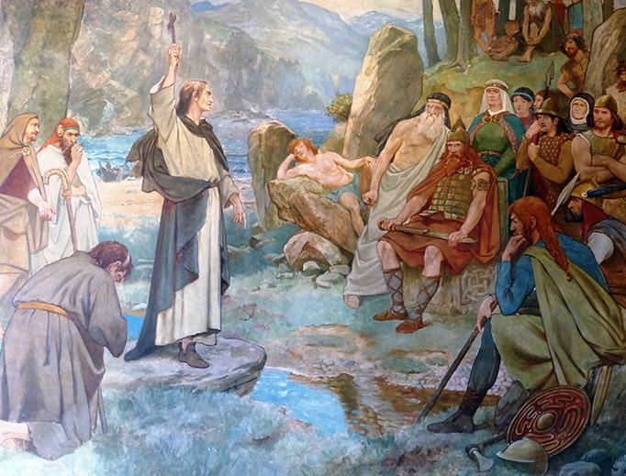
Columba
http://www.ncregister.com/blog/astagnaro/st.-columba-and-the-loch-ness-monster

Slide 12
*Columba
If Patrick was the “apostle of Ireland”, Columba (AD 521-97) has been called the “apostle of Scotland”.
Born in north-western Ireland, he was a presbyter-monk who established a number of churches and monasteries in his Irish homeland before crossing over to Scotland in AD 563.
Tall, beautiful, burning with physical energy, constantly singing the Psalms of David in a booming voice, fearless, and in love with travel and adventure, Columba summed up in his own person and life the essence of Celtic Christianity.
His missionary expedition to Scotland followed the normal Irish pattern – twelve missionaries under the leadership of a thirteenth, based on the twelve apostles under the leadership of Christ.
Needham, Nick. 2,000 Years of Christ's Power Vol. 1: The Age of the Early Church Fathers

Slide 13
*Columba
Columba and his team set up their headquarters on the tiny island of Iona, off the west coast of Scotland.
Needham, Nick. 2,000 Years of Christ's Power Vol. 1: The Age of the Early Church Fathers

Slide 14
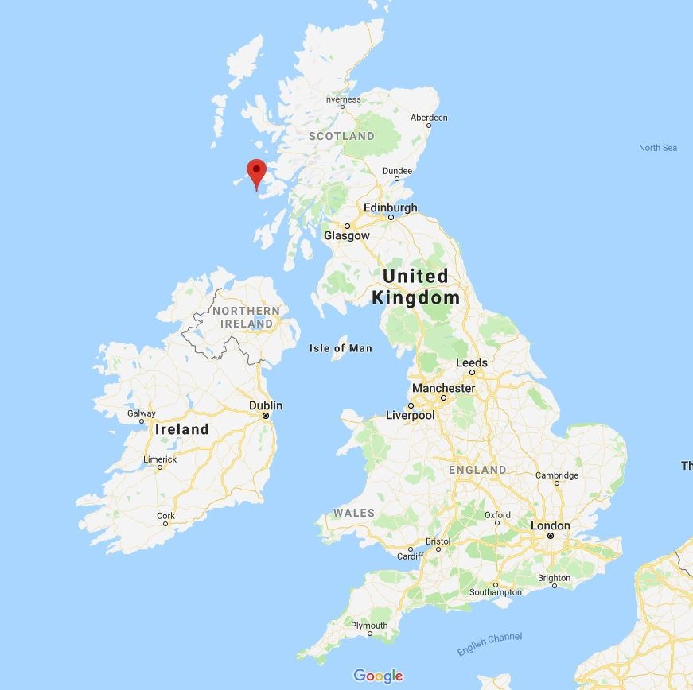
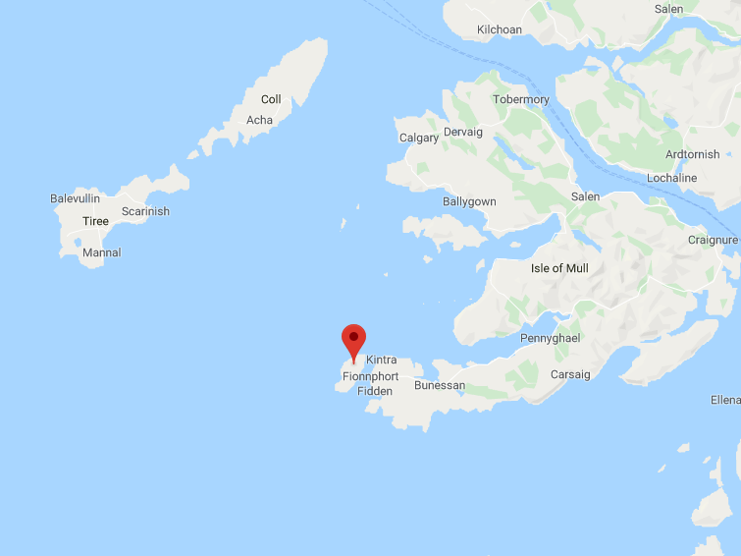
Iona

Slide 15
*Columba
Columba and his team set up their headquarters on the tiny island of Iona, off the Scottish west coast.
The monastery he founded there became one of the most successful centers of missionary work in the history of Christianity.
From Iona, Columba’s disciples planted churches and monasteries throughout Scotland and northern England; Iona became the spiritual capital of the whole region.
Among the northern Celtic Christians, the authority of the abbot of Iona carried far more weight than the word of the bishop of Rome.
Needham, Nick. 2,000 Years of Christ's Power Vol. 1: The Age of the Early Church Fathers

Slide 16
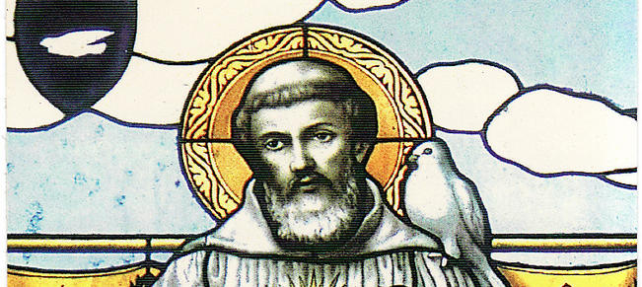
Columbanus
https://www.irelandsown.ie/st-columbanus-from-navan-to-bobbio/

Slide 17
*Columbanus
The handsome and hot-headed Columbanus was one of Western Europe's most successful evangelists ever.
According to Columbanus's first biographer, writing a mere 28 years after his subject's death, “Columbanus's fine figure, his splendid color, and his noble manliness made him beloved by all.”
And therein lay the problem: “He aroused…the lust of lascivious maidens, especially of those whose fine figure and superficial beauty are wont to enkindle mad desires in the minds of wretched men.”
As a young man, he was afraid he was on the brink of giving in to such vain “lusts of the world,” so he sought the guidance of a local female hermit.
Galli, Mark. 131 Christians Everyone Should Know (p. 232). B&H Publishing Group.

Slide 18
*Columbanus
“Away, O youth, away!” she advised. “Flee from corruption, into which, as you know, many have fallen.”
Columbanus left, shaken, went home and packed his things with the intention of taking up the monastic life.
When he told his mother he was leaving, she became so distraught, she blocked the doorway.
But Columbanus was undeterred, “leaping over both threshold and mother.”
Thus began his life of Christian ministry.
Galli, Mark. 131 Christians Everyone Should Know (p. 232). B&H Publishing Group.

Slide 19
*Columbanus
Columbanus studied under Comgall of Bangor, whose monastery was famous for its asceticism.
Not only did Columbanus thrive there, but he codified such asceticism into two rules for monasteries—one for individual monks, the other for communities.
These rules could be extremely harsh:
  Merely desiring to hit someone meant 40 days on bread and water.
  Actually hitting someone (and drawing blood) meant penance for three years.
  Even speaking ill of the rules meant exile from the community.
Galli, Mark. 131 Christians Everyone Should Know (p. 233). B&H Publishing Group.

Slide 20
*Columbanus
In about AD 590 Columbanus went as leader of a band of twelve missionaries to France, and labored in:
  Burgundy (south-eastern France)
  Constance (northern Switzerland
  Northern Italy where he founded the important monastery of Bobbio.
Famed for the purity and simplicity of his life and his outspoken courage in denouncing wickedness in high places (for which the unworthy king of Burgundy banished him), Columbanus was also one of the most learned men of his age, educated in Greek and Hebrew when the knowledge of these languages had almost died out in the West.
After his death, his disciples went on to evangelize Switzerland, Swabia and Franconia.
Needham, Nick. 2,000 Years of Christ's Power Vol. 1: The Age of the Early Church Fathers

Slide 21
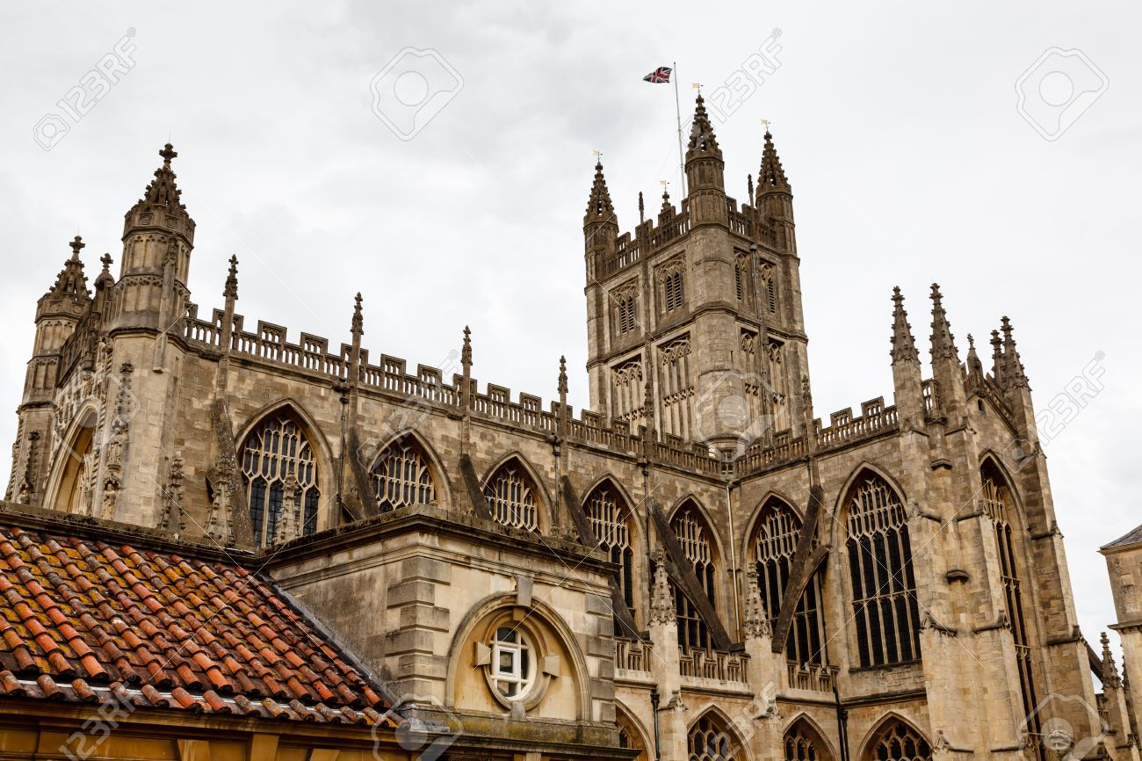
The Medieval Church
https://www.123rf.com/photo_15057019_bath-abbey-is-england-s-last-great-medieval-church.html

Slide 22
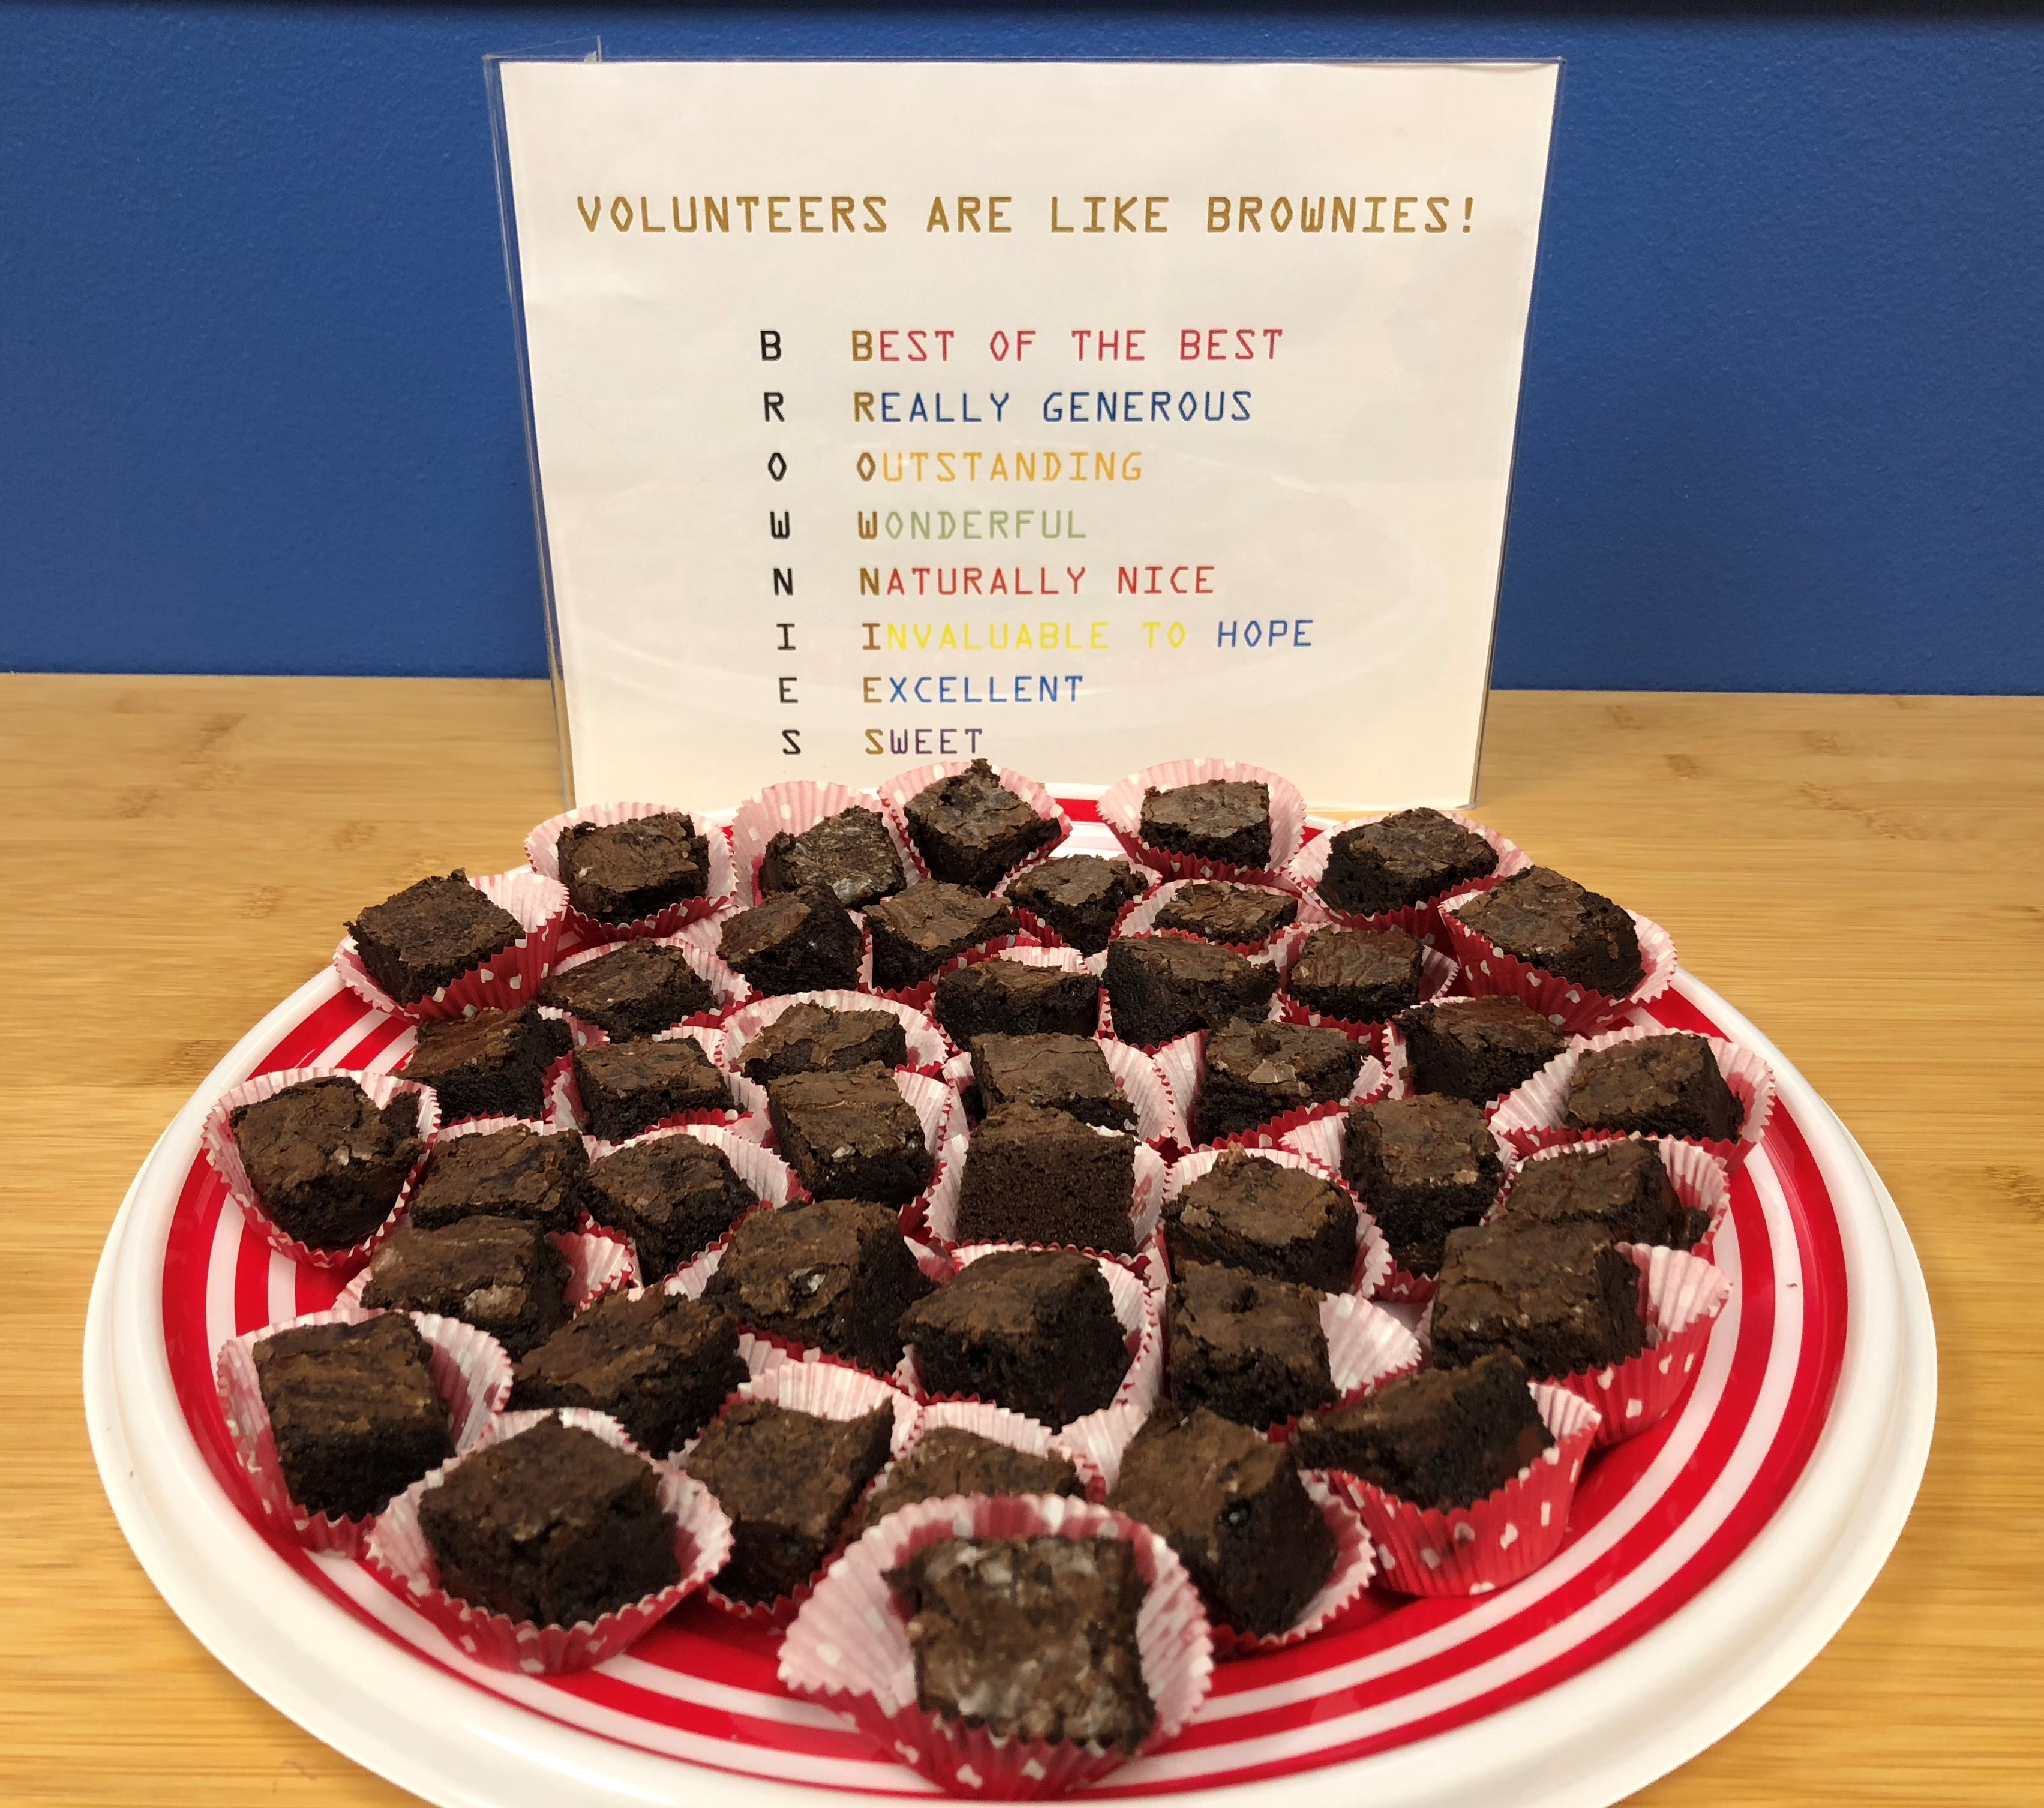
https://www.hopehelps.org/volunteer-appreciation-week-2018/

Slide 23

Class Discussion Time
https://www.weareteachers.com/moving-beyond-classroom-discussions/

Slide 24
*Class Discussion Time
Patrick was a nominal Christian until he was kidnapped and taken into slavery by Irish raiders. As a result of this experience, Patrick turned to God and eventually lead a missionary effort that resulted in the evangelism of an entire country. Have you seen a serious trial in your life or the life of someone you know that lead to a spiritual awakening?
Patrick was motivated by a dream that he had to return to Ireland as a missionary. What do we make of this? Was this God’s way of telling Patrick that He wanted him to go to Ireland? Is there a danger in seeing our dreams as a source of divine revelation?
Do you have a topic or question that you would like to see us to discuss?

