Slide 1


Slide 2
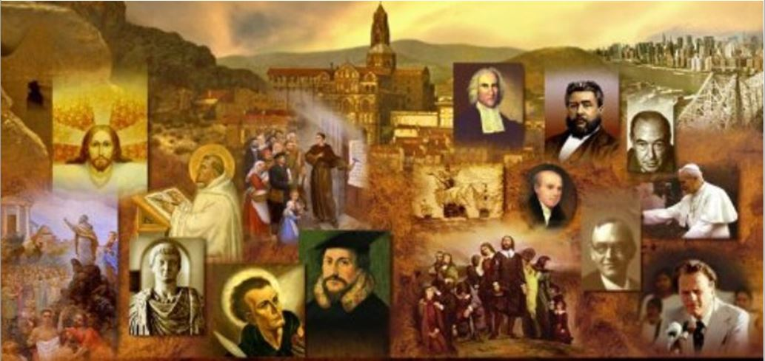
Review
Where did Gottschalk grow up as a child?
  His parents placed him in the abbey of Fulda when he was a child.
Of which great church Father did Gottschalk become a disciple?
  Augustine of Hippo
Which of Augustine's doctrines did Gottschalk begin teaching with passionate enthusiasm?
  His doctrines of sin, grace and predestination.
What two doctrinal ideas did Gottschalk espouse that seem to have even gone beyond Augustine’s view of predestination?
  “Limited atonement”
  The doctrine of “reprobation”
When Gottschalk was severely beaten and imprisoned for his views, men from which city defended him, as they and a number of others in this city held similar views?
  Lyons, France

Slide 3
Review
Last week we talked about a dispute that arose in the ninth century that concerned the relationship between the bread and wine of the Lord’s Supper and the flesh and blood of Christ’s human body.
Radbertus, a distinguished scholar, developed a view that closely resembles the teaching on this subject held by the Roman Catholic Church today. What did he say occurred with the communion elements during the mass when these element were presented?
  Radbertus argued that the bread and wine of communion were changed completely into the flesh and blood of Christ, so that the bread and wine no longer existed – they only seemed to be bread and wine, but in reality they were now entirely the flesh and blood of the Savior.
Radbertus further taught that when communion was celebrated, the very sacrifice of Christ’s flesh and blood on the cross of Calvary became miraculously present. What did he teach it was effective to do for the believer who partook of it?
  He taught it was effective for the washing away of sins.

Slide 4
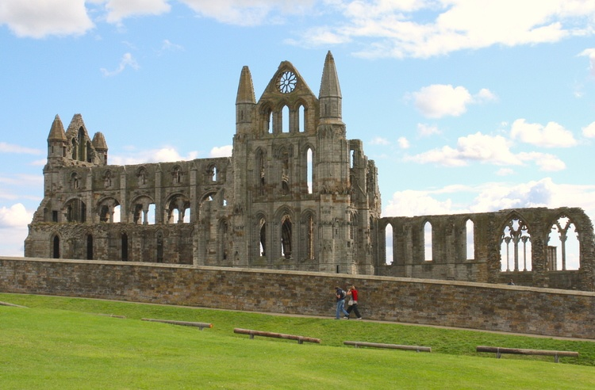
Medieval Monasteries
Whitby Abbey, North Yorkshire, England. Founded in the 7th century
https://www.ancient.eu/image/9703/whitby-abbey/

Slide 5
Medieval Monasteries
You can’t tell the story of medieval Christendom without talking about monasteries :¹
  They were a key part of the Medieval educational system.
  They were the primary means by which manuscripts were copied and ancient works were preserved.
  They were the main method by which Christianity was spread to pagan lands.
One of the most influential figures in Western monasticism was Benedict, of Nursia.²
Benedict’s greatest impact came through a written document known as the Rule that he gave to his monastic community.²
Although fairly brief, this document would determine the shape of monasticism for centuries.²
¹ James White – 2016 Church History Series #43 – Holy Roman Empire
² Gonzalez, Justo L.. The Story of Christianity: Volume 1: The Early Church to the Dawn of the Reformation pp. 277-278

Slide 6
Medieval Monasteries
Benedict was born in Nursia, about eighty-five miles northeast of Rome, late in the fifth century.¹
As a young man he adopted an extreme form of asceticism and lived as a hermit high in a lonely cave in wild country south of Rome.¹
He spent three years there in the study of the Scriptures and in severe self-denial, until the monks of a neighboring monastery chose him for their abbot, the fatherly spiritual leader of a monastic group.¹
In AD 529, on the heights of Monte Cassino, eighty-five miles southeast of Rome, he laid the foundations of what became the most famous monastery in Europe, the founding monastery of what would later become the Benedictine order.¹
Shortly thereafter his sister Scholastica settled nearby and founded a similar community for women.²
¹Shelley, Dr. Bruce L.. Church History in Plain Language: Fourth Edition (pp. 129-130)
²Gonzalez, Justo L.. The Story of Christianity: Volume 1: The Early Church to the Dawn of the Reformation (p. 278)

Slide 7
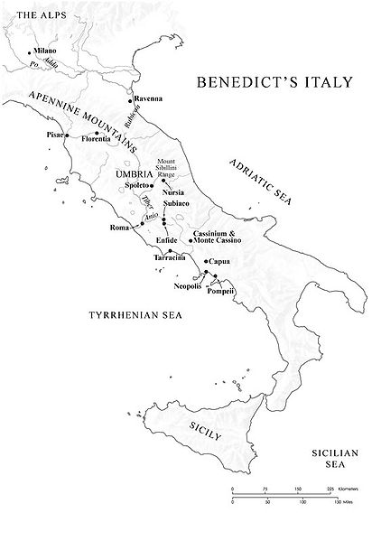
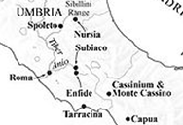
Benedict’s Italy
https://commons.wikimedia.org/wiki/File:Benedict%27s_Italy.jpg

Slide 8
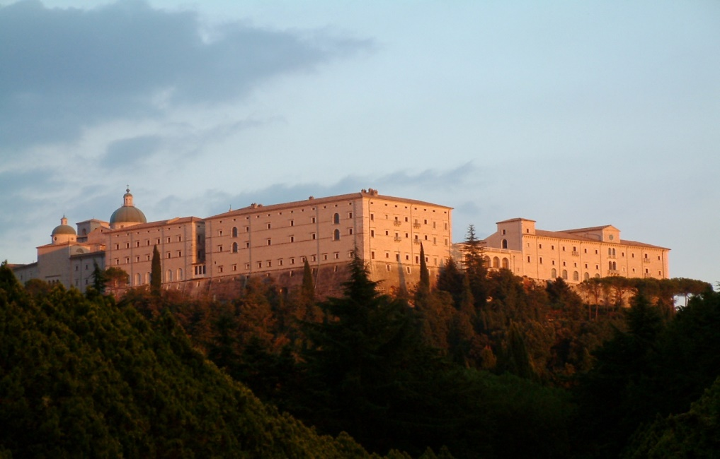
The Rebuilt Abbey of Monte Cassino
https://en.wikipedia.org/wiki/Monte_Cassino#/media/File:Monte_Cassino_Opactwo_1.JPG

Slide 9
Medieval Monasteries
It was for this monastery Benedict wrote his famous Rule. Here he taught, preached, and lived a pattern of monastic piety until his death in AD 542.
Benedict was no scholar, but he had the Roman genius for administration, an earnest belief in monasticism as the ideal Christian life, and a profound knowledge of people.
In drawing up his set of regulations— the Rule— he built on the work of earlier leaders of monasticism, but he revealed a sense of moderation and good judgment that came from keen observation of human nature.
Shelley, Dr. Bruce L.. Church History in Plain Language: Fourth Edition (pp. 129-130)

Slide 10
Medieval Monasteries
Rather than extreme asceticism, what the Rule seeks is a wise ordering of the monastic life, with strict discipline, but without undue harshness.
Thus, while many of the monks of the desert lived on bread, salt, and water, Benedict prescribed that his monks would have two meals a day, each with two cooked dishes, and at times with fresh fruits and vegetables.
Also, each monk was to receive a moderate amount of wine every day.
And, in addition to his bed, each monk should have a cover and a pillow.
All this was to be done only in times of abundance, for in times of scarcity monks should be content with whatever was available.
Gonzalez, Justo L.. The Story of Christianity: Volume 1: The Early Church to the Dawn of the Reformation pp. 277-278

Slide 11
Medieval Monasteries
The government of the monastery was vested in an abbot.¹
The abbot was chosen by the monks themselves, and he could decide major matters only after calling for the judgment of the whole body.¹
But the abbot was also to be obeyed “without delay.”²
This meant not only instant obedience, but also willing obedience.²
If what was commanded seemed impossible, the monk was to explain to the abbot why it was so.²
If, after hearing the explanation, the superior insisted on the command, it was to be obeyed as well as possible.²
¹Shelley, Dr. Bruce L.. Church History in Plain Language: Fourth Edition (pp. 129-130)
²Gonzalez, Justo L.. The Story of Christianity: Volume 1: The Early Church to the Dawn of the Reformation pp. 278-280

Slide 12
Medieval Monasteries
An errant monk was to be admonished secretly.
If after two such admonitions he did not repent, he was to be reprimanded before the community.
The next step was excommunication, which means being barred, not only from communion, but also from the meals in common and from every contact with the other monks.
If he was still unrepentant, he was to be whipped.
If even this was to no avail, he was to be sorrowfully expelled from the community. But, if he repented, he was to be received again.
This process could be repeated up to three times: after the third expulsion, the monastery would be forever closed to him.
Gonzalez, Justo L.. The Story of Christianity: Volume 1: The Early Church to the Dawn of the Reformation pp. 278-280

Slide 13
Medieval Monasteries
The Rule also insisted on physical labor, which was to be shared by all.¹
Except in exceptional cases of illness or of unique gifts, all would take turns in every task.¹
Benedict prescribed that each monastery, wherever feasible, should be equipped to furnish all the necessities of life.²
Monks wove their own cloth, made their own wine, and were their own carpenters and masons.²
Benedict considered wandering outside the walls of the monastery to be a great spiritual danger for a monk. ²
¹Gonzalez, Justo L.. The Story of Christianity: Volume 1: The Early Church to the Dawn of the Reformation pp. 280-281
²Shelley, Dr. Bruce L.. Church History in Plain Language: Fourth Edition (pp. 130-131)

Slide 14
Medieval Monasteries
The core of the monastic life as Benedict conceived it was prayer.
Periods were assigned each day for private prayer, but most of the devotions took place in the chapel.
There the monks were to gather eight times a day: seven during the daytime, and once in the middle of the night, for the Psalmist says: “seven times a day I praise thee” (Ps. 119: 164) and “At midnight I rise to praise thee” (Ps. 119: 62).
So, the first gathering for prayer took place in the early hours of dawn, and was followed by seven others throughout the day.
Most of the time at each of these gatherings was devoted to reciting the Psalms (which they read through in the course of a week) and to readings of other portions of scripture.
Gonzalez, Justo L.. The Story of Christianity: Volume 1: The Early Church to the Dawn of the Reformation pp. 280-281

Slide 15
Medieval Monasteries
Benedict’s most fruitful requirements were regarding labor. “Idleness,” he said in the Rule, “is hostile to the soul, and therefore the brethren should be occupied at fixed times in manual labor, and at definite hours in religious reading.”
He saw clearly the moral value of work; and he was broad-minded enough in his conception of labor to include work of the mind as well as work of the hands.
The proportion naturally varied with the seasons.
In the harvest time of summer the manual labor of the fields came first, but in the comparative rest of winter, especially in Lent, opportunities for reading increased.
Shelley, Dr. Bruce L.. Church History in Plain Language: Fourth Edition (pp. 130-131)

Slide 16
Medieval Monasteries
A Benedictine monastery that was true to the purposes of its founder was, therefore, “a little world in itself, in which the monks lived a strenuous but not overburdened life, involving worship, vigorous labor in the shop and fields, and serious reading.”
Every Benedictine monastery included a library.
Benedictine monks copied and read the great literary works of Latin antiquity.
We are indebted to them for preserving the writings of the Latin church fathers and the masterpieces of Roman literature.
Shelley, Dr. Bruce L.. Church History in Plain Language: Fourth Edition (pp. 130-131)

Slide 17
Medieval Monasteries
Monasteries also became teaching centers, particularly for the many children who were placed under its care in order to be trained as monks.
They also served as hospitals and pharmacies, or as hostels where a weary traveler could find shelter.
Eventually, monasteries also had a profound economic impact, for many were established on marginal lands that were brought into production by the labor of the monks.
Furthermore, in a society where the wealthy considered manual labor demeaning, the monasteries showed that the highest intellectual and spiritual achievements could be coupled with hard physical labor.
Gonzalez, Justo L.. The Story of Christianity: Volume 1: The Early Church to the Dawn of the Reformation pp. 280-281

Slide 18
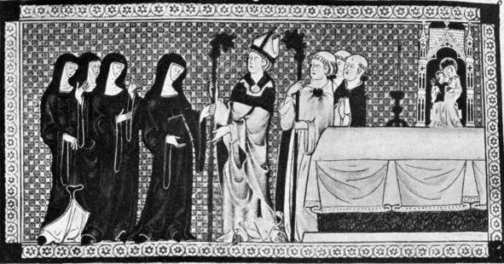
Medieval Nunneries
https://www.gutenberg.org/files/39537/39537-h/39537-h.htm

Slide 19
Medieval Nunneries
Perhaps more than half of the Medieval monasteries were devoted solely to women.
These monasteries for women were referred to as “nunneries” and the women who inhabited them were called “nuns”.
The rules and lifestyle within a nunnery were very similar to those in a male monastery.
Nuns took vows of chastity, renounced worldly goods and devoted themselves to prayer, religious studies and helping society's most needy.
Many nuns produced religious literature and music as well.
https://www.ancient.eu/article/1298/the-daily-life-of-medieval-nuns/

Slide 20
Medieval Nunneries
Women joined a nunnery primarily because of piety and a desire to live a life which brought them closer to God.
But there were sometimes more practical considerations, especially concerning aristocratic women, who were the principal source of recruits (much more so than aristocratic men were a source for monks).
A woman from the aristocracy, at least in most cases, really had only two options in life: marry a man who could support her or join a nunnery.
For this reason, nunneries were never short of recruits and by the 12th century they were just as numerous as male monasteries.
Young girls were often sent by their parents to nunneries in order to gain an education – the best one available to girls in the medieval world.
https://www.ancient.eu/article/1298/the-daily-life-of-medieval-nuns/

Slide 21
Medieval Nunneries
The nuns were led by an abbess who had absolute authority and who was often a widow with some experience of managing her deceased husband’s estate before she joined the nunnery.
Unlike monks, a nun (or any woman for that matter) could not become a priest and for this reason services in a nunnery required the regular visit of a male priest.
A nun was expected to wear simple clothing as a symbol of her shunning of worldly goods and distractions.
The long tunic was typical attire, with a veil to cover all but the face. The veil hid the nun’s hair which had to be kept cut short.
https://www.ancient.eu/article/1298/the-daily-life-of-medieval-nuns/

Slide 22
Medieval Nunneries
The daily routine of a nun was much like a monk's: she was required to attend various services throughout the day and say prayers for those in the outside world – in particular for the souls of those who had made donations to the nunnery. ¹
Nuns also spent a lot of time reading, writing and illustrating, especially small devotional books, compendiums of prayers, guides for religious contemplation, etc. ¹
One very interesting fact: the nuns had a running battle with the bishops over one important issue: whether you could have pets in your room. ²
¹https://www.ancient.eu/article/1298/the-daily-life-of-medieval-nuns/
²James White – 2016 Church History Series #43 – Holy Roman Empire

Slide 23
Medieval Nunneries
Unlike monks, nuns performed tasks of needlework such as embroidering robes and textiles for use in church services.
Nuns gave back to the community through charitable work, especially distributing clothes and food to the poor on a daily basis.
Besides giving out alms, nuns often acted as tutors to children, they looked after the sick, helped women in distress and provided hospice services for the dying.
Nunneries thus tended to be more closely related to their local communities than male monasteries were and nunneries tended to be located in more urban settings rather than physically remote places.
https://www.ancient.eu/article/1298/the-daily-life-of-medieval-nuns/

Slide 24
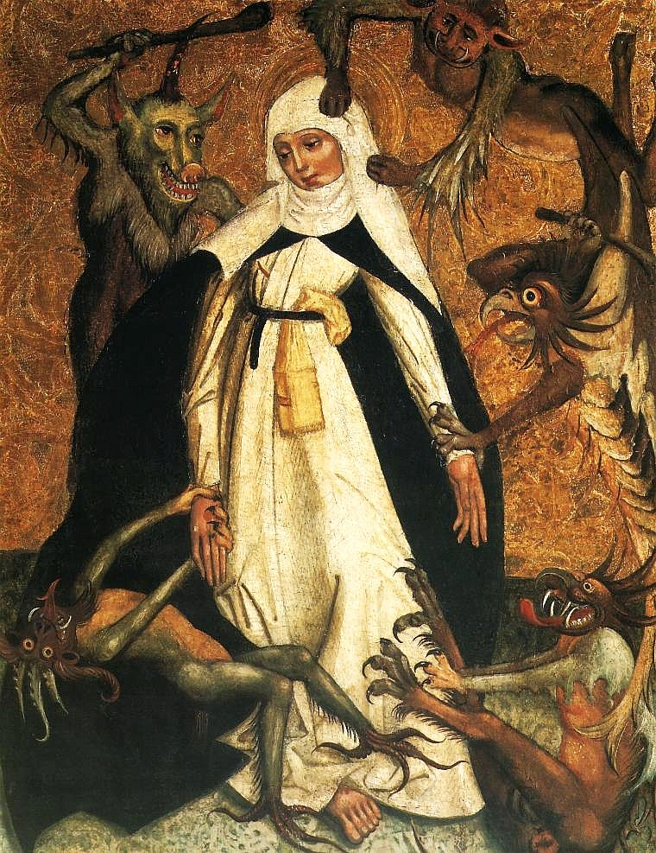
Corruption in the
Medieval Church
St Catherine and the Demons by an unknown artist, c. 1500, National Museum, Warsaw.
https://en.wikipedia.org/wiki/Catherine_of_Siena#/media/File:Lesser_Poland_St._Catherine_of_Siena.jpg

Slide 25

https://www.hopehelps.org/volunteer-appreciation-week-2018/

Slide 26

Class Discussion Time
https://www.weareteachers.com/moving-beyond-classroom-discussions/

Slide 27
*Class Discussion Time
The monks were to gather eight times a day: seven during the daytime, and once in the middle of the night, for the Psalmist says: “seven times a day I praise thee” (Ps. 119: 164) and “At midnight I rise to praise thee” (Ps. 119: 62).
Do the scriptures teach that we are to pray seven times a day and at least once at midnight? Explain your answer.
We have seen where the monasteries provided many beneficial services to the ancient societies: preservation of knowledge, education, caring for the sick and needy. Who primarily meets these needs in our day? Are we better off? Why or why not?
This week we have looked at many of the positive aspects of monasteries. The Reformers had a very negative view of monasteries and essentially did away with them. Were the reformers right in doing this? Do you see any negative aspects of monasticism? If so what?
Do you have a topic or question that you would like to see us to discuss?

