Slide 1


Slide 2
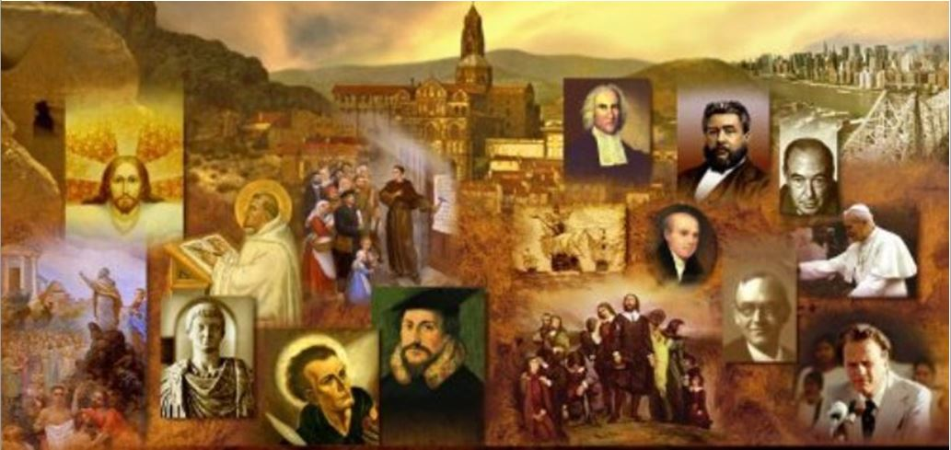
Review
What city was the Eastern Roman Empire centered on?
Constantinople
What are some of the differences between an Eastern Orthodox worship service and a worship service in a typical Protestant or Roman Catholic Church?
No pews – people stand for the service
No pulpit
No organ (or any other musical instrument)
What purpose do “icons” (flat two-dimensional images of Christ, Biblical characters, and Orthodox saints) serve in the mind of Eastern Orthodox worshippers?
The icons are believed by the Orthodox to be a window into the heavenly worship, revealing the presence of the saints and angels.
What is the largest Eastern Orthodox Church in the world?
The Russian Orthodox Church

Slide 3
Review
What was the most powerful and prosperous city in Russia in the 10th century?
Kiev
Where did Russia get its name?
it means “land of the Rus”, i.e. the pagan Rus that lived there
How were the early Russians originally exposed to Christianity
Trading with the Christians in the Byzantine Empire
What religions was Prince Vladimir considering when he ended up deciding to become an Orthodox Christian?
Judaism
Islam
Roman Catholicism
Eastern Orthodoxy
What was it that attracted him to Eastern Orthodox over Roman Catholicism?
The beauty of their worship

Slide 4
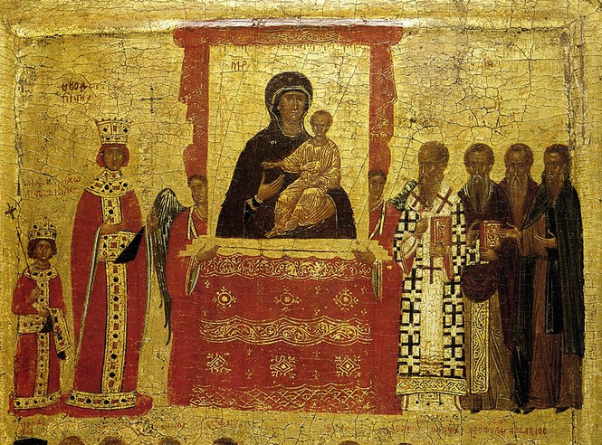
The Iconoclast Controversy
https://en.wikipedia.org/wiki/Byzantine_Iconoclasm#/media/File:Triumph_orthodoxy.jpg

Slide 5
The Iconoclast Controversy
In the 8th and 9th centuries, a dispute over the use of religious images (icons) arose in the Byzantine Empire .
A group known as Iconoclasts (“image breakers”) objected to icon veneration for several reasons, including the Old Testament prohibition against images in the Ten Commandments (Exodus 20:4) and the possibility of idolatry.
In response, a group known as Iconodules (those who supported the veneration of religious icons) held that the 2nd Commandment forbids the making of Pagan icons and images of false gods, not icons of Christ who is the Truth.
Needham, Nick. 2,000 Years of Christ's Power Vol. 2: The Middle Ages

Slide 6
The Iconoclast Controversy
The Iconodules further pointed out that God positively sanctioned many icons in the Old Testament system of worship:
Golden cherubim over the ark of the covenant (Exod. 25: 18-22),
Cherubim woven into the tabernacle curtain (Exod. 26: 31-32),
Pomegranates woven into the high priest’s robe (Exod. 28: 33-34),
Olive-wood cherubim in the inner sanctuary of the temple (1 Kings 6: 23-28),
Carved figures of cherubim, palm trees and open flowers on the temple walls and doors (1 Kings 6: 29-35),
Twelve bronze oxen carrying the bronze sea, and the bronze carts with carved oxen, lions and cherubim, in the temple court (1 Kings 7: 23-51),
The brazen serpent which was a symbol of the crucified Christ (Num. 21: 8-9, John 3: 14-15).
Needham, Nick. 2,000 Years of Christ's Power Vol. 2: The Middle Ages

Slide 7
The Iconoclast Controversy
Iconodules maintained that they did not actually worship the icon itself; it would indeed be idolatry to worship a picture.
They worshipped, not the physical substance of the icon, but the adorable person represented by the icon.
Part of the dispute centered around what was best for uneducated people who could not read.
Iconoclasts said that icons would lead such people astray into idolatry: they would worship the icon as if it were a divine object.
Iconodules, by contrast, argued that icons served as “books” for those who couldn’t read: they portrayed the people and stories of the Bible and early Church history, so that the illiterate could see and learn about them.
Needham, Nick. 2,000 Years of Christ's Power Vol. 2: The Middle Ages

Slide 8
The Iconoclast Controversy
Prior to the eighth century, the use of icons steadily gained in popularity, especially in the eastern provinces of the Roman Empire.
But in AD 726, the Byzantine emperor Leo III took a public stand against what he perceived to be the worship of icons, and in AD 730 their use was officially prohibited.
In the reign of Leo’s successor, Constantine V (AD 741–775) there was a severe persecution of icon venerators.
In AD 787, however, the empress Irene convoked the seventh ecumenical council at Nicaea at which Iconoclasm was condemned and the use of images was reestablished.
https://www.britannica.com/event/Iconoclastic-Controversy

Slide 9
The Iconoclast Controversy
The Iconoclasts regained power in AD 814 after Leo V’s accession, and the use of icons was again forbidden at a council in AD 815.
The second Iconoclast period ended with the death of the emperor Theophilus in AD 842.
In AD 843 his widow finally restored icon veneration, an event still celebrated in the Eastern Orthodox Church as the Feast of Orthodoxy.
https://www.britannica.com/event/Iconoclastic-Controversy

Slide 10
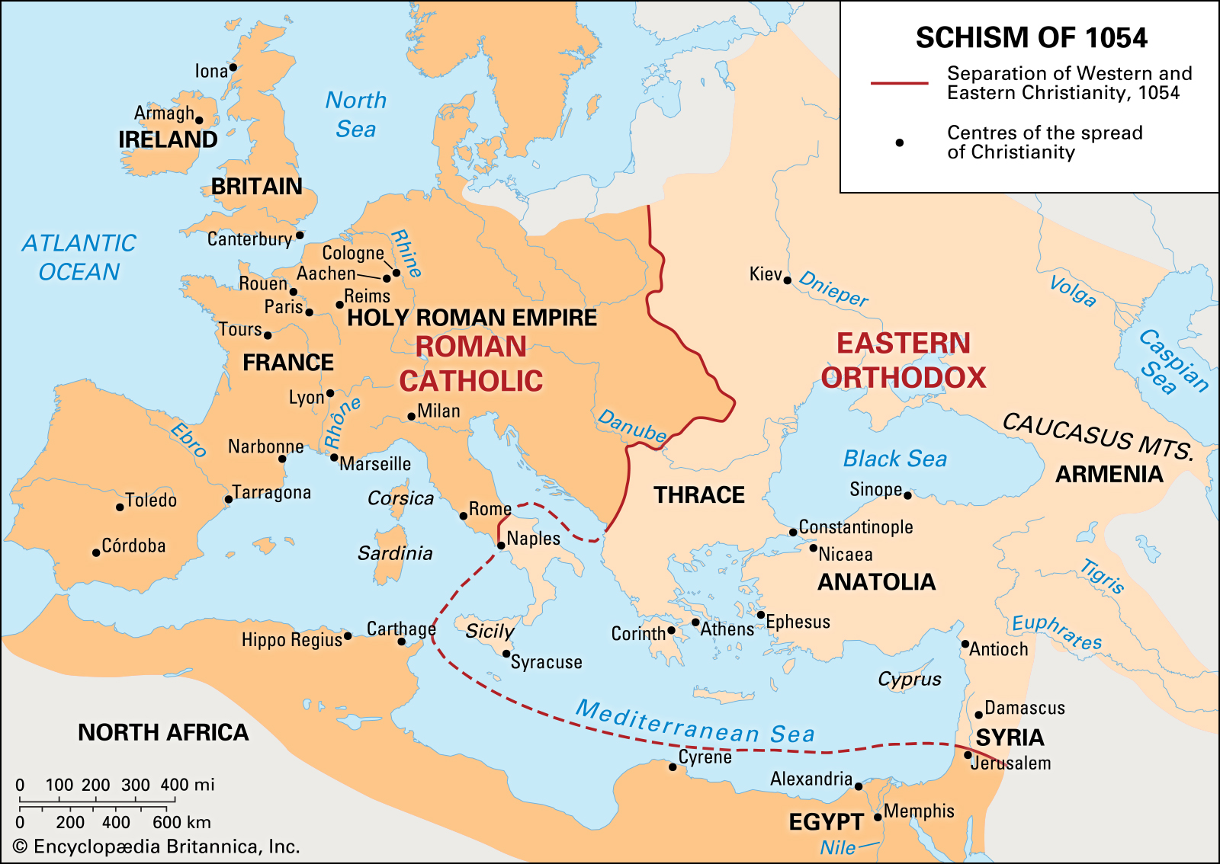
The East West Schism of 1054
https://www.britannica.com/event/East-West-Schism-1054

Slide 11
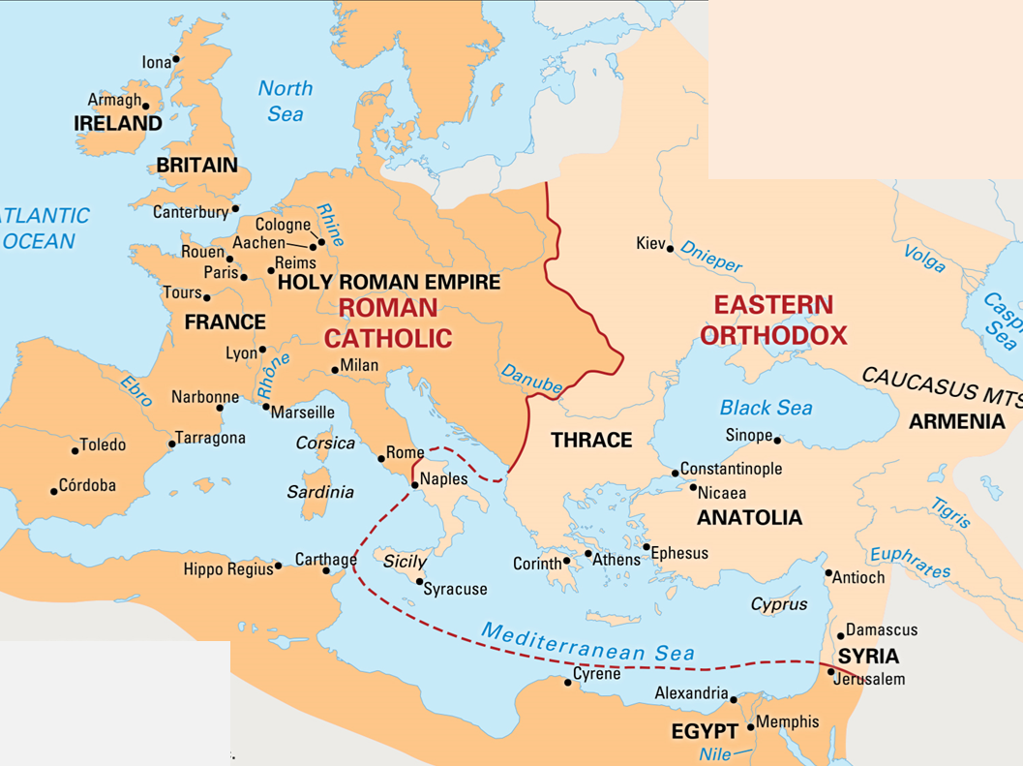
The East West Schism of 1054
The Eastern and Western wings of the one universal Church had been drifting apart ever since the fall of the Roman Empire in the West in 410.
East and West spoke different languages (Greek in the East, Latin in the West – someone once made the witty comment that “East and West did not understand each other, because they did not understand each other”).
They operated in different cultural and political worlds:
The Eastern Church within the ancient Christian Byzantine Empire
The Western church within the new Germanic and Norse kingdoms, comparatively uncivilized, and only just converted from Arianism and Paganism
Needham, Nick. 2,000 Years of Christ's Power Vol. 2: The Middle Ages

Slide 12
The East West Schism of 1054
Over the centuries, a great many differences, disagreements and misunderstandings had grown up between Eastern and Western Christendom.
These included the following:
The Rivalry Between Rome and Constantinople
Differences in Religious Practice
Theological Differences
Needham, Nick. 2,000 Years of Christ's Power Vol. 2: The Middle Ages

Slide 13
Rivalry Between Rome and Constantinople
During the Middle Ages, Rome’s claims became ever more exalted.
The popes began by claiming a place of special honor among bishops; they ended by claiming absolute authority over the entire Church.
The East denied the papacy’s claims, rejecting the idea that the Church has a visible earthly head
Instead, they held that the five ancient patriarchs of Rome, Constantinople, Antioch, Jerusalem, and Alexandria should together offer leadership to Christians.
Needham, Nick. 2,000 Years of Christ's Power Vol. 2: The Middle Ages

Slide 14
Differences in Religious Practice
Celibacy of the Priesthood
The West did not allow priests to marry.
The East allowed them to marry prior to ordination, and almost all Eastern priests were, in fact, married men (although bishops had to be celibate).
Communion
The West used unleavened bread in communion.
The East used leavened bread.
Facial Hair
East – tendency towards the full beard
West – not the practice
Needham, Nick. 2,000 Years of Christ's Power Vol. 2: The Middle Ages

Slide 15
Differences in Religious Practice
Baptism
The East held that threefold immersion was the only valid form of baptism.
The West considered threefold immersion, single immersion, and pouring as all being valid modes of baptism, although pouring increasingly became the Western norm.
The Date of the Celebration of Easter
East – Passover
West – Starting with Victor, varied all over the place
The Date of the Celebration of Christmas
West – December 25
East – January 6
Needham, Nick. 2,000 Years of Christ's Power Vol. 2: The Middle Ages

Slide 16
Differences in Religious Practice
Statues and Icons
In the West, by this time, there was veneration not only of two-dimensional pictures (known in the East as “icons”) but also three-dimensional statues of Christ, Mary, saints, and angels.
In the thought of the Eastern Church, statues cannot represent spiritual realities, because a statue belongs to this present world too much – it is too solid and material and “in the world”, and therefore liable to lead people astray into worshipping the statue itself.
People are less likely to worship a flat two-dimensional icon of Christ or a saint (the East argues), because it is more obviously a mere image of a higher spiritual reality. Eastern iconography (the painting of icons) underlined this point by deliberately refusing to depict Christ and the saints in a realistic manner.
Needham, Nick. 2,000 Years of Christ's Power Vol. 2: The Middle Ages

Slide 17
Theological Differences
Purgatory and Indulgences in the West
The West held that some aspects of sin’s penalty could be removed on earth by penance or by an indulgence.
If a believer died without paying all the punishment he owed, he had to pay off his outstanding debt by sufferings in the fire of purgatory.
However, the pope had the power to release souls from purgatory, because God had given the papacy control over the “treasury of merits” of the saints.
The pope could transfer these merits to souls in purgatory by means of an indulgence, thus paying off their temporal punishment for them and releasing them.
Needham, Nick. 2,000 Years of Christ's Power Vol. 2: The Middle Ages

Slide 18
Theological Differences
Purgatory and Indulgences in the East
By contrast, the East denied the existence of purgatory, rejected the idea that the righteous were punished after death, and did not believe either in the “treasury of merits” or in indulgences.
However, Easterners did accept that true believers, whose Christian lives had fallen seriously short of God’s standards, would not be immediately admitted into heaven; they would have to wait in a condition of shadow and sorrow until God had mercy on them.
Still, no punishment, no torment, and no purifying fire were involved.
All the Church on earth could do was pray humbly and lovingly for these souls, especially at holy communion; but neither the pope nor anyone else on earth had any spiritual power over them – this was the prerogative of Christ alone.
Needham, Nick. 2,000 Years of Christ's Power Vol. 2: The Middle Ages

Slide 19
Theological Differences
Consequences of Original Sin in the West
In Western thinking, dominated as it was by Augustine’s theology, the doctrine of original sin was central.
For Western theologians, all human beings were born with the guilt and corruption of Adam’s sin resting upon them.
Salvation was therefore understood as being fundamentally a deliverance from the debt of guilt and the stain of depravity.
Death was the consequence of sin; the atoning work of Christ dealt with sin and thereby conquered death.
Needham, Nick. 2,000 Years of Christ's Power Vol. 2: The Middle Ages

Slide 20
Theological Differences
Consequences of Original Sin the East
In Eastern thought, the fundamental problem was perceived as death rather than sin.
“Original sin”, for Easterners, referred to the grip that death had on human nature through Adam’s sin; they rejected any idea of Adam’s guilt being imputed to his descendants.
Salvation, accordingly, meant liberation from the objective power of death.
Given these differing outlooks, it is not surprising that Western piety came to be centered increasingly on the cross of Christ, whereas Eastern piety tended to focus more on His resurrection.
Needham, Nick. 2,000 Years of Christ's Power Vol. 2: The Middle Ages

Slide 21
Theological Differences
The Filioque Clause in the Nicene Creed
The East held that in the inner life of the Trinity, the Holy Spirit proceeds from the Father alone, whereas the West maintained that the Spirit proceeds from the Father and the Son (filioque).
The East also objected profoundly to the way that the West had inserted the filioque clause into the Nicene Creed, thus altering the first and greatest of the Church’s ecumenical Creeds.
Needham, Nick. 2,000 Years of Christ's Power Vol. 2: The Middle Ages

Slide 22
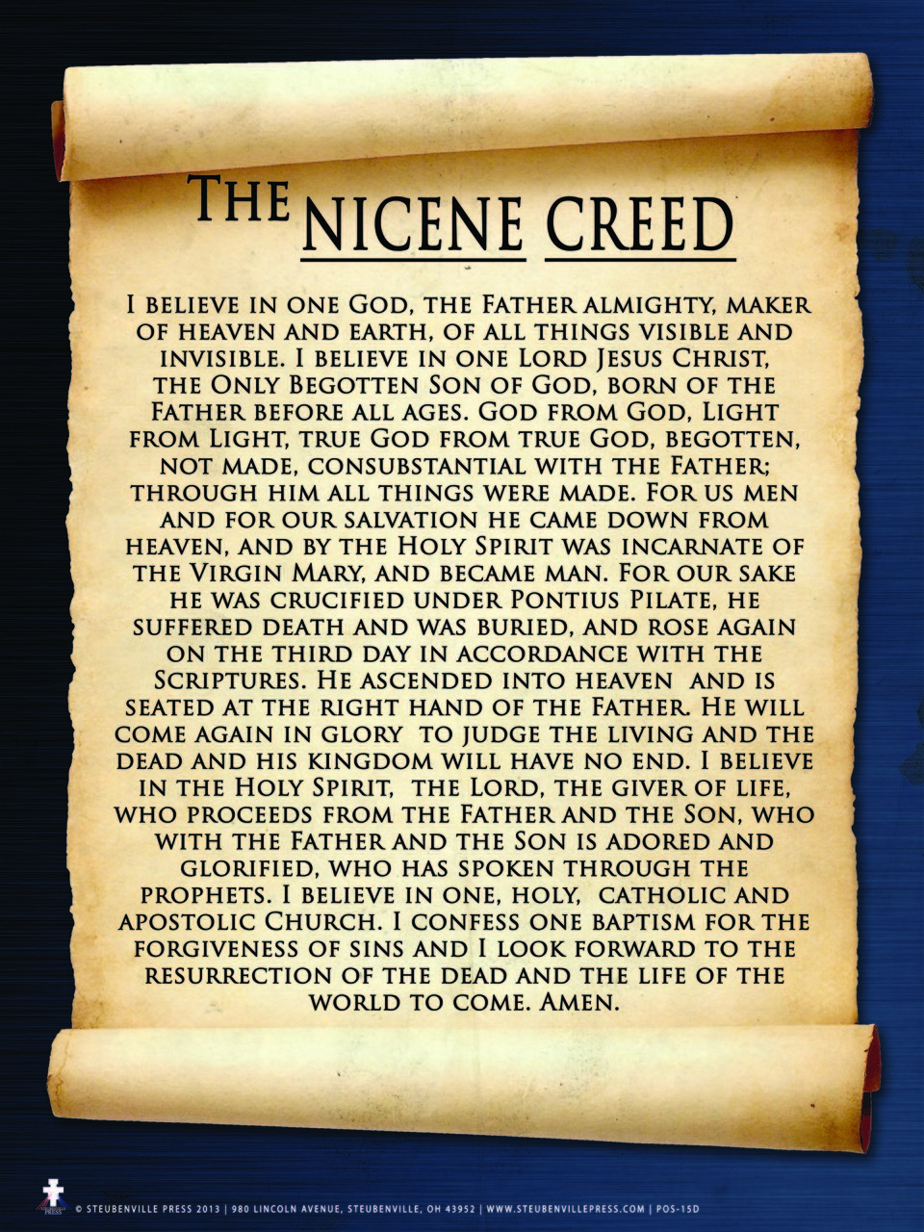

Slide 23
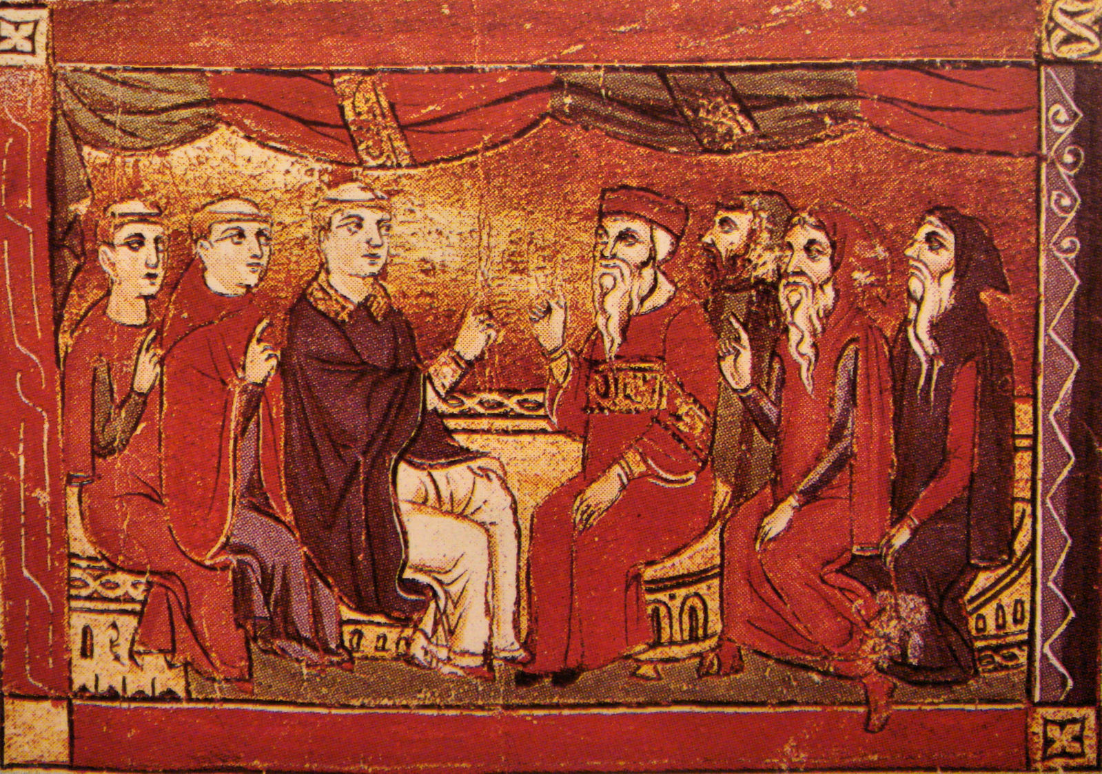
The Final Split Between East and West
http://wp.production.patheos.com/blogs/jappersandjanglers/files/2016/07/DebateBetweenCatholicsAndOrientalChristiansInThe13thCenturyAcre1290.jpg

Slide 24

https://www.hopehelps.org/volunteer-appreciation-week-2018/

Slide 25

Class Discussion Time
https://www.weareteachers.com/moving-beyond-classroom-discussions/

Slide 26
*Class Discussion Time
Scripture teaches:
You shall not make for yourself a carved image, or any likeness of anything that is in heaven above, or that is in the earth beneath, or that is in the water under the earth. You shall not bow down to them or serve them, for I the LORD your God (Exodus 20:4-5)
Flee from idolatry. (1Co 10:14)
Keep yourselves from idols (1 Jn. 5:21)
Do these or other related scriptures prohibit us from:
Having religious art (such as pictures or statues) in our homes or in the public square:
To commemorate Jesus, historical Christians, or historical events?
To aid in teaching about God, historical Christians, or historical events?
Having religious art in our church buildings to aid in our worship or to elevate religious feelings?
Bowing before a statue or picture of Jesus while you pray to him?
Do you have a topic or question that you would like to see us to discuss?

