Slide 1


Slide 2
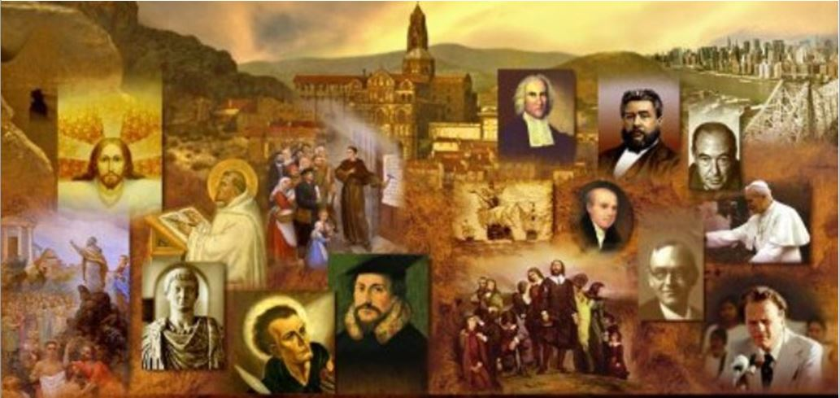
Review
In what year did the final split between the Eastern and Western Church take place?
  1054
What is a Papal Bull?
  an official papal document
To what city and church was the Papal Bull excommunicating the Eastern Church delivered?
  In Constantinople to the church of Hagia Sophia (which means “Holy Wisdom”)
What were the Crusades and what was their original purpose?
  The Crusades were a series of military expeditions to the Middle East by Western Catholics, inspired and blessed by the Catholic Church, with the aim of recapturing the Holy Land (especially Jerusalem) from the Muslims.

Slide 3
Review
What event originally triggered the Crusades?
  The great Byzantine Emperor Alexius I Comnenus appealed to Pope Urban II for help in fighting the Seljuk Turks.
What event took place in 1055 that enraged the Western Catholics and made them want to drive the Muslims out of the Holy land?
  The Seljuk Turks took control of the Holy Land and began to persecute Christians on their pilgrimages to the Holy Land.
Name some of the other reasons Western Catholics were motivated to carry on the Crusades.
  There was a growing feeling in the West at this time that the forces of Christianity could defeat and expel the Muslims from Christian lands they had conquered.
  They wanted to free the tomb of Christ from the Muslims, as an act of devotion to their Savior.
  The papacy also offered heavenly rewards to the Crusading knights, promising them complete pardon from all the “temporal penalties” of their sins.
  To win land and achieve military glory for themselves

Slide 4
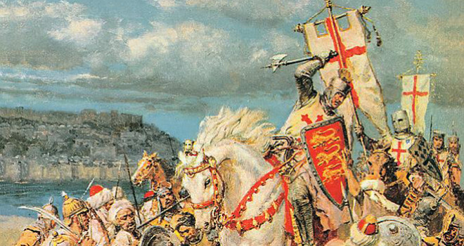
The History of the Crusades
https://www.crisismagazine.com/2015/history-crusades-obama-read

Slide 5
The History of the Crusades
Although we divide up the Crusades into a number of separate expeditions, we must remember that after the First Crusade there was a constant trickle of Catholic soldiers going to the Holy Land to join the Crusaders who were already there, to defend and extend the territory they had already won from the Turks.
Fighting was going on all the time. What we call “the First Crusade”, “the Second Crusade”, etc., were the times when the West made specific and concentrated attempts at destroying Turkish power.
Needham, Nick. 2,000 Years of Christ's Power Vol. 2: The Middle Ages

Slide 6
The First Crusade, 1096-99
The First official Crusade was an impressive assembly of Western Europe’s greatest French and Norman nobles.
Unfortunately the Crusaders appointed no single commander, and the expedition was cursed by constant quarrelling among the various leaders.
The character of those leading this Crusade varied:
  Some of the them were men of integrity, who were praised by their own generation as the perfect models of chivalrous Christian knights.
  But many of them were severely lacking in Christian integrity.
Needham, Nick. 2,000 Years of Christ's Power Vol. 2: The Middle Ages

Slide 7
The First Crusade, 1096-99
The Crusading armies gathered at Constantinople in the winter and spring of 1096-97.
It was a huge force – as many as 300,000, according to some estimates.
They arrived at just the right time: the empire of the Seljuk Turks had broken up into warring factions.
The disunity of the Turks enabled the Crusaders to defeat the separate Turkish forces one by one.
The Crusaders began by recapturing Nicaea from the Turks in 1097.
They defeated a Turkish army at Dorylaeum in July.
Needham, Nick. 2,000 Years of Christ's Power Vol. 2: The Middle Ages

Slide 8
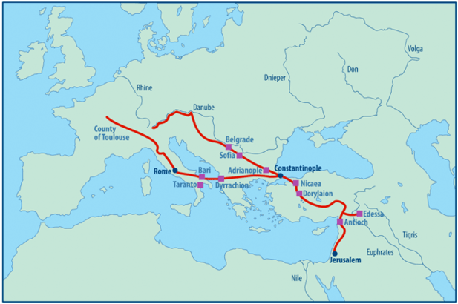
The First Crusade Routes
https://www.ancient.eu/image/9023/map-of-the-first-crusade-routes/

Slide 9
The First Crusade, 1096-99
The siege of Antioch was a difficult enterprise.
Those being besieged in Antioch had more supplies than the crusaders, who were about to run out of food and had been plagued by desertions.
But then, in an unexpected stroke of providential good fortune, an Armenian Christian who resided in the city opened a gate to them!
With a cry of “God wills it,” the crusaders charged into the city, while its Turkish defenders sought refuge in the citadel.
But then, four days later, a large Turkish army showed up, and the crusaders found themselves besieged while the citadel itself had not yet surrendered to them.
Hungry and discouraged, the crusaders began to doubt the wisdom of the entire enterprise.
Gonzalez, Justo L.. The Story of Christianity: Volume 1: The Early Church to the Dawn of the Reformation (pp. 347-348).

Slide 10
The First Crusade, 1096-99
But then one of the crusaders claimed to have a vision, that the Holy Lance with which Christ’s side had been pierced lay buried in Antioch.
So they went and dug in the place where the seer had told them that the Lance was buried, and lo and behold they found a spear!
Convinced that this was the Holy Lance, the crusaders resolved to continue their enterprise.
After five days of fasting and prayer, as indicated by the visionary who had told them where to dig, they attacked the much larger Turkish army that surrounded the city, while holding high the standard of the Holy Lance.
They were possessed of such frenzied zeal that the Turks broke and ran, and the crusaders helped themselves to all the provisions that the Turks had brought with them.
Gonzalez, Justo L.. The Story of Christianity: Volume 1: The Early Church to the Dawn of the Reformation (pp. 347-348).

Slide 11
The First Crusade, 1096-99
It then took the Crusaders another year to reach Jerusalem, by which time their forces had been reduced by battle, famine, and pestilence to a mere 20,000 men.
But it was enough: they captured Jerusalem in June 1099 after a siege of six weeks.
Once inside the Holy City, the Crusaders spared no-one; they carried out a merciless massacre of its entire Muslim and Jewish population, including women and children.
Needham, Nick. 2,000 Years of Christ's Power Vol. 2: The Middle Ages

Slide 12
The First Crusade, 1096-99
The military results of the First Crusade were the restoration of western Asia Minor to Byzantine rule, and the setting up of four independent “Crusader states” in Syria and Palestine.
These are often called the “Latin” kingdoms because their rulers belonged to the Latin-speaking Catholic Church.
The jewel of the Latin kingdoms was Jerusalem.
One of the conquering knights, Godfrey of Bouillon, was offered the title “king” of Jerusalem, but refused to wear a crown of gold in the city where his Lord had worn a crown of thorns.
Instead he took the more lowly title “Defender of the Holy Tomb”.
Needham, Nick. 2,000 Years of Christ's Power Vol. 2: The Middle Ages

Slide 13
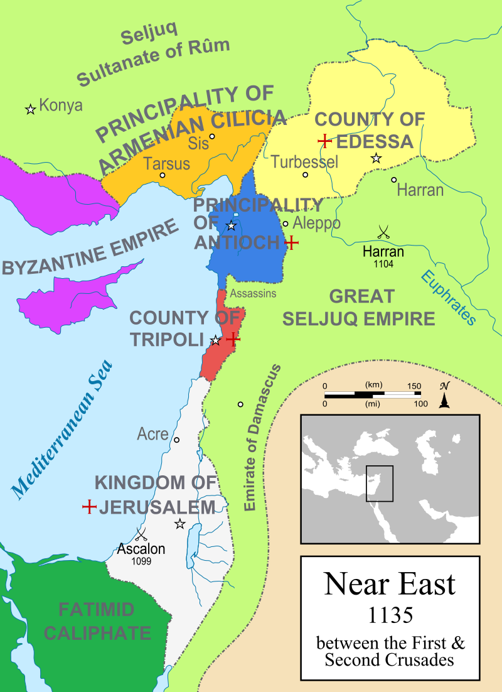
The Crusader States, 1135
.Byblos
https://en.wikipedia.org/wiki/Crusader_states#/media/File:Map_Crusader_states_1135-en.svg

Slide 14
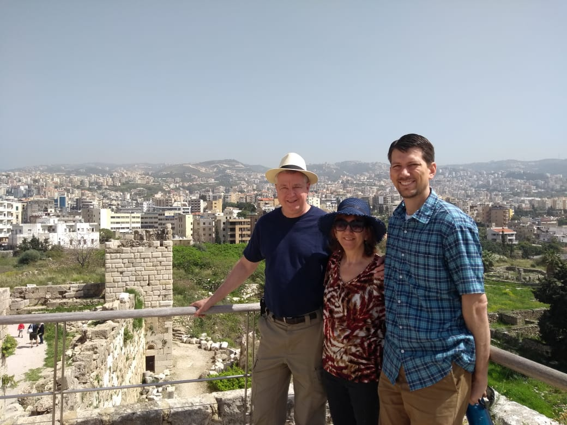
Crusader Fortress at Byblos, Lebanon

Slide 15
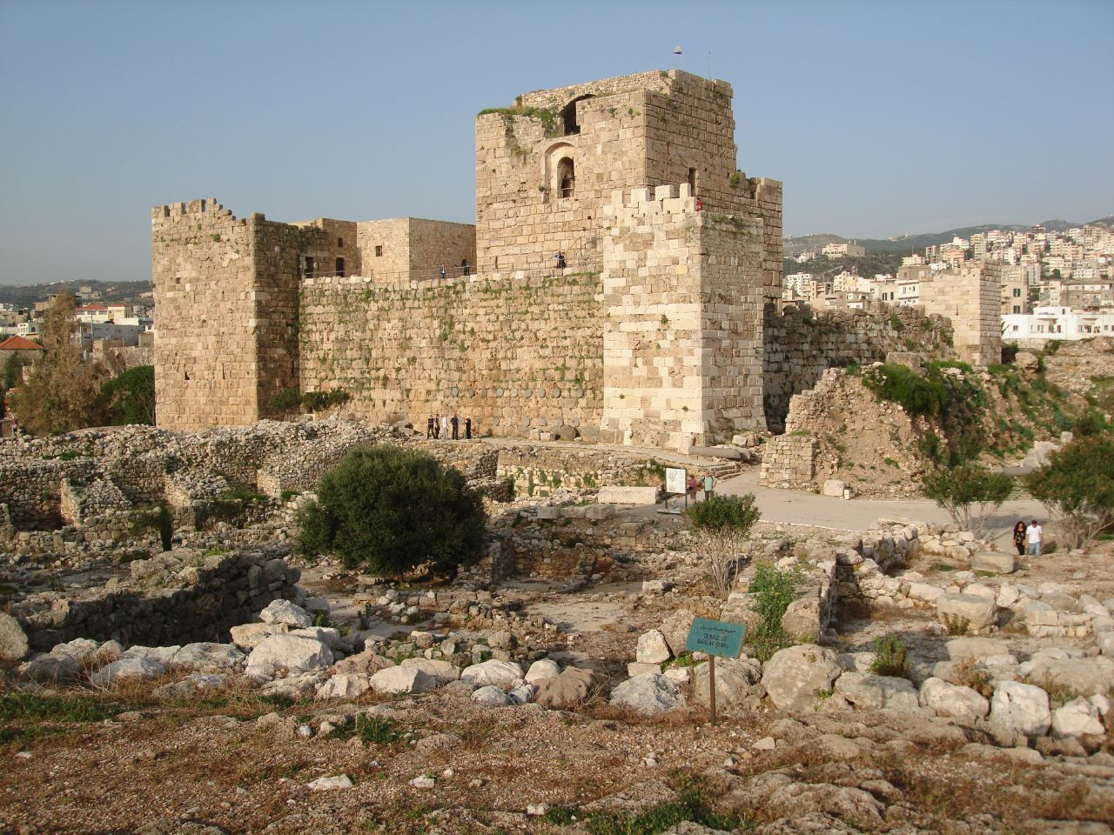
Crusader Fortress at Byblos, Lebanon
https://farm3.static.flickr.com/2355/2377148778_88bac21299_o.jpg

Slide 16
The First Crusade, 1096-99
The creation of these Latin Crusader states did far more than the schism of 1054 to breed real practical division between Eastern Orthodox and Western Catholic Christians.
Wherever the Crusaders conquered, they forcibly took over the churches of Easterners and set up their own Western Latin bishops, to whom they expected Eastern believers to submit.
Indeed, the sometimes brutal way the Crusaders trod down the native Orthodox peoples of the Middle East became so hateful to the Orthodox, that they were soon fighting alongside the more tolerant Muslims to throw out the oppressive Crusaders!
Needham, Nick. 2,000 Years of Christ's Power Vol. 2: The Middle Ages

Slide 17
The Second Crusade, 1147-49
The fall of the Latin kingdom of Edessa to a Turkish army in 1144 gave rise to the Second Crusade.
Pope Eugenius III proclaimed it, but the real force behind the Second Crusade was Bernard of Clairvaux (1090-1153).
Bernard’s involvement in the Second Crusade came about because Pope Eugenius III was a former monk of Bernard’s, and Eugenius asked him to act as a sort of publicity agent for the Crusade.
Bernard agreed and preached passionately all over Western Europe, exhorting people to go to the rescue of the kingdom of Jerusalem.
Needham, Nick. 2,000 Years of Christ's Power Vol. 2: The Middle Ages

Slide 18
The Second Crusade, 1147-49
Here is a typical example of Bernard’s Crusade preaching:
  The earth trembles and shakes, because the King of heaven has lost His country, the country where once He appeared to men, where He walked among them for more than 30 years, the country made glorious by His miracles and holy by His blood, the country where the flowers of the resurrection first bloomed. And now, because of our sins, the enemy of the cross has begun to lift his blasphemous head there, and to devastate with his sword that blessed land of promise. The great eye of providence surveys these acts in silence; it wishes to see if there is anyone who seeks God, anyone who suffers with Him in His sorrow, anyone who will restore His heritage to Him. I say to you, the Lord is testing you!
Needham, Nick. 2,000 Years of Christ's Power Vol. 2: The Middle Ages

Slide 19
The Second Crusade, 1147-49
Bernard’s appeals were successful.
The Second Crusade was led by King Louis VII of France and the Holy Roman Emperor, Conrad III.
However, once the Crusaders arrived in the East, they met with total disaster.
The Eastern Byzantine Christians, who had not asked the Crusaders to come, received them badly.
Most of the Crusaders perished in Asia Minor through famine, fever, and Turkish attacks.
Their one serious military operation, the siege of Damascus, was a failure.
Catholic Europe was shaken to the core.
Needham, Nick. 2,000 Years of Christ's Power Vol. 2: The Middle Ages

Slide 20
The Second Crusade, 1147-49
Many blamed the collapse of the Crusade on the ill-will and treachery of the Byzantines.
Bernard of Clairvaux, however, blamed it on the sins of Western Catholics; God was judging and punishing them for their ungodly lives:
  It seems that our sins have provoked the Lord, and He has forgotten His pity and has come to judge the world before the appointed time. He has not spared His own people; He has not spared even His own name. The Pagans say, ‘Where is their God?’ We promised victory; behold – desolation!
Needham, Nick. 2,000 Years of Christ's Power Vol. 2: The Middle Ages

Slide 21
The Second Crusade, 1147-49
Bernard’s involvement in the Second Crusade contrasts strangely with his moderate and gentle attitude towards heretics and Jews within Catholic Europe.
He advocated tolerance towards the Jews, and maintained that the only weapons the Church should use against heretics were argument and persuasion.
However, these were the days before the founding of the inquisition.
Once the inquisition was established, the Church buried Bernard’s tolerant opinions in silence.
Bernard was swiftly canonized (officially proclaimed a saint) in 1174, only 21 years after his death.
Needham, Nick. 2,000 Years of Christ's Power Vol. 2: The Middle Ages

Slide 22
The Second Crusade, 1147-49
As a popular saint Bernard was eclipsed by Francis of Assisi in the 1200s.
But his reputation endured and even survived the storms of the Protestant Reformation in the 16th century.
When the Reformers broke with the papacy, they made severe criticisms of many medieval saints and theologians; but they could never bring themselves to speak very harshly of Bernard.
Martin Luther, in his commentary on Galatians, extolled Bernard as a shining example of a man who lived by genuine heartfelt faith in Jesus Christ: “Bernard, a man so godly, so holy, so pure, that we should commend and prefer him before all the theologians of the Church.”
Needham, Nick. 2,000 Years of Christ's Power Vol. 2: The Middle Ages

Slide 23
The History of the Crusades
(Continued)
https://www.crisismagazine.com/2015/history-crusades-obama-read

Slide 24
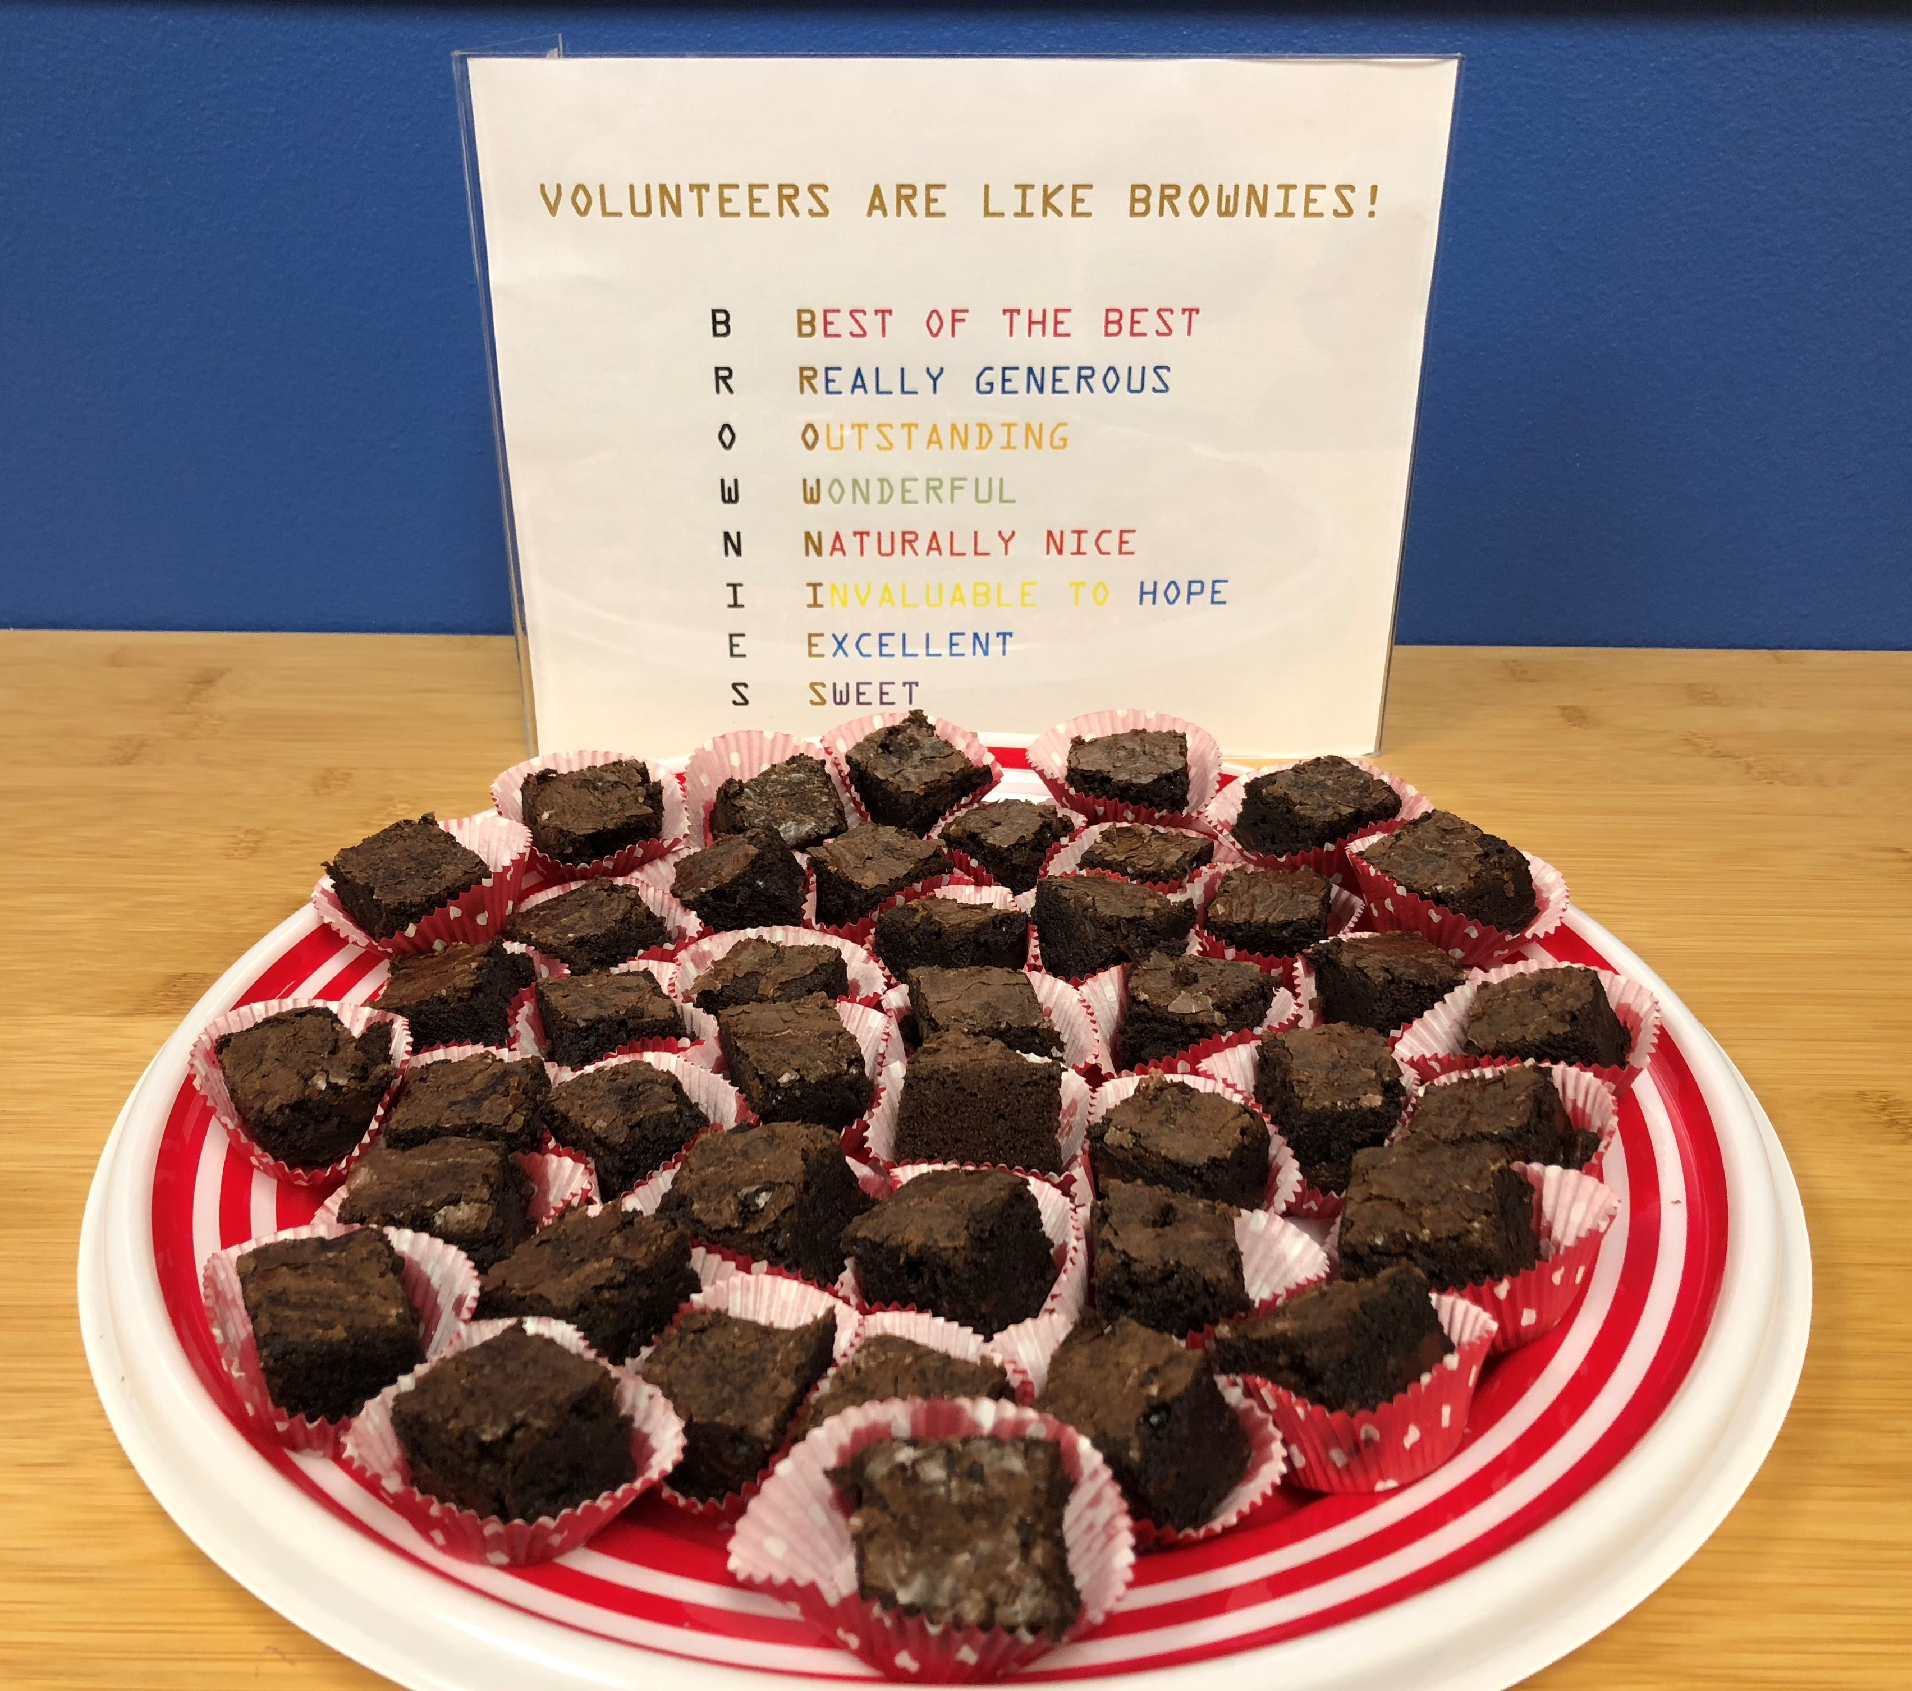
https://www.hopehelps.org/volunteer-appreciation-week-2018/

Slide 25

Class Discussion Time
https://www.weareteachers.com/moving-beyond-classroom-discussions/

Slide 26
*Class Discussion Time
The Crusaders, who were facing dire circumstances while being besieged by a large Turkish army at Antioch, were comforted and inspired by a vision that they believed was from the Lord – a vision confirmed by a seemingly miraculous event that was too amazing to be “just a coincidence”.
Do you believe that the vision given by the seer to the Crusaders was, in fact, a “word from the Lord”?
In a similar manner, Christians in our day are sometimes convinced that they have received an extra-biblical “word from the Lord”, especially if such a word is accompanied by a seemingly miraculous coincidence.
Should we be looking to receive extra-biblical communication from the Lord? If so, how can we be sure that the information we have received truly is from the Lord? In other words, how do we do what the Apostle John commands when he says: Beloved, do not believe every spirit, but test the spirits to see whether they are from God, for many false prophets have gone out into the world. (1 John 4:1)
Do you have a topic or question that you would like to see us to discuss?

