Slide 1


Slide 2
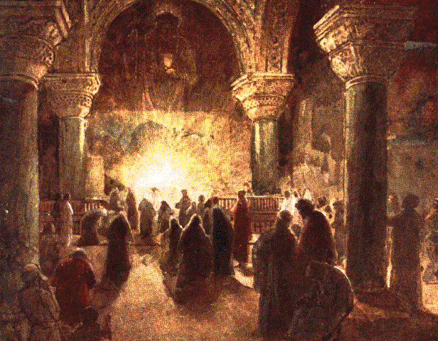
Christmas Music in the Early Church
https://www.johnsanidopoulos.com/2012/11/continuity-and-change-in-fourth-century.html

Slide 3
Christmas Music in the Early Church
The first hymns in honor of the Nativity were written in the fourth and fifth centuries, soon after Christmas was fully established as one of the great annual feasts.
These early Latin hymns were solemn, dwelling exclusively on the supernatural aspects of Christmas.
One of the earliest Latin hymns was:
  Jesus Refulsit Omnium (Jesus, light of all the nations), by Saint Hilary of Poitiers (AD 368).
Other well-known early Latin hymns include:
  Veni Redemptor Gentium (Come, Redeemer of Nations), by Saint Ambrose, Bishop of Milan (AD 397)
  Corde Natus Ex Parentis (Of the Father's love begotten), by Prudentius (AD 405), a layman, governmental official of the Roman Empire, and one of the greatest Latin Christian poets
http://archive.wf-f.org/Hymns-carols.html

Slide 4
Jesus Refulsit Omnium
(Jesus, light of all the nations) by Saint Hilary of Poitiers (AD 368)
Latin | English Translation
Jesus refulsit omnium Pius redemptor gentium Totum genus fidelium Laudes celebret dramatum | Jesus, devoted redeemer of all nations, has shone forth, Let the whole family of the faithful celebrate the stories.
Quem stella natum fulgida Monstrat micans per authera Magosque duxit praevia Ipsius ad cunabula | The shining star, gleaming in the heavens, makes him known at his birth and, going before, has led the Magi to his cradle
Illi cadentes parvulum Pannis adorant obsitum Verum fatentur ut Deum Munus ferendo mysticum. | Falling down, they adore the tiny baby hidden in rags, as they bear witness to the true God by bringing a mystical gift.
http://archive.wf-f.org/Hymns-carols.html

Slide 5
Veni Redemptor Gentium
(Come,Redeemer of Nations) by Saint Ambrose, Bishop of Milan (AD 397)
Latin | English Translation
1. Veni, redemptor gentium; ostende partum Virginis; miretur omne saeculum: talis decet partus Deum. | Come, thou Redeemer of the earth, and manifest thy virgin-birth: let every age adoring fall; such birth befits the God of all.
2. Non ex virili semine, Sed mystico spiramine Verbum Dei factum caro Fructusque ventris floruit. | Begotten of no human will, But of the Spirit, Thou art still The Word of God in flesh arrayed, The promised fruit to men displayed.
3. Alvus tumescit Virginis, Claustra pudoris permanent, Vexilla virtutum micant, Versatur in templo Deus. | The virgin womb that burden gained With virgin honor all unstained; The banners there of virtue glow; God in His temple dwells below.
https://en.wikipedia.org/wiki/Veni_redemptor_gentium

Slide 6
Veni Redemptor Gentium
(Come,Redeemer of Nations) by Saint Ambrose, Bishop of Milan (AD 397)
Latin | English Translation
4. Procedens de thalamo suo, Pudoris aula regia, Gemine gigas substantiae, Alacris ut currat viam. | Forth from His chamber goeth He, That royal home of purity, A giant in two-fold substance one, Rejoicing now His course to run.
5. Egressus ejus a Patre, Regressus ejus ad Patrem: Excursus usque ad inferos Recursus ad sedem Dei. | From God the Father He proceeds, To God the Father back He speeds; His course He runs to death and hell, Returning on God's throne to dwell.
6. Aequalis eterno Patri, Carnis trophato accingere: Infirma nostri corporis Virtute firmans perpeti. | O equal to the Father, Thou! Gird on Thy fleshly mantle now; The weakness of our mortal state With deathless might invigorate.
7. Presepe jam fulget tuum, Lumenque nox spirat novum, Quod nulla nox interpolet, Fideque jugi luceat. | Thy cradle here shall glitter bright And darkness breathe a newer light, Where endless faith shall shine serene, And twilight never intervene.
Latin | English Translation
1. Veni, redemptor gentium; ostende partum Virginis; miretur omne saeculum: talis decet partus Deum. | Come, thou Redeemer of the earth, and manifest thy virgin-birth: let every age adoring fall; such birth befits the God of all.
2. Non ex virili semine, Sed mystico spiramine Verbum Dei factum caro Fructusque ventris floruit. | Begotten of no human will, But of the Spirit, Thou art still The Word of God in flesh arrayed, The promised fruit to men displayed.
3. Alvus tumescit Virginis, Claustra pudoris permanent, Vexilla virtutum micant, Versatur in templo Deus. | The virgin womb that burden gained With virgin honor all unstained; The banners there of virtue glow; God in His temple dwells below.
https://en.wikipedia.org/wiki/Veni_redemptor_gentium

Slide 7
  Corde Natus Ex Parentis
  (Of the Father's heart begotten) by Prudentius (AD 405) a layman, governmental official of the Roman Empire, and one of the greatest Latin Christian poets
Latin | English Translation
Corde natus ex parentis Ante mundi exordium A et O cognominatus, ipse fons et clausula Omnium quæ sunt, fuerunt, quæque post futura sunt. Sæculorum sæculis. | Of the Father's heart begotten, Ere the world from chaos rose, He is Alpha, from that Fountain All that is and hath been flows; He is Omega, of all things, Yet to come the mystic Close, Evermore and evermore.
https://en.wikipedia.org/wiki/Of_the_Father%27s_Heart_Begotten

Slide 8
  Corde Natus Ex Parentis
  (Of the Father's heart begotten) by Prudentius (AD 405) a layman, governmental official of the Roman Empire, and one of the greatest Latin Christian poets
Latin | English Translation
Ipse iussit et creata, dixit ipse et facta sunt, Terra, cælum, fossa ponti, trina rerum machina, Quæque in his vigent sub alto solis et lunæ globo. Sæculorum sæculis. | By His Word was all created He commanded and 'twas done; Earth and sky and boundless ocean, Universe of three in one, All that sees the moon's soft radiance, All that breathes beneath the sun, Evermore and evermore.
Corporis formam caduci, membra morti obnoxia Induit, ne gens periret primoplasti ex germine, Merserat quem lex profundo noxialis tartaro. Sæculorum sæculis. | He assumed this mortal body, Frail and feeble, doomed to die, That the race from dust created, Might not perish utterly, Which the dreadful Law had sentenced In the depths of hell to lie, Evermore and evermore.
Latin | English Translation
Corde natus ex parentis Ante mundi exordium A et O cognominatus, ipse fons et clausula Omnium quæ sunt, fuerunt, quæque post futura sunt. Sæculorum sæculis. | Of the Father's heart begotten, Ere the world from chaos rose, He is Alpha, from that Fountain All that is and hath been flows; He is Omega, of all things, Yet to come the mystic Close, Evermore and evermore.
https://en.wikipedia.org/wiki/Of_the_Father%27s_Heart_Begotten

Slide 9
  Corde Natus Ex Parentis
  (Of the Father's heart begotten) by Prudentius (AD 405) a layman, governmental official of the Roman Empire, and one of the greatest Latin Christian poets
Latin | English Translation
Ipse iussit et creata, dixit ipse et facta sunt, Terra, cælum, fossa ponti, trina rerum machina, Quæque in his vigent sub alto solis et lunæ globo. Sæculorum sæculis. | By His Word was all created He commanded and 'twas done; Earth and sky and boundless ocean, Universe of three in one, All that sees the moon's soft radiance, All that breathes beneath the sun, Evermore and evermore.
Corporis formam caduci, membra morti obnoxia Induit, ne gens periret primoplasti ex germine, Merserat quem lex profundo noxialis tartaro. Sæculorum sæculis. | He assumed this mortal body, Frail and feeble, doomed to die, That the race from dust created, Might not perish utterly, Which the dreadful Law had sentenced In the depths of hell to lie, Evermore and evermore.
Latin | English Translation
O beatus ortus ille, virgo cum puerpera Edidit nostram salutem, feta Sancto Spiritu, Et puer redemptor orbis os sacratum protulit. Sæculorum sæculis. | O how blest that wondrous birthday, When the Maid the curse retrieved, Brought to birth mankind's salvation By the Holy Ghost conceived, And the Babe, the world's Redeemer In her loving arms received, Evermore and evermore.
Ecce, quem vates vetustis concinebant sæculis, Quem prophetarum fideles paginæ spoponderant, Emicat promissus olim; cuncta conlaudent eum. Sæculorum sæculis. | This is He, whom seer and sibyl Sang in ages long gone by; This is He of old revealed In the page of prophecy; Lo! He comes the promised Savior; Let the world his praises cry! Evermore and evermore.
Latin | English Translation
Corde natus ex parentis Ante mundi exordium A et O cognominatus, ipse fons et clausula Omnium quæ sunt, fuerunt, quæque post futura sunt. Sæculorum sæculis. | Of the Father's heart begotten, Ere the world from chaos rose, He is Alpha, from that Fountain All that is and hath been flows; He is Omega, of all things, Yet to come the mystic Close, Evermore and evermore.
https://en.wikipedia.org/wiki/Of_the_Father%27s_Heart_Begotten

Slide 10
  Corde Natus Ex Parentis
  (Of the Father's heart begotten) by Prudentius (AD 405) a layman, governmental official of the Roman Empire, and one of the greatest Latin Christian poets
Latin | English Translation
Ipse iussit et creata, dixit ipse et facta sunt, Terra, cælum, fossa ponti, trina rerum machina, Quæque in his vigent sub alto solis et lunæ globo. Sæculorum sæculis. | By His Word was all created He commanded and 'twas done; Earth and sky and boundless ocean, Universe of three in one, All that sees the moon's soft radiance, All that breathes beneath the sun, Evermore and evermore.
Corporis formam caduci, membra morti obnoxia Induit, ne gens periret primoplasti ex germine, Merserat quem lex profundo noxialis tartaro. Sæculorum sæculis. | He assumed this mortal body, Frail and feeble, doomed to die, That the race from dust created, Might not perish utterly, Which the dreadful Law had sentenced In the depths of hell to lie, Evermore and evermore.
Latin | English Translation
O beatus ortus ille, virgo cum puerpera Edidit nostram salutem, feta Sancto Spiritu, Et puer redemptor orbis os sacratum protulit. Sæculorum sæculis. | O how blest that wondrous birthday, When the Maid the curse retrieved, Brought to birth mankind's salvation By the Holy Ghost conceived, And the Babe, the world's Redeemer In her loving arms received, Evermore and evermore.
Ecce, quem vates vetustis concinebant sæculis, Quem prophetarum fideles paginæ spoponderant, Emicat promissus olim; cuncta conlaudent eum. Sæculorum sæculis. | This is He, whom seer and sibyl Sang in ages long gone by; This is He of old revealed In the page of prophecy; Lo! He comes the promised Savior; Let the world his praises cry! Evermore and evermore.
Latin | English Translation
Psallat altitudo caeli, psallite omnes angeli, Quidquid est virtutis usquam psallat in laudem Dei, Nulla linguarum silescat, vox et omnis consonet. Sæculorum sæculis. | Sing, ye heights of heaven, his praises; Angels and Archangels, sing! Wheresoe’er ye be, ye faithful, Let your joyous anthems ring, Every tongue his name confessing, Countless voices answering, Evermore and evermore.
Latin | English Translation
Corde natus ex parentis Ante mundi exordium A et O cognominatus, ipse fons et clausula Omnium quæ sunt, fuerunt, quæque post futura sunt. Sæculorum sæculis. | Of the Father's heart begotten, Ere the world from chaos rose, He is Alpha, from that Fountain All that is and hath been flows; He is Omega, of all things, Yet to come the mystic Close, Evermore and evermore.
https://en.wikipedia.org/wiki/Of_the_Father%27s_Heart_Begotten

Slide 11
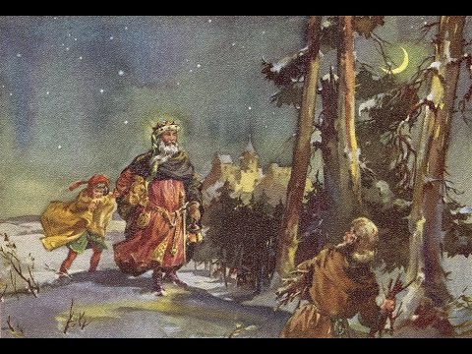
Good King Wenceslas
10th Century Duke of Bohemia
https://www.youtube.com/watch?v=y6Xt5SjHbBA

Slide 12
Good King Wenceslas
The Bohemians (or Czechs) were a Slavic people, strongly influenced by Western Christianity from AD 850 onwards.
The Christian faith first became a powerful force among them under “King Wenceslas”, Duke of Bohemia (AD 907–935).
"Good King Wenceslas" is a Christmas carol that tells a story of the Bohemian duke going on a journey and braving harsh winter weather to give alms to a poor peasant on the Feast of Stephen.
In 1853, English hymn writer John Mason Neale wrote the "Wenceslas" lyrics.
Neale's lyrics were set to the melody of 13th-century Finnish song "Tempus adest floridum" ("The time is near for flowering") first published in the 1582.
https://en.wikipedia.org/wiki/Good_King_Wenceslas

Slide 13
Good King Wenceslas
Good King Wenceslas looked out, on the Feast of Stephen, When the snow lay round about, deep and crisp and even; Brightly shone the moon that night, tho' the frost was cruel, When a poor man came in sight, gath'ring winter fuel.
"Hither, page, and stand by me, if thou know'st it, telling, Yonder peasant, who is he? Where and what his dwelling?" "Sire, he lives a good league hence, underneath the mountain; Right against the forest fence, by Saint Agnes' fountain."
"Bring me flesh, and bring me wine, bring me pine logs hither: Thou and I shall see him dine, when we bear them thither." Page and monarch, forth they went, forth they went together; Through the rude wind's wild lament and the bitter weather.
https://en.wikipedia.org/wiki/Good_King_Wenceslas

Slide 14
Good King Wenceslas
Good King Wenceslas looked out, on the Feast of Stephen, When the snow lay round about, deep and crisp and even; Brightly shone the moon that night, tho' the frost was cruel, When a poor man came in sight, gath'ring winter fuel.
"Hither, page, and stand by me, if thou know'st it, telling, Yonder peasant, who is he? Where and what his dwelling?" "Sire, he lives a good league hence, underneath the mountain; Right against the forest fence, by Saint Agnes' fountain."
"Bring me flesh, and bring me wine, bring me pine logs hither: Thou and I shall see him dine, when we bear them thither." Page and monarch, forth they went, forth they went together; Through the rude wind's wild lament and the bitter weather.
Good King Wenceslas
"Sire, the night is darker now, and the wind blows stronger; Fails my heart, I know not how; I can go no longer." "Mark my footsteps, good my page. Tread thou in them boldly Thou shalt find the winter's rage freeze thy blood less coldly."
In his master's steps he trod, where the snow lay dinted; Heat was in the very sod which the saint had printed. Therefore, Christian men, be sure, wealth or rank possessing, Ye who now will bless the poor, shall yourselves find blessing
https://en.wikipedia.org/wiki/Good_King_Wenceslas

Slide 15
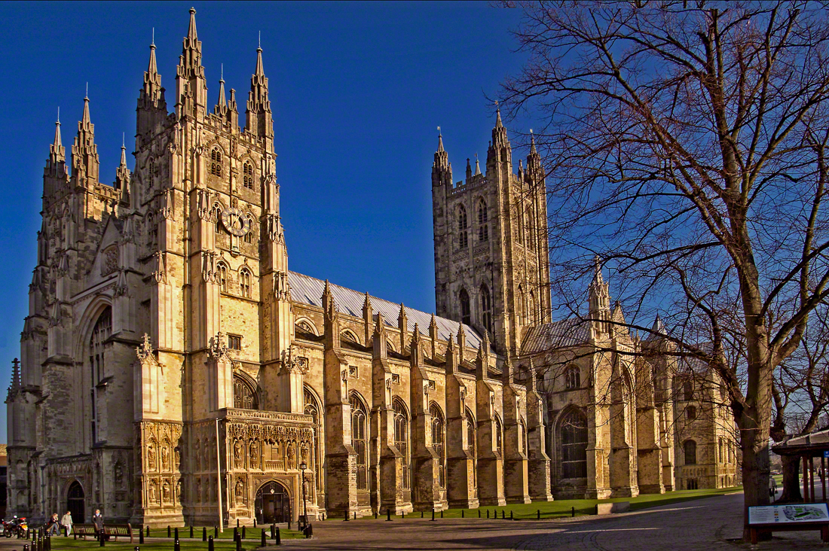
Christmas Music in the Middle Ages
Canterbury Cathedral in Canterbury, Kent, is one of the oldest and most famous Christian structures in England. Originally built in AD 597; rebuilt several times since.
https://en.wikipedia.org/wiki/Canterbury_Cathedral#/media/File:Canterbury-cathedral-wyrdlight.jpg

Slide 16
Puer natus est nobis
(A Child is born to us)
12th Century Gregorian Chant
Puer Natus est is the Introit for the third Mass of Christmas Day (in the monasteries).
In a medieval Mass the Introit was the first item and would be sung as the celebrants entered the sanctuary.
Its text changed daily and featured a dialogue of sorts between the choir singing the Antiphon (in this case the repeated section beginning at Puer Natus est) and verses from the Psalms sung by the cantor.
http://www.toddtarantino.com/hum/puernatusest.html

Slide 17
Puer natus est nobis
(A Child is born to us)
Latin | English Translation
Antiphon: Puer natus est nobis, et filius datus est nobis: cuius imperium super humerum eius: et vocabitur nomen eius, magni consilii Angelus | Antiphon: (Isaiah 9:6) A child is born to us, and a Son is given to us: Whose government is upon His shoulder: and His Name shall be called, the Angel of Great Counsel.
Sung by the cantor: Cantate Domino canticum novum: quia mirabilia fecit. | Sung by the cantor: (Psalm 98:1) Sing ye to the Lord a new canticle: because He hath done wonderful things.
(Repeat Antiphon) | (Repeat Antiphon)
Sung by the cantor: Notum fecit Dominus salutare suum: in conspectu gentium revelavit iustitiam suam. | Sung by the cantor: (Psalm 98:2) The Lord has made known his salvation; to all nations he has revealed his justice.
http://www.toddtarantino.com/hum/puernatusest.html

Slide 18
Entre le bœuf et l’âne gris
(Between the Ox and the Grey Donkey)
13th (or 16th) Century French Christmas Carol
One of the oldest French Christmas carols that is still sung today.
According to different sources, the song either dates back to as early as the 13th century or the 16th century.
Like most early Christmas songs, “Between the Ox and the Grey Donkey” is about the nativity scene.
Not much is known about the song other than the fact that it originated in France.
The song may have been inspired by the Isaiah 1:3 - The ox knows its owner, and the donkey its master's crib, but Israel does not know, my people do not understand.
http://www.oldest.org/religion/christmas-songs/

Slide 19
Entre le bœuf et l’âne gris
(Between the Ox and the Grey Donkey)
French | English Translation
Entre le bœuf et l’âne gris Dort, dort, dort le petit fils Mille anges divins, Mille séraphins Volent à l’entour de ce grand dieu ’amour. Roi des anges dort. | Between the ox and the grey donkey Sleeps, sleeps, sleeps the little son, A thousand divine angels, A thousand seraphim Fly around this great God of love. King of angels sleeps.
Entre les roses et les lys Dort, dort, dort le petit fils Mille anges divins, Mille séraphins Volent à l’entour de ce grand dieu d’amour. Roi des anges dort. | Between the roses and the lilies, Sleeps, sleeps, sleeps the little son, A thousand divine angels, A thousand seraphim Fly around this great God of love. King of angels sleeps.
Entre les pastoureaux jolis Dort, dort, Jésus qui sourit Mille anges divins, Mille séraphins Volent à l’entour de ce grand dieu d’amour. Roi des anges dort. | Amidst the gentle shepherds Sleeps, sleeps Jesus who smiles, A thousand divine angels, A thousand seraphim Fly around this great God of love. King of angels sleeps.
https://en.wikipedia.org/wiki/Entre_le_b%C5%93uf_et_l%27%C3%A2ne_gris

Slide 20
Resonet in laudibus
(Christ was born on Christmas Day)
14th Century Traditional Christmas Carol
A traditional Christmas carol from 14th century Europe.
Its exact origins are difficult to date, but it was widely-known and sung all over medieval Europe.
The oldest known written copy of the song appears in a collection of songs written in 1360.
In 1582, the Piae Cantiones – a collection of medieval Latin songs – was first published.
This book helped popularize several of the most-known Christmas carols including “Resonet in laudibus.”
Popular English hymn writer, John M. Neale, translated the song into English as “Christ was born on Christmas Day” and based his version of the one in Piae Cantiones.
http://www.oldest.org/religion/christmas-songs/

Slide 21
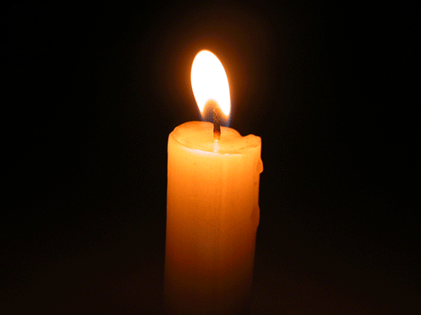
Resonet in laudibus
(Christ was born on Christmas Day)
Latin | English Translation
Resonet in laudibus, Cum iucundis plausibus, Sion cum fidelibus, Apparuit, Quem genuit Maria. | Let praises ring out, And joyful acclaim, To Zion’s faithful, The child born of Mary has appeared.
Gaudete, Gaudete! Christus Natus Hodie. Gaudete, Gaudete! Ex Maria virgine | Rejoice, Rejoice! Christ is Born Today. Rejoice, Rejoice! From the Virgin Mary.
Pueri concurrite, Nato Regi psallite, Voce pia dicite, Apparuit quem genuit Maria. | Let us sing together to the child Let us sing to the newborn King; And with the pious ones say: The child born of Mary has appeared.
Gaudete, Gaudete! Christus Natus Hodie. Gaudete, Gaudete! Ex Maria virgine | Rejoice, Rejoice! Christ is Born Today. Rejoice, Rejoice! From the Virgin Mary.
https://www.youtube.com/watch?v=9rEuyfvVb3Y

Slide 22
In dulci jublio
(Good Christian Men, Rejoice)
14th Century Traditional Christmas Carol
Another traditional Christmas carol dating back to medieval times. The song’s exact origins are unknown, but Heinrich Seuse is typically credited as the song’s author.
According to German folklore, Seuse wrote the song sometime in 1328 after he heard the angels sing the words and joined them in a dance of worship.
The original song lyrics are a mixture of German and Latin and the oldest extant copy of the song is found in a manuscript dating from around 1400.
One of the most popular versions of the song is the English version written by J.M. Neale called “Good Christian Men, Rejoice.”
http://www.oldest.org/religion/christmas-songs/

Slide 23
In dulci jublio
(Good Christian Men, Rejoice)
German/Latin | English Translation
In dulci jubilo, Nun singet und seid froh! Unsers Herzens Wonne Leit in praesepio; Und leuchtet wie die Sonne Matris in gremio. Alpha es et O! Alpha es et O! | In sweet rejoicing, now sing and be glad! Our hearts' joy lies in the manger; And it shines like the sun in the mother's lap. You are the alpha and omega! You are the alpha and omega!
https://en.wikipedia.org/wiki/In_dulci_jubilo
https://www.youtube.com/watch?v=iXze_TLUTqM&t=48s

Slide 24
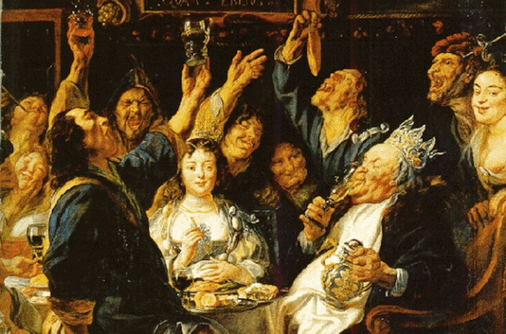
Wassail!
https://www.youtube.com/watch?v=y6Xt5SjHbBA

Slide 25
Wassail!
Of course, when it comes to songs of Christmas, we cannot forget Wassailing.
The history of the English Wassail actually dates back much farther than most written English carols, and can be traced to the time of the Norman conquests of 1066 A.D.
In the Middle Ages, wassailing was a means for the feudal peasants who lived on the land of their lord to be invited to the lord's manner and to dine and drink together and enjoy the bounty of his table.
The drink itself comes in a lovely variety of spiked punches and hot, mulled ciders.
https://radio.wosu.org/post/history-christmas-music-middle-ages-and-renaissance#stream/0

Slide 26
Wassail!
Chorus: Wassail! wassail! all over the town, Our toast it is white and our ale it is brown; Our bowl it is made of the white maple tree; With the wassailing bowl, we'll drink to thee.
So here is to Cherry and to his right cheek Pray God send our master a good piece of beef And a good piece of beef that may we all see With the wassailing bowl, we'll drink to thee.
Come butler, come fill us a bowl of the best Then we hope that your soul in heaven may rest But if you do draw us a bowl of the small Then down shall go butler, bowl and all.
Then here's to the maid in the lily white smock Who tripped to the door and slipped back the lock Who tripped to the door and pulled back the pin For to let these jolly wassailers in.
Gloucestershire Wassail sung by Montana A Cappella Society; Album: Christmasse Comes But Once a Year

Slide 27
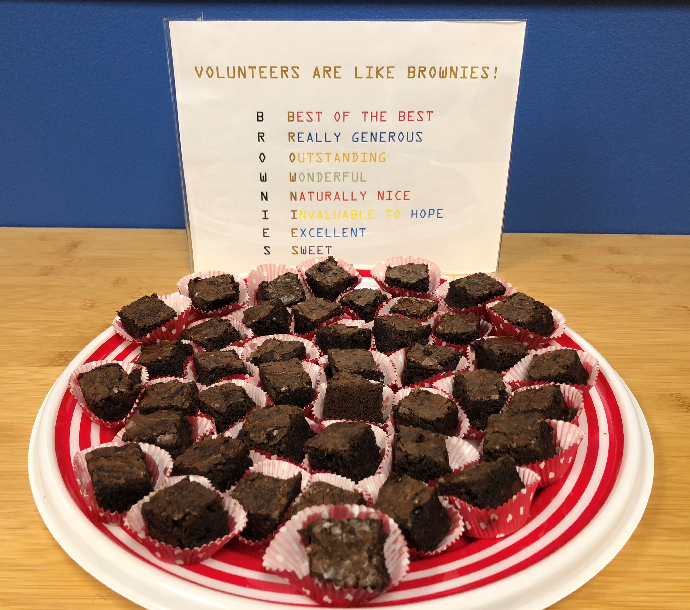
https://www.hopehelps.org/volunteer-appreciation-week-2018/

Slide 28

Class Discussion Time
https://www.weareteachers.com/moving-beyond-classroom-discussions/

