Slide 1


Slide 2
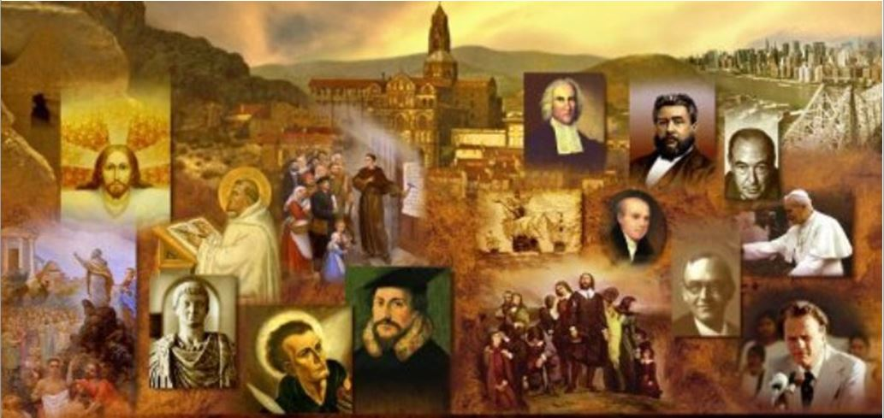
Review
The 12th and 13th centuries saw a great flowering of knowledge, especially theology and philosophy, in Western Christendom.
At the heart of this flowering of knowledge was the rise of the university.
The institution of the university came to the West from where?
  the Muslim world.
What was the normal age that a man would enter the university in the Middle Ages?
  14 or 15
What language was spoken in all universities in the Middle Ages?
  Latin

Slide 3
Review
The scholastic theologians were deeply concerned about the relationship between faith and reason.
They wanted to see how far “pure reason” could discover or prove the doctrines of the Christian faith.
Give some of the examples that I provided last week of the kind of questions that schoolman spent time exploring in the Middle Ages that we would consider pointless in our day.
  Could God have become incarnate as an animal, or as a woman?
  Can one angel be in two places at the same time?
  Can two angels be in the same place at the same time?
  Who sinned most, Adam or Eve?

Slide 4
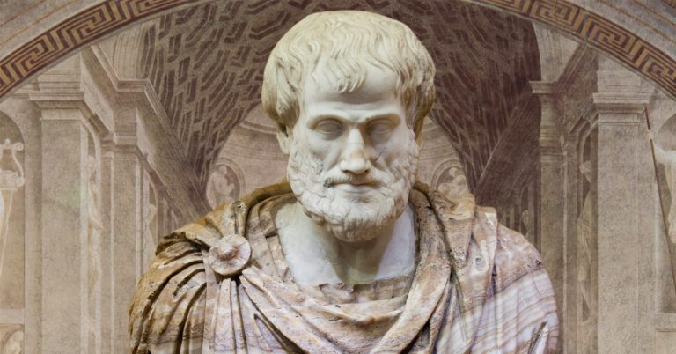
Philosophy and the Writings of Aristotle
https://brewminate.com/the-science-and-biology-of-aristotle/

Slide 5
Philosophy and the Writings of Aristotle
Besides being theologians, the schoolmen were also the philosophers of the Middle Ages.
They wanted to give a comprehensive account, not just of Church teaching, but of all truth.
So they did not limit themselves to theological questions.
They would try to answer deep philosophical questions too:
  What is matter?
  What is mind?
  What is time?
  What is space?
  What is being?
  What is the nature of cause-and- effect?
Needham, Nick. 2,000 Years of Christ's Power Vol. 2: The Middle Ages

Slide 6
Philosophy and the Writings of Aristotle
In the 13th century, scholastic theology came to rely increasingly on the philosophy of Aristotle.
Aristotle was one of the greatest of the ancient Pagan philosophers of Greece.
A few of Aristotle’s works had been known to the early schoolmen, because Boethius in the 6th century had translated them into Latin.
However, almost all of Aristotle’s writings became available in Latin in the 1100s, largely through two great Muslim philosophers:
  the Persian Avicenna (980-1037)
  the Spanish Averroes (1126-1198)
They translated Aristotle from Greek into Arabic for the benefit of the Islamic world.
Needham, Nick. 2,000 Years of Christ's Power Vol. 2: The Middle Ages

Slide 7
Philosophy and the Writings of Aristotle
Christian scholars, such as Michael Scotus, then translated the Arabic (along with Islamic commentaries on Aristotle) into Latin for the benefit of the Western Catholic world.
Later scholars translated Aristotle into Latin directly from the original Greek.
This rediscovery of Aristotle by Western Europe had a huge impact on Western thought.
In the writings of Aristotle, Christian thinkers found an interpretation of God, humanity and the world which seemed logical, convincing, comprehensive – an interpretation that had been worked out without any reference to the Bible.
Needham, Nick. 2,000 Years of Christ's Power Vol. 2: The Middle Ages

Slide 8
Philosophy and the Writings of Aristotle
The problem was that some of Aristotle’s teachings contradicted the teachings of the Bible.
For instance, Aristotle taught that the world had always existed.
Some Western thinkers were so enthusiastic for Aristotle, especially as he had been interpreted by the Muslim philosopher Averroes, that they accepted and taught even the anti-Christian elements in his thought.
These men were called “Averroists”, and their greatest champion was Siger of Brabant (1235-1282).
Siger taught that the universe had existed from all eternity, and that individual human souls were not immortal but were absorbed into a “world-soul” after death.
Needham, Nick. 2,000 Years of Christ's Power Vol. 2: The Middle Ages

Slide 9
Philosophy and the Writings of Aristotle
Siger at first lectured in Paris, but when the Church condemned his teachings as heretical in 1276 he fled to Italy.
This did not prove to be much of a safe haven, since Siger was murdered there by a priest whose enthusiasm for orthodoxy proved stronger than his respect for the sixth commandment.
To defend themselves against charges of heresy, some Averroists put forward a theory of “double truth”.
This theory held that human reason, by itself, would compel philosophers to accept certain things as truth; but then divine revelation showed that those things were false, and something else was really the truth.
Needham, Nick. 2,000 Years of Christ's Power Vol. 2: The Middle Ages

Slide 10
Philosophy and the Writings of Aristotle
This “double truth” theory set reason and faith in sharp conflict with each other.
It meant that if a person followed reason, he was bound to end up believing some things that contradicted revelation.
At first, many Catholic theologians reacted against Aristotle and saw his philosophy as a dangerous alternative to Christianity, especially in view of what the Averroists were saying.
Up until then, the Western Church had found the philosophy of Plato to be the most suitable ally of Christian theology, especially since Augustine of Hippo, the greatest Western theologian, had been a Platonist.
Needham, Nick. 2,000 Years of Christ's Power Vol. 2: The Middle Ages

Slide 11
Philosophy and the Writings of Aristotle
But Aristotle disagreed with some of Plato’s basic teachings.
For example, Plato held that the human soul had a direct inner knowledge of a higher spiritual world, and that this knowledge did not depend on our experience of life in the outward physical world.
He taught that we derive our fundamental ideas (such as beauty and justice) from this inner knowledge.
Aristotle, on the other hand, taught that all human knowledge arose from experience mediated to the soul through the senses – through what we can see, hear and touch.
According to Aristotle we can know that a spiritual being like God exists, then, only by reasoning from our experience of the external world; the soul cannot have any direct or immediate spiritual knowledge of God.
Needham, Nick. 2,000 Years of Christ's Power Vol. 2: The Middle Ages

Slide 12
Philosophy and the Writings of Aristotle
Many traditional Catholic theologians preferred Plato to Aristotle, and they led a campaign to ban the study of Aristotle’s writings.
For a time they enjoyed a measure of success. However, by the 13th century, the tide had turned in Aristotle’s favor, and scholastic theologians were hailing him as the great Pagan forerunner of Christian truth, whose philosophy was almost perfectly suited to undergird, express, and explain the theology of the Church.
The schoolmen now sought to bring together Aristotle’s philosophy and Christian theology into a harmonious unity (much as today’s theologians often try to marry theology to the latest scientific theory about the origin of the universe or humankind).
Needham, Nick. 2,000 Years of Christ's Power Vol. 2: The Middle Ages

Slide 13
Philosophy and the Writings of Aristotle
The theological upheavals Aristotle caused in the Western Catholic world had no parallel in the Orthodox East, where the knowledge of Aristotle had never been lost.
The Greek in which Aristotle wrote did not need to be translated for Byzantine theologians, as it was their own native language.
There was therefore no “revival” of Aristotelian philosophy in the East, no sudden Aristotelian challenge to throw Orthodox theology off balance, and no real Eastern equivalent of Western scholasticism.
Needham, Nick. 2,000 Years of Christ's Power Vol. 2: The Middle Ages

Slide 14
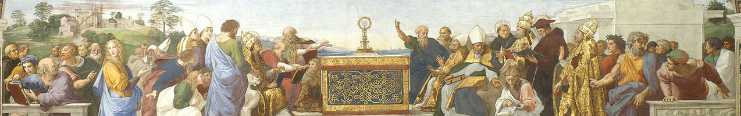
Great Scholastic Theologians
https://www.studium-scholasticum.org/

Slide 15
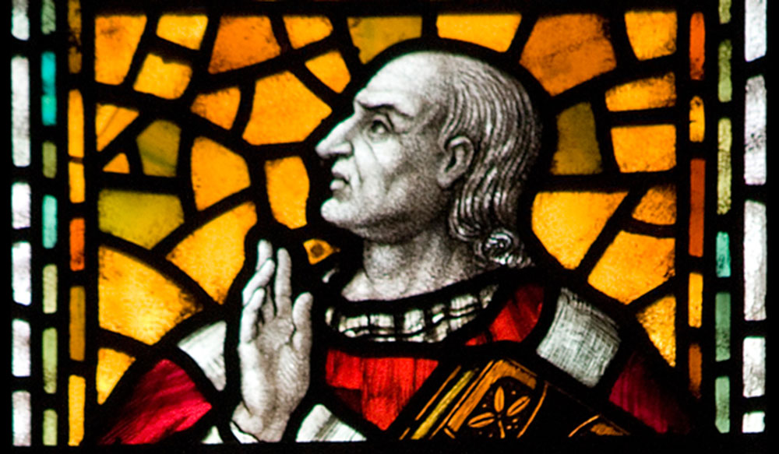
Anselm of Canterbury
https://journeychattanooga.com/nothing-greater-anselm-of-canterbury/

Slide 16
Anselm of Canterbury
Anselm (1033 – 1109) was born in northern Italy, became a monk in the French Benedictine abbey of Le Bec in Normandy, and was elected its abbot in 1078.
In 1093 he became archbishop of Canterbury
He was one of the greatest saints of the Western medieval Church: a man of spotless life, unflinching devotion to truth and righteousness, and a profound reverence and burning love for Christ.
Anselm’s most important writings for the development of scholastic theology were his :
  Monologion and Proslogion, which tried to prove the existence of God by pure reason
  Cur deus homo, which offered the first systematic theology of the atonement
Needham, Nick. 2,000 Years of Christ's Power Vol. 2: The Middle Ages

Slide 17
Anselm of Canterbury
We can sum up Anselm’s argument for God’s existence (sometimes referred to as the Ontological Argument for the existence of God) as follows:
  By definition, God is the most perfect of all possible beings.
  But if God does not exist, He would not be the most perfect of all possible beings; for a God who does exist would be more perfect than a God who does not exist.
  Therefore, if God is, by definition, the most perfect of all possible beings, He must exist.
Theologians and philosophers have argued for a thousand years about whether Anselm’s proof is valid.
Needham, Nick. 2,000 Years of Christ's Power Vol. 2: The Middle Ages

Slide 18
Anselm of Canterbury
On the Atonement, Anselm rejected the view, widespread among many early Church fathers, that Christ’s death was a ransom paid to Satan to free sinners from captivity to him.
Satan has no “rights” over the human race, Anselm argued; he is a robber and an outlaw who has taken us captive unjustly. Christ’s death was paid as a ransom, not to Satan, but to God.
Human sin, Anselm reasoned, has outraged God’s honor and majesty.
The human race must either suffer punishment, or offer compensation (“satisfaction”) to God for the outrage.
But we cannot offer any satisfaction for so great an outrage.
Sin is infinitely serious; so a just satisfaction to God would have to be infinite in value.
Needham, Nick. 2,000 Years of Christ's Power Vol. 2: The Middle Ages

Slide 19
Anselm of Canterbury
Only God could offer Himself such an infinite satisfaction.
However, because the Trinity is merciful as well as just, and willed to save sinners, God the Son became human in Jesus Christ; and Christ the God-Man, on humanity’s behalf, offered to God the Father an infinite satisfaction for the outrage of sin.
That satisfaction was the God-Man’s own infinitely valuable life.
Because He was without sin, Christ did not have to die, but He freely surrendered His life to the Father on the cross.
God then rewarded Christ for His voluntary self-sacrifice by applying the infinite worth or merit of His death to the elect, those sinners predestined to salvation by divine grace.
Needham, Nick. 2,000 Years of Christ's Power Vol. 2: The Middle Ages

Slide 20
Anselm of Canterbury
Anselm’s doctrine of the atonement contained many fruitful ideas which later theologians built into the classic Western understanding of Christ’s death. ¹
Anselm’s argument in Cur deus homo shows us the mind of a scholastic theologian at work. ¹
He is not content simply to believe that Christ died for sinners. He wants to know why Christ had to die for sinners. ¹
Anselm’s motto was credo ut intelligam: I believe so that I may know. ²
So in Anselm’s view, belief, acknowledgement of God and God’s categories are foundational to human knowledge. ²
¹ Needham, Nick. 2,000 Years of Christ's Power Vol. 2: The Middle Ages
²James White 2016 Church History Series #46

Slide 21
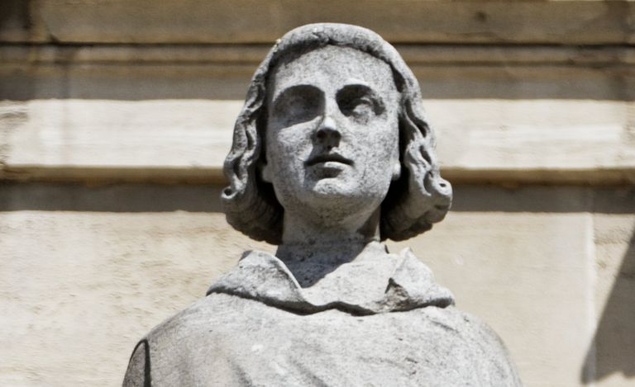
Peter Abelard
https://www.thoughtco.com/peter-abelard-profile-1788349

Slide 22

https://www.hopehelps.org/volunteer-appreciation-week-2018/

Slide 23

Class Discussion Time
https://www.weareteachers.com/moving-beyond-classroom-discussions/

Slide 24
*Class Discussion Time
Aristotle taught that all human knowledge arose from experience mediated to the soul through the senses – through what we can see, hear and touch.
  Do you agree with this?
  Is there a place for this kind of approach to understanding reality?
  What are the limitations to this kind of approach to understanding reality?
Did you find Anselm’s Ontological Proof for the existence of God persuasive?
What do you think of Anselm’s explanation of Christ’s atonement?
Do you have a topic or question that you would like to see us to discuss?

