Slide 1


Slide 2
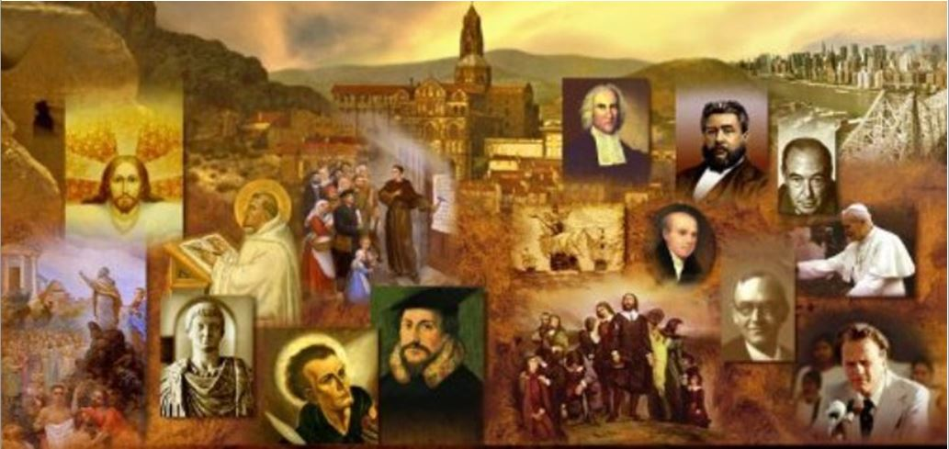
Review
Abelard rejected Anselm’s motto, which was credo ut intelligam: I believe so that I may know.
What was Abelard’s motto?
  intelligo ut credam: I know that I may believe.
Peter Lombard was the first Catholic theologian to define the number of the “sacraments” as seven. What were they?
  Baptism, holy communion, confirmation, penance, marriage, ordination, and extreme unction.
What did Albertus Magnus, Aquinas’s teacher and lifelong friend, say to Aquinas fellow students when they nicknamed him the “dumb ox” due to his slowness of speech?
  “This dumb ox will make such a roaring in theology that he will be heard through all the earth!”

Slide 3
Review
Finish this statement from last week’s lesson: “For Aquinas, Aristotle’s philosophy laid the foundation for a rational knowledge of the universe; divine revelation then…
  built the temple of Christian truth on that foundation.
Did Aquinas blindly accept everything that Aristotle taught? Explain your answer.
  No, on points where Aquinas believed that Aristotle contradicted Christian teaching, he corrected the philosopher in the light of the Bible.
What view of women did Aquinas absorb from Aristotle?
  That women were “misbegotten men”.

Slide 4
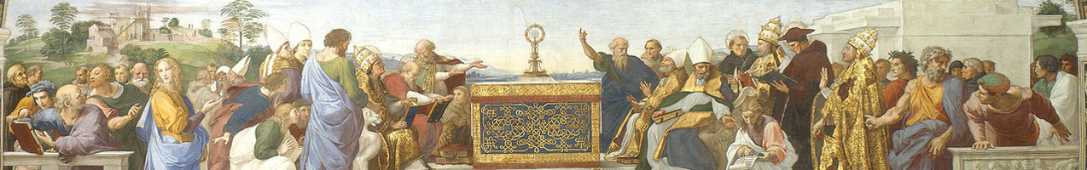
Great Scholastic Theologians
(Continued)
https://www.studium-scholasticum.org/

Slide 5

Thomas Aquinas – Summa Theologiae
A complete copy found in the catalog of the city of Lyon – dated 1624
https://www.edition-originale.com/en/antique-books-1455-1820/philosophy/thomas-daquin-summa-theologiae-1624-38709

Slide 6
Thomas Aquinas – Summa Theologiae
Aquinas’s Summa Theologiae was a systematic theology – perhaps one of the greatest ever written.
Aquinas looked at 512 disputed questions, and divided each question into a number of “articles” or points of inquiry.
He began each point of inquiry by presenting evidence which seemed to oppose his own view – philosophical arguments, quotations from the Bible and the early Church fathers.
Then he offered a reason or quotation for the view he favored.
Next he presented detailed arguments for this view.
Finally he responded to the arguments against his own view and disproved them. By this method Aquinas tried to give a complete account of the question he was dealing with.
Needham, Nick. 2,000 Years of Christ's Power Vol. 2: The Middle Ages

Slide 7
Thomas Aquinas – Summa Theologiae
Aristotle was the philosopher Aquinas quoted most often – Aquinas referred to him simply as “the philosopher”.
Among theologians, Augustine of Hippo was his favorite.
Although Augustine had been a Platonist, and Aquinas was an Aristotelian, Aquinas still had a high regard for Augustine.
Thus, Aquinas tried to combine many aspects of Augustine’s theology with Aristotle’s philosophy.
Needham, Nick. 2,000 Years of Christ's Power Vol. 2: The Middle Ages

Slide 8
The Theology of Thomas Aquinas
Aquinas’s theology, became particularly famous for three things:
  Aquinas claimed that the existence of God could be proved by reason.
  Aquinas taught that all our knowledge of God is through analogy.
  Aquinas was the first Catholic theologian to offer a full account of the doctrine of transubstantiation
Needham, Nick. 2,000 Years of Christ's Power Vol. 2: The Middle Ages

Slide 9
Aquinas’s Proofs for the Existence of God
Aquinas claimed that the existence of God could be proved by reason.
Anselm of Canterbury, of course, had made the same claim, but Aquinas rejected Anselm’s proof.
Because Aquinas had embraced Aristotle’s philosophy, he believed that all human knowledge arose from our experience of life in the outward physical world.
Therefore God’s existence had to be proved from the world, rather than (as Anselm had tried to do) from the inner ideas of the mind.
Needham, Nick. 2,000 Years of Christ's Power Vol. 2: The Middle Ages

Slide 10
Aquinas’s Proofs for the Existence of God
Aquinas offered five such proofs for God’s existence, usually referred to as the “five ways” of arguing from the world to God.
These five ways were all based on the fundamental idea that the world is an “effect” which needs a “cause”, and the cause is God.
For example, Aquinas argued that everything in this physical universe was “contingent”; its existence was not necessary – it did not have to exist.
Therefore it existed only because it depended on a being whose existence was necessary – and this being was God.
Aquinas thought that anyone trained in philosophy could reason in this sort of way from creation to the existence of the Creator.
Needham, Nick. 2,000 Years of Christ's Power Vol. 2: The Middle Ages

Slide 11
Our Knowledge of God is Through Analogy
Aquinas taught that all our knowledge of God is through analogy.
This means that whatever we say about God, our language refers in the first place to created things.
This, of course, followed from Aquinas’s belief that all human knowledge was mediated to the soul through the senses.
So, for example, if we call God “strong”, our idea of strength has come from seeing a strong man or a strong animal.
But God is not strong in exactly the same way that a man or an animal is.
Therefore, when we say “God is strong,” we are really speaking by way of “analogy”: making a comparison between human or animal strength and God’s strength, but also acknowledging that there is a difference.
Needham, Nick. 2,000 Years of Christ's Power Vol. 2: The Middle Ages

Slide 12
Our Knowledge of God is Through Analogy
Aquinas believed that all our knowledge and language about God are necessarily imperfect.
In Aquinas’s own words, “God surpasses human understanding and speech. The person who knows God best is he who recognizes that whatever he thinks and says falls short of what God really is.”
Aquinas would say that we can ascribe to God such properties as intelligence and love, which we understand from our own experience; but in order to understand what those qualities look like in God, we must then strip them of everything that makes them finite (all the limitations that apply to human intelligence and love).
As a result, we cannot have a positive idea of what intelligence and love are in the infinite God – only a negative idea of what they are not (they are not limited by time, space, change, contingency, fallibility, etc.).
Needham, Nick. 2,000 Years of Christ's Power Vol. 2: The Middle Ages

Slide 13
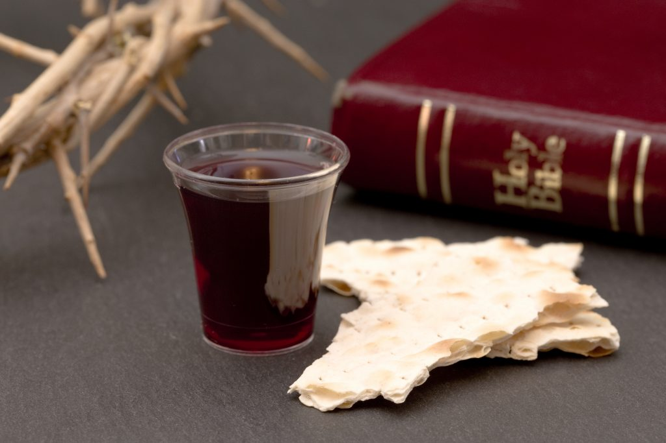
Aquinas on Transubstantiation
https://hoshanarabbah.org/blog/2017/12/17/communion-or-the-lords-supper/christian-communion-a-celebration-of-the-jesus-death/

Slide 14
Aquinas on Transubstantiation
Aquinas was the first Catholic theologian to offer a full account of the doctrine of transubstantiation.
By the 11th century the view had prevailed in Catholic Europe that the bread and wine of the mass were entirely transformed into the flesh and blood of Christ.
In the 12th century, Hildebert of Tours invented the word “transubstantiation” (“change of substance”) to describe this view, and the Fourth Lateran Council in 1215 officially sanctioned both the word and the view that it signified.
Aquinas used the philosophy of Aristotle to give a theological explanation of what happened when the bread and wine were transubstantiated.
Needham, Nick. 2,000 Years of Christ's Power Vol. 2: The Middle Ages

Slide 15
Aquinas on Transubstantiation
Aristotle had distinguished between the “substance” and “accidents” of an object.
What Aristotle meant by substance was the inner reality that gives any object its particular identity.
For example, if you are walking in a field and see a tree, there is obviously “something there” that looks like a tree.
The substance is the inner reality of the “something there”, that makes it a tree, rather than a stone, a frog, a human being, or an angel.
Needham, Nick. 2,000 Years of Christ's Power Vol. 2: The Middle Ages

Slide 16
Aquinas on Transubstantiation
The accidents, by contrast, are the various physical properties, dimensions, and qualities which make an object appear the way it does to our bodily senses.
In the case of the tree, the accidents would be the particular kind of wood, leaves, and fruit, with their particular colors, odors, and textures.
So in the case of any object, we have
  An outward form presented to us through physical qualities (the accidents), which are grasped by the bodily senses.
  A basic “inner something” (the substance) which the mind alone perceives.
Needham, Nick. 2,000 Years of Christ's Power Vol. 2: The Middle Ages

Slide 17
Aquinas on Transubstantiation
Aquinas applied this reasoning to the bread and wine of the Eucharist.
When the priest pronounces the words, “This is My body, this is My blood”:
  The substance (the non-physical inner reality) of the bread and wine is miraculously changed into Christ’s flesh and blood.
  But, the accidents (the physical form, taste, and smell) of the bread and wine remain the same; as far as human bodily senses are concerned, they are still bread and wine.
Needham, Nick. 2,000 Years of Christ's Power Vol. 2: The Middle Ages

Slide 18
Aquinas on Transubstantiation
Here is a crude illustration of transubstantiation:
  Imagine a football filled with air.
  You cannot see or touch the air inside the football; yet the air is what gives the football its shape and bounce.
  Now imagine that someone lets the air out of the football and fills it instead with some other gas, e.g. helium.
  The football’s outward form, shape and texture have not changed; it looks and feels the same as before.
  In fact, outwardly, it is the same as before.
  But its “inner reality” has changed from air to helium; it is now helium, not air, which is giving the ball its shape and bounce.
In a similar way in the Eucharist, Aquinas held that the outward physical qualities of the bread and wine do not change; but “inside”, beyond sight and touch, the inner reality has become the body and blood of Christ.
Needham, Nick. 2,000 Years of Christ's Power Vol. 2: The Middle Ages

Slide 19
Aquinas on Transubstantiation
According to Aquinas, then, those who take part in the Eucharist are not eating the physical body and blood of the Lord, but the substance (the nonphysical essence, the inner reality) of His body and blood.
This inner essence of a thing, which our senses can never perceive, was – in Aquinas’s thinking – more real than mere physical qualities and dimensions.
When people today react against Aquinas’s theology of the Eucharist, it is often because they see an object’s physical qualities as the most real thing about it.
But for Aquinas, reality lay ultimately beyond the outward physical form, in the inward and hidden realm of “substance”.
Needham, Nick. 2,000 Years of Christ's Power Vol. 2: The Middle Ages

Slide 20
Aquinas on Transubstantiation
Aquinas also developed the view that the entire flesh and blood of Christ were present both in the bread and in the wine.
So it did not matter if lay people ate only the bread, and did not drink the wine; they still received the whole of Christ in the bread.
This taking of the bread alone by the laity, while only the priest drank the wine, was quite a late development in the Western Church.
It became widespread only in the 13th century, and seems to have grown out of a fear that the blood of the Savior would be dishonored if any of the wine were spilt.
Similar fears led to the use of a special wafer instead of ordinary bread: the wafer did not crumble, so no transubstantiated bits of Christ’s body could fall on the floor and be stepped on.
Needham, Nick. 2,000 Years of Christ's Power Vol. 2: The Middle Ages

Slide 21
Aquinas on Transubstantiation
Giving only the bread to the laity was a purely Western Catholic practice.
The Eastern Orthodox Church continued to serve both the bread and the wine to the laity, and also used real bread.
Aquinas taught that when people ate the wafer, it was a sacrament, feeding the believer by means of Christ’s very flesh and blood.
But in fact, a Western medieval congregation hardly ever ate the wafer at a celebration of mass; normally, they just watched the priest celebrating it.
Indeed, by Aquinas’s time, the Catholic mass had become a sort of spiritual “spectator sport”.
Needham, Nick. 2,000 Years of Christ's Power Vol. 2: The Middle Ages

Slide 22
Aquinas on Transubstantiation
So for ordinary Catholics, their normal act of worship at mass was looking at the wafer, rather than eating it.
So much was this the case that the 4th Lateran Council in 1215 had to insist that Catholics must actually eat the wafer at least once a year.
But Aquinas taught that the mass was also a sacrifice, his point was that even when the congregation did not eat the wafer, the mass still had value, because the priest was offering a sacrifice.
And so, in effect, Christ is re-sacrificed every time the mass takes place!
As a result, he taught that the mass washed away the sins of those for whom it was offered.
Needham, Nick. 2,000 Years of Christ's Power Vol. 2: The Middle Ages

Slide 23
Aquinas on Transubstantiation
This enabled Aquinas to explain theologically how a priest could offer mass as a sacrifice both for the living and the dead – for those still on earth, and for souls in purgatory.
In the case of souls in purgatory, offering masses for them would apply Christ’s sacrifice to them, thus helping to pay off their debt of sin and hastening their progress to heaven.
Indeed, rich people often left legacies in their wills to pay for priests to say masses for their departed souls, in order to secure for them a swifter release from purgatory.
Masses for the dead were called “requiem” masses, from the Latin prayer requiem in pace, “rest in peace”.
Needham, Nick. 2,000 Years of Christ's Power Vol. 2: The Middle Ages

Slide 24
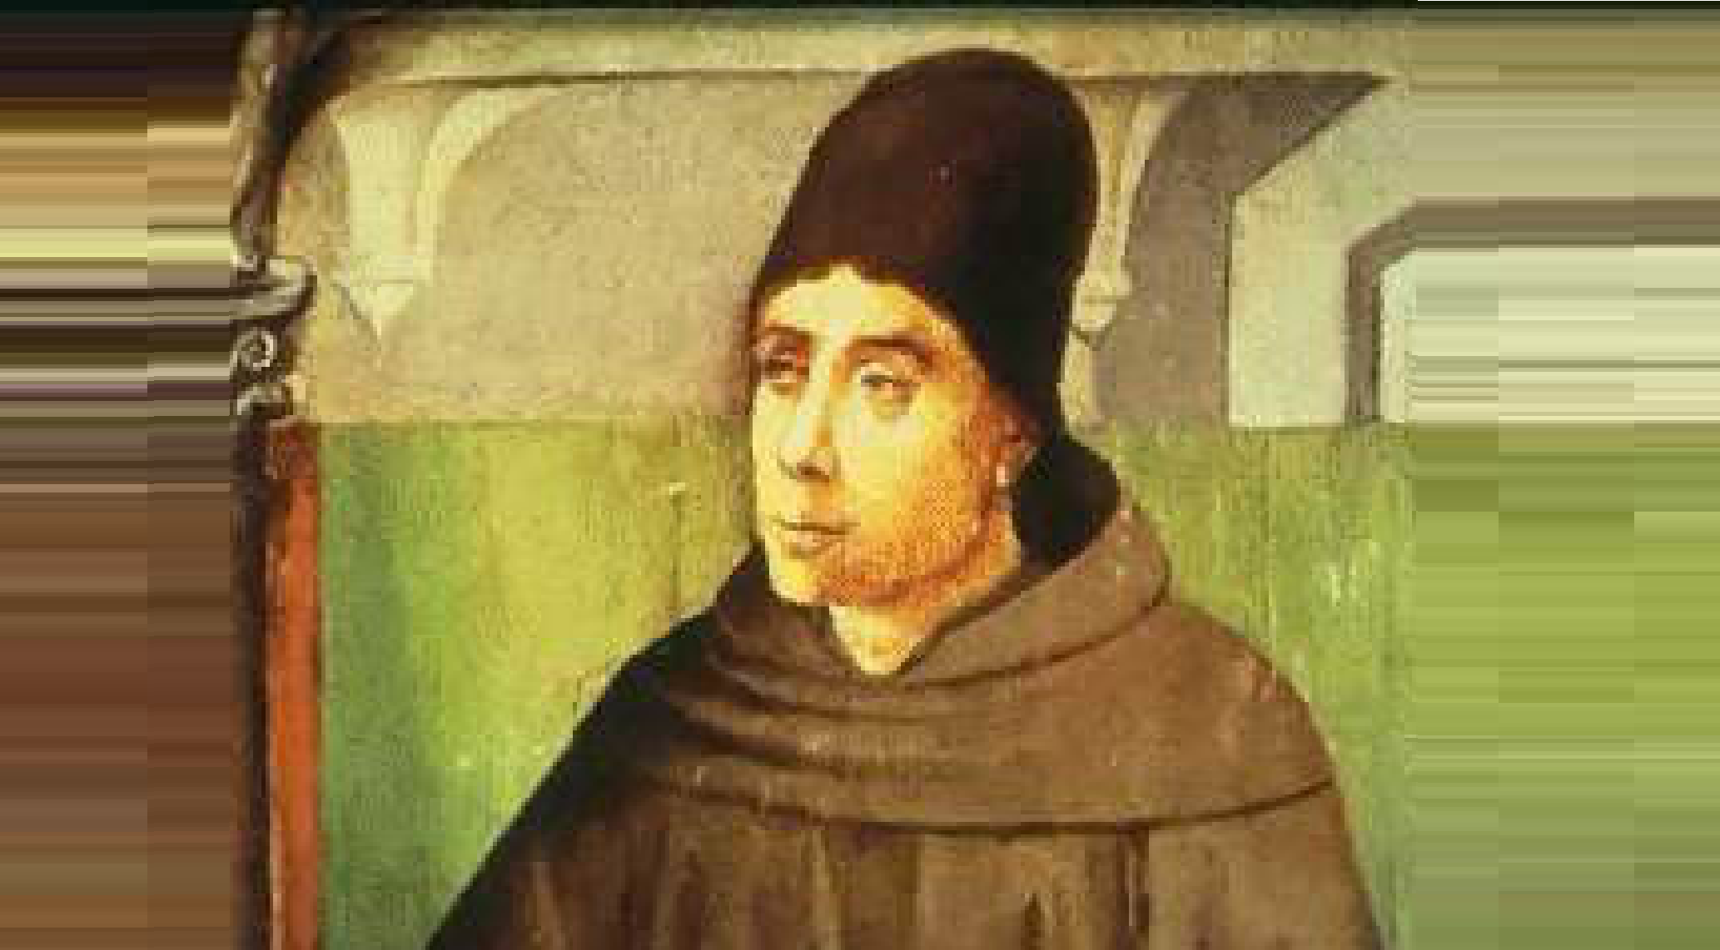
John Duns Scotus
https://medium.com/the-liturgical-legion/john-duns-scotus-and-divine-atemporal-knowledge-76352b5cbc75

Slide 25

https://www.hopehelps.org/volunteer-appreciation-week-2018/

Slide 26

Class Discussion Time
https://www.weareteachers.com/moving-beyond-classroom-discussions/

Slide 27
*Class Discussion Time
Another one of Aquinas’s proofs for the existence of God is that: In the world, we can see that things are caused. If the things by which the things in the world were caused were themselves caused, then they too must have a cause. But this cannot be an infinitely long chain, so, there must be an ultimate cause which is not itself caused by anything further. This everyone understands to be God. Do you find this kind of argumentation to be persuasive?
Do you think Aquinas is right in saying that we cannot fully understand God because he is infinite and we can only understand him in terms of our finite understanding and experience?
Do you agree with Aristotle’s analysis that all physical things have both
  substance (an inner reality that gives the object its particular identity )
  and accidents (physical properties, and qualities which make an object appear the way it does to our bodily senses)?
Do you have a topic or question that you would like to see us to discuss?

