Slide 1


Slide 2
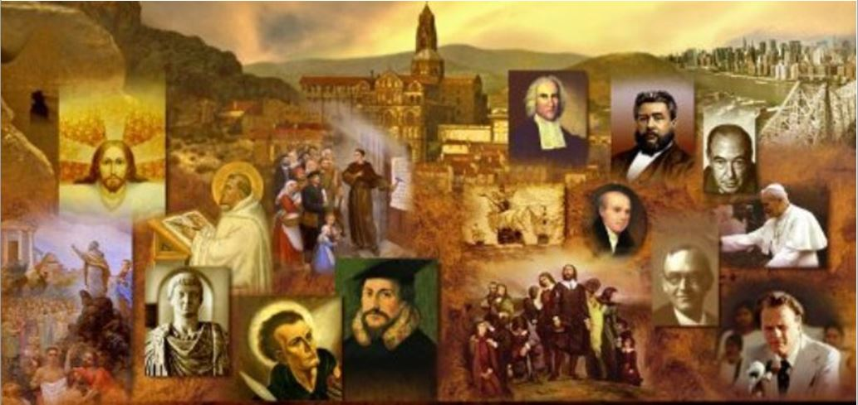
Review
Fill in the blanks: Aquinas was strongly influenced by the theology of _____and the philosophy of _____.
  Augustine
  Aristotle
Aquinas’s “five ways,” or proofs for God’s existence, were all based on the fundamental idea that the world is an _____ which needs a _____, and the cause is God.
  “effect”
  “cause”
Finish this statement: Aquinas said that “The person who knows God best is he who recognizes …
  that whatever he thinks and says falls short of what God really is.”

Slide 3
Review
Aristotle had distinguished between the “accidents” and “substance” of an object. Describe what Aristotle meant by each of these ideas.
  The accidents of an object were the physical qualities of that object which could be grasped by the bodily senses.
  the substance of an object was the basic inner reality, perceived only by the mind, that gives that object its particular identity.
Explain how Aquinas used these categories to defend the Roman Catholic doctrine of Transubstantiation that had developed by his day.
  When the priest pronounces the words, “This is My body, this is My blood”:
    the substance (the non-physical inner reality) of the bread and wine is miraculously changed into Christ’s flesh and blood.
    While the accidents (the physical form, taste, and smell) of the bread and wine remain the same; as far as human bodily senses are concerned, they are still bread and wine.

Slide 4
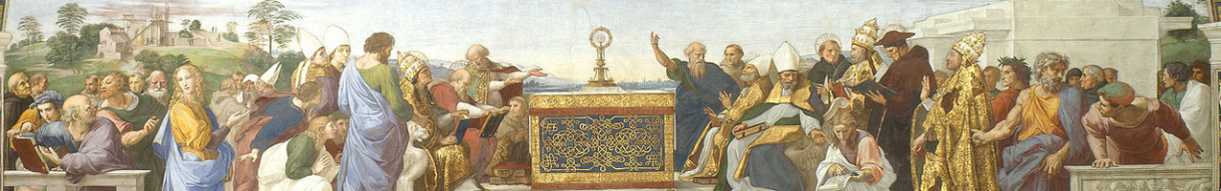
Later Scholastic Theologians
https://www.studium-scholasticum.org/

Slide 5
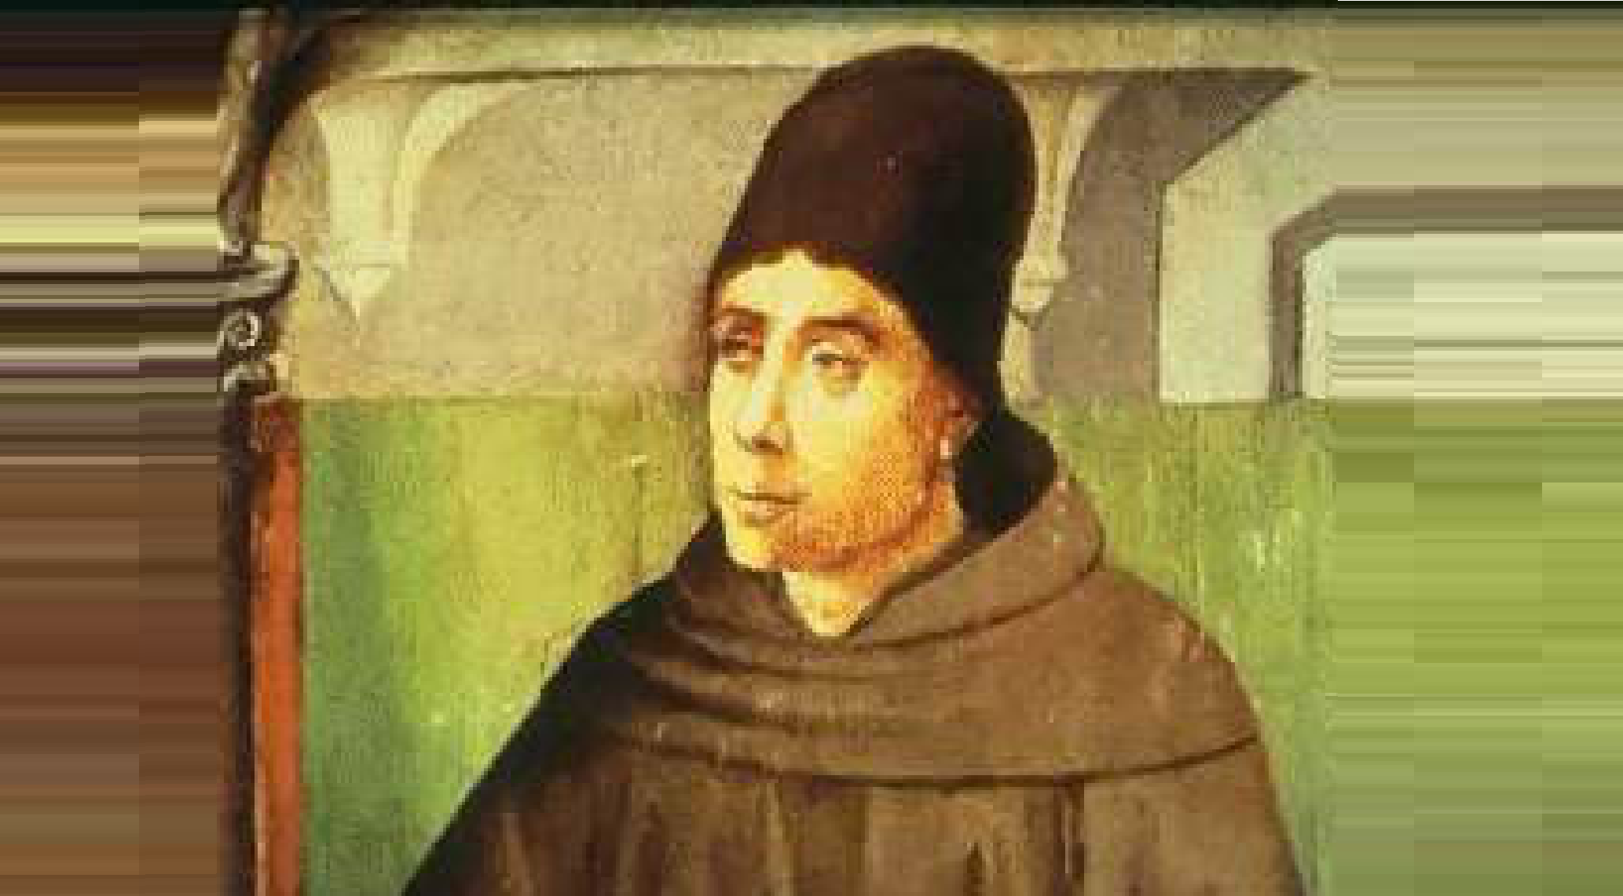
John Duns Scotus
https://medium.com/the-liturgical-legion/john-duns-scotus-and-divine-atemporal-knowledge-76352b5cbc75

Slide 6
John Duns Scotus
John Duns Scotus (1265-1308) was born in Scotland.
In his youth he joined the Franciscan order, and studied at Oxford and Paris Universities.
Scotus was opposed to many of the teachings of Thomas Aquinas. He began a revolutionary new trend in scholasticism by separating theology from philosophy.
Scotus insisted, for example, that reason could not establish the existence of the Christian God; all it could do was prove the existence of a Being who was infinite.
The human mind, he said, could only know the attributes and character of this Being through special divine revelation.
So where Aquinas had “married” theology with philosophy, Scotus started proceedings for their divorce. This would soon alter the whole character of the scholastic enterprise.
Needham, Nick. 2,000 Years of Christ's Power Vol. 2: The Middle Ages

Slide 7
John Duns Scotus
In determining divine truths, Scotus emphasized God’s will over human reason.
The world was what it was, not because reason demanded it, but because God’s will had freely and sovereignly chosen to make things this way.
For example, Scotus applied this outlook to the atonement: he said that Christ’s death had saving power, not because of any inherent worth or value possessed by Christ or His sacrifice, but simply because God sovereignly willed to accept it as a sufficient payment for sin.
Needham, Nick. 2,000 Years of Christ's Power Vol. 2: The Middle Ages

Slide 8
John Duns Scotus
Therefore, according to Scotus, it was impossible for human reason to show that Christian doctrines were “reasonable”, because what God had done was not required of Him by reason, but freely chosen.
We cannot reason about what God must have done or must do; we can only accept, by faith in His revelation, what He has chosen to do.
This new stress in Scotus’s writings on the supremacy of God’s revelation laid the basis for a theology which was more Biblical and less philosophical in character.
Needham, Nick. 2,000 Years of Christ's Power Vol. 2: The Middle Ages

Slide 9
John Duns Scotus
Another conflict between Scotus and Aquinas centered on the doctrine of the “immaculate conception” of the Virgin Mary.
This is the belief that Mary was conceived without original sin (“immaculate” means “without blemish”).
Radbertus in the 9th century seems to have been the first to suggest this idea, but the teaching was rejected by many church leaders including Anselm and Bernard of Clairvaux.
Aquinas taught that Mary was conceived with original sin like all human beings, but was then purified from sin at some point between her conception and her birth.
Needham, Nick. 2,000 Years of Christ's Power Vol. 2: The Middle Ages

Slide 10
John Duns Scotus
Scotus, however, argued that it was a more perfect exercise of God’s grace to preserve an individual from ever having original sin, than to purify an individual from its stain.
Since Christ, the Second Adam, was free from original sin, it seemed fitting that Mary, the Second Eve, should also be free from it.
Therefore, Scotus concluded, since Scripture and Church tradition did not deny it, it seemed “probable” that Mary was conceived without original sin.
Needham, Nick. 2,000 Years of Christ's Power Vol. 2: The Middle Ages

Slide 11
John Duns Scotus
Scotus never went further than saying that the immaculate conception was “probable” because it appeared to follow from other known doctrines.
His followers were less hesitant, and proclaimed the immaculate conception as a definite truth.
Although it was not until 1854 that the immaculate conception became an official Roman Catholic doctrine.
Eastern Orthodoxy and Protestantism both reject the immaculate conception.
Needham, Nick. 2,000 Years of Christ's Power Vol. 2: The Middle Ages

Slide 12
John Duns Scotus
Due to the intricacy and complexity of his theories, Scotus came to be called “The Subtle Doctor” and his most devoted students and followers came to be known as “Dunsmen.”
Scotus’ teachings was viewed favorably by ecclesiastical scholars in the centuries immediately following his death in 1308.
But by the mid-16th century “The Subtle Doctor’s” intensely analytical writings and logic came to be seen as overly complex, and so the Dunsmen, or “Duns” of that day came to be associated with idiocy.
And so we see the origin of the modern term “dunce”.
Needham, Nick. 2,000 Years of Christ's Power Vol. 2: The Middle Ages

Slide 13
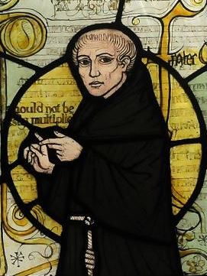
William of Ockham
From stained glass window at a church in Surrey, England
https://upload.wikimedia.org/wikipedia/commons/7/70/William_of_Ockham.png

Slide 14
William of Ockham
William of Ockham (1285-1349) was born at Ockham in Surrey, southern England.
He studied theology at Oxford University where he joined the Franciscan order.
In 1324, Pope John XXII summoned Ockham to Avignon, France where, he became involved in a controversy.
A party called the “spiritual Franciscans” wanted all members of their order to practice absolute poverty, as their founder Francis of Assisi had intended.
Ockham supported this view, but it was condemned by Pope John XXII in 1328.
Needham, Nick. 2,000 Years of Christ's Power Vol. 2: The Middle Ages

Slide 15
William of Ockham
Ockham then fled to Germany where he was protected by the Holy Roman Emperor, Louis the Bavarian, a violent enemy of the papacy.
John XXII excommunicated Ockham, who then spent the rest of his life in Louis’ service.
Ockham wrote against the papacy for Louis, teaching that:
  An ecumenical council of the whole Church was superior to the papacy.
  Popes could err but ecumenical councils and the Bible were both infallible.
  The pope had no power to depose kings and emperors, but an emperor had the power to depose an erring pope.
Needham, Nick. 2,000 Years of Christ's Power Vol. 2: The Middle Ages

Slide 16
William of Ockham
Ockham was a highly influential thinker.
He took further the divorce between theology and philosophy that Scotus had started.
Ockham held that reason could not prove the existence of God; all it could do was suggest arguments to show that, at best, God probably existed.
Ockham also maintained that all our human knowledge was strictly limited to our experience of individual things.
Needham, Nick. 2,000 Years of Christ's Power Vol. 2: The Middle Ages

Slide 17
William of Ockham
For Ockham, then, there was no pathway from reason or experience to spiritual realities or to God.
Reason shows us a spiritually dark and Godless world; only the light of divine revelation in Scripture manifests God to us.
The proper religious task of reason, Ockham said, was not to “prove” Christian doctrines or show how “reasonable” they were, but simply to examine the various statements of Scripture.
By teaching this, Ockham had in some ways abandoned the whole scholastic attempt to build a theology with rational foundations.
Needham, Nick. 2,000 Years of Christ's Power Vol. 2: The Middle Ages

Slide 18
William of Ockham
Occam is most famous for what is known as “Occam’s razor.”
Occam's razor says that when presented with competing hypotheses that make the same predictions, one should select the solution with the fewest assumptions. Or to paraphrase: “the simplest solution is most likely the right one”
Although since Occam’s time this principle has been employed as an argument against the existence of God, this was not Occam’s purpose, for he was convinced that God does exist, even though such existence cannot be proven by rational argument, but must simply be accepted by faith.
And faith affirms not only that God exists, but also that God is omnipotent.
Gonzalez, Justo L.. The Story of Christianity: Volume 1: The Early Church to the Dawn of the Reformation (pp. 434-435).

Slide 19
William of Ockham
Starting from divine omnipotence, Occam and his followers reached the conclusion that human natural reason can prove absolutely nothing regarding God or the divine purposes.
Whatever God pleases to do is possible. Nothing is above the absolute power of God— not even reason, nor the distinction between good and evil.
Strictly speaking, one should not say that God always does good, but rather that whatever God does, no matter what it might be, is good.
It is God who determines what is good, and not vice versa.
Gonzalez, Justo L.. The Story of Christianity: Volume 1: The Early Church to the Dawn of the Reformation (pp. 434-435).

Slide 20
William of Ockham
Likewise, it is incorrect to say that God has to act reasonably.
Reason does not determine God’s action. On the contrary, it is the sovereign will of God that determines what is reasonable.
If this is true, it meant that all the traditional arguments where theologians had tried to prove that a doctrine was “reasonable” were of no value!
Ockham’s theology, after showing that reason could not reach the depths of God, placed everything in God’s hands, and was ready to believe anything that God had revealed.
And to believe it, not because it made sense, but because it had been revealed.
Gonzalez, Justo L.. The Story of Christianity: Volume 1: The Early Church to the Dawn of the Reformation (pp. 434-435).

Slide 21
William of Ockham
Ockham was also influential in reviving Semi-Pelagianism.
The great schoolmen before Ockham had, on the whole (with various modifications), been followers of Augustine and his theology of grace and predestination.
Ockham, however, taught that an unbeliever could merit God’s grace by “doing his best”.
Ockham denied that humanity’s fallen will was in bondage to sin, and made God’s predestination depend on His foreknowledge of those unbelievers who would “do their best” by their own natural capacity.
Needham, Nick. 2,000 Years of Christ's Power Vol. 2: The Middle Ages

Slide 22
William of Ockham
Ockham’s type of Semi-Pelagianism placed a far stronger emphasis on the power of the human will than the older Semi-Pelagians had done.
The older Semi-Pelagians had not held that a sinner could merit grace by doing his natural best, but that unbelievers could freely accept the unmerited grace which alone converts and saves.
Ockham’s teaching was in fact much closer to pure Pelagianism; we could more accurately describe it as “neo-Pelagianism” (the “new Pelagianism”).
This neo-Pelagian trend in scholasticism, begun by William of Ockham, came to its highest point in the great German theologian Gabriel Biel (1420-95), sometimes called “the last of the schoolmen.
Needham, Nick. 2,000 Years of Christ's Power Vol. 2: The Middle Ages

Slide 23
William of Ockham
The theology of Ockham and Gabriel Biel became known as the via moderna, the “modern way”, in contrast to the via antiqua, the “old way” of the previous schoolmen.
The via moderna dominated scholastic theology until the dawn of the Protestant Reformation.
This helps us to understand the forceful way in which the Protestant Reformers denounced scholasticism.
They were, in part, condemning the neo-Pelagian theology of Ockham, Biel and the via moderna, which made salvation into the fruit of natural human free-will and merit, rather than (as the Reformers believed) the fruit of God’s sovereign grace.
Needham, Nick. 2,000 Years of Christ's Power Vol. 2: The Middle Ages

Slide 24
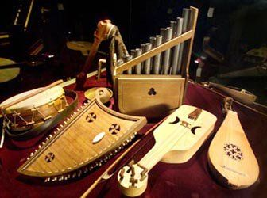
The Rise of Musical Instruments in Worship
https://www.pinterest.com/pin/474496510716734374/visual-search/

Slide 25

https://www.hopehelps.org/volunteer-appreciation-week-2018/

Slide 26

Class Discussion Time
https://www.weareteachers.com/moving-beyond-classroom-discussions/

Slide 27
*Class Discussion Time
John Duns Scotus argued that Christ’s death had saving power, not because of any inherent worth or value possessed by Christ or His sacrifice, but simply because God sovereignly willed to accept it as a sufficient payment for sin. Do you agree or disagree? Explain your answer.
William of Ockham argued that, strictly speaking, one should not say that God always does good, but rather that whatever God does, no matter what it might be, is good. It is God who determines what is good, and not vice versa. Do you agree or disagree. Explain your answer.
Do you agree with Occam when he says that “when presented with competing hypotheses that make the same predictions, one should select the solution with the fewest assumptions”. Or to paraphrase: “the simplest solution is most likely the right one?”
Do you have a topic or question that you would like to see us to discuss?

