Slide 1


Slide 2
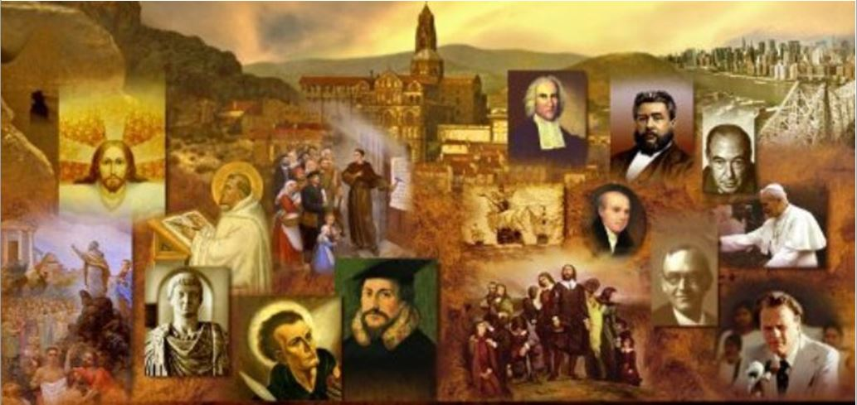
Review
One of the most widespread 13th century dissenting movements from Catholicism was the Cathars (Greek for “____ ____”).
  “pure ones”
French Cathars were called _______
  Albigensians.
The beliefs and practices of the Cathars were basically identical with those of what heretical early Church group?
  Gnostics
When the missionary efforts of the Catholic Church failed to persuade the Cathars, what did the Pope Innocent III do next?
  He launched a Crusade against them
What other dissenting group did the Catholics end up killing along with the Cathars as a part of this Crusade?
  The Waldensians

Slide 3
Review
After an early life as a soldier, Francis had a number of religious experiences in his twenties which led him to embrace a life of _____.
  poverty
In 1210, Francis went to Rome to ask Innocent III to give the new Franciscan movement his backing. After some hesitation, Innocent agreed, having been deeply influenced by a _____.
  dream
Why did Francis resign as leader of the Franciscans in 1220?
  He lost faith in the direction his movement was taking.
Francis was the first known person who claimed to experience the stigmata. Describe what that is.
  A mysterious bleeding from the hands, feet, and side – the places where Christ’s body was pierced.

Slide 4
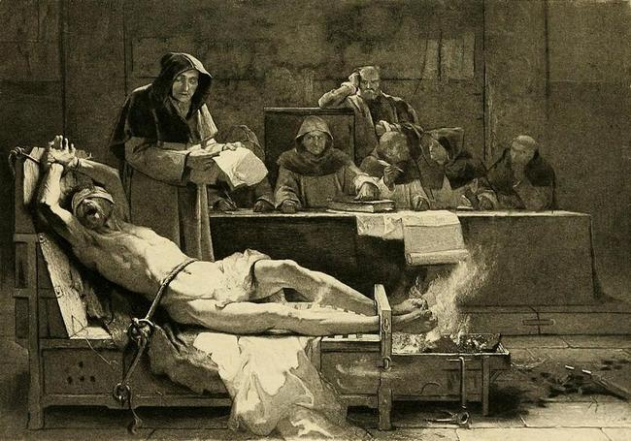
The Inquisition
http://churchandstate.org.uk/wordpressRM/wp-content/uploads/2016/04/Inquisition-1.jpg

Slide 5
The Inquisition
During the progress of the Albigensian crusade, Pope Innocent III took another step towards centralizing Church organization around the papacy.
Previously, the Western Church had left the investigation of heresy to local bishops, who were often ineffective.
Innocent turned the investigation of heresy into a centrally controlled systematic operation, carried out by special papal agents.
His actions laid the basis for what in 1227 became the “inquisition” (or “holy office”, as it was called).
Needham, Nick. 2,000 Years of Christ's Power Vol. 2: The Middle Ages

Slide 6
The Inquisition
The inquisition was a separate organization within the Catholic Church, free from episcopal control and subject only to the pope, dedicated exclusively to uncovering and punishing heretics in Catholic Europe.
It developed into the most feared organization of the later Middle Ages.
The activities of the inquisition forced dissenting movements (like the Waldensians) to meet in secret.
This is the main reason why we know so little about the history of religious dissent in medieval Catholic Europe, compared with what we know of the history of the Catholic Church itself.
Some notable Catholics of the Middle Ages opposed the use of force in dealing with heretics. The most famous was Bernard of Clairvaux.
Needham, Nick. 2,000 Years of Christ's Power Vol. 2: The Middle Ages

Slide 7
The Inquisition
Inquisitors would arrive in a town and announce their presence, giving citizens a chance to admit to heresy.
Those who confessed received a punishment ranging from a pilgrimage to a whipping.
Those accused of heresy were forced to testify. If the heretic did not confess, torture and execution were inescapable.
Heretics weren’t allowed to face accusers, received no counsel, and were often victims of false accusations.
https://www.history.com/topics/religion/inquisition

Slide 8
The Inquisition
Each Inquisition was comprised of about twenty officials:
  a grand inquisitor
  three principal inquisitors or judges
  a finance supervisor
  a civil officer
  an official to receive and account for money fines
  a similar one for confiscated property
  several assessors to evaluate property
  a jailer
  counselors to interview and advise the accused
  executioners to conduct tortures, stranglings, and burnings
  physicians to oversee the torture
  surgeons to repair body damage caused by torture
  clerks to record the proceedings and confessions in Latin
  doorkeepers
  “familiars” who wormed their way into the confidences of those suspected of heresy and then testified against them
Foxe, John. Foxes Book of Martyrs; Updated by Harold J. Chadwick (pp. 71-72) Kindle Version

Slide 9
The Inquisition
Each trial also had witnesses or informers against the accused, and favored visitors, who were sworn to keep secret any procedures and proceedings that they witnessed.
At first the Inquisition was only concerned with charges of heresy, but it soon expanded it’s authority to include charges of such things as sorcery, alchemy, blasphemy, sexual aberration, infanticide, reading the Bible in the common language, or reading the Talmud of the Jews or the Koran of the Muslims.
As heresy charges became less popular in the late 15th century, an increasing number of witches and sorcerers were burned, thereby justifying and prolonging the existence of the Inquisition.
Foxe, John. Foxes Book of Martyrs; Updated by Harold J. Chadwick (pp. 71-72) Kindle Version

Slide 10
The Inquisition
Regardless of the charges, the inquisitors performed their examinations with the utmost severity, having little or no mercy on anyone no matter what their age, sex, race, high birth, distinguished rank or social standing, or physical or mental condition.
And they were especially cruel to those who opposed papal doctrine or authority, most particularly those who once were Roman Catholics and now were Protestants.
A defense before the Inquisition was of little use, for having been charged was sufficient evidence of guilt, and the greater the wealth of the person charged, the greater his danger.
Foxe, John. Foxes Book of Martyrs; Updated by Harold J. Chadwick (pp. 72-75) Kindle Version

Slide 11
The Inquisition
Often a person was executed not for heresy, but for his property.
Many times great lands and homes and even provinces and principalities were acquired by the papal church or by the governing authority cooperating with the Inquisition in their work.
Those charged by the Inquisition were never allowed to know the names of their accusers, and two informants were usually sufficient for a charge.
Foxe, John. Foxes Book of Martyrs; Updated by Harold J. Chadwick (pp. 72-75) Kindle Version

Slide 12
The Inquisition
Every method of persuasion was used by the inquisitors to make the accused persons confess to the charges, and thereby prove the evidence against them and convict themselves.
To do this, every method of physical torture known or that can be imagined was used—such as:
  stretching limbs on the rack;
  burning with live coals or heated metals;
  breaking fingers and toes;
  crushing feet and hands;
  squeezing flesh with pincers;
  scourging with rods or various kinds of whips;
  beating with fists, rods, and clubs;
  twisting limbs and dislocating joints.
The methods used by the sadistic inquisitors are too numerous and horrendous to list.
Foxe, John. Foxes Book of Martyrs; Updated by Harold J. Chadwick (pp. 72-75) Kindle Version

Slide 13
The Inquisition
At the beginning of the questioning, which was recorded in papal Latin by a clerk, suspects and witnesses had to swear under oath that they would reveal everything.
If they would not take the oath, then it was interpreted as a sign of agreement with the charges.
If they denied the charges without proof that they were not guilty, or if they stubbornly refused to confess, or persisted in the heresy, then they were given the most severe punishment, their properties were confiscated, and almost without exception they were sentenced to death by burning.
In its great hypocrisy, the papal church said it was not allowed to shed blood, and so the condemned heretic was turned over to the cooperating secular authorities for punishment and execution.
Foxe, John. Foxes Book of Martyrs; Updated by Harold J. Chadwick (pp. 72-75) Kindle Version

Slide 14
The Inquisition
After the Inquisition completed its judgments, a solemn ceremony was held at the place of execution.
It was attended by local officials, the papal clergy, and all, whether enemies or friends of the heretics, who wished to view the penalties and executions.
If the condemned heretics confessed their heresies and recanted, then they were given their penalties, which might range from being severely whipped to being sent to the gallows.
In any case, all their properties and goods were confiscated for use by the papal church or the local authorities.
Foxe, John. Foxes Book of Martyrs; Updated by Harold J. Chadwick (pp. 72-75) Kindle Version

Slide 15
The Inquisition
If the accused obstinately clung to their heresies, they were solemnly cursed and turned over to the executioner to be burned immediately for all to see.
By this public display, the Roman clergy hoped that fear of the Inquisition would be burned into the minds and hearts of those watching the flames consume heretics who opposed the papal church.
But those who had true faith in Christ were actually strengthened in their faith as they saw the courage of the martyrs and the grace of God that sustained them through their tortures and in the flames.
Of all the offices of the Inquisition throughout the world, the Inquisition in Spain was the most active and sadistic, and is an example of the terrible danger of giving unlimited power over the bodies and lives of people to unholy men who claim to be holy.
Foxe, John. Foxes Book of Martyrs; Updated by Harold J. Chadwick (pp. 72-75) Kindle Version

Slide 16
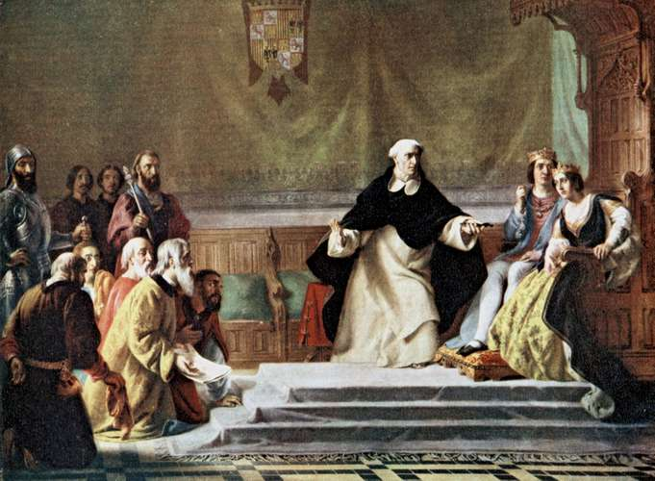
The Spanish Inquisition
Spanish Jews pleading before King Ferdinand and Queen Isabella, while grand inquisitor Tomás de Torquemada argues for their expulsion from Spain
Painting by Solomon A. Hart, 19th Century British painter
https://www.britannica.com/topic/Spanish-Inquisition

Slide 17
The Spanish Inquisition
Although there are almost no records of the number of people killed or tortured throughout the world by the Inquisition, a few records concerning the Spanish Inquisition have come down to us.
There were seventeen tribunals in Spain, and each burned an average of 10 heretics a year, and tortured and mutilated thousands of others who were never able to fully recover from their wounds.
Over the years of the Spanish Inquisition it is estimated that about 32,000 people, who were guilty of nothing more than disagreeing with papal doctrine, or who had been accused of superstitious crimes, were tortured beyond belief and then burned alive.
Foxe, John. Foxes Book of Martyrs; Updated by Harold J. Chadwick (pp. 75-77) Kindle Version

Slide 18
The Spanish Inquisition
In 1483, at the insistence of the Roman Catholic rulers of Spain, Ferdinand II of Aragon and Isabella I of Castile, Pope Sixtus IV created an independent Spanish Inquisition to be presided over by a high council and grand inquisitor.
In 1487 Pope Innocent VIII appointed Spanish Dominican monk, Tomas de Torquemada, as grand inquisitor. Under his authority, thousands of Christians, Jews, Muslims, suspected witches, and others were killed or tortured.
Those in the greatest danger from the Inquisition were the Protestants and the Spanish mystics.
Foxe, John. Foxes Book of Martyrs; Updated by Harold J. Chadwick (pp. 75-77) Kindle Version

Slide 19
The Spanish Inquisition
Torquemada’s name became synonymous with cruelty, bigotry, intolerance, and hate.
He was the most feared man in Spain, and during his reign of terror from 1487 to 1498 he personally ordered more than 2000 people to be burned at the stake.
This amounted to 181 people a year, when the average Spanish tribunal was burning only 10 a year.
With the support of the Roman Catholic rulers, the early Spanish inquisitors were so savage in their methods of torture and terror that even Pope Sixtus IV cringed at the reports, but was unable to lessen the horrors that he had unleashed on Spain.
Foxe, John. Foxes Book of Martyrs; Updated by Harold J. Chadwick (pp. 75-77) Kindle Version

Slide 20
The Spanish Inquisition
When Torquemada was made grand inquisitor, it was even worse, and he conducted the Inquisition as if he were the god of Spain.
Anything that he could classify as a spiritual offense was given to the attention of his inquisitors.
In 1492 the Inquisition was used to expel all Jews and Moors from Spain or to force their conversion to Roman Catholicism.
At Torquemada’s urging, Ferdinand and Isabella expelled from Spain more than 160,000 Jews who had not converted to the papal religion.
Foxe, John. Foxes Book of Martyrs; Updated by Harold J. Chadwick (pp. 75-77) Kindle Version

Slide 21
The Spanish Inquisition
For political purposes, the inquisitors also held their cruel investigations among the colonists and converted Indians in the Spanish colonies in America.
Despite an eventual decline in its cruelties, the Inquisition remained in effect in one form or another until the early 19th century—1834 in Spain, and 1821 in Portugal—when it was simply renamed but not abolished.
In 1908, the Inquisition was reorganized under the title Congregation of the Holy Office, and redefined during Vatican Council II in 1965 by Pope Paul VI as the Congregation for the Doctrine of the Faith.
It has today, it is said, the more positive task of furthering right doctrine rather than “censuring” heresy.
Foxe, John. Foxes Book of Martyrs; Updated by Harold J. Chadwick (pp. 75-77) Kindle Version

Slide 22
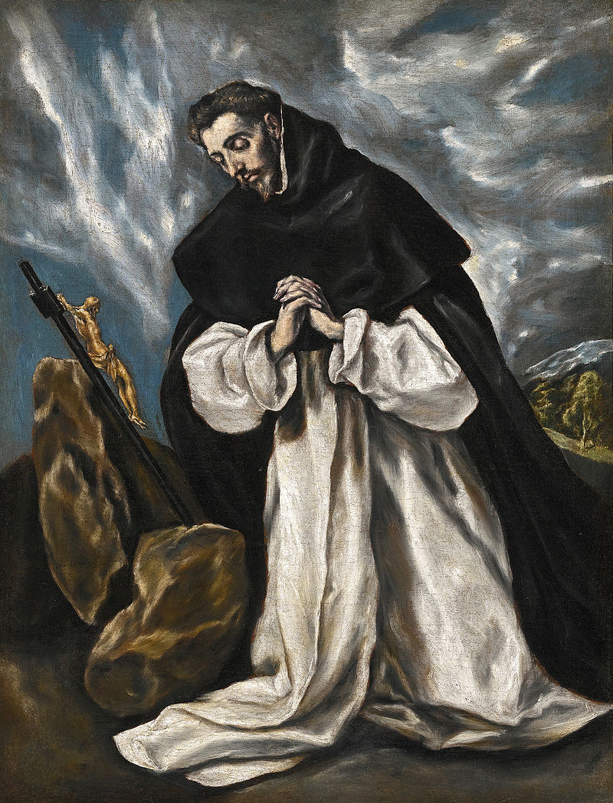
Saint Dominic and the Dominicans
Portrait by El Greco, about 1600
https://en.wikipedia.org/wiki/Dominican_Order#/media/File:Santo_Domingo_en_oraci%C3%B3n.jpg

Slide 23

https://www.hopehelps.org/volunteer-appreciation-week-2018/

Slide 24

Class Discussion Time
https://www.weareteachers.com/moving-beyond-classroom-discussions/

Slide 25
*Class Discussion Time
In the Inquisition we see the violation of a legal concept that has been held in high regard in most civilized nations since the time of Roman law: that a person is to be presumed innocent until proven guilty. Do you think this is an important legal principle? If so, why?
In the inquisition we also see a violation of a protection granted in the Eighth Amendment to the United States Constitution which prohibits “cruel and unusual punishments”. One of the difficulties that arises in enforcing this prohibition is defining what is and is not “cruel and unusual”. For example some have argued that the death penalty is cruel and unusual. What are your thoughts on this subject?
Do you have a topic or question that you would like to see us to discuss?

