Slide 1


Slide 2
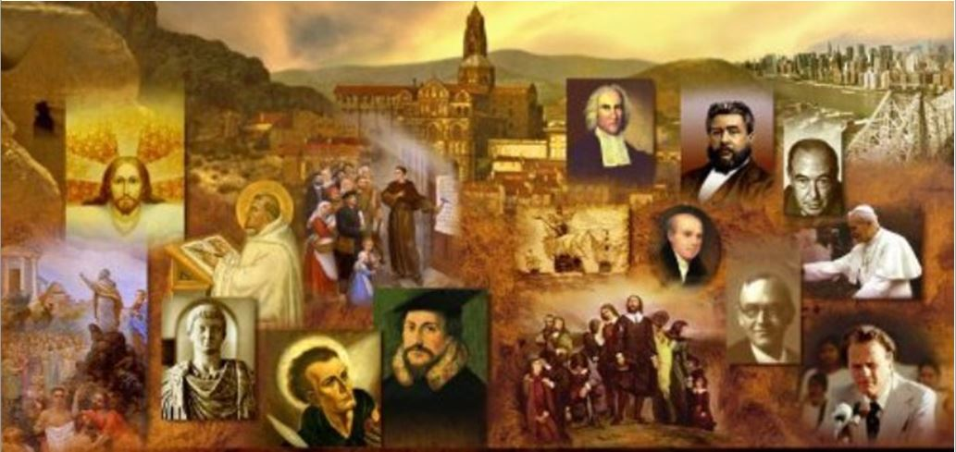
Review
In the 13th and early 14th centuries, Franciscans and Dominicans were at the forefront of a new wave of Catholic missionary enterprise to reach what two people groups?
  Muslims and Mongols
Raymond of Penafort, a Spanish Dominican, who evangelized Muslims in Spain and North-West Africa from 1240 to 1275, persuaded _____ to write his Summa contra Gentiles as a handbook for teaching Christianity to Muslims.
  Thomas Aquinas
After emerging from Mongolia under Genghis Khan in 1205, the Mongols had created a vast empire which included land now occupied by what modern day countries and/or regions?
  China, the Middle East, and southern Russia.
The great Mongol ruler Kublai Khan came in touch with Western Christianity through the travels of the _____ family, merchants of Venice, who were in China from 1260 to 1269, and again from 1275 to 1291. The most famous of which was who?
  Polo
  Marco Polo

Slide 3
Review
The Black Plague, one of the most devastating pandemics in human history, was most likely carried by _____ living on the ____ that traveled on all merchant ships, spreading throughout the Mediterranean Basin and Europe.
  Fleas
  Black rats
The Black Death is estimated to have killed __ to __ % of Europe's population.
  30% to 60%
With such a large population decline from the Plague, _____ soared in response to a labor shortage.
  wages
Why did Christians sometimes blame the Jews for causing the plague?
  Because the plague seemed to make less headway in Jewish neighborhoods.

Slide 4
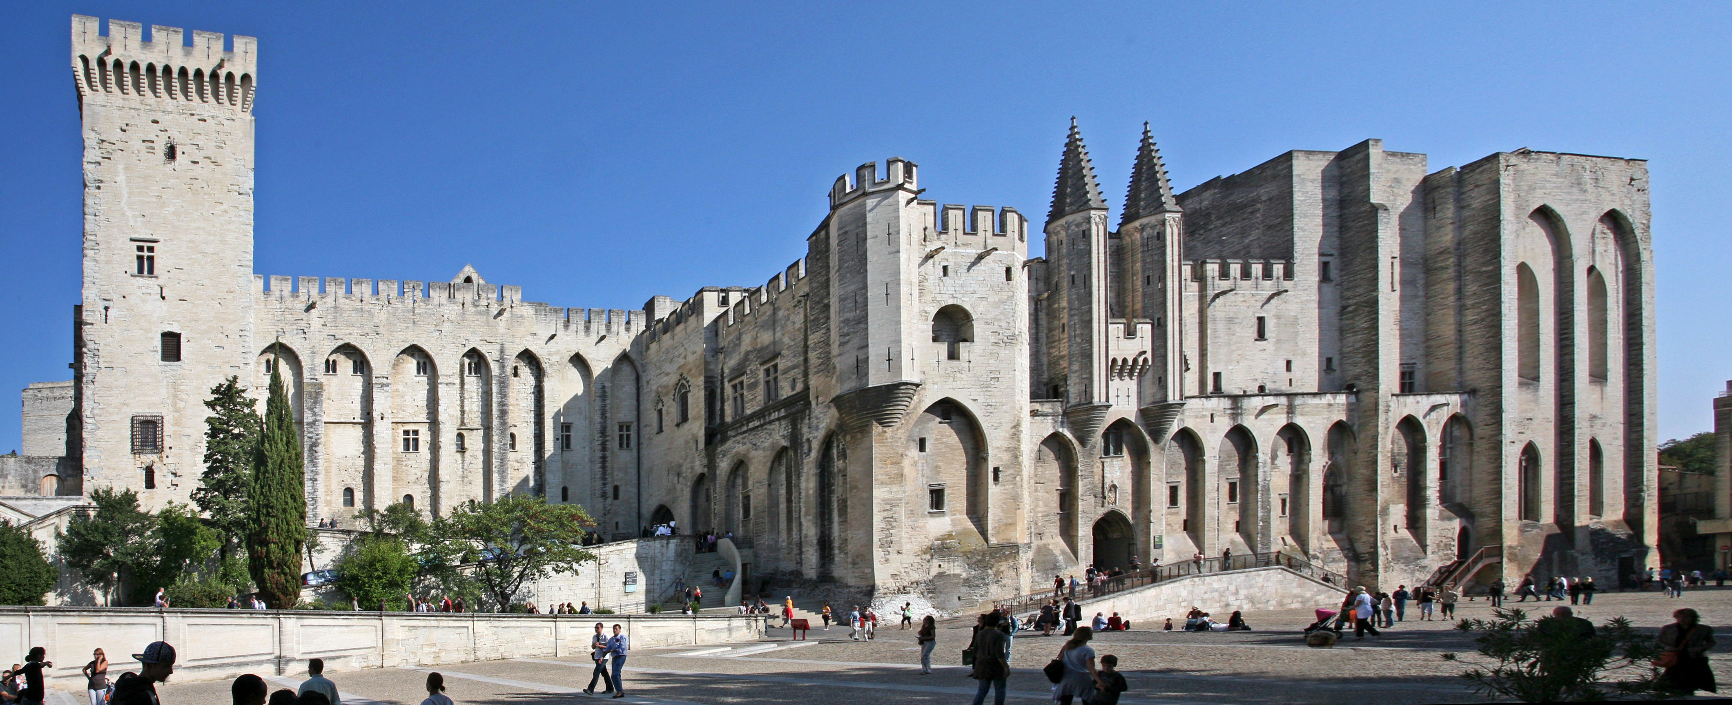
The “Babylonian Captivity” of the Papacy (1309-77)
The Papal palace in Avignon, France
https://en.wikipedia.org/wiki/Avignon_Papacy#/media/File:Avignon,_Palais_des_Papes_by_JM_Rosier.jpg

Slide 5
The "Babylonian Captivity" of the Papacy
The papacy had reached the height of its political power in Western Europe under Innocent III.
His death in 1216 was followed by a period of disaster.
The popes continued to struggle against the Holy Roman Emperors; their conflict with Frederick II (1210-50), whom Innocent III himself had settled on the German throne, was especially bitter.
However, the long warfare between papacy and Empire had permanently weakened the power of the German monarchy, by undermining Germany’s national unity.
Because of this, the real power lay in the hands of the local German princes, not the Emperor.
Therefore the threat to the independence of the papacy no longer came from Germany, but from France.
Needham, Nick. 2,000 Years of Christ's Power Vol. 2: The Middle Ages

Slide 6
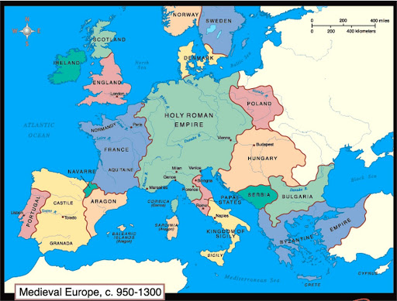
Medieval Europe 950-1300

Slide 7
The "Babylonian Captivity" of the Papacy
In contrast to the situation in Germany, the French monarchy was growing in strength.
It reached dangerous levels, as far as the papacy was concerned, under King Philip the Fair (1285-1314).
Philip was a ruthless tyrant who had the highest views of his own absolute authority over all French affairs.
Conflict broke out between Philip and Pope Boniface VIII (1294-1303) over taxation.
In 1295 Philip levied a tax on the French clergy to finance a war with England.
The French clergy complained to Boniface, who decreed the excommunication of all who imposed or paid such taxes without papal permission.
Philip responded by forbidding the export of gold and silver from France; this crippled the economy of Rome.
Needham, Nick. 2,000 Years of Christ's Power Vol. 2: The Middle Ages

Slide 8
The "Babylonian Captivity" of the Papacy
In 1301 Pope Boniface sent a special papal legate to Philip’s court to complain about Philip’s, seizure of Church property.
King Philip had the legate arrested and charged with high treason. The conflict escalated.
Pope Boniface ordered the release of the legate and summoned Philip to Rome.
Philip called a national assembly of French nobles, clergy and commoners, which supported him in his defiance of the papacy.
Boniface reacted by issuing a “papal bull” in 1302, entitled Unam sanctam, which claimed that all political authorities are subject to the pope, and that submission to the pope is necessary for salvation.
Needham, Nick. 2,000 Years of Christ's Power Vol. 2: The Middle Ages

Slide 9
The "Babylonian Captivity" of the Papacy
King Philip’s response was to declare that Pope Boniface was unfit to occupy the papal throne, and he summoned the pope to appear before an ecumenical Council of the whole Church.
The French parliament, clergy and Paris University all joined in this declaration.
Boniface prepared to excommunicate Philip, but before he could do so, the French king had Boniface kidnapped and imprisoned.
Philip’s agents demanded that he resign from the papacy; Boniface refused.
Allies rescued Boniface from imprisonment, but he died a month later, an old and broken man, while the struggle was still raging.
Needham, Nick. 2,000 Years of Christ's Power Vol. 2: The Middle Ages

Slide 10
The "Babylonian Captivity" of the Papacy
The papacy was now in serious trouble.
Philip had appealed to French national opinion against the claims of Rome, and had succeeded.
When Pope Boniface’s successor, Pope Benedict XI (1303-4), died after a reign of only eight months, the French faction of cardinals succeeded in electing a French pope, Clement V (1305-14).
Pope Clement was a weak man who simply became the tool of King Philip.
Pope Clement never set foot in Rome, and after four years of wandering around southern France, in 1309 he established the papal court in Avignon, a city near southern France.
Needham, Nick. 2,000 Years of Christ's Power Vol. 2: The Middle Ages

Slide 11
The "Babylonian Captivity" of the Papacy
The papacy remained in Avignon for nearly 70 years (1309-77), a captive of the French monarchy and its policies.
Those hostile to France referred to this period as the “Babylonian captivity” of the papacy; modern historians call it the “Avignonese captivity”.
There were seven popes in this period, all Frenchmen.
According to Roman Catholic theology, the apostle Peter, the “first pope”, had been the bishop of Rome and therefore it was paramount that the pope continue to reside in Rome.
With the popes now in Avignon, torn loose from their ancient historic seat in Rome, it seemed to many that the papacy had lost its true identity and become nothing more than a mere political pawn in the hands of the French kings.
Needham, Nick. 2,000 Years of Christ's Power Vol. 2: The Middle Ages

Slide 12
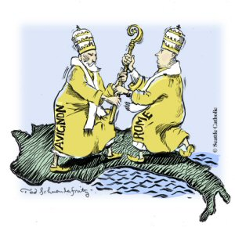
The Western Schism
http://medievalchurchhistory.blogspot.com/2012/10/lesson-26-babylonian-captivity-of.html

Slide 13
The Western Schism
The papacy finally returned to Rome in 1377 under Pope Gregory XI (1370- 78); the great Italian mystic, Catherine of Siena, inspired him to make the move.
Needham, Nick. 2,000 Years of Christ's Power Vol. 2: The Middle Ages

Slide 14
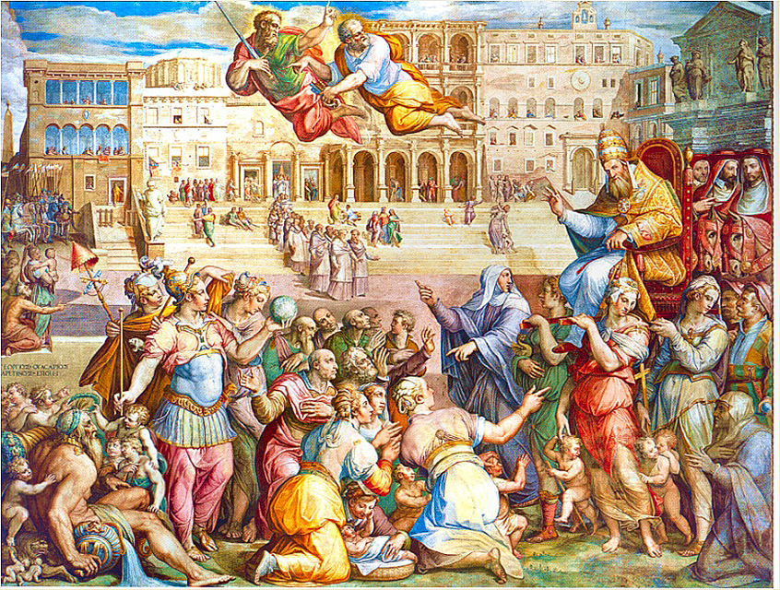
The Return of Pope Gregory XI to Rome
https://en.wikipedia.org/wiki/Avignon_Papacy

Slide 15
The Western Schism
The papacy finally returned to Rome in 1377 under Pope Gregory XI (1370- 78); the great Italian mystic, Catherine of Siena, inspired him to make the move.
Gregory died the following year.
The French cardinals would gladly have gone back to Avignon, but the Roman population was determined to keep the papacy in Rome and demanded an Italian pope.
Under pressure from the Roman population, the cardinals elected Pope Urban VI (1378-89), an Italian who wanted to liberate the papacy from French control.
However, a few months after Urban’s election, 12 of the 16 cardinals declared that the election was null and void, because it had been carried out under threat of popular violence.
Needham, Nick. 2,000 Years of Christ's Power Vol. 2: The Middle Ages

Slide 16
The Western Schism
So the cardinals chose another Frenchman as pope – Clement VII (1378-94).
Clement and his cardinals returned to Avignon and set up court there. Urban VI stayed in Rome.
There were now two rival popes.
This had happened before, when an Emperor had set up a rival pope for political reasons.
However, this time the two popes had both been elected by the Church itself – by the same body of cardinals.
The two rival popes, Urban VI and Clement VII, excommunicated each other.
Needham, Nick. 2,000 Years of Christ's Power Vol. 2: The Middle Ages

Slide 17
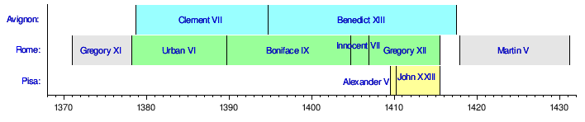
The Western Schism
https://en.wikipedia.org/wiki/Western_Schism

Slide 18
The Western Schism
Since there was no higher authority in the Church above a pope who had been elected by the cardinals, there was no power that could choose between them.
This rending asunder of the Catholic Church is known as the “Western Schism”.
Catholic Europe was split down the middle.
The Roman pope, Urban VI, won the support of northern and central Italy, England, the Scandinavian countries, and most of Germany.
The Avignonese pope, Clement VII, had the backing of France, Spain, southern Italy, Scotland, and some parts of Germany.
Needham, Nick. 2,000 Years of Christ's Power Vol. 2: The Middle Ages

Slide 19
The Western Schism
Urban VI died in 1389, and the Roman line of popes carried on with Boniface XI (1389-1404), Innocent VII (1404-1406) and Gregory XII (1406-15).
In Avignon, Clement VII was succeeded by Benedict XIII (1394-1417).
If the Avignonese captivity had damaged the reputation of the papacy, the Western Schism caused it to sink even lower.
The visible unity of the Catholic Church was broken. And the situation dragged on for nearly 40 years.
The minds of many loyal and sincere Churchmen began to feel that the answer to the scandal of the Great Schism must be found in an ecumenical Council of the whole Catholic Church – and in making the papacy subject to the Council.
Needham, Nick. 2,000 Years of Christ's Power Vol. 2: The Middle Ages

Slide 20
The Western Schism
The first attempt to end the Great Schism by an ecumenical Council took place in 1409 at the Council of Pisa (north-western Italy).
The Council was summoned by the cardinals acting on their own authority.
The Council deposed both rival popes, Gregory XII (Rome) and Benedict XIII (Avignon), and asserted that ecumenical councils were superior to the papacy. But the disposed popes refused to step down.
So when the Council then elected a new pope, Alexander V (1409-10), there were now three rival popes!
England and France acknowledged the new Pisan pope, Alexander V, but Italy and much of Germany continued to support Gregory XII of Rome, while Spain and Scotland stayed loyal to Benedict XIII of Avignon!
Needham, Nick. 2,000 Years of Christ's Power Vol. 2: The Middle Ages

Slide 21
The Western Schism
In 1414-18 the Council of Constance (in north-eastern Switzerland) made another attempt to end the Schism.
This time it was the Holy Roman Emperor Sigismund (1410-37) who summoned the Council.
Sigismund acted in alliance with Pope John XXIII (1410-15), the successor to Alexander V who had been elected by the Council of Pisa.
However, once the Council of Constance met, it deposed Pope John XXIII for scandalous misconduct, and persuaded Pope Gregory XII of Rome to resign.
The Council then officially deposed Benedict in 1417.
Then the cardinals, together with representatives of the nations present, elected the Italian cardinal, Colonna, as the new pope; he assumed the name Martin V (1417- 31).
Needham, Nick. 2,000 Years of Christ's Power Vol. 2: The Middle Ages

Slide 22
The Western Schism
The Council of Constance was revolutionary. It had ended the Great Schism, but only by subjecting the papacy to the authority of an ecumenical Council.
It seemed that the conciliarists had demolished the absolute papal monarchy of Hildebrand and Innocent III, and replaced it by a more limited, constitutional, democratic form of Church government.
However, the new pope, Martin V, after ascending the papal throne, abandoned whatever conciliarist convictions he may have had, and there was much friction between him and the next two ecumenical Councils at Pavia-Siena (1423-24) and Basel (1431-49).
Martin V died only months after the Council of Basel (north-western Switzerland) opened; Eugenius IV (1431-47) succeeded him.
Needham, Nick. 2,000 Years of Christ's Power Vol. 2: The Middle Ages

Slide 23
The Western Schism
Eugenius tried to adjourn the Council, but it refused to disband and declared its own superiority over him as pope. The Council then began a great program of administrative and moral reforms.
It appeared that Pope Eugenius was captive to the Council.
However, Eugenius turned the tables completely in 1437 by moving the Council to the north-eastern Italian city of Ferrara, where he received the Byzantine Emperor John VIII, the patriarch of Constantinople, Joseph II, and other delegates of Eastern Orthodoxy.
The Byzantines wanted to negotiate a union with the Catholic Church in return for Western military support against the Ottoman Turks.
Needham, Nick. 2,000 Years of Christ's Power Vol. 2: The Middle Ages

Slide 24
The Western Schism
The Council at Basel was split; a minority followed the pope to Ferrara.
In 1439 Eugenius moved the Council again, to Florence (south of Ferrara).
He successfully concluded a union with the Orthodox, the “Union of Florence”, which sent his personal prestige soaring.
The Council at Basel reacted rather foolishly by deposing Eugenius and electing a new pope, Felix V (1439-49).
But this act dealt a mortal blow to the influence of the conciliarists, because they were seen as plunging the Church into schism again.
Eventually, more and more members of the Council defected to Eugenius and what was left of the Council dissolved itself in 1449.
Needham, Nick. 2,000 Years of Christ's Power Vol. 2: The Middle Ages

Slide 25
The Western Schism
This marked the end of the conciliar movement. The papacy had triumphed.
Eventually, the Orthodox Churches of the East scorned the agreement its delegates had made with Pope Eugenius, but it had served Eugenius’s purposes well.
He had re-established the papacy as the true leader of Western Catholicism.
The conciliar theory lived on in the Church, but the incredible incompetence of the conciliarists at Basel had ruined any hope of making the Catholic Church into a more democratic institution.
Needham, Nick. 2,000 Years of Christ's Power Vol. 2: The Middle Ages

Slide 26
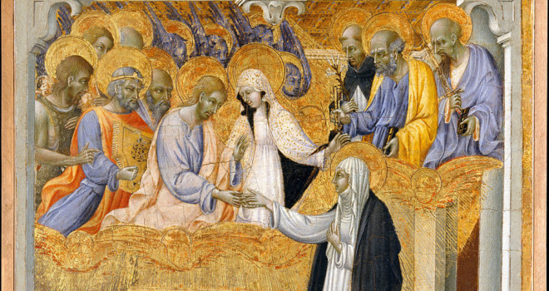
The Medieval Mystics
The Mystic Marriage of Saint Catherine of Siena - Giovanni Di Paolo (1403–1482)
https://catholicexchange.com/spiritual-guidance-st-catherine-siena

Slide 27

https://www.hopehelps.org/volunteer-appreciation-week-2018/

Slide 28

Class Discussion Time
https://www.weareteachers.com/moving-beyond-classroom-discussions/

Slide 29
*Class Discussion Time
While modern “Protestant” churches would never think of trying to appoint a “pope” to rule over the church, there is a longstanding tendency in churches to reject the Biblical teaching that local churches are to be ruled of a plurality of elders and to choose instead to set things up where one man is leading the church. What is it about the leadership of a single individual that churches find so attractive?
Likewise, the scriptures teach that church leadership should be limited to the local church. In light of what happened with the hierarchical approach to church leadership that occurred within the Roman Catholic Church, do you see the value of subsidiarity when it comes to church leadership?
Do you have a topic or question that you would like to see us to discuss?

