Slide 1


Slide 2
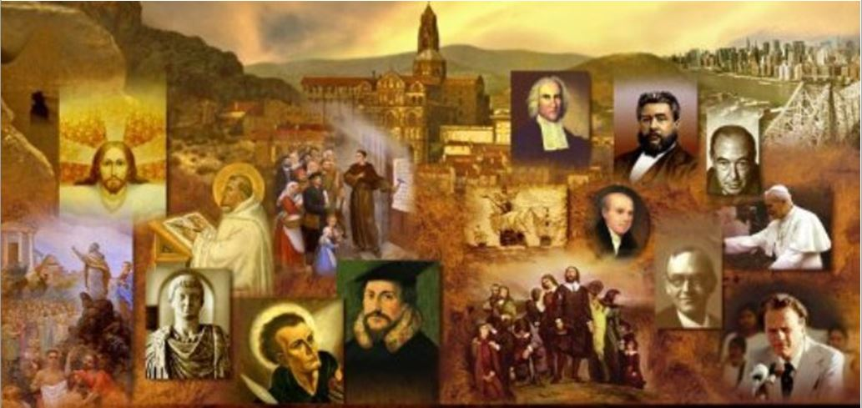
Review
What country posed the biggest threat to the independence of the papacy in the late 13th century?
  France
What started the conflict between King Philip of France and Pope Boniface VIII?
  King Philip began taxing the clergy in order to help finance his war with England
How was King Philip able to succeed in his conflict with the pope?
  He was able to keep French opinion on his side.
Why was it so devastating to Roman Catholic theology for the French to move the papacy to Avignon for 70 years?
  Because according to Roman Catholic theology, the apostle Peter, the “first pope”, had been the bishop of Rome and therefore it was paramount that the pope continue to reside in Rome.

Slide 3
Review
Who convinced Pope Gregory XI to return from Avignon to Rome in 1377?
  The great Italian mystic, Catherine of Siena
What was it that caused the same group of cardinals to elect Pope Urban VI, an Italian pope, to then turn right around a few months later and chose a second pope – Clement VII, a Frenchman?
  Pressure and the threat of violence from the Roman population
How did the Council of Pisa end up raising the number of simultaneously serving popes from two to three?
  They appointed a third pope, Alexander V, but were unable to successfully depose the two existing popes.
How did the problem of having three simultaneously serving popes in finally get resolved?
  In 1417, the Council of Constance was able to successfully remove the three existing popes and elect a new Italian pope, Martin V.

Slide 4
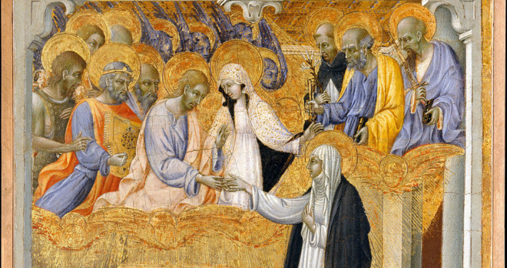
The Medieval Mystics
The Mystic Marriage of Saint Catherine of Siena - Giovanni Di Paolo (1403–1482)
https://catholicexchange.com/spiritual-guidance-st-catherine-siena

Slide 5
The Medieval Mystics
Mysticism exists in every religion.
Mystics tend to view mainline religion as too cold, doctrinal, orthodox, etc. They are looking for an experience of some kind.
Mysticism became very popular in the late medieval time period (14th – 16th centuries). People were looking for a direct experience with God.
Put together scholasticism and the corruption of the church and you can see what would drive people to mysticism.
People often want to react against cerebralism and grab hold of something more emotional.
The Eastern Orthodox not only had mysticism, mysticism became mainstream in the East. The Eastern Orthodox want nothing to do with religious dogma.
James White – 2016 Church History Series #49 – Inquisition and Witches; Mystics - Introduction

Slide 6
The Medieval Mystics
Catherin of Sienna (1347 -1380)
She devoted herself to prayer.
Practiced self-flagellation for her sins
She claimed that Christ appeared to her and gave her a ring and asked her to marry him.
She requested the stigmata, the marks of the crucifixion.
She went to Florence and negotiated peace between Florence and Abigion.
James White – 2016 Church History Series #50 – Mystics and Pre-Reformation Reformers

Slide 7
The Medieval Mystics
Catherin of Sienna (continued)
She convinced Pope Gregory XI to bring the papacy back to Rome, during the Avignon period.
She survived an attack of small pox.
When she died, her head was made a relic.
She was canonized, made the patron saint of Rome.
In the 1960s she was made a “doctor of the church”, i.e., a person who had a tremendous impact on the church down through the ages.
James White – 2016 Church History Series #50 – Mystics and Pre-Reformation Reformers

Slide 8
The Medieval Mystics
Meister Eckhart (1260-1327)
Was considered the great teacher of German mysticism.
He would often say things that were open to misinterpretation and led many to consider him a heretic.
For example, Eckhart believed that all language about God is analogical, and therefore inexact.
But here is how he said it: “If I say, ‘God is good,’ that is not true. I am good. God is not.”
This statement gave the impression that Eckhart lacked respect for the godhead, even though that’s not what believed.
Gonzalez, Justo L.. The Story of Christianity: Volume 1: The Early Church to the Dawn of the Reformation (p. 426).

Slide 9
The Medieval Mystics
Meister Eckhart (continued)
Another example: Eckhart believed that before the foundation of the world, the ideas of all things that would exist were in the mind of God.
But here is how he said it:
  Within that true essence of the godhead… I already existed. There I willed myself. There I knew myself. There I wished to create the man I am. For that reason, I am my own cause according to my being, which is eternal, although not according to my becoming, which is temporal.
This statement led many to consider him a heretic.
Eckhart protested repeatedly that such charges were based on mistaken interpretations of his teachings.
Toward the end of his career, he was formally charged with heresy, and convicted of it. He then appealed to Rome, but died before the case was settled.
Gonzalez, Justo L.. The Story of Christianity: Volume 1: The Early Church to the Dawn of the Reformation (p. 426).

Slide 10
The Medieval Mystics
Thomas à Kempis (1380-1471)
Is the author of one of the most famous literary works of the mystics: The Imitation of Christ.
This devotional classic was published in Latin, French, German, Spanish, Italian, and English by the end of the fifteenth century, and it remains one of the most popular devotional guides to this day.
Sir Thomas More (1478-1535), England's famous lord chancellor under Henry VIII, said it was one of the three books that everybody ought to own.
Methodist founder John Wesley said it was the best summary of the Christian life he had ever read.
Galli, Mark. 131 Christians Everyone Should Know (p. 262, 265).

Slide 11
The Medieval Mystics
Thomas à Kempis (continued)
In The Imitation, Thomas combines a painfully accurate analysis of the soul with a clear vision of the fullness of the divine life.
Some examples of teachings found in this work:
  “If you want to learn something that will really help you, learn to see yourself as God sees you and not as you see yourself in the distorted mirror of your own self-importance.”
  “This is the greatest and most useful lesson we can learn: to know ourselves for what we truly are, to admit freely our weaknesses and failings, and to hold a humble opinion of ourselves because of them.”
  “If you aim at a fervent spiritual life, then you too must turn your back on the crowds as Jesus did. The only man who can safely appear in public is the one who wishes he were at home. He alone can safely speak who prefers to be silent. Only he can safely govern who prefers to live in submission, and only he can safely command who prefers to obey.”
Galli, Mark. 131 Christians Everyone Should Know (p. 263).

Slide 12
The Medieval Mystics
Savonarola (1452-1498)
Was a Dominican monk in Florence who claimed to have had visions. As a result of these visions, he attacked the church and even the papacy for its luxuriousness.
Savonarola prophesied that there would be divine judgment on the city of Florence because of its sins.
In his prophecy he was very specific, saying that the coming judgment would be by the king of France.
In September 1494 King Charles VIII of France crossed the Alps with a formidable army, throwing Italy into political chaos.
Many viewed the arrival of King Charles as proof of Savonarola's gift of prophecy. They repented wholesale.
John H. Gerstner - Handout Church History – Study Guide; Lesson 17

Slide 13
The Medieval Mystics
Savonarola (continued)
Pope Alexander, who believed Savonarola to be a false prophet, became concerned that Savonarola’s influence in Florence might continue to grow.
Therefore he threatened the people, and excommunicated and arrested Savonarola.
Savonarola’s last words as he was being burned may have been his greatest and truest: “You may cut me off from the church militant here below, but you cannot cut me off from the church triumphant above.”
John H. Gerstner - Handout Church History – Study Guide; Lesson 17

Slide 14
The Medieval Mystics
Teresa of Avila (1515-1582)
Spanish mystic, later made a doctor of the church.
She was an active reformer of the Carmelites, one of the orders of the Roman church at that time.
Her parents were Jewish converts.
At age 21, against her father's wishes, she professed vows as a Carmelite at the Spanish Convent of the Incarnation in Avila.
As a reformer she worked tirelessly to eradicate abuses.
In the Carmelites, she founded 17 convents in Spain.
She once had a vision of an angel driving a spear into her abdomen.
James White – 2016 Church History Series #50 – Mystics and Pre-Reformation Reformers

Slide 15
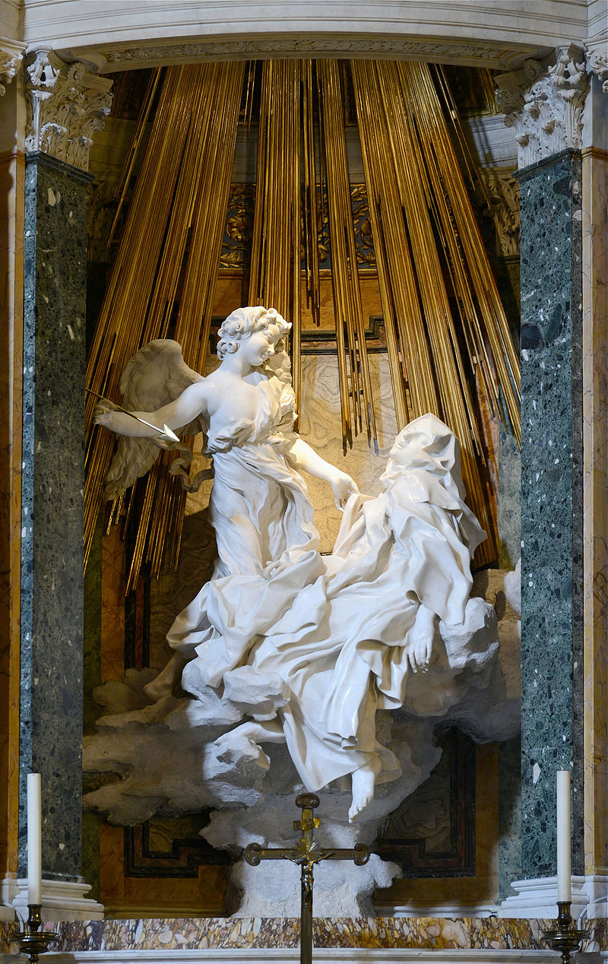
The “Ecstasy of Saint Teresa”
https://en.wikipedia.org/wiki/Ecstasy_of_Saint_Teresa

Slide 16
The Medieval Mystics
Julian of Norwich (1342-1416)
She was a recluse who lived in a door-less apartment that had only two windows, that looked into a church, which is where food would be passed into her.
She claimed to receive revelations.
In 1473, she got one where God told her that she was his wife. And from that she wrote a devotional commentary in which she spoke of the “motherhood of God”.
James White – 2016 Church History Series #50 – Mystics and Pre-Reformation Reformers

Slide 17
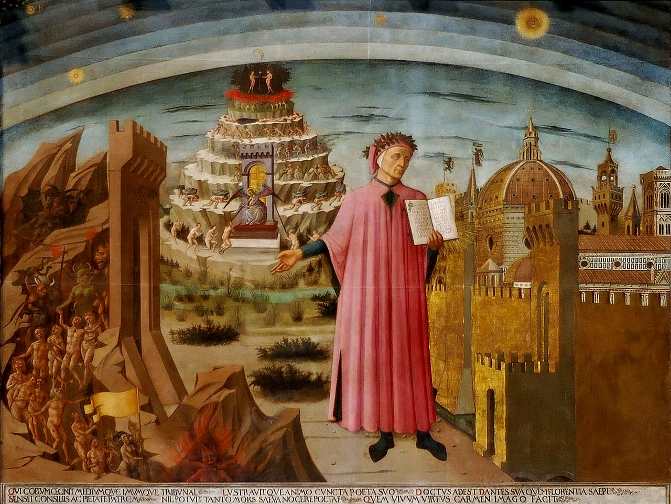
Dante and the
Divine Comedy
Dante shown holding a copy of the Divine Comedy, next to the entrance to Hell, the seven terraces of Mount Purgatory and the city of Florence, with the spheres of Heaven above, in Michelino's fresco
https://en.wikipedia.org/wiki/Divine_Comedy

Slide 18
Dante and the Divine Comedy
We now take a brief look at the life and work of a man usually ranked as the greatest Christian poet of all time – Dante Alighieri (1265-1321).
Dante was born in the Italian city of Florence. The first part of his life saw him actively committed to Florentine politics, which proved complex and catastrophic.
Although Florence was a Guelf (papalist) city in the conflict between pope and Holy Roman Emperor, the Florentine Guelfs were themselves divided into White and Black Guelfs.
Dante was a White Guelf – a papalist, but opposed Pope Boniface VIII’s ambitions for secular dominion.
Needham, Nick. 2,000 Years of Christ's Power Vol. 2: The Middle Ages

Slide 19
Dante and the Divine Comedy
In 1302 the Black Guelfs seized power in Florence and exiled the leading White Guelfs, including Dante, who never set foot inside his native city again.
He spent the rest of his life wandering across northern Italy, dying of malaria in Ravenna in 1321.
Dante’s bitter experience of banishment hardened his political views into a more anti-papal form; his treatise De Monarchia (“Concerning Monarchy”) argued that papacy and Empire were equal in authority, each having its own sphere, and that in civil, secular affairs the Emperors were not subject to papal decrees.
An enraged papacy had Dante’s book publicly burnt.
Needham, Nick. 2,000 Years of Christ's Power Vol. 2: The Middle Ages

Slide 20
Dante and the Divine Comedy
Dante’s emotional and spiritual life was dominated by a woman – Beatrice Portinari.
Just a few months older than Beatrice, Dante first met her when they were nine, and then again when they were 18.
He was utterly and forever enchanted by Beatrice’s grace and beauty; her image in his mind had a sweetening influence which expelled all impure thoughts.
Unfortunately for lovers of romance, Beatrice married another man in 1289, and then died a year later at the age of 25, without enjoying even a single kiss from Dante.
Even so, she lived on in Dante’s heart and imagination for the rest of his life as the ideal of perfect womanhood.
Needham, Nick. 2,000 Years of Christ's Power Vol. 2: The Middle Ages

Slide 21
Dante and the Divine Comedy
Dante himself married three years after Beatrice’s death, but his own wife Gemma had no chance of winning his affections away from his adored Beatrice; in fact, when the Black Guelfs banished him from Florence in 1302, Dante left Gemma behind and never saw her again.
Dante’s poetic masterpiece was his Divine Comedy, divided into three books – Inferno, Purgatory, and Paradise.
It begins with Dante lost in a gloomy forest (symbolizing sin), where he meets the great Pagan Roman poet Virgil (70-19 BC), who symbolizes human philosophy.
Virgil guides Dante through hell and purgatory, where among other suffering souls he sees numerous popes.
Needham, Nick. 2,000 Years of Christ's Power Vol. 2: The Middle Ages

Slide 22
Dante and the Divine Comedy
Leaving purgatory, now cleansed from his own sins, Dante meets his beloved Beatrice, who symbolizes the light of divinely revealed truth; she now guides him to the exalted heights which Virgil (philosophy) cannot reach – heaven.
For the vision of God, even Beatrice must give place to Bernard of Clairvaux, Dante’s most admired saint, who presents him to the Virgin Mary; and through Mary’s intercession, Dante receives a glimpse of the Trinity in all its glory.
Needham, Nick. 2,000 Years of Christ's Power Vol. 2: The Middle Ages

Slide 23
Dante and the Divine Comedy
Students of poetry have generally regarded the Divine Comedy as the most glorious Christian poem ever written, the Christian equivalent of Homer’s Iliad.
Its outlook is that of a devout medieval Catholic;
Dante was a disciple of Thomas Aquinas in doctrinal matters.
However, his imaginative and moving depiction of the central Christian theme – the salvation of the soul from sin by the mercy of God in Christ – has won admiration among believers of every shade of theology; and his hostility to a corrupt papacy and its pretensions to world dominion has endeared Dante to Protestants.
Needham, Nick. 2,000 Years of Christ's Power Vol. 2: The Middle Ages

Slide 24
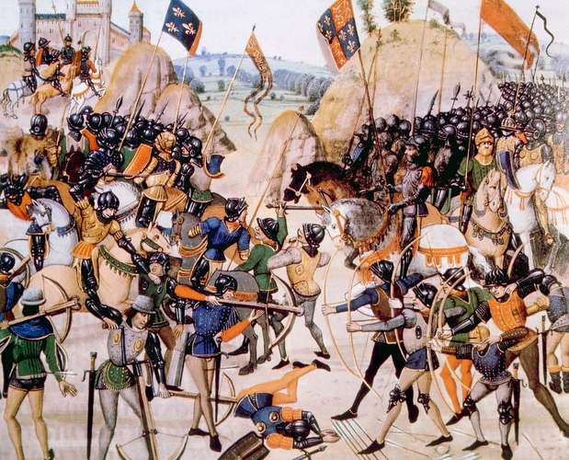
The Hundred Years War
Image depicting the Battle of Crécy, in which Edward III of England defeated Philip VI of France, August 26, 1346
https://www.britannica.com/event/Hundred-Years-War/From-the-Treaty-of-Bretigny-to-the-accession-of-Henry-V-1360-1413

Slide 25

https://www.hopehelps.org/volunteer-appreciation-week-2018/

Slide 26

Class Discussion Time
https://www.weareteachers.com/moving-beyond-classroom-discussions/

Slide 27
*Class Discussion Time
Regarding the popularity of mysticism in the late medieval period, James White said “People often want to react against cerebralism and grab hold of something more emotional”. Do you think he is right about this? Do you think that’s a good thing?
In his “Handout Church History”, from which I drew my material on Savonarola in today’s material, Dr. John Gerstner (mentor of R.C. Sproul) wrote:
  “Savonarola did not know that the miracle of predictive prophecy had ceased with the apostolic age… God, who is sometimes pleased to allow the deceived to remain deceived, permitted the successful and sobering invasion of Charles… The easily and willingly deceived people saw this as divine confirmation of Savonarola.”
What are your thoughts on Dr. Gerstner’s assessment of that historical event?
Do you have a topic or question that you would like to see us to discuss?

