Slide 1


Slide 2
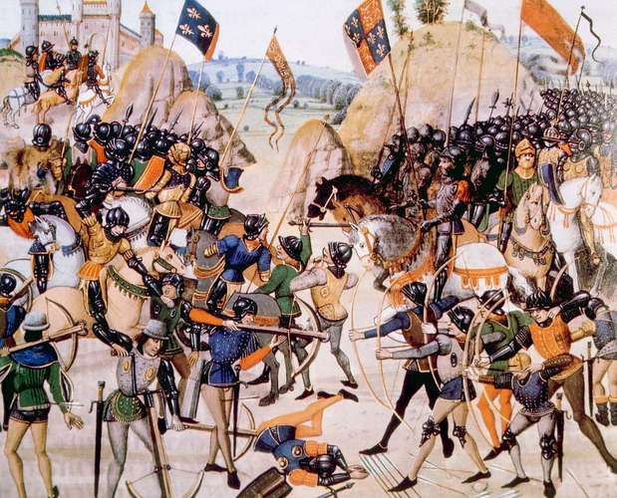
The Hundred Years War
Image depicting the Battle of Crécy, in which Edward III of England defeated Philip VI of France, August 26, 1346
https://www.britannica.com/event/Hundred-Years-War/From-the-Treaty-of-Bretigny-to-the-accession-of-Henry-V-1360-1413

Slide 3
The Hundred Years War
The dominant political and military event of the fourteenth and fifteenth centuries was the Hundred Years’ War (1337– 1475).¹
The Hundred Years' War was a series of conflicts in which five generations of kings from two rival dynasties fought for the throne of the largest kingdom in Western Europe. ²
Although basically a conflict between France and England, this war so involved the rest of Europe that some historians suggest that it be called the “First European War.” ¹
¹Gonzalez, Justo L.. The Story of Christianity: Volume 1: The Early Church to the Dawn of the Reformation (p. 388).
²https://en.wikipedia.org/wiki/Hundred_Years%27_War

Slide 4
The Hundred Years War
Repeatedly the English invaded France, won impressive victories on the battlefield, but then were forced to withdraw for lack of funds. ¹
But by 1378, the French under King Charles the Wise (aka Charles V) had reconquered most of the lands they lost leaving the English with only a few cities on the continent. ²
In the following decades, however, the newly crowned Henry V of England seized the opportunity presented by the mental illness of Charles VI of France and the French civil war that occurred under his watch to revive the conflict.²
¹ Gonzalez, Justo L.. The Story of Christianity: Volume 1: The Early Church to the Dawn of the Reformation (p. 388).
² https://en.wikipedia.org/wiki/Hundred_Years%27_War

Slide 5
The Hundred Years War
The English and their allies were winning when Charles VI died.
Charles VI’s son Dauphin, whose party had been losing in the French civil war, declared that he was now king, and took the name of Charles VII.
He was besieged in Orleans (in 1429), and had little hope of truly becoming the ruler of France, when many of his former enemies decided that, now that his father was dead, they should support him.
It was also at that time that Dauphin first heard of Joan of Arc, a young woman from the village of Domrémy.
Gonzalez, Justo L.. The Story of Christianity: Volume 1: The Early Church to the Dawn of the Reformation (p. 388).

Slide 6
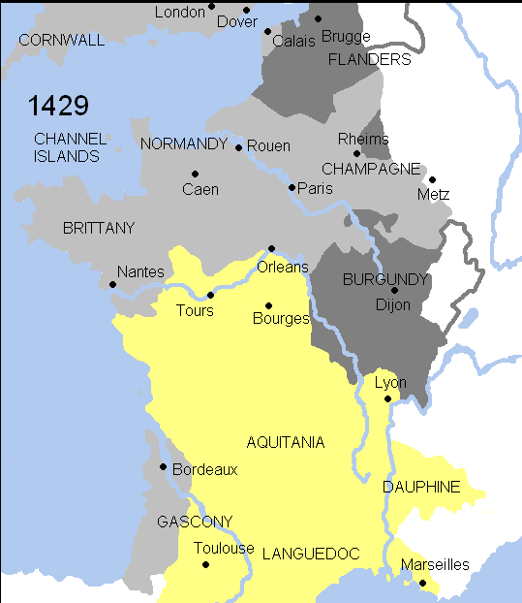
Siege of Orléans
https://en.wikipedia.org/wiki/Hundred_Years%27_War#/media/File:Hundred_years_war.gif

Slide 7
The Hundred Years War
Joan of Arc claimed that she had had visions of Saints Catherine and Margaret, and of Archangel Michael, ordering her to lead the Dauphin’s troops to break the siege of Orleans, and then to have him crowned at Rheims, the place where kings of France were traditionally crowned.
On hearing this, Dauphin, who was somewhat skeptical of her claims, sent for her, perhaps to amuse himself.
But Joan convinced him to trust her, and she was sent across enemy lines to bring back to city supplies that were sorely needed.
She was then allowed to lead an attack against the besiegers, in which she had incredible success.
Gonzalez, Justo L.. The Story of Christianity: Volume 1: The Early Church to the Dawn of the Reformation (p. 388).

Slide 8
The Hundred Years War
Rumors circulated in the enemy camp of this young maiden, clad in armor, who, every day came out of the city, and every day took one of their bastions.
Finally, the siege was broken, and the enemy withdrew.
The “Maid of Orleans”— as she was then called— did not allow the Dauphin’s troops to follow the retreating armies, pointing out that it was Sunday, a day for prayer and not for battle.
From that point on, the course of the war changed.
Gonzalez, Justo L.. The Story of Christianity: Volume 1: The Early Church to the Dawn of the Reformation (p. 388).

Slide 9
The Hundred Years War
The French, tired of civil war, flocked to the Dauphin’s standards, and Joan was able to accompany him in a triumphal march to Rheims.
This and other cities that had long held out against him opened their gates, and he was finally crowned in the Cathedral of Rheims, while the Maid of Orleans stood by the altar.
She wished to return to Domrémy, but the king would not allow it. Instead she was forced to continue fighting, was eventually captured, and was then sold to the English.
Her former allies abandoned her, and it seems that the king did not even try to negotiate for her ransom.
Gonzalez, Justo L.. The Story of Christianity: Volume 1: The Early Church to the Dawn of the Reformation (p. 388).

Slide 10
The Hundred Years War
The English sold her for ten thousand francs to a bishop in northern France, who then tried her as a heretic and a witch. The trial took place in Rouen (northern France).
She was accused of heresy for claiming to receive orders from heaven, for insisting that these orders were given to her in French, and for dressing as a man.
She agreed to sign a recantation, and was condemned to life imprisonment.
But then she said that Saints Catherine and Margaret had spoken to her again, and rebuked her for her recantation, which she now withdrew.
In consequence, she was taken to the Old Market Square in Rouen and burned alive.
Gonzalez, Justo L.. The Story of Christianity: Volume 1: The Early Church to the Dawn of the Reformation (p. 388).

Slide 11
The Hundred Years War
Joan of Arc’s last request to the priest who accompanied her was to hold the crucifix high, and speak the words of salvation loudly, so she could hear them above the roar of the flames.
Twenty years later, Charles VII (Dauphin) entered Rouen and ordered an inquiry which, as was to be expected, exonerated her.
In 1920, Pope Benedict XV granted her sainthood within the Roman Catholic Church.
But long before that she had become the national hero of France.
Gonzalez, Justo L.. The Story of Christianity: Volume 1: The Early Church to the Dawn of the Reformation (p. 388).

Slide 12
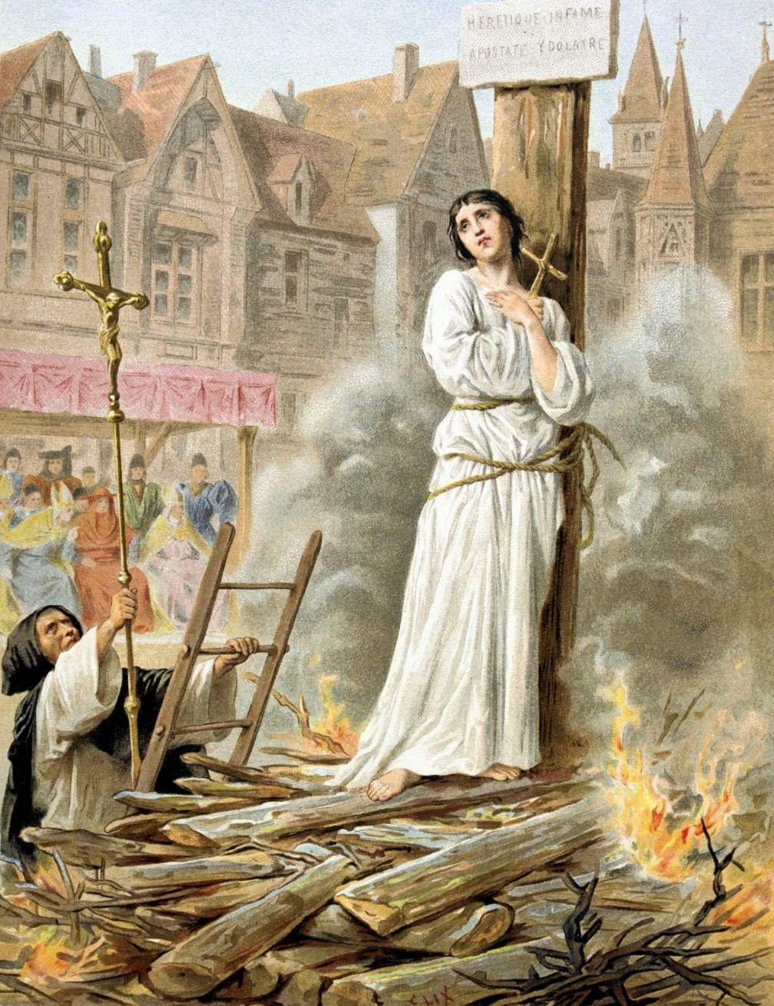
Joan of Arc Burned Alive
https://www.catholica.com/why-was-st-joan-of-arc-burned-to-death/

Slide 13
The Hundred Years War
In 1475 a peace treaty was finally signed between England and France.
This long war had enormous consequences for the life of the church.
Since during part of the war the popes resided in Avignon under the shadow of the French, the English came to see the papacy as their enemy.
Later, during the Western Schism, the church was divided in its allegiance to two rival popes, nations chose their allegiance partly on the basis of alliances and enmities created by the Hundred Years’ War— and the war itself made it more difficult to put an end to the schism.
The enduring international conflict strengthened nationalist sentiments in Europe, and thus weakened the claims of the papacy to universal authority.
Gonzalez, Justo L.. The Story of Christianity: Volume 1: The Early Church to the Dawn of the Reformation (p. 388).

Slide 14
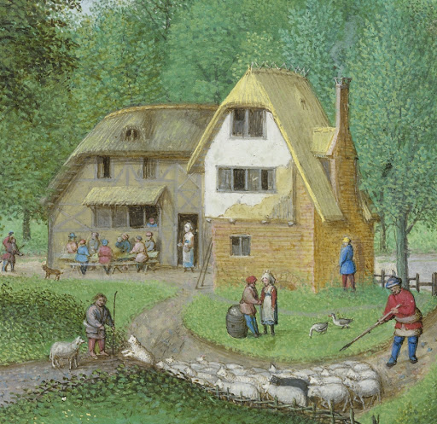
Medieval Family Life
http://www.ampltd.co.uk/collections_az/Medieval-Family-Life/highlights.aspx

Slide 15
Consent in Marriage
By the twelfth century, European civilization had been transformed from a tribal to a feudal system.
One profound change during this process, which affected all aspects of society, was the establishment of the rights of the individual as expressed in necessity for "consent" by the parties entering into marriage.
In the course of establishing this fundamental norm, the Church found itself in a great struggle with the landed aristocracy, who used arranged marriage and family ties to build alliances and extend power.
World Eras Vol. 4 - Medieval Europe (814-1350); Jeremiah Hackett; p.308

Slide 16
Influences on Marriage Practices
There were three central influences on the development of marriage customs in the Middle Ages:
  Roman law
  Germanic traditions
  Christian theology
In some areas these value systems were in agreement; in others they differed and needed to be modified and integrated into a coherent set of beliefs and practices.
All three gave priority to the family unit and prohibited incest.
All three sought to promote exogamy (marriage outside the immediate family group).
World Eras Vol. 4 - Medieval Europe (814-1350); Jeremiah Hackett; p.308

Slide 17
Influences on Marriage Practices
Two areas of divergence from Christian practice included the Germanic practice of:
  Polygamy (marriage to more that one mate at the same time)
  Concubinage (cohabitation with a person to whom one is not legally married)
The Romans and the Germanic peoples accorded men greater sexual freedom than women.
Both allowed men to dissolve their marriages, but only Roman law allowed women to divorce their husbands.
While recognizing the authority of fathers and husbands, the Church prohibited all divorce and wanted to restrict sexual activity to married couples.
The process by which these three value systems were integrated was slow and involved a growing tension between secular and ecclesiastical values.
World Eras Vol. 4 - Medieval Europe (814-1350); Jeremiah Hackett; p.308

Slide 18
Monogamy
Prior to the eighth century, powerful men often followed the Germanic customs of having multiple wives as well as concubines.
This practice had concentrated women among a small elite and left many men without the possibility of finding marriage partners.
In the eighth century, the Church was successful at imposing monogamy on the laity.
Monogamy helped to distribute women more evenly across society, allowing more men to marry and more households to be established.
This process, however, took centuries and was met with great resistance by the aristocracy, who resisted the imposition of monogamy openly in the ninth century and more indirectly, but just as energetically, on into the thirteenth.
World Eras Vol. 4 - Medieval Europe (814-1350); Jeremiah Hackett; p.308-9

Slide 19
Extension of Church Control
In the ninth century a wedding was essentially a secular ceremony that a priest might be invited to bless
By the twelfth century marriage had become one of the seven sacraments and as such was celebrated in church as a public ecclesiastical ritual.
An outcome of this change was the doctrine of the indissolubility of marriage – a couple united by God should not be separated for earthly considerations.
The Church also tried unsuccessfully to eliminate secular marriages, but—in accordance with its emphasis on the importance of mutual consent and the indissolubility of the marriage bond—it recognized these unions as long as there was proof of consent.
World Eras Vol. 4 - Medieval Europe (814-1350); Jeremiah Hackett; p.309

Slide 20
Sex in Marriage
Many medieval people believed that virginity was a higher state than marriage and procreation. Thus, a celibate lifestyle was adopted by many religious people.
Some ongoing ancient traditions condemned sexual pleasure as sinful and sought to regulate it in sexual acts.
The Church taught that procreation—not sexual enjoyment—was the important outcome of the conjugal act and prohibited any sex act that did not fall into that category.
And yet, it is apparent that in society sexual activity outside of marriage was common.
World Eras Vol. 4 - Medieval Europe (814-1350); Jeremiah Hackett; p.308-9

Slide 21
Childbirth and Baptism
Because of limited medical knowledge and unsterile conditions, having a baby was one of the most dangerous times in a medieval woman's life.
Midwives assisted in childbirth, drawing on knowledge and experience passed down through generations.
By the thirteenth century, midwives were being trained and licensed.
If possible an infant was baptized in a formal ceremony about one week after its birth.
World Eras Vol. 4 - Medieval Europe (814-1350); Jeremiah Hackett; p.309

Slide 22
Childhood Responsibilities
Between the ages of four and eight peasant children were occupied mainly with children’s games, and usually only after the age of eight were given chores, most of them at home:
  the boys guarding the sheep or geese, pasturing or watering oxen and horses, gleaning after harvest;
  the girls picking wild fruit, fetching water, helping with the cooking.
At adolescence, boys joined their fathers in the fields.
Gies, Frances. Marriage and the Family in the Middle Ages (Medieval Life) (p. 208-9).

Slide 23
Preparation for Adulthood
Among all classes, noble, artisan, and peasant, some adolescents left home, to be educated, to learn a trade, or to become servants.
The sons and daughters of the nobility were sent to other aristocratic households, often those of relatives, the sons to train as knights, the daughters to learn social graces.
A city boy might be boarded out as an apprentice to the master of a craft, his parents paying for his maintenance.
Most guilds did not allow boys to be apprenticed to their own fathers, so apprenticeship normally meant leaving home at an early age.
Even middle-class boys who went to school were commonly apprenticed once they had learned to read and write, education was considered a luxury whereas competence in business or a craft was viewed as life-sustaining.
Gies, Frances. Marriage and the Family in the Middle Ages (Medieval Life) (p. 209).

Slide 24
Preparation for Adulthood
Peasants, male and female, sometimes left home to become servants.
A peasant might in effect sell his daughter to a master who paid him a modest lump sum, fed, clothed, and lodged her, and let her small wages accumulate for her dowry.
When the girl was of marriageable age, the employer undertook to find her a match, or she might return home to marry.
Boys also might go to work on the manorial farm or for other peasant families.
Gies, Frances. Marriage and the Family in the Middle Ages (Medieval Life) (p. 210).

Slide 25
Preparation for Adulthood
A noble or peasant boy might board at a cathedral school, whose curriculum included Latin grammar, the Latin classics, and philosophy.
Masters devoted the morning to reading and interpreting Latin authors, the afternoon to grammar, and the evening to philosophical discussion, concluding with prayer.
Every day, each student was required to recite part of what he had learned the day before, so “each succeeding day thus became the disciple of its predecessor.”
Students were then required to write compositions imitating the authors they had studied.
To ensure that their reading was retained and not “precipitated to flight by spurs,” each student daily had to memorize a poem or story and recite it.
When they did poorly, they were beaten.
Gies, Frances. Marriage and the Family in the Middle Ages (Medieval Life) (p. 210).

Slide 26

The Dawn of the Reformation
http://www.redlightdawn.com/

Slide 27

https://www.hopehelps.org/volunteer-appreciation-week-2018/

Slide 28

Class Discussion Time
https://www.weareteachers.com/moving-beyond-classroom-discussions/

Slide 29
*Class Discussion Time
Joan of Arc, was one of the rare exceptions historically of women serving in combat (much less leading in combat). In our day, feminists have sought to challenge this thinking. Do you think there is something to the idea that only men should serve in combat roles – or is that just patriarchal thinking that we should abandon? Please explain your answer.
We saw today that during the Middle Ages that the aristocracy held to the idea that parents should decide who their children would marry, whereas the church challenged this assumption and insisted that individuals had the right to choose their own spouse – which is pretty much the practice in the West in our day. Do you think the church was right in insisting on the right of individuals to choose their own spouse, or would we be better off returning to the practice of parents choosing who their children will marry (a practice that we also see in OT times). Please defend your answer.
What do you think about the Medieval practice of farming out your kids to another family or institution in order to train them for their life occupation?
Do you have a topic or question that you would like to see us to discuss?

