Slide 1


Slide 2
Major Periods of Church History
Early Church
Medieval Church
Reformation
Modern Church
AD 33
600
1517
1648

Slide 3


The Early Church
Persecuted Church
Imperially Sanctioned Church
325 – The Council of Nicaea
410 – Rome sacked by Visigoths
33 – Death, Burial, and Resurrection of Christ
354-430 – Augustine of Hippo
313 - Edict of Milan
First Century
Second Century
Third Century
Fourth Century
Fifth
Century
Sixth
Century
AD 1
100
200
300
400
500
600

Slide 4
The Medieval Church
Early
Middle Ages
High
Middle Ages
Late
Middle Ages
7th Century
8th Century
9th Century
10th Century
11th
Century
12th
Century
13th
Century
14th
Century
15th
Century
600
700
800
900
1000
1100
1200
1300
1400
1500

Slide 5
The Early Middle Ages
The Rise and Spread of Islam – The Spread and Corruption of the Church
The Rise of the “Holy Roman Empire”
805 – 869 – Gottschalk – Medieval Calvinist
656 – Muslims divide into Shias and Sunnis
831 – Early form of Transubstantiation Introduced by Radbertus
732 – Battle of Tours – Charles Martel Halts Islamic Advance
731 – Venerable Bede's Ecclesiastical History published
970 – Founding of Al-Azhar – Oldest Muslim University
800 – Charlemagne crowned Holy Roman Emperor
901 – Corruption of the Papacy begins (Pornocracy)
716 – Boniface begins mission to the Germans
610 – Muhammad’s Vision – Rise of Islam
726 – Beginning of the Iconoclast Controversy
590 – 604 – Gregory the Great
988 – Christianization of “Russia”
675 – 749 – John of Damascus
7th Century
8th Century
9th Century
10th Century
600
700
800
900
1000

Slide 6
High Middle Ages
The Height of Papal Power – Physical Attacks on “Enemies” of the Church The Rise of Scholasticism and the University
1151 – Peter Lombard writes the standard theological textbook
1274 – Thomas Aquinas writes the Summa Theologica
1122 – Peter Abelard writes his well-known work Sic et non
1220 – Dominic Guzman founded the Dominican Order
1256 – Establishment of the Augustinian Order
1093 – Anselm becomes Archbishop of Canterbury
1054 – The East West Schism
1073 – Hildebrand becomes Pope
1096 – 1099 – The First Crusade
1155 – Bologna recognized as a university
1170 – Notre Dame becomes a university
1182 – 1226 – Saint Francis of Assisi
1189 – 1192 – The Third Crusade
1198 – Innocent III becomes Pope
1202-1204 – The Fourth Crusade
1209 – Albigensian Crusade
1227 – Beginning of the Inquisition
1184 – Waldensians excommunicated
1147 – 1149 – The Second Crusade
1285 – 1349 – William of Ockham
11th
Century
12th
Century
13th
Century
1000
1100
1200
1300

Slide 7
Late Middle Ages
The Weakening and Division of the Papacy – Wars and Plagues
The Rise of Nationalism – Forerunners to the Reformation
1303 – John Duns Scotus teaches Immaculate Conception
1377 – Catherin of Sienna persuades Pope to return to Rome
1453 – Constantinople falls; End of Eastern Roman Empire
1309–1377 – The Babylonia Captivity of the Papacy
1418 – Thomas a' Kempis writes The Imitation of Christ
1380 – Wycliffe supervises English Bible translation
1431 – Joan of Arc burned at stake
1320 – Dante completed the Divine Comedy
1456 – Gutenberg produces first printed Bible
1337–1453 – The Hundred Years War
1479 – Establishment of Spanish Inquisition
1378–1417 – The Western Schism
1497 – Savonarola excommunicated
1347–1400 – The Black Plague
1415 – Jan Hus burned at stake
1414 – Council of Constance
14th
Century
15th
Century
1300
1400
1500

Slide 8

The Dawn of the Reformation
http://www.redlightdawn.com/

Slide 9
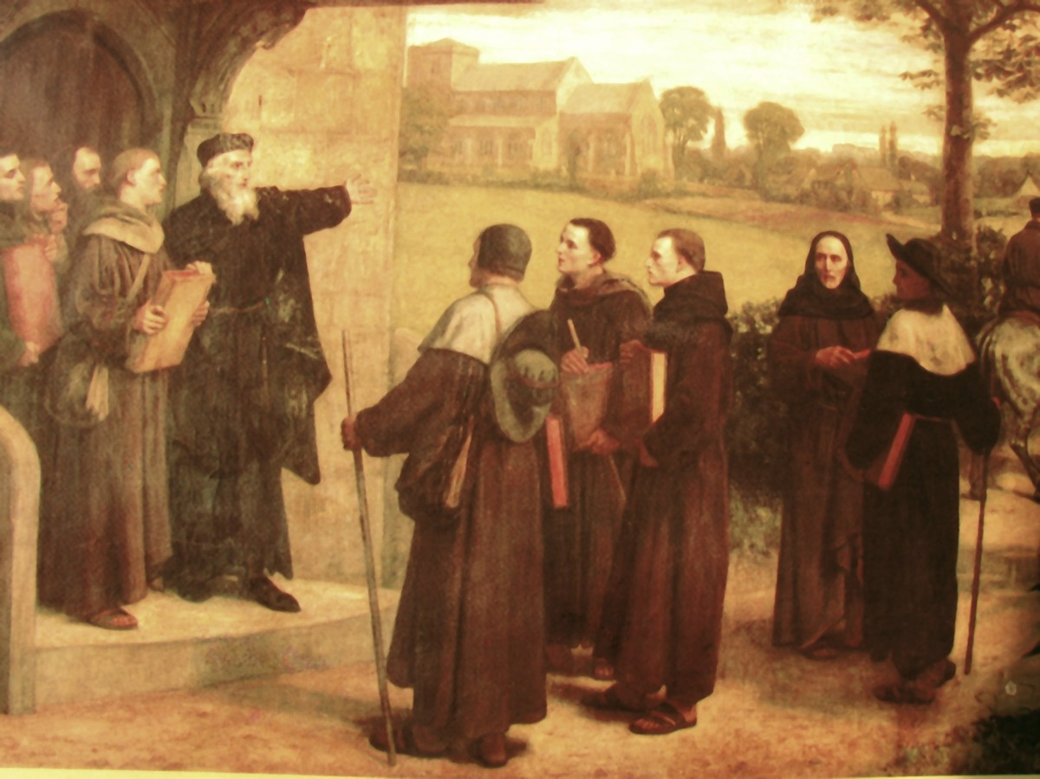
John Wycliffe
Wycliffe Giving "The Poor Priests" His Translation of the Bible (William Frederick Yeames)
https://en.wikipedia.org/wiki/John_Wycliffe#/media/File:WycliffeYeamesLollards_01.jpg

Slide 10
John Wycliffe
During the Babylonia Captivity of the Papacy and the Western Schism, a new and potentially deadly challenge to the papacy arose in England. It came from a theologian at Oxford University by the name of John Wycliffe (1330-84), a native of Yorkshire in northern England.
After studying theology at Oxford, where he achieved fame as a lecturer in theology and philosophy in the 1360s, Wycliffe became a religious advisor to the court of the English king, Edward III (1327-77).
Wycliffe had developed theological views which the English monarchy and nobility found useful in their conflict with the papacy; this conflict revolved around the papacy’s claim to own England, based on the fact that King John had surrendered England to Pope Innocent III in 1213.
Needham, Nick. 2,000 Years of Christ's Power Vol. 2: The Middle Ages

Slide 11
John Wycliffe
According to Wycliffe, all legitimate dominion comes from God. But such dominion is characterized by the example of Christ, who came to serve, not to be served.
Any lordship used for the profit of the ruler rather than for that of the governed is not true dominion, but usurpation.
The same is true of any dominion, no matter how legitimate, which seeks to expand its power beyond the limits of its authority.
Therefore, any supposed ecclesiastical authority that collects taxes for its own benefit, or seeks to extend its power beyond the sphere of spiritual matters, is illegitimate.
Naturally, these views were well received by civil authorities in England, involved as they were in a constant quarrel with the papacy precisely over the questions of taxation and of the temporal authority of popes.
Gonzalez, Justo L.. The Story of Christianity: Volume 1: The Early Church to the Dawn of the Reformation (p. 412)

Slide 12
John Wycliffe
Such opinions got Wycliffe into trouble, and Bishop Courtney of London summoned Wycliffe to appear before his tribunal in London in February 1377 to answer for his views, but the protection of King Edward III’s younger son, John of Gaunt, prevented Courtney from harming Wycliffe. ¹
Three months later, Pope Gregory XI issued five bulls (church edicts) against Wycliffe, in which Wycliffe was accused on 18 counts and was called “the master of errors.” ²
At a subsequent hearing before the archbishop at Lambeth Palace, Wycliffe replied, “I am ready to defend my convictions even unto death…I have followed the Sacred Scriptures and the holy doctors.” ²
He went on to say that the pope and the church were second in authority to Scripture. ²
¹ Needham, Nick. 2,000 Years of Christ's Power Vol. 2: The Middle Ages
² Galli, Mark. 131 Christians Everyone Should Know (p. 212). B&H Publishing Group.

Slide 13
John Wycliffe
When the Western Schism broke out on the death of Pope Gregory XI in March 1378, Wyclif’s theology began to become more radical.
He published a book called The Truth of Holy Scripture, in which he argued that the Bible was the only source of Christian doctrine, by which believers must test all the teachings of the Church, including the early Church fathers, the papacy and ecumenical Councils.
All Christians should read the Bible, so it must be translated from the Latin of the Vulgate into the native languages of the various nations.
Wyclif’s views here were quite revolutionary.
In the Middle Ages in Western Europe, people had come to regard the Bible as the clergy’s book; priests and theologians alone could interpret it correctly and teach laypeople what it meant.
Needham, Nick. 2,000 Years of Christ's Power Vol. 2: The Middle Ages

Slide 14
John Wycliffe
Wycliffe began translating the Bible into English, with the help of his good friend John Purvey.
The church bitterly opposed it: “By this translation, the Scriptures have become vulgar, and they are more available to lay, and even to women who can read, than they were to learned scholars, who have a high intelligence. So the pearl of the gospel is scattered and trodden underfoot by swine.”
Wycliffe replied, “Englishmen learn Christ's law best in English. Moses heard God's law in his own tongue; so did Christ's apostles.”
Wycliffe died before the translation was complete (and before authorities could convict him of heresy); his friend Purvey is considered responsible for the version of the “Wycliffe” Bible we have today.
Galli, Mark. 131 Christians Everyone Should Know (pp. 212-213).

Slide 15
John Wycliffe
Later in 1378, Wycliffe wrote another important book entitled On the Church.
In this book, Wycliffe defined the Church, not in terms of an outward organization controlled by papacy and priesthood, but as the whole body of the elect, those eternally predestined to salvation by the pure grace of God.
And if, from the viewpoint of eternity, the Church was the elect on earth at any given point in time, in other words, the entire company of true believers in every land.
The Church was thus a spiritual and invisible body, rooted in God’s eternal predestination, infallibly known to God alone, and its head was not the pope but Christ Himself.
Needham, Nick. 2,000 Years of Christ's Power Vol. 2: The Middle Ages

Slide 16
John Wycliffe
The pope, Wycliffe said, could be the head only of the outward and visible church that existed in the city of Rome, which was made up of both the elect and the non-elect.
In 1379, Wycliffe wrote The Power of the Pope. Here he argued that the papacy was of human not divine origin, and denied that the pope had any authority over any secular government.
Then in 1380 came his boldest stroke: he attacked the Catholic doctrine of holy communion in his On the Eucharist.
Wycliffe rejected transubstantiation and went back to the earlier views of Augustine and Ratramnus.
Needham, Nick. 2,000 Years of Christ's Power Vol. 2: The Middle Ages

Slide 17
John Wycliffe
The true view of the eucharist, Wycliffe argued, had vanished from the Western Church since the 11th century, but was still preserved in the Eastern Orthodox Church.
This was not the only appeal Wycliffe made to the Eastern Church; he also held it up as an example in other matters, e.g. allowing the clergy to marry.
Thus John Wycliffe began the great tradition of Western reformers using the Eastern Church as a weapon with which to attack the corruptions of Rome.
It was a clever strategy. For in many disputed matters, if Rome claimed that it had the ancient practice of the Church on its side, a reformer could simply point to the Eastern Orthodox and say, “But they are as ancient as you, and they don’t do this or believe this!”
Needham, Nick. 2,000 Years of Christ's Power Vol. 2: The Middle Ages

Slide 18
John Wycliffe
By Catholic standards, Wyclif’s denial of transubstantiation had made him into a dangerous heretic, and the English court and nobility (including John of Gaunt) broke off their support for him.
Oxford University also turned against him, expelling his followers.
Wycliffe retired to Lutterworth in the English midlands, where he was the parish priest.
He spent the last three years of his life writing popular pamphlets, in which he set out his views vigorously and effectively in the English language, and several academic works in Latin in which he explained his views in a more scholarly way.
Needham, Nick. 2,000 Years of Christ's Power Vol. 2: The Middle Ages

Slide 19
John Wycliffe
Wycliffe sent out preachers to proclaim the Gospel, and provided sermons for them.
For Wycliffe, the essence of the ordained ministry was preaching the Word, rather than celebrating the sacraments; it was preaching that made unbelievers into true Christians, and it was preaching above all that built Christians up in the faith by helping them to understand what it meant.
Wycliffe died in 1384, and was buried in the Lutterworth church graveyard.
34 years later the Church authorities dug up his body, burnt it for heresy, and threw its ashes into the river Swift.
Needham, Nick. 2,000 Years of Christ's Power Vol. 2: The Middle Ages

Slide 20
John Wycliffe
Protestants have hailed Wycliffe as “the morning star of the Reformation”.
Wyclif’s followers were called Wycliffites, or “Lollards” (a term of abuse which probably means “mumblers”).
The Lollards became the English equivalent of the Waldensians.
In 1395, a group of Lollard members of parliament published a manifesto called The Twelve Conclusions, which denounced the English Church’s bondage to the papacy, advocated the marriage of the clergy, and condemned transubstantiation, prayers for the dead, pilgrimages, and the holding of political office by bishops.
Needham, Nick. 2,000 Years of Christ's Power Vol. 2: The Middle Ages

Slide 21
John Wycliffe
Like the Waldensians, the Lollards became a secret underground sect.
They were found mainly in London and the surrounding areas in southern England; it was a family-based “heresy”, passed on from father to son.
Despite persecution, the Lollards survived until the Protestant Reformation, and in many ways helped to prepare the way for it by circulating Lollard tracts and the Bible in English.
When the Reformation came to England, the Lollards were its earliest supporters, and they soon merged into the mainstream of English Protestantism.
Needham, Nick. 2,000 Years of Christ's Power Vol. 2: The Middle Ages

Slide 22
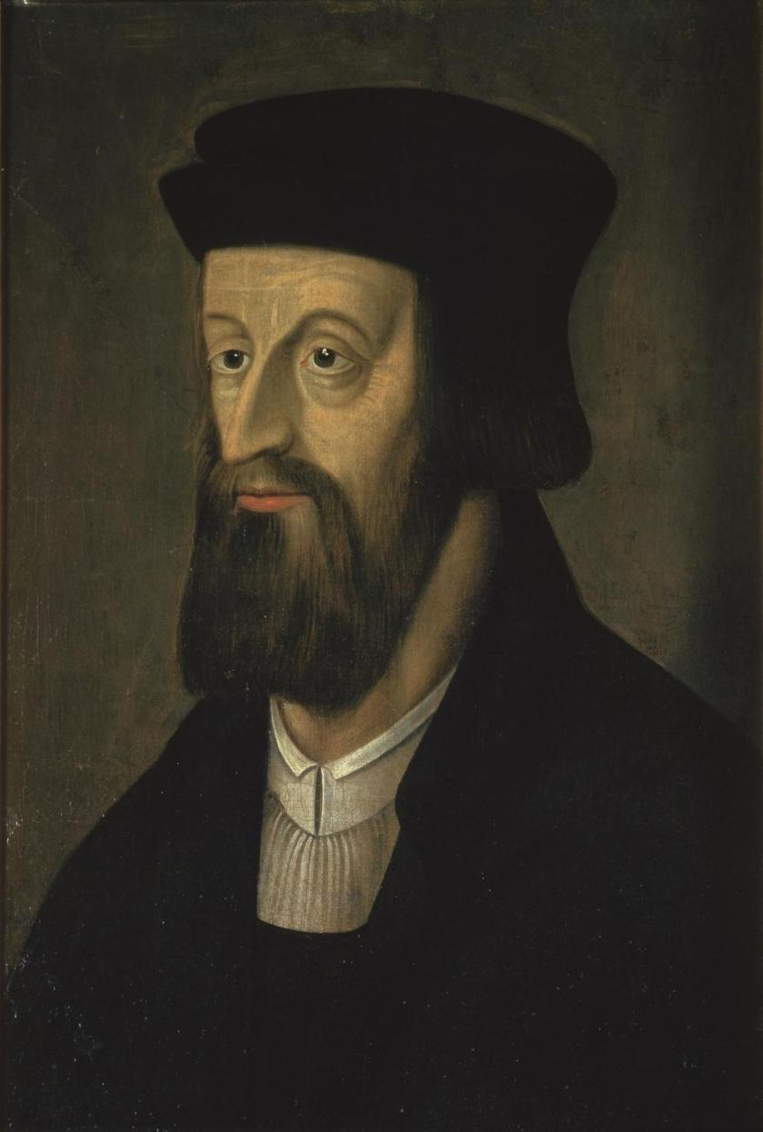
John Huss
https://en.wikipedia.org/wiki/Jan_Hus#/media/File:Jan_Hus_2.jpg

Slide 23

https://www.hopehelps.org/volunteer-appreciation-week-2018/

Slide 24

Class Discussion Time
https://www.weareteachers.com/moving-beyond-classroom-discussions/

Slide 25
*Class Discussion Time
Wycliffe argued that any lordship used for the profit of the ruler rather than for that of the governed is not true dominion, but usurpation and the same is true of any dominion, no matter how legitimate, which seeks to expand its power beyond the limits of its authority.
Christians in other ages have sometimes argued on the basis of Romans 13 and other passages that even abusive civil authority is ordained by God is to be obeyed. Did Wycliffe get it wrong?
In the Middle Ages in Western Europe, people had come to regard the Bible as the clergy’s book; priests and theologians alone could interpret it correctly and teach laypeople what it meant.
While modern Evangelicals might recoil from such an idea, do you think that, in effect, many Christians today do the same thing when they refrain from being good Bereans (Acts 17:11) by failing to verify from the Scriptures whether the things they have been taught by their pastors and teachers are true or not?
Do you have a topic or question that you would like to see us to discuss?

