Slide 1


Slide 2
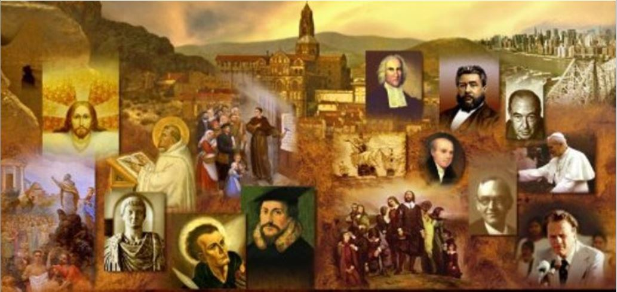
Review
Luther had every intention of becoming a lawyer until one day in 1505 something changed that – what was it?
  He was caught in a thunderstorm while walking - a bolt of lightning knocked him to the ground, and Luther, terrified, called out to Catholicism’s patroness of miners, “St. Anne, save me! And I’ll become a monk.”
Luther’s spiritual guide was Johannes von Staupitz, vicar-general of the Augustinian friars in Saxony. What other role did he play in Luther’s life?
  Staupitz was Luther’s “confessor” – the one to whom Luther made his confessions of sin in order to receive absolution.
  Staupitz tried to lead the tormented young friar to a self-abandoning trust in God’s free and undeserved mercy.

Slide 3
Review
What NT passage was Luther pondering in 1515 that suddenly helped him realize that a sinner’s right standing before God comes from a righteousness imputed to him by God? Give at least the book and chapter – bonus for giving the verse number and/or paraphrasing the content of the passage.
  Paul’s Letter to the Romans, Luther came upon the words, “For in the gospel a righteousness from God is revealed, a righteousness that is by faith from first to last, just as it is written: ‘The righteous will live by faith.’” (Romans 1:17 NIV)
What role did Prince Frederick the Wise of Saxony play in Luther’s later conflict with the pope?
  He backed Luther and provided for his protection.
What early companion of Luther at Wittenberg ended up becoming his sidekick and later had a major influence on the Lutheran Church’s theology?
  Philip Melanchthon

Slide 4
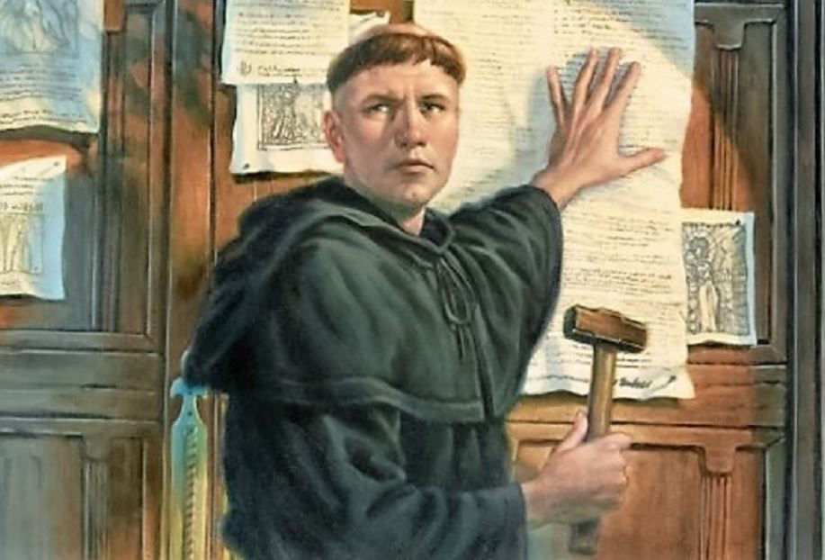
Luther’s 95 Theses
https://www.intellectualtakeout.org/article/5-causes-protestant-reformation-besides-indulgences/

Slide 5
Luther’s 95 Theses
In April 1517, Luther decided to declare open war on scholastic theology through an academic “disputation”, with his 97 theses (not to be confused with the more famous 95 theses of October 1517).
The 97 theses, entitled Disputation against Scholastic Theology, attacked the Neo-Pelagian theology of the later scholastic scholars and called for a return to the theology of Augustine.
To Luther’s keen disappointment, the 97 theses awakened no public interest and sank without trace.
However, when he resolved five months later in his 95 theses to protest against the sale of indulgences, the response was amazingly different.
Needham, Nick. 2,000 Years of Christ's Power Vol. 3: Renaissance and Reformation

Slide 6
Luther’s 95 Theses
An indulgence was a certificate of pardon issued by the pope, by which the merits of the saints in heaven were transferred to a sinner, releasing him from the “temporal penalties” of sin.
The pope could even extend these pardons to souls (supposedly) in purgatory, hastening their passage to heaven.
In 1515, Pope Leo X (1513-21) authorized the sale of a special set of indulgences in Germany.
Their purpose was to bring in cash to finance the building of Saint Peter’s basilica in Rome, and the papal agent selling the indulgences was a Dominican friar called Johann Tetzel (1470-1519).
Needham, Nick. 2,000 Years of Christ's Power Vol. 3: Renaissance and Reformation

Slide 7
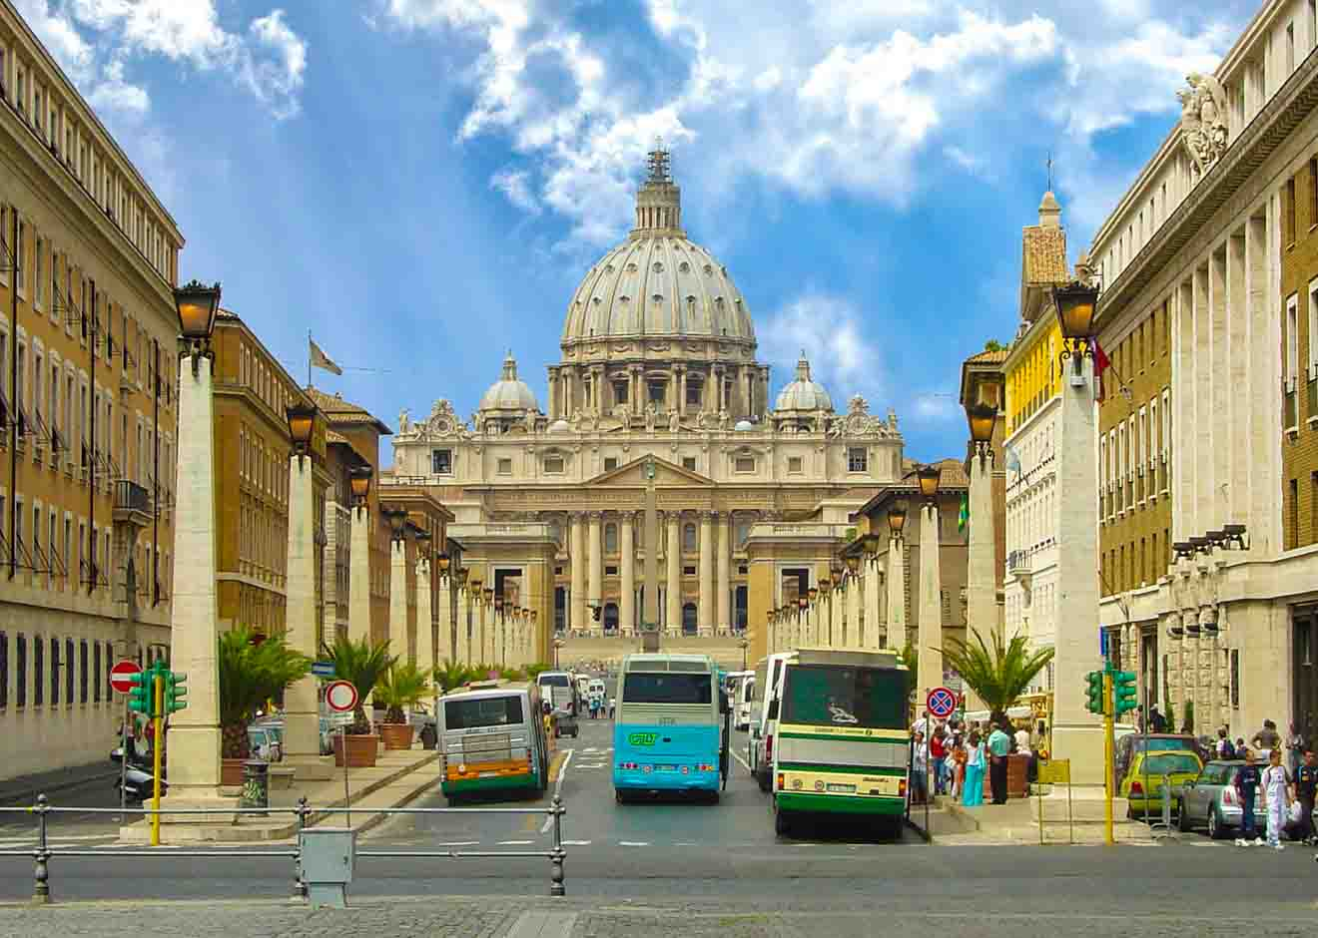
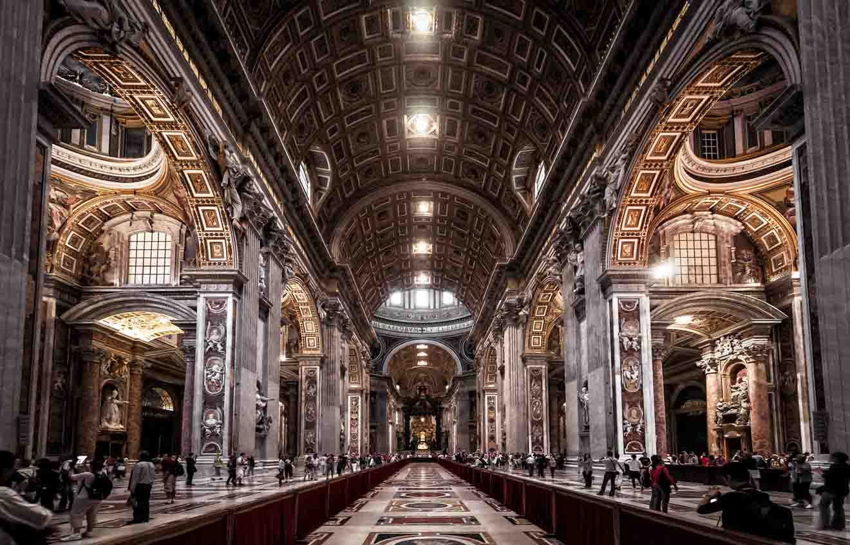
Saint Peter’s Basilica Today
https://misstourist.com/st-peters-basilica-tickets-vatican-rome-italy/

Slide 8
Luther’s 95 Theses
Tetzel’s indulgence preaching was an overpowering act of emotional manipulation.
Tetzel promised his hearers that as soon as they bought one of his indulgences on behalf of a dead relative, God would instantly set the relative’s poor suffering soul free from purgatory and admit it into the bliss of heaven.
Tetzel used a little rhyme – “As soon as the coin in the money-box rings, the soul from purgatory springs!”
If a person bought an indulgence for himself, Tetzel claimed, it would automatically wash away the foulest of sins, even if the sinner had raped the Virgin Mary.
Tetzel’s publicity campaign was crude, tasteless, vulgar, sensational, and contrary even to the official theology of indulgences, which taught that to be effective indulgences had to be accompanied by repentance.
Needham, Nick. 2,000 Years of Christ's Power Vol. 3: Renaissance and Reformation

Slide 9
Luther’s 95 Theses
By April 1517, Tetzel was preaching and selling indulgences in the area around Wittenberg.
Luther’s anxiety about the indulgences was not purely academic.
Luther had by now accumulated many pastoral responsibilities in the Church:
  In 1512 Staupitz had put Luther in charge of the studies of all the new friars at the Augustinian convent in Wittenberg.
  In 1514 Luther had been appointed pastor of Wittenberg’s parish church, where he preached every Sunday
  At around the same time, eleven convents were placed under his supervision, which brought legal and financial as well as spiritual burdens.
Needham, Nick. 2,000 Years of Christ's Power Vol. 3: Renaissance and Reformation

Slide 10
Luther’s 95 Theses
Luther was no ivory tower intellectual obsessed with his own private ideas!
As Wittenberg’s parish priest, he was deeply horrified that people in his own congregation were buying Tetzel’s indulgences, thinking that salvation could be purchased for cash, without showing any sign of repentance for their sins.
Frederick the Wise had banned Tetzel from his own lands, but people were crossing the river Elbe into the territory of Frederick’s brother, Duke John, where Tetzel was actively preaching.
So, despite the lack of interest shown in the 97 theses that he had posted in April, Luther arranged another academic disputation, this time on the topic of indulgences.
Needham, Nick. 2,000 Years of Christ's Power Vol. 3: Renaissance and Reformation

Slide 11
Luther’s 95 Theses
Luther wrote his 95 Theses concerning indulgences on October 31, 1517 and announced that he was going to debate the subject in public at Wittenberg University on the following day.
This was the occasion when Luther nailed up the 95 Theses on the door of Wittenberg’s castle church: not a dramatic gesture, but the normal way of posting a public announcement.
The 95 Theses offered penetrating criticisms of the practice of indulgences, colored with a display of humanist learning, and lit up by a bright, Erasmus-like vision of Christianity as a religion of inward heart-spirituality which bears fruit in a life of love.
To his astonishment, Luther found that he had loosed a storm of controversy that would grow steadily more furious and rip apart the very fabric of Western Europe.
Needham, Nick. 2,000 Years of Christ's Power Vol. 3: Renaissance and Reformation

Slide 12
Luther’s 95 Theses
Luther had no wish to stir up a public quarrel when he announced the disputation.
He was not even criticizing the official theology of indulgences, but Tetzel’s grim perversion of it.
Even so, within months, the whole of Germany was in an uproar.
Humanists translated the 95 Theses from Luther’s Latin into German, and printed and distributed thousands of copies throughout Germany – without Luther’s approval.
Luther found himself under attack from bishops, universities, monks (especially the Dominicans, who rallied to Tetzel’s support), and all the upholders of scholastic theology.
Needham, Nick. 2,000 Years of Christ's Power Vol. 3: Renaissance and Reformation

Slide 13
Luther’s 95 Theses
Luther’s assault on indulgences, however, won widespread support among three crucial groups:
  Humanists like Erasmus, who despised indulgences as a corruption of the spiritual religion of the New Testament. Erasmus never gave total support to Luther, but in these early days of the Reformation he sympathized strongly with much that Luther was saying. On indulgences, Erasmus said: I do not condemn them, but I think it is nonsense to suppose that a person can buy his way to heaven. What a filthy trade this is, designed to fill up money-boxes, rather than to enrich people’s spirituality!
  German nationalists, especially the German knights like Ulrich von Hutten, who saw indulgences as one of the papacy’s instruments for draining away German cash to Rome.
  Many ordinary German Christians, who longed for the Church to be purified from its abuses, and needed only a leader to give a voice to their grievances and aspirations.
Needham, Nick. 2,000 Years of Christ's Power Vol. 3: Renaissance and Reformation

Slide 14
Luther’s 95 Theses
The Dominicans, and Archbishop Albert of Mainz (who was profiting handsomely from the sale of the indulgences), lodged official charges against Luther in Rome.
Pope Leo X, however, did not take the controversy very seriously (it was all a tempest in a teacup, Leo felt: just one more quarrel between Dominicans and Augustinians).
Still, Leo instructed the head of Luther’s Augustinian order, Gabriel della Volta, to end the dispute; and so della Volta summoned Luther to appear before the governing body of the Augustinians which met in Heidelberg (south-western Germany) in April 1518.
Here, Luther presented his “Heidelberg disputation”, 40 theses in which he defended Augustine’s doctrines of sin and grace, and attacked the way that the schoolmen had subjected Christian theology to Aristotle’s philosophy.
Needham, Nick. 2,000 Years of Christ's Power Vol. 3: Renaissance and Reformation

Slide 15
Luther’s 95 Theses
The Heidelberg disputation also set out Luther’s important contrast between a “theology of glory” and a “theology of the cross”.
By a theology of glory, he meant a theology that glorifies human achievement, whether the intellectual achievement of human philosophy in seeking to understand God, or the moral achievement of human goodness in seeking to earn its own salvation.
By a theology of the cross, he meant God’s rejection of human achievement, a rejection revealed in the cross of Jesus Christ; the true knowledge of God, and true salvation, are found not in the strivings of human philosophy or ethics, but only in Christ crucified.
The sinner must die to his own achievements, Luther said, and despair of his own intellectual and moral ability to find God, if he is ever to receive the grace of Christ.
Needham, Nick. 2,000 Years of Christ's Power Vol. 3: Renaissance and Reformation

Slide 16
Luther’s 95 Theses
Luther’s performance at the disputation won over two young friars, Martin Bucer and Johannes Brenz, who were soon to become the leading Protestant Reformers of Strasbourg and Swabia.
Luther as yet had no thought of breaking with the papacy. Nevertheless, with the benefit of hindsight, we can see that his theology was becoming slowly and gradually more “Protestant”.
In a popular pamphlet written to explain the 95 theses, Luther cast doubt on the divine right of the pope to be head of the Church; in the days of Pope Gregory the Great, Luther said, the Church of Rome was not superior to the Eastern Church.
He was soon criticizing even the official theology of indulgences, denying that the pope had any power to release souls from purgatory.
Needham, Nick. 2,000 Years of Christ's Power Vol. 3: Renaissance and Reformation

Slide 17
Luther’s 95 Theses
He also started teaching that excommunication from the Catholic Church did not affect a soul’s eternal salvation; no earthly power could separate a true believer from Christ’s love.
So if a sentence of excommunication was unjust, it severed the soul only from the outward and visible Church of the papacy, but not from the spiritual Church of the elect; and if the excommunication was deserved, sincere personal repentance before God would save the excommunicated person, even if the Catholic Church never received him back.
In August, Pope Leo summoned Luther to appear in Rome within sixty days to answer for his errors; he also ordered Luther’s prince, Frederick the Wise of Saxony, to hand Luther over to the papal legate, known as Cardinal Cajetan, a distinguished Italian theologian and disciple of Thomas Aquinas.
Needham, Nick. 2,000 Years of Christ's Power Vol. 3: Renaissance and Reformation

Slide 18
Luther’s 95 Theses
Frederick, however, took Luther’s side, and arranged a peaceful meeting between Luther and Cajetan at Augsburg in October.
Cajetan was not an extremist or a diehard defender of the old order.
Cajetan agreed with some of Luther’s criticisms of indulgences, and referred to points of disagreement as “errors” rather than “heresies” on Luther’s part.
The cardinal steadily pressed Luther on the absolute authority of the papacy to interpret Scripture, ordered the German to withdraw his errors, and threatened to excommunicate him.
Luther refused to submit, and Cajetan’s arguments forced the Wittenberg professor for the first time to deny the infallibility of the pope.
Needham, Nick. 2,000 Years of Christ's Power Vol. 3: Renaissance and Reformation

Slide 19
Luther’s 95 Theses
It was becoming increasingly clear to Luther that he must either abandon all his convictions and submit unconditionally to the papacy’s claim to absolute authority in spiritual matters – or else stand by his views, at the price of accusing the papacy itself of being in error.
At this stage, Luther still accepted that the papacy was the visible head of the Church, but maintained that the pope was subject to correction by Scripture and an ecumenical council of the whole Church.
These views did not impress Cajetan, who dismissed Luther sternly: “Withdraw your errors, or do not come again into my presence!”
Luther felt it prudent to flee from Augsburg on horseback, and in November he appealed to an ecumenical council to settle the dispute.
Needham, Nick. 2,000 Years of Christ's Power Vol. 3: Renaissance and Reformation

Slide 20
Luther’s 95 Theses
Political events gave Luther a respite for the next few months. The Holy Roman Emperor, Maximilian I, was dying, and both King Francis I of France, and King Charles I of Spain (Maximilian’s grandson), were offering themselves to the German princes as candidates to be elected as the new Emperor.
Pope Leo did not want either of them elected, because a German Emperor who also controlled France or Spain would be a serious threat to the independence of the papacy in Italy.
Leo’s candidate was Frederick the Wise of Saxony – Luther’s prince. Therefore Leo could not afford to antagonize Frederick by persecuting Luther.
During this period of peace, Luther continued exhorting people to submit to the “holy Roman Church” as (under Christ) the supreme power in heaven and earth.
Needham, Nick. 2,000 Years of Christ's Power Vol. 3: Renaissance and Reformation

Slide 21
Luther’s 95 Theses
But privately the thought more and more disturbed him that the pope might be the Antichrist!
Luther was convinced that what he was teaching was the truth of Scripture. If the pope was hostile to Scripture, then perhaps Antichrist had already come – perhaps he was the pope!
Luther here was echoing a medieval theme, when popes had declared hostile Emperors or rival popes to be Antichrist, and dissenting movements (such as the Waldensians, Cathars, Lollards, and Hussites) had applied Antichrist language to the papacy itself.
In June and July 1519, Luther and his colleagues Melanchthon and Carlstadt took part in a disputation at Leipzig (eastern-central Germany) with Johann Eck.
Needham, Nick. 2,000 Years of Christ's Power Vol. 3: Renaissance and Reformation

Slide 22
Luther’s 95 Theses
Eck was professor of theology at Ingolstadt University, a learned scholastic, one of the greatest debaters of the day, and an arrogant bully who looked more like a butcher than a theologian.
Eck challenged Carlstadt, who held a more senior position than Luther at Wittenberg University, to defend the doctrines its lecturers taught; Luther and Melanchthon accompanied Carlstadt to Leipzig to give him support.
The proceedings opened with a dispute between Carlstadt and Eck about Augustine’s doctrines of sin and grace.
Carlstadt was a boring bumbler in debate, and Eck easily got the better of him.
Then Luther stepped in. He took up the subject of the papacy, setting out to prove that neither Scripture nor the early Church fathers supported the absolute supremacy of the pope.
Needham, Nick. 2,000 Years of Christ's Power Vol. 3: Renaissance and Reformation

Slide 23
Luther’s 95 Theses
A distinguished humanist Latin scholar, who chaired the Leipzig disputation, has left us a vivid portrait of Luther, which captures the essence of the man with remarkable accuracy:
  Luther is of medium size, his body thin, and so worn out by burdens of responsibility and study, that you can almost count all his bones. He is in the full maturity of his powers. His voice is clear and beautiful. His learning, and his knowledge of Scripture, are so extraordinary, that he can quote anything perfectly from memory. He understands Greek and Hebrew well enough to give his own judgment on what words and phrases mean. When he speaks, he has a rich store of subjects at his command, and a huge forest of thoughts and words at his disposal. There is nothing lofty or proud about him; he knows how to adapt himself to different people and circumstances. He is always fresh, cheerful and relaxed, with a pleasant expression on his face, no matter how hard his enemies press him – you just cannot help believing that heaven is with him in his mighty labor. However, most people criticize him for not being moderate enough when he argues against his foes; he lacks prudence, and is more cutting in speech than a theologian and reformer ought to be. During the debate he carried a bunch of flowers in his hand, and whenever the argument became heated, he looked at his flowers and smelled them.
Needham, Nick. 2,000 Years of Christ's Power Vol. 3: Renaissance and Reformation

Slide 24
Luther’s 95 Theses
As the argument swung back and forth, Eck cleverly cornered Luther into admitting that his views were similar to those of John Huss, whom the Council of Constance had burnt for heresy in 1415.
This forced Luther to acknowledge that even ecumenical councils were fallible: the Council of Constance had erred in condemning Huss.
Luther now appealed to the Scriptures as the sole infallible authority.
This position became known by the Latin tag of “sola Scriptura” (Latin for “Scripture alone”).
Needham, Nick. 2,000 Years of Christ's Power Vol. 3: Renaissance and Reformation

Slide 25

http://www.menwithchests.com/sola-scriptura/

Slide 26

Class Discussion Time
https://www.weareteachers.com/moving-beyond-classroom-discussions/

Slide 27
*Class Discussion Time
Luther posted his 97 thesis and they fell flat in terms of public response. Six month’s later he posted his 95 thesis and they “went viral”. Looking back in hindsight, what do you suppose it was that caused the vastly different response between the two postings? Can you describe to us a time when you experienced something like this?
Luther’s passion in debating indulgences were primarily driven, not from a mere academic concern, but the loving concern of a pastoral heart. While pastoral concern appears to be a more noble motivation, is there anything wrong with mere academic concern about a theological issue?
Luther’s understanding of Reformed Theology and his eventual break from Rome evolved slowly over time. Have you experienced a similar development in your theological thinking over time? Tell us what that looked like.
Much of Luther’s theological development was honed in debate with sharp opponents like Johann Eck – a sort of “iron sharpens iron” (Prov. 27:17) kind of experience. Can you describe to us a time in your life when your theological thinking was sharpened through a process of theological discussion and debate with those who held an opposing view?
Do you have a topic or question that you would like to see us to discuss?

