Slide 1


Slide 2
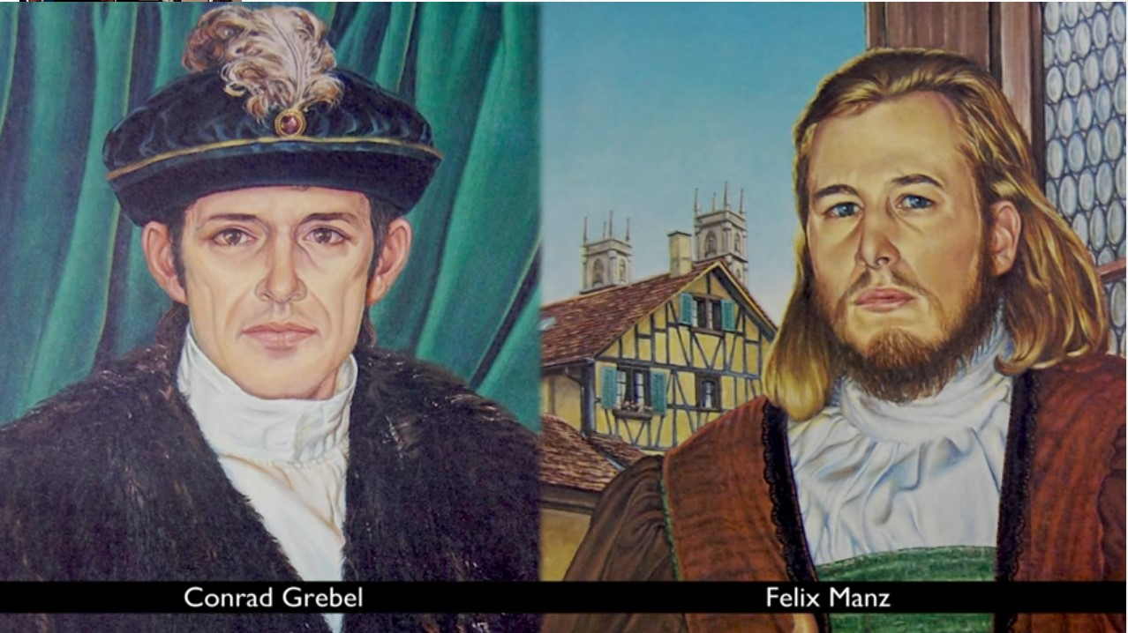
The Radical Reformation
https://www.youtube.com/watch?v=Mn1DIt2dIEI

Slide 3
The Radical Reformation
The Reformation was a complex phenomenon. The Magisterial Reformers that we have looked at so far (Lutheran and Reformed) differed among themselves in their theology.
However, in addition to the Magisterial Reformers, the Radical Reformers stand out as yet another reforming force that was quite distinct in guiding beliefs and ideology from all branches of the Magisterial Reformation.
The term “Radical Reformation” can be misleading, if we take it to mean that there was a single great entity called “the Reformation” and that the Radicals were simply one aspect of it.
Needham, Nick. 2,000 Years of Christ's Power Vol. 3: Renaissance and Reformation

Slide 4
The Radical Reformation
Indeed the Magisterial and Radical Reformers held in common a shared critique of certain aspects of late medieval Catholicism, and their rejection of the papacy.
In the early days of Luther and Zwingli, therefore, when people were still thinking out the implications of their protest against Rome and the shape of their own positive alternative to a discredited Catholicism, it was only natural that all anti-Romanists should have seemed to be on the same side.
It soon became increasingly clear, however, that this was far from the case.
Needham, Nick. 2,000 Years of Christ's Power Vol. 3: Renaissance and Reformation

Slide 5
The Radical Reformation
Luther was the first to perceive this; his swift and complete repudiation of the Zwickau prophets in 1522 raised up a standard that served to separate the Lutheran Reformation from the Radical Reformation, which Luther profoundly believed had tried to hijack his own movement for a different and false agenda.
Zwingli came to the same conclusion regarding the Zurich Radicals in 1523.
Needham, Nick. 2,000 Years of Christ's Power Vol. 3: Renaissance and Reformation

Slide 6
The Radical Reformation
What, then, was the Radical agenda?
The foremost modern historian of the Radical Reformation, George Huntston Williams, has argued that we can best understand the Radicals by viewing them as having one of three tendencies: ¹
Anabaptist – strong Biblicist who held to believer’s baptism ²
Spiritualist – or inspirationist who believed that the Spirit took precedence over the Bible ²
Rationalist – put primary emphasis on the place of reason in interpreting the scriptures and were, for the most part, anti-Trinitarian ²
¹ Needham, Nick. 2,000 Years of Christ's Power Vol. 3: Renaissance and Reformation
² William R. Estep. The Anabaptist Story: An Introduction to Sixteenth-Century Anabaptism

Slide 7
The Radical Reformation
This may be confusing to those who have learned to see all the Radicals as “Anabaptists”; indeed, in the 16th century, all Radicals were called Anabaptists by their critics.
This threefold scheme of Anabaptist, Spiritualist, and Rationalist, is now widely adopted by historians and serves as a useful way to distinguish between the various streams of thought within the Radical Reformation.
Among the three Radical tendencies, the Anabaptist was perhaps the most influential, and the Anabaptist Radicals stood closest to the Magisterial Reformers in their theological outlook.
The birthplace of Anabaptist Radicalism is normally seen as Zwingli’s Zurich, so we will begin our story there.
Needham, Nick. 2,000 Years of Christ's Power Vol. 3: Renaissance and Reformation

Slide 8
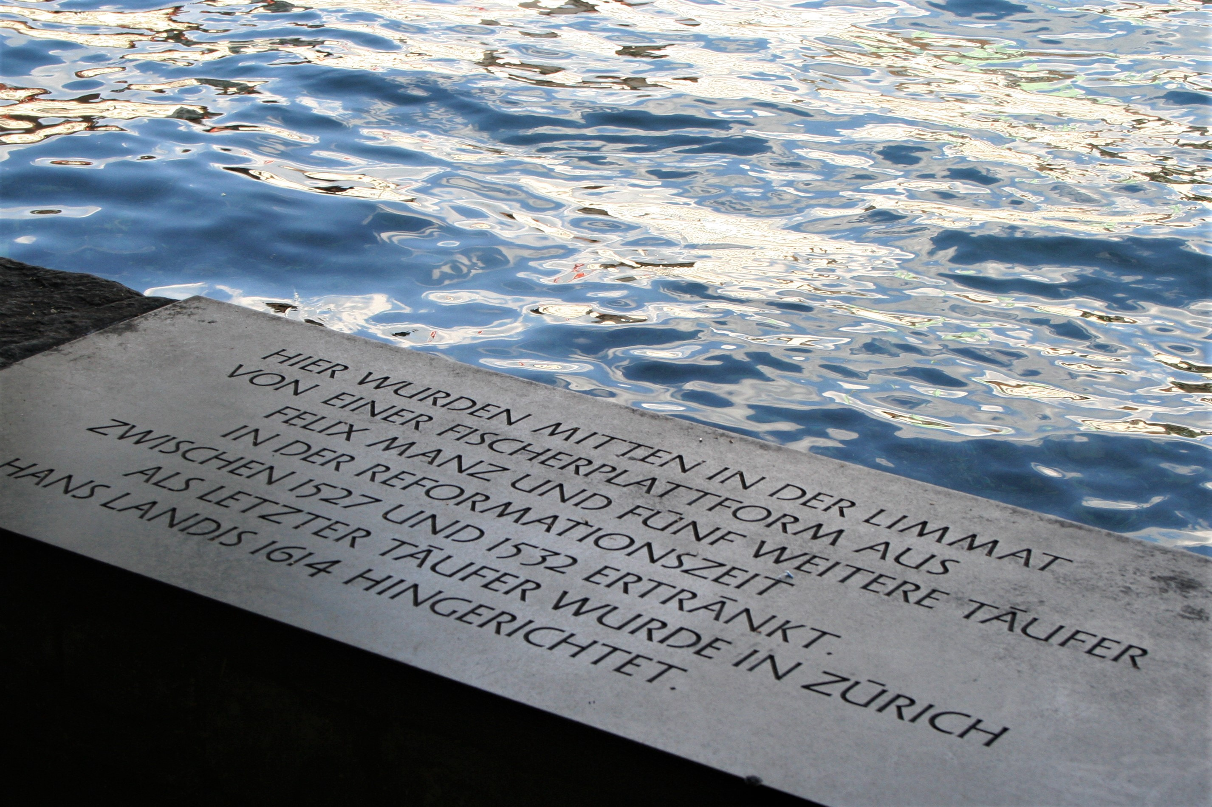
Zwingli and the Radical Reformers
https://medium.com/christian-citizen/reformation-and-resolutions-baptist-gather-in-zurich-respond-to-crisis-on-the-u-s-6040a95d3870

Slide 9
Zwingli and the Radical Reformers
Zwingli was a scholar, a humanist, and an evangelical reformer all blended into an attractive and forceful personality.
Because of this, a number of gifted young intellectuals primarily interested in study of the Greek classics were drawn to him.
Taking advantage of this, Zwingli soon introduced his young students to the Greek New Testament.
By 1522 the group included Simon Stumpf, Felix Manz and Conrad Grebel, among others.
Soon, they, like Zwingli, had become zealous for reform.
But their devotion to the Word of God soon took precedence over their loyalty to Ulrich Zwingli.
William R. Estep. The Anabaptist Story: An Introduction to Sixteenth-Century Anabaptism

Slide 10
Zwingli and the Radical Reformers
These two loyalties came into conflict in October, 1523 when a disputation took place before the Council in Zurich concerning the use of images and the traditional practice of the Catholic Mass.
Prior to the debate Zwingli and his young disciples had agreed to follow the Bible explicitly in their program of reform.
On the first day of the disputation, the use of images in the church was discussed and roundly denounced by all participants.
On the second day the Mass was repeatedly described as an abomination before God.
At this point in the disputation Grebel, Stumpf, and possibly others had expected some explicit directions from Zwingli to the council on the abolition of the Mass.
William R. Estep. The Anabaptist Story: An Introduction to Sixteenth-Century Anabaptism

Slide 11
Zwingli and the Radical Reformers
Throughout the October disputation the common appeal of the speakers had been to the Word of God.
Undoubtedly Zwingli and his zealous students had dared to hope that the disputation would prepare the way for changing the Mass into an observance of the Lord's Supper.
But at the close of the debate on the Mass the council made no moves to have it abolished.
William R. Estep. The Anabaptist Story: An Introduction to Sixteenth-Century Anabaptism

Slide 12
Zwingli and the Radical Reformers
The leader of the city council got up and announced that the disputation would move on the next day from further consideration of the Mass to a discussion of purgatory.
Upon hearing this, Grebel stood up and requested that the present subject continue until other abuses of the Mass had been discussed and instructions given as to how it would be abolished.
To this suggestion Zwingli replied, “My lords [i.e. the council] will decide whatever regulations are to be adopted in the future in regard to the Mass.”
This unexpected and rather curt statement from Zwingli provoked Simon Stumpf to exclaim, “Master Ulrich, you do not have the right to place the decision on this matter in the hands of my lords, for the decision has already been made, the Spirit of God decides.”
William R. Estep. The Anabaptist Story: An Introduction to Sixteenth-Century Anabaptism

Slide 13
Zwingli and the Radical Reformers
In response, Zwingli explained the difference between truth as determined from study of the Scriptures and the implementation of truth by the council.
To which Stumpf responded: “If my lords adopt and decide on some other course that would be against the decision of God, I will ask Christ for his Spirit, and I will preach and act against it!”
Zwingli immediately responded to Stumpf's statement with a ringing affirmation: “That’s right! I will also preach and act against it if they decide otherwise. I am not putting the decision in their hand. They are not over the Word of God, and this goes not only for them but for the whole world.”
Then, once again, Zwingli explained there is a difference between truths raised in the disputation and the implementation of these truths by the council.
William R. Estep. The Anabaptist Story: An Introduction to Sixteenth-Century Anabaptism

Slide 14
Zwingli and the Radical Reformers
In other words, Zwingli believed his task was done when he had proclaimed the truth. It was not up to him, or to any private individual, to remove the icons or end the Mass; this must be done legally by the Christian magistrates.
When the Zurich city council, therefore, failed to take any action in the immediate aftermath of the disputation, Zwingli was not too upset.
He would simply go on preaching, and external reform would inevitably follow when enough people were won over. (The city council in fact decreed the “cleansing of the churches” from icons eight months later, in June 1524.)
Needham, Nick. 2,000 Years of Christ's Power Vol. 3: Renaissance and Reformation

Slide 15
Zwingli and the Radical Reformers
But Zwingli’s radical students were left totally disenchanted. For them, Zwingli seemed to be divorcing truth from action and they felt they could no longer endure it.¹
In the eyes of the Brethren he had compromised revealed truth in deference to constituted political authority.²
The authority of the Word of God had been sacrificed on the altar of human expediency.²
The Brethren felt themselves to have been betrayed.²
Many attempts were made by Stumpf, Manz, and Grebel to present a more biblical program of reform to Zwingli, but without success. ²
¹ Needham, Nick. 2,000 Years of Christ's Power Vol. 3: Renaissance and Reformation
² William R. Estep. The Anabaptist Story: An Introduction to Sixteenth-Century Anabaptism

Slide 16
Zwingli and the Radical Reformers
Sometime later a serious question developed among the Radicals regarding the validity of infant baptism. ²
Wilhelm Reublin, pastor at a neighboring village to Zurich, seems to have been the first among the Swiss Brethren to preach against infant baptism. ²
Soon parents in his congregation were refusing to bring their children for baptism. ¹
When the Zurich city council found out, it responded by ordering the parents to present their children for baptism. ¹
Grebel had heard as early as a year and a half before that some were claiming that infants should not be baptized. ²
But he was not aroused by the issue until after Reublin and others had taken their stand. ²
Once aroused, he became completely committed. ²
¹ Needham, Nick. 2,000 Years of Christ's Power Vol. 3: Renaissance and Reformation
² William R. Estep. The Anabaptist Story: An Introduction to Sixteenth-Century Anabaptism

Slide 17
Zwingli and the Radical Reformers
The Zurich city council decreed a public disputation on baptism, to be held in January, 1525 in the Zurich town hall. Zwingli and Heinrich Bullinger acted as the spokesmen for infant baptism; Grebel, Manz, Roubli, and Blaurock argued the case for believers’ baptism.
The debate lasted for two days. The council awarded victory to Zwingli and Bullinger, and decreed that those who had refused to bring their children for baptism must do so within eight days on pain of banishment.
They further decreed that lay preaching and private religious gatherings were also forbidden.
Needham, Nick. 2,000 Years of Christ's Power Vol. 3: Renaissance and Reformation

Slide 18
Zwingli and the Radical Reformers
Then followed one of the great symbolic scenes of the Radical Reformation.
In January, 1525, some sixteen or so men of Zurich made their way through the snow to the house of Felix Manz, quite close to the cathedral.
After praying together, George Blaurock asked Conrad Grebel to baptize him with true Christian baptism on profession of his faith.
Grebel poured water over him while Blaurock knelt. Blaurock himself then baptized the fifteen others. Soon many more adult baptisms followed.
The newly baptized then began celebrating the Lord’s Supper among themselves, outside the structure of Zurich’s established church order.
In effect a new Church, these one-time followers of Zwingli are often called the “Swiss Brethren”.
Needham, Nick. 2,000 Years of Christ's Power Vol. 3: Renaissance and Reformation

Slide 19
Zwingli and the Radical Reformers
To Zwingli and the city council, the baptisms and eucharists of the Swiss Brethren were acts of anarchy which struck at the roots of the Zwinglian vision of Zurich as a united Christian community.
Religion, for the medieval mind, was the glue that held society together. And the Magisterial Reformation was far more of a medieval than a modern phenomenon.
Consequently, Zwingli saw nothing unChristian in the city council’s response to the situation when it arrested a large number of the Radicals in February, including Grebel, Manz, Blaurock, and Roubli.
Once more Zwingli engaged in private discussion with his ex-disciples, but to no avail; they simply asserted their freedom to believe and practice as their consciences directed, whatever Zwingli or the city council might think or do.
Needham, Nick. 2,000 Years of Christ's Power Vol. 3: Renaissance and Reformation

Slide 20
Zwingli and the Radical Reformers
Eventually Manz was fined, Blaurock was banished, and Grebel and Roubli departed from the city voluntarily after being given a stern warning never again to disturb the good Christian order of Zurich by their revolutionary fanaticism.
In May, Zwingli wrote his first theological treatise against the Radicals, entitled Baptism, Rebaptism, and Infant Baptism.
The word he used for rebaptism was “Anabaptism”, from the Greek ana, “again”.
So was born the 16th century name for those Radicals (the majority) who practiced believers’ baptism – the Anabaptists, i.e., the “Rebaptizers”.
Anabaptists themselves rejected the label, since they held infant baptism to be invalid; in their view they were not being rebaptized, but baptized for the first time.
Needham, Nick. 2,000 Years of Christ's Power Vol. 3: Renaissance and Reformation

Slide 21
Zwingli and the Radical Reformers
Zwingli’s response to these challenges was enormously consequential for the future of Reformed theology.
The Zurich Reformer constructed a biblical defense of infant baptism by appealing to the analogy of circumcision.
In the Old Testament Church, Zwingli argued, the offspring of covenant members were themselves born into the covenant community, and received circumcision as the initiating sign of this membership.
Since the coming of Christ in the flesh, baptism has replaced circumcision; therefore the children of covenant parents are now to receive baptism as the initiating sign of their New Covenant membership.
Needham, Nick. 2,000 Years of Christ's Power Vol. 3: Renaissance and Reformation

Slide 22
Zwingli and the Radical Reformers
Romans chapter 4 was Zwingli’s proof-text for all this, with its theology of Abraham’s circumcision as a “sign and seal” of covenant righteousness.
To the fires, then, of the Zwingli–Anabaptist controversy, we can trace (at least in part) the origins of Reformed “covenant theology”, which is still today the mainstream Reformed paedobaptist understanding of Church and sacraments.
As for the Radical challenge that a baby lacks faith and repentance, Zwingli countered this by arguing that the parents accept the baptismal obligation on the child’s behalf, promising to bring him up as a faithful, penitent Christian.
Needham, Nick. 2,000 Years of Christ's Power Vol. 3: Renaissance and Reformation

Slide 23
Zwingli and the Radical Reformers
Despite the banishment of the leading Swiss Brethren, Radicalism itself had not died out in Zurich.
On one notable occasion, a procession of Radicals marched through the streets of the city, waving willow branches, chanting “Woe unto thee, Zurich!” and denouncing Zwingli as none other than the Great Red Dragon of the book of Revelation.
In October, the council once more arrested Grebel, Manz, and Blaurock for their unabated Radical activities within the canton of Zurich.
Another public disputation on baptism was arranged for 6-8 November.
So many people attended, it had to be held in the cathedral to accommodate them all.
Zwingli, Jud, and Megander faced Grebel, Manz, and Blaurock, but the “debate” swiftly degenerated into a shouting match, each side heaping abuse on the other.
Needham, Nick. 2,000 Years of Christ's Power Vol. 3: Renaissance and Reformation

Slide 24
Zwingli and the Radical Reformers
In March 1526, the council reached the end of its patience with the Zurich Radicals, and passed an ominous decree that henceforth anyone who rebaptized another was to be put to death by drowning.
This had Zwingli’s approval; like Calvin, he accepted the medieval concept that heresy was a capital crime.
The first to suffer the penalty was Felix Manz, who thus enjoys the singular honor of being the first Radical to be executed for his religion by a Protestant state.
Manz was led out to execution in January, 1527; by a cruel irony, given Manz’s Anabaptist beliefs, he was put to death by drowning in the river Limmat.
Conrad Grebel, in many ways the leading personality among the Zurich Radicals, eluded all forms of martyrdom by dying of the plague in the summer of 1526.
Needham, Nick. 2,000 Years of Christ's Power Vol. 3: Renaissance and Reformation

Slide 25

The Schleitheim Confession
http://dustoffthebible.com/Blog-archive/2016/11/16/what-is-the-schleitheim-confession/

Slide 26

Class Discussion Time
https://www.weareteachers.com/moving-beyond-classroom-discussions/

Slide 27
*Class Discussion Time
Zwingli believed his task was done when he had proclaimed the truth. It was not up to him, or to any private individual, to remove the icons or end the Mass; this must be done legally by the Christian magistrates. But in the eyes of the Zwingli’s students, he had compromised revealed truth in deference to constituted political authority. The authority of the Word of God had been sacrificed on the altar of human expediency. Had you been present in that day, who would you have sided with and why?
How would you counter Zwingli’s argument that since the coming of Christ in the flesh, baptism has replaced circumcision; therefore the children of covenant parents are now to receive baptism as the initiating sign of their New Covenant membership.
Do you have a topic or question that you would like to see us to discuss?

