Slide 1


Slide 2
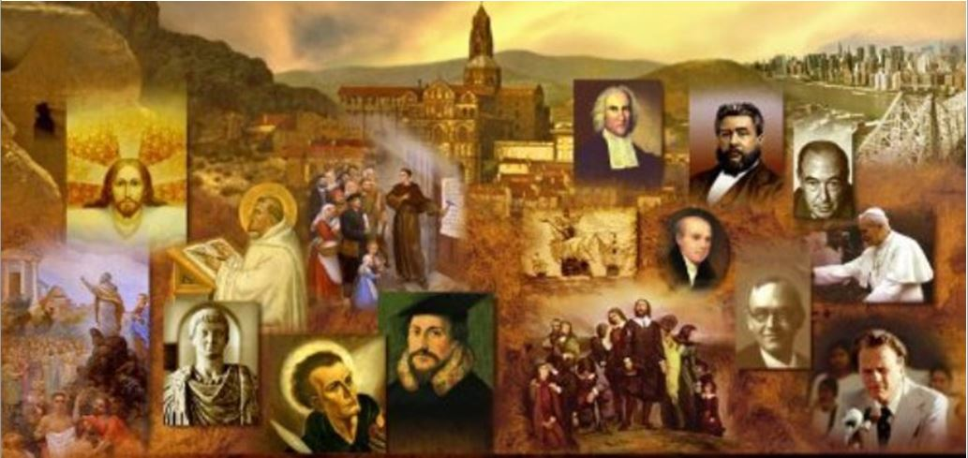
Review
What three tendencies of the Radical Reformation did historian, George Huntston Williams identify that help us understand the main streams of thought among the Radicals?
  Anabaptist – strong Biblicist who held to believer’s baptism
  Spiritualist – or inspirationist who believed that the Spirit took precedence over the Bible
  Rationalist – put primary emphasis on the place of reason in interpreting the scriptures and were, for the most part, anti-Trinitarian

Slide 3
Review
When the Zurich council did not immediately move to end the practice of the Roman Catholic Mass after hearing from Zwingli and his students that the practice was unscriptural, Zwingli was not upset. Why?
  Zwingli believed his task was done when he had proclaimed the truth. It was not up to him, or to any private individual, to remove the icons or end the Mass; this must be done legally by the Christian magistrates.
  He simply planned to go on preaching, and external reform would inevitably follow when enough people were won over.
The students, on the other hand, were very upset. Why?
  For them, Zwingli seemed to be divorcing truth from action and they felt they could no longer endure it. In their eyes of he had compromised revealed truth in deference to constituted political authority. The authority of the Word of God had been sacrificed on the altar of human expediency and they felt betrayed.

Slide 4

The Schleitheim Confession
http://dustoffthebible.com/Blog-archive/2016/11/16/what-is-the-schleitheim-confession/

Slide 5
The Schleitheim Confession
It was in the immediate aftermath of Manz’s martyrdom in February 1527 that one of the most historically significant Radical gatherings took place in Schleitheim – a northern Swiss city on the German border.
It was during this gathering that the assembled Radical Reformers produced a document know as the Schleitheim Confession.
The most well known figure in that gathering was Wilhelm Roubli, one of Zwingli’s former students.
However, the person who exerted the most influence in the gathering was Michael Sattler.
Originally a Benedictine monk, Sattler abandoned his religious order in 1523 under the influence of Reformation teachings. Soon after that, he got married.
Needham, Nick. 2,000 Years of Christ's Power Vol. 3: Renaissance and Reformation

Slide 6
The Schleitheim Confession
Sattler ended up in Zurich where he threw in his lot with the Radicals, for which he was banished in November 1525.
Sattler continued to promote the Anabaptist faith in other cities around southern Germany, including Strasbourg.
In Strasbourg he interacted with the Magisterial Reformers Martin Bucer and Wolfgang Capito, who found Sattler much more orthodox than most of the other Radicals they had encountered, and treated him sympathetically.
Needham, Nick. 2,000 Years of Christ's Power Vol. 3: Renaissance and Reformation

Slide 7

Reformation Map
SCHLEITHEIM
http://www.tutkutours.com/00_REFORMATION.asp

Slide 8
The Schleitheim Confession
Then in February 1527 Sattler journeyed back to Switzerland, where he effectively presided over the Radical synod which had assembled in Schleitheim.
The Schleitheim Confession dealt almost exclusively with matters of morality and Church order.
In this respect, it served to highlight the crucial moral and ecclesiastical differences between the majority of Anabaptist Radicals and the Magisterial Reformation.
The Confession was soon adopted as a statement of fundamental beliefs by many Anabaptist Radicals, functioning much as the Augsburg Confession did among Lutherans.
Needham, Nick. 2,000 Years of Christ's Power Vol. 3: Renaissance and Reformation

Slide 9
The Schleitheim Confession
We can summarize the teachings of the Schleitheim Confession under the following headings:
  Believers’ baptism
  A rigorous approach to the excommunication of the sinful members – or the “ban”, as Anabaptists called it
  The Lord’s Supper as an ordinance that belongs only to those baptized as believers
  The complete separation of true believers from unbelievers in all religious and political matters
  The high importance of the pastoral office
  Total pacifism and non-violence, and hence the rejection of Christians serving as magistrates, since magistrates have to use force to uphold the law
  The total rejection of oaths.
Needham, Nick. 2,000 Years of Christ's Power Vol. 3: Renaissance and Reformation

Slide 10
The Schleitheim Confession
The Schleitheim Confession does not say much regarding any theological issues; for example, we find nothing in its pages about the nature of God, Christ, or salvation.
It has been argued that this glaring absence of theology was due to the specific circumstances which produced the Confession – the need felt by those at Schleitheim to state their views on controversial points, rather than on points where there was general agreement.
On this basis, one might maintain that the Confession does not deal with theology because there was a broad agreement among the Anabaptist Radicals on theological issues.
But there is good reason to believe this was not the case.
Needham, Nick. 2,000 Years of Christ's Power Vol. 3: Renaissance and Reformation

Slide 11
The Schleitheim Confession
There certainly were theological questions, very serious ones, that separated the Anabaptists from the Magisterial Reformers, and from other Radicals.
Why were these not addressed in the Confession?
It seems more likely that the Confession’s silence on theology was itself a symptom of the prevailing mindset among the Anabaptist Radicals.
Needham, Nick. 2,000 Years of Christ's Power Vol. 3: Renaissance and Reformation

Slide 12
The Schleitheim Confession
The Anabaptist Radicals were not primarily interested in theology, but in ethics in the Christian life, which they understood in terms of the importance of love and the imitation of Christ.
This very attitude set them apart sharply from Luther, Zwingli, and Calvin, who perceived Christianity primarily in terms of dogma.
For the Magisterial Reformers, theology came first and determined everything else.
For the Anabaptist Radicals, it was really lifestyle that came first, and much of their theologizing arose out of their ethical and communal concerns.
Needham, Nick. 2,000 Years of Christ's Power Vol. 3: Renaissance and Reformation

Slide 13
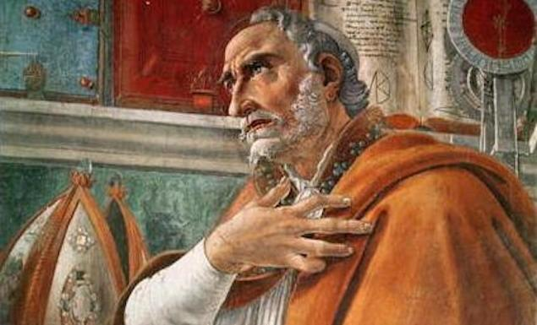
Anabaptist Rejection of Augustinian Theology
https://www.theschooloflife.com/thebookoflife/the-great-philosophers-augustine/

Slide 14
Anabaptist Rejection of Augustinian Theology
What, then, was the distinctive theology of the Swiss Brethren (even if it is not found in the Schleitheim Confession)?
Naturally we are tempted to rush first to their doctrine of believers’ baptism, which is in the Confession, but there were more significant differences between the Anabaptists and Zwingli.
The most fundamental was that the Anabaptists did not share Zwingli’s commitment to Augustinian views of salvation.
One of the characteristics of the whole Radical Reformation was that it had a more optimistic stance on human nature than the Magisterial Reformers held.
Needham, Nick. 2,000 Years of Christ's Power Vol. 3: Renaissance and Reformation

Slide 15
Anabaptist Rejection of Augustinian Theology
Radicals rejected the bondage of the will, modified or even rejected the doctrine of original sin, and affirmed the freedom of all human beings to respond savingly to God’s grace.
A constant element in their arguments against the Magisterial Reformation was that its Augustinian theology of human depravity and sovereign grace was nothing more than a license to sin.
Here we see again the practical lifestyle thrust of the Radicals: theology must be supportive of the life of obedience.
Their animus against Augustinianism stemmed from their conviction that its pessimism about human nature sapped the foundations of serious moral and spiritual efforts.
Needham, Nick. 2,000 Years of Christ's Power Vol. 3: Renaissance and Reformation

Slide 16
Anabaptist Rejection of Augustinian Theology
In this respect, it has been argued that the Radicals were actually far less radical than the Magisterial Reformers: it was Luther and Zwingli who broke “radically” with the Semi-Pelagian theology of medieval Roman Catholicism, whereas the Radicals preserved and maintained it.
In a similar vein, the Anabaptists rejected the Magisterial doctrine of legal justification by faith alone.
Although we find clear statements from Anabaptist leaders that Christ and His salvation are initially received by faith, Anabaptists viewed legal justification as a threat to the life of obedience, a license to sin.
Needham, Nick. 2,000 Years of Christ's Power Vol. 3: Renaissance and Reformation

Slide 17
Anabaptist Rejection of Augustinian Theology
In place of legal justification through the objective work of Christ, they located the controlling theme of Christian faith in the new birth, conversion, and holiness.
For the Magisterial Reformers the essential question was, “What must I do to be saved?”; but for the Anabaptists, it was, “How should a Christian live?”
Not surprisingly, this Anabaptist distaste for legal justification, and focusing on subjective holiness, prompted the Magisterial Reformers to see them as no better than Roman Catholics – Anabaptists were “the new monks”, as Luther put it.
Needham, Nick. 2,000 Years of Christ's Power Vol. 3: Renaissance and Reformation

Slide 18

Anabaptist Distinction Between Church and Society
https://www.jw.org/en/library/magazines/w20150315/loyal-to-christs-brothers/

Slide 19
Distinction Between Church and Society
Another pervasive theme which made agreement difficult between Zwingli and the Swiss Brethren was their conflicting theology of the Church and its relationship to civil society.
Zwingli was willing to accept as a Church member anyone who professed Christianity, which in the religious culture of his day meant all the citizens of Zurich.
In practice, therefore, Church and civil society were simply two sides of the same coin.
The Anabaptists, by contrast, saw the Church as a stark alternative to civil society, and restricted Church membership to those who gave evidence of their inward sincerity and commitment.
Needham, Nick. 2,000 Years of Christ's Power Vol. 3: Renaissance and Reformation

Slide 20
Distinction Between Church and Society
The Anabaptists completely repudiated the medieval concept of Christendom, in which everyone born into a “Christian society” soaked up Christianity from his culture and was automatically regarded as a Christian unless he opted out through heresy or unbelief.
For the Anabaptists, the Church of Jesus Christ was a radically separate community which an individual had to opt into by a personal act of faith.
The moral purity of this community was then to be preserved by a strict and unsentimental use of the ban.
The Anabaptists may have advocated religious toleration in society at large, but they tended to be extremely intolerant of what they considered moral lapses among their own.
Many of the most wounding internal divisions of the Anabaptists were over the extent and severity of the ban.
Needham, Nick. 2,000 Years of Christ's Power Vol. 3: Renaissance and Reformation

Slide 21
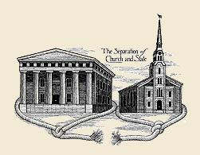
Anabaptist Separation of Church and State
http://www.angelfire.com/il/schalten/separate.html

Slide 22

Class Discussion Time
https://www.weareteachers.com/moving-beyond-classroom-discussions/

Slide 23
*Class Discussion Time
For the Magisterial Reformers, theology came first and determined everything else. For the Anabaptist Radicals, it was really lifestyle that came first, and much of their theologizing arose out of their ethical and communal concerns. Which one got it right and why?
The Anabaptists viewed the Augustinian theology of human depravity, sovereign grace and legal justification as a threat to the life of obedience and a license to sin. Are they right about this? Why or why not?
Zwingli was willing to accept as a Church member anyone who professed Christianity, whereas the Anabaptists restricted Church membership to those who gave evidence of their inward sincerity and commitment. Which one got it right and why?
Do you have a topic or question that you would like to see us to discuss?

