Slide 1


Slide 2
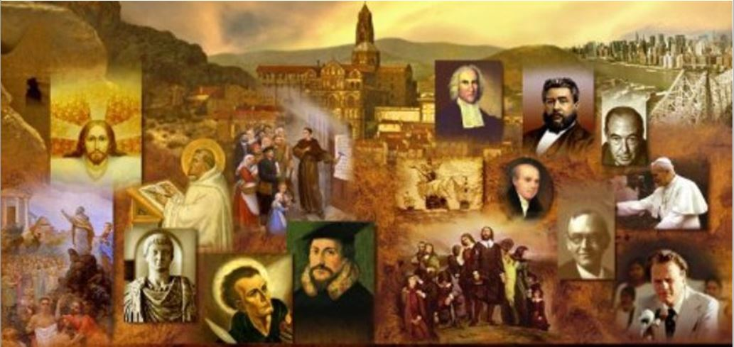
Review
What was the Schleitheim Confession?
A statement of fundamental beliefs held by many Anabaptist Radicals, functioning much as the Augsburg Confession did among Lutherans.
Give the name of the man who had the most influence in producing the Schleitheim Confession.
Michael Sattler
The Schleitheim Confession does not say much regarding any theological issues – why is that?
The Anabaptist Radicals were not primarily interested in theology, but in ethics in the Christian life, which they understood in terms of the importance of love and the imitation of Christ.

Slide 3
Review
What is one way that the Radicals were actually far less radical than the Magisterial Reformers?
The Radicals preserved and maintained the Semi-Pelagian theology of medieval Roman Catholicism – it was Luther and Zwingli who broke “radically” with it.
Zwingli was willing to accept as a Church member anyone who professed Christianity, which in the religious culture of his day meant all the citizens of Zurich. What contrasting belief did the Anabaptists hold to regarding church membership?
The Anabaptists, by contrast, saw the Church as a stark alternative to civil society, and restricted Church membership to those who gave evidence of their inward sincerity and commitment.

Slide 4
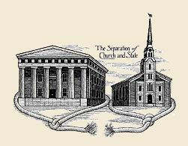
Anabaptist Separation of Church and State
http://www.angelfire.com/il/schalten/separate.html

Slide 5
Anabaptist Separation of Church and State
The dichotomy between the Zwinglian and Anabaptist attitude towards Church and state was stretched to the breaking point when the Anabaptists made it clear that opting into the Church meant opting out of civil society – becoming “drop-outs”, as we might say today.
In the eyes of the government of Zurich, this was undoubtedly the greatest crime of the Swiss Brethren.
Their countercultural revolution against the state involved the rejection of the normal responsibilities of citizenship.
Needham, Nick. 2,000 Years of Christ's Power Vol. 3: Renaissance and Reformation

Slide 6
Anabaptist Separation of Church and State
The Anabaptists refused, as we have noted from the Schleitheim Confession, to swear any oaths, taking their stand on Christ’s command “Swear not at all” in the Sermon on the Mount.
This not only disrupted the legal system, it laid the Brethren open to the charge of treason, because they would not take the oath of loyalty which the urban Swiss were required to swear to their city each year.
Equally serious in the eyes of the magistrates (and in the eyes of most ordinary folk) was the pacifism of the Anabaptist Radicals.
Needham, Nick. 2,000 Years of Christ's Power Vol. 3: Renaissance and Reformation

Slide 7
Anabaptist Separation of Church and State
Anabaptists refused all military service on principle.
This was of critical significance in the Swiss context, since the cantons of Switzerland had no standing armies; every man was expected to defend his canton as part of a citizen army when called to arms by the government.
This was particularly important in city-cantons like Zurich, because of their culture of intense civic pride and patriotism, the very fact that they had a city to defend.
To decline military service was perceived as deeply unpatriotic and criminally treacherous.
Needham, Nick. 2,000 Years of Christ's Power Vol. 3: Renaissance and Reformation

Slide 8
Anabaptist Separation of Church and State
To compound matters, the Swiss Brethren went even further, entirely rejecting politics as a Christian vocation.
No Christian, they argued, could be a magistrate, because magistrates had to use force to uphold the law, and this was contrary to Christ’s teaching of peace.
They recognized that the state was instituted by God, but maintained that it was “outside the perfection of Christ”, i.e. it was instituted for the government of the unbelieving world, and its sword-bearing magistrates could be taken only from among unbelievers.
Needham, Nick. 2,000 Years of Christ's Power Vol. 3: Renaissance and Reformation

Slide 9
Anabaptist Separation of Church and State
Further, the Anabaptist Radicals denied to the state any coercive power in matters of religion.
On the one hand, this meant that the state had no role in the ordering of the Church, e.g. in appointing pastors, or telling Christians what they must believe – a point on which most later Reformed Churchmen would have agreed.
On the other hand, however, the Anabaptist view also meant that the state had no right to punish heresy, blasphemy, or idolatry; and this was the real parting of the ways between the Radical Reformation and all other contemporary forms of Christianity, whether Protestant, Roman Catholic, or Eastern Orthodox.
Needham, Nick. 2,000 Years of Christ's Power Vol. 3: Renaissance and Reformation

Slide 10
Anabaptist Separation of Church and State
Radicals were fighting for what we would call “liberty of conscience” or “religious toleration”.
These concepts, though, had a very limited appeal to most 16th century Christians, because to the majority the Radical view seemed to de-Christianize the state.
How can the state bow the knee to Christ, and enact laws on the basis of His religion, without having any right to discourage or suppress idolatrous religions which attack the very foundations of a Christian moral and political order?
Needham, Nick. 2,000 Years of Christ's Power Vol. 3: Renaissance and Reformation

Slide 11
Anabaptist Separation of Church and State
To most Christians today, it will seem obvious that the Anabaptists were both right and noble in their advocacy of religious freedom.
To most of their Christian contemporaries, it seemed equally obvious that this was one of the Radical Reformation’s most dangerous, even blasphemously anti-Christian ideas.
Needham, Nick. 2,000 Years of Christ's Power Vol. 3: Renaissance and Reformation

Slide 12

Anabaptist Baptism
https://www.amazon.com/Radicals-Norbert-Weisser/dp/B0002ZQLJM/ref=sr_1_1?dchild=1&keywords=the+radicals+dvd&qid=1597285753&sr=8-1

Slide 13
Anabaptist Baptism
The Swiss Brethren’s understanding of the nature and extent of the Church came to be focused in the issue of baptism – specifically, infant baptism.
Zwingli himself, in his early reforming days, had not been convinced that infant baptism was biblical. He admitted to Balthasar Hubmaier in 1523, prior to the Second Zurich Disputation, that it would be better if children were not baptized until they had been instructed in the faith.
Around the same time, Zwingli had written concerning infant baptism: “I leave it untouched; I call it neither right nor wrong. If we were to baptize as Christ instituted it, then we would not baptize anyone until he reached the age of discretion.”
Needham, Nick. 2,000 Years of Christ's Power Vol. 3: Renaissance and Reformation

Slide 14
Anabaptist Baptism
By the end of 1523, however, Zwingli had moved to a decided commitment to infant baptism, probably because he realized that its rejection undermined the concept of Zurich as a corporately Christian city, and hence led to the end of government support for his reforming program.
The Swiss Radicals took the opposite path, carrying Zwingli’s initial doubts to their logical conclusion.
Their rejection of infant baptism, they claimed, was the only position consistent with the principle of the sole infallible authority of Scripture.
Needham, Nick. 2,000 Years of Christ's Power Vol. 3: Renaissance and Reformation

Slide 15
Anabaptist Baptism
More importantly, the Baptist theology of the Radicals was bound up with their view of the Church as a voluntary society of penitent believers.
A baby is not capable of repenting, believing the gospel, or joining himself to God’s people by his own volition; therefore, no baby should be baptized, since baptism signifies repentance, faith, and Church membership.
The Swiss Brethren articulated a strongly ethical interpretation of baptism: it is a penitential act, a symbolic breaking with the old life of sin, and initiation into the new life of obedience in Christ. “It is,” Hubmaier explained, “an outward and public testimony to the inward baptism of the Spirit.”
Needham, Nick. 2,000 Years of Christ's Power Vol. 3: Renaissance and Reformation

Slide 16
Anabaptist Baptism
The baptized person was publicly renouncing sin, and entering into a voluntary covenant with Christ, and into Christ’s covenanted community, the local church.
The Anabaptists also stressed the point that had been made so cogently by Luther and Zwingli regarding the eucharist, that without faith the sacraments can confer no benefit. What benefit, then, does a baby receive from baptism?
Needham, Nick. 2,000 Years of Christ's Power Vol. 3: Renaissance and Reformation

Slide 17
Anabaptist Baptism
Zwingli constructed a biblical defense of infant baptism by appealing to the analogy of circumcision.
In the Old Testament Church, Zwingli argued, the offspring of covenant members were themselves born into the covenant community, and received circumcision as the initiating sign of this membership.
Since the coming of Christ in the flesh, baptism has replaced circumcision; therefore the children of covenant parents are now to receive baptism as the initiating sign of their New Covenant membership.
Needham, Nick. 2,000 Years of Christ's Power Vol. 3: Renaissance and Reformation

Slide 18
Anabaptist Baptism
Romans chapter 4 was Zwingli’s proof-text for all this, with its theology of Abraham’s circumcision as a “sign and seal” of covenant righteousness.
To the fires, then, of the Zwingli–Anabaptist controversy, we can trace (at least in part) the origins of Reformed “covenant theology”, which is still today the mainstream Reformed paedobaptist understanding of Church and sacraments.
As for the Radical challenge that a baby lacks faith and repentance, Zwingli countered this by arguing that the parents accept the baptismal obligation on the child’s behalf, promising to bring him up as a faithful, penitent Christian.
Needham, Nick. 2,000 Years of Christ's Power Vol. 3: Renaissance and Reformation

Slide 19
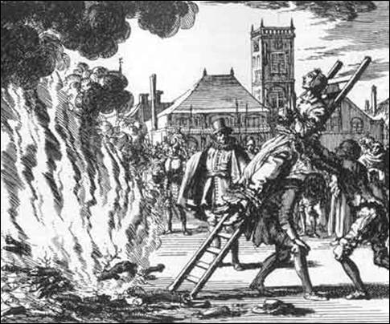
The Martyrdom of Michael Sattler
https://friendsofjustice.blog/2016/07/10/in-spite-of-dungeon-fire-and-sword/

Slide 20

Class Discussion Time
https://www.weareteachers.com/moving-beyond-classroom-discussions/

Slide 21
*Class Discussion Time
The Anabaptists refused to swear any oaths, taking their stand on Christ’s command “Swear not at all” (Mat 5:34-37) in the Sermon on the Mount. Do you think Jesus’ command absolutely prohibits us from ever taking an oath under any circumstances (even in a court of law, for example). Why or why not?
The Anabaptists understood Jesus’ teaching to prohibit Christians from ever engaging in any kind of physical conflict – including self-defense, serving as a magistrate, or serving in the military. Do you believe that Jesus’ teaching prohibits Christians from these activities? Why or why not?
Anabaptists believed that the state had no right to punish citizens for heresy, blasphemy, or idolatry. In our day, we often hear a similar cry that the government “should not legislate morality” – and yet we’re told in Romans 13:4 that governing authorities are the servants of God “who carries out God's wrath on the wrongdoer”. In your view, what are the limits as to the kinds of immorality the government should and should not penalize?
Do you have a topic or question that you would like to see us to discuss?

