Slide 1
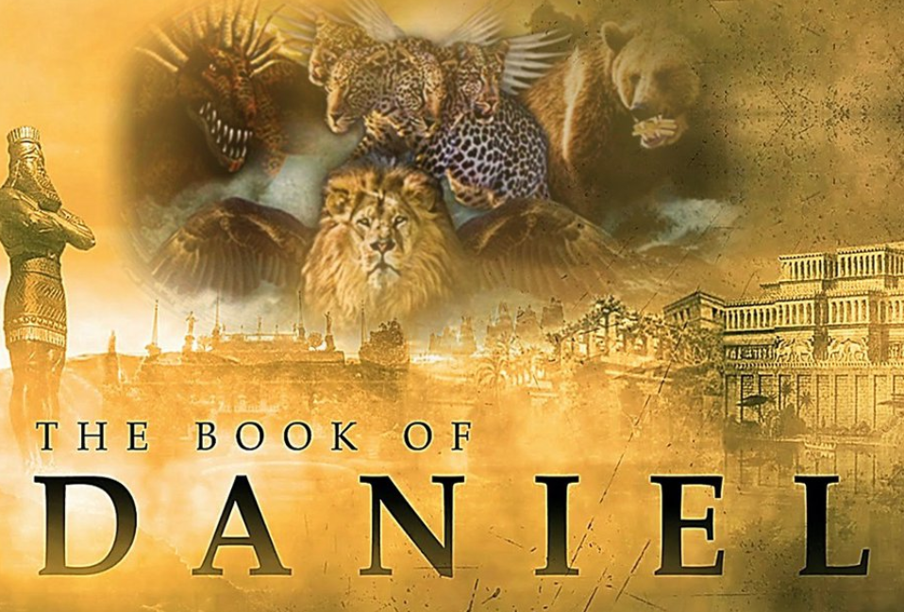
The Most High God rules over the kingdoms of the world and appoints anyone he desires to rule over them.
(Dan 5:21b NLT)
To Download this lesson go to:
http://www.purifiedbyfaith.com/Daniel/Daniel.htm
https://subsplash.com/charis/media/ms/+b72rmnj

Slide 2
Daniel’s Interprets the King’s Dream (2:31-44)
^{2:31} “You looked, O king, and there before you stood a large statue--an enormous, dazzling statue, awesome in appearance. ³² The head of the statue was made of pure gold, its chest and arms of silver, its belly and thighs of bronze, ³³ its legs of iron, its feet partly of iron and partly of baked clay. ³⁴ While you were watching, a rock was cut out, but not by human hands. It struck the statue on its feet of iron and clay and smashed them. ³⁵ Then the iron, the clay, the bronze, the silver and the gold were broken to pieces at the same time and became like chaff on a threshing floor in the summer. The wind swept them away without leaving a trace. But the rock that struck the statue became a huge mountain and filled the whole earth.

Slide 3
Daniel’s Interprets the King’s Dream (2:31-44)
^{2:36} “This was the dream, and now we will interpret it to the king. ³⁷ You, O king, are the king of kings. The God of heaven has given you dominion and power and might and glory; ³⁸ in your hands he has placed mankind and the beasts of the field and the birds of the air. Wherever they live, he has made you ruler over them all. You are that head of gold. ³⁹ “After you, another kingdom will rise, inferior to yours. Next, a third kingdom, one of bronze, will rule over the whole earth. ⁴⁰ Finally, there will be a fourth kingdom, strong as iron--for iron breaks and smashes everything--and as iron breaks things to pieces, so it will crush and break all the others.

Slide 4
Daniel’s Interprets the King’s Dream (2:31-44)
^{2:41} Just as you saw that the feet and toes were partly of baked clay and partly of iron, so this will be a divided kingdom; yet it will have some of the strength of iron in it, even as you saw iron mixed with clay. ⁴² As the toes were partly iron and partly clay, so this kingdom will be partly strong and partly brittle. ⁴³ And just as you saw the iron mixed with baked clay, so the people will be a mixture and will not remain united, any more than iron mixes with clay. ⁴⁴ “In the time of those kings, the God of heaven will set up a kingdom that will never be destroyed, nor will it be left to another people. It will crush all those kingdoms and bring them to an end, but it will itself endure forever. ⁴⁵ This is the meaning of the vision of the rock cut out of a mountain, but not by human hands--a rock that broke the iron, the bronze, the clay, the silver and the gold to pieces. “The great God has shown the king what will take place in the future. The dream is true and the interpretation is trustworthy.”

Slide 5
^{2:31} "You saw, O king, and behold, a great image. This image, mighty and of exceeding brightness, stood before you, and its appearance was frightening. (ESV)
Nebuchadnezzar had seen an enormous statue in his dream.
How large the statue was is not reported, but the image Nebuchadnezzar built later may have been patterned after this one, and that structure was ninety feet tall (3:1).
Consisting mostly of metal, the statue reflected the light and therefore was said to be “of exceeding brightness.”
Nebuchadnezzar found the statue to be “frightening”
This certainly is understandable, for the huge image would have stood like a dazzling colossus before the king.
Miller, Stephen R., Daniel, vol. 18, The New American Commentary (p. 91)

Slide 6
^{2:32} The head of this image was of fine gold, its chest and arms of silver, its middle and thighs of bronze, ³³ its legs of iron, its feet partly of iron and partly of clay. (ESV)
These verses describe the various parts of the statue and the material of which these parts were made:
The head of the statue was made of “fine gold,”
Its chest and arms of “silver”
Its belly and thighs of “bronze”
Its legs were made of “iron”, and its feet were
Partly made of “iron”
Partly made of baked “clay”
Each of the parts below the head were less valuable and less impressive than the parts that preceded it.
Miller, Stephen R., Daniel, vol. 18, The New American Commentary (p. 91)

Slide 7
^{2:34} As you looked, a stone was cut out by no human hand, and it struck the image on its feet of iron and clay, and broke them in pieces. ³⁵ Then the iron, the clay, the bronze, the silver, and the gold, all together were broken in pieces, and became like the chaff of the summer threshing floors; and the wind carried them away, so that not a trace of them could be found. But the stone that struck the image became a great mountain and filled the whole earth. (ESV)
As the king watched in his dream, a “stone” was cut out “by no human hand”.
Though it is not stated, the rock evidently was hurled by some force at the statue, striking it on its feet and breaking the iron and clay into pieces.
Not only were the feet of iron and clay destroyed, but the entire statue (the bronze, silver, and gold) disintegrated into powder as it fell to the earth.
The powder itself was blown away by the wind, removing all traces of the colossus.
Finally, the rock that had destroyed the statue grew into “a great mountain and filled the whole earth”.
Miller, Stephen R., Daniel, vol. 18, The New American Commentary (pp. 91–92)

Slide 8
^{2:34} As you looked, a stone was cut out by no human hand, and it struck the image on its feet of iron and clay, and broke them in pieces. ³⁵ Then the iron, the clay, the bronze, the silver, and the gold, all together were broken in pieces, and became like the chaff of the summer threshing floors; and the wind carried them away, so that not a trace of them could be found. But the stone that struck the image became a great mountain and filled the whole earth. (ESV)
Several features of the rock would have impressed Nebuchadnezzar:
Its origin was supernatural, for it was cut out of the mountain without human hands.
The rock had extraordinary power, for it had annihilated the statue.
The scope of its influence was worldwide as symbolized by the fact that it grew into a huge mountain and “filled the whole earth”.
In vv. 44–45, Daniel will identify this great “stone” as the coming kingdom of God, and its development into a huge mountain symbolizes its universal dominion (cf. Isaiah 2:2; cf. Mic 4:1).
Miller, Stephen R., Daniel, vol. 18, The New American Commentary (pp. 91–92)

Slide 9
^{2:36} “This was the dream. Now we will tell the king its interpretation. (ESV)
Now that Daniel had shared the substance of the dream with the king, he promised to interpret it.
It says, “Now we will tell the king its interpretation” – the “we” here may refer to God and Daniel as God’s servant.
In that is the case, Daniel would again be showing humility by emphasizing the fact that the message was from God.
The plural could be a reference to Daniel and his three friends, but this is not likely since there is no evidence that they were even there.
Daniel explained the dream as a panorama of four great Gentile empires.
Virtually all scholars agree that the different parts of the statue represent empires or kingdoms, although there is disagreement concerning their identification.
Miller, Stephen R., Daniel, vol. 18, The New American Commentary (pp. 92–93)

Slide 10
^{2:37} You, O king, the king of kings, to whom the God of heaven has given the kingdom, the power, and the might, and the glory, ³⁸ and into whose hand he has given, wherever they dwell, the children of man, the beasts of the field, and the birds of the heavens, making you rule over them all--you are the head of gold. (ESV)
The phrase “king of kings” here is a Hebrew expression used to describe a supreme monarch, or one who has other kings under him as those who pay tribute to him. ¹
In Revelation 17:14 and 19:16 we see this title is applied to the Son of God. ¹
But Daniel was quick to remind Nebuchadnezzar that his position was a stewardship from the God of heaven who had granted him “the kingdom, the power, and the might, and the glory”. ²
In these two verses Daniel emphasized the sovereignty of his God over the kings of the earth, even Nebuchadnezzar, the greatest king of the day. ²
¹ Barnes, Albert; The Ultimate Commentary On Daniel: A Collective Wisdom On The Bible (pp. 162-163)
² Miller, Stephen R., Daniel, vol. 18, The New American Commentary (pp. 92–93)

Slide 11
^{2:37} You, O king, the king of kings, to whom the God of heaven has given the kingdom, the power, and the might, and the glory, ³⁸ and into whose hand he has given, wherever they dwell, the children of man, the beasts of the field, and the birds of the heavens, making you rule over them all--you are the head of gold. (ESV)
Daniel begins his interpretation of the dream by telling Nebuchadnezzar, “you are the head of gold.”
Frequently in Scripture the terms “king” and “kingdom” are employed interchangeably since the king was considered to be the embodiment of his kingdom.
The reference here is not merely to the Nebuchadnezzar as an individual, but to the Babylonian empire itself.
We know this because it is stated in the very next verse that another “kingdom” (not king) will stand in Nebuchadnezzar’s place
Daniel therefore interpreted the first kingdom to be the ancient Babylonian Empire represented by its king, Nebuchadnezzar.
For sixty-six years (605–539 B.C.) the Neo-Babylonian Empire ruled the Near East
Miller, Stephen R., Daniel, vol. 18, The New American Commentary (pp. 92–93)

Slide 12
^{2:39} Another kingdom inferior to you shall arise after you, and yet a third kingdom of bronze, which shall rule over all the earth. ⁴⁰ And there shall be a fourth kingdom, strong as iron, because iron breaks to pieces and shatters all things. And like iron that crushes, it shall break and crush all these. (ESV)
Daniel tells Nebuchadnezzar that another “kingdom” would rise after his Babylonian Empire.
History is plain that the next great power to appear on the world scene was the Medo-Persian Empire led by Cyrus the Great.
This empire is symbolized by the silver chest and arms of the great statue.
Medo-Persian dominance continued for approximately 208 years (539–331 B.C.).
The Medo-Persian Empire is mentioned here briefly but is described in greater detail in chapters 7–8.
A bear symbolizes this kingdom in 7:5; in 8:20 a two-horned ram is specifically designated as “the kings of Media and Persia”.
Miller, Stephen R., Daniel, vol. 18, The New American Commentary (pp. 93–94)

Slide 13
^{2:39} Another kingdom inferior to you shall arise after you, and yet a third kingdom of bronze, which shall rule over all the earth. ⁴⁰ And there shall be a fourth kingdom, strong as iron, because iron breaks to pieces and shatters all things. And like iron that crushes, it shall break and crush all these. (ESV)
Daniel described the second kingdom as “inferior” to Nebuchadnezzar’s empire, and inferiority of each subsequent empire is expressed by the decreasing value of the materials.
The silver of the Medo-Persian Empire is substantially inferior and less valuable than the gold of the Babylonian kingdom.
Yet in what respects was the Babylonian Empire superior to that of Medo-Persia?
Medo-Persia was not inferior in size, for it controlled much more territory than Babylon.
A plethora of explanations have been offered, but the best view seems to be that the inferiority of Medo-Persia to Babylon is to be understood in a moral sense because the general condition of the world was worse under the second monarchy, as men’s vices and corruptions increase more and more.
Miller, Stephen R., Daniel, vol. 18, The New American Commentary (pp. 93–94)

Slide 14
^{2:39} Another kingdom inferior to you shall arise after you, and yet a third kingdom of bronze, which shall rule over all the earth. ⁴⁰ And there shall be a fourth kingdom, strong as iron, because iron breaks to pieces and shatters all things. And like iron that crushes, it shall break and crush all these. (ESV)
Through the portrayal of each subsequent empire as inferior to its predecessor, Daniel seems to have been suggesting that the sinfulness of the world would continue to increase until the culmination of history.
Certainly, the last phase of the fourth empire, described in detail later in Daniel, reaches the height of blasphemy, cruelty, and evil.
According to Daniel, the world’s kingdoms are not moving toward utopia, but in the opposite direction.
Miller, Stephen R., Daniel, vol. 18, The New American Commentary (pp. 93–95)

Slide 15
^{2:39} Another kingdom inferior to you shall arise after you, and yet a third kingdom of bronze, which shall rule over all the earth. ⁴⁰ And there shall be a fourth kingdom, strong as iron, because iron breaks to pieces and shatters all things. And like iron that crushes, it shall break and crush all these. (ESV)
A third kingdom of “bronze” (i.e., represented by the bronze belly and thighs of the statue) was then prophesied to appear on the world scene; and, of course, the empire that followed Medo-Persia was Greece (cf. 7:6; 8:5; 11:3–4).
In 332 B.C. the armies of the great conqueror Alexander the Great marched against the Medo-Persian Empire and defeated it in a series of decisive battles.
The Greek Empire dominated for approximately 185 years (331–146 B.C.).
Daniel made clear that these kingdoms “rule over all the earth,” that is, over the civilized world of the day, and were not merely individual nations with limited influence.
They were the great world empires of history.
Miller, Stephen R., Daniel, vol. 18, The New American Commentary (pp. 93–95)

Slide 16
^{2:39} Another kingdom inferior to you shall arise after you, and yet a third kingdom of bronze, which shall rule over all the earth. ⁴⁰ And there shall be a fourth kingdom, strong as iron, because iron breaks to pieces and shatters all things. And like iron that crushes, it shall break and crush all these. (ESV)
The image’s legs of “iron” represent the empire that dominated the world after Greece—ancient Rome.
Several phrases are used in this verse (“breaks to pieces ,” “shatters all things,” “crushes”) to emphasize the tremendous power this fourth kingdom would exert.
Rome ruled the nations with an iron hand and like a huge iron club shattered all who resisted its will.
The Roman Empire dominated the world from the defeat of Carthage in 146 B.C. to the division of the East and West empires in A.D. 395, approximately five hundred years.
The last Roman emperor ruled in the West until A.D. 476, and the Eastern division of the empire continued until A.D. 1453.
Miller, Stephen R., Daniel, vol. 18, The New American Commentary (pp. 95–96)

Slide 17
^{2:41} And as you saw the feet and toes, partly of potter's clay and partly of iron, it shall be a divided kingdom, but some of the firmness of iron shall be in it, just as you saw iron mixed with the soft clay. ⁴² And as the toes of the feet were partly iron and partly clay, so the kingdom shall be partly strong and partly brittle. ⁴³ As you saw the iron mixed with soft clay, so they will mix with one another in marriage, but they will not hold together, just as iron does not mix with clay. (ESV)
Like all human kingdoms, however, Rome has a flaw. Its feet are “partly of potter's clay and partly of iron”.
With this unstable base, it can stand “partly strong and partly brittle” for some time.
But it cannot stand indefinitely. Unity is impossible and the kingdom is vulnerable because it is seeking to unite elements which will not coalesce.
Leaders will try to stabilize the kingdom by mixing “with one another in marriage”, which may refer to intermarriage of royal families or relocating people in new lands.
The text does not specify here what sort of mingling takes place.
Nonetheless, its clear that whatever they try will fail.
House, Paul R.; Daniel (Tyndale Old Testament Commentaries); (pp. 72-73)

Slide 18
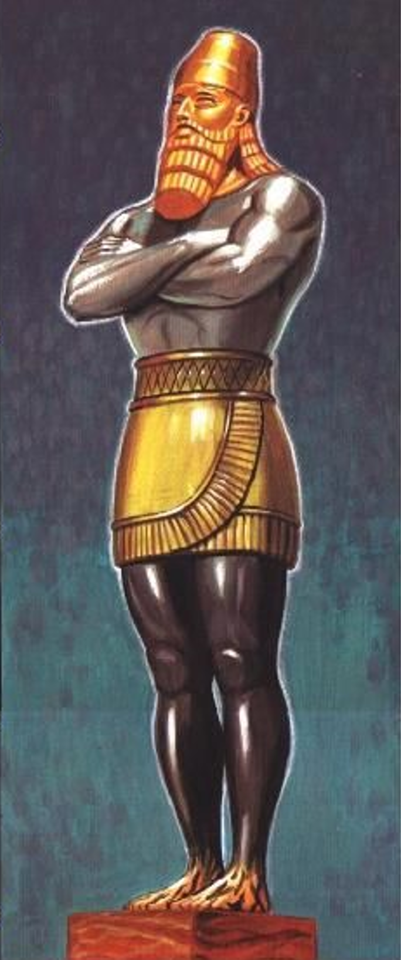
Head of Gold
BABYLON
(B.C 605-539)
The Statue in Nebuchadnezzar’s Dream (Daniel 2)
Breast of Silver
MEDO-PERSIA
(B.C 539-331)
Thighs of Brass
GREECE
(B.C 331-146)
Legs of Iron
Feet of Iron and Clay
ROME
(B.C 146 - A.D. 476)
https://www.pinterest.com/pin/386535580488110781/

Slide 19
^{2:44} And in the days of those kings the God of heaven will set up a kingdom that shall never be destroyed, nor shall the kingdom be left to another people. It shall break in pieces all these kingdoms and bring them to an end, and it shall stand forever, ⁴⁵ just as you saw that a stone was cut from a mountain by no human hand, and that it broke in pieces the iron, the bronze, the clay, the silver, and the gold. A great God has made known to the king what shall be after this. The dream is certain, and its interpretation sure." (ESV)
Daniel says here that God’s kingdom will be established “in the days of those kings ”, that is, during the period of the four empires previously described.
The time frame is not given in detail. Indeed the suggestion seems to be that the work of establishing the kingdom of God will run parallel with, and even unnoticed, by the great leaders of history.
Ultimately, however, all the kingdoms of the world will be shattered against the “kingdom” that God establishes.
What more can we say about this “kingdom” on the basis of these verses?
The destruction of these great kingdoms is not an accident of history, but instead, it is the outworking of the judgment of God on kingdoms that have turned against Him and forsaken His Word.
Ferguson, Sinclair B.; The Preacher's Commentary - Vol. 21: Daniel; (pp. 63-65)

Slide 20
^{2:44} And in the days of those kings the God of heaven will set up a kingdom that shall never be destroyed, nor shall the kingdom be left to another people. It shall break in pieces all these kingdoms and bring them to an end, and it shall stand forever, ⁴⁵ just as you saw that a stone was cut from a mountain by no human hand, and that it broke in pieces the iron, the bronze, the clay, the silver, and the gold. A great God has made known to the king what shall be after this. The dream is certain, and its interpretation sure." (ESV)
Next, we are told that the stone “shall break in pieces ” all other dominions
There seems to be an echo here of the promise given by God to the Messiah in Psalm 2:
Ask of me, and I will make the nations your heritage, and the ends of the earth your possession. You shall break them with a rod of iron and dash them in pieces like a potter's vessel. (Psalm 2:8-9)
There can be no doubt that the kingdom represented by this stone is the messianic kingdom of God.
This kingdom has several features.
It is God’s creation, His kingdom: “in the days of those kings the God of heaven will set up a kingdom ”.
Ferguson, Sinclair B.; The Preacher's Commentary - Vol. 21: Daniel; (pp. 63-65)

Slide 21
^{2:44} And in the days of those kings the God of heaven will set up a kingdom that shall never be destroyed, nor shall the kingdom be left to another people. It shall break in pieces all these kingdoms and bring them to an end, and it shall stand forever, ⁴⁵ just as you saw that a stone was cut from a mountain by no human hand, and that it broke in pieces the iron, the bronze, the clay, the silver, and the gold. A great God has made known to the king what shall be after this. The dream is certain, and its interpretation sure." (ESV)
We’re told it is an indestructible and unending kingdom “that shall never be destroyed, nor shall the kingdom be left to another people”.
It is an all-victorious kingdom, eternal in its duration: “It shall break in pieces all these kingdoms and bring them to an end, and it shall stand forever”.
Furthermore, as we already saw back in vs. 35, it will be a universal kingdom: “the stone that struck the image became a great mountain and filled the whole earth”.
All this will occur despite the obscurity and apparent weakness of its origin; it is represented by a mere stone, “cut from a mountain by no human hand”.
Ferguson, Sinclair B.; The Preacher's Commentary - Vol. 21: Daniel; (pp. 63-65)

Slide 22
^{2:44} And in the days of those kings the God of heaven will set up a kingdom that shall never be destroyed, nor shall the kingdom be left to another people. It shall break in pieces all these kingdoms and bring them to an end, and it shall stand forever, ⁴⁵ just as you saw that a stone was cut from a mountain by no human hand, and that it broke in pieces the iron, the bronze, the clay, the silver, and the gold. A great God has made known to the king what shall be after this. The dream is certain, and its interpretation sure." (ESV)
The “stone” here of course represents Christ.
He is the stone that crushes the kingdoms of this world because He is the one into whose hands the Father has committed all judgment (John 5:22).
He is the stone that the builders rejected which became the chief cornerstone (Acts 4:11).
Few subjects evoke more discussion and controversy among scholars than the topic of the kingdom of God.
It is relatively common at this point in the text of Daniel to look from verses 44–45 (“in the days of those kings ”) to some future period of history when ten kings will reign over the earth (the ten toes of the feet of the great statue).
Ferguson, Sinclair B.; The Preacher's Commentary - Vol. 21: Daniel; (pp. 65-66)

Slide 23
^{2:44} And in the days of those kings the God of heaven will set up a kingdom that shall never be destroyed, nor shall the kingdom be left to another people. It shall break in pieces all these kingdoms and bring them to an end, and it shall stand forever, ⁴⁵ just as you saw that a stone was cut from a mountain by no human hand, and that it broke in pieces the iron, the bronze, the clay, the silver, and the gold. A great God has made known to the king what shall be after this. The dream is certain, and its interpretation sure." (ESV)
However, no mention is made in the dream or its interpretation of toes or the number ten.
And I believe the words “those kings ” in this verse refer to the great emperors and empires of Babylon, Medo-Persia, Greece, and Rome spoken of in the immediate context – not to some far-distant period of history.
The decisive moment for the kingdom of God is seen as taking shape in the days of the fourth empire (Rome).
It was during the period of the Roman Empire, when Palestine was an occupied country, that Jesus came in Galilee, preaching that the kingdom of God had drawn near in His ministry (Mark 1:15).
Ferguson, Sinclair B.; The Preacher's Commentary - Vol. 21: Daniel; (pp. 66-68)

Slide 24
^{2:44} And in the days of those kings the God of heaven will set up a kingdom that shall never be destroyed, nor shall the kingdom be left to another people. It shall break in pieces all these kingdoms and bring them to an end, and it shall stand forever, ⁴⁵ just as you saw that a stone was cut from a mountain by no human hand, and that it broke in pieces the iron, the bronze, the clay, the silver, and the gold. A great God has made known to the king what shall be after this. The dream is certain, and its interpretation sure." (ESV)
It is clear from Jesus’ teaching (in which other imagery than that of the stone was usually employed) that He too saw the kingdom of God/heaven growing from unrecognized beginnings until it filled the whole earth (Mat 13:31-35; 13:47-51; 24:14).
The kingdom had come; its powers were already released in the world, but in a full and final sense it was still coming, all that it promised would be fulfilled.
If we understand these verses against that background, Daniel and his friends were receiving a message that would give them strength, hope, and confidence in the dark days that were still to come.
This message has had the same effect on God’s children in every age.
Ferguson, Sinclair B.; The Preacher's Commentary - Vol. 21: Daniel; (pp. 66-68)

Slide 25
^{2:44} And in the days of those kings the God of heaven will set up a kingdom that shall never be destroyed, nor shall the kingdom be left to another people. It shall break in pieces all these kingdoms and bring them to an end, and it shall stand forever, ⁴⁵ just as you saw that a stone was cut from a mountain by no human hand, and that it broke in pieces the iron, the bronze, the clay, the silver, and the gold. A great God has made known to the king what shall be after this. The dream is certain, and its interpretation sure." (ESV)
As the people of God, we already belong to the kingdom of God.
And yet we live in a world that is dominated by other kingdoms.
Totalitarian rulers and systems often arise, demanding loyalty and persecuting those of us who live in the kingdom of God.
We often find ourselves living in conflict with the edicts of evil governing authorities.
But when we do, there is no doubt as to where our loyalties lie: We must obey God rather than rulers.
Whatever other elements of this chapter might fascinate us, we must allow nothing to obscure this plain fact: God’s kingdom will triumph in the end.
Ferguson, Sinclair B.; The Preacher's Commentary - Vol. 21: Daniel; (pp. 66-68)

Slide 26
^{2:44} And in the days of those kings the God of heaven will set up a kingdom that shall never be destroyed, nor shall the kingdom be left to another people. It shall break in pieces all these kingdoms and bring them to an end, and it shall stand forever, ⁴⁵ just as you saw that a stone was cut from a mountain by no human hand, and that it broke in pieces the iron, the bronze, the clay, the silver, and the gold. A great God has made known to the king what shall be after this. The dream is certain, and its interpretation sure." (ESV)
“For he must reign until he has put all his enemies under his feet.” (1 Cor 15:25).
And “the kingdom of the world has become the kingdom of our Lord and of his Christ, and he shall reign forever and ever.” (Rev. 11:15)
We have received a “kingdom that cannot be shaken”. (Heb. 12:28)
This has often been the great hope that has encouraged the people of God in times of physical trials and in spiritual darkness.
It gave courage to Daniel and has given hope and energy to many Daniels since.
Does this chapter not give heightened meaning to our prayer: “Our Father in heaven Hallowed be Your name. Your kingdom come…”?
Ferguson, Sinclair B.; The Preacher's Commentary - Vol. 21: Daniel; (pp. 66-68)

Slide 27

Class Discussion Time
Does it encourage you to be reminded by this and other passages that God’s kingdom will triumph in the end?
Most conservative scholars understand the “legs of iron” in the statue of Nebuchadnezzar’s dream to refer to the ancient Roman empire.
But some commentaries understand “its feet partly of iron and partly of clay.” (Dan 2:33) as referring to a different kingdom that is yet future:
“its feet partly of iron and partly of clay” – “In light of Dan 7 the contemporaneous “kings” of v. 44 (“in the time of those kings”) are best interpreted as those symbolized by the ten toes of the statue. its this final empire will consist of ten kingdoms (or nations) ruling jointly at the time of Christ’s return. John the apostle also speaks of this eschatological ten-kingdom confederacy (cf. Rev 13:1; 17:12). (Miller, Stephen R., Daniel, vol. 18, The New American Commentary (p. 98)

Slide 28
Class Discussion Time
I will withhold judgment on Daniel 7 and the book of Revelation, until I come to those texts in our study.
But as I pointed out in my material, today’s text does not say anything about the “ten toes” (though I don’t doubt they existed) and I am therefore hesitant to assign symbolic meaning to something the text never mentions.
Nor does our text describe the feet as a separate kingdom, but seems to include them as part of the iron legs.
The text does mention the mix of clay and iron as symbolizing some kind of diversity that existed within this kingdom that they tried to overcome by intermarriage, but that ultimately contributed to its weakness and downfall. This seems to fit what we know of ancient Rome.
Consequently, in my explanation, I described them both as part of the Roman empire.
What are your thoughts?

