Slide 1
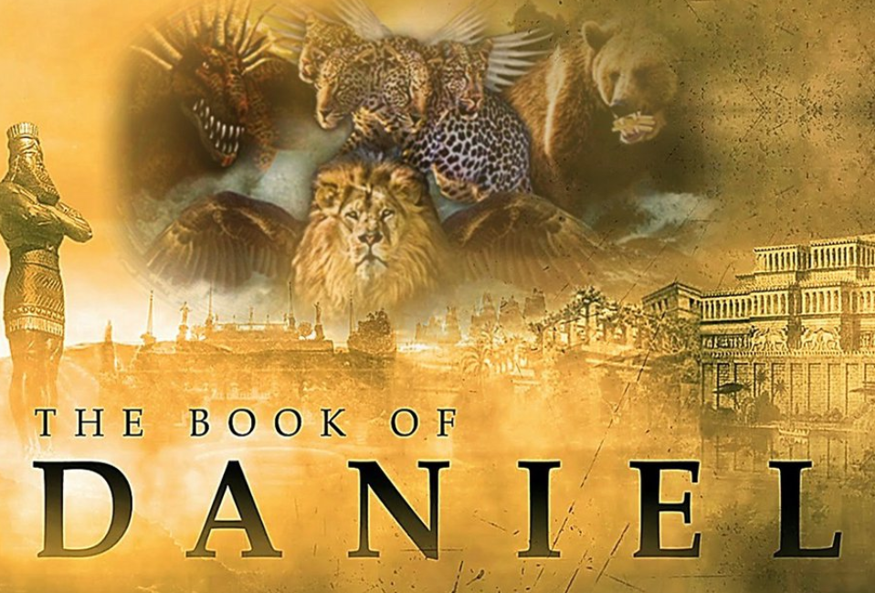
The Most High God rules over the kingdoms of the world and appoints anyone he desires to rule over them.
(Dan 5:21b NLT)
To Download this lesson go to:
http://www.purifiedbyfaith.com/Daniel/Daniel.htm
https://subsplash.com/charis/media/ms/+b72rmnj

Slide 2
Brief Recap of Last Week’s Lesson
Last week I reminded you the book of Daniel consists of two major parts:
Chapters 1-6 – The Historical Section (Stories)
Chapters 7-12 – The Prophetic Section (Visions)
I introduced the second section of the book of Daniel (chapters 7-12) and then covered verses 1-6
I pointed out that the style of writing in chapters 7-12 is described by theologians as Apocalyptic writing which we defined as:
A revelation of the ending of this present age, which is an age characterized by conflict, and its replacement by the final age of peace. It shows us ahead of time the end of the kingdoms of this world and their replacement by the kingdom of our God and of his Christ. This revelation is unfolded in complex and mysterious imagery, and has the purpose of comforting and exhorting the faithful.
To put it briefly, Apocalyptic literature is intended to give hope to those whom the world has marginalized by reminding us that God is presently on the throne and that he will ultimately triumph.

Slide 3
Brief Recap of Last Week’s Lesson
As we covered the first 6 verses, we saw symbolic language used to describe a number of events that were yet future to Daniel.
We saw “four winds of heaven” that were “stirring up” the “sea”.
The “sea” represents the sea of humanity or peoples of the earth
The “four winds of heaven” represent factors of all kinds that produce turmoil among the earth’s nations throughout history.
Daniel then spoke of “four great beasts” which symbolize the four great empires that would dominate the world from the time of Daniel until the coming of Messiah – the same four empires symbolized by the four parts of the statue in Daniel chapter 2.
The first “beast” which looked like a “lion” with the “wings” of an “eagle” represents Babylon and its king, Nebuchadnezzar.
The second “beast” which looked like a “bear” with one side above the other and “had three ribs in its mouth” represents Medo-Persia.
The third “beast” which looked like a “leopard” with “four wings” on its back and “four heads” represents Greece.

Slide 4
Daniel’s Vision of the Four Beasts (7:1-8)
^{7:1} In the first year of Belshazzar king of Babylon, Daniel had a dream, and visions passed through his mind as he was lying on his bed. He wrote down the substance of his dream. ² Daniel said: “In my vision at night I looked, and there before me were the four winds of heaven churning up the great sea. ³ Four great beasts, each different from the others, came up out of the sea.

Slide 5
Daniel’s Vision of the Four Beasts (7:1-8)
^{7:4} “The first was like a lion, and it had the wings of an eagle. I watched until its wings were torn off and it was lifted from the ground so that it stood on two feet like a man, and the heart of a man was given to it. ⁵ “And there before me was a second beast, which looked like a bear. It was raised up on one of its sides, and it had three ribs in its mouth between its teeth. It was told, ‘Get up and eat your fill of flesh!’ ⁶ “After that, I looked, and there before me was another beast, one that looked like a leopard. And on its back it had four wings like those of a bird. This beast had four heads, and it was given authority to rule.

Slide 6
Daniel’s Vision of the Four Beasts (7:1-8)
^{7:7} “After that, in my vision at night I looked, and there before me was a fourth beast--terrifying and frightening and very powerful. It had large iron teeth; it crushed and devoured its victims and trampled underfoot whatever was left. It was different from all the former beasts, and it had ten horns. ⁸ “While I was thinking about the horns, there before me was another horn, a little one, which came up among them; and three of the first horns were uprooted before it. This horn had eyes like the eyes of a man and a mouth that spoke boastfully. (NIV)

Slide 7
^{7:7a} After this I saw in the night visions, and behold, a fourth beast, terrifying and dreadful and exceedingly strong. It had great iron teeth; it devoured and broke in pieces and stamped what was left with its feet. It was different from all the beasts that were before it… (ESV)
The fourth beast was “terrifying” and “dreadful” because it was “exceedingly strong” and “had great iron teeth” protruding from its mouth with which it “devoured” its prey.
“broke in pieces” either refers to the tearing of the prey with the animal’s great teeth or to its pouncing upon the victim and crushing it with its body and powerful legs.
Any fragments of its victims that remained were “stamped” under the monster’s feet.
All of these factors in addition to its ferocious behavior would certainly inspire great fear.
Miller, Stephen R., Daniel, vol. 18, The New American Commentary (pp. 200–201)

Slide 8
^{7:7a} After this I saw in the night visions, and behold, a fourth beast, terrifying and dreadful and exceedingly strong. It had great iron teeth; it devoured and broke in pieces and stamped what was left with its feet. It was different from all the beasts that were before it… (ESV)
That no name is given to the fourth beast is not due to the author’s lack of imagination but because, it defies any zoological category.
The lion, bear, and leopard certainly were not like any real-life versions of those animals, but overall they did exhibit many of their characteristics.
Yet the fourth beast did not look like any animal Daniel had ever seen.
By the second century B.C., Rome had superseded Greece as the dominant world power.
The fourth beast, therefore, represents the Roman Empire, symbolized in chapter 2 by the iron legs and feet of the great statue.
Miller, Stephen R., Daniel, vol. 18, The New American Commentary (pp. 200–201)

Slide 9
^{7:7a} After this I saw in the night visions, and behold, a fourth beast, terrifying and dreadful and exceedingly strong. It had great iron teeth; it devoured and broke in pieces and stamped what was left with its feet. It was different from all the beasts that were before it… (ESV)
The incredible might and cruelty of Rome are aptly depicted by Daniel’s fourth beast.
Just as this monster was “different” from all the others, so the Roman Empire differed from those that had preceded it.
Rome possessed a power and longevity unlike anything the world had ever known.
Nations were crushed under the iron boot of the Roman legions, its power was virtually irresistible, and the extent of its influence surpassed the other three kingdoms.
Miller, Stephen R., Daniel, vol. 18, The New American Commentary (pp. 200–201)

Slide 10
^{7:7b} …and it had ten horns. ⁸ I considered the horns, and behold, there came up among them another horn, a little one, before which three of the first horns were plucked up by the roots. And behold, in this horn were eyes like the eyes of a man, and a mouth speaking great things. (ESV)
Here our text describes the “horns” found on the fourth beast. Specifically:
First we’re told that the fourth beast had “ten horns”
Then we’re told that “there came up among them another horn, a little one”
Finally, we are told that “before” the little horn “three of the first horns were plucked up by the roots”
The question we must now answer is: What do these horns symbolize?
The vast majority of my best commentaries on the book of Daniel all see these “horns” as representing kings and/or kingdoms that are, at least in part, yet future to us – going all the way until the time of the Anti-Christ (1 John 2:18) whom Christ will destroy at his Second coming (2 Thess 2:3–12).
I want to begin by laying out for you what my best commentaries say each of these “horns” in the above text (Daniel 7:7b-8) represent.
Then I want to show you an alternative understanding of this passage that I believe is a better fit.

Slide 11
^{7:7b} …and it had ten horns. ⁸ I considered the horns, and behold, there came up among them another horn, a little one, before which three of the first horns were plucked up by the roots. And behold, in this horn were eyes like the eyes of a man, and a mouth speaking great things. (ESV)
The beast itself stands for the Roman Empire as it appeared at the birth of Christ and in the years subsequent.
With regard to the fourth beast, Daniel sees not only certain characteristics but also the unfolding of a history:
The beast itself is first presented in the vision.
Then there is a period of the ten horns.
Then there is a period of the little horn.
Following the historical Roman Empire is the period represented by the ten horns.
From Daniel 7:24 we see that the “ten horns” represent ten kings:
As for the ten horns, out of this kingdom ten kings shall arise…
Young, Edward J.; The Prophecy of Daniel: A Commentary); (p. 147–150)

Slide 12
^{7:7b} …and it had ten horns. ⁸ I considered the horns, and behold, there came up among them another horn, a little one, before which three of the first horns were plucked up by the roots. And behold, in this horn were eyes like the eyes of a man, and a mouth speaking great things. (ESV)
Like the number four in vs. 6, the number ten here should be taken in a symbolic sense as representing a multiplicity of rulers, or an indefinitely large number of kings.
These kingdoms in one sense or another, arise historically from the ancient Roman Empire.
This does not mean that each one of the empires must be able to trace its origin immediately to Rome.
The kingdoms of modern Europe, for example, might be said to have come from the Roman Empire, but certainly not directly.
Young, Edward J.; The Prophecy of Daniel: A Commentary); (p. 147–150)

Slide 13
^{7:7b} …and it had ten horns. ⁸ I considered the horns, and behold, there came up among them another horn, a little one, before which three of the first horns were plucked up by the roots. And behold, in this horn were eyes like the eyes of a man, and a mouth speaking great things. (ESV)
So, from the time of the destruction of the Roman Empire to the appearance of the little horn there will be a number of kingdoms, which may truly be said to originate from the ancient Roman Empire.
To seek to identify these kingdoms, when Scripture furnishes no clue as to their identity, is very precarious and probably unwarranted.
Toward the close of the second period there appears another kingdom, symbolized by the little horn.
This kingdom or government uproots some of the others (I am not sure that the number three is to be pressed).
Young, Edward J.; The Prophecy of Daniel: A Commentary); (p. 147–150)

Slide 14
^{7:7b} …and it had ten horns. ⁸ I considered the horns, and behold, there came up among them another horn, a little one, before which three of the first horns were plucked up by the roots. And behold, in this horn were eyes like the eyes of a man, and a mouth speaking great things. (ESV)
This kingdom’s dominion will immediately precede the return of Christ, for the empire will be destroyed by the coming of the kingdom of God (cf. 7:11, 13–14, 21–22, 26–27).
Daniel predicts that the ruler of this kingdom (little horn) will be brilliant (“eyes like the eyes of a man”) and arrogant (“a mouth speaking great things”).
The picture of this evil, future king in these verses concurs with descriptions of him found in other Scripture passages (cf. Dan 11:36–37; 2 Thess 2:3–12; Rev 13:5–6).
He is none other than the most infamous person in all of human history—the “Antichrist”.
Miller, Stephen R., Daniel, vol. 18, The New American Commentary (pp. 201–203)

Slide 15
^{7:7b} …and it had ten horns. ⁸ I considered the horns, and behold, there came up among them another horn, a little one, before which three of the first horns were plucked up by the roots. And behold, in this horn were eyes like the eyes of a man, and a mouth speaking great things. (ESV)
Centuries ago (ca. A.D. 400) Jerome identified this individual as the Antichrist and described him as “one of the human race, in whom Satan will wholly take up his residence in bodily form.”
Thus, Daniel predicted that in the last days a powerful empire made up of a confederation of kingdoms or nations will rise out of the ashes of the old Roman Empire.
This final empire will have incredible power, for by its force Antichrist will rule the whole earth (cf. Rev 13:3, 7–8, 12).
Thus, in one remarkable picture, the entire course of history is given from the appearance of the historical Roman Empire until the end of human government.
Miller, Stephen R., Daniel, vol. 18, The New American Commentary (pp. 201–203)

Slide 16
An Alternative View
At this point I would like to briefly present an alternative view of what the symbols in Daniel 7:7-8 represent.
This alternative view that I am now going to present represents what is known in theological circles as the Preterist view.
In short, a Preterist is one who believes that most of the so-called “apocalyptic” prophecies of Daniel, Ezekiel, Zechariah, Matthew 24 and Revelation were fulfilled by AD 70.
As you listen to the presentation of this view, compare it with what you just heard and try to determine which seems to be the best fit, both with the text and the facts of history as we know it.
Rogers, Jay. In The Days of These Kings: The Book of Daniel in Preterist Perspective (p. 124).

Slide 17
^{7:7b} …and it had ten horns. ⁸ I considered the horns, and behold, there came up among them another horn, a little one, before which three of the first horns were plucked up by the roots. And behold, in this horn were eyes like the eyes of a man, and a mouth speaking great things. (ESV)
Given that the fourth beast is the Roman empire, I would see the “ten horns” as “ten kings ” (again, see verse 24) within the Roman empire, rather than a series of kings or kingdoms that succeed the Roman empire.
If we start with Julius Caesar, we see that there is sequence of ten emperors reigning from the beginning of that empire until the time of the destruction of Jerusalem in AD 70.
The reign of these kings cover the period of the ministry of the Messiah and the Apostles:
Julius (100 BC – 44 BC) Augustus (27 BC–14 AD) Tiberius (14–37 AD) Caligula (37–41 AD) Claudius (41–54 AD) | Nero (54–68 AD) Galba (68–69 AD) Otho (January–April 69 AD) Aulus Vitellius (July–December 69 AD) Vespasian (69–79 AD)
Rogers, Jay. In The Days of These Kings: The Book of Daniel in Preterist Perspective (p. 77).

Slide 18
^{7:7b} …and it had ten horns. ⁸ I considered the horns, and behold, there came up among them another horn, a little one, before which three of the first horns were plucked up by the roots. And behold, in this horn were eyes like the eyes of a man, and a mouth speaking great things. (ESV)
So, we have “ten horns” or ten kings of the Roman empire.
We then come to the infamous “little horn” of verse 8.
We are told a “little one [i.e. horn]” rises up from “among” the 10 horns.
There is good evidence to suggest that what the writer intended with his language was that the little horn was one of the 10 horns.
I suggest that the little horn was Emperor Nero, the sixth of the 10 emperors in world history.
Rogers, Jay. In The Days of These Kings: The Book of Daniel in Preterist Perspective (p. 77-78).

Slide 19
^{7:7b} …and it had ten horns. ⁸ I considered the horns, and behold, there came up among them another horn, a little one, before which three of the first horns were plucked up by the roots. And behold, in this horn were eyes like the eyes of a man, and a mouth speaking great things. (ESV)
The text then tells us in verse 8 that “three of the first horns were plucked up by the roots” by this little horn.
And we know from world history that three of the first ten emperors, Tiberius, Caligula and Claudius, were assassinated to make way for Nero, who was not in the line of succession.
With this understanding of our text, what we find is that Daniel’s prophecies are pinpoint accurate to what actually happened in world history, just as it has been in all of the previous predictions.
Rogers, Jay. In The Days of These Kings: The Book of Daniel in Preterist Perspective (p. 77-78).

Slide 20
A Major Decision Point
So, we have seen two views of how to understand this text starting in Daniel 7:7-8.
Which ever view you go with will end up affecting how you interpret all of the rest of this chapter and will have impacts even on how you will understand the symbols given in the later chapters in Daniel.
Because of this, I thought it was important for us to camp here and have a discussion of the two views that have been presented and think about which view best fits:
What we see in the text
What we know of history

Slide 21

Class Discussion Time
As I was working through this material this week, I received a quote of Alistair Begg from a friend of mine that pretty much sums up how I feel about today’s lesson:
In what follows, I reserve the right to change my mind later this evening, and as often as necessary for the rest of my life, until I finally settle the matter. What I am about to now unfold for you will annoy some, disappoint others, confuse many, and perhaps encourage a few.
I personally am leaning towards the Preterist understanding of this text right now, but I am still trying to think it through and I would value any insights that you all might have to offer on what I have presented thus far.

