Slide 1

The Most High God rules over the kingdoms of the world and appoints anyone he desires to rule over them.
(Dan 5:21b NLT)
To Download this lesson go to:
http://www.purifiedbyfaith.com/Daniel/Daniel.htm
https://subsplash.com/charis/media/ms/+b72rmnj

Slide 2
Daniel Seeks Clarification and Receives Assurance (12:8-13)
^{12:8} I heard, but I did not understand. So I asked, “My lord, what will the outcome of all this be?” ⁹ He replied, “Go your way, Daniel, because the words are closed up and sealed until the time of the end. ¹⁰ Many will be purified, made spotless and refined, but the wicked will continue to be wicked. None of the wicked will understand, but those who are wise will understand. ¹¹ “From the time that the daily sacrifice is abolished and the abomination that causes desolation is set up, there will be 1,290 days. ¹² Blessed is the one who waits for and reaches the end of the 1,335 days. ¹³ “As for you, go your way till the end. You will rest, and then at the end of the days you will rise to receive your allotted inheritance.” (NIV)

Slide 3
^{12:8} I heard, but I did not understand. Then I said, "O my lord, what shall be the outcome of these things?” ⁹ He said, "Go your way, Daniel, for the words are shut up and sealed until the time of the end. (ESV)
There was much that Daniel still “did not understand” about the vision.
He asked for further information either from Gabriel or more likely from “the man clothed in linen” (Christ) who had just spoken.
Daniel’s question may be about Israel’s fate, or perhaps “these things” includes the whole range of future events that the angel had revealed to Daniel in this vision.
Gabriel (or perhaps Christ) replied, “Go your way, Daniel”.
This is not a rebuke (additional information is provided in vv. 11–12) but simply indicates that Daniel should go on about his life and not be concerned about his lack of knowledge because the vision speaks of future events that do not involve him.
Yet Daniel was assured that these prophecies, which he had just been given, would be preserved (“shut up and sealed”; cf. v. 4) for those who will need them, that is, the persons who live at “the time of the end.”
Miller, Stephen R., Daniel, vol. 18, The New American Commentary (p. 324)

Slide 4
^{12:10} Many shall purify themselves and make themselves white and be refined, but the wicked shall act wickedly. And none of the wicked shall understand, but those who are wise shall understand. (ESV)
Elaborating on the thought of the previous verse, the idea here seems to be: Fear not, Daniel, for although you yourself do not “understand” the words of this prophesy, when that time comes of which this prophesy speaks, there will be “many” who do “understand” them.
These words, “shut up and sealed ”until that “time of the end” when the Romans lay siege to Jerusalem, will be a source of blessing to the people of God in that day.
For persecutions, trials and afflictions will come in that “time of trouble” (cf. 12:1), and when they do, there will be “many” who will “purify themselves and make themselves white and be refined” (i.e. be sanctified through their suffering)
And because they “are wise”, they will “understand” the words of this prophecy.
But the “wicked” of that day, like the wicked of every age, will continue to act “wickedly” and therefore “none” of them will “understand” or heed the warnings contained in this prophesy.
Young, Edward J.; The Prophecy of Daniel: A Commentary; (p. 261)

Slide 5
^{12:11} And from the time that the regular burnt offering is taken away and the abomination that makes desolate is set up, there shall be 1,290 days. ¹² Blessed is he who waits and arrives at the 1,335 days. (ESV)
These next two verses provide further details concerning the events that will take place in this future “time of trouble” described in Daniel 12:1ff, including a couple of very specific time periods: “1,290 days” and “1,335 days”.
As you might imagine, commentaries vary significantly in how they explain these two time period and the events they involve.
Part of the variation comes from the fact that commentaries differ in their understanding of when the events of this passage take place.
As I’ve mentioned before, the vast majority of commentaries take a futurist view of this passage and see the events described here as occurring in the last days before the second coming of Christ.
They see these days as including a seven-year tribulation period and an Antichrist who will be fighting the last battle against Christ and his people.
Mauro, Philip, The Seventy Weeks: And the Great Tribulation (pp.87-88)

Slide 6
^{12:11} And from the time that the regular burnt offering is taken away and the abomination that makes desolate is set up, there shall be 1,290 days. ¹² Blessed is he who waits and arrives at the 1,335 days. (ESV)
Others see this as further description of Antiochus IV Epiphanes and his reign of terror, which has been previously mentioned and described in a couple of Daniel’s earlier prophecies.
My view, as I’ve stated in my previous lesson (where I covered Daniel 12:1-7), is that this passage refers to the events of A.D. 70 when the Romans laid siege to Jerusalem and destroyed the temple.
While my view has its problems, I think, on balance, it provides the best and least problematic explanation of this passage as a whole.
Philip Mauro, who I cited quite a bit when interpreting at the last part of chapter 11 (which I see as applying to King Herod), offers what I find to be the best explanation of these two verses in particular.
So that is the explanation I will be providing in these next few slides.
Mauro, Philip, The Seventy Weeks: And the Great Tribulation (pp.87-88)

Slide 7
^{12:11} And from the time that the regular burnt offering is taken away and the abomination that makes desolate is set up, there shall be 1,290 days. ¹² Blessed is he who waits and arrives at the 1,335 days. (ESV)
I believe the “the regular burnt offering ” mentioned here refers to the sacrifice of a lamb that was offered up every morning and evening by the Jews prior to the destruction of the temple in 70 AD.
This sacrifice was offered daily by the children of Israel throughout their entire history, starting in the days of Moses (Exodus 29:38-45).
But this daily sacrifice ended (was “taken away ”) during the siege of Jerusalem in A.D. 70.
And this was seen as such a significant event that Josephus recorded the very date on which this sacrifice ceased to be offered, saying:
“And now Titus … had been informed that, on that very day, which was the seventeenth day of Panemus (= July, A.D. 70), the sacrifice called ‘the daily sacrifice’ had failed, and had not been offered to God for want of men to offer it; and that the people were grievously troubled at it” (Wars, VI. 2.1.)
Mauro, Philip, The Seventy Weeks: And the Great Tribulation (pp.87-89)

Slide 8
^{12:11} And from the time that the regular burnt offering is taken away and the abomination that makes desolate is set up, there shall be 1,290 days. ¹² Blessed is he who waits and arrives at the 1,335 days. (ESV)
The phrase “abomination that makes desolate” is cited by Jesus in a sermon given just prior to his crucifixion, known as the Olivet Discourse, which we find recorded in all three of the synoptic Gospels (Mat 24-25; Mark 13; Luke 21:5-36).
In that sermon, Jesus prophesies a number of future events, including a series of events which he tells his audience would occur before the “generation” of those standing there (in A.D. 30) had passed away (Mat 24:34).
Specifically, Jesus prophesied that within the lifetime of those standing there, the Roman armies would:
Lay siege to the city of Jerusalem (Luke 21:20)
And would eventually tear down the temple complex to such an extent that “there will not be left… one stone upon another that will not be thrown down” (Mat 24:2)
Mauro, Philip, The Seventy Weeks: And the Great Tribulation (pp.87-89)

Slide 9
^{12:11} And from the time that the regular burnt offering is taken away and the abomination that makes desolate is set up, there shall be 1,290 days. ¹² Blessed is he who waits and arrives at the 1,335 days. (ESV)
Jesus then warned his listeners (since a number of them would still be alive when these events occurred) that as soon as they saw these things beginning to occur, they should flee the city in haste :
Let those who are in Judea flee to the mountains. Let the one who is on the housetop not go down to take what is in his house, and let the one who is in the field not turn back to take his cloak. And alas for women who are pregnant and for those who are nursing infants in those days! Pray that your flight may not be in winter or on a Sabbath. (Mat 24:16-20)
Jesus then went on to tell them why they need to flee in haste - so as to avoid the “great tribulation, such as has not been from the beginning of the world until now, no, and never will be.” (Mat 24:21 cf. Daniel 12:1)
Mauro, Philip, The Seventy Weeks: And the Great Tribulation (pp.87-89)

Slide 10
^{12:11} And from the time that the regular burnt offering is taken away and the abomination that makes desolate is set up, there shall be 1,290 days. ¹² Blessed is he who waits and arrives at the 1,335 days. (ESV)
In giving this warning to flee in haste, Jesus refers to the Roman army, or perhaps events associated with the presence of the Roman army, as the “abomination of desolation”:
“So when you see the abomination of desolation spoken of by the prophet Daniel, standing in the holy place (let the reader understand), then let those who are in Judea flee to the mountains. (Mat 24:15-16)
“But when you see the abomination of desolation standing where he ought not to be (let the reader understand), then let those who are in Judea flee to the mountains. (Mar 13:14)
“But when you see Jerusalem surrounded by armies, then know that its desolation has come near. Then let those who are in Judea flee to the mountains… (Luke 21:20-21)
Mauro, Philip, The Seventy Weeks: And the Great Tribulation (pp.87-89)

Slide 11
^{12:11} And from the time that the regular burnt offering is taken away and the abomination that makes desolate is set up, there shall be 1,290 days. ¹² Blessed is he who waits and arrives at the 1,335 days. (ESV)
Therefore, based on Jesus’ citation of this passage (he even tells us he is quoting from Daniel), I believe Jesus expects us to understand (let the reader understand) that the events Daniel is describing in our text (Daniel 12:1-12) are events that took take place when the Romans laid siege to Jerusalem and eventually destroyed the temple (which we now know happened in A.D. 70).
Events such as:
“the abomination that makes desolate” (Dan 12:11)
“the regular burnt offering is taken away ” (Dan 12:11)
“a time of trouble, such as never has been since there was a nation till that time.” (Dan 12:1)
“at that time your people shall be delivered, everyone whose name shall be found written in the book” (Dan 12:1) – part of the way they were “delivered” was by Jesus warning them to flee as he cited this passage in Daniel
Mauro, Philip, The Seventy Weeks: And the Great Tribulation (pp.87-89)

Slide 12
^{12:11} And from the time that the regular burnt offering is taken away and the abomination that makes desolate is set up, there shall be 1,290 days. ¹² Blessed is he who waits and arrives at the 1,335 days. (ESV)
So, we see two events mentioned in verse 11:
The approach of the Roman armies, identified by Jesus as “the abomination that makes desolate”
The cessation of the daily Jewish sacrifice “the regular burnt offering is taken away ”
The text then states that the number of days between these two events is “1,290 days”
According to Josephus:
The first approach of the Roman armies under Cestius is described by Josephus in his book of Wars as occurring in November, A.D. 66. (The Jewish War, Book 2, Chapter 19, Section 4.)
The cessation of the daily Jewish sacrifice, as we saw earlier, occurred in July, A.D. 70 (Wars, VI. 2.1.)
Mauro, Philip, The Seventy Weeks: And the Great Tribulation (pp.87-89)

Slide 13
^{12:11} And from the time that the regular burnt offering is taken away and the abomination that makes desolate is set up, there shall be 1,290 days. ¹² Blessed is he who waits and arrives at the 1,335 days. (ESV)
Philip Mauro notes that “1,290 days” is exactly 43 months (if you count each month as 30 days each, according to the Hebrew method of reckoning), and there is, as it turns out, just 43 full months between the two events, if you ignore the parts of the two months in which the events occurred.
Notice this corresponds to the “time, times, and half a time” (3 ½ years) in which the “the power of the holy people” will be “shattered” (i.e., the nation of Israel will be utterly defeated by their enemies) mentioned in Daniel 12:7.
Nov A.D. 66 – Approach of the Roman armies
July A.D. 70 – End of the daily Jewish sacrifice
Jan
A.D. 67
Jan
A.D. 68
Jan
A.D. 69
Jan
A.D. 70
1 month
36 months
6 months
Mauro, Philip, The Seventy Weeks: And the Great Tribulation (pp.87-89)

Slide 14
^{12:11} And from the time that the regular burnt offering is taken away and the abomination that makes desolate is set up, there shall be 1,290 days. ¹² Blessed is he who waits and arrives at the 1,335 days. (ESV)
In verse 12, there is mention of a time period of “1,335 days”.
“1,335 days” is 45 days longer than “1,290 days”.
We are told in verse 12, that those who are able to wait it out and survive an additional 45 days beyond the “1,290 days” to “1,335 days” are “blessed”.
According to Josephus about a month and a half (i.e. 45 days) after the daily sacrifice failed, the siege on Jerusalem was ended by Titus’ as he gained possession of the upper city, the last stronghold of the besieged. (Wars, VI 8, 4, 5)
Titus immediately extended clemency to the survivors and set them free.
Indeed, those who survived until that time were truly “blessed”
Mauro, Philip, The Seventy Weeks: And the Great Tribulation (pp.87-89)

Slide 15
^{12:13} But go your way till the end. And you shall rest and shall stand in your allotted place at the end of the days." (ESV)
God had revealed many wonderful truths to Daniel over the years, but v. 13 implies that no more revelations would be granted him.
Daniel was now a very old man, and he was instructed to cease being anxious about these matters and be satisfied with what he had been told for as long as he lived (“go your way till the end”).
Daniel would die (probably soon after this vision) and “rest” from the labors of this life (and his body would rest in the grave; cf. Isa 57:2), but “at the end of the days” he “shall stand” (be resurrected) in his “allotted place.”
The promise of the resurrection set forth in 12:2 is now specifically applied to Daniel.
Miller, Stephen R., Daniel, vol. 18, The New American Commentary (pp. 326–327)

Slide 16
^{12:13} But go your way till the end. And you shall rest and shall stand in your allotted place at the end of the days." (ESV)
Daniel was not to be concerned, for he would be resurrected and receive a great reward and a part in the kingdom of God (predicted in Daniel’s own prophecies) that will someday come upon the earth and then continue into the eternal state.
Keil has aptly commented: “Well shall it be for us if in the end of our days we too are able to depart hence with such consolation of hope!”
This “consolation of hope” belongs to all who have received Jesus Christ as Lord and Savior.
May every person who reads these words be part of that great host of the redeemed who “will shine like the brightness of the heavens” and “like the stars for ever and ever!”
Miller, Stephen R., Daniel, vol. 18, The New American Commentary (pp. 326–327)

Slide 17
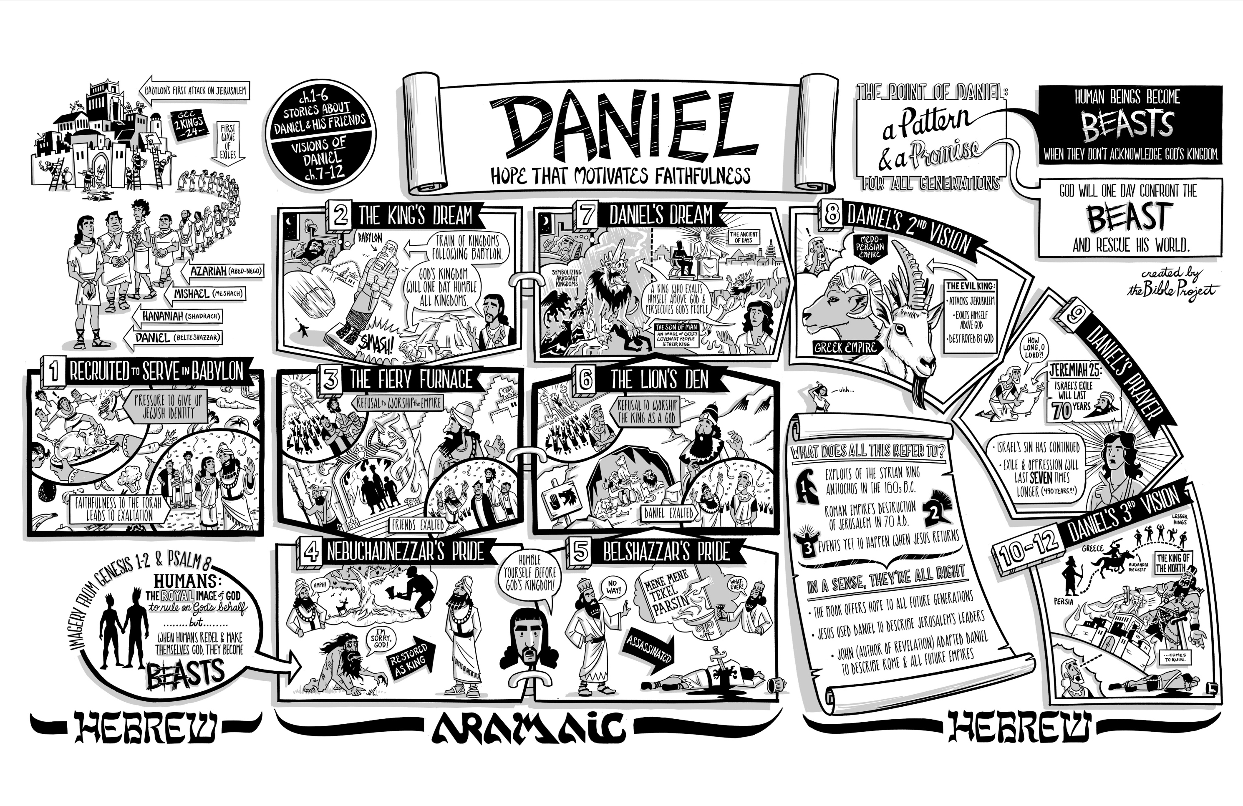
A Quick High-Level Summary of the Book of Daniel
Book of Daniel Summary: A Complete Animated Overview – YouTube

Slide 18

Class Discussion Time
In light of what we covered today, especially the comparison of what Jesus says as he cites this passage in the Olivet Discourse, what do you now think of my identification of the events mentioned in this passage as the events that occur during the last days of Jewish history prior to the destruction of the temple in A.D. 70?
In particular, events mentioned in this passage would include:
A “time of trouble, such as never has been since there was a nation till that time” (Daniel 12:1)
“the time of the end” (Daniel 12:4, 9)
It would be for “time, times, and half a time” when “the shattering of the power of the holy people comes to an end” and “all these things would be finished” (Daniel 12:7)
“the time that the regular burnt offering is taken away” (Daniel 12:11)
“the abomination that makes desolate” (Daniel 12:11)
What do you think of the opposing view taken by the majority of modern commentators, that this is instead a reference to a seven-year period of tribulation that they believe will occur just prior to Christ’s second coming?
What do you see as the pros and cons of these two views?

Slide 19
Class Discussion Time
What do you think of the explanation I cited from Philip Mauro explaining how the “1,290 days” and “1,335 days” describe time periods related to the events of A.D. 70. In particular:
“1,290 days” is the exact time period from:
The approach of the Roman armies, identified by Jesus as “the abomination that makes desolate”
And the cessation of the daily Jewish sacrifice “the regular burnt offering is taken away”
“1,335 days” is the period of time that believers in the day when Rome besieged Jerusalem and destroyed the temple would need to survive in order for them to be “blessed” and be set free for the period of trouble had passed.
Do you think:
“Wow! That’s an amazing fulfillment of prophesy!”
Or “Nah! That’s just a little too neat and tidy to be true”.
Or something else?

Slide 20
Class Discussion Time
What are your thoughts on our study of the book of Daniel?
Did you profit from it? If so, it what ways?
What was your favorite part of the study?
What was your least favorite part of the study?
If I were to ever teach the series again in the future, is there anything you think I should do differently?

