Slide 1

Young Earth Creation
A Brief Look at the
Biblical Creation –
in Contrast with
Modern Secular Evolution
For further information on this topic visit my website at https://www.purifiedbyfaith.com/ and click on the “Creation versus Evolution” link
Image credit – https://www.peakpx.com/en/hd-wallpaper-desktop-kiaqp

Slide 2

Did God really say . . .
Image credit – https://upsidedownsavior.home.blog/2020/09/01/the-real-enemy/

Slide 3
Did God really say . . .
That about 6,000 years ago (cf. Genesis 5 and 11) He made the heavens and the earth and all that is in them in six ordinary days? (Genesis 1:1-2:4; Exodus 20:8-11)
That He made the earth before He made the stars? (Genesis 1:1 cf. 1:14-19), and He made plants before He made the sun? (Genesis 1:11-13 cf. 1:14-19)
That He directly made the first plants and animals – and made them to reproduce “according to their kind”? (Genesis 1:11,12,21,24,25)
That He made the men of every nation from just one man (Adam) whom He created directly from the dust of the ground and one woman whom He created from Adam’s rib? (Genesis 1:26-28; 2:7, 18, 20-25; Acts 17:26)
That before the first man Adam sinned, there was no suffering or death in the world like there is today? (Genesis 3:16-20; Romans 5:12, 8:18-23)
That some men in ancient times lived in excess of 900 years? (Genesis 5:5,8,11,14,20,27)
That God once judged the whole world by sending a flood that covered every mountain on earth and killed every living breathing creature that was not on Noah’s ark? (Genesis 6:1-8:22; Luke 17:26-27; 2 Peter 2:5)

Slide 4
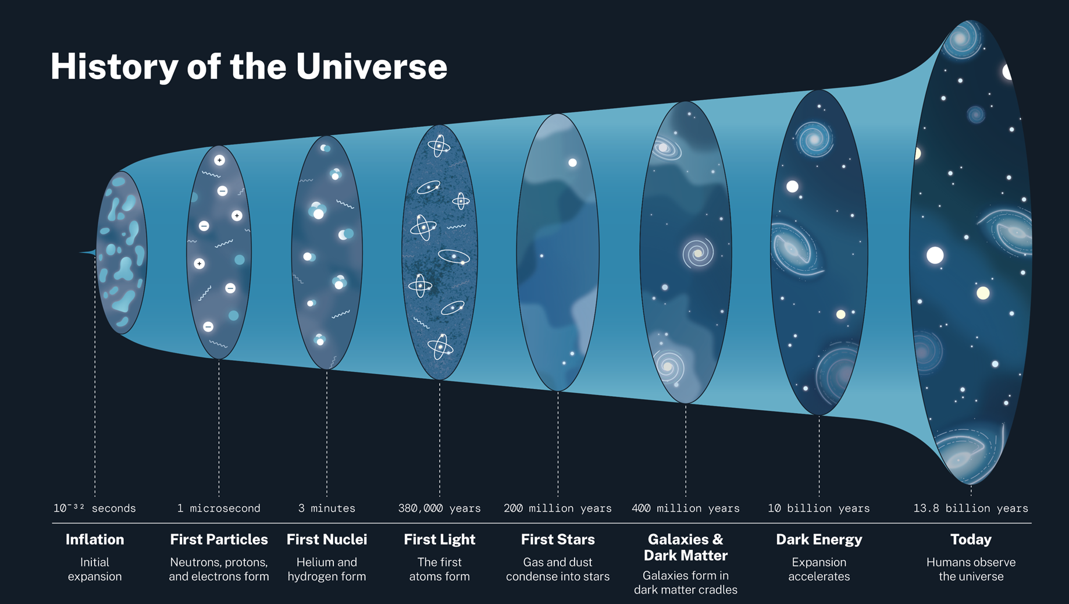
Did God really say . . .
God really did say those things – and yet many in our world today present a very different picture of how our universe began:
  We’re told that the universe began as an infinitesimally small, infinitely dense particle 13.8 billion years ago, which then began expanding at the speed of light, ultimately resulting in the universe as we know it today.
  We’re not told where this infinitesimally small, infinitely dense particle came from – just that it was there.
  And we’re not told how it organized itself into the universe we see today with all of its beauty and complexity through nothing but mindless random forces!
https://science.nasa.gov/resource/history-of-the-universe/

Slide 5

Did God really say . . .
  Furthermore, we’re told that life on this planet (the only place in the universe where life is known to exist) started 4 billion years ago with single one-celled organism.
  But secular biologists can’t explain how that first one-celled organism, composed of many extremely complex parts (which could not have evolved independently since they are mutually dependent on each other for their continued existence), suddenly popped into existence and began reproducing itself.
  Nor can they explain where all the genetic information came from to go from a single cell to all the complex lifeforms that exist today.

Slide 6

An Illustration of the Absurdity of Believing That Our Complex Universe and All the Complex Life Forms on Earth Evolved Through Random Processes Over Billions of Years

Slide 7
The Real Issue – Willfully Suppressing the Truth
The Bible teaches that God has made Himself known to all men “in the things that have been made” (the creation) and therefore those who deny His existence are fools who wickedly suppress that knowledge and are without excuse.
Romans 1:18-20 - The wrath of God is revealed from heaven against all ungodliness and unrighteousness of men, who by their unrighteousness suppress the truth. For what can be known about God is plain to them, because God has shown it to them. For his invisible attributes, namely, his eternal power and divine nature, have been clearly perceived, ever since the creation of the world, in the things that have been made. So they are without excuse.
Psalm 53:1 - The fool says in his heart, "There is no God.”

Slide 8
Twisted Views of Creation
As we have seen, evolutionary scientists claim that the universe is 13.8 billion years old and biological life is 4 billion years old.
Some Christians who hear this claim, and are worried that science may end up disproving the Bible, will try to reinterpret the Bible so as to accommodate these long ages (rather than question the evolutionists’ claim).
In the process they end up twisting the clear teaching of the scriptures.
The three most common views held by Christians who try to read long ages into the Bible are:
  Theistic Evolution: God used Evolution.
  The “Gap” Theory: There is a time “gap” between Genesis 1:1 and Genesis 1:2.
  The Day-Age (“Progressive Creationist”) View: The “days” of Genesis 1 are indefinitely long ages.

Slide 9

Theistic Evolution?

Slide 10
Objections to Theistic Evolution
The Bible says that God made the universe and all that is in it in six ordinary days – not 13.8 billion years.
  Exodus 20:9,11 - Six days you shall labor, and do all your work, but the seventh day is a Sabbath to the LORD… For in six days the LORD made heaven and earth, the sea, and all that is in them…
The story of evolution was made up as a way of explaining how the Universe got here without God.
Why would we now want to replace the trustworthy biblical account that God has given us with an evolutionary story that involves God but still makes no sense?

Slide 11
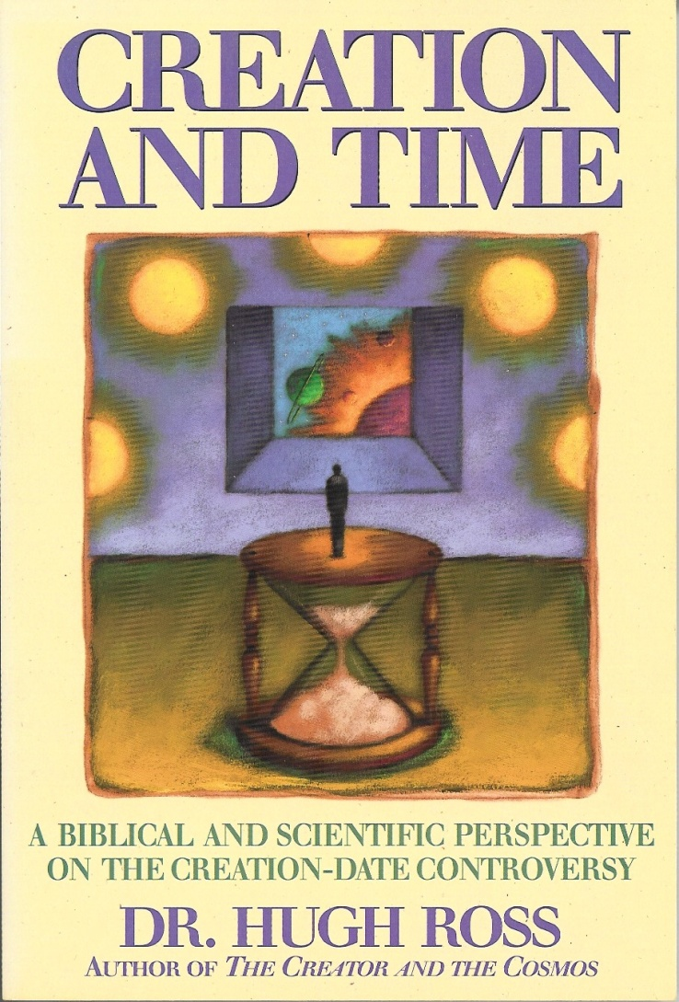
The Day-Age (“Progressive Creationist”) View

Slide 12
The Day-Age (“Progressive Creationist”) View
Those who teach this view argue that yom (the Hebrew word for “day”) sometimes means an “indefinite period of time”.
And since those who hold this view are looking for a way to insert billions of years into the text (in hopes of making the biblical account fit with modern secular science), they argue that the seven “days” of creation were not ordinary 24 hour days (the most common meaning of the Hebrew word yom) but indefinitely long periods of time (i.e. billions of years).
There are three reasons this method of interpretation doesn’t work:
  The grammatical construction of Genesis 1 is clearly describing ordinary (24 hour days) – not indefinite periods of time.
  Even if the days of Genesis 1 were long periods of time (billions of years), the creation account still won’t fit with secular science.
  Exodus 20:9,11 - Six days you shall labor, and do all your work, but the seventh day is a Sabbath to the LORD… For in six days the LORD made heaven and earth, the sea, and all that is in them…

Slide 13

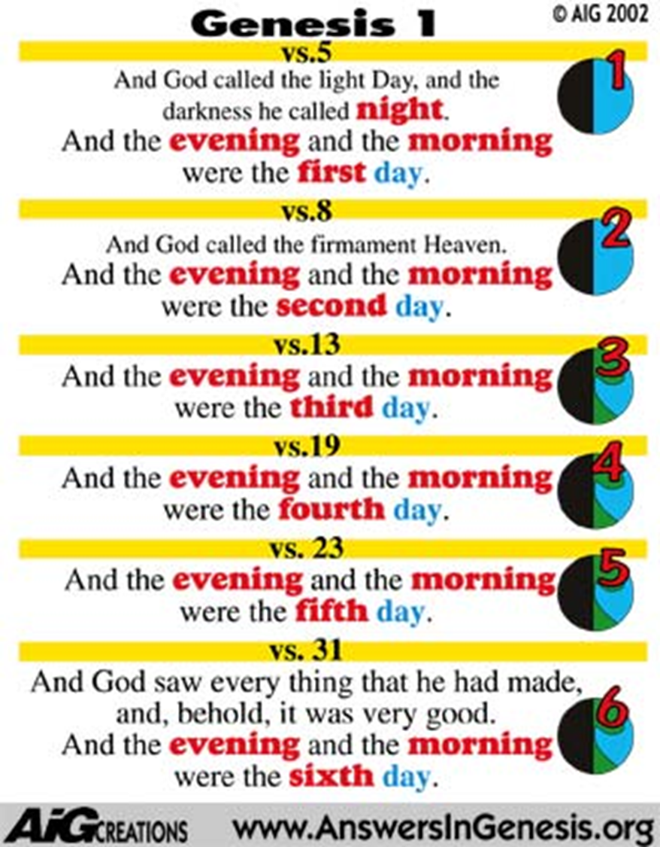
The “days” in Genesis 1 are Ordinary (24-hour) Days

Slide 14
Long Days Don’t Solve the Problem
Genesis Says:
Secular Science Says:
Earth (1st day) before the sun and stars (4th day)
Sun and stars before the earth
Light (1st day) before the sun (4th day)
Sun, the earth’s first light
Land vegetation (3rd day) before sun (4th day)
Sun before land vegetation
Plants (3rd day) before insects (included in “creeping things” - 6th day)
Insects before flowering plants. Few flowering plants could survive for very long without insects for pollination.
Birds and fish created at the same time (5th day)
Fish came millions of years before Birds
Fish (5th day) before insects (included in “creeping things” - 6th day)
Insects before fish
Birds (5th day) before land reptiles (6th day)
Reptiles before birds
Marine mammals (5th day) before land mammals (6th day)
Land mammals before marine mammals

Slide 15

Did Man Descend from Adam or Apes?

Slide 16







Two Contrasting Views
The Bible teaches that God created man
Evolution begins with the assumption that man has evolved from ape-like creatures
So God created man in his own image, in the image of God created he him; male and female
Genesis 1:27
Pick your relative

Slide 17
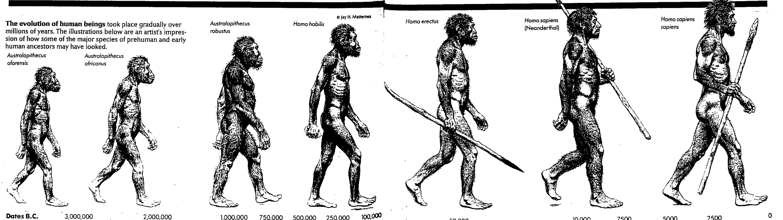

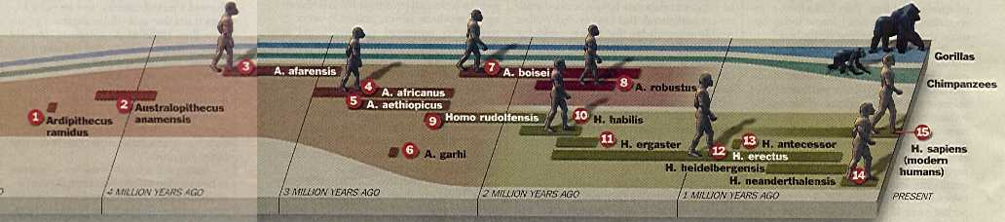

The Origin of Man According to Secular Evolution:
According to the 1996 World Book Encyclopedia:
According to Time magazine (Aug 1999):
“. . . all [evolutionary] researchers agree on certain basic facts. We know, for example, that humans evolved from ancestors we share with other living primates such as chimpanzees and apes.” (Miller and Levine, Biology, 2000, p. 757.)

Slide 18
The Evolutionary Approach to Man’s Origins
Evolutionists begin with a preconceived bias that man evolved from ape-like creatures millions of years ago.
From this starting point:
  Evolutionists “build their case” - often using faulty or insufficient evidence and often ignoring evidence to the contrary.
  Evolutionists then create misleading stories, pictures, models, videos, etc. in newspapers, magazines, textbooks, museums, documentaries etc. in order to market their evolutionary views.

Slide 19
There Are Only Three Ways to Make an “Apeman”
The next time you go to a museum, or read a news story about one of our supposed apelike ancestors, just remember that the fossil evidence they are presenting to you is one of three things:
  Combining Men and Apes – They combine ape fossil bones with human fossil bones and declare the two to be one individual – a real “ape-man.” (e.g. “Piltdown Man”)
  Making Men Out of Apes – They emphasize certain humanlike qualities of fossilized ape bones, and with imagination upgrade apes to be more humanlike. (e.g. “Lucy” – Australopithecus afarensis)
  Making Apes Out of Men – They emphasize certain apelike qualities of fossilized human bones, and with imagination downgrade humans to be more apelike. (e.g. “Neanderthal”)
In reality, “As far back as the human fossil record goes the human body has remained substantially the same and has not evolved from something else.” (Marvin Lubenow in Bones of Contention, p.140)
http://www.answersingenesis.org/articles/wow/did-humans-really-evolve

Slide 20






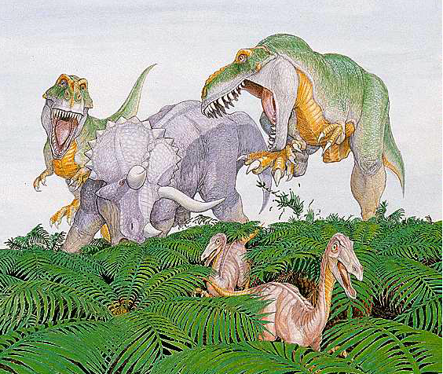








What About the Dinosaurs?
T-Rex Attack on Triceratops

Slide 21
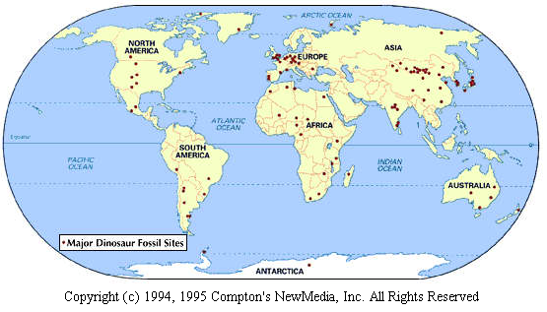
The Discovery of Dinosaurs
  Dinosaur fossils were first discovered in the early 1800s
  The term "dinosaur", which means "terrible lizard", was coined in 1841 by the famous paleontologist, Sir Richard Owen.
  Since these early finds, more than 1,000 different sites containing dinosaur fossils have been uncovered around the world:

Slide 22
The Evolutionary View of Dinosaurs
  Evolutionists believe that dinosaurs “evolved” about 230 million years ago and then died out about 65 million years ago.
  Evolutionists are uncertain as to why dinosaurs went extinct.

Slide 23
What’s the Biblical Perspective on Dinosaurs?
  Dinosaurs would have been included in the animals created on the fifth and sixth days of creation.
  If the dinosaurs lived until the time of Noah's flood…
    Many dinosaurs would have perished in the flood - leaving numerous fossils.
    Dinosaurs would have also been among those animals that God preserved on the ark.
    The apparent extinction of dinosaurs today would have taken place after the flood - perhaps due to changing conditions on the earth.
  There are good reasons to believe that dinosaurs and man co-existed on the earth – even in fairly recent times.
  There are many ancient legends throughout the world that speak of “dragons” – many of which sound remarkably similar to what we would call dinosaurs today (remember the term “dinosaur” did not yet exist until 1841):
  There are a number of references in the Bible to creatures that we would probably identify today as dinosaurs:
    Behemoth (Job 40:15-24)
    Leviathan (Job 41:1-34)
    Sea Monsters? Dragons? (Psalm 74:13; Psalm 148:7; Isaiah 27:1)

Slide 24

How Old is the
Human Race?
Image credit – https://vanguardculture.com/7-billion-others-on-the-inter-connectedness-of-all-of-us-on-this-planet/

Slide 25
How Old is the Human Race?
  If we read the genealogies of Genesis 5 and 11 in a straightforward, literal manner then the human race is about 6000 years old:
    From Adam to the Abraham: 2,000 years
    From Abraham to Christ: 2,000 years
    From Christ to the Present: 2,000 years
    Age of the Human Race: 6,000 years
  In fact, from a biblical perspective, assuming the days of Genesis 1 are regular 24 hour days, the age of the earth and the entire universe is about 6,000 years old.

Slide 26

How Old is the Earth?

Slide 27

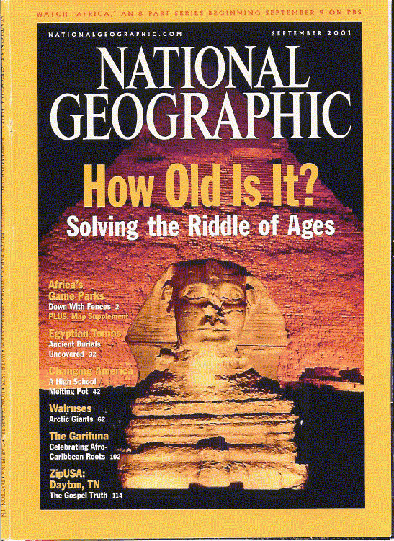
How Old is the Earth?
The Secular Answer:
“The world’s oldest known rock was dated . . . at 4.03 billion years. The earth itself goes back 4.5 billion years.”
National Geographic, September 2001, p. 91

Slide 28
How Old is the Earth?
  To those who believe in secular evolution, an old earth is considered essential -
    “The secrets of evolution are death and time - the death of enormous numbers of life forms that were imperfectly adapted to the environment; and time for a long succession of small mutations that were by accident adaptive, time for the slow accumulation of patterns of favorable mutations” [emphasis added] (Carl Sagan , Cosmos, 1980, p.30)
    “Time is in fact the hero of the plot . . . given so much time the ‘impossible’ becomes possible, the possible probable and the probable virtually certain. One has only to wait: time itself performs miracles” [emphasis added]. (George Wald, “The Origin of Life,” Physics and the Chemistry of Life, 1955, p.12)

Slide 29


For the Secular Worldview – Billions of Years are Essential

Slide 30

How Can We Know How Old Something Is?

Slide 31
How Can We Know How Old Something Is?
A. First Hand Knowledge
B. A Reliable Eyewitness
C. A Reliable “Clock”
  So how do we know how old the earth is?:
  Option A - We weren’t there (Job 38:4).
  Option B - Since the Bible is the Word of God, we have a reliable eyewitness account of when the earth was created.
  Option C - Those who are not willing to trust the Bible as a reliable eyewitness account, must rely on option “C”. The “clock” most often chosen by secular scientists by which they arrive at such ancient dates for the age of the earth is the “clock” of radioactive decay – which is not always very reliable.

Slide 32

Radioactive
Dating Methods
Image credit – https://www.advancedsciencenews.com/molecule-modification-could-improve-reprocessing-of-spent-nuclear-fuel/

Slide 33
How Radioactive Dating Works
  A radioactive element (known as the “parent” element) gives off radiation at an (assumed) constant rate.
  As this happens, the radioactive element turns into another (usually non-radioactive) element (known as the “daughter” element).
  The time it takes for half of any parent element to turn into the daughter element is called the “half-life” of that element.
  By measuring the amount of parent and daughter elements present in a rock, scientists (given certain assumptions) believe that they can determine the age of that rock.

Slide 34
Radioactive Decay
Parent element
Daughter element
Uranium
Eventually Decays Into
Lead
Potassium
Eventually Decays Into
Argon

Slide 35
Apparent Problems with Radioactive Dating
  Scientists often encounter examples in the real world that contradict their assumptions about the reliability of radioactive dating methods:
  Scientists often get conflicting dates using different radioactive dating methods on the same rock. Obviously both dates can't be right!
  Sometimes rocks that are thought to be much older than other rocks (because they are buried several layers under them) date much younger than the rocks found above them!
  Often rocks that are known to be very young (because they come from recent volcanoes whose eruption date is known) give dates using radioactive dating methods that are very old and therefore known to be erroneous.

Slide 36


Apparent Problems with Radioactive Dating
Just to give one example: rocks from the cooled lava dome of Mount St. Helens (which at the time were about 10 years old) were sent to a reputable lab to be dated - without telling the lab where the rocks had come from.
The lab (using K-Ar) dating returned results ranging from:
0.34 ± 0.06 million years old to
2.8 ± 0.6 million years old!
Keith Swensen, Creation, June - August 2001, Vol. 23 No. 3, p.23-25

Slide 37

How Old is the Universe?
https://esahubble.org/images/potw1108a/

Slide 38


According to Secular Science:
National Geographic, September 2001, p. 85

Slide 39
The Problem of Seeing Light From Distant Stars
  As we have already seen, the Bible, if read in a straightforward manner, clearly suggests that the Universe is only 6,000 years old.
  So how is it that we can see stars that are billions of light years away?
  If the light that allows us to see those stars, takes billions of years to get here, doesn’t that prove the universe must be billions of years old?
  Over the years, a number of PhD Astronomers who believe God’s Word and therefore believe the universe is thousands, not billions of years old, have put forth some really fascinating ideas on how we can see light from distant stars in a “young” universe.
  In order to follow some of the explanations they have put forth, you need to understand some rather complex aspects of Einstein’s Theory of Relativity.
  Given the time constraints of today’s class, I will not be able to do that today, but I have explained some of their ideas on my website at: https://www.purifiedbyfaith.com/ – click on “Creation versus Evolution”.
  Keep in mind their theories, though they are insightful, are really just ways to help us reconcile what we see in the world around us with God’s Word.
  Ultimately, our belief in a young universe must be grounded in our trust in God and in his Word: “Let God be true, and every man a liar.” (Rom 3:4)

Slide 40
The Flood

Slide 41
The Biblical Flood of Genesis 6-9 was Universal and Global
Universal: Every living, breathing creature was destroyed by the Flood - with the exception of those creatures that were preserved on the ark with Noah, his three sons and their wives. (Genesis 6:17-19; 7:21-23; 9:11,15; 1 Peter 3:20; 2 Peter 2:5; 3:6)
  Note: The living things that were completely destroyed by the flood involved specifically those animals that lived on "dry land" and "breathed" (Gen.7:22). Animals that lived in the water (e.g. fish) could survive outside the ark, though, no doubt, in the turbulence of the flood, many fish died as well.
Global: Every high mountain on the face of the earth was covered by the waters of the Flood (Genesis 7:18-20; Psalm 104:5-9; Isaiah 54:9)

Slide 42
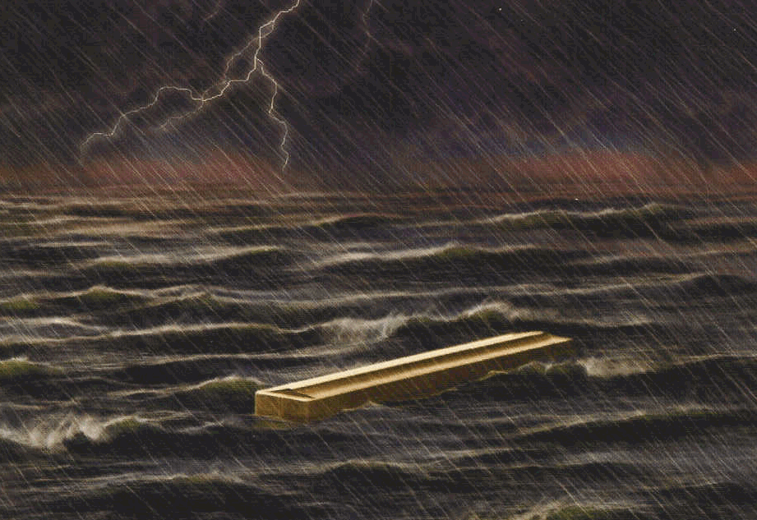
Where Did All the Water For the Flood Come From?

Slide 43
Where Did All the Water For the Flood Come From?
Genesis 7:11 - In the six hundredth year of Noah's life, in the second month, on the seventeenth day of the month, on that day all the fountains of the great deep burst forth, and the windows of the heavens were opened.
Two Sources:
1. The Fountains of the Great Deep
  May Have Lasted For 150 days
  Came from within the earth
  Probably Involved a Great Deal of Volcanic Activity
2. The “Windows” of the Heavens
  An Extraordinary Rain
  Lasted for "40 days and 40 nights"

Slide 44
What Are the Fountains of the Deep?
Referred to twice in the flood account:
  Genesis 7:11 – … the fountains of the great deep burst forth…
  Genesis 8:2 - The fountains of the deep… were closed…
As best we can tell, the “fountains of the great deep ” seem to be underground water sources that existed deep within the earth prior to the flood.
These springs are said to “burst forth” which seems to imply a violent release of the water as it breaks through the ground.
Note: Given the number of volcanic rocks that we see interspersed between the layers in the rocks laid down by the Flood – it seems likely that the bursting forth of these fountains involved an large number volcanic eruptions as well.
http://www.answersingenesis.org/home/area/answersbook /flood12.asp#2

Slide 45

Fountains of the Deep Burst Forth?
Taken from Walt Brown, Ph.D., In the Beginning – Compelling Evidence for Creation and the Flood, 7th Edition, 2001, p.101
Available at www.creationscience.com

Slide 46

Springs (or Fountains) of the Deep Burst Forth?
Brown, In the Beginning, p.101

Slide 47
Where Did All the Water Go After the Flood?

Slide 48


Where Did All the Water Go After the Flood?
Psalm 104:6 – You covered [the earth] with the deep as with a garment; the waters stood above the mountains. ⁷ At your rebuke they fled; at the sound of your thunder they took to flight. ⁸ The mountains rose, the valleys sank down to the place that you appointed for them. ⁹ You set a boundary that they may not pass, so that they might not again cover the earth.
If this passage refers to the process that God used at the time of Noah’s flood, then it would seem to indicate that the bulk of the waters from the flood ended up in today's ocean basins.

Slide 49
Evidence of a Global Flood

Slide 50
Evidence of a Global Flood
As we look around our world, we find a great deal of evidence for the global flood talked about in scripture:
  Large Sedimentary Deposits containing the fossilized remains of dead plants and animals – including fossils of sea creatures on top of the highest mountains!
  Large Canyons carved out by vast amounts water and mud as it ran rapidly back into the seas after the flood.
  Flood Legends in Cultures Throughout the World
Notes:
The deepest ocean is the Marianas Trench in the Pacific Ocean which is 36,201 feet (6.9 miles) below sea level.
The highest mountain is Mount Everest which is 29,028 feet (5.5 miles) above sea level.

Slide 51

Normandy, France

Slide 52

The White Cliffs of Dover, England

Slide 53
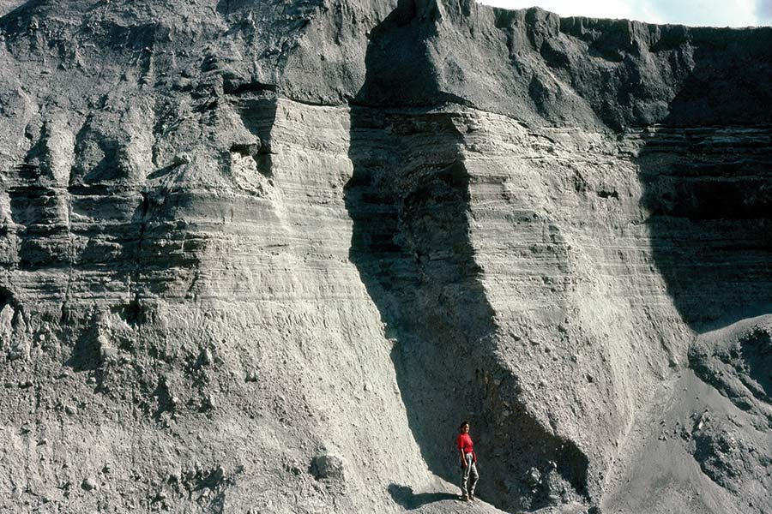
Mount Saint Helens – Rock Layers Formed Rapidly
Evolutionists tell us that it takes millions of years for such rock layers to form - but the layers pictured above were produced within a matter of hours during the Mount Saint Helens volcano eruption on June 12, 1980.
https://answersingenesis.org/geology/mount-st-helens/lasting-lessons-mount-st-helens/

Slide 54

The Grand Canyon
Evolutionists tell us that it took millions of years for the river pictured above to carve out this canyon.

Slide 55
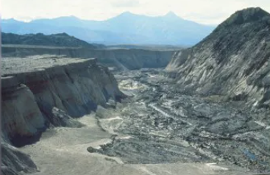
Mount Saint Helens – Small Model of the Grand Canyon?
But the 100-foot-deep Engineer’s Canyon on the north fork of the Toutle River is like a small scale model of the Grand Canyon.
And it was carved very quickly by a catastrophic mud flow produced by one volcano eruption (Mount Saint Helens)
https://answersingenesis.org/age-of-the-earth/how-old-does-earth-look/

Slide 56

Flood Traditions
(http://www.answersingenesis.org/docs2004/0324ark.asp)

Slide 57

Some Final Things to Think About

Slide 58
Some Final Things to Think About
There is a war going on and we are right in the middle of it! “For though we live in the world, we do not wage war as the world does. The weapons we fight with are not the weapons of the world. On the contrary, they have divine power to demolish strongholds. We demolish arguments and every pretension that sets itself up against the knowledge of God”(2 Corinthians 10:3-5)
To challenge Creation (as taught in the Bible) is to challenge God’s credibility and His ability to communicate clearly. “I have spoken to you of earthly things and you do not believe; how then will you believe if I speak of heavenly things? ”(John 3:12)
We must hold fast to God's Word and turn away from false “knowledge” that may cause others to wander away from the faith. “Turn away from godless chatter and the opposing ideas of what is falsely called knowledge, which some have professed and in so doing have wandered from the faith.”(1 Timothy 6:20-21)

Slide 59
Some Final Things to Think About
It should not surprise us in these “last days" that there are many “scoffers” who deliberately ignore God as Creator and Judge: “In the last days scoffers will come, scoffing and following their own evil desires. They will say… “Ever since our fathers died, everything goes on as it has since the beginning of creation.” But they deliberately forget that long ago by God's word the heavens existed and the earth was formed out of water and by water. By these waters also the world of that time was deluged and destroyed… ” (2 Peter 3:3-7)
It should not surprise us that many brilliant scientific minds have bought into the lie of Evolution: “Brothers, think of what you were when you were called. Not many of you were wise by human standards… But God chose the foolish things of the world to shame the wise; ” (1 Corinthians 1:26-29)
Regardless of how confident and dogmatic a secular Evolutionist might sound - in his heart of hearts he is suppressing the obvious truth that God is his Creator and Judge: “For since the creation of the world God's invisible qualities--his eternal power and divine nature--have been clearly seen, being understood from what has been made, so that men are without excuse.”(Romans 1:18-20 )

