Slide 1
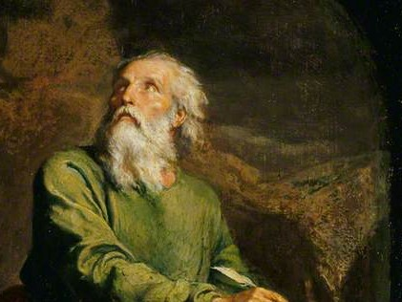
Highlights
From the
Book of
Isaiah
To Download this lesson go to:
http://www.purifiedbyfaith.com/Isaiah/Isaiah.htm
https://www.wikiart.org/en/ernest-meissonier/isaiah

Slide 2
Introduction to Isaiah 6:1-13:
R.C. Sproul on
“The Importance of Holiness”
The first time I heard R. C. Sproul teach was several decades ago. I can't recall the exact date, but I do remember his teaching like it was yesterday...
He began in Isaiah 6, a passage I knew well. I had preached on it myself more than once. But after hearing R. C.'s powerful description of the majesty and magnificence of “the Lord sitting upon a throne, high and lifted up” (Isaiah 6:1), I never looked at that passage the same way again. It was as if R. C. had taken us into the very throne room of heaven to see a glimpse of God's holiness with our own eyes.
(John MacArthur)
https://www.gty.org/library/blog/B171214

Slide 3
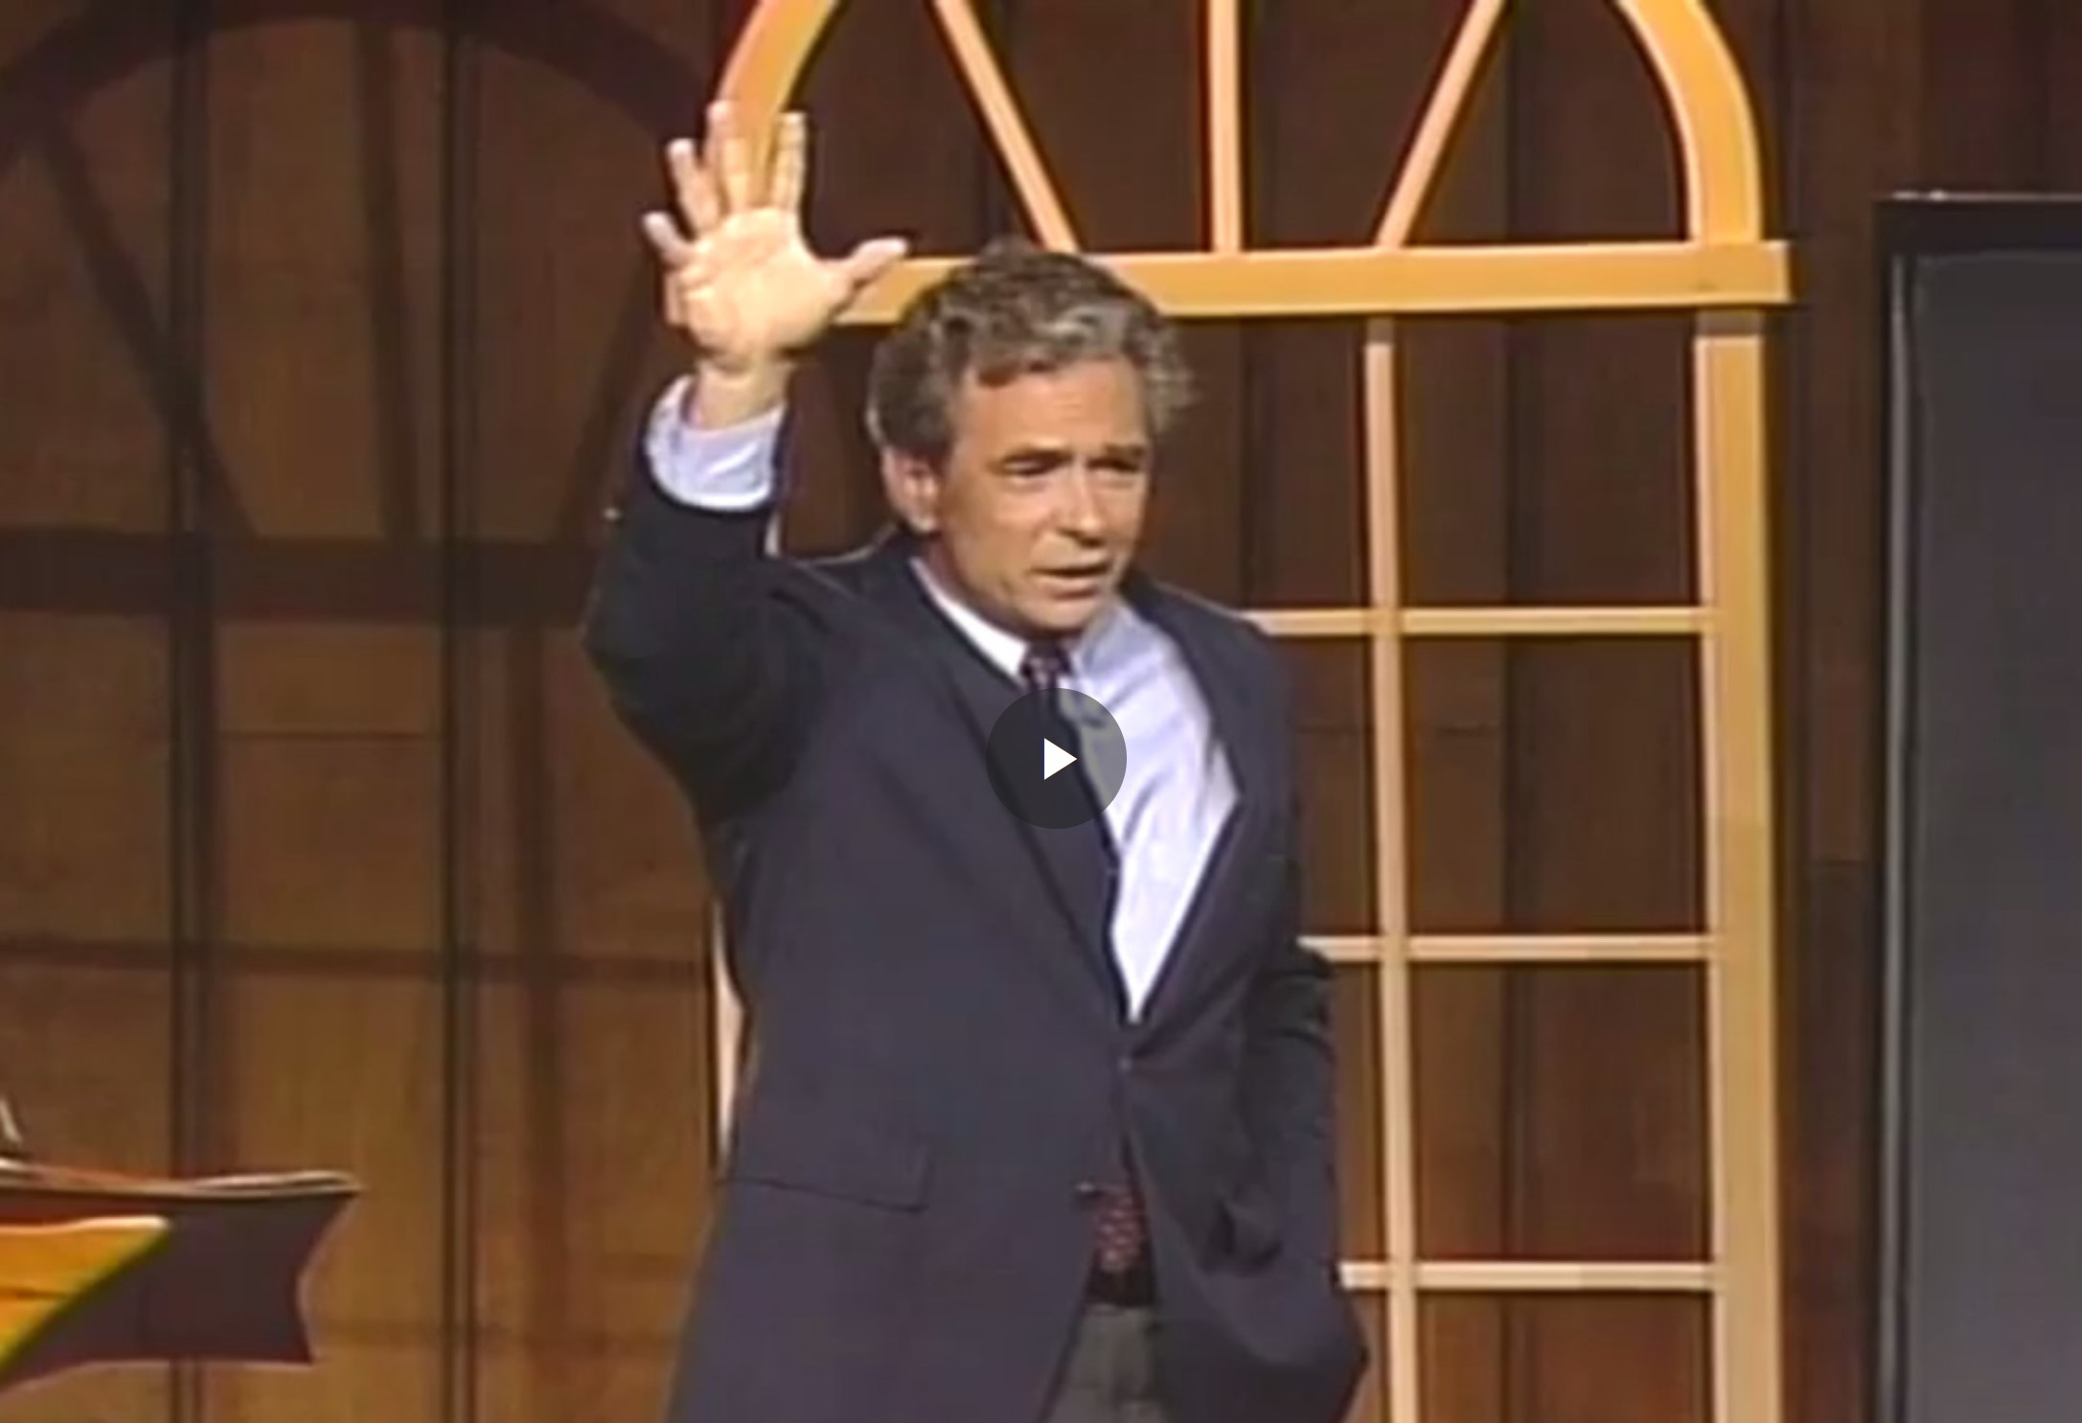
Introduction to Isaiah 6:1-13:
R.C. Sproul on
“The Importance of Holiness”
https://www.ligonier.org/learn/series/holiness-of-god/the-importance-of-holiness

Slide 4
Next Time
I plan to recap some of the major ideas that we heard R.C. Sproul talk about in Isaiah 1:1-4 and then I plan to cover the remainder of the Isaiah 6:1-13 which talks about Isaiah’s Commission.

Slide 5

Class Discussion Time
https://www.weareteachers.com/moving-beyond-classroom-discussions/

Slide 6
*Class Discussion Time
Do you think Christians today are sometimes too casual in the way they approach God?
What about:
  Let us then with confidence draw near to the throne of grace (Heb 4:16)
  Brothers, since we have confidence to enter the holy places by the blood of Jesus… (Heb 10:19)
Is there a balance to be had here?

