Slide 1
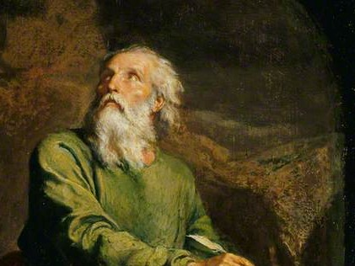
Highlights
From the
Book of
Isaiah
To Download this lesson go to:
http://www.purifiedbyfaith.com/Isaiah/Isaiah.htm
https://www.wikiart.org/en/ernest-meissonier/isaiah

Slide 2
A Slight Change in Plans…
I had originally planned to cover Isaiah 7:10-17 this week which talks about The Sign of Immanuel.
But when I began studying this section, I realized that it would be very difficult to fully understand Isaiah 7:10-17 without having at least a basic understanding of the section the precedes it: Isaiah 7:1-9 where we see a Call For King Ahaz to Trust in The Lord.
So my new plan for this morning is to lay the groundwork for covering The Sign of Immanuel by:
  First covering Isaiah 7:1-9 at a high level
  Then covering Isaiah 7:10-14 verse by verse
  Then next week we will focus exclusively on The Sign of Immanuel by picking up at verse 14 where the sign is first mentioned.

Slide 3
A Call For King Ahaz to Trust in The Lord
(Isaiah 7:1-9)
Following his commission in chapter 6, Isaiah attempts to present his people with the vision of God that he saw.
The “Holy One of Israel”, is great enough and wise enough and transcendent enough that he can be trusted.
If Israel would only come to grasp that vision of Yahweh, there would be hope for them!
But alas, as the Lord predicted, Isaiah’s message falls on deaf ears, and his vision is unintelligible to the blind eyes of the people.
Yet Isaiah is faithful, and all later history is the beneficiary of his faithfulness.
Oswalt, John – Isaiah (The NIV Application Commentary) (pp. 135-136). Zondervan

Slide 4
A Call For King Ahaz to Trust in The Lord
(Isaiah 7:1-9)
¹ During the reign of Ahaz son of Jotham, son of Uzziah, king of Judah, King Rezin of Syria and King Pekah son of Remaliah of Israel marched up to Jerusalem to do battle, but they were unable to prevail against it. ² It was reported to the family of David, “Syria has allied with Ephraim.” They and their people were emotionally shaken, just as the trees of the forest shake before the wind.

Slide 5
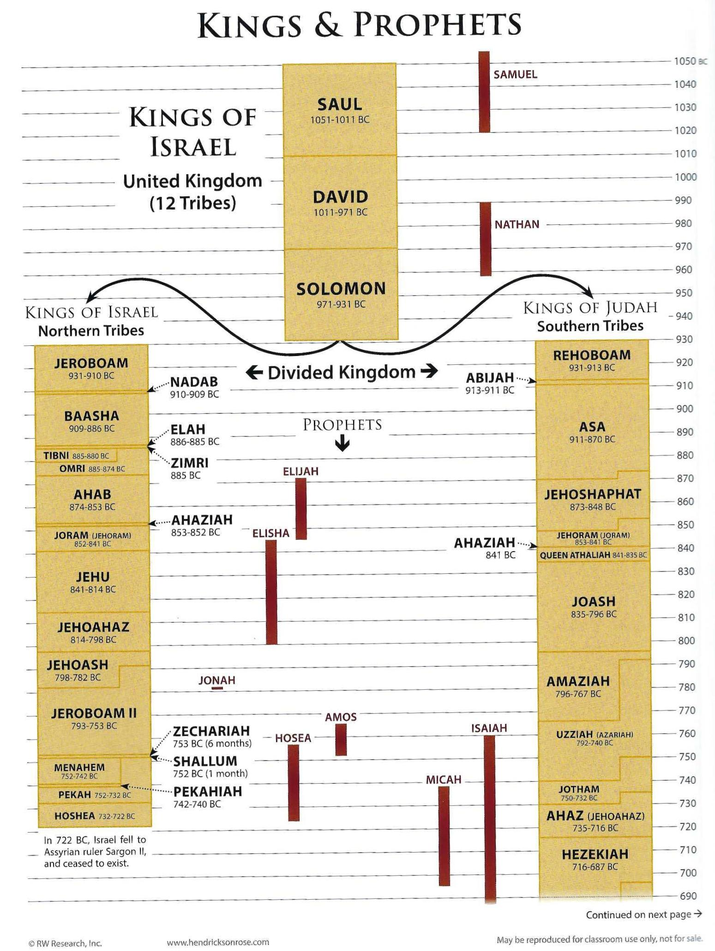
Kings and Prophets of Israel and Judah
Rose Book of Bible Charts, Maps and Time Lines; Rose Publishing; p.110-111

Slide 6
A Call For King Ahaz to Trust in The Lord
(Isaiah 7:1-9)
The events described in these verses probably occur about 735 BC:
  Three years before the conquest of Damascus in 732 BC
  Thirteen years before the destruction of Samaria in 722 BC
We don’t know the for sure why Syria and Israel are attacking Judah.
However, it seems probable that they are attempting to force Judah to join a coalition with them against the Assyrians.
In fact, Ahaz has already allied himself with the Assyrians (2 Kings 16:7), and the kings of Syria and Israel are seeking to punish him for this.
Oswalt, John – Isaiah (The NIV Application Commentary) (p. 137). Zondervan

Slide 7
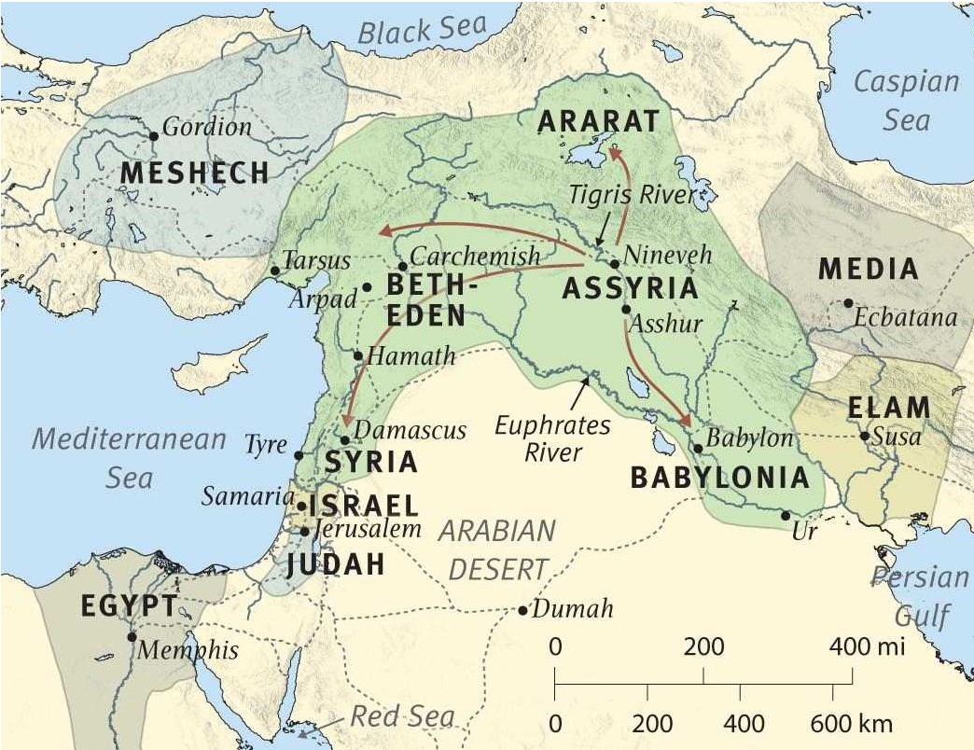
Near East in 735 BC
ESV Study Bible (p. 5434). Crossway.

Slide 8
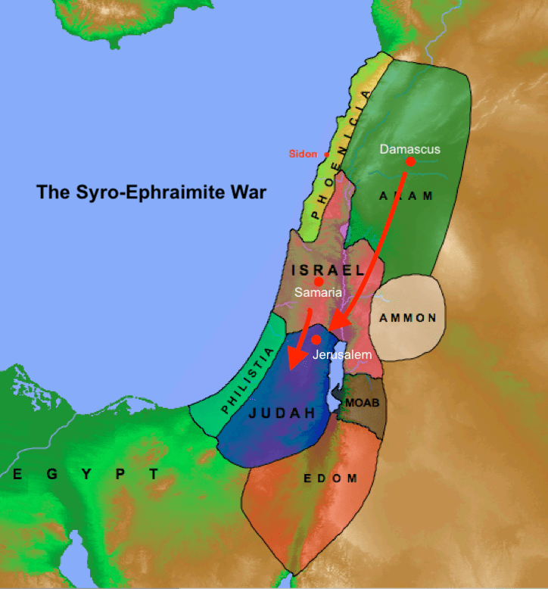
Aram (aka Syria) and Israel (aka Ephraim) Attack Jerusalem (735 BC)
https://www.fbcthomson.org/post/god-promises-a-study-of-isaiah-7

Slide 9
A Call For King Ahaz to Trust in The Lord
(Isaiah 7:1-9)
³ So the LORD told Isaiah, “Go out with your son Shear Jashub and meet Ahaz at the end of the conduit of the upper pool that is located on the road to the field where they wash and dry cloth. ⁴ Tell him, ‘Make sure you stay calm! Don’t be afraid. Don’t be intimidated by these two stubs of smoking logs, or by the raging anger of Rezin, [King of] Syria, and the son of Remaliah [aka Pekah, King of Israel]. ⁵ Syria has plotted with Ephraim [= Israel] and the son of Remaliah [aka Pekah] to bring about your demise. ⁶ They say, “Let’s attack Judah, terrorize it, and conquer it. Then we’ll set up the son of Tabeel as its king.”

Slide 10
A Call For King Ahaz to Trust in The Lord
(Isaiah 7:1-9)
The two neighboring kingdoms are attacking Judah with the express purpose of deposing Ahaz and putting someone named “Tabeel” on the throne in his place.
The “conduit of the upper pool that is located on the road to the field where they wash and dry cloth” (7:3) is evidently just outside the city walls and close enough so that someone standing there and speaking in a loud voice can be heard by those sitting on the wall.
Most likely Ahaz is looking over the city’s water supply in preparation for the coming siege.
In a well-defended, walled city, it was possible to force such a city to surrender if its water supply could be cut off. Ahaz wants to be sure that doesn’t happen.
Oswalt, John – Isaiah (The NIV Application Commentary) (p. 137). Zondervan

Slide 11
A Call For King Ahaz to Trust in The Lord
(Isaiah 7:1-9)
Throughout chapters 7-11 children are important figures, and this is especially true in chapters 7-8, where three children are presented, all with names symbolic of what Isaiah is predicting.
At least two of them are Isaiah’s own children.
The first is presented here, accompanying his father to confront the king.
This child’s name is Shear-Jashub, which means “only a remnant will return.”
Perhaps this child was born after Isaiah’s experience in chapter 6, where God gave Isaiah the awareness that the only hope for the future of Judah was in a “remnant” (Isaiah 6:13 cf. 1:9).
Oswalt, John – Isaiah (The NIV Application Commentary) (pp. 137-139). Zondervan

Slide 12
A Call For King Ahaz to Trust in The Lord
(Isaiah 7:1-9)
Isaiah addresses the king’s fear telling him that there is no need to be afraid (7:4-9).
Rezin of Damascus and Pekah of Samaria do not really pose a threat.
For all their bluster they are unable to “unable to prevail against [Jerusalem]” (7:1).
The LORD tells Ahaz that they are just like “two stubs of smoking logs” – the burned-out ends of logs remaining around the edges of the campfire when the real fire has gone out.
They may still be smoldering, but there is no genuine fire there, and Ahaz need not fear them.
Oswalt, John – Isaiah (The NIV Application Commentary) (pp. 137-139). Zondervan

Slide 13
A Call For King Ahaz to Trust in The Lord
(Isaiah 7:1-9)
⁷ For this reason the Sovereign LORD says [to Ahaz]: “[the conquest of Judah by Syria and Israel] will not take place; it will not happen. ⁸ For Syria’s [capital] is Damascus, and the leader of Damascus is Rezin. Within 65 years Ephraim [= another name for the Northern Kingdom] will no longer exist as a nation. ⁹ Ephraim’s [capital] is Samaria, and Samaria’s leader is the son of Remaliah [aka Pekah, king of Israel]. If your faith does not remain firm, then you will not remain secure.”

Slide 14
A Call For King Ahaz to Trust in The Lord
(Isaiah 7:1-9)
In the end it doesn’t matter what Rezin and Pekah say (7: 5-6) – it only matters what the “Sovereign LORD ” says, and he says that their threats will amount to nothing.
In fact, “within 65 years ” the northern kingdom of Israel, far from being a dominating kingdom, they won’t even be a people!
Oswalt, John – Isaiah (The NIV Application Commentary) (pp. 137-139). Zondervan

Slide 15
A Call For King Ahaz to Trust in The Lord
(Isaiah 7:1-9)
“Within 65 years ” (i.e., by 670 BC), the deportations of the Israelites (beginning in 722 BC) and the importing of groups from other areas in the empire will have completely diluted the genetic heritage of those remaining in the northern kingdom .
But if Ahaz won’t stand firm in his faith in God and what God has said through his prophet, then he will not stand at all. (Isa 7:9 NIV)
Oswalt, John – Isaiah (The NIV Application Commentary) (pp. 137-139). Zondervan

Slide 16
The Sign of Immanuel
(Isaiah 7:10-17)
¹⁰ The LORD again spoke to Ahaz: ¹¹ “Ask for a confirming sign from the LORD your God. You can even ask for something miraculous.” ¹² But Ahaz responded, “I don’t want to ask; I don’t want to put the LORD to a test.” ¹³ So Isaiah replied, “Pay attention, family of David. Do you consider it too insignificant to try the patience of men? Is that why you are also trying the patience of my God? ¹⁴ For this reason the Lord himself will give you a confirming sign. Look, this young woman is about to conceive and will give birth to a son. You, young woman, will name him Immanuel.

Slide 17
¹⁰ The LORD again spoke to Ahaz: ¹¹ “Ask for a confirming sign from the LORD your God. You can even ask for something miraculous.”
Evidently Ahaz did not believe the Lord’s assurances given through Isaiah concerning the outcome Israel and Syria’s planned attack.
Therefore, the LORD proposes to Ahaz that he “ask for a confirming sign from the LORD your God” – so as to provide Ahaz with confirmation that what the LORD had promised through Isaiah was in fact beyond doubt.
Albert Barnes Commentary

Slide 18
¹⁰ The LORD again spoke to Ahaz: ¹¹ “Ask for a confirming sign from the LORD your God. You can even ask for something miraculous.”
If Ahaz had confidence in what God had spoken, he would have believed what Isaiah said without “miraculous” proof.
But Ahaz apparently had no such confidence.
The giving of a miraculous sign would leave Ahaz without excuse for his lack of faith and confidence in the LORD, and, at the same time, give the people assurance that the city and kingdom were safe.
Albert Barnes Commentary

Slide 19
¹² But Ahaz responded, “I don’t want to ask; I don’t want to put the LORD to a test.”
On the surface, Ahaz’s response gives the appearance of one who is pious and acting out of reverence for God.
He says he doesn’t want to ask God for a miracle, citing the principle taught in Deut 6:16, where it is says, “You must not put the Lord your God to the test”
But the real reason Ahaz didn’t want God to give him a sign was, that he had already entered into a negotiation with the king of Assyria to come and defend him.
Albert Barnes Commentary

Slide 20
¹² But Ahaz responded, “I don’t want to ask; I don’t want to put the LORD to a test.”
In fact, Ahaz was even stripping the Lord’s temple of its silver and gold in order to secure this assistance from the king of Assyria.
In 2 Kings we read:
  Ahaz sent messengers to King Tiglath-Pileser of Assyria, saying, “I am your servant and your dependent. March up and rescue me from the power of the king of Syria and the king of Israel, who have attacked me.” Then Ahaz took the silver and gold that were in the Lord’s temple and in the treasuries of the royal palace and sent it as tribute to the king of Assyria. (2 Kings 16: 7-8).
Albert Barnes Commentary

Slide 21
¹² But Ahaz responded, “I don’t want to ask; I don’t want to put the LORD to a test.”
When people are depending on their own devices and resources, they are unwilling to seek aid from God.
And it’s not uncommon for them to try to cover up their lack of trust in God by some outward show of religiosity.
Albert Barnes Commentary

Slide 22
¹³ So Isaiah replied, “Pay attention, family of David. Do you consider it too insignificant to try the patience of men? Is that why you are also trying the patience of my God?
Isaiah is understandably angered at Ahaz’s blatant lack of faith. ¹
The phrase “family of David” occurs several times in this chapter (cf. verses 2 and 17) and refers to the Davidic dynasty, i.e., the kings descended from David of which Ahaz is the most recent. ²
¹ Wegner, Paul D. – Isaiah An Introduction and Commentary – Tyndale OT Commentaries
² Motyer, J. Alec – The Prophecy of Isaiah (p. 84). InterVarsity Press

Slide 23
¹³ So Isaiah replied, “Pay attention, family of David. Do you consider it too insignificant to try the patience of men? Is that why you are also trying the patience of my God?
The verb translated “try the patience of men”, is in the plural, indicating that the failure of the “family of David” isn’t limited to just Ahaz. ²
Ahaz is just one in a whole series of failed Davidic kings who have tried the patience of the nation over the years.²
But now the Davidic king Ahaz is also “trying the patience of my God” by declining his offer to give Ahaz a reassuring miraculous sign. ¹
¹ Wegner, Paul D. – Isaiah An Introduction and Commentary – Tyndale OT Commentaries
² Motyer, J. Alec – The Prophecy of Isaiah (p. 84). InterVarsity Press

Slide 24
¹³ So Isaiah replied, “Pay attention, family of David. Do you consider it too insignificant to try the patience of men? Is that why you are also trying the patience of my God?
The change from “your God” in verse 10 to “my God” here is ominous.
Isaiah seems to be saying that Ahaz has rejected the God who would have supported and established him.
Therefore Isaiah can no longer speak to Ahaz about “your God.”
Now it’s only “my God” – Ahaz has alienated himself and his Davidic household from God.
This whole verse seems pregnant with threat.
Oswalt, John N.. The Book of Isaiah, Chapters 1–39 (The NIC on the OT) (p. 209). Eerdmans.

Slide 25
¹⁴ For this reason the Lord himself will give you a confirming sign. Look, this young woman is about to conceive and will give birth to a son. You, young woman, will name him Immanuel.
The LORD will still give a “sign”, not to encourage Ahaz’s faith but to confirm God’s truthfulness.
The “sign”, directed to Ahaz and the entire nation (the “you” here is plural), has both positive and negative aspects.
The welcome news is that the Syrian-Israelite coalition will soon be destroyed (vv. 14–16).
The bad news is that Assyria will also attack Judah (in 701 BC – see v. 17).
Thus the “sign” (i.e. the child “Immanuel”) will remind the whole nation of God’s message and its consequences
Wegner, Paul D. – Isaiah An Introduction and Commentary – Tyndale OT Commentaries

Slide 26
Next Time
I plan to cover Isaiah 7:14-17 which talks in more detail about the promised Sign of Immanuel.
I will also be looking at the near and far fulfillment of this sign which will probably take us to:
  Isaiah 8:1-10 – the near fulfillment
  Mat 1:22-23 – the far fulfillment

Slide 27

Class Discussion Time
https://www.weareteachers.com/moving-beyond-classroom-discussions/

Slide 28
*Class Discussion Time
God offers to give Ahaz a “confirming (miraculous) sign” that he might have assurance that God will indeed do what he has promised.
Ahaz refuses to take God up on his offer, citing Deut 6:16, where it is says, “You must not put the Lord your God to the test”
As a result, Ahaz is severely rebuked by Isaiah (vs 13ff).
What do we make of all this? Is it a sin to “put God to the test” by asking for a sign or not?
What about the example of Gideon?

Slide 29
*Class Discussion Time
One of the commentaries observed concerning Ahaz’s seemingly pious remark in not asking God for a sign that “When people are depending on their own devices and resources, they are unwilling to seek aid from God. And it’s not uncommon for them to try to cover up their lack of trust in God by some outward show of religiosity.”
Do you find this to be true? Can you think of an example of where you have seen this in your own life or in the lives of others?

