Slide 1
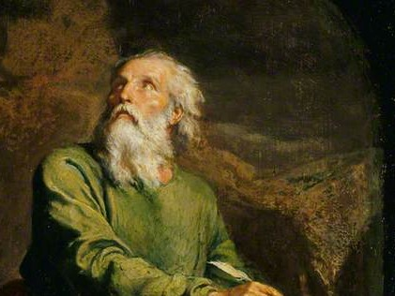
Highlights
From the
Book of
Isaiah
To Download this lesson go to:
http://www.purifiedbyfaith.com/Isaiah/Isaiah.htm
https://www.wikiart.org/en/ernest-meissonier/isaiah

Slide 2
The Folly of Idolatry (44:6-20)
In the latter chapters of Isaiah, God has spoken repeatedly of his determination and his ability to deliver his people from Babylonian captivity.
Furthermore, he has pointed out to the people of Israel that, far from being cast off, they are his “witnesses” (43:10, 12; 44:8) – living evidence to the world that he alone has the power and compassion to protect and deliver them.
All of this is briefly but forcefully summarized in 44:6-8.
Oswalt, John N.. The Book of Isaiah, Chapters 40–66 (The NIC on the OT) (pp. 174-175).

Slide 3
The Folly of Idolatry (44:6-20)
Next God turns to the pagan nations who serve as “witnesses” idol-gods (as he did in the “courtroom scene” that we looked at a couple of weeks ago in 43:8-13).
What kind of evidence can they produce that their gods are supreme?
This question is addressed in 44:9-20.
In excruciating detail the prophet describes how the idol worshipers go about constructing an idol.
How, he asks, can something like this, made by humans from the stuff of creation, ever save anyone?
In fact, he argues, those who bow down to the work of their own hands reduce themselves to “nothing”.
They, in effect, are worshipping themselves rather than the true God who made them.
Oswalt, John N.. The Book of Isaiah, Chapters 40–66 (The NIC on the OT) (pp. 174-175).

Slide 4
The Uniqueness of the LORD (44:6-8)
^{44:6} This is what the LORD, Israel’s King, says, their Protector, the LORD of Heaven’s Armies: “I am the first and I am the last, there is no God but me. ⁷ Who is like me? Let him make his claim! Let him announce it and explain it to me – since I established an ancient people – let them announce future events. ⁸ Don’t panic! Don’t be afraid! Did I not tell you beforehand and decree it? You are my witnesses! Is there any God but me? There is no other sheltering rock; I know of none.

Slide 5
The Uniqueness of the LORD (43:6-8)
Here, once again, the LORD declares his absolute uniqueness.
Although he is the only God, “the first and… the last,” he is also the One who has made himself known in the context of a relationship with a small and insignificant people – the nation of Israel.
The pagan gods cannot explain why he has done this, nor can they explain where the relationship is going to go in the future.
But the LORD has explained this, and the people of Israel are “witnesses” to that fact (44:8).
In an ever changing, unstable world, there is only One who does not change – a “Rock” to which a beaten and battered people may cling.
Oswalt, John . Isaiah (The NIV Application Commentary) (p. 502)

Slide 6
Idols Are Worthless (44:9-11)
^{44:9} All who form idols are nothing; the things in which they delight are worthless. Their witnesses cannot see; they recognize nothing, so they are put to shame. ¹⁰ Who forms a god and casts an idol that will prove worthless? ¹¹ Look, all his associates will be put to shame; the craftsmen are mere humans. Let them all assemble and take their stand. They will panic and be put to shame.

Slide 7
^{44:9} All who form idols are nothing; the things in which they delight are worthless. Their witnesses cannot see; they recognize nothing, so they are put to shame.
In contrast to God’s “witnesses”, who find their significance in the eternal “rock” (v. 8), the “witnesses” of the “idols” become “nothing” through their allegiance to their “worthless” gods. ¹
The word translated “nothing” is the Hebrew word (tōhû), the same word that was used to describe the original, unshaped chaos that characterized the earth before God created life (Gen 1:2). ²
Many of the pagans in Isaiah’s day believed that their gods had brought order to the primeval chaos. ²
But Isaiah asserts that those who make these idols are just part of the chaos, because they do not have a true and coherent understanding of the cosmos as God created it. ²
¹ Oswalt, John N.. The Book of Isaiah, Chapters 40–66 (The NIC on the OT) (p. 176).
² Mackay, John L. – A Study Commentary on Isaiah Volume 2: Chapters 40-66 – pp. 142–143.

Slide 8
^{44:9} All who form idols are nothing; the things in which they delight are worthless. Their witnesses cannot see; they recognize nothing, so they are put to shame.
Although those “who form idols… delight” in the objects they produce, these idols are “worthless” to them. ¹
But they are so steeped in their spiritual blindness (“cannot see”) and darkened understanding (“they recognize nothing”) that they completely miss this obvious fact. ²
Isaiah tells us that they engage in such spiritual blindness in order that they may “put to shame”. ²
This last clause shows that these pagan sinners are not free of guilt, but they purposely follow idolatry out of a depraved will. ²
And they are permitted by God to remain in the darkness of their ignorance in order that their “shame” may be seen when they stand before him on the Day of Judgment. ²
¹ Mackay, John L. – A Study Commentary on Isaiah Volume 2: Chapters 40-66 – pp. 142–143.
² Young, Edward – The Book of Isaiah Volume 3: Chapters 40–66 (p. 172)

Slide 9
^{44:10} Who forms a god and casts an idol that will prove worthless?
Isaiah asks a rhetorical question about who would engage in such hard and costly work when it “will prove worthless”.
The word “forms” describes the activity of craftsmen – a word which Isaiah used in an earlier verse (cf. 44:2) to described how the LORD “formed” Israel.
Here, however, instead of God forming man, it is man forming “a god” – just to state the idea shows its absurdity!
The rhetorical question expressed by this verse expects the answer, “No one”.
But Isaiah goes on to describe those who nevertheless continue to engage in such profitless activity!
Mackay, John L. – A Study Commentary on Isaiah Volume 2: Chapters 40-66 – p. 143.

Slide 10
^{44:11} Look, all his associates will be put to shame; the craftsmen are mere humans. Let them all assemble and take their stand. They will panic and be put to shame.
Here Isaiah calls attention to the ultimate fate of those who are producing idols.
“all his associates” are those who assist the idol-maker or join him in his worship.
The repeated use of the word “all” emphasizes how many of them there are.
Surely such a large number cannot all be wrong!
Nevertheless Isaiah repeats his prediction for them: They will “be put to shame” (cf. 44:9) because, no matter how skillfully the idols have been made, they are produced by “mere humans” who cannot rise above themselves.
Mackay, John L. – A Study Commentary on Isaiah Volume 2: Chapters 40-66 – pp. 143–144.

Slide 11
^{44:11} Look, all his associates will be put to shame; the craftsmen are mere humans. Let them all assemble and take their stand. They will panic and be put to shame.
To trust in man-made gods is to court disaster.
And there will be great consternation on the part of the idolaters when they are called upon to give an account of their conduct on the Day of Judgment.
The words translated “assemble” (cf. 43:9) and “take their stand” are terms that were used of courtroom proceedings.
The craftsmen are pictured here as mounting a joint defense – but to no avail.
They will shake and “panic” in the presence of the divine Judge.
They will be confounded when they finally realize the absurdity of their conduct.
Mackay, John L. – A Study Commentary on Isaiah Volume 2: Chapters 40-66 – pp. 143–144.

Slide 12
An Idol Is No Better Than the One Who Made It (44:12-13)
^{44:12} A blacksmith works with his tool and forges metal over the coals. He forms it with hammers; he makes it with his strong arm. He gets hungry and loses his energy; he drinks no water and gets tired. ¹³ A carpenter takes measurements; he marks out an outline of its form; he scrapes it with chisels and marks it with a compass. He patterns it after the human form, like a well-built human being, and puts it in a shrine.

Slide 13
^{44:12} A blacksmith works with his tool and forges metal over the coals. He forms it with hammers; he makes it with his strong arm. He gets hungry and loses his energy; he drinks no water and gets tired.
Here Isaiah takes us through the process of god making at the final stage, where metal is applied to the wooden form.
We stand in awe as we watch a man of strength and skill go through all the steps of forging metal to take the shape that he has designed.
In both this verse and the next the piling up of activities suggests what a complex and wearisome task the business of making gods is.
That suggestion is made explicit here with the closing statement: “He gets hungry and loses his energy; he drinks no water and gets tired”.
No matter how strong the ironworker may be, he will faint if he does not eat and drink.
Oswalt, John N.. The Book of Isaiah, Chapters 40–66 (The NIC on the OT) (p. 180).

Slide 14
^{44:12} A blacksmith works with his tool and forges metal over the coals. He forms it with hammers; he makes it with his strong arm. He gets hungry and loses his energy; he drinks no water and gets tired.
The contrast between this and the relationship Israel has with their God is evident.
Because Israel has not formed God, but he has formed them, they need not be wearied (40:28-31); because they do not carry him, but he carries them (45:20; 46:3)
They need not hunger and thirst (43:19-20).
There is also the suggestion of compulsion here on the part of the pagan craftsman.
These activities must be completed even to the point of exhaustion.
After all, a god is being made here; the craftsman is driven in order to prepare a body for his god!
Oswalt, John N.. The Book of Isaiah, Chapters 40–66 (The NIC on the OT) (p. 180).

Slide 15
^{44:13} A carpenter takes measurements; he marks out an outline of its form; he scrapes it with chisels and marks it with a compass. He patterns it after the human form, like a well-built human being, and puts it in a shrine.
Isaiah’s description now moves back to an earlier stage in the manufacture of the idol, in which “a carpenter” has to prepare a wooden framework for it.
It is stressed how carefully he goes about his task.
Rather than just cutting at random, “he marks out an outline of its form” and uses “a compass” to ensure that he gets the proportions right.
He uses “chisels” to scrape away what is superfluous.
But what is it he produces? A “human form”.
In his mind the idol maker cannot rise higher than himself.
True, it is an attractive likeness, yet it still is anchored in the human, not the divine.
Mackay, John L. – A Study Commentary on Isaiah Volume 2: Chapters 40-66 – p. 145.

Slide 16
^{44:13} A carpenter takes measurements; he marks out an outline of its form; he scrapes it with chisels and marks it with a compass. He patterns it after the human form, like a well-built human being, and puts it in a shrine.
All this effort just to project themselves on the heavens!
Again Isaiah demonstrates how well he understands the nature of paganism.
Above all else, it is an attempt to cast eternal reality into the shape of humanity.
We have not progressed beyond that today.
Modern humanism is only an abstract form of this age-old effort.
We will be God, and God will be us.
Oswalt, John N.. The Book of Isaiah, Chapters 40–66 (The NIC on the OT) (pp. 180-181).

Slide 17
Idolators Have Lost Touch With Reality! (44:14-17)
^{44:14} He cuts down cedars and acquires a cypress or an oak. He gets trees from the forest; he plants a cedar and the rain makes it grow. ¹⁵ A man uses it to make a fire; he takes some of it and warms himself. Yes, he kindles a fire and bakes bread. Then he makes a god and worships it; he makes an idol and bows down to it. ¹⁶ Half of it he burns in the fire— over that half he cooks meat; he roasts a meal and fills himself. Yes, he warms himself and says, ‘Ah! I am warm as I look at the fire.’ ¹⁷ With the rest of it he makes a god, his idol; he bows down to it and worships it. He prays to it, saying, ‘Rescue me, for you are my god!’

Slide 18
^{44:14} He cuts down cedars and acquires a cypress or an oak. He gets trees from the forest; he plants a cedar and the rain makes it grow.
Moving back yet another stage, Isaiah considers where the material used has come from, and introduces the figure of a forester, who “cuts down” whatever species of tree provides costly, durable wood suitable for his purpose.
If he does not find a fully grown plant, then he may select a sapling which he will watch carefully until it has matured sufficiently.
But even that might not always be possible.
Sometimes it will require starting from scratch by planting a tree, such as the quicker-growing “cedar” with softer wood.
Mackay, John L. – A Study Commentary on Isaiah Volume 2: Chapters 40-66 – pp. 145-146.

Slide 19
^{44:14} He cuts down cedars and acquires a cypress or an oak. He gets trees from the forest; he plants a cedar and the rain makes it grow.
No matter how imposing the end product is, this is an exercise of human skill to achieve human ends.
And even so, there is much that lies outside the craftsman’s control.
The statement that “the rain makes it grow” reminds Isaiah’s audience that the origin of the idol, or the tree, is not supernatural; it comes from the processes of the natural world.
Mackay, John L. – A Study Commentary on Isaiah Volume 2: Chapters 40-66 – pp. 145-146.

Slide 20
^{44:15} A man uses it to make a fire; he takes some of it and warms himself. Yes, he kindles a fire and bakes bread. Then he makes a god and worships it; he makes an idol and bows down to it.
When the tree is cut down, the idolater burns part of it to warm himself, to roast meat, or to heat an oven for baking bread.
But then, from the same log of wood he forms a god which he bows down to!
Indeed, the fabrication of the idol appears to be something of an afterthought, made from what is left over.
How can that be of such spiritual significance as to warrant being called “a god”?
The Hebrew word for “worships” here is a word that refers to falling prostrate, with one’s face to the ground.
Mackay, John L. – A Study Commentary on Isaiah Volume 2: Chapters 40-66 – pp. 146–147.

Slide 21
^{44:16} Half of it he burns in the fire— over that half he cooks meat; he roasts a meal and fills himself. Yes, he warms himself and says, ‘Ah! I am warm as I look at the fire.’
The words “half of it ” are emphatic, to show that not all the wood is used either for the construction of the idol or for purposes of everyday life, but that the uses to which the wood is put are diverse.
With the fire kindled by the burning of half of the wood, the worshipper prepares food to eat.
This preparation is done by means of roasting, and it brings satisfaction to the one who cooked it.
Young, Edward – The Book of Isaiah Volume 3: Chapters 40–66 (pp. 178–179)

Slide 22
^{44:16} Half of it he burns in the fire— over that half he cooks meat; he roasts a meal and fills himself. Yes, he warms himself and says, ‘Ah! I am warm as I look at the fire.’
In addition to eating, the man “warms himself” with the fire.
The satisfaction the fire brings to the man is expressed by his statement, “Ah! I am warm as I look at the fire”.
He sees and feels the fire and expresses his joy and satisfaction in its possession.
Wood that is used as fuel for a fire, truly serves the man who is using it.
But wood that is used to make an idol does not serve him, but becomes an occasion for his stumbling.
Young, Edward – The Book of Isaiah Volume 3: Chapters 40–66 (pp. 178–179)

Slide 23
^{44:17} With the rest of it he makes a god, his idol; he bows down to it and worships it. He prays to it, saying, ‘Rescue me, for you are my god!’
The “the rest of it ” is the half of the wood that has not been used for fuel and heat.
With this half the worshipper makes a god in the form of an idol.
Then he prostrates himself to it and looks for deliverance, saying, “Rescue me, for you are my god!”
For someone to use part of a tree to warm himself or cook his food and then turn around and use part of the same tree to form an “idol” which he “bows down” and “worships” as his “god” which he then commands to “rescue” him, is absurd on the face of it!
Clearly, at this point, the man’s spiritual blindness has caused him to lose all touch with reality!
Young, Edward – The Book of Isaiah Volume 3: Chapters 40–66 (pp. 179–180)

Slide 24
Idolaters Are Spiritually Blind (44:18-20)
^{44:18} They do not comprehend or understand, [for their eyes are smeared over so they cannot see, so their heart cannot be wise.] ¹⁹ No one thinks to himself, nor do they comprehend or understand and say to themselves: ‘I burned half of it in the fire— yes, I baked bread over the coals; I roasted meat and ate it. With the rest of it should I make a disgusting idol? Should I bow down to dry wood?’ ²⁰ He feeds on ashes; his deceived mind misleads him. He cannot rescue himself, nor does he say, ‘Is this not a false god I hold in my right hand?’

Slide 25
^{44:18} They do not comprehend or understand, [for their eyes are smeared over so they cannot see, so their heart cannot be wise.]
Although the folly of the idolater has been clearly exposed, Isaiah expresses utter amazement at the spiritual blindness that is involved.
But whose agency is implied when it says “for their eyes are smeared over so they cannot see”?
Undoubtedly this is the act of divine judgement which the LORD imposes directly on those who stubbornly turn away from him.
Compare this with a similar statement in Isaiah 6:10: “Make the hearts of these people calloused; make their ears deaf and their eyes blind. Otherwise they might see with their eyes and hear with their ears, their hearts might understand and they might repent and be healed.”
Mackay, John L. – A Study Commentary on Isaiah Volume 2: Chapters 40-66 – pp. 146–147.

Slide 26
^{44:19} No one thinks to himself, nor do they comprehend or understand and say to themselves: ‘I burned half of it in the fire— yes, I baked bread over the coals; I roasted meat and ate it. With the rest of it should I make a disgusting idol? Should I bow down to dry wood?’
Those who permit themselves to be caught up in idolatry have not stopped to think about what they are doing, or how absurd the whole process is. ¹
If they would only take a moment to reflect, they would realize that the wood they use to cook food is the same wood they make into a “disgusting idol” (literally, “an abomination”). ²
It is a moral outrage to fall down and worship a block of wood, especially when they could be serving the living God. ²
¹ Mackay, John L. – A Study Commentary on Isaiah Volume 2: Chapters 40-66 – pp. 147–148.
² Wegner, Paul D. – Isaiah An Introduction and Commentary – Tyndale OT Commentaries

Slide 27
^{44:20} He feeds on ashes; his deceived mind misleads him. He cannot rescue himself, nor does he say, ‘Is this not a false god I hold in my right hand?’
The “feeding” referred to is spiritual, and “ashes” points to the idols that were manufactured from the same wood that is also burned in the fire.
Ashes do not nourish the body, and idols do not nourish the soul.
The idol worshipper does not realize this because he is deluded in his own heart.
His thinking is corrupt and unclear, so that he lacks the willpower to escape from the addictive behavior to which he has accustomed himself.
Mackay, John L. – A Study Commentary on Isaiah Volume 2: Chapters 40-66 – pp. 147–148.

Slide 28
^{44:20} He feeds on ashes; his deceived mind misleads him. He cannot rescue himself, nor does he say, ‘Is this not a false god I hold in my right hand?’
The idolator being described in the singular emphasizes that this is a choice which each person has to make individually.
However, once such a mindset has been adopted it is no easy matter to get outside of it and critically analyze what is going on in one’s life.
He is unable to look at the idol which he cherishes in his right hand, see it for what it is: a “false god”
Mackay, John L. – A Study Commentary on Isaiah Volume 2: Chapters 40-66 – pp. 147–148.

Slide 29
Next Time
I plan to look at Isaiah’s description of “The God Who Does All Things” in Isaiah 44:24 – 45:7. This section includes Isaiah’s amazing prophesy of Cyrus.

Slide 30

Class Discussion Time
https://www.weareteachers.com/moving-beyond-classroom-discussions/

Slide 31
Class Discussion Time
It would be easy to look at the idolatrous behavior described in this text and think that the pagans in our day are far more “sophisticated” than the pagans of the ancient world.
But are they?
Instead of believing that pagan gods brought order to the primeval chaos – our “sophisticated” pagan scientists try to tell us that the amazing beauty and order that we see in our universe came about as a result of purposeless, random processes operating over billions of years!
Is that really a more sophisticated and believable explanation?

Slide 32
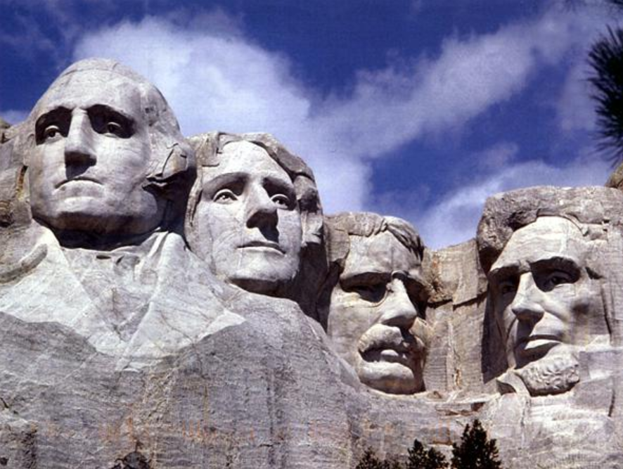
Class Discussion Time

Slide 33
Class Discussion Time
Suppose for a minute that you had never seen or heard of Mount Rushmore, but then one day while walking through the woods in South Dakota you looked up and saw it for the first time.
What would you think was the cause of what you were seeing:
  That over millions of years the wind and weather and various other purposeless random processes just happened to wear away these stones to look the way they do?
  Or that someone must have carved them into the side of the mountain?
Consider this: The physical makeup of the men who are depicted on Mount Rushmore was far more sophisticated than the carvings of them that we now see there.
And yet our modern “sophisticated” pagan scientists believe that the physical bodies of these men came (and all other living things) came about as a result of billions of years of random processes.
Does this make any sense? Are modern pagan really any more sophisticated than their ancient counterparts?

