Slide 1
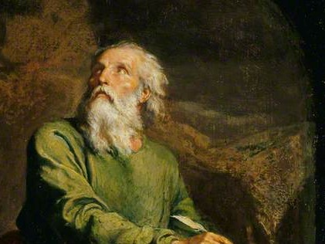
Highlights
From the
Book of
Isaiah
To Download this lesson go to:
http://www.purifiedbyfaith.com/Isaiah/Isaiah.htm
https://www.wikiart.org/en/ernest-meissonier/isaiah

Slide 2
Outline of the Book of Isaiah
Warning of Judgment on Israel (1-39)
The Promise of Future Hope in the New Jerusalem (40-66)
  The Announcement of Hope (40-48)
  The Servant Fulfills God’s Mission (49-55)
  The Servants Inherit God’s Kingdom (56-66)

Slide 3
Final Judgment and Glory of the LORD (66:14b-24)
When we look at the book of Isaiah as a whole, the contrast of judgment and hope is unmistakable.
We see this contrast in the two major sections:
  Chapters 1-39 – Judgment
  Chapters 40-66 – Hope
But even within each of these two major sections, the contrast continues to be seen on a smaller scale, with announcements of hope occurring in chapters 1-39 , and announcements of judgment occurring in chapters 40-66.
In today’s text this contrast occurs for the last time:
  verses 15-17 (and verse 24) describe the judgement of those who persist in rebellion against God.
  verses 18-23 describe the salvation of the nations that will occur as a result of God’s redemption.
Oswalt, John N.. The Book of Isaiah, Chapters 40–66 (The NIC on the OT) (pp. 683-684).

Slide 4
Final Judgment and Glory of the LORD (66:14b-24)
As far as the book of Isaiah is concerned, judgment and hope are inseparable.
It is out of judgment that hope emerges, but hope never removes the potential and the reality of judgment.
I have divided today’s text into three sections:
  The Doom of the Rebellious (66:14b-17)
  God’s Glorious Plan to Deliver the Nations Using a Remnant in Israel (66:18-21)
  Dramatic Contrast Between the Final Destinations of the Righteous and the Wicked (66:22-24)
Oswalt, John N.. The Book of Isaiah, Chapters 40–66 (The NIC on the OT) (pp. 683-684).

Slide 5
The Doom of the Rebellious (66:14b-17)
^{66:14b} The LORD will reveal his power to his servants and his anger to his enemies. ¹⁵ For look, the LORD comes with fire; his chariots come like a windstorm to reveal his raging anger, his [rebuke with flames of fire.] ¹⁶ For the LORD judges all humanity with fire and his sword; the LORD will kill many. ¹⁷ “As for those who consecrate and ritually purify themselves so they can follow their leader and worship in the sacred orchards, those who eat the flesh of pigs and other disgusting creatures, like mice – they will all be destroyed together,” says the LORD.

Slide 6
^{66:14b} The LORD will reveal his power to his servants and his anger to his enemies
Isaiah never wants his readers to be left in a position where they are so secure in God’s election love that they forget the real possibility of judgment.
The LORD “will reveal his power” to “his servants.”
But it is “his anger” that will be shown to “his enemies.”
As we read this, we should ask ourselves: Am I among the LORD’s “servants” or his “enemies”?
Oswalt, John . Isaiah (The NIV Application Commentary) (pp. 695-696)

Slide 7
^{66:15} For look, the LORD comes with fire; his chariots come like a windstorm to reveal his raging anger, his [rebuke with flames of fire.]
Isaiah further elaborates on the statement just made in the previous verse concerning his judgment.
“For look” calls attention to the tremendous significance of God’s judgement.
“the LORD comes ” and when he “comes” he will mete out judgment.
His “chariots” come like a “windstorm”.
As a “windstorm” sweeps briskly across the open desert, so “[the LORD’s] chariots” are moving here and there to accomplish His purposes.
The purpose of the LORD’s coming is “to reveal his raging anger”.
Young, Edward – The Book of Isaiah Volume 3: Chapters 40–66 (pp. 529–530)

Slide 8
^{66:15} For look, the LORD comes with fire; his chariots come like a windstorm to reveal his raging anger, his [rebuke with flames of fire.]
God’s anger has been aroused because of the nation’s sins.
This anger must be appeased, and the manner in which this will be done is through the outpouring of God’s wrath upon the sinner.
In the Bible the “rebuke” of God is often mentioned in connection with His wrath (cf. 17:13; 51:20; 54:9).
Here his “rebuke” is accompanied by the outpouring of judgement, described as “flames of fire”.
The use of “fire” to describe God’s judgement points to the all-consuming power of that judgement and the complete destruction of God’s enemies that occurs as a result of that judgement.
Young, Edward – The Book of Isaiah Volume 3: Chapters 40–66 (pp. 529–530)

Slide 9
^{66:16} For the LORD judges all humanity with fire and his sword; the LORD will kill many.
Along with God’s judgement being described by “fire”, this verse also depicts the LORD as a warrior.
And, being a warrior, he has a “sword” which he will use to “kill many”.
Leupold, H. C. – Exposition of Isaiah, Volume 2 (p. 377)

Slide 10
^{66:17} “As for those who consecrate and ritually purify themselves so they can follow their leader and worship in the sacred orchards, those who eat the flesh of pigs and other disgusting creatures, like mice – they will all be destroyed together,” says the LORD.
Here Isaiah mentions some specific idolatrous practices that have roused the LORD’s indignation.
The “sacred orchards” were mentioned previously in 65:3. They were a place where the rebellious Israelites would carry out idolatrous pagan worship.
Apparently there was a “leader” who would lead them in the performance of these pagan rites.
Certain repulsive things were eaten by these rebels: “the flesh of pigs and other disgusting creatures”, and lastly “mice” – all of which were forbidden in the Law (cf. Lev. 11:41–43; Lev. 11:29ff).
The LORD warns here that those involved in these idolatrous practices “will all be destroyed together”.
Leupold, H. C. – Exposition of Isaiah, Volume 2 (p. 377)

Slide 11
God’s Glorious Plan to Deliver the Nations (66:18-21)
^{66:18} “I hate their deeds and thoughts! So I am coming to gather all the nations and ethnic groups; they will come and [see my glory]. ¹⁹ I will perform a mighty act among them and then send some of those who remain to the nations—to Tarshish, Pul, Lud (known for its archers), Tubal, Javan, and to the distant coastlands that have not heard about me or seen my [glory]. They will tell the nations of my [glory]. ²⁰ They will bring back all your countrymen from all the nations as an offering to the LORD. They will bring them on horses, in chariots, in wagons, on mules, and on camels to my holy hill Jerusalem,” says the LORD, “just as the Israelites bring offerings to the LORD’s temple in ritually pure containers. ²¹ And I will choose some of them as priests and Levites,” says the LORD.

Slide 12
^{66:18} “I hate their deeds and thoughts! So I am coming to gather all the nations and ethnic groups; they will come and [see my glory].
Here Isaiah summarizes God’s entire program for the evangelization of the world.
In a word, God’s fundamental response to the evil actions and imaginations of his creatures is one of grace.
His gathering, rescuing activity, once restricted to the dispersed people of Israel, is now to be extended to all people.
He will come and gather people of “all the nations and ethnic groups”.
The goal of mission is to bring “glory” to God – that God might be known and honored for who he really is.
How this goal is to be achieved is spelled out in the remaining verses.
Webb, Barry G.. The Message of Isaiah (The Bible Speaks Today Series) (pp. 249-250)

Slide 13
^{66:19} I will perform a mighty act among them and then send some of those who remain to the nations—to Tarshish, Pul, Lud (known for its archers), Tubal, Javan, and to the distant coastlands that have not heard about me or seen my [glory]. They will tell the nations of my [glory].
God will “perform a mighty act ” in the midst of the nations.
In context (see verses 7-16) this refers to the miraculous complex of events which occurred when Israel was judged and the church was born at the time of Christ’s coming.
“those who remain” are the faithful remnant of Jews at the beginning of the New Testament period (including the apostles) whom God has chosen to spearhead his mission to the nations.
Webb, Barry G.. The Message of Isaiah (The Bible Speaks Today Series) (pp. 249-250)

Slide 14
^{66:19} I will perform a mighty act among them and then send some of those who remain to the nations—to Tarshish, Pul, Lud (known for its archers), Tubal, Javan, and to the distant coastlands that have not heard about me or seen my [glory]. They will tell the nations of my [glory].
The place names listed in this verse are drawn from Isaiah’s own world, but as the farthest outposts they stand symbolically for the whole earth.
God’s mission to the world at that time (which we now know as the New Testament period) will know no ethnic, geographical or national boundaries.
It is to extend all the way to the “distant coastlands”.
Webb, Barry G.. The Message of Isaiah (The Bible Speaks Today Series) (pp. 249-250)

Slide 15
^{66:20} They will bring back all your countrymen from all the nations as an offering to the LORD. They will bring them on horses, in chariots, in wagons, on mules, and on camels to my holy hill Jerusalem,” says the LORD, “just as the Israelites bring offerings to the LORD’s temple in ritually pure containers. ²¹ And I will choose some of them as priests and Levites,” says the LORD.
The mention of “offerings” here introduces the figure of a great harvest.
For Isaiah’s original readers, this must have been one of the most startling and controversial aspects of his missionary vision.
The terms used here are drawn from the familiar world of Isaiah’s immediate audience (“offerings”, “Jerusalem”, “temple”, “priests” and “Levites”), but the vision itself turns that world upside down!
Webb, Barry G.. The Message of Isaiah (The Bible Speaks Today Series) (pp. 250-251)

Slide 16
^{66:20} They will bring back all your countrymen from all the nations as an offering to the LORD. They will bring them on horses, in chariots, in wagons, on mules, and on camels to my holy hill Jerusalem,” says the LORD, “just as the Israelites bring offerings to the LORD’s temple in ritually pure containers. ²¹ And I will choose some of them as priests and Levites,” says the LORD.
It is the “nations” that are harvested, and converts from all nations that are presented to the LORD as holy “offerings”.
Converted Jew and converted Gentile become covenant brothers, united in a new kind of priestly ministry in which both alike, in due course, share in the privileges and responsibilities of leadership.
Webb, Barry G.. The Message of Isaiah (The Bible Speaks Today Series) (pp. 250-251)

Slide 17
Dramatic Contrast Between the Righteous and the Wicked (66:22-24)
^{66:22} “For just as the new heavens and the new earth I am about to make will remain standing before me,” says the LORD, “so your descendants and your name will remain. ²³ From one month to the next and from one Sabbath to the next, all people will come to worship me,” says the LORD. ²⁴ “They will go out and observe the corpses of those who rebelled against me, for the maggots that eat them will not die, and the fire that consumes them will not die out. All people will find the sight abhorrent.”

Slide 18
^{66:22} “For just as the new heavens and the new earth I am about to make will remain standing before me,” says the LORD, “so your descendants and your name will remain. ²³ From one month to the next and from one Sabbath to the next, all people will come to worship me,” says the LORD.
This final picture presented by Isaiah has to do with the origin and outcome of God’s mission.
Verse 22 contains one final word of assurance to faithful Israelites, the true children of Abraham of the Old Testament period.
The LORD’s promise to them of an enduring “name” and many “descendants” will not fail.
This promise will have its perfect fulfilment in the “new heavens and the new earth”, where the redeemed of the entire human race will offer unending worship to their creator.
Webb, Barry G.. The Message of Isaiah (The Bible Speaks Today Series) (pp. 250-251)

Slide 19
^{66:24} “They will go out and observe the corpses of those who rebelled against me, for the maggots that eat them will not die, and the fire that consumes them will not die out. All people will find the sight abhorrent.”
But the final verse contains a chilling reminder that those promises of blessing to those who faithfully serve the LORD, are accompanied by the promise of everlasting judgment to those who rebel against him.
The last verse does not detract in any way from the victory of the previous verse, but rather testifies to the completeness of it.
God will be glorified as much by his righteous judgment as he is by his saving grace.
Webb, Barry G.. The Message of Isaiah (The Bible Speaks Today Series) (pp. 250-251)

Slide 20
Conclusion
At its most fundamental level, this closing paragraph brings us back to the basic truth that God is creator, and therefore ruler, of his world.
The book of Isaiah, like the Bible itself, moves from the heavens and the earth (1:2) to the new heavens and new earth (66:22).
God’s mission is simply the outworking of the intentions he had at the beginning, expressed in the blessing he pronounced on the first couple (Adam and Eve) and confirmed in the promises he made to Abraham.
Webb, Barry G.. The Message of Isaiah (The Bible Speaks Today Series) (pp. 251-252)

Slide 21
Conclusion
And Isaiah leaves us in no doubt that the key to it all is God’s perfect Servant, our LORD Jesus Christ.
How eloquently and simply the apostle John put it! “Isaiah”, he says, “saw Christ's glory, and spoke about him”. (John 12:41)
In the second half of the book of Isaiah the new creation unfolds from his saving work like a bud bursting into bloom, and the last verse challenges us never to take it lightly, but to ponder (as we shall for all eternity) the greatness of our redemption and the terrible fate from which we have been saved.
As we think on this, what can we do but worship?
Webb, Barry G.. The Message of Isaiah (The Bible Speaks Today Series) (pp. 251-252)

Slide 22
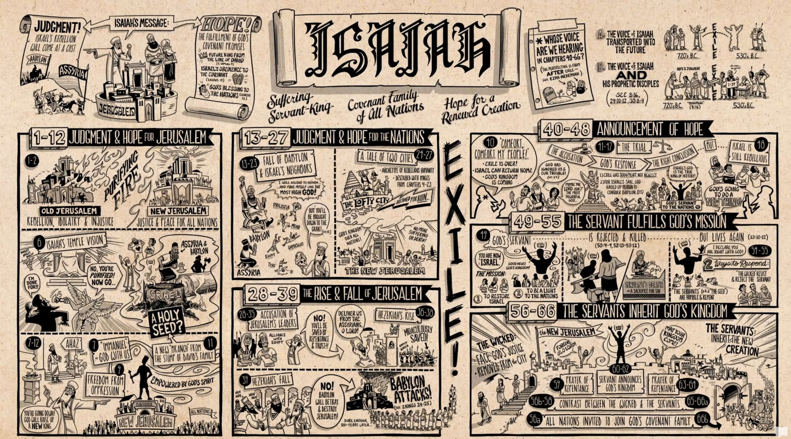
A Quick High Level Summary of the Book of Isaiah
Part 1: https://www.youtube.com/watch?v=d0A6Uchb1F8
Part 2: https://www.youtube.com/watch?v=_TzdEPuqgQg

Slide 23
Number Verses That We Covered in Isaiah
There are a total of 1,291 verses in Isaiah.
In the course of this study, where we looked at the “highlights” of Isaiah, we covered a total of 577 of those verses.
By my count, there are a total of 51 passages in the book of Isaiah that are cited by the New Testament.
I made a point to include every one of those passages in this study.

Slide 24
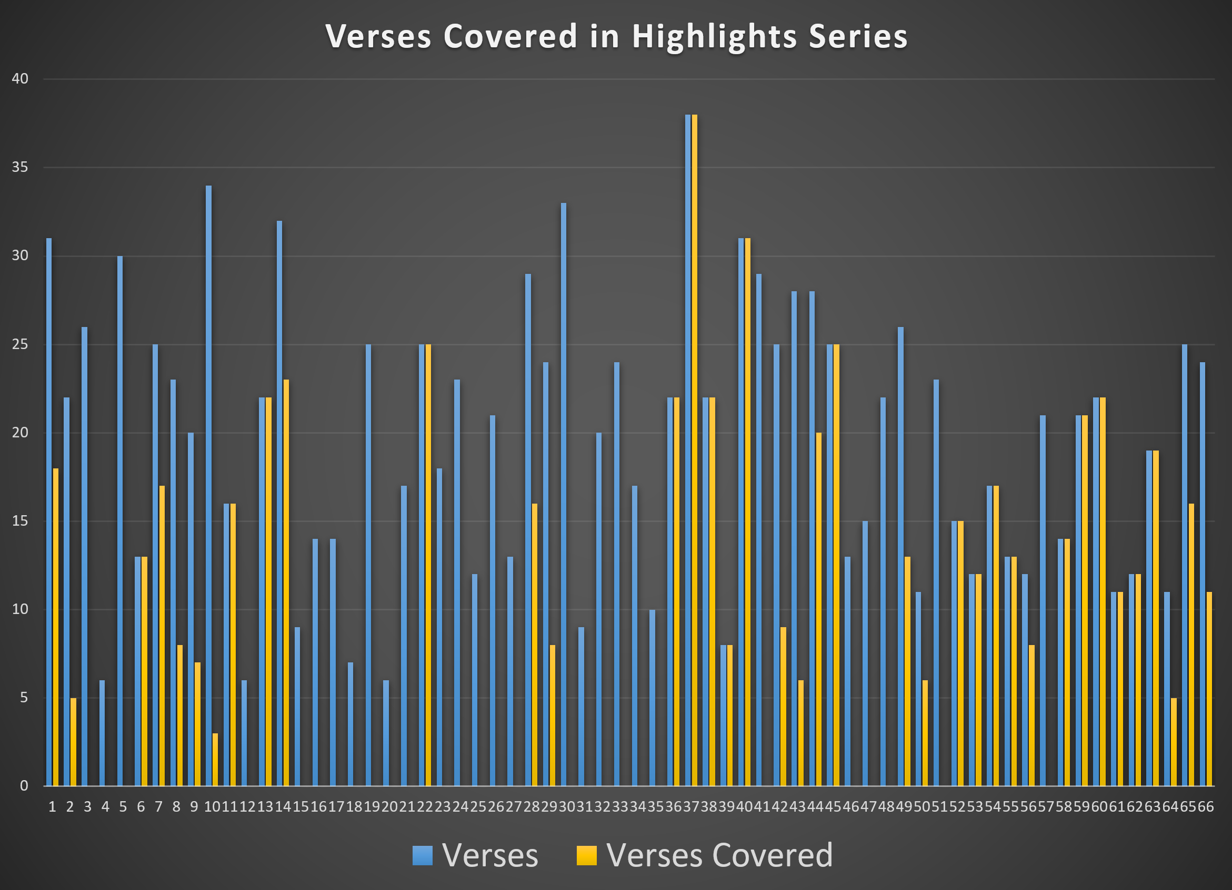

Slide 25
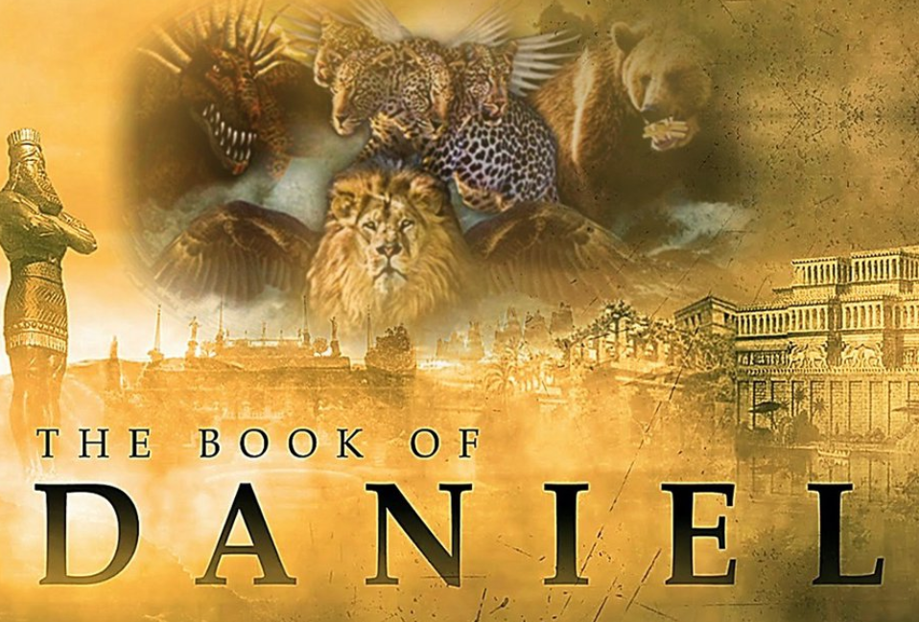
To Download this lesson go to:
http://www.purifiedbyfaith.com/Isaiah/Isaiah.htm
https://subsplash.com/charis/media/ms/+b72rmnj

Slide 26

Class Discussion Time
How well did you understand the book of Isaiah before we taught this class? How well do you feel you understand it now?
What are some notable things that you learned in this class?
Were some parts of this series particularly helpful to you? If so, what were they?

