Slide 1
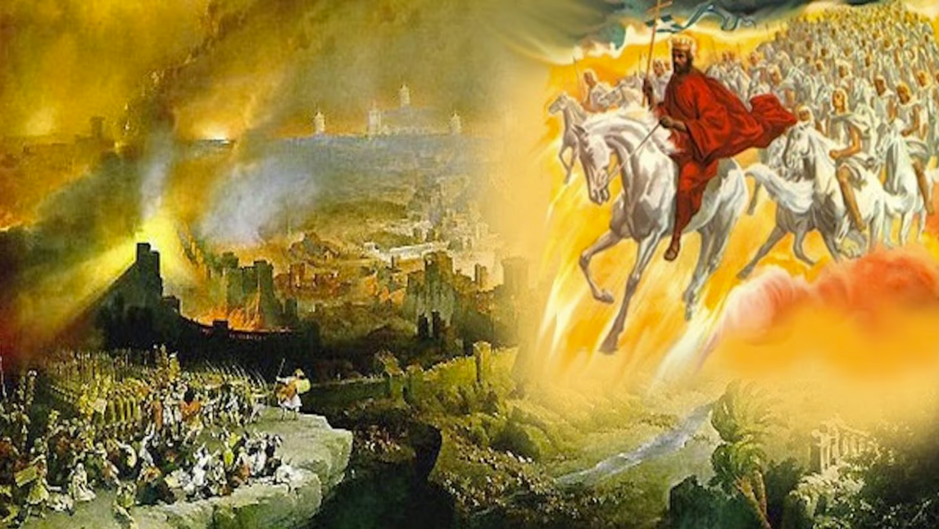
The Book of Revelation
Image credit – https://www.bible.com/events/84698
“The kingdom of the world has become the kingdom of our Lord and of His Christ,
and He shall reign forever and ever.” (Revelation 11:15)
Sermon Available on https://www.purifiedbyfaith.com/

Slide 2
The Commissioning of John (1:9-11)
^{1:9} I, John, your brother and companion in the suffering and kingdom and patient endurance that are ours in Jesus, was on the island of Patmos because of the word of God and the testimony of Jesus. ¹⁰ On the Lord's Day I was in the Spirit, and I heard behind me a loud voice like a trumpet, ¹¹ which said: “Write on a scroll what you see and send it to the seven churches: to Ephesus, Smyrna, Pergamum, Thyatira, Sardis, Philadelphia and Laodicea.” (NIV)

Slide 3
^{1:9} I, John, your brother and partner in the tribulation and the kingdom and the patient endurance that are in Jesus, was on the island called Patmos on account of the word of God and the testimony of Jesus. (ESV)
John begins this section by identifying himself as a fellow believer who is suffering alongside the churches he is writing to.
He does not speak as a distant authority figure, but as their “brother” and “partner” in three areas: "
“tribulation”
[belonging to Christ’s] “kingdom”
“patient endurance”
The point here is that being part of Jesus’ kingdom does not mean an easy life.
When we are faced with suffering, it does not mean we have somehow fallen out of Christ’s kingdom – in fact, just the opposite – sometimes we will experience suffering because we are members of Christ's kingdom.
Gentry, Kenneth. The Divorce of Israel; Volume 1; (2024)

Slide 4
^{1:9} I, John, your brother and partner in the tribulation and the kingdom and the patient endurance that are in Jesus, was on the island called Patmos on account of the word of God and the testimony of Jesus. (ESV)
John says he was on the island of Patmos because of “the word of God and the testimony of Jesus.”
Most likely means he had been exiled there because of his witness for Christ, not that he went there voluntarily.
Patmos was a small island away from the mainland, and John’s presence there shows that he was already experiencing the same kind of persecution he warns the churches about in this vision.
This is important because it shows that Revelation was written to real first-century Christians who were already under pressure and facing even more trouble ahead.
John wants them to understand that suffering is not a sign that Christ has abandoned them.
Instead, “patient endurance” is part of faithful Christian living.
Gentry, Kenneth. The Divorce of Israel; Volume 1; (2024)

Slide 5
^{1:10} I was in the Spirit on the Lord's day, and I heard behind me a loud voice like a trumpet ¹¹ saying, “Write what you see in a book and send it to the seven churches, to Ephesus and to Smyrna and to Pergamum and to Thyatira and to Sardis and to Philadelphia and to Laodicea.” (ESV)
Here John describes how he received the revelation.
He says he was “in the Spirit,” meaning he was caught up in a special prophetic vision given by the Holy Spirit.
This was not just ordinary spiritual meditation.
It was a powerful revelatory experience like those given to Old Testament prophets such as Ezekiel and Daniel.
This gave John prophetic authority: what he writes is not his private opinion, but a message from God to his readers (and by way of application – to us).
Gentry, Kenneth. The Divorce of Israel; Volume 1; (2024)

Slide 6
^{1:10} I was in the Spirit on the Lord's day, and I heard behind me a loud voice like a trumpet ¹¹ saying, “Write what you see in a book and send it to the seven churches, to Ephesus and to Smyrna and to Pergamum and to Thyatira and to Sardis and to Philadelphia and to Laodicea.” (ESV)
John tells us he was “in the Spirit” on (literally “in”) “the Lord's day.”
Most interpreters understand John to be saying that he received this vision on Sunday, the Christian day of worship.
But Gentry, Walvoord, Lightfoot and others argue that the “in the Lord's day” is another way of saying “in the day of the Lord – meaning a day of divine judgment.
In other words, John is telling us that he was spiritually transported (“in the Spirit”) into a vision of the coming day of judgment that Revelation describes.
If we understand “the Lord's day” to refer to a time of God’s judgment, it sets the tone for the whole book: Revelation is about Christ revealing himself as judge and sovereign ruler in a time of crisis.
Gentry, Kenneth. The Divorce of Israel; Volume 1; (2024)

Slide 7
^{1:10} I was in the Spirit on the Lord's day, and I heard behind me a loud voice like a trumpet ¹¹ saying, “Write what you see in a book and send it to the seven churches, to Ephesus and to Smyrna and to Pergamum and to Thyatira and to Sardis and to Philadelphia and to Laodicea.” (ESV)
And this fits with the fact that the book of Revelation is full of judgment language, trumpet imagery, wrath, and warnings.
Understanding “the Lord's day” in this way connects John’s experience here to other biblical “day of the Lord” passages, where God comes in power to judge:
Wail, for the day of the LORD is near; as destruction from the Almighty it will come! (Isaiah 13:6)
For the day is near, the day of the LORD is near; it will be a day of clouds, a time of doom for the nations. (Ezek 30:3)
See also: Isa 13 9; Eze 13:5; Joel 1:15; 2:1, 31; Am 5:18; Ob 1:15; Zep 1:14; Mal 4:5; Ac 2:20; 1Th 5:2; 2Pe 3:10
So, by this understanding of the phrase, John is not merely receiving the vision on a Sunday, but that he was made to see the meaning and nearness of a coming act of divine judgment.
Gentry, Kenneth. The Divorce of Israel; Volume 1; (2024)

Slide 8
^{1:10} I was in the Spirit on the Lord's day, and I heard behind me a loud voice like a trumpet ¹¹ saying, “Write what you see in a book and send it to the seven churches, to Ephesus and to Smyrna and to Pergamum and to Thyatira and to Sardis and to Philadelphia and to Laodicea.” (ESV)
While in this visionary state, John hears “a loud voice” behind him, “like a trumpet ”.
The trumpet image suggests power, authority, and divine announcement.
In the Bible, trumpets often signal that God is about to act.
The voice is most likely Christ’s voice, because when John turns around, he sees Christ, and later the same speaker gives him further instructions.
Gentry, Kenneth. The Divorce of Israel; Volume 1; (2024)

Slide 9
^{1:10} I was in the Spirit on the Lord's day, and I heard behind me a loud voice like a trumpet ¹¹ saying, “Write what you see in a book and send it to the seven churches, to Ephesus and to Smyrna and to Pergamum and to Thyatira and to Sardis and to Philadelphia and to Laodicea.” (ESV)
The “voice” tells John to write what he sees “in a book” and send it “to the seven churches” in Asia Minor: “Ephesus and to Smyrna and to Pergamum and to Thyatira and to Sardis and to Philadelphia and to Laodicea”.
This shows that Revelation was meant to be a written message delivered to actual congregations, not a private mystical experience.
It was intended to be read aloud in those churches so the believers could hear, obey, and be strengthened.
The order of the churches named here follows an ancient Roman postal route.
This suggests that Revelation was intentionally directed to these particular churches as representative centers of Christian life in that region.
Gentry, Kenneth. The Divorce of Israel; Volume 1; (2024)

Slide 10
^{1:10} I was in the Spirit on the Lord's day, and I heard behind me a loud voice like a trumpet ¹¹ saying, “Write what you see in a book and send it to the seven churches, to Ephesus and to Smyrna and to Pergamum and to Thyatira and to Sardis and to Philadelphia and to Laodicea.” (ESV)
A major theme running through this whole passage is that Revelation is meant to strengthen believers for difficult times.
John shares in their suffering, but he also shares in Christ’s kingdom.
The message is that tribulation, kingdom, and patient endurance belong together.
Christians suffer, but they suffer as people who already belong to Jesus and who are called to persevere until God’s purposes are fulfilled.
So, the main point of this section is that John, exiled for his faith, received a divine vision from Christ while in the Spirit.
He was commanded to write down what he saw and send it to the churches.
The vision came in a setting of suffering and coming judgment, and its purpose was to prepare and encourage believers to remain faithful while under pressure.
Gentry, Kenneth. The Divorce of Israel; Volume 1; (2024)

Slide 11
The Vision of Jesus (1:12-16)
^{1:12} I turned around to see the voice that was speaking to me. And when I turned I saw seven golden lampstands, ¹³ and among the lampstands was someone “like a son of man,” dressed in a robe reaching down to his feet and with a golden sash around his chest. ¹⁴ His head and hair were white like wool, as white as snow, and his eyes were like blazing fire. ¹⁵ His feet were like bronze glowing in a furnace, and his voice was like the sound of rushing waters. ¹⁶ In his right hand he held seven stars, and out of his mouth came a sharp double-edged sword. His face was like the sun shining in all its brilliance. (NIV)

Slide 12
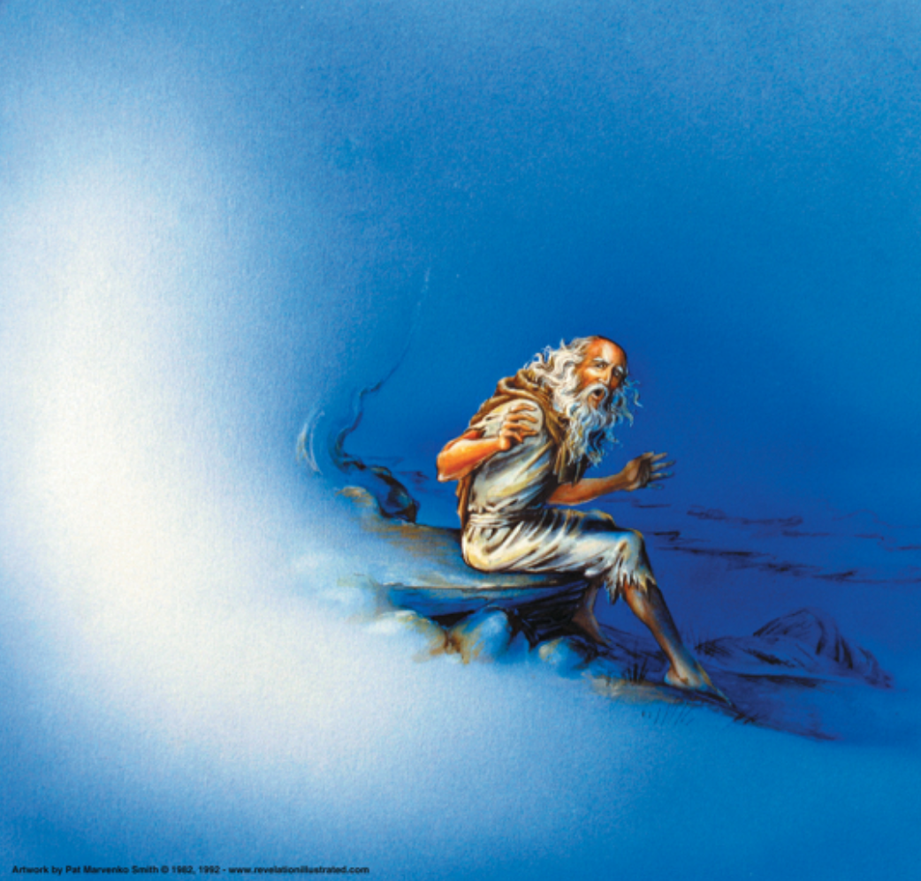
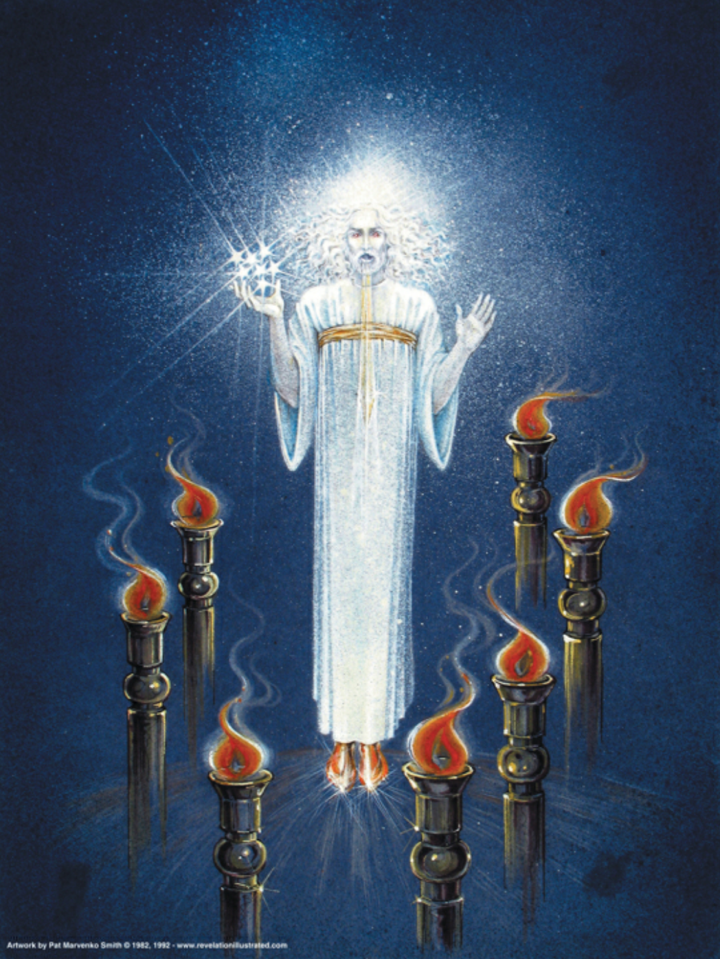
The Vision of Jesus (1:12-16)
Pat Marvenko Smith. Revelation Illustrated: An Artist's View of the Bible's Last Book (1982)

Slide 13
^{1:12} Then I turned to see the voice that was speaking to me, and on turning I saw seven golden lampstands, ¹³ and in the midst of the lampstands one like a son of man, clothed with a long robe and with a golden sash around his chest. (ESV)
John turns and sees “seven golden lampstands”, which (we’ll be told later) represent the seven churches in Asia (Rev. 1:12, 20).
The image of the “seven golden lampstands” comes from the Old Testament tabernacle and temple, where lampstands gave light in God’s presence (Exod. 25:31–37; 1 Kings 7:48–49; Zech. 4:2).
The point is that the churches are meant to shine in a dark world, speaking and living out Christ’s message by the power of the Holy Spirit (Zech. 4:6; Matt. 5:16; Phil. 2:15).
Schreiner, Thomas R.; Revelation, Baker Exegetical Commentary on the New Testament; (2023)

Slide 14
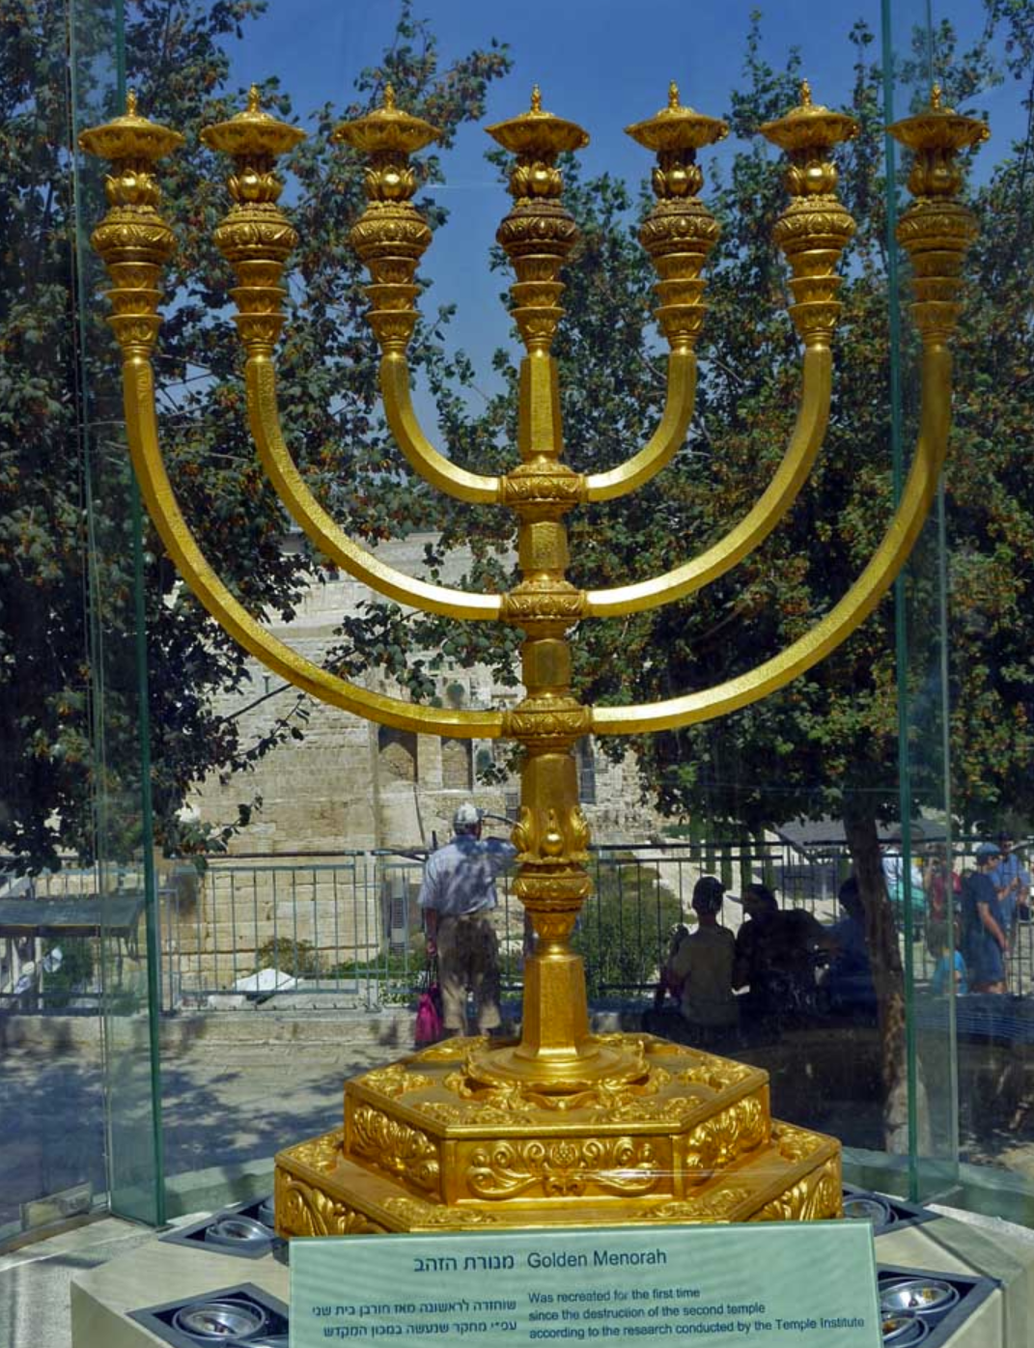
The “seven golden lampstands”(1:12)
https://templeinstitute.org/history-holy-temple-menorah/

Slide 15
^{1:12} Then I turned to see the voice that was speaking to me, and on turning I saw seven golden lampstands, ¹³ and in the midst of the lampstands one like a son of man, clothed with a long robe and with a golden sash around his chest. (ESV)
This figure John sees, “in the midst of the lampstands one like a son of man” is Christ. He stands “in the midst of ” the churches and he knows them.
The vision shows that Jesus is not distant from his people but personally involved with every church.
The title “son of man” points especially to Daniel 7:13–14, where a humanlike figure comes before God and receives authority, glory, and an everlasting kingdom.
In the Old Testament, “son of man” can simply mean “human being,” emphasizing human weakness (Ezek 2:1, 3, 6, 8; 3:1 etc.)
But in Daniel—and here in Revelation—the title carries much more weight.
It refers to one who is truly human, yet also shares in divine authority and glory.
This fits how Jesus uses the title in the Gospels: he is the Son of Man who forgives sins, rules as Lord, suffers, dies, rises, and will return to judge the world (Mark 2:10, 28; Matt. 20:28; 26:64; Luke 19:10).
Schreiner, Thomas R.; Revelation, Baker Exegetical Commentary on the New Testament; (2023)

Slide 16
^{1:12} Then I turned to see the voice that was speaking to me, and on turning I saw seven golden lampstands, ¹³ and in the midst of the lampstands one like a son of man, clothed with a long robe and with a golden sash around his chest. (ESV)
John also describes Christ as wearing a “long robe ” and a “golden sash around his chest”.
At the very least, this clothing shows Christ’s greatness, majesty, and dignity.
Many interpreters also think it points to a priestly role, since similar language is often used for priestly garments in the Old Testament and later Jewish writings (Exod. 28:4, 31; Lev. 8:7).
That would fit the setting well, because priests were responsible for tending the lampstands in the temple (Exod. 27:20–21; Lev. 24:1–4).
In that sense, Christ is pictured as the one who cares for and sustains the churches.
So the overall message is that Christ stands among his churches as the glorious Son of Man—the one who is both human and divine, who has all authority, and who cares personally for his people.
The churches are called to shine with his light in the world, and Christ himself is present among them to sustain them.
Schreiner, Thomas R.; Revelation, Baker Exegetical Commentary on the New Testament; (2023)

Slide 17
^{1:14} His head and hair were white like wool, as white as snow, and his eyes were like blazing fire. ¹⁵ His feet were like bronze glowing in a furnace, and his voice was like the sound of rushing waters. (ESV)
John’s vision now focuses on the appearance of the Son of Man, especially his hair, eyes, feet, and voice.
Each feature is symbolic and communicates something about Christ’s nature and authority.
First, John notices that the head and hair of the Son of Man are dazzling white, described as “white like wool” and “white as snow”
This description comes directly from Daniel 7:9, where “the Ancient of Days”—a title for God—has hair like white wool.
By applying this description to the Son of Man, John is showing that Jesus shares in the wisdom, eternity, and divine nature of God.
In other words, the qualities that belong to God in Daniel are now attributed to Christ.
Schreiner, Thomas R.; Revelation, Baker Exegetical Commentary on the New Testament; (2023)

Slide 18
^{1:14} His head and hair were white like wool, as white as snow, and his eyes were like blazing fire. ¹⁵ His feet were like bronze glowing in a furnace, and his voice was like the sound of rushing waters. (ESV)
At the same time, Revelation still distinguishes between God the Father and Jesus (Rev. 1:4–6; 2:18; 3:12).
Jesus calls God “my God” (3:2, 12), yet he is also described with divine characteristics.
This shows a very high view of Christ: he is distinct from the Father but shares in God’s glory and authority.
The color white throughout Revelation also symbolizes purity, goodness, and victory (Rev. 2:17; 3:4–5; 6:11; 7:9; 19:14).
Schreiner, Thomas R.; Revelation, Baker Exegetical Commentary on the New Testament; (2023)

Slide 19
^{1:14} His head and hair were white like wool, as white as snow, and his eyes were like blazing fire. ¹⁵ His feet were like bronze glowing in a furnace, and his voice was like the sound of rushing waters. (ESV)
John describes Christ’s feet as looking like “like bronze glowing in a furnace” beneath his long robe.
The image emphasizes strength, firmness, and stability.
John also says that Christ’s voice “like the sound of rushing waters”, similar to the roar of a powerful waterfall.
This picture conveys overwhelming power and majesty.
The same description is used in the Old Testament for the voice of God (Ezek. 43:2) and elsewhere in Revelation for the powerful sound of a great heavenly multitude (Rev. 14:2; 19:6).
The imagery highlights the authority and awe-inspiring presence of Christ.
Robert H. Mounce, The Book of Revelation, The New International Commentary on the New Testament (1997)

Slide 20
^{1:14} His head and hair were white like wool, as white as snow, and his eyes were like blazing fire. ¹⁵ His feet were like bronze glowing in a furnace, and his voice was like the sound of rushing waters. (ESV)
Overall, these images portray Jesus as majestic, powerful, pure, and all-knowing.
The Son of Man shares in God’s glory, sees everything with penetrating insight, stands with unshakable strength, and speaks with overwhelming authority.
For believers facing persecution, the vision assures them that Christ reigns with divine power and will ultimately judge the world according to truth.
Schreiner, Thomas R.; Revelation, Baker Exegetical Commentary on the New Testament; (2023)

Slide 21
^{1:16} In his right hand he held seven stars, from his mouth came a sharp two-edged sword, and his face was like the sun shining in full strength. (ESV)
In the vision, the Son of Man holds “seven stars” in his “right hand”, symbolizing his authority over the “angels” connected with the seven churches (cf. Rev. 1:20).
The “right hand” represents strength and power, showing that these “angels” are under his control.
A “sharp two-edged sword” comes from “his mouth”, representing the power of Christ’s word.
This imagery comes from Old Testament prophecies (Isa. 11:4; 49:2) and shows that his word brings judgment, defeating evil and exposing the truth.
No one can escape the authority of his judgment.
Finally, Christ’s “face” is “like the sun shining in full strength”, expressing his divine glory and majesty, similar to the glory revealed at the transfiguration (Matt. 17:2).
Schreiner, Thomas R.; Revelation, Baker Exegetical Commentary on the New Testament; (2023)

Slide 22
Christ’s Impact on John (1:17-20)
^{1:17} When I saw him, I fell at his feet as though dead. Then he placed his right hand on me and said: “Do not be afraid. I am the First and the Last. ¹⁸ I am the Living One; I was dead, and behold I am alive for ever and ever! And I hold the keys of death and Hades. ¹⁹ “Write, therefore, what you have seen, what is now and what will take place later. ²⁰ The mystery of the seven stars that you saw in my right hand and of the seven golden lampstands is this: The seven stars are the angels of the seven churches, and the seven lampstands are the seven churches. (NIV)

Slide 23
^{1:17} When I saw him, I fell at his feet as though dead. But he laid his right hand on me, saying, "Fear not, I am the first and the last, ¹⁸ and the living one. I died, and behold I am alive forevermore, and I have the keys of Death and Hades. (ESV)
When John sees the glorious vision of the Son of Man, he is overwhelmed and collapses at Jesus’s feet “as though dead”.
This reaction is common in Scripture when people encounter the presence of God or a heavenly being (Ezek. 1:28; Dan. 8:17; Matt. 17:6).
However, unlike when John later falls before an angel and is rebuked (Rev. 19:10; 22:8–9), Jesus does not correct him.
Instead, Jesus comforts him by placing his “right hand ”—a symbol of strength and authority—on him and telling him not to be afraid.
This moment also serves as John’s prophetic commissioning.
Like Old Testament prophets such as Isaiah, Daniel, and Ezekiel, John receives a vision of God’s glory, falls in fear, is strengthened by a heavenly figure, and then receives a message to deliver.
Jesus is preparing him to write and share the revelation with the seven churches.
Gentry, Kenneth. The Divorce of Israel; Volume 1; (2024)

Slide 24
^{1:17} When I saw him, I fell at his feet as though dead. But he laid his right hand on me, saying, "Fear not, I am the first and the last, ¹⁸ and the living one. I died, and behold I am alive forevermore, and I have the keys of Death and Hades. (ESV)
Jesus reassures John by declaring that he is “the first and the last” (Rev. 1:17), a title used for God in Isaiah (Isa. 44:6; 48:12).
This shows that Jesus shares in God’s eternal authority over all history.
He also calls himself “the living one.”
Although he truly died, he now lives forever because death could not hold him.
Because Jesus conquered death, he now holds “the keys of Death and Hades.”
Keys symbolize authority and control.
This means Christ has power over death and the realm of the dead.
For believers facing persecution and even martyrdom, this was deeply comforting.
Jesus rules over life and death, and those who remain faithful to him—even unto death—will ultimately share in his eternal life.
Gentry, Kenneth. The Divorce of Israel; Volume 1; (2024)

Slide 25
^{1:19} Write therefore the things that you have seen, those that are and those that are to take place after this. ²⁰ As for the mystery of the seven stars that you saw in my right hand, and the seven golden lampstands, the seven stars are the angels of the seven churches, and the seven lampstands are the seven churches. (ESV)
These verses record Jesus’ command to John to write down the revelation he is receiving.
The main point is not to give an outline of the whole book, but to tell John to record what God is showing him about the present situation and what is going to happen soon afterward (“those that are and those that are to take place after this”).
Verse 20 then explains the symbolic meaning of the “mystery” of the “seven stars” and the “seven golden lampstands”.
In this context, “mystery” does not mean something permanently unknowable.
It means something that was unknown but that God now reveals.
The explanation is this:
“the seven stars are the angels of the seven churches”
“the seven lampstands are the seven churches”
Aune, Dr. David. Revelation 1-5, Volume 52A (Word Biblical Commentary); (2013)

Slide 26
^{1:19} Write therefore the things that you have seen, those that are and those that are to take place after this. ²⁰ As for the mystery of the seven stars that you saw in my right hand, and the seven golden lampstands, the seven stars are the angels of the seven churches, and the seven lampstands are the seven churches. (ESV)
The “lampstands” clearly symbolize the churches themselves.
The image suggests that the churches are meant to shine with God’s light in the world.
This image appears again in Revelation 2:5, where Jesus warns the church in Ephesus that he can remove its lampstand—that is, remove that church’s place as a true Christian witness.
The seven stars are more difficult.
They are identified as “the angels of the seven churches”.
Aune, Dr. David. Revelation 1-5, Volume 52A (Word Biblical Commentary); (2013)

Slide 27
^{1:19} Write therefore the things that you have seen, those that are and those that are to take place after this. ²⁰ As for the mystery of the seven stars that you saw in my right hand, and the seven golden lampstands, the seven stars are the angels of the seven churches, and the seven lampstands are the seven churches. (ESV)
The word “angel” can mean either a heavenly being or a human messenger, but throughout the rest of the book of Revelation the word almost always refers to supernatural angels.
Interpreters debate exactly who these “angels of the seven churches” are.
The text itself does not fully explain it here, only that the “stars” represent them.
So, the basic message of these two verses is that John must write down God’s revealed message about the present and near future, and that the symbols in his vision have specific meanings: the lampstands are the churches, and the stars are their angels.
Aune, Dr. David. Revelation 1-5, Volume 52A (Word Biblical Commentary); (2013)

Slide 28

Class Discussion Time
We are reminded here that, while none of us wish for suffering in our lives, suffering is a natural part of being in Christ’s kingdom – even the Apostle John was not exempt.
How well do you handle suffering in your life – weather it be persecution (the kind of suffering described in today’s text) or suffering for other reasons?
How much impact do you suppose your mindset has on your ability to “suffer well”?
A primary focus of our text today as it speaks to the suffering of the original readers (and by implication, our suffering as members of Christ’s kingdom) is the magnification and glorification of Christ.
If you were to fully internalize what today’s text is telling you about Christ, do you think it would have a positive impact on our attitude towards suffering? If so, how?

Slide 29
Class Discussion Time
What do you think about my suggestion that John receiving this vision “on the Lord’s Day” means he was spiritually transported to “the day of the Lord”, i.e., a day of judgment?
Who do you think the “angels” of the seven chuches refer to?

