Slide 1
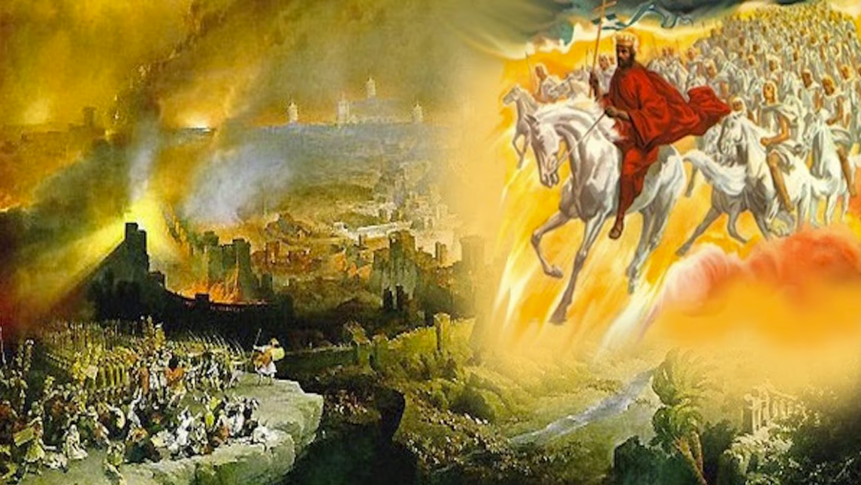
The Book of Revelation
Image credit – https://www.bible.com/events/84698
“The kingdom of the world has become the kingdom of our Lord and of His Christ,
and He shall reign forever and ever.” (Revelation 11:15)
Sermon Available on https://www.purifiedbyfaith.com/

Slide 2
Letter to the Church in Pergamum (2:12-17)
^{2:12} "To the angel of the church in Pergamum write: These are the words of him who has the sharp, double-edged sword. ¹³ I know where you live--where Satan has his throne. Yet you remain true to my name. You did not renounce your faith in me, even in the days of Antipas, my faithful witness, who was put to death in your city--where Satan lives. ¹⁴ Nevertheless, I have a few things against you: You have people there who hold to the teaching of Balaam, who taught Balak to entice the Israelites to sin by eating food sacrificed to idols and by committing sexual immorality. ¹⁵ Likewise you also have those who hold to the teaching of the Nicolaitans. ¹⁶ Repent therefore! Otherwise, I will soon come to you and will fight against them with the sword of my mouth. ¹⁷ He who has an ear, let him hear what the Spirit says to the churches. To him who overcomes, I will give some of the hidden manna. I will also give him a white stone with a new name written on it, known only to him who receives it.” (NIV)

Slide 3
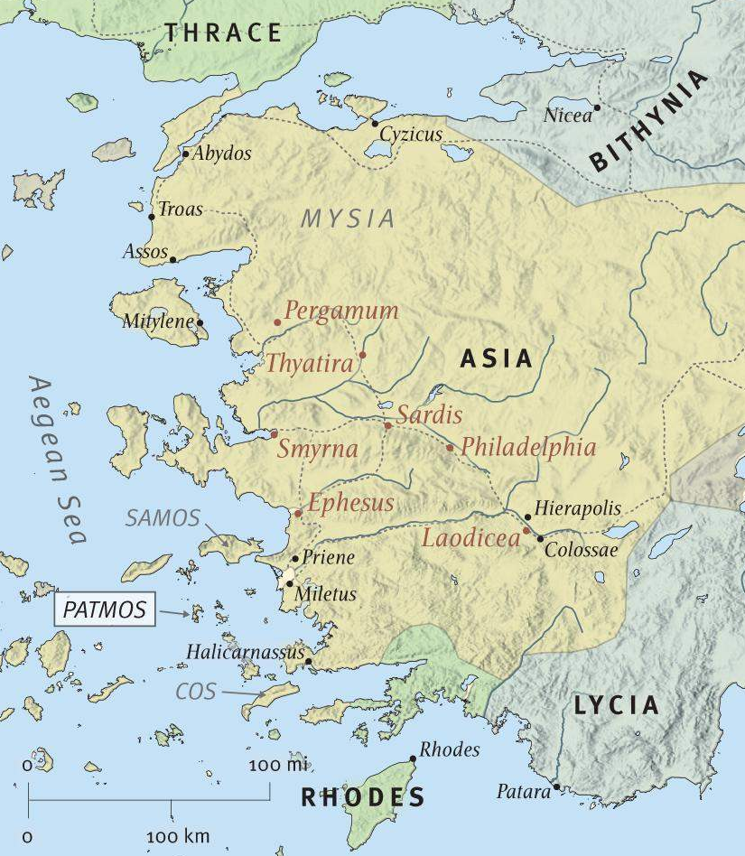
John Writes to the Seven Churches
ESV Study Bible;
Introduction to Revelation

Slide 4
The Church in Pergamum – Historical Context
Pergamum sat about sixty-five miles north of Smyrna, perched dramatically on a rocky hill rising a thousand feet above the surrounding plain.
It was originally the provincial capital of Asia (before it was moved to Ephesus around 29 BC) — Rome's political headquarters in the region — and one of the most impressive cities in the ancient world.
Its famous library, second only to Alexandria, and its stunning acropolis lined with temples and palaces made it a center of culture, medicine, and power.
Religiously, Pergamum was saturated with paganism.
It housed temples to Zeus, Athena, Dionysus, and Asclepius — the god of healing whose shrine drew people from across the empire seeking cures.

Slide 5
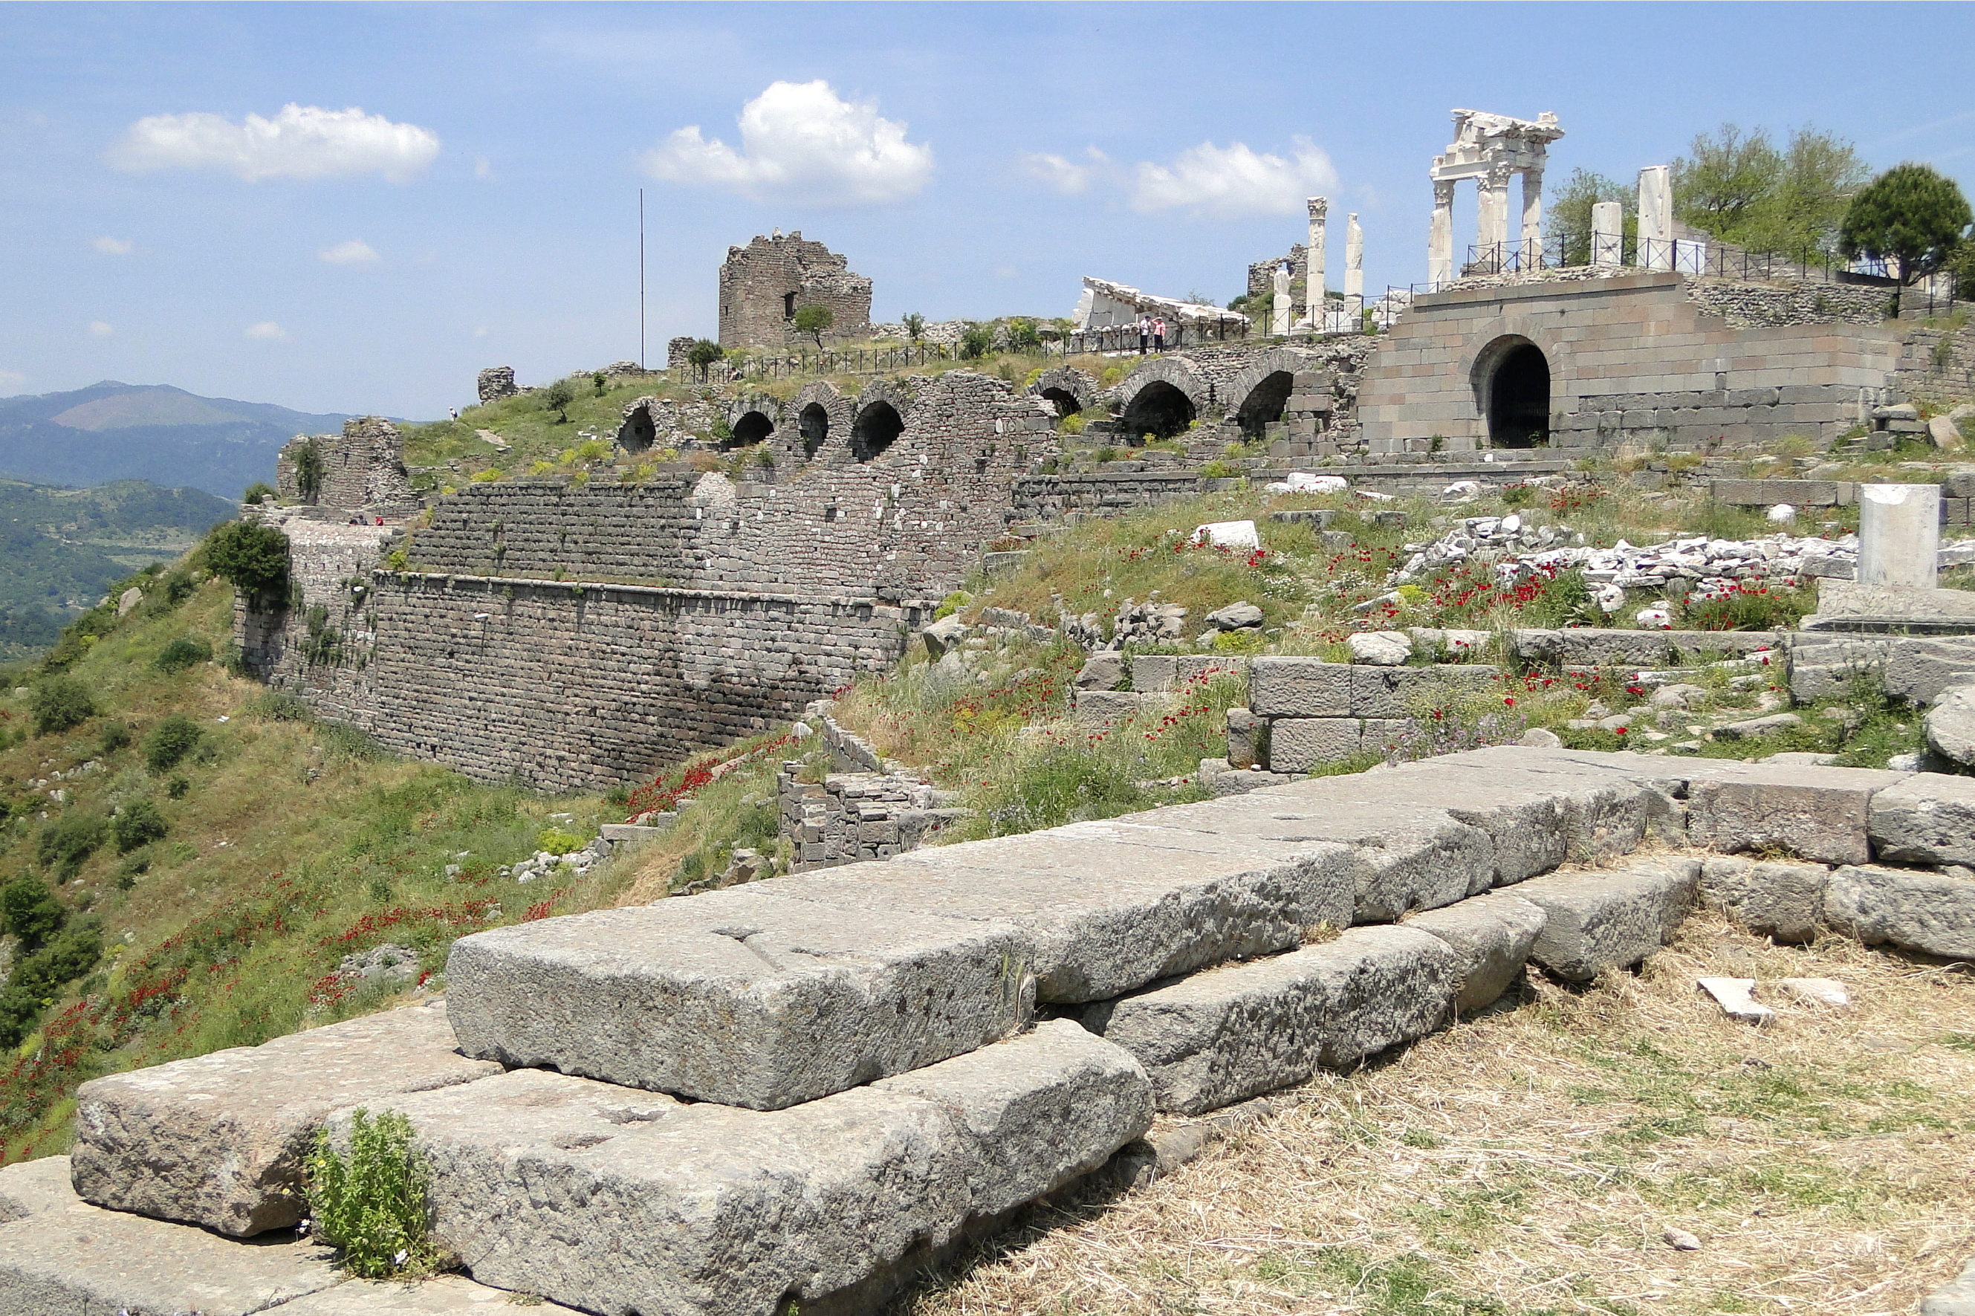
Ancient Acropolis at Pergamum
https://en.wikipedia.org/wiki/Pergamon

Slide 6
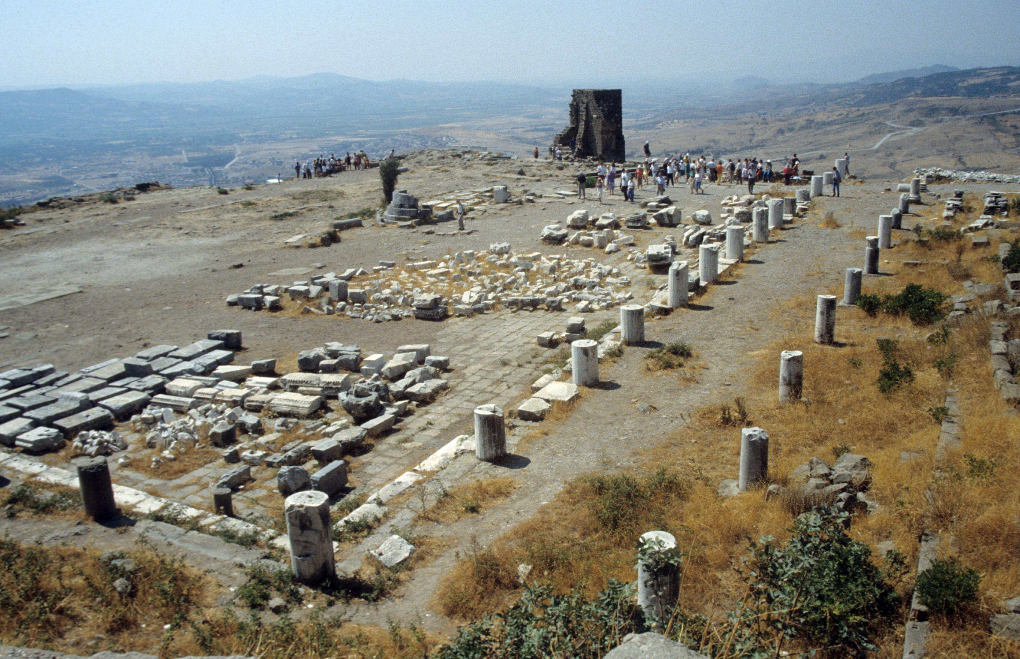
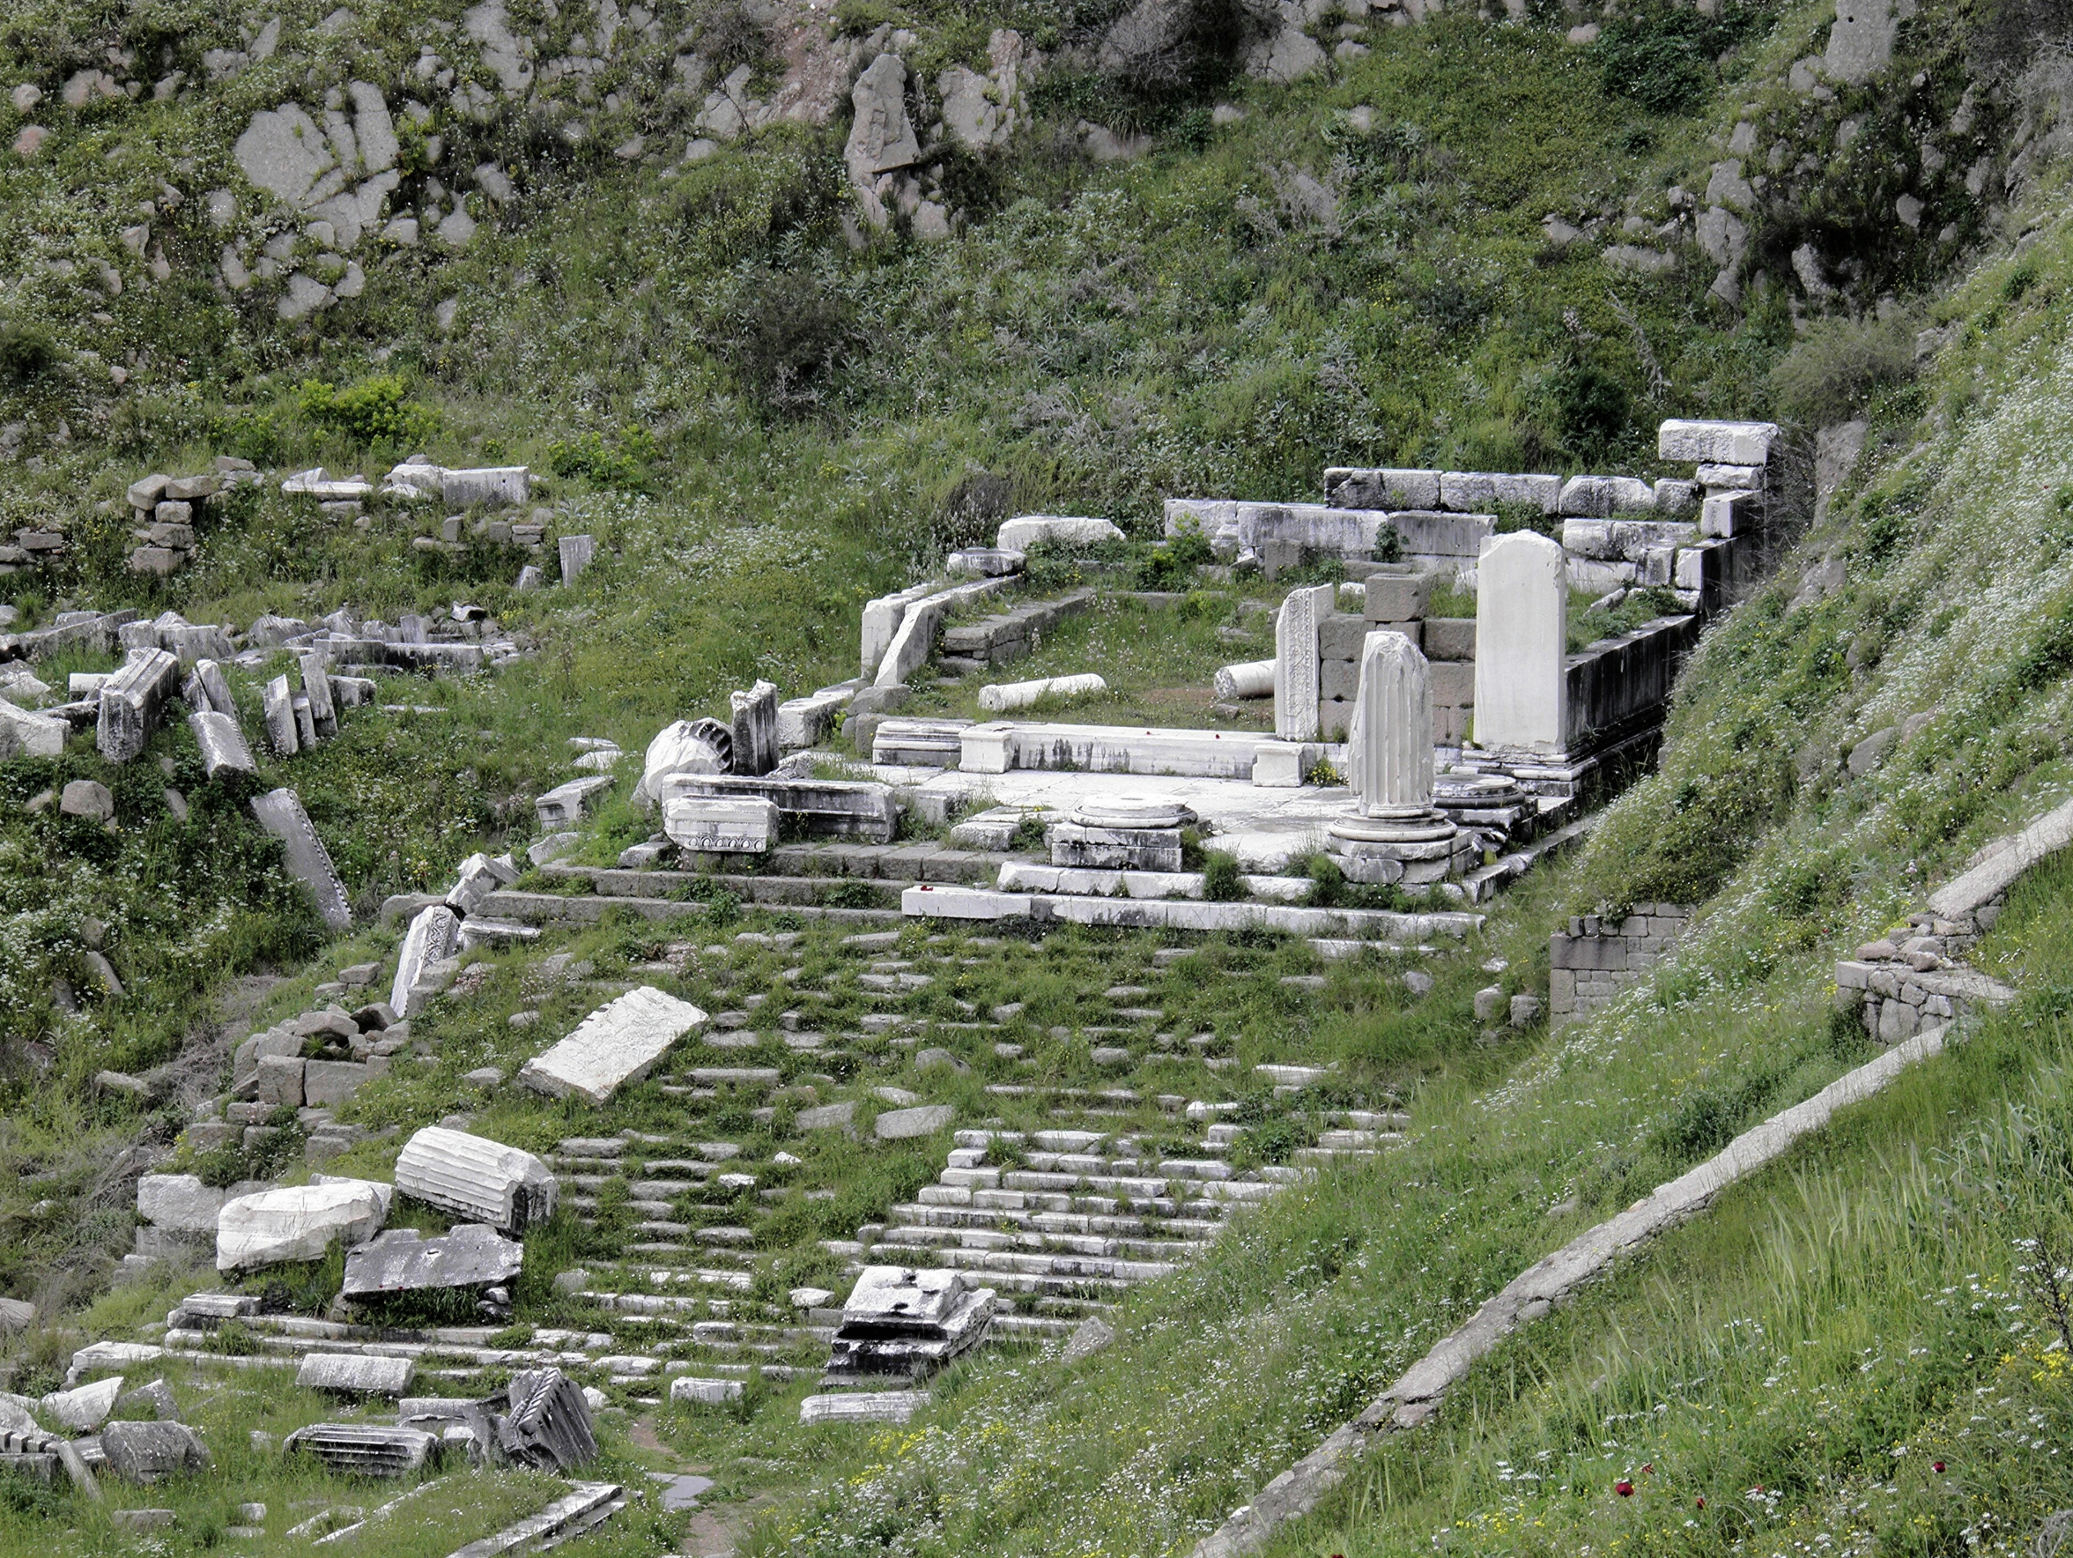
Temples in Ancient Pergamum
Temple of Athena
Temple of Dionysus
https://en.wikipedia.org/wiki/Pergamon

Slide 7
The Church in Pergamum – Historical Context
Most significantly, Pergamum was home to the first temple built to a living Roman emperor, erected in honor of Augustus in 29 BC.
This made it the birthplace of the imperial cult in Asia, the very place where worshiping Caesar as a god was most deeply embedded in civic life.
Christ addresses this church as the one who holds the sharp, double-edged sword — a deliberate contrast with the sword of Roman authority seated in their city.
He commends their faithfulness under pressure, grieves over their tolerance of false teaching, and calls them to repent before his word does what Rome's sword cannot.

Slide 8
^{2:12} "And to the angel of the church in Pergamum write: 'The words of him who has the sharp two-edged sword. ¹³ "'I know where you dwell, where Satan's throne is. Yet you hold fast my name, and you did not deny my faith even in the days of Antipas my faithful witness, who was killed among you, where Satan dwells. (ESV)
Christ addresses Pergamum as “him who has the sharp two-edged sword” – a title loaded with meaning for a city where the Roman proconsul held the “power of the sword,” i.e., the legal power to execute.
The point is deliberate: whatever authority Rome wielded, Christ's authority is greater.
Christ’s sword is his word (cf. 1:16, also Isaiah 49:2; Heb 4:12), the instrument of both conviction and judgment.
It is mentioned at the beginning and end of this letter, framing the entire message as one that carries the weight of divine judgment for a church that is compromising with the world around it.

Slide 9
^{2:12} "And to the angel of the church in Pergamum write: 'The words of him who has the sharp two-edged sword. ¹³ “'I know where you dwell, where Satan's throne is. Yet you hold fast my name, and you did not deny my faith even in the days of Antipas my faithful witness, who was killed among you, where Satan dwells. (ESV)
Christ opens his assessment with “I know where you dwell.”
That phrase sets the stage for everything that follows, because the place where the Pergamum believers lived was no ordinary place.
He calls it the place “where Satan's throne is… where Satan dwells.”
Exactly what this refers to has been debated by scholars.
Pergamum was a city of wealth and culture, but, as we’ve already seen, it was also a center of pagan worship.
Nearly all the pagan religions had shrines in Pergamum – there was even one for the emperor.
Pergamum was, in the fullest sense, enemy territory.
Though Satan operates everywhere, it appears that in the prominent cities of this world, such as Pergamos, Satan is even more active.

Slide 10
^{2:12} "And to the angel of the church in Pergamum write: 'The words of him who has the sharp two-edged sword. ¹³ "'I know where you dwell, where Satan's throne is. Yet you hold fast my name, and you did not deny my faith even in the days of Antipas my faithful witness, who was killed among you, where Satan dwells. (ESV)
And yet the church had held its ground.
They had continued to “hold fast” to Christ's name and had not denied their faith — even when it cost someone their life.
“Antipas” is the only individual martyr named in all seven letters.
Christ honors him with the same title used of Jesus himself in chapter one: “faithful witness” (Rev 1:5).
We know almost nothing else about him — later legends are considered unreliable by most scholars — but his death had clearly shaken the congregation.
The fact that the church did not collapse after his execution is itself remarkable, and Christ explicitly commends them for it.

Slide 11
^{2:12} "And to the angel of the church in Pergamum write: 'The words of him who has the sharp two-edged sword. ¹³ "'I know where you dwell, where Satan's throne is. Yet you hold fast my name, and you did not deny my faith even in the days of Antipas my faithful witness, who was killed among you, where Satan dwells. (ESV)
The commendation is genuine and significant.
To hold fast to Christ in a city where Caesar demanded worship, where pagan religion pervaded every layer of public life, and where a fellow believer had already been killed for his faith — that required real courage.
But the commendation is not the whole story.
Despite their bravery under persecution, something had gone wrong inside the church, and Christ is about to address it.

Slide 12
^{2:14} But I have a few things against you: you have some there who hold the teaching of Balaam, who taught Balak to put a stumbling block before the sons of Israel, so that they might eat food sacrificed to idols and practice sexual immorality. ¹⁵ So also you have some who hold the teaching of the Nicolaitans. (ESV)
Despite the church's genuine courage under persecution, Christ has a complaint.
Some in Pergamum were following what he calls “the teaching of Balaam” – and tolerating it was no small matter.
Balaam was an Old Testament prophet who, motivated by greed (2 Pet 2:15; Jude 11), advised the Moabite king Balak on how to undermine Israel from within.
Rather than cursing them directly, he suggested using Moabite women to draw Israelite men into idolatrous feasts and sexual immorality (Numbers 25 cf. 31:16).
The scheme worked, and Israel stumbled badly.
Balaam's name became shorthand in Jewish tradition for any corrupt teacher who leads God's people into fatal compromise with the surrounding culture – and that is exactly how Christ uses it here.

Slide 13
^{2:14} But I have a few things against you: you have some there who hold the teaching of Balaam, who taught Balak to put a stumbling block before the sons of Israel, so that they might eat food sacrificed to idols and practice sexual immorality. ¹⁵ So also you have some who hold the teaching of the Nicolaitans. (ESV)
The “sexual immorality” mentioned is interpreted by scholars in two primary ways:
Literal Sexual Immorality – a common feature of pagan festivities and banquets (1 Cor. 10:7–8).
Spiritual Adultery: In the Old Testament tradition, sexual sin often serves as a metaphor for spiritual unfaithfulness and idolatry (Jer. 3:1; Rev. 17:2).
Whether literal or metaphorical, these practices formed a poisonous cocktail that threatened the church’s its spiritual integrity.
Jesus then links these practices to the “Nicolaitans” – another movement within the church that was pushing compromise under the guise of Christian liberty.
These teachers argued that believers could maintain a peaceful coexistence with Roman society without being unfaithful to Christ.

Slide 14
^{2:14} But I have a few things against you: you have some there who hold the teaching of Balaam, who taught Balak to put a stumbling block before the sons of Israel, so that they might eat food sacrificed to idols and practice sexual immorality. ¹⁵ So also you have some who hold the teaching of the Nicolaitans. (ESV)
Christ’s warning is clear: holding fast to His name is inconsistent with holding on to teachings that excuse sin.
Tolerance of such error is not a virtue but a danger that “leavens the whole lump” (1 Cor. 5:6).
Just as Balaam was ultimately judged by the sword (Num. 31:8), the risen Christ warns that if they do not repent, they too will be judged.

Slide 15
^{2:16} Therefore repent. If not, I will come to you soon and war against them with the sword of my mouth. ¹⁷ He who has an ear, let him hear what the Spirit says to the churches. To the one who conquers I will give some of the hidden manna, and I will give him a white stone, with a new name written on the stone that no one knows except the one who receives it.' (ESV)
Here the Risen Christ presents the church at Pergamum with a stark ultimatum: Repent or face “the sword” (divine judgment).
This passage joins a call for immediate internal discipline with a series of profound, future promises for those who remain faithful.
The command to “repent” is urgent.
If the church continues to tolerate the compromise of the Nicolaitans, Christ warns He will come “soon” to make war against them (Rev. 2:16; 22:7).
The weapon he will use is “the sword of my mouth.”
The sword (a long rhomphaia) represents the Word of God that judges and exposes evil (Jer. 21:5; Rev. 19:15).
Notice, Christ does not threaten the entire church, but specifically those holding the false teachings.

Slide 16
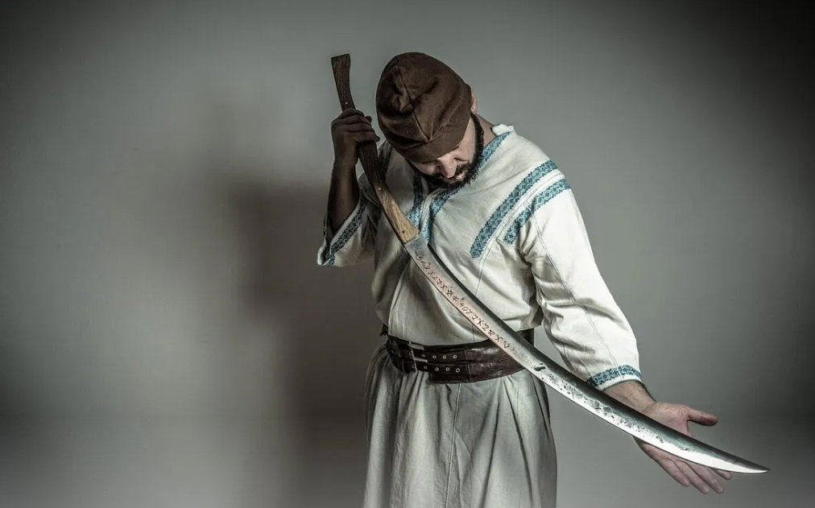
The Rhomphaia Sword
https://medium.com/@ancient.rome/the-rhomphaia-a-formidable-weapon-of-the-ancient-thracians-ca84d9c3c4d2

Slide 17
^{2:16} Therefore repent. If not, I will come to you soon and war against them with the sword of my mouth. ¹⁷ He who has an ear, let him hear what the Spirit says to the churches. To the one who conquers I will give some of the hidden manna, and I will give him a white stone, with a new name written on the stone that no one knows except the one who receives it.' (ESV)
“To the one who conquers” the temptation of cultural compromise, Christ promises three specific rewards:
“hidden manna”
“a white stone”
“a new name”
It’s difficult to know with certainty what any of these things are. Consequently, scholars will vary in terms of how they understand them.
Here are the most commonly suggested understandings for these three rewards:
Hidden Manna: This is probably an allusion to the jar of manna kept in the Ark of the Covenant (Exod. 16:31–35; Heb. 9:4).
Jewish tradition suggested Jeremiah hid the Ark and its manna before the Babylonians destroyed the Temple in 586 BC, and it was only to be revealed when the Messiah appears (2 Macc. 2:4–7).
Spiritually, this manna represents Christ Himself—the "true bread from heaven" (John 6:32–35)—sustaining His people in the wilderness of a pagan society.

Slide 18
^{2:16} Therefore repent. If not, I will come to you soon and war against them with the sword of my mouth. ¹⁷ He who has an ear, let him hear what the Spirit says to the churches. To the one who conquers I will give some of the hidden manna, and I will give him a white stone, with a new name written on the stone that no one knows except the one who receives it.' (ESV)
The White Stone:
It may represent acquittal in a court of law, where a white stone signified “not guilty” (Acts 26:10).
Others see it as a token, an admission pass to a royal banquet, in contrast with the idolatrous feasts the believers were told to avoid.
Some suggest it functions like a stone worn in the ancient world as an amulet (basically a “good luck charm”), signifying the security and protection found in Christ.
A New Name: This stone bears a “new name” known only to the recipient.
This echoes Isaiah’s prophecy of Israel’s vindication (Isa. 62:2; 65:15).
Whether this name is a secret name for Christ (Rev. 19:12) or a new identity given to the believer (Rev. 3:12), it signifies an intimate, indestructible relationship with God.
Ultimately, these rewards—sustenance, acquittal, and identity—are all found in Jesus Himself.
Those who refuse the “soiled” food of the world are promised the “hidden” feast of the Kingdom of Christ.

Slide 19
Letter to the Church in Thyatira (2:18-29)
^{2:18} "To the angel of the church in Thyatira write: These are the words of the Son of God, whose eyes are like blazing fire and whose feet are like burnished bronze. ¹⁹ I know your deeds, your love and faith, your service and perseverance, and that you are now doing more than you did at first. ²⁰ Nevertheless, I have this against you: You tolerate that woman Jezebel, who calls herself a prophetess. By her teaching she misleads my servants into sexual immorality and the eating of food sacrificed to idols. ²¹ I have given her time to repent of her immorality, but she is unwilling. ²² So I will cast her on a bed of suffering, and I will make those who commit adultery with her suffer intensely, unless they repent of her ways. ²³ I will strike her children dead. Then all the churches will know that I am he who searches hearts and minds, and I will repay each of you according to your deeds.

Slide 20
Letter to the Church in Thyatira (2:18-29)
^{2:24} Now I say to the rest of you in Thyatira, to you who do not hold to her teaching and have not learned Satan's so-called deep secrets (I will not impose any other burden on you): ²⁵ Only hold on to what you have until I come. ²⁶ To him who overcomes and does my will to the end, I will give authority over the nations-- ²⁷ 'He will rule them with an iron scepter; he will dash them to pieces like pottery'-- just as I have received authority from my Father. ²⁸ I will also give him the morning star. ²⁹ He who has an ear, let him hear what the Spirit says to the churches. (NIV)

Slide 21
The Church in Thyatira – Historical Context
Thyatira, located about forty to fifty miles southeast of Pergamum, was historically considered the least significant of the seven cities, yet it received the longest and most complex message in Revelation.
Originally a military outpost with no natural defenses, it evolved into a prosperous manufacturing center famous for its trade guilds.
These guilds—representing dyers, tanners, and bronze-smiths—were essential for economic survival.
Notably, Acts 16:14–15 records that Lydia, a seller of purple and Paul’s first convert in Philippi, was from this city.

Slide 22
The Church in Thyatira – Historical Context
The spiritual tension in Thyatira centered on compromise.
Guild membership required participation in pagan festivals, which involved eating food sacrificed to idols and sexual immorality
Addressing the church as the “Son of God” (the only such instance in Revelation), Christ uses imagery of fiery eyes and bronze feet to signify His penetrating judgment (Rev. 2:18).
While the church is commended for its growing love, faith, and service (Rev. 2:19), they are rebuked for tolerating a prophetess named Jezebel who encouraged religious promiscuity (Rev. 2:20).
Ultimately, this letter serves as a warning against worldliness, promising that those who conquer will share in Christ’s own royal authority and receive the "morning star" (Rev. 2:26–28).

Slide 23
^{2:18} "And to the angel of the church in Thyatira write: 'The words of the Son of God, who has eyes like a flame of fire, and whose feet are like burnished bronze. (ESV)
Jesus calls Himself the “Son of God,” a title used only once in Revelation.
This connects to the Old Testament idea of God’s chosen king (like in 2 Samuel 7 and Psalm 2).
But it also challenges Roman culture, where emperors claimed to be divine “sons of god,” including Domitian.
It even confronts local worship of Apollo, believed to be the son of Zeus.
Jesus’ description shows His authority and power.
His “eyes like a flame of fire” mean He sees everything clearly, even people’s hidden thoughts and motives.
His “feet are like burnished bronze” represent strength, purity, and the ability to judge and defeat evil.
Overall, Jesus is presented as the true divine ruler—greater than any earthly king or false god—and the one who perfectly sees and judges all people.

Slide 24
^{2:19} "'I know your works, your love and faith and service and patient endurance, and that your latter works exceed the first. (ESV)
Christ begins with a warm commendation, telling them, “I know your works”.
He praises the church for four distinct virtues:
“love”
“faith”
“service”
“patient endurance”
Unlike the church at Ephesus, which had lost its first love, the church at Thyatira was actually improving.
Their “latter works” were greater than their “first”, showing visible spiritual growth and maturity.

Slide 25
^{2:20} But I have this against you, that you tolerate that woman Jezebel, who calls herself a prophetess and is teaching and seducing my servants to practice sexual immorality and to eat food sacrificed to idols. ²¹ I gave her time to repent, but she refuses to repent of her sexual immorality. (ESV)
Here Christ shifts from praise to a sharp rebuke of the church because they “tolerate” of a false prophetess He calls “Jezebel.”
This title is a strategic allusion to the Old Testament queen who led Israel into Baal worship (1 Kings 16:31; 2 Kings 9:22).
This woman used her claimed prophetic authority to justify “sexual immorality” and eating “food sacrificed to idols”.
These compromises were likely driven by the economic pressure to participate in local trade guilds, which held feasts in pagan temples.
Christ’s primary grievance is that the church allowed her to deceive his “servants”.
In his mercy he gives Jezebel “time to repent”.
But because she willfully “refuses” to turn, judgment has become inevitable.

Slide 26
^{2:22} Behold, I will throw her onto a sickbed, and those who commit adultery with her I will throw into great tribulation, unless they repent of her works, ²³ and I will strike her children dead. And all the churches will know that I am he who searches mind and heart, and I will give to each of you according to your works. (ESV)
Jezebel will be thrown “onto a sickbed” – a striking reversal – the bed of her adultery becomes a bed of sickness and suffering.
Her followers who have joined her in both her idolatrous compromises and likely her sexual sin will face great tribulation, though repentance remains possible for them.
Her “children” (her most devoted disciples) face certain death – including the second death or final judgment in the lake of fire.

Slide 27
^{2:22} Behold, I will throw her onto a sickbed, and those who commit adultery with her I will throw into great tribulation, unless they repent of her works, ²³ and I will strike her children dead. And all the churches will know that I am he who searches mind and heart, and I will give to each of you according to your works. (ESV)
This judgment has a bigger purpose: so that all the churches will know that Christ searches the “mind and heart” (literally “kidneys and hearts”).
In ancient Greek, the “kidneys” (translated here as “mind”) represent deep emotion and desire, and the “heart” represents decision and will.
John is clearly drawing here from Jeremiah 17:10, where it tells us it is Yahweh who “searches mind and heart”.
But here it is Christ who does so, demonstrating that Christ is Yahweh.
Finally, we are told Christ will repay each person “according to [their] works”, a principle found throughout the scriptures (cf. Ps. 62:12; Jer. 17:10; Matt. 16:27; Rom. 2:6).

Slide 28

Class Discussion Time
Both the churches that we looked at today, while showing faithfulness in many important ways, were compromising their faith in two areas in particular:
Eating food sacrificed to idols while participating in pagan feasts and rituals
“Sexual Immorality” – whether spiritual adultery (idolatry) or actual physical immorality, perhaps also as a part of pagan feasts and rituals.
We don’t tend to struggle with eating food sacrificed to idols in our day.
Can you think of any areas where the church today does struggle that might be the equivalent of this? What are the idols that the church today tends to fall for?

Slide 29
Class Discussion Time
Notice that in both churches, Christ not only condemns those who sin directly by compromising with the pagan culture around them, but he also condemns those in the church who, while not necessarily compromising personally, are tolerating those who do.
In our day, it is considered a virtue by some (even some churches) to not judge others for their “lifestyle choices” (for example).
In light of Christ’s rebuke of the tolerance these churches had for compromising with the culture around them, what do you think Christ would say to churches today who pride themselves in “tolerance”?

Slide 30
Class Discussion Time
Christ warns the church in Thyatira that he “will give to each of [them] according to [their] works” (Rev 2:23).
How is this consistent with the idea that we are saved by grace alone?

