Slide 1
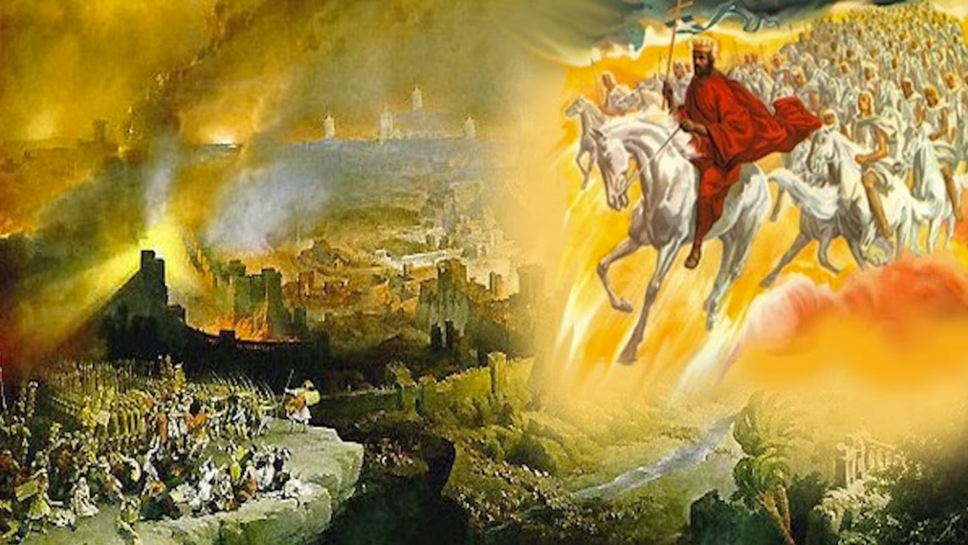
The Book of Revelation
Image credit – https://www.bible.com/events/84698
“The kingdom of the world has become the kingdom of our Lord and of His Christ,
and He shall reign forever and ever.” (Revelation 11:15)
Class Recording and Notes Will Be Available on https://www.purifiedbyfaith.com/

Slide 2
High Level Outline of the Book of Revelation
Introduction (1:1-8)
Jesus Among the Seven Churches (1:9-20)
Letters to the Seven Churches: (Chapters 2-3)
The Throne of God and the Lamb (Chapters 4-5)
Three Sets of Divine Judgments (6:1-16:21)
  Seven Seals (6:1-17; 8:1)
  Interlude: Sealing of the 144,000 (7:1-17)
  Seven Trumpets (8:2-11:19)
  Interlude: Persecution, Deliverance and Judgment (Chapters 12–14)
  Seven Bowls (Chapters 15–16)
The Fall of Babylon (17:1-19:10)
The Last Battle (19:11-20:15)
The Marriage of Heaven and Earth (21:1-22:5)
Epilogue (22:6-21)

Slide 3
Introduction to Revelation 4-5
Revelation 4–5 is the theological heart of the entire book.
Everything else in Revelation pivots on these two chapters.
After addressing the seven churches, John is transported “in the Spirit” from earth to heaven, where he receives a stunning vision of God's throne room — a perspective meant to reframe everything his readers are experiencing on earth.
Chapter 4 is largely descriptive and static, painting a portrait of God enthroned as sovereign Creator.
Surrounding the throne are “four living creatures” (drawn from Isaiah 6 and Ezekiel 1) and “twenty-four elders”.
Lightning, thunder, burning lamps (or torches), and a crystal sea fill the scene, all pointing to God's overwhelming holiness.
The living creatures worship him ceaselessly as "holy, holy, holy," and the elders cast their crowns before him, confessing that he alone is worthy of all glory, honor, and power (4:9–11).
The message is clear: God has not lost control of history.

Slide 4
Introduction to Revelation 4-5
Chapter 5 shifts from description to action.
A scroll sealed with seven seals appears, and no one is found worthy to open it — until Christ steps forward as both the Lion of Judah and the slain Lamb (5:5–6).
His death and resurrection have conquered, and he alone can open the scroll and unfold history's destiny.
The result is an explosion of worship from the living creatures, the elders, “myriads of myriads and thousands of thousands” of angels, and ultimately all of creation, declaring the Lamb worthy to receive power, wealth, wisdom, and glory (5:12–13).
These chapters draw deeply from the Old Testament, especially Daniel 7 (the “Ancient of Days” and the “Son of Man” approaching the throne) and Ezekiel 1:5,22 (the “four living creatures” and the “sea” (or “expanse” like “crystal”).
These chapters also draw a sharp contrast between true heavenly worship versus the emperor worship demanded by Rome, reminding believers who should be their ultimate authority.

Slide 5
Introduction to Revelation 4-5
The pastoral purpose is powerful.
Christians facing persecution needed to see what John saw — that God and the Lamb reign over all, that Christ has already overcome (5:5), and that the suffering of the present moment is not the final word.
Believers are assured they are part of a “kingdom and priests” (5:9–10, echoing Exodus 19:6), called to reign under God just as Adam was originally designed to do.
In short, Revelation 4–5 addresses the suffering believer's deepest anxieties: Is God still in charge? Does any of this matter?
This vision that we are about to study answers those questions with a resounding “yes!”
The throne is occupied, the Lamb has conquered, and all of heaven is already worshiping.
The remainder of Revelation simply unpacks what that means for history and for the church.

Slide 6
The Throne of God (4:1-11)
^{4:1} After this I looked, and there before me was a door standing open in heaven. And the voice I had first heard speaking to me like a trumpet said, "Come up here, and I will show you what must take place after this." ² At once I was in the Spirit, and there before me was a throne in heaven with someone sitting on it. ³ And the one who sat there had the appearance of jasper and carnelian. A rainbow, resembling an emerald, encircled the throne. ⁴ Surrounding the throne were twenty-four other thrones, and seated on them were twenty-four elders. They were dressed in white and had crowns of gold on their heads. ⁵ From the throne came flashes of lightning, rumblings and peals of thunder. Before the throne, seven lamps were blazing. These are the seven spirits of God.

Slide 7
The Throne of God (4:1-11)
^{4:6} Also before the throne there was what looked like a sea of glass, clear as crystal. In the center, around the throne, were four living creatures, and they were covered with eyes, in front and in back. ⁷ The first living creature was like a lion, the second was like an ox, the third had a face like a man, the fourth was like a flying eagle. ⁸ Each of the four living creatures had six wings and was covered with eyes all around, even under his wings. Day and night they never stop saying: “Holy, holy, holy is the Lord God Almighty, who was, and is, and is to come.” ⁹ Whenever the living creatures give glory, honor and thanks to him who sits on the throne and who lives for ever and ever, ¹⁰ the twenty-four elders fall down before him who sits on the throne, and worship him who lives for ever and ever. They lay their crowns before the throne and say: ¹¹ “You are worthy, our Lord and God, to receive glory and honor and power, for you created all things, and by your will they were created and have their being.” (NIV)

Slide 8
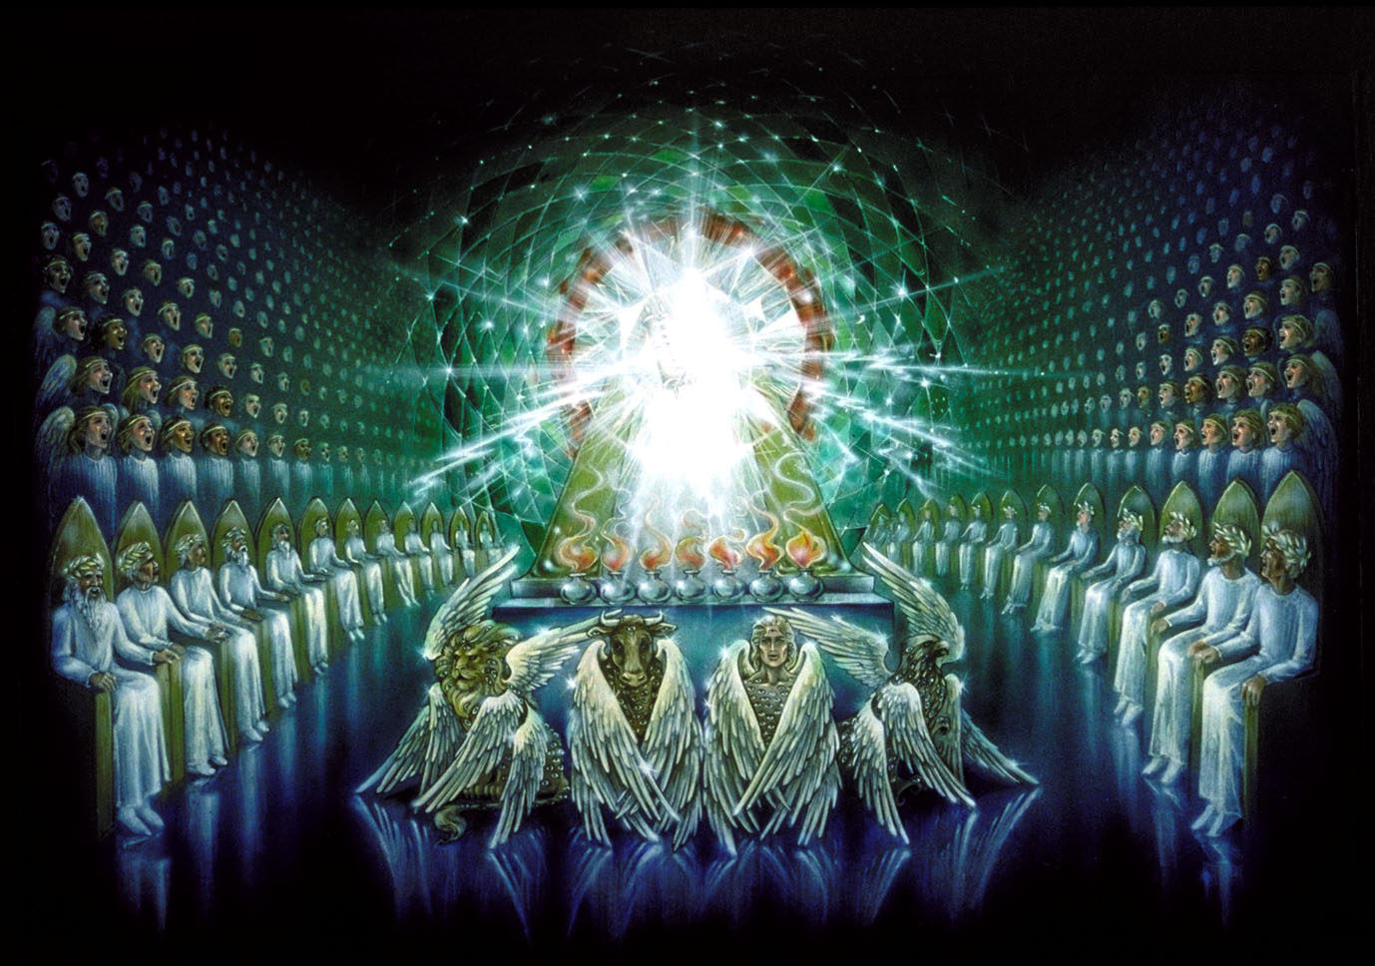
The Emerald Throne Scene in Heaven (Rev 4:2-11)
Pat Marvenko Smith. Revelation Illustrated: An Artist's View of the Bible's Last Book (1982)

Slide 9
^{4:1} After this I looked, and behold, a door standing open in heaven! And the first voice, which I had heard speaking to me like a trumpet, said, “Come up here, and I will show you what must take place after this.” (ESV)
The scene opens with a dramatic shift as John sees “a door standing open in heaven” and hears a commanding voice inviting him to “Come up here.”
The phrase “After this ” refers primarily to the sequence of John’s visions, not necessarily to a chronological order of historical events being described.
In other words, John is describing what he saw next, not necessarily what happens next in history.
This pattern of vision introduction mirrors language found in Daniel 7 and Ezekiel 1, placing John firmly in the tradition of Old Testament prophets like Isaiah (Isaiah 6:1), Micaiah (1 Kgs. 22:19), and Ezekiel (Ezekiel 1:1), who were ushered into God's heavenly abode to receive revelation.
The “door standing open in heaven” indicates that a disclosure of God is about to be given as he sits in his heavenly abode — similar occasions in Scripture include Peter's vision (Acts 10:11), Stephen's glimpse of the exalted Christ (Acts 7:56), and the opening of heaven at Jesus's baptism (Luke 3:21–22).

Slide 10
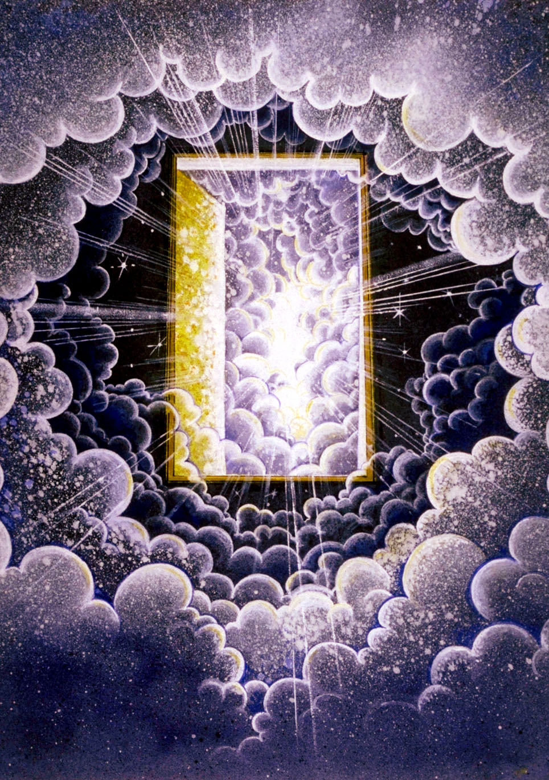
“After this I looked, and behold, a door standing open in heaven! ” (Rev 4:1)
Pat Marvenko Smith. Revelation Illustrated: An Artist's View of the Bible's Last Book (1982)

Slide 11
^{4:1} After this I looked, and behold, a door standing open in heaven! And the first voice, which I had heard speaking to me like a trumpet, said, “Come up here, and I will show you what must take place after this.” (ESV)
The “voice” John hears speaking is most likely that of the risen Christ (the same voice John heard “first” in 1:10 which was also described as being “like a trumpet”).
The “trumpet” sound conveys both urgency and the awesome weight of the occasion (cf. Exod. 19:16).
John is promised a revelation of “what must take place after this” – a phrase echoing Daniel 2:28–29, 45, where God revealed to Nebuchadnezzar the future course of history.
The word “must” underscores divine necessity and purpose in these coming events.
Futurist commentators, especially dispensationalists, view chapter 4 as a turning point marking the start of a future tribulation period, with some even seeing John's heavenly transportation as a “type” of the rapture of the church.
But this is reading all kinds of things into the text that are simply not there.
The text speaks only of John personally entering a visionary state “in the Spirit” (Rev. 4:2), not of the church being physically removed from the earth.

Slide 12
^{4:2} At once I was in the Spirit, and behold, a throne stood in heaven, with one seated on the throne. (ESV)
Immediately, John is carried “in the Spirit” — a phrase occurring at four key junctures in Revelation (1:10; 4:2; 17:3; 21:10) and echoing Ezekiel's repeated prophetic raptures (Ezek. 8:3; 11:5).
Whether this refers to the Holy Spirit or a visionary trance state is disputed (Schreiner affirms the Holy Spirit; Aune prefers “prophetic trance”), though these two ideas need not be mutually exclusive.
The central feature of this vision is a “throne… in heaven”.
The word “throne” appears fourteen times in chapter 4 alone and forty-seven times across Revelation, underscoring that God's sovereign rule is the reality behind all that follows.
Every judgment and every heavenly act issues from this throne (6:1–8; 8:2–6; 16:17).
For the persecuted churches, this image offered immense comfort: however chaotic the world may have appeared, God reigned supreme.

Slide 13
^{4:3} And he who sat there had the appearance of jasper and carnelian, and around the throne was a rainbow that had the appearance of an emerald. (ESV)
John carefully avoids giving a direct physical description of God.
Instead, he describes God as having the “appearance” of brilliant colors and precious stones: jasper, sardius (carnelian), and an emerald-like rainbow surrounding the throne.
This imagery echoes what we find in Ezekiel 1:26–28 and Isaiah 6:1.
Notice also the indirectness of the language used here.
John uses the word “appearance” because God’s glory is ultimately beyond human description.
The dazzling stones mentioned here are an attempt to pictorially represent the beauty, majesty, holiness, transcendence, and overwhelming glory of God.

Slide 14
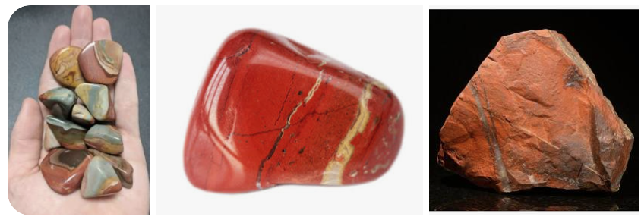
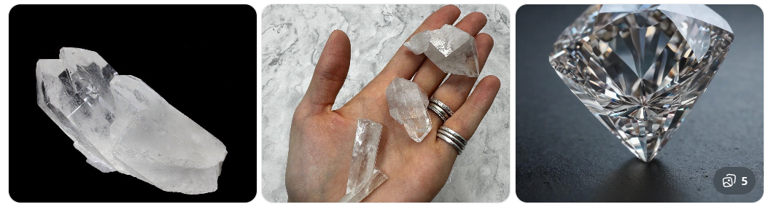
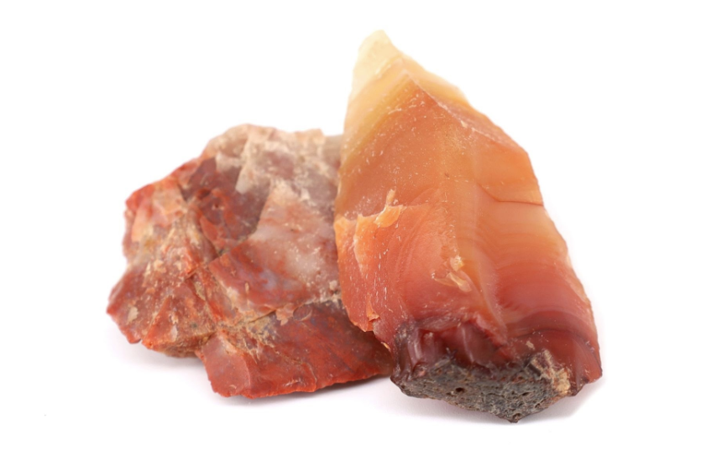
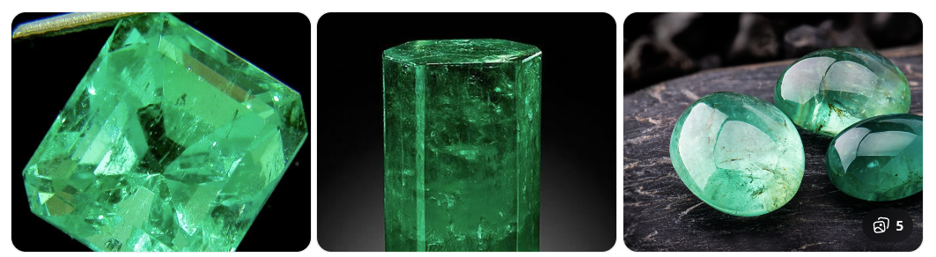
^{4:3} And he who sat there had the appearance of jasper and carnelian, and around the throne was a rainbow that had the appearance of an emerald. (ESV)
Jasper — Iaspis (ἴασπις)
Modern Jasper: | Ancient Jasper (cf. Rev 21:11):
Carnelian — Sardion (σάρδιον)
Emerald — Smaragdinos (σμαράγδινος)

Slide 15
^{4:3} And he who sat there had the appearance of jasper and carnelian, and around the throne was a rainbow that had the appearance of an emerald. (ESV)
All three of the stones mentioned here appear in the high priest's breastplate (Exod. 28:17–20) and recur in the description of the New Jerusalem (Rev. 21:11, 18–19), perhaps suggesting that the glory of God persists from the Old Covenant, through John’s day and on into the new creation.
The rainbow encircling the throne reminds us of God's covenant with Noah (Gen. 9:13–16), and most commentators see here at minimum an allusion to divine faithfulness and mercy even as judgments unfold.
Or the point of the rainbow may simply be, along with the stones, to illustrate pictorially the profound beauty and loveliness of the glory of God.
Together, Revelation 4:1–3 sets the stage for all that follows: John is granted access to the timeless, heavenly perspective from which all of history and all coming events must be understood.
God reigns — transcendent, glorious, and faithful — and every judgment, every mercy, and every act of redemption proceeds from his throne.

Slide 16
^{4:4} Around the throne were twenty-four thrones, and seated on the thrones were twenty-four elders, clothed in white garments, with golden crowns on their heads. (ESV)
In John’s vision of heaven, God’s “throne” remains the center of everything.
“Around” God's central throne are “twenty-four thrones” occupied by the “twenty-four elders”, all clothed in “white garments” and wearing “golden crowns”.
The picture emphasizes that, although other thrones exist in heaven, none rival God’s authority.
The elders surround His throne, showing that all authority derives from and is subordinate to Him.
The identity of the “twenty-four elders” is one of the most debated questions in Revelation.
Many commentators, including Schreiner, Beale, and Mounce, believe the elders are exalted heavenly beings or angelic representatives of God’s people.
They note that the elders are consistently associated with heavenly creatures and angels, appear continually in God’s presence, and sometimes seem distinct from redeemed believers (Rev. 5:9–10; 7:9–17; 14:3).

Slide 17
^{4:4} Around the throne were twenty-four thrones, and seated on the thrones were twenty-four elders, clothed in white garments, with golden crowns on their heads. (ESV)
Other commentaries argue that the elders represent redeemed humanity, especially the people of God viewed in their glorified state.
A common mediating view is that the elders are heavenly representatives of God’s people rather than the people themselves.
The number “twenty-four” is also interpreted in different ways.
Some connect it with the twelve tribes of Israel plus the twelve apostles (Rev. 21:12–14), symbolizing the complete people of God across both covenants.
Others see an allusion to the twenty-four divisions of priests and Levites established by David (1 Chron. 24–25), suggesting a priestly worship setting in heaven.

Slide 18
^{4:4} Around the throne were twenty-four thrones, and seated on the thrones were twenty-four elders, clothed in white garments, with golden crowns on their heads. (ESV)
The elders’ clothing and crowns are significant.
“white garments” symbolize purity, holiness, and victory (Rev. 3:4–5), while “golden crowns” signify royal authority and reward.
These blessings mirror promises given to faithful believers throughout Revelation (Rev. 2:10; 3:5, 21), which would indicate that the elders either represent believers directly or perhaps symbolize them in some way.
Thus, the important thing to understand about the “twenty-four elders” is not so much who they are (we’re not told!), but what they portray: the destiny of God’s faithful people: holiness, victory, and participation in Christ’s reign.

Slide 19
^{4:5} From the throne came flashes of lightning, and rumblings and peals of thunder, and before the throne were burning seven torches of fire, which are the seven spirits of God… (ESV)
Verse 5 shifts attention back to God’s throne itself.
From the throne come “flashes of lightning, and rumblings and peals of thunder.”
These images are reminiscent of God’s appearance at Mount Sinai (Exod. 19:16; 20:18), where thunder, lightning, fire, and smoke revealed His awesome holiness.
The scene reminds readers that God is not merely comforting and merciful; He is also majestic, powerful, and fearsome in His holiness.
These same phenomena reappear later in Revelation (8:5; 11:19; 16:18) at crucial moments of divine judgment.
Thus the lightning and thunder in John’s vision serve as signs that God’s judgments proceed from His throne and that He remains sovereign over history and human affairs.

Slide 20
^{4:5} From the throne came flashes of lightning, and rumblings and peals of thunder, and before the throne were burning seven torches of fire, which are the seven spirits of God… (ESV)
Before the throne burn “seven torches [or “lamps” – see KJV, NIV] of fire”, identified as “the seven spirits of God.”
Most commentators understand this as a symbolic description of the Holy Spirit in His fullness and perfection, drawing on imagery from Zechariah 4:2–6 (where “seven lamps” = the Spirit's empowering presence) and Isaiah 11:2 (where a sevenfold description is given to describe the Spirit's perfect fullness).
A minority view, represented by Mounce and some others, interprets the seven spirits as a high order of angels.
The majority, however, sees the seven lamps as portraying the fullness of the Holy Spirit, whose presence, holiness, purity, and power fill God’s heavenly temple.
Overall, Revelation 4:4–5 presents a heavenly court centered on God’s sovereign throne, surrounded by representatives of His people, and illuminated by the fullness of His Spirit.
The scene prepares readers for the worship and judgments that will unfold throughout the rest of the book.

Slide 21
^{4:6} and before the throne there was as it were a sea of glass, like crystal. And around the throne, on each side of the throne, are four living creatures, full of eyes in front and behind: ⁷ the first living creature like a lion, the second living creature like an ox, the third living creature with the face of a man, and the fourth living creature like an eagle in flight. (ESV)
Before God's throne stretches what John describes as “a sea of glass, like crystal”.
Most commentators agree this glassy expanse communicates the transcendence and awesome majesty of God — a vast, shimmering barrier between the Creator and creation.
Mounce helpfully pictures it as reflecting the flashing, many-colored light from the throne (cf. 4:3, 5a), creating an overwhelming sense of God's separateness from all he has made.
The imagery draws most directly on Ezekiel 1:22, where the prophet sees “the likeness of an expanse, shining like awe-inspiring crystal” spread above the living creatures in Ezekiel’s vision.

Slide 22
^{4:6} and before the throne there was as it were a sea of glass, like crystal. And around the throne, on each side of the throne, are four living creatures, full of eyes in front and behind: ⁷ the first living creature like a lion, the second living creature like an ox, the third living creature with the face of a man, and the fourth living creature like an eagle in flight. (ESV)
Around the throne are “four living creatures” who stand in God’s presence.
Their appearance combines features from Ezekiel’s living creatures/cherubim (Ezekiel 1; 10) and Isaiah’s seraphim (Isaiah 6:1–3).
Unlike Ezekiel’s creatures, each creature in Revelation has only one face rather than four, and each has “six wings” (see vs. 8) like Isaiah’s seraphim.
The four creatures resemble a “lion”, an “ox”, a “man”, and an “eagle in flight”.
Most commentators understand these figures as representing the highest forms of earthly life: the lion among wild animals, the ox among domesticated animals, the eagle among birds, and man as the crown of creation.
Together they symbolize the whole created order worshiping and serving God.
The creatures are covered with “eyes”, both “in front and behind”. This imagery symbolizes vigilance, knowledge, and constant awareness. Nothing escapes their notice.

Slide 23
^{4:8} And the four living creatures, each of them with six wings, are full of eyes all around and within, and day and night they never cease to say, “Holy, holy, holy, is the Lord God Almighty, who was and is and is to come!” (ESV)
“day and night”, without ceasing, “the four living creatures” cry: “Holy, holy, holy, Lord God Almighty, who was and is and is to come.”
This is the first of Revelation's great hymns, echoing the seraphim of Isaiah 6:3.
The threefold repetition of “holy” is the strongest form of emphasis available in Hebrew — God is not merely holy but maximally, infinitely holy, utterly distinct from all creation.
In addition to being “holy” he is called “the Lord God Almighty” a title appearing seven times in Revelation (1:8; 4:8; 11:17; 15:3; 16:7; 19:6; 21:22).
The final phrase — “who was and is and is to come” — affirms God's sovereignty over all history, past, present, and future.
These hymns are meant to fortify believers against imperial pressure, reminding the persecuted church that their loyalty belongs to the one on the heavenly throne, not to any earthly emperor.

Slide 24
^{4:9} And whenever the living creatures give glory and honor and thanks to him who is seated on the throne, who lives forever and ever... (ESV)
Revelation 4:9–11 presents one of Scripture's most magnificent portraits of heavenly worship.
The passage begins with the four “living creatures” offer “glory and honor and thanks” to the One seated on the throne.
These three expressions emphasize different aspects of worship.
“Glory” recognizes God's greatness and majesty, “honor” acknowledges His rightful place above all others, and “thanks” expresses gratitude for all He has done, including giving life itself.
The worship is directed to the One who “lives forever and ever,” highlighting God's eternal nature.
Unlike earthly rulers whose reigns are temporary, God's kingdom never ends (Dan. 4:34; Dan. 6:26–27; Dan. 12:7).

Slide 25
^{4:10} the twenty-four elders fall down before him who is seated on the throne and worship him who lives forever and ever. They cast their crowns before the throne, saying, ¹¹ “Worthy are you, our Lord and God, to receive glory and honor and power, for you created all things, and by your will they existed and were created.” (ESV)
In response, “the twenty-four elders” fall before God and “cast their crowns before [His] throne”.
This act symbolizes complete submission and recognition that any authority, honor, or victory they possess comes from God and belongs ultimately to Him.
In the ancient world kings and rulers sometimes laid crowns before a greater ruler as a sign of loyalty and dependence.
The elders therefore acknowledge that whatever authority they (or any other creature) has is delegated to them by God alone.

Slide 26
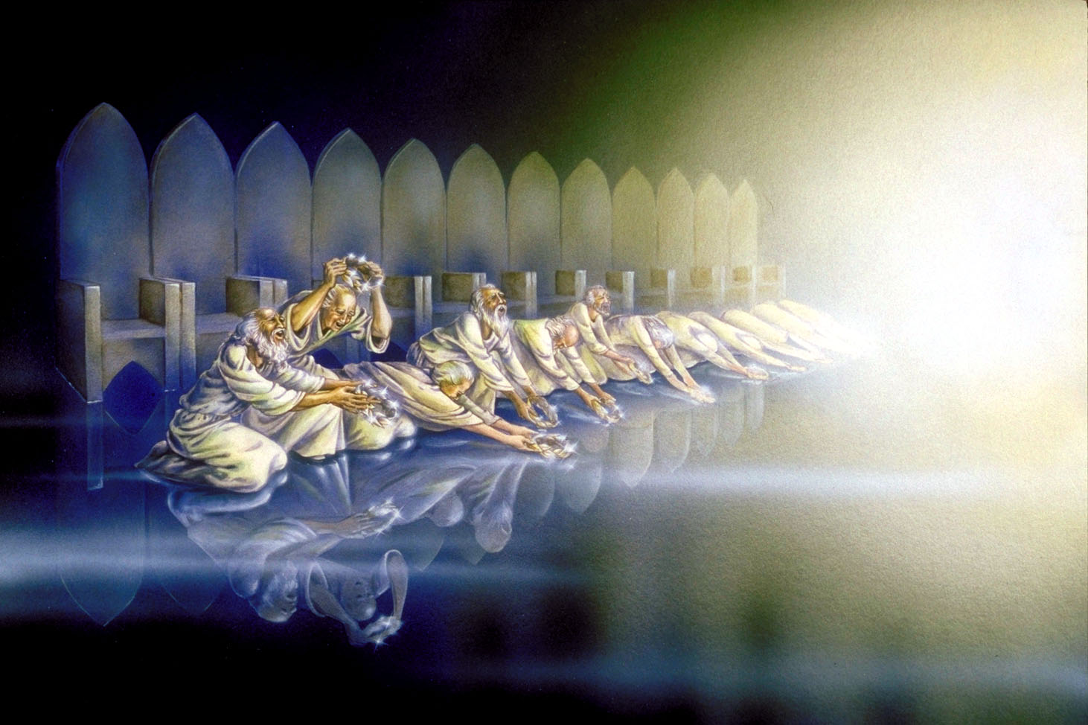
^{4:10} the twenty-four elders fall down before him who is seated on the throne and worship him who lives forever and ever. They cast their crowns before the throne, saying, ¹¹ “Worthy are you, our Lord and God, to receive glory and honor and power, for you created all things, and by your will they existed and were created.” (ESV)
Pat Marvenko Smith. Revelation Illustrated: An Artist's View of the Bible's Last Book (1982)

Slide 27
^{4:10} the twenty-four elders fall down before him who is seated on the throne and worship him who lives forever and ever. They cast their crowns before the throne, saying, ¹¹ “Worthy are you, our Lord and God, to receive glory and honor and power, for you created all things, and by your will they existed and were created.” (ESV)
The elders then proclaim, “Worthy are you, our Lord and God, to receive glory and honor and power.”
The language is significant because it deliberately contrasts God's true lordship with the claims of earthly rulers.
Roman emperors, were sometimes addressed with titles such as “Lord and God.”
Revelation counters such claims by declaring that these titles belong only to the God who sits on the heavenly throne.
The reason God is worthy is stated clearly: “for you created all things, and by your will they existed and were created.”

Slide 28
^{4:11} “Worthy are you, our Lord and God, to receive glory and honor and power, for you created all things, and by your will they existed and were created.” (ESV)
Here we see that God's worthiness is grounded in His role as Creator.
Everything owes its existence to His will.
The universe is not self-originating, nor is God dependent on creation.
Rather, all things came into being because He willed them to exist (cf. Gen. 1; Isa. 45:12, 18; Jer. 10:11–12; Heb. 11:3).
God not only created the world but continues to sustain it.
Creation still exists because God actively preserves it.
This truth provides comfort to suffering believers: history remains under God's control, and He has not abandoned His throne.

Slide 29
^{4:11} “Worthy are you, our Lord and God, to receive glory and honor and power, for you created all things, and by your will they existed and were created.” (ESV)
Whatever John witnesses hereafter—however terrifying the judgments, however fierce the opposition—believers may confidently trust in God's powerful superintendence of history.
Not only does Christ concern himself with the affairs of his people (1:13–20), but God the Almighty actively controls all things from above history (4:2; cf. Dan. 2:21; 4:35; Rom. 8:28; Eph. 1:11).
The throne vision is not background scenery; it is the theological foundation on which everything else in Revelation stands.
A new and better day is coming, and the God who created all things by his sovereign will is more than able to bring it to pass.

Slide 30

Class Discussion Time
We saw today that the throne room scene was designed, at least in part, to show that regardless of all the horrible things that take place in our fallen world (many of which are represented in the visions that follow in the book of Revelation), God is still on his throne, sovereignly determining the course of history, and through all of it, is worthy of worship by all his created beings – from the greatest to the least of them.
Does this heavenly vision help you put the horrible things that you see taking place in this world (and perhaps in your own personal life) in perspective?

Slide 31
Class Discussion Time
I pointed out in class, that the rainbow is first and foremost God’s symbol.
It appears in Genesis 9 as God promises never again to destroy the whole earth with a flood.
And we see in our passage today, the emerald-colored beauty of the rainbow is invoked to describe the very throne room of God.
What do you think about the fact that the modern LGBT movement has coopted this beautiful symbol as a symbol of their sexual rebellion against the Creation order?

Slide 32
Class Discussion Time
We saw in verse 9 that the four “living creatures” offer “glory and honor and thanks” to the One seated on the throne.
I then explained that:
  “glory” recognizes God's greatness and majesty
  “honor” acknowledges His rightful place above all others
  “thanks” expresses gratitude for all He has done, including giving life itself
They then go on to praise God’s eternality: “to him who is seated on the throne, who lives forever and ever”
Might there be some examples here of how we can (and perhaps should) worship God in our prayers?
If so, what are your take aways from this?

