Slide 1
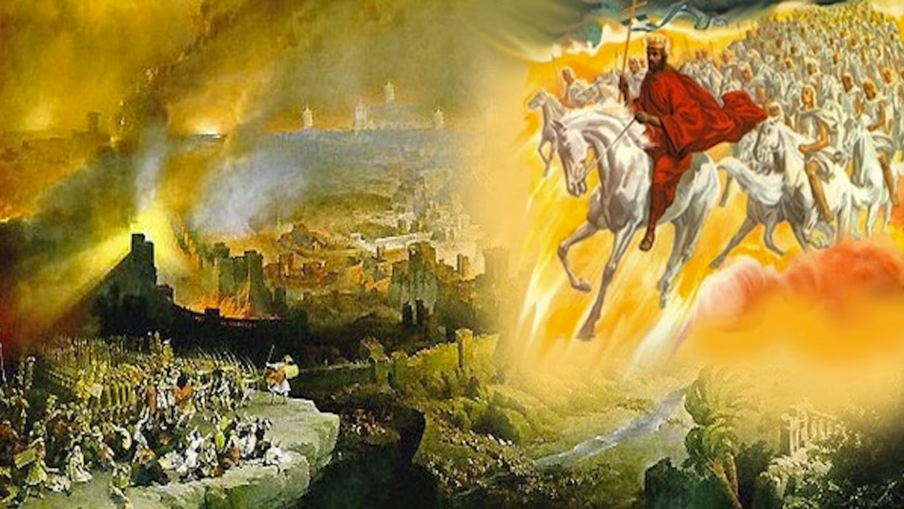
The Book of Revelation
Image credit – https://www.bible.com/events/84698
“The kingdom of the world has become the kingdom of our Lord and of His Christ,
and He shall reign forever and ever.” (Revelation 11:15)
Class Recording and Notes Will Be Available on https://www.purifiedbyfaith.com/

Slide 2
High Level Outline of the Book of Revelation
Introduction (1:1-8)
Jesus Among the Seven Churches (1:9-20)
Letters to the Seven Churches: (Chapters 2-3)
The Throne of God and the Lamb (Chapters 4-5)
Three Sets of Divine Judgments (6:1-16:21)
  Seven Seals (6:1-17; 8:1)
  Interlude: Sealing of the 144,000 (7:1-17)
  Seven Trumpets (8:2-11:19)
  Interlude: Persecution, Deliverance and Judgment (Chapters 12–14)
  Seven Bowls (Chapters 15–16)
The Fall of Babylon (17:1-19:10)
The Last Battle (19:11-20:15)
The Marriage of Heaven and Earth (21:1-22:5)
Epilogue (22:6-21)

Slide 3
Introduction to the Seven Seals (Rev. 6:1–8:1)
Following the heavenly throne room vision of chapters 4–5 , Revelation 6:1–8:1 depicts the progressive opening of the seven seals of God's scroll by Jesus, the Lamb:
  The first four seals, which we will be covering today, form a distinct literary unit featuring the iconic Four Horsemen (6:1-8)
  Followed the fifth and sixth seals. (6:9-17)
  John then introduces a dramatic interlude in chapter 7 to provide comfort regarding God's (144,000) protected people. (7:1-17)
  After this the seventh seal is broken, resulting in a solemn, half-hour silence in heaven that transitions into the seven trumpet judgments. (8:1)
Many of the images used in these seal judgments is heavily rooted in the Old Testament.
The Four Horsemen draw directly from the colored horses and chariots patrolling the earth in Zechariah 1:8–11 and 6:1–8.
In addition, the explicit listing of sword, famine, pestilence, and wild beasts acts as a summary of the classic corporate judgments outlined in Ezekiel 14:12–21 and the sevenfold covenant curses threatened in Leviticus 26:18–28.

Slide 4
Introduction to the Seven Seals (Rev. 6:1–8:1)
There are a number of differences between commentators on how the judgments unleashed by these seals are to be understood.
One disagreement concerns the relationship between the seals and the scroll itself.
At least one commentary (Mounce) contends that the scroll cannot truly be opened until all seven seals are removed, making the seal judgments preliminary to the scroll’s contents.
While I can appreciate that is how an actual scroll would have worked in the ancient world, it seems clear (and most commentaries agree) that the contents of the scroll are progressively revealed and enacted as each seal is broken.

Slide 5
Introduction to the Seven Seals (Rev. 6:1–8:1)
The primary disagreement among commentators involves the historical timing of when these judgments take place.
Futurist interpreters teach that the judgments in these seals take place in a future end-times period, thousands of years after John wrote these things.
A good number of other commentaries argue that the judgments in these seals describe conditions that characterize a wide period of human history – from John’s day until the second coming of Christ.
I believe it is best to understand these judgments as having taken place “near” (cf. Rev 1:3; 22:10) the time in which John wrote these things, because John himself tells us that God gave him this revelation to “show to his servants the things that must soon take place. ” (Rev 1:1; 22:6).

Slide 6
Introduction to the Seven Seals (Rev. 6:1–8:1)
Furthermore, I believe that the judgments associated with these seven seals in Rev. 6 are the same judgments that Jesus prophesied in a sermon given just prior to his crucifixion, known as the Olivet Discourse.
We find this sermon of Jesus recorded in all three of the synoptic Gospels (Mat 24-25; Mark 13; Luke 21:5-36).
In that sermon, Jesus prophesies a number of future events, including a series of events which he tells his audience would occur before the “generation” of those standing there (in A.D. 30) had passed away (Mat 24:34).

Slide 7
Introduction to the Seven Seals (Rev. 6:1–8:1)
Specifically, Jesus prophesied that within the lifetime of those standing there, the Roman armies would:
  Lay siege to the city of Jerusalem (Luke 21:20)
  And would eventually tear down the temple complex to such an extent that “there will not be left… one stone upon another that will not be thrown down” (Mat 24:2)
  We now know historically that these judgments came upon the city of Jerusalem in A.D. 70 which is:
    Within the lifetime of those hearing Jesus prophecy about those judgments in the Olivet Discourse (given in A.D. 30)
    And also “near” (cf. Rev 1:3; 22:10) the time that John predicted these judgments in the book of Revelation (written between A.D. 65 and A.D. 66) and told his readers that they “must soon take place” (Rev 1:1; 22:6).

Slide 8
Comparison of The Seal Judgments and Olivet Discourse
The Six Seals of Revelation | The Olivet Discourse
Seal #1: War | And you will hear of wars and rumors of wars (Mat 24:6 )
Seal #2: Violent Conflict, Loss of Peace | nation will rise against nation (Mat 24:7 )
Seal #3: Famine | there will be famines (Mat 24:7 )
Seal #4: Pestilence | there will also be plagues, terrors (Luke 21:11)
Seal #5: Persecu­tion | they will deliver you up to tribulation and put you to death, and you will be hated by all nations for my name's sake (Mat 24:9)
Seal #6: I looked, and behold, there was a great earthquake, and the sun became black as sackcloth, the full moon became like blood, and the stars of the sky fell to the earth (Rev 6:12-13) everyone, slave and free, hid themselves in the caves and… calling to the mountains and rocks, “Fall on us and hide us from… the wrath of the Lamb” (Rev 6:15-16) | there will be… earthquakes in various places (Mat 24:7) there will be signs in sun and moon and stars (Luke 21:25) people fainting with fear… of what is coming on the world (Luke 21:26)
Gentry, Kenneth. The Divorce of Israel; Volume 1; (2024)

Slide 9
Introduction to the Four Horsemen (Rev. 6:1-8)
The opening of the first four seals in Revelation 6:1–8 introduces the famous and sobering image of what is commonly known as the Four Horsemen of the Apocalypse.
Brought forth sequentially as the Lamb breaks each seal, these figures represent the unfolding of history under God's sovereign control.
The sequence is initiated by the Lamb breaking the seals, each of which prompts one of the four living creatures to thunderously command the rider described in that seal to “Come!”

Slide 10
Introduction to the Four Horsemen (Rev. 6:1-8)
As I pointed out earlier, these images bring to mind Zechariah 1 and 6, where colored horses are sent to patrol the earth.
However, there is some variation in how the symbols are used:
  Zechariah’s patrols simply report on the state of the nations,
  The horsemen in Revelation actively execute judgments.
While the commentaries share a common understanding of the passage's overall gravity, they differ significantly over such things as the identities of the riders, the historical timing, and the specific nature of the judgments.

Slide 11
The Four Horsemen (6:1–8)
^{6:1} I watched as the Lamb opened the first of the seven seals. Then I heard one of the four living creatures say in a voice like thunder, “Come!” ² I looked, and there before me was a white horse! Its rider held a bow, and he was given a crown, and he rode out as a conqueror bent on conquest. ³ When the Lamb opened the second seal, I heard the second living creature say, “Come!” ⁴ Then another horse came out, a fiery red one. Its rider was given power to take peace from the earth and to make men slay each other. To him was given a large sword.

Slide 12
The Four Horsemen (6:1–8)
^{6:5} When the Lamb opened the third seal, I heard the third living creature say, “Come!” I looked, and there before me was a black horse! Its rider was holding a pair of scales in his hand. ⁶ Then I heard what sounded like a voice among the four living creatures, saying, “A quart of wheat for a day's wages, and three quarts of barley for a day's wages, and do not damage the oil and the wine!” ⁷ When the Lamb opened the fourth seal, I heard the voice of the fourth living creature say, “Come!” ⁸ I looked, and there before me was a pale horse! Its rider was named Death, and Hades was following close behind him. They were given power over a fourth of the earth to kill by sword, famine and plague, and by the wild beasts of the earth. (NIV)

Slide 13
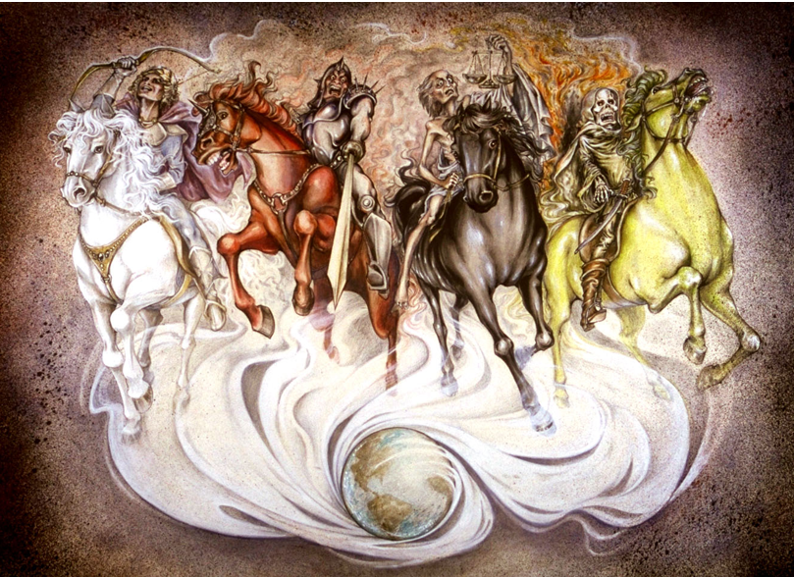
The Four Horsemen (6:1–8)
Pat Marvenko Smith. Revelation Illustrated: An Artist's View of the Bible's Last Book (1982)

Slide 14
^{6:1} Now I watched when the Lamb opened one of the seven seals, and I heard one of the four living creatures say with a voice like thunder, “Come!” ² And I looked, and behold, a white horse! And its rider had a bow, and a crown was given to him, and he came out conquering, and to conquer. (ESV)
The identity of the first rider on the “white horse”—carrying a “bow” and wearing a “crown”—is one of the most heavily disputed aspects of this section.
The commentaries fall into two primary camps as to who this figure represents:
  Jesus Christ and/or the Gospel
  Military Conquest or War

Slide 15
^{6:1} Now I watched when the Lamb opened one of the seven seals, and I heard one of the four living creatures say with a voice like thunder, “Come!” ² And I looked, and behold, a white horse! And its rider had a bow, and a crown was given to him, and he came out conquering, and to conquer. (ESV)
Jesus Christ and/or the Gospel:
  Schreiner and many older interpreters argue that the “white horse” represents Christ and the victorious spread of the gospel.
  This view is supported by the explicit identification of Jesus on a white horse in Revelation 19:11 and the consistently positive, holy associations of the color “white” throughout the book.
  In this view, the phrase describing this rider as “conquering, and to conquer” emphasizes the unstoppable, global triumph of the gospel message despite worldly opposition.
  While these things are true about Jesus and the triumph of the gospel, I do not believe that idea fits well with the other three horsemen – all of which bring suffering, death, and/or destruction.

Slide 16
^{6:1} Now I watched when the Lamb opened one of the seven seals, and I heard one of the four living creatures say with a voice like thunder, “Come!” ² And I looked, and behold, a white horse! And its rider had a bow, and a crown was given to him, and he came out conquering, and to conquer. (ESV)
Military Conquest or War:
  Carson, Beale, and many modern commentators interpret the white horse as militarism and aggressive imperial conquest.
  But then the question becomes, historically what specific imperial conquest is in view here? Below is a summary of the three main perspectives for this horseman:
Futurist
The rise of the future Antichrist, who initially conquers through diplomacy, deception, or political power during the Tribulation.
Historicist
The early military victories and expansion of the Roman Empire, especially during its period of greatest strength and conquest.
Idealist
The recurring human drive toward conquest and domination throughout history.

Slide 17
^{6:1} Now I watched when the Lamb opened one of the seven seals, and I heard one of the four living creatures say with a voice like thunder, “Come!” ² And I looked, and behold, a white horse! And its rider had a bow, and a crown was given to him, and he came out conquering, and to conquer. (ESV)
Military Conquest or War:
  I believe the best way to understand this passage is the preterist view as explained by Kenneth Gentry:
  I see the white horse as representing war, specifically the military developments leading to Jerusalem's destruction in A.D. 70.
  This horseman launches the series of judgments that will eventually bring devastation upon Israel.
  Taking the imagery in this way fits well with Jesus' Olivet Discourse, where wars and military upheavals are among the signs preceding Jerusalem's fall (Matt. 24:6–7; Mark 13:7–8; Luke 21:9–10).
Gentry, Kenneth. The Divorce of Israel; Volume 1; (2024)

Slide 18
^{6:3} When he opened the second seal, I heard the second living creature say, “Come!” ⁴ And out came another horse, bright red. Its rider was permitted to take peace from the earth, so that people should slay one another, and he was given a great sword. (ESV)
The “second” horse is “bright red”.
Its rider is given power to take peace from the earth so that people slaughter one another.
A “great sword” (machaira) is given to him.
Virtually all commentators agree that this horse symbolizes violent conflict.
The “red” color naturally suggests bloodshed.
The rider removes “peace” and unleashes widespread violence.
Some distinguish this rider from the first by seeing the first horse as organized conquest and the second as civil unrest, revolution, or social breakdown.
Carson especially emphasizes this distinction: the first rider represents conquering armies, while the second represents people turning on one another in violent internal conflict.

Slide 19
^{6:3} When he opened the second seal, I heard the second living creature say, “Come!” ⁴ And out came another horse, bright red. Its rider was permitted to take peace from the earth, so that people should slay one another, and he was given a great sword. (ESV)
But again, then the question becomes, historically when did this widespread violence and civil unrest occur?
Below is a summary of the three main perspectives for this horseman:
Futurist
Widespread warfare that breaks out during the future Tribulation after the Antichrist's initial rise.
Historicist
The civil wars, revolts, and internal bloodshed that weakened the Roman Empire after its early expansion.
Idealist
The continual reality of war, violence, and bloodshed that afflicts humanity in every age.

Slide 20
^{6:3} When he opened the second seal, I heard the second living creature say, “Come!” ⁴ And out came another horse, bright red. Its rider was permitted to take peace from the earth, so that people should slay one another, and he was given a great sword. (ESV)
I see the judgments that accompany this seal fulfilled in the social and political chaos that accompanied the Roman siege of Jerusalem in A.D. 70.
When you read the historical accounts of Josephus, you see that the suffering and devastation that occurred during the Roman siege of Jerusalem was a result of more than just Roman aggression.
Jerusalem was torn apart by factional violence, civil strife, and internal bloodshed before the city finally fell.
Thus, this “second seal” intensifies the first: conquest from without is accompanied by collapse from within.
Gentry, Kenneth. The Divorce of Israel; Volume 1; (2024)

Slide 21
^{6:5} When he opened the third seal, I heard the third living creature say, “Come!” And I looked, and behold, a black horse! And its rider had a pair of scales in his hand. ⁶ And I heard what seemed to be a voice in the midst of the four living creatures, saying, “A quart of wheat for a denarius, and three quarts of barley for a denarius, and do not harm the oil and wine!” (ESV)
The third rider sits on a “black horse” and carries “a pair of scales in his hand”.
A voice announces: “A quart of wheat for a denarius, and three quarts of barley for a denarius, and do not harm the oil and wine!”
The “scales” symbolize rationing and scarcity.
A “denarius” was a day's wage, yet it purchases only enough grain for basic survival (“a quart of wheat ” or “three quarts of barley”).

Slide 22
^{6:5} When he opened the third seal, I heard the third living creature say, “Come!” And I looked, and behold, a black horse! And its rider had a pair of scales in his hand. ⁶ And I heard what seemed to be a voice in the midst of the four living creatures, saying, “A quart of wheat for a denarius, and three quarts of barley for a denarius, and do not harm the oil and wine!” (ESV)
Clearly famine and severe economic hardship are in view.
Food prices have become many times higher than normal, making survival difficult.
The phrase “do not harm the oil and wine!” is interpreted in several ways:
  Some see it as evidence that the wealthy continue to enjoy luxuries while the poor suffer.
  Others view it as a limitation on the judgment, showing that God's wrath is severe but restrained.
  Carson favors the idea that the devastation is significant but not yet total; worse judgments remain to come.

Slide 23
^{6:5} When he opened the third seal, I heard the third living creature say, “Come!” And I looked, and behold, a black horse! And its rider had a pair of scales in his hand. ⁶ And I heard what seemed to be a voice in the midst of the four living creatures, saying, “A quart of wheat for a denarius, and three quarts of barley for a denarius, and do not harm the oil and wine!” (ESV)
So, when historically did the famine and severe economic hardship spoken of here occur?
Below is a summary of the three main perspectives for this horseman:
Futurist
Severe famine and economic collapse during the future Tribulation, often viewed as a consequence of war.
Historicist
Economic hardship, scarcity, oppressive taxation, and famine experienced during various stages of Roman decline.
Idealist
The recurring conditions of scarcity, poverty, famine, and economic inequality found throughout human history.

Slide 24
^{6:5} When he opened the third seal, I heard the third living creature say, “Come!” And I looked, and behold, a black horse! And its rider had a pair of scales in his hand. ⁶ And I heard what seemed to be a voice in the midst of the four living creatures, saying, “A quart of wheat for a denarius, and three quarts of barley for a denarius, and do not harm the oil and wine!” (ESV)
I believe this is a description of the conditions that developed during the siege of Jerusalem in A.D. 70.
As supplies dwindled and normal commerce collapsed, food became desperately scarce.
The famine imagery echoes both Old Testament covenant curses and Jesus' prediction of famines in the Olivet Discourse.
Regarding the command to “not harm the oil and wine”, I believe this phrase shows that God is restraining the devastation at this stage.
Wheat and barley are expensive, but more judgment is coming.
This fits the broader pattern of Revelation, where judgments increase progressively in severity.
Gentry, Kenneth. The Divorce of Israel; Volume 1; (2024)

Slide 25
^{6:7} When he opened the fourth seal, I heard the voice of the fourth living creature say, “Come!” ⁸ And I looked, and behold, a pale horse! And its rider's name was Death, and Hades followed him. And they were given authority over a fourth of the earth, to kill with sword and with famine and with pestilence and by wild beasts of the earth. (ESV)
The final horse is “pale” or sickly green, the color of a corpse.
Its rider is named “Death”, and “Hades” (= the abode of the dead) follows behind.
This rider gathers together the effects of the previous judgments.
“Death” is said here to come through “sword”, “famine”, “pestilence”, and “wild beasts”.
The fourfold killing mechanism—sword, famine, pestilence, and wild beasts—are a direct echo of Ezekiel 14:21, where God threatened Jerusalem in that day with these same judgments.
“Death, and Hades” are not independent powers. Authority is “given” to them to operate only within the limits established by God.
Their judgment reaches only “a fourth of the earth”, demonstrating that God's judgment is real but still restrained at this point.

Slide 26
^{6:7} When he opened the fourth seal, I heard the voice of the fourth living creature say, “Come!” ⁸ And I looked, and behold, a pale horse! And its rider's name was Death, and Hades followed him. And they were given authority over a fourth of the earth, to kill with sword and with famine and with pestilence and by wild beasts of the earth. (ESV)
So, when historically was “Death, and Hades” unleashed over a “fourth of the earth” through sword, famine, pestilence, and wild beasts?
Below is a summary of the three main perspectives for this horseman:
Futurist
Massive death through war, famine, disease, and other disasters during the future Tribulation period.
Historicist
The widespread death, pestilence, and societal collapse that accompanied the later deterioration of the Roman Empire.
Idealist
Death as the inevitable companion of war, disease, famine, and suffering in a fallen world throughout the church age.

Slide 27
^{6:7} When he opened the fourth seal, I heard the voice of the fourth living creature say, “Come!” ⁸ And I looked, and behold, a pale horse! And its rider's name was Death, and Hades followed him. And they were given authority over a fourth of the earth, to kill with sword and with famine and with pestilence and by wild beasts of the earth. (ESV)
I would see the judgments that come with the fourth seal as describing some of the horrors experienced by the Jews in Jerusalem during and immediately after the Roman siege of the city in AD 70 .
“famine” and “pestilence” are known to have taken place during the siege.
“wild beasts” could be a reference to the fact that, according to Josephus, the dead during the siege piled up faster than they could be buried, were thrown over the walls into the Kidron Valley, and were left exposed to scavengers, thus fulfilling a judgment that the Lord said in Deut 28:26 would come upon those who disobeyed him: “And your dead body shall be food for all birds of the air and for the beasts of the earth, and there shall be no one to frighten them away.”
Authority is given over only a “fourth of the land [earth]”.
Gentry cites a source indicating that, counting Passover pilgrims who had flooded into Jerusalem for the feast and then found themselves trapped by the encircling Roman army, the city's population during the siege may have approached something like a quarter of the nation's total population.
Gentry, Kenneth. The Divorce of Israel; Volume 1; (2024)

Slide 28

Class Discussion Time
In my discussion of the six seals described in Revelation 6:1-8:1 I said that I believed that the judgments associated with those seals were the same judgments that Jesus described in the Olivet Discourse for two reasons:
  The judgments in each case would have occurred around the same timeframe (A.D. 70)
  The descriptions of the judgments are very similar and fit well with the events that occurred with the Fall of Jerusalem in A.D 70
What do you think? Do you think I’ve made a good case here?

Slide 29
Class Discussion Time
As I went through each of the judgments associated with the Four Horseman of the Apocalypse I explained how each of these judgments would be identified historically by four most common views taken by commentaries writing about the judgments found in the book of Revelation:
  The Futurist View – that these things take place at some future time (even to us) and thus occurred thousands of years after the time when John was writing.
  The Historicist View – that these things take place over a long period of history, starting with Roman Empire and potentially continuing until Christ’s Return.
  The Idealist View – That the judgments are just general descriptions of things that happen over and over throughout history.
  The Preterist View (which is my view) – that these are descriptions of judgments that will be taking place very “near” the time John is writing and mostly describe events that occurred around A.D. 70 when the city of Jerusalem fell at the hand of the Romans.
Which of these views do you find most persuasive and why?
What would you say are the strong points and weak points of each of these four views?

