Slide 1
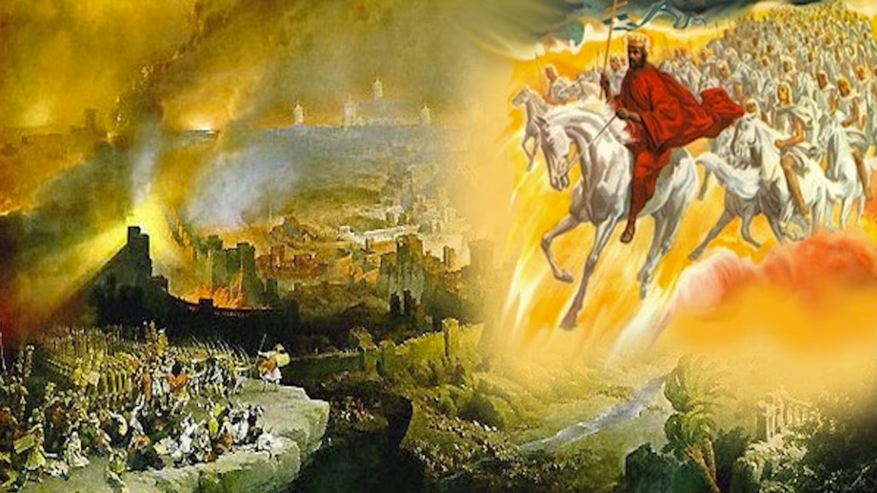
The Book of Revelation
Image credit – https://www.bible.com/events/84698
“The kingdom of the world has become the kingdom of our Lord and of His Christ,
and He shall reign forever and ever.” (Revelation 11:15)
Class Recording and Notes Will Be Available on https://www.purifiedbyfaith.com/

Slide 2
High Level Outline of the Book of Revelation
Introduction (1:1-8)
Jesus Among the Seven Churches (1:9-20)
Letters to the Seven Churches: (Chapters 2-3)
The Throne of God and the Lamb (Chapters 4-5)
Three Sets of Divine Judgments (6:1-16:21)
  Seven Seals (6:1-17; 8:1)
  Interlude: Sealing of the 144,000 (7:1-17)
  Seven Trumpets (8:2-11:19)
  Interlude: Persecution, Deliverance and Judgment (Chapters 12–14)
  Seven Bowls (Chapters 15–16)
The Fall of Babylon (17:1-19:10)
The Last Battle (19:11-20:15)
The Marriage of Heaven and Earth (21:1-22:5)
Epilogue (22:6-21)

Slide 3
Brief Review of the Seven Seals (Rev. 6:1–8:1)
We are currently looking at the opening of the seven seals of God's scroll by Jesus, the Lamb:
  Last week we covered the first four seals also known as the Four Horsemen (6:1-8)
  This week we will be looking at the fifth and sixth seals. (6:9-17)
  After this, John will introduce a dramatic interlude in chapter 7 to provide comfort regarding God's (144,000) protected people. (7:1-17)
  Then the seventh seal will be broken, resulting in a solemn, half-hour silence in heaven that transitions into the seven trumpet judgments. (8:1)

Slide 4
Brief Review of the Seven Seals (Rev. 6:1–8:1)
We saw last week that the primary disagreement among commentators involves the historical timing of when the judgments related to the seven seals take place:
  Futurists see these judgments as still future – even to us, and therefore will take place thousands of years after John predicted them
  Historicists see them as playing out over a long period of time
  Idealists see them as describing things that occur over and over throughout time
  I believe these judgments took place during the Roman siege of Jerusalem and destruction of the temple in A.D. 70 – events that take place “near” (cf. Rev 1:3; 22:10) or “soon” (Rev 1:1; 22:6) after John is writing these things (around A.D. 65)
Furthermore, I believe these are the same judgments predicted by Jesus in the Olivet Discourse, which he said would occur before the “generation” of those standing there (in A.D. 30) had passed away (Mat 24:34).

Slide 5
Comparison of The Seal Judgments and Olivet Discourse
The Six Seals of Revelation | The Olivet Discourse
Seal #1: War | And you will hear of wars and rumors of wars (Mat 24:6 )
Seal #2: Violent Conflict, Loss of Peace | nation will rise against nation (Mat 24:7 )
Seal #3: Famine | there will be famines (Mat 24:7 )
Seal #4: Pestilence | there will also be plagues, terrors (Luke 21:11)
Seal #5: Persecu­tion | they will deliver you up to tribulation and put you to death, and you will be hated by all nations for my name's sake (Mat 24:9)
Seal #6: I looked, and behold, there was a great earthquake, and the sun became black as sackcloth, the full moon became like blood, and the stars of the sky fell to the earth (Rev 6:12-13) everyone, slave and free, hid themselves in the caves and… calling to the mountains and rocks, “Fall on us and hide us from… the wrath of the Lamb” (Rev 6:15-16) | there will be… earthquakes in various places (Mat 24:7) there will be signs in sun and moon and stars (Luke 21:25) people fainting with fear… of what is coming on the world (Luke 21:26)
Gentry, Kenneth. The Divorce of Israel; Volume 1; (2024)

Slide 6
The Fifth Seal (6:9-11)
^{6:9} When he opened the fifth seal, I saw under the altar the souls of those who had been slain because of the word of God and the testimony they had maintained. ¹⁰ They called out in a loud voice, "How long, Sovereign Lord, holy and true, until you judge the inhabitants of the earth and avenge our blood?" ¹¹ Then each of them was given a white robe, and they were told to wait a little longer, until the number of their fellow servants and brothers who were to be killed as they had been was completed. (NIV)

Slide 7
^{6:9} When he opened the fifth seal, I saw under the altar the souls of those who had been slain for the word of God and for the witness they had borne. (ESV)
The opening of the “fifth seal” introduces a poignant martyr scene that acts as a literary and spiritual counterweight to the devastating horrors unleashed by the first four horsemen.
This vision does not represent a new chronological event succeeding the prior judgments, but rather offers divine encouragement and vindication for Christians enduring intense first-century tribulation at the hands of those on whom God will soon be bringing the kinds of judgments mentioned in the first four seals.
This verse mirrors Christ’s statement in the Olivet Discourse concerning the systemic execution of his followers during this pre-AD 70 era:
  Then they will deliver you up to tribulation and put you to death, and you will be hated by all nations for my name's sake. (Matt. 24:9)
  You will be delivered up even by parents and brothers and relatives and friends, and some of you they will put to death. You will be hated by all for my name's sake. (Luk 21:16-17)

Slide 8
^{6:9} When he opened the fifth seal, I saw under the altar the souls of those who had been slain for the word of God and for the witness they had borne. (ESV)
John witnesses “the souls of those who had been slain for the word of God and for the witness they had borne” residing “under the altar”.
This imagery draws directly from the practice of Old Testament sacrifices in the tabernacle and (later) in the temple (Lev. 4:7; 17:11), where the blood—containing the life or soul of the victim—was poured out at the base of the altar.
So, in other wards, the martyrs are symbolically depicted as holy sacrifices whose lives were offered in service to their testimony.

Slide 9
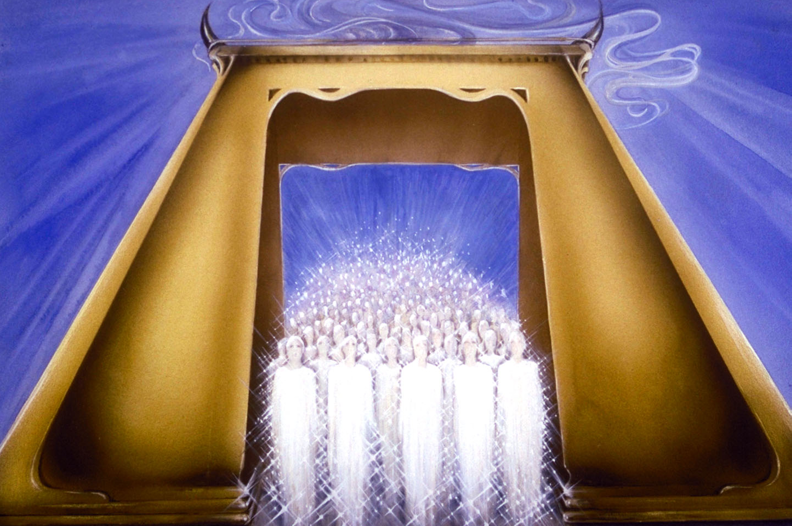
^{6:9} When he opened the fifth seal, I saw under the altar the souls of those who had been slain for the word of God and for the witness they had borne. (ESV)
Pat Marvenko Smith. Revelation Illustrated: An Artist's View of the Bible's Last Book (1982)

Slide 10
^{6:10} They cried out with a loud voice, “O Sovereign Lord, holy and true, how long before you will judge and avenge our blood on those who dwell on the earth?” (ESV)
These souls cry out with a “loud voice,” demanding: “O Sovereign Lord, holy and true, how long before you will judge and avenge our blood on [the inhabitants of the land]?”.
This is not an expression of personal malice or human vindictiveness.
Rather, it functions as a formal judicial plea before the absolute sovereign (despotes) for God to act according to his own holiness, truth, and covenant obligations.
The text brings to mind Gen. 4:10 where the Lord says that the innocent blood of Abel cried out from the ground for divine justice when he was murdered by his brother Cain (Gen. 4:10).

Slide 11
^{6:10} They cried out with a loud voice, “O Sovereign Lord, holy and true, how long before you will judge and avenge our blood on those who dwell on the earth?” (ESV)
Most commentators interpret the phrase translated here as “those who dwell on the earth” as a reference to rebellious humanity in general.
The Greek words behind this phrase can legitimately be translated: “the inhabitants of the land” and in this context I believe that would be a better translation.
I don’t see this as a general reference to all humanity, but a technical term referring primarily to unbelieving Jews living in the “land” of Israel – against whom the Lord will “soon” bring judgment.
In the Old Testament, the Lord uses this exact phrase in a number of passages (Hosea 4:1; Jer 1:14; 6:12; 10:18; Eze 7:7; Joel 1:2,14; 2:1; Zep 1:18) where he is addressing his covenant people as they come under divine judgment:
  Hear the word of the LORD, O children of Israel, for the LORD has a controversy with the inhabitants of the land. (Hos 4:1)

Slide 12
^{6:11} Then they were each given a white robe and told to rest a little longer, until the number of their fellow servants and their brothers should be complete, who were to be killed as they themselves had been. (ESV)
Each martyr then receives a white robe—symbolizing their righteousness, their victory, and God's reversal of the unjust verdict the world rendered against them.
They are told to rest “a little longer” until the full number of their fellow servants about to be killed has been completed.
The word “little” (micros) means exactly what it says: a short period in human terms, pointing to the small number of years remaining before God would act to avenge the deaths of these martyrs (in AD 70).
This is similar to the statement made about this same group by Jesus in the Olivet Discourse where he says:
  And will not God give justice to his elect, who cry to him day and night? Will he delay long over them? I tell you, he will give justice to them speedily… (Luke 18:7–8)

Slide 13
The Sixth Seal (6:12-17)
^{6:12} I watched as he opened the sixth seal. There was a great earthquake. The sun turned black like sackcloth made of goat hair, the whole moon turned blood red, ¹³ and the stars in the sky fell to earth, as late figs drop from a fig tree when shaken by a strong wind. ¹⁴ The sky receded like a scroll, rolling up, and every mountain and island was removed from its place. ¹⁵ Then the kings of the earth, the princes, the generals, the rich, the mighty, and every slave and every free man hid in caves and among the rocks of the mountains. ¹⁶ They called to the mountains and the rocks, “Fall on us and hide us from the face of him who sits on the throne and from the wrath of the Lamb! ¹⁷ For the great day of their wrath has come, and who can stand?” (NIV)

Slide 14
^{6:12} When he opened the sixth seal, I looked, and behold, there was a great earthquake, and the sun became black as sackcloth, the full moon became like blood, ¹³ and the stars of the sky fell to the earth as the fig tree sheds its winter fruit when shaken by a gale. ¹⁴ The sky vanished like a scroll that is being rolled up, and every mountain and island was removed from its place.(ESV)
We come now to the climactic “sixth seal”.
When the Lamb opened the preceding seal, we heard a divine voice comforting the martyrs who had been slain for maintaining their testimony (6:9).
There they were promised that their deaths would be vindicated after a “little while”.
Here, with the opening of the sixth seal, that promised action begins to unfold.
This seal’s judgments are much more catastrophic than the first four.
The first four seals (represented by the four horsemen) brought war, famine, and pestilence, and death upon the earth.
Gentry, Kenneth. The Divorce of Israel; Volume 1; (2024)

Slide 15
^{6:12} When he opened the sixth seal, I looked, and behold, there was a great earthquake, and the sun became black as sackcloth, the full moon became like blood, ¹³ and the stars of the sky fell to the earth as the fig tree sheds its winter fruit when shaken by a gale. ¹⁴ The sky vanished like a scroll that is being rolled up, and every mountain and island was removed from its place.(ESV)
But the imagery used to describe this seal involves natural disasters affecting the very fabric of the cosmos:
  “a great earthquake”
  “the sun became black as sackcloth”
  “the full moon became like blood”
  “stars of the sky fell to the earth”
  “the sky vanished like a scroll that is being rolled up”
  “every mountain and island was removed from its place”
This is apocalyptic, de-creation language: in his righteous anger the God of creation is undoing his creation!
These kinds of images are used in a number of Old Testament passages to describe a situation where God’s judgments have brought cataclysmic death and destruction on a nation that is being judged.

Slide 16
^{6:12} When he opened the sixth seal, I looked, and behold, there was a great earthquake, and the sun became black as sackcloth, the full moon became like blood, ¹³ and the stars of the sky fell to the earth as the fig tree sheds its winter fruit when shaken by a gale. ¹⁴ The sky vanished like a scroll that is being rolled up, and every mountain and island was removed from its place.(ESV)
But when futurists see this kind of language in a passage like this, they insist we must take this language literally.
And since cosmic events of this magnitude have never happened in known human history, they assume these passages must be referring to future events that will occur during a final Great Tribulation prior to the second coming of Christ.
For example, in Matthew 24, where similar apocalyptic language is used, John MacArthur writes in his commentary, “Jesus here describes the heavenly setting of His appearance. The whole universe will begin to disintegrate.... [W]hen the Lord withdraws the least of his power from the universe, nothing in it will function normally, and every aspect of the physical world will be disrupted beyond imagination. ... The heavenly bodies will careen helter-kelter through space.”
Orr, Brian; The Olivet Discourse: A Preterist Reading; (2024)

Slide 17
^{6:12} When he opened the sixth seal, I looked, and behold, there was a great earthquake, and the sun became black as sackcloth, the full moon became like blood, ¹³ and the stars of the sky fell to the earth as the fig tree sheds its winter fruit when shaken by a gale. ¹⁴ The sky vanished like a scroll that is being rolled up, and every mountain and island was removed from its place.(ESV)
Ryrie (along with Walvoord, Morris, and other futurists) takes the apocalyptic language in this passage (Rev 6:12ff) quite literally (except in the case of stars falling, which he thinks refer to a meteor shower). He identifies six catastrophic events calculated “to strike terror into the hearts of men living on the earth.… At this point men will know assuredly that the tribulation has begun, for they recognize it as ‘the great day of his wrath.’”
Hal Lindsey contends that this seal describes the first nuclear exchange. A nuclear explosion will trigger the worst earthquake (v. 12) ever. The smoke will darken the sun and make the moon appear red. The falling stars (v. 13) are Russian bombs.
Steve Gregg, Revelation, Four Views: A Parallel Commentary; (1997)

Slide 18
^{6:12} When he opened the sixth seal, I looked, and behold, there was a great earthquake, and the sun became black as sackcloth, the full moon became like blood, ¹³ and the stars of the sky fell to the earth as the fig tree sheds its winter fruit when shaken by a gale. ¹⁴ The sky vanished like a scroll that is being rolled up, and every mountain and island was removed from its place.(ESV)
But almost every one of the apocalyptic expressions used in this passage, also appear elsewhere in the Old Testament where they are used to metaphorically describe the prophetic judgments that God was about to bring on a nation:
Nation | Passage | Cosmic Imagery | Historic Fulfillment
Babylon | Isaiah 13:1-19 | sun, moon, stars darkened | conquered by the Medes in 539 BC
Egypt | Ezekiel 32:2-12 | sun, moon, stars darkened | conquered by Babylon in 567 B.C
Edom | Isaiah 34:1-4 | the skies roll up like a scroll; stars fall | military defeat; depopulation
Judah | Jeremiah 4:11-29 | the heavens give no light | conquered by Babylon in 586 B.C.
Judah | Joel 2:1,10 | heavens tremble; sun, moon and stars go dark | overrun by locusts and/or invading army
Judah | Joel 2:28-32 | sun turned to darkness, and the moon to blood | coming of the New Covenant; Jerusalem eventually destroyed in AD 70 (cf. Acts 2:16-21)

Slide 19
^{6:12} When he opened the sixth seal, I looked, and behold, there was a great earthquake, and the sun became black as sackcloth, the full moon became like blood, ¹³ and the stars of the sky fell to the earth as the fig tree sheds its winter fruit when shaken by a gale. ¹⁴ The sky vanished like a scroll that is being rolled up, and every mountain and island was removed from its place.(ESV)
So, with that background, lets look at some of the specific expressions used here to describe the judgments that were a part of in the “sixth seal”:
The first words we hear upon the opening of the sixth seal are that there was “a great earthquake”
Four times in Revelation we read of a “great earthquake” (6:12; 11:13; 16:18[2x]).
Earthquakes were one of the most feared natural disasters in antiquity.
Any great earthquake could easily destroy buildings and crush out life (Isa 5:25; 29:6a; Jer 49:20-21; Eze 38:19-21; Ac 16:26; Rev 11:13).
This was partly due to poor construction practices in ancient times such that even modest earthquakes could cause serious destruction.
Gentry, Kenneth. The Divorce of Israel; Volume 1; (2024)

Slide 20
^{6:12} When he opened the sixth seal, I looked, and behold, there was a great earthquake, and the sun became black as sackcloth, the full moon became like blood, ¹³ and the stars of the sky fell to the earth as the fig tree sheds its winter fruit when shaken by a gale. ¹⁴ The sky vanished like a scroll that is being rolled up, and every mountain and island was removed from its place.(ESV)
Here “a great earthquake” symbolizes the violent collapse of Israel's political and physical structures.
It might also reflect actual severe earthquakes that plagued the era.
Josephus mentions a particularly devastating earthquake that occurred in Israel during the Roman siege of Jerusalem.
“sun… black as sackcloth” and “moon… like blood” – In the ancient world, heavenly bodies represented governmental rule.
Their failure represents the total collapse of Jewish political authority and the high priestly aristocracy.
Additionally, this imagery matches the literal war-zone reality of skies blackened by the thick, billowing smoke of Jerusalem's burning ruins.
Gentry, Kenneth. The Divorce of Israel; Volume 1; (2024)

Slide 21
^{6:12} When he opened the sixth seal, I looked, and behold, there was a great earthquake, and the sun became black as sackcloth, the full moon became like blood, ¹³ and the stars of the sky fell to the earth as the fig tree sheds its winter fruit when shaken by a gale. ¹⁴ The sky vanished like a scroll that is being rolled up, and every mountain and island was removed from its place.(ESV)
“the stars of the sky” that “fell… as the fig tree sheds its winter fruit”: The language here is similar to what is said concerning Edom in Isaiah 34:4.
In Scripture, the “fig tree” is a well-established symbol for Israel in a covenant relation with God.
Stars falling like unripe figs dramatically portrays God stripping away Israel's political and religious stability due to her failure to produce spiritual fruit.
“The sky vanished like a scroll that is being rolled up” dramatically represents Israel's covenantal world as coming apart.
The destruction of the temple in AD 70 meant the collapse of Israel's universe.
The rolling up of the sky symbolizes God ripping apart and dissolving the fabric of the old covenant order.
Gentry, Kenneth. The Divorce of Israel; Volume 1; (2024)

Slide 22
^{6:12} When he opened the sixth seal, I looked, and behold, there was a great earthquake, and the sun became black as sackcloth, the full moon became like blood, ¹³ and the stars of the sky fell to the earth as the fig tree sheds its winter fruit when shaken by a gale. ¹⁴ The sky vanished like a scroll that is being rolled up, and every mountain and island was removed from its place.(ESV)
“every mountain and island was removed from its place” – this catastrophic language serves as a metaphor for judgment.
But it may also simultaneously represent literal historical events.
In the context of Israel's judgment, the uprooting of mountains and islands can symbolically portray the devastating, wide-ranging effects of Rome's deadly siege warfare, which physically shattered walls and toppled towers.
Gentry, Kenneth. The Divorce of Israel; Volume 1; (2024)

Slide 23
^{6:15} Then the kings of the earth and the great ones and the generals and the rich and the powerful, and everyone, slave and free, hid themselves in the caves and among the rocks of the mountains, ¹⁶ calling to the mountains and rocks, “Fall on us and hide us from the face of him who is seated on the throne, and from the wrath of the Lamb, ¹⁷ for the great day of their wrath has come, and who can stand?” (ESV)
The seven classes of humanity who flee to caves and rocks represent all of Jewish society, from the high priestly aristocracy (“kings of the earth,” which represent Israel's religious rulers) down to slaves and freedmen.
Their desperate cry to the mountains— “Fall on us and hide us from the face of him who is seated on the throne, and from the wrath of the Lamb” — is undoubtably a fulfillment of what Jesus said to the daughters of Jerusalem as he was being led away to be crucified in Luke 23:28-30:
  Daughters of Jerusalem, do not weep for me, but weep for yourselves and for your children. For behold, the days are coming [in AD 70?] when they will say, ‘Blessed are the barren and the wombs that never bore and the breasts that never nursed!’ Then they will begin to say to the mountains, ‘Fall on us,’ and to the hills, ‘Cover us.’
Gentry, Kenneth. The Divorce of Israel; Volume 1; (2024)

Slide 24
^{6:15} Then the kings of the earth and the great ones and the generals and the rich and the powerful, and everyone, slave and free, hid themselves in the caves and among the rocks of the mountains, ¹⁶ calling to the mountains and rocks, “Fall on us and hide us from the face of him who is seated on the throne, and from the wrath of the Lamb, ¹⁷ for the great day of their wrath has come, and who can stand?” (ESV)
The Lamb who was slain is now the Lamb whose wrath has come.
The Romans were his armies (Matt. 22:7), much as Assyria was “the rod of God's anger” (Isa. 10:5).
The passage closes with the anguished question: “who can stand?”
The answer comes in chapter 7—only those bearing God's seal of protection.
The Land-dwellers have no refuge.
Their covenantal world has come apart, and the judgment the martyrs cried out for has arrived, swiftly and completely, just as God promised.
Gentry, Kenneth. The Divorce of Israel; Volume 1; (2024)

Slide 25

Class Discussion Time
In my discussion of the six seals described in Revelation 6:1-8:1 I said that I believed that the judgments associated with those seals were the same judgments that Jesus described in the Olivet Discourse for two reasons:
  The judgments in each case would have occurred around the same timeframe (A.D. 70)
  The descriptions of the judgments are very similar and fit well with the events that occurred with the Fall of Jerusalem in A.D 70
What do you think? Do you think I’ve made a good case here?

Slide 26
Class Discussion Time
As we looked at the sixth seal, we saw a lot of apocalyptic language used in predicting the judgments associated with this seal which, if interpreted literally, would indicate that a number of catastrophic events would be taking place, such as has never been seen (sun going dark, moon turning to blood, stars falling to the earth).
How do the futurists tell us we should understand these events?
I gave you six Old Testament examples of where this kind of apocalyptic language was used to predict judgments that God brought on nations in the past.
How were those prophesies fulfilled? Literally? Or figuratively?
In light of those past examples, how do you think we should interpret the exact same kind of language when we see it in the book of Revelation? Explain your answer.

Slide 27
Class Discussion Time
In Rev 6:10-11 God encouraged the martyred saints to rest “a little longer”, promising that he would soon judge and avenge the slain souls’ blood on “those who dwell on the earth”.
I pointed out that the Greek words behind this last phrase could legitimately be translated: “the inhabitants of the land” and in this context I believe that would be a better translation.
Do you remember what reasons I gave for saying this?
Do you agree with what I said about how the phrase would be better translated? Please explain your answer.

