Slide 1
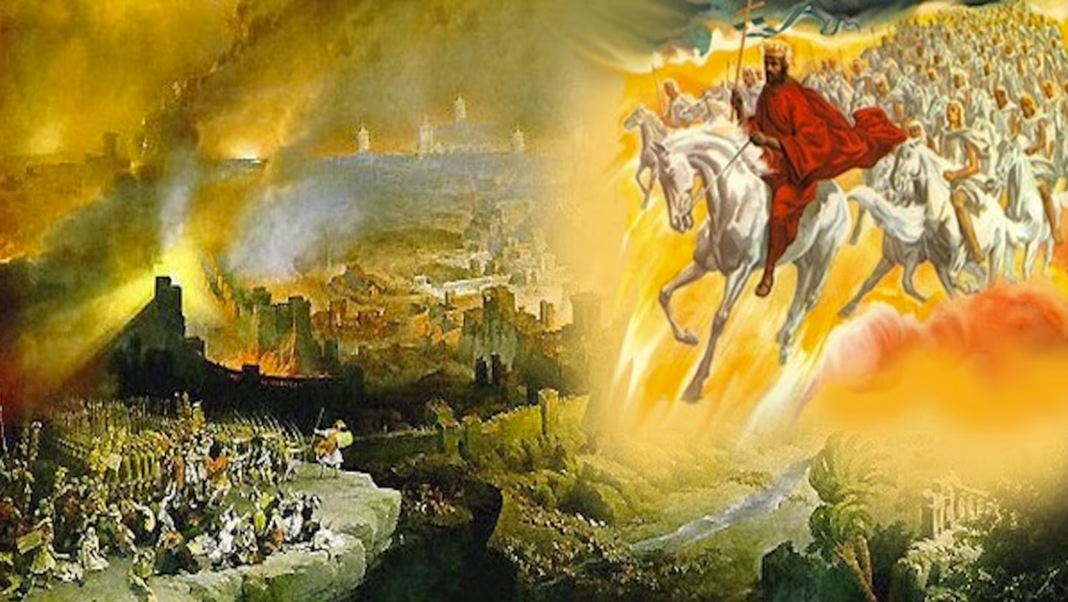
The Book of Revelation
Image credit – https://www.bible.com/events/84698
“The kingdom of the world has become the kingdom of our Lord and of His Christ,
and He shall reign forever and ever.” (Revelation 11:15)
Class Recording and Notes Will Be Available on https://www.purifiedbyfaith.com/

Slide 2
High Level Outline of the Book of Revelation
Introduction (1:1-8)
Jesus Among the Seven Churches (1:9-20)
Letters to the Seven Churches: (Chapters 2-3)
The Throne of God and the Lamb (Chapters 4-5)
Three Sets of Divine Judgments (6:1-16:21)
  Seven Seals (6:1-17; 8:1)
  Interlude: Sealing of the 144,000 (7:1-8); and Great Multitude Before the Throne (7:9-17)
  Seven Trumpets (8:2-11:19)
  Interlude: Persecution, Deliverance and Judgment (Chapters 12–14)
  Seven Bowls (Chapters 15–16)
The Fall of Babylon (17:1-19:10)
The Last Battle (19:11-20:15)
The Marriage of Heaven and Earth (21:1-22:5)
Epilogue (22:6-21)

Slide 3
The Last Seal; Transition to the Seven Trumpets (8:1-5)
^{8:1} When he opened the seventh seal, there was silence in heaven for about half an hour. ² And I saw the seven angels who stand before God, and to them were given seven trumpets. ³ Another angel, who had a golden censer, came and stood at the altar. He was given much incense to offer, with the prayers of all the saints, on the golden altar before the throne. ⁴ The smoke of the incense, together with the prayers of the saints, went up before God from the angel's hand. ⁵ Then the angel took the censer, filled it with fire from the altar, and hurled it on the earth; and there came peals of thunder, rumblings, flashes of lightning and an earthquake. (NIV)

Slide 4
^{8:1} When the Lamb opened the seventh seal, there was silence in heaven for about half an hour. (ESV)
Here we’re told that with the breaking of the seventh seal by the Lamb, “there was silence in heaven for about half an hour”.
Given that Revelation is filled with continuous worship, thundering voices, and loud shouts, etc., this sudden stillness is striking.
There are a number of possible reasons for this silence:
  The silence creates a dramatic pause, enhancing the solemnity of the vision that is about to unfold.
  Heaven becomes quiet so that the prayers of the suffering believers on earth can be heard before the throne of God (see verses 3-4).
  It reflects the thirty-minute period of quiet reverence (described in Jewish rabbinic tradition) that occurred during Old Testament temple worship when the priest burned incense inside the sanctuary as the congregation prayed silently outside (Luke 1:8–11, 21; Lev. 16:13–14).
  The silence mirrors Old Testament prophetic warnings where all creation is commanded to be silent before the Lord in anticipation of His approaching judgment (Isa. 41:1; Zeph. 1:7; Zech. 2:13).

Slide 5
^{8:2} Then I saw the seven angels who stand before God, and seven trumpets were given to them. (ESV)
Following the silence, John beholds “the seven angels who stand before God,” to whom “seven trumpets” are given.
These angels are thought by some to be the seven archangels of Jewish tradition (Uriel, Raphael, Raguel, Michael, Saraqael, Gabriel, Remiel — 1 Enoch 20:1-8; Tobit 12:15) who stand in the presence of God.
“Trumpets” had several Old Testament functions: They summoned people to worship, announced kings, warned of danger, and called armies into battle (Numbers 10:1–10; 1 Kings 1:34, 39; Joel 2:1; Zephaniah 1:16).
Many see an echo here of Joshua 6, where seven priests with seven trumpets preceded the destruction of Jericho.
As Jericho fell before Israel entered the Promised Land, so now another condemned city is about to experience God's judgment.

Slide 6
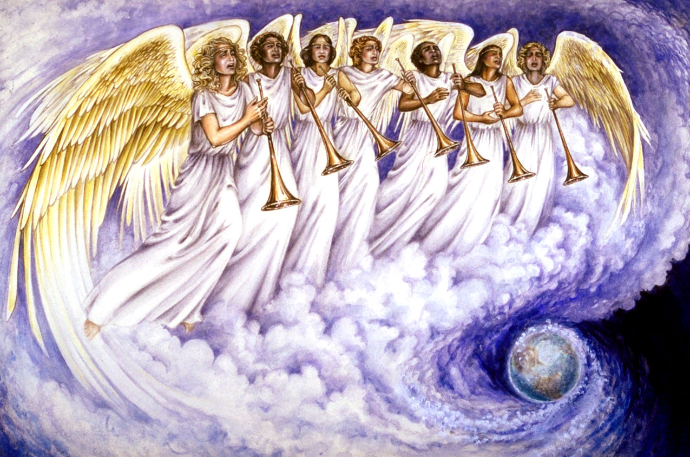
^{8:2} Then I saw the seven angels who stand before God, and seven trumpets were given to them. (ESV)
Pat Marvenko Smith. Revelation Illustrated: An Artist's View of the Bible's Last Book (1982)

Slide 7
^{8:3} And another angel came and stood at the altar with a golden censer, and he was given much incense to offer with the prayers of all the saints on the golden altar before the throne, ⁴ and the smoke of the incense, with the prayers of the saints, rose before God from the hand of the angel. (ESV)
Before the trumpets sound, “another angel” holding a “golden censer” steps forward to the altar before the throne.
This angel is given “much incense” to offer alongside “the prayers of all the saints”
This brings to mind Psalm 141:2, where prayer is compared to incense, and also Revelation 5:8, where incense is said to represent the prayers of the saints.
Most commentaries understand “the prayers of all the saints ” here to be a reference to the cry of the martyrs that we saw described in Rev. 6:9–10 : “O Sovereign Lord... how long before you will judge and avenge our blood?”
God had told them to wait “a little longer” (Rev. 6:11).
Revelation 8 now shows that their prayers have reached God's throne and the judgment they had prayed for is now about to take place.
This follows a common biblical pattern: God's oppressed people cry out to Him, He hears them, and He acts against their oppressors (Exodus 2:23; 3:7–10; Luke 18:7–8).
The added “incense” may represent Christ's intercession and merits, which purify and absorb the flaws of human prayers, making them acceptable to God.

Slide 8
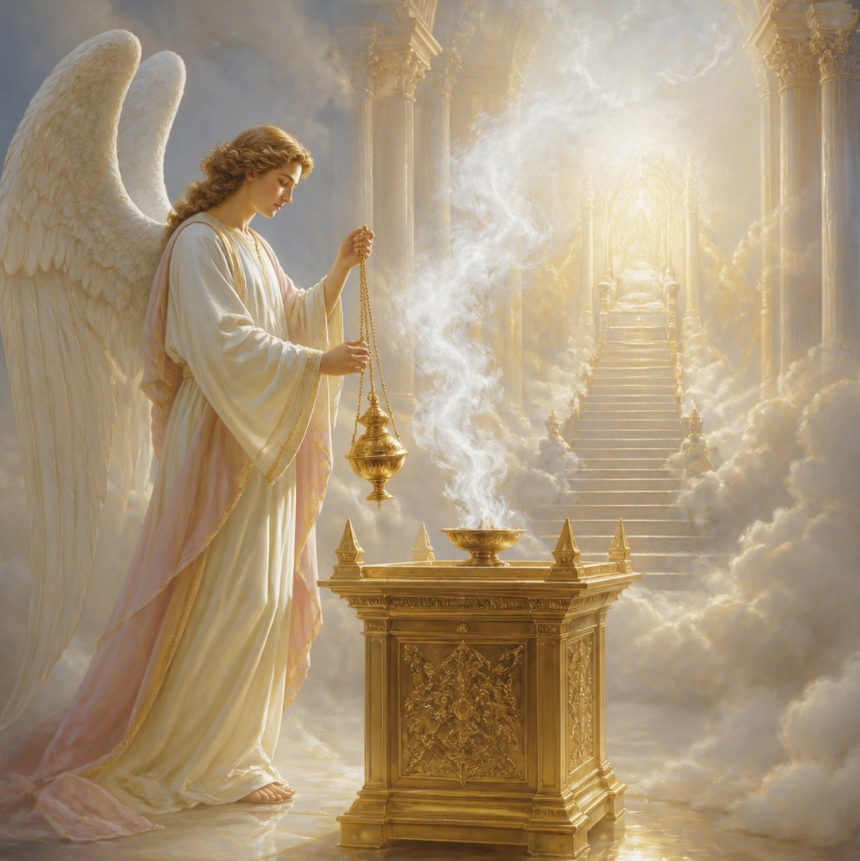
^{8:3} And another angel came and stood at the altar with a golden censer, and he was given much incense to offer with the prayers of all the saints on the golden altar before the throne, ⁴ and the smoke of the incense, with the prayers of the saints, rose before God from the hand of the angel. (ESV)
https://bible.art/prayer/revelation-8%3A3-4

Slide 9
^{8:5} Then the angel took the censer and filled it with fire from the altar and threw it on the earth (Land), and there were peals of thunder, rumblings, flashes of lightning, and an earthquake. (ESV)
The angel then fills the censer with fire from the altar and hurls it to the earth, producing “peals of thunder, rumblings, flashes of lightning, and an earthquake”, language echoing the Lord’s appearance on Mount Sinai (Exod. 19:16–19) and Ezekiel's vision of coals scattered over Jerusalem (Ezek. 10:2).
I would argue that “the earth” here should be translated as “the Land” — Judea specifically — so that the fire directly answers the martyrs' prayer for vengeance on Jerusalem, fulfilling the covenant curses of Deuteronomy 28 that the Lord promised would come upon the Jews if they violated his covenant.

Slide 10
The First Four Trumpets (8:6-12)
^{8:6} Then the seven angels who had the seven trumpets prepared to sound them. ⁷ The first angel sounded his trumpet, and there came hail and fire mixed with blood, and it was hurled down upon the earth. A third of the earth was burned up, a third of the trees were burned up, and all the green grass was burned up. ⁸ The second angel sounded his trumpet, and something like a huge mountain, all ablaze, was thrown into the sea. A third of the sea turned into blood, ⁹ a third of the living creatures in the sea died, and a third of the ships were destroyed. ¹⁰ The third angel sounded his trumpet, and a great star, blazing like a torch, fell from the sky on a third of the rivers and on the springs of water-- ¹¹ the name of the star is Wormwood. A third of the waters turned bitter, and many people died from the waters that had become bitter. ¹² The fourth angel sounded his trumpet, and a third of the sun was struck, a third of the moon, and a third of the stars, so that a third of them turned dark. A third of the day was without light, and also a third of the night.

Slide 11
^{8:6} Now the seven angels who had the seven trumpets prepared to blow them. (ESV)
The first four trumpets in Revelation 8:6–12 depict a unified sequence of divine judgments that result from the prayers of persecuted believers ascending to God's altar.
Rather than representing a sequence of far-future global events (as futurist interpreters of Revelation would argue), I believe these trumpet visions expand on the imagery that we saw in the sixth seal, highlighting God's covenantal retribution against first-century apostate Israel and Jerusalem.
The symbolism in this section draws heavily upon Israel’s Old Testament heritage (such as the plagues of Egypt, the fall of Babylon, and the fall of Jericho) in order to demonstrate that Israel had spiritually reversed its identity as the people of God, and have now become the enemy of God.

Slide 12
^{8:6} Now the seven angels who had the seven trumpets prepared to blow them.. (ESV)
Like the seven seals, the seven trumpets divide into a group of four and a group of three:
  The first four trumpets affect the natural environment (earth, sea, fresh water, and heavenly bodies),
  The final three target humanity directly through a series of severe “woes”.
The scope of devastation expands from “a fourth” under the seal judgments (see Rev 6:8) to “a third” under the trumpets (Rev 8:7–12).
This fractional destruction indicates that while these judgments are severe and increasing, they are not yet total or final.
I believe the Greek term gē throughout this section is best translated as:
  “the Land” (specifically the Land of Israel) as it is translated in Young’s Literal Translation
  Rather than “earth” (implying the entire planet Earth) as it is translated in the ESV.

Slide 13
^{8:7} The first angel blew his trumpet, and there followed hail and fire, mixed with blood, and these were thrown upon the earth [Land]. And a third of the earth [Land] was burned up, and a third of the trees were burned up, and all green grass was burned up. (ESV)
Here we see at the sounding of the “first” trumpet, “hail and fire, mixed with blood” fall upon the “Land,” burning a “third of the Land”, a “third of the trees”, and “all green grass”.
This verse weaves together Old Testament threads to show this coming judgment is the covenantal outcome of Israel’s apostasy and persecution of God’s saints.
The primary allusion is the seventh Egyptian plague (Exodus 9:22–26), where Yahweh unleashed “hail and fire” against Egypt's vegetation while sparing Israel.
John uses this exact “hail and fire” imagery to signal a profound thematic reversal.
By directing an Exodus-style plague against “the Land” (gē, Israel) instead of a pagan oppressor (Egypt), John demonstrates that apostate Jerusalem has now taken Egypt's place!
Having rejected her Messiah, the covenant nation now suffers the plagues once reserved for Pharaoh.

Slide 14
^{8:7} The first angel blew his trumpet, and there followed hail and fire, mixed with blood, and these were thrown upon the earth [Land]. And a third of the earth [Land] was burned up, and a third of the trees were burned up, and all green grass was burned up. (ESV)
John, however, adds something not found in that plague: the hail and fire are “mixed with blood.”
That addition probably draws upon other OT judgment imagery, particularly Joel 2:30, with its “blood and fire,” and Ezekiel 38:22, where God judges his enemies with “blood,” “hailstones,” and “fire.”
The martyrs had cried out for God to avenge their “blood” (Rev. 6:9–10).
Here we see that the “blood” accompanying the first trumpet signifies, at least in part, that these persecutors who shed the innocent blood of those Christian martyrs will now experience at the hand of an avenging God the shedding of their own “blood”!
This corresponds directly with Jesus' pronouncement upon first-century Jerusalem in Matthew 23:34–36 (just before giving the Olivet Discourse) that the guilt of “all the righteous blood shed on earth” would come upon “this generation” of Jewish leaders who themselves shed the “blood” of God’s messengers and prophets (including Jesus himself).

Slide 15
^{8:7} The first angel blew his trumpet, and there followed hail and fire, mixed with blood, and these were thrown upon the earth [Land]. And a third of the earth [Land] was burned up, and a third of the trees were burned up, and all green grass was burned up. (ESV)
Historically, this judgment was fulfilled in the Roman army's systematic campaign during the Jewish War (A.D. 66–70).
Led by Vespasian and Titus, Roman legions used brutal “scorched-earth” tactics across Galilee and Judea.
They catapulted incendiary weapons (such as flaming darts and arrows, fireballs and firepots) into the city, burned villages, and stripped the countryside of trees for miles to build massive siege works, leaving the Land completely desolate.
This physical destruction brought immense bloodshed.
Roman troops slaughtered thousands in the countryside, and during the siege of Jerusalem, cut down starving residents and crucified thousands of captives along the city walls.
By the time Jerusalem and the temple fell, the slaughter was so extreme that the historian Josephus reported Roman soldiers walking over piles of corpses, with streams of blood actually putting out fires in the streets!

Slide 16
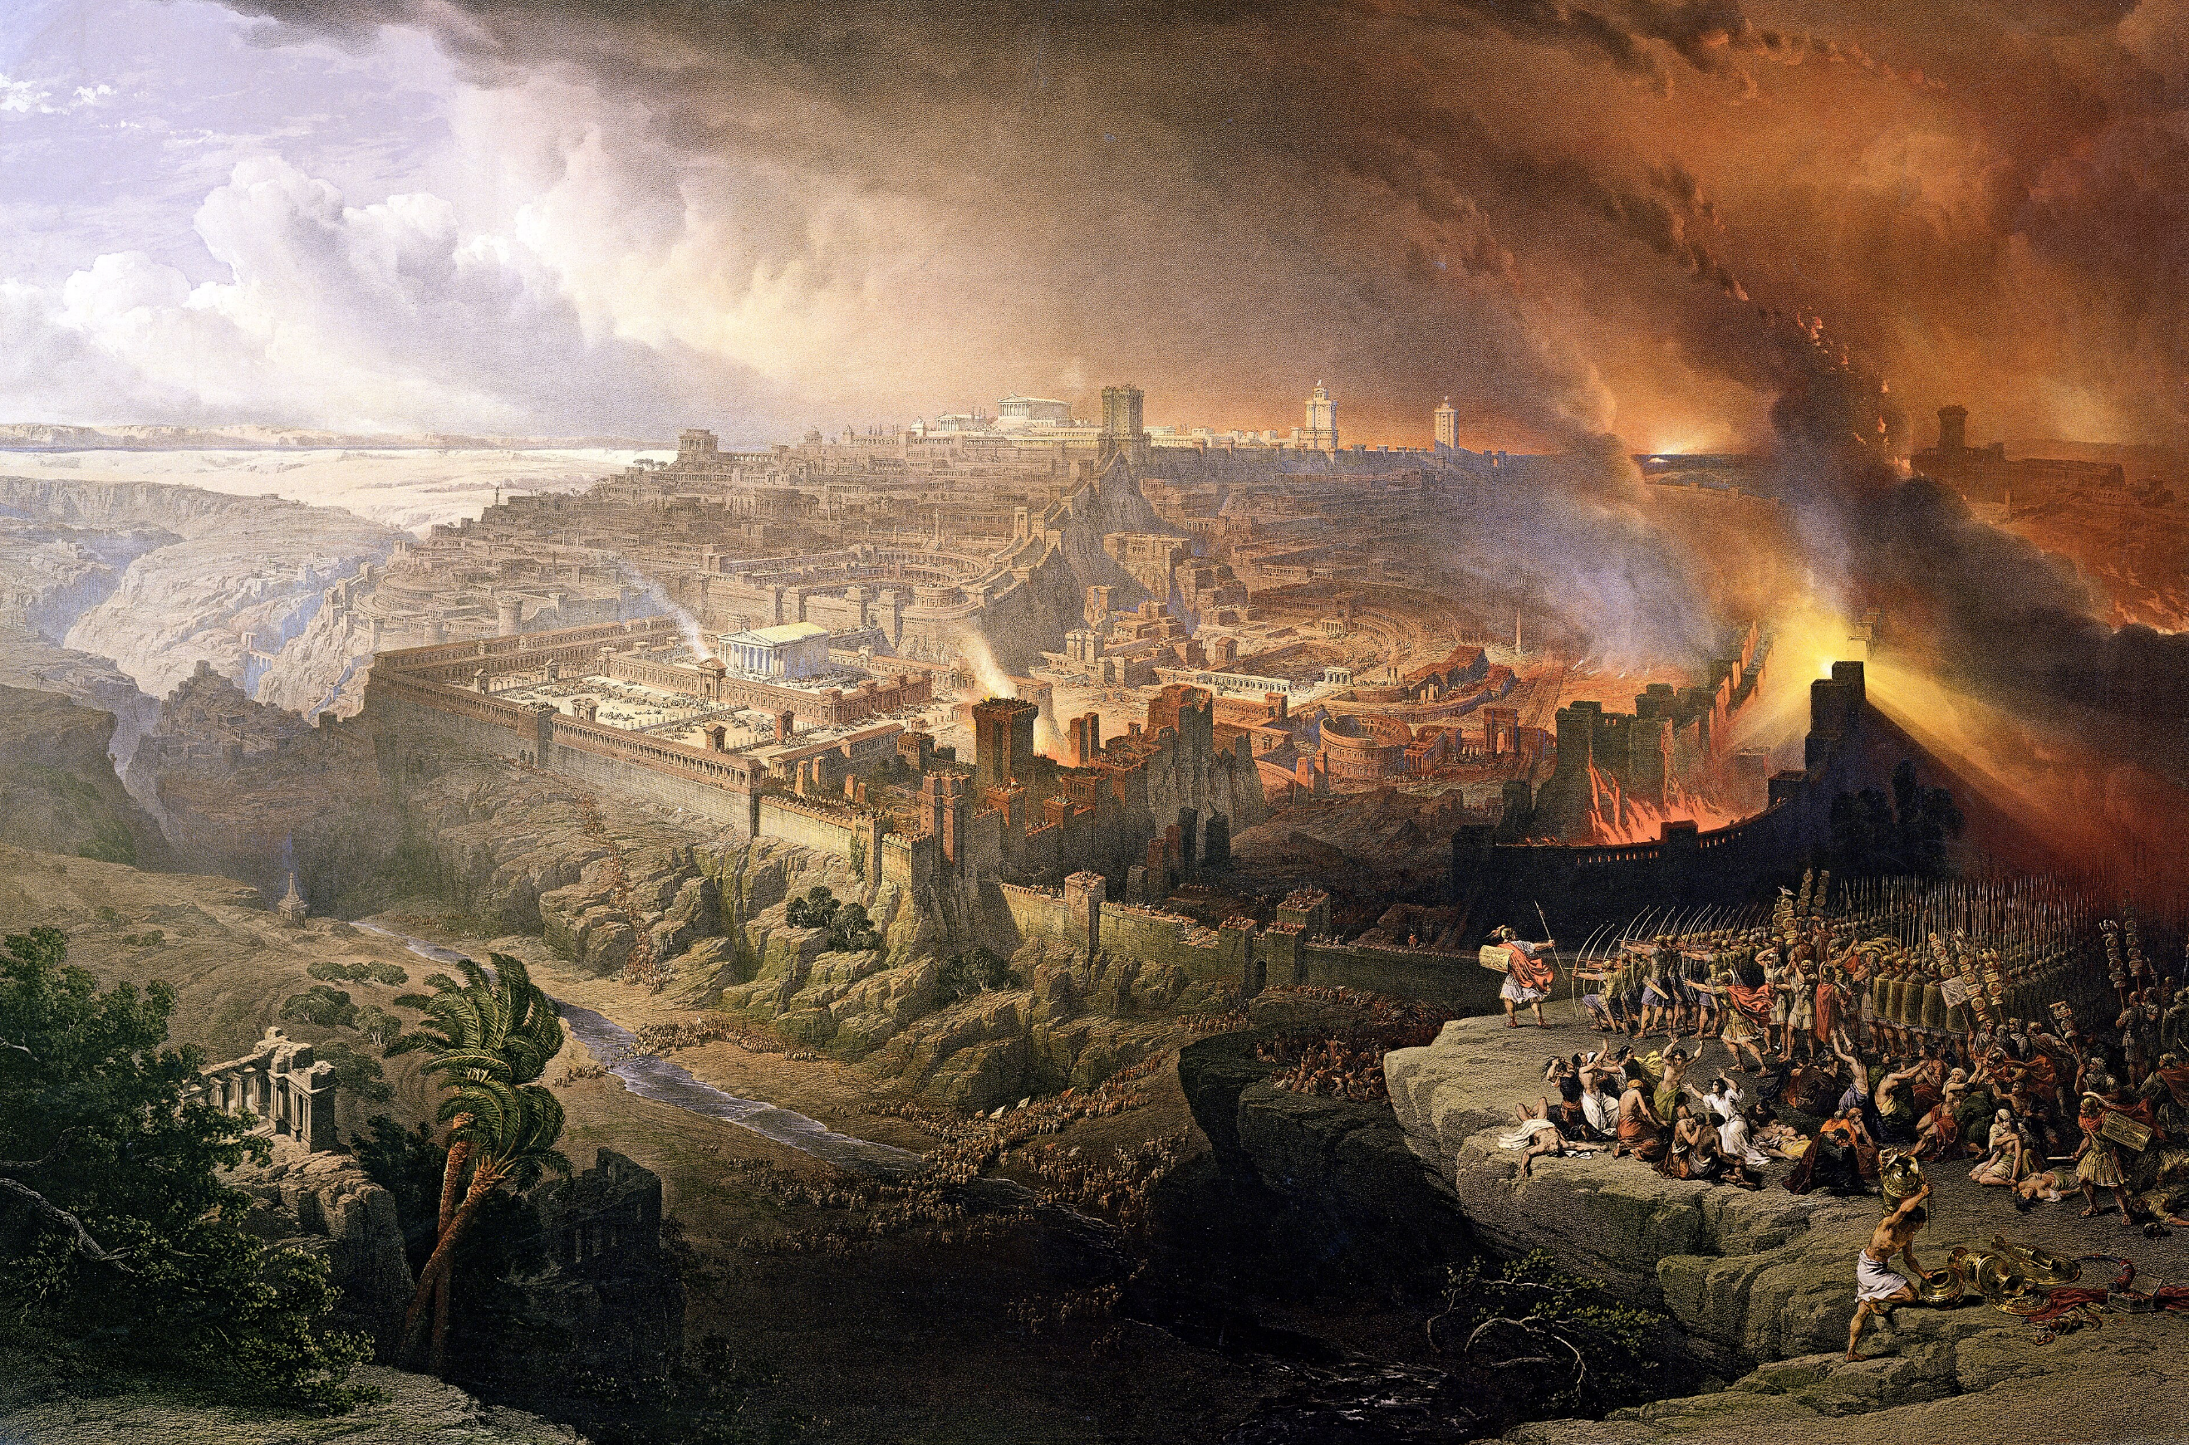
^{8:7} The first angel blew his trumpet, and there followed hail and fire, mixed with blood, and these were thrown upon the earth [Land]. And a third of the earth [Land] was burned up, and a third of the trees were burned up, and all green grass was burned up. (ESV)
https://en.wikipedia.org/wiki/Early_thermal_weapons#

Slide 17
^{8:8} The second angel blew his trumpet, and something like a great mountain, burning with fire, was thrown into the sea, and a third of the sea became blood. ⁹ A third of the living creatures in the sea died, and a third of the ships were destroyed. (ESV)
Here we see the “second” trumpet sends “something like a great mountain, burning with fire” into the sea, turning a “third of the sea” into “blood”, killing a third of its living creatures, and destroying a third of the ships.
The sea becoming blood is an echo of Egypt’s first plague (Exodus 7:17–21).
The burning mountain represents Israel, Jerusalem, and particularly the temple mount.
Mountains often symbolize kingdoms (Isaiah 2:2–3; Jeremiah 51:25), but Zion in particular was the “mountain” of God’s dwelling and the location of the temple (Psalm 48:1; Isaiah 2:2–3; Micah 4:1–2).
In the book of Jeremiah, Babylon is called a “destroying mountain” that God would burn and cast down into the sea (Jeremiah 51:25, 42).
John now applies that imagery to Jerusalem because she has become another Babylon.

Slide 18
^{8:8} The second angel blew his trumpet, and something like a great mountain, burning with fire, was thrown into the sea, and a third of the sea became blood. ⁹ A third of the living creatures in the sea died, and a third of the ships were destroyed. (ESV)
Jesus may have anticipated this event when he spoke of his disciples saying to “this mountain, ‘Be taken up and thrown into the sea’” (Matthew 21:21).
While often interpreted generally as a metaphor for overcoming difficult obstacles, the immediate narrative and geographic context point to a specific, historical judgment.
Jesus uttered these words while standing directly on the Mount of Olives, looking across the Kidron Valley at the Temple Mount in Jerusalem.
Jesus was not talking about mountains in general; He was pointing directly to the temple mount itself.
Immediately preceding this statement, Jesus entered the temple, drove out the money changers, and cursed the unfruitful fig tree—a classic prophetic symbol for apostate Israel (Matt 21:18–20).
Cursing the fig tree and commanding "this mountain" to be cast into the sea are paired prophetic acts signaling the impending destruction of the temple system.

Slide 19
^{8:8} The second angel blew his trumpet, and something like a great mountain, burning with fire, was thrown into the sea, and a third of the sea became blood. ⁹ A third of the living creatures in the sea died, and a third of the ships were destroyed. (ESV)
The “great mountain, burning with fire” represents the destruction of Jerusalem and the burning of the temple on Mount Zion in A.D. 70.
In biblical imagery, “the sea” routinely represents the chaotic, pagan Gentile nations (e.g., Dan 7:2–3; Rev 13:1; 17:15).
For the holy mountain of God to be thrown into the sea signified a total reversal of covenant status: the temple mount would be defiled, dismantled, and swallowed up by Gentile pagan powers.
The bloody sea and destroyed ships may be a reference to the violent naval engagements on the Sea of Galilee and the Mediterranean coast (such as at Joppa), where (according to Josephus) fleeing Jewish forces were slaughtered by the Romans until the waters ran red.

Slide 20
^{8:10} The third angel blew his trumpet, and a great star fell from heaven, blazing like a torch, and it fell on a third of the rivers and on the springs of water. ¹¹ The name of the star is Wormwood. A third of the waters became wormwood, and many people died from the water, because it had been made bitter. (ESV)
Here we see at the sounding of the “third” trumpet, great star named “Wormwood” falls from heaven like a burning torch, falling upon a third of the rivers and springs, making the waters bitter and causing many to die.
The name “Wormwood” signifies bitter judgment and covenantal curse for idolatry and apostasy (Deut 29:18; Jer 9:15; 23:15; Lam 3:15, 19).
It presents an ironic reversal of the miracle at Marah (Exod 15:22–25), where bitter waters were made sweet.
The falling star is a metaphor that represents the catastrophic downfall of the Jewish high-priestly line and ruling aristocracy, whose glory was traditionally compared to stars (Sirach 50:5–7).
By rejecting the Messiah (Matt 26:63–66) and persecuting the Church, the high priesthood became a source of spiritual corruption and physical death, turning the life-giving streams of Israel into poisonous waters.
Historically, dead bodies literally polluted the Jordan River and Dead Sea during the Roman campaign.

Slide 21
^{8:12} The fourth angel blew his trumpet, and a third of the sun was struck, and a third of the moon, and a third of the stars, so that a third of their light might be darkened, and a third of the day might be kept from shining, and likewise a third of the night. (ESV)
We see here at the sounding of the “fourth” trumpet, a third of the sun, moon, and stars are struck and “darkened”, diminishing the light of both day and night by a third.
This judgment echoes the ninth Egyptian plague of thick darkness (Exod 10:21–23).
Throughout Old Testament prophecy, the darkening of cosmic light sources serves as standard apocalyptic imagery for the collapse of political rulers, governments, and nations (Isa 13:9–10; Ezek 32:7–8; Joel 2:10, 31).
The quenching of these light-bearers signifies the rapid collapse of Jewish political authority and civil structure leading up to A.D. 70, alongside the tumultuous leadership crises in the Roman Empire during the “Year of the Four Emperors” (A.D. 69), where multiple rulers died by violence or suicide.

Slide 22
The Eagle of Woe (8:13)
^{8:13} As I watched, I heard an eagle that was flying in midair call out in a loud voice: "Woe! Woe! Woe to the inhabitants of the earth, because of the trumpet blasts about to be sounded by the other three angels!" (NIV)

Slide 23
^{8:13} Then I looked, and I heard an eagle crying with a loud voice as it flew directly overhead, “Woe, woe, woe to those who dwell on the earth [Land], at the blasts of the other trumpets that the three angels are about to blow!” (ESV)
Finally, an “eagle” flies overhead crying, “Woe, woe, woe”.
Eagles symbolize swift covenant judgment (Deuteronomy 28:49; Jeremiah 4:13; Hosea 8:1; Habakkuk 1:8).
This could also be an allusion to the fact that the Roman legions also marched under standards that bore the image of an eagle, making the symbol especially appropriate.
Three cries of “woe” will be used to announce the remaining three trumpets (Rev 9:12; 11:14), whose judgments will be even more severe as they fall directly upon the people of the Land.
The first four trumpets, therefore, portray the progressive dismantling of old-covenant Israel as God judged Jerusalem for rejecting Christ and persecuting his church.

Slide 24
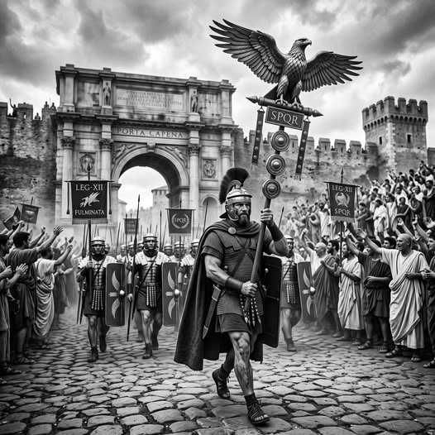
The Roman legions also marched under standards that bore the image of an eagle
https://www.facebook.com/groups/1406391500042069/posts/1999880017359878/

Slide 25

Class Discussion Time
In our today’s lesson, we saw an example of Christian martyrs who had, in a previous text (Rev. 6:11), earnestly prayed for God to do something (in this case, avenge their death) and had been told to wait “a little longer”.
In today’s text we saw where the Lord finally did answer their prayer by destroying Jerusalem and the Jewish temple – and in so doing, brought down the entire Jewish religious system that had been responsible for the death of Christ and the persecution and death of many faithful believers in the early church.
The prayer prayed by these martyrs is classified by Christian theologians as an imprecatory prayer – a prayer that asks God to bring judgment, calamity, or curses down upon one’s enemies or those who commit severe evil.

Slide 26
Class Discussion Time
We see examples of these kinds of prayers throughout scripture:
  Psalm 35:1–8 — David asks God to fight his enemies
  “Contend, O LORD, with those who contend with me; fight against those who fight against me!” (v. 1)
  Nehemiah 4:4–5 says:
  “Hear, O our God, for we are despised. Turn back their taunt on their own heads... Do not cover their guilt.”
  In Galatians 1:8–9, Paul pronounces a curse upon anyone preaching a false gospel:
  “Let him be accursed.”
  In 1 Corinthians 16:22, Paul says:
  “If anyone has no love for the Lord, let him be accursed.”
Do you think there is a place for Christians today to pray imprecatory prayers? Have you ever prayed such a prayer?
The prayer prayed by these martyrs is also an example of a prayer where the Lord delayed before giving them what they asked for.
Has the Lord ever delayed in answering your prayers?

Slide 27
Class Discussion Time
In our lesson today I alluded to this peculiar, but well-known passage:
  In the morning, as [Jesus] was returning to the city, he became hungry. And seeing a fig tree by the wayside, he went to it and found nothing on it but only leaves. And he said to it, "May no fruit ever come from you again!" And the fig tree withered at once. When the disciples saw it, they marveled, saying, ‘How did the fig tree wither at once?’ And Jesus answered them, "Truly, I say to you, if you have faith and do not doubt, you will not only do what has been done to the fig tree, but even if you say to this mountain, 'Be taken up and thrown into the sea,' it will happen. And whatever you ask in prayer, you will receive, if you have faith.” (Mat 21:18-22 )
I pointed out that, while often interpreted as a metaphor for overcoming difficult obstacles, the immediate narrative and geographic context point to a specific, historical judgment.
Cursing the fig tree and commanding “this mountain” to be cast into the sea are paired prophetic acts signaling the impending destruction of the temple system.
What do you think about my take on this passage?

Slide 28
Class Discussion Time
In Rev 8:4 I suggested that the added “incense” may represent Christ's intercession and merits, which purify and absorb the flaws of human prayers, making them acceptable to God.
There is a similar idea expressed in Paul’s letter to the Romans concerning the Holy Spirit where it says: “… the Spirit helps us in our weakness; for we do not know how to pray as we ought, but the Spirit himself intercedes for us with sighs too deep for words.” (Rom 8:26)
Does it comfort you to know that, in a case where, perhaps due to some shortcoming or inadequacy on your part, you don’t know how to pray as you “ought” that God extends grace to you in this way?

