Slide 1
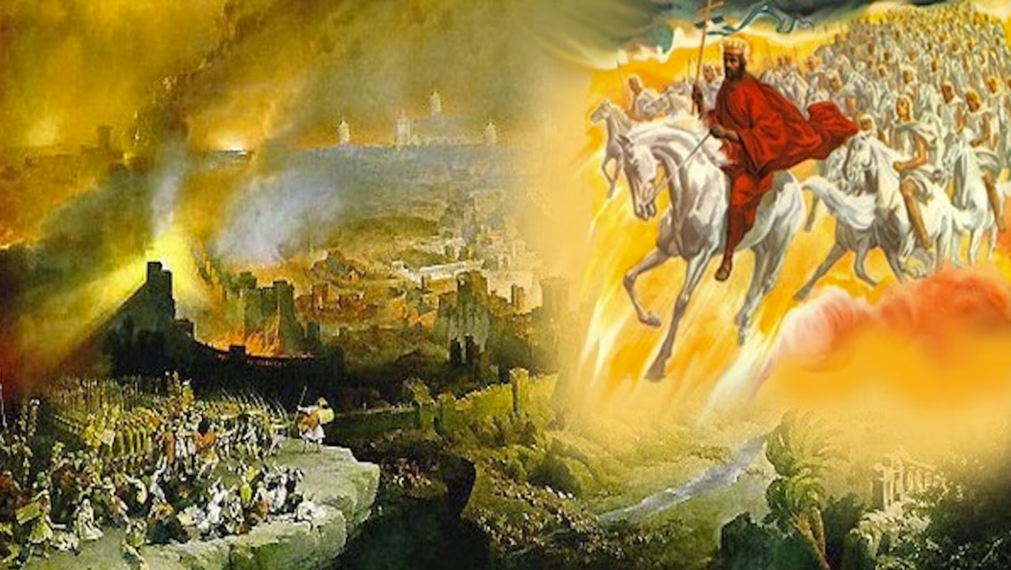
The Book of Revelation
Image credit – https://www.bible.com/events/84698
“The kingdom of the world has become the kingdom of our Lord and of His Christ,
and He shall reign forever and ever.” (Revelation 11:15)
Class Recording and Notes Will Be Available on https://www.purifiedbyfaith.com/

Slide 2
High Level Outline of the Book of Revelation
Introduction (1:1-8)
Jesus Among the Seven Churches (1:9-20)
Letters to the Seven Churches: (Chapters 2-3)
The Throne of God and the Lamb (Chapters 4-5)
Three Sets of Divine Judgments (6:1-16:21)
  Seven Seals (6:1-17; 8:1)
  Interlude: Sealing of the 144,000 (7:1-8); and Great Multitude Before the Throne (7:9-17)
  Seven Trumpets (8:2-11:19)
  Interlude: Persecution, Deliverance and Judgment (Chapters 12–14)
  Seven Bowls (Chapters 15–16)
The Fall of Babylon (17:1-19:10)
The Last Battle (19:11-20:15)
The Marriage of Heaven and Earth (21:1-22:5)
Epilogue (22:6-21)

Slide 3
The Fifth Trumpet – All Hell Breaks Loose (9:1-12)
^{9:1} The fifth angel sounded his trumpet, and I saw a star that had fallen from the sky to the earth. The star was given the key to the shaft of the Abyss. ² When he opened the Abyss, smoke rose from it like the smoke from a gigantic furnace. The sun and sky were darkened by the smoke from the Abyss. ³ And out of the smoke locusts came down upon the earth and were given power like that of scorpions of the earth. ⁴ They were told not to harm the grass of the earth or any plant or tree, but only those people who did not have the seal of God on their foreheads. ⁵ They were not given power to kill them, but only to torture them for five months. And the agony they suffered was like that of the sting of a scorpion when it strikes a man. ⁶ During those days men will seek death, but will not find it; they will long to die, but death will elude them.

Slide 4
The Fifth Trumpet – All Hell Breaks Loose (9:1-12)
^{9:7} The locusts looked like horses prepared for battle. On their heads they wore something like crowns of gold, and their faces resembled human faces. ⁸ Their hair was like women's hair, and their teeth were like lions' teeth. ⁹ They had breastplates like breastplates of iron, and the sound of their wings was like the thundering of many horses and chariots rushing into battle. ¹⁰ They had tails and stings like scorpions, and in their tails they had power to torment people for five months. ¹¹ They had as king over them the angel of the Abyss, whose name in Hebrew is Abaddon, and in Greek, Apollyon. ¹² The first woe is past; two other woes are yet to come. (NIV)

Slide 5
^{9:1} And the fifth angel blew his trumpet, and I saw a star fallen from heaven to earth, and he was given the key to the shaft of the bottomless pit. (ESV)
When the fifth angel sounds his trumpet, John sees a “star” that has already “fallen from heaven”.
Because the star is referred to as “he” and receives a “key”, it’s obvious that this “star” represents a personal being rather than a literal star.
More than likely this fallen star represents a fallen angelic being, perhaps Satan himself – this can especially be seen when we compare this passage with other passages like:
  Isaiah 14:12 – How you are fallen from heaven, O Day Star, son of Dawn! How you are cut down to the ground, you who laid the nations low! (this passage directly describes the fall of the proud king of Babylon, but its imagery may also reflect Satan’s pride and fall.)
  Luke 10:18 – And [Jesus] said to them, “I saw Satan fall like lightning from heaven…”
  Revelation 12:4 – [the great red dragon’s] tail swept down a third of the stars of heaven and cast them to the earth. And the dragon stood before the woman who was about to give birth, so that when she bore her child he might devour it.
  Revelation 12:9 – And the great dragon was thrown down, that ancient serpent, who is called the devil and Satan, the deceiver of the whole world—he was thrown down to the earth, and his angels were thrown down with him.

Slide 6
^{9:1} And the fifth angel blew his trumpet, and I saw a star fallen from heaven to earth [the Land], and he was given the key to the shaft of the bottomless pit. (ESV)
The Greek word ge translated as “the earth” might be better understood here in its localized, Hebraic sense as “the Land” – specifically the Land of Israel.
Because in this context, the falling of the “star” pictures Satan, having been cast down, and concentrating his destructive fury within the geographic domain of Judea during the First Jewish-Roman War.
“the key” here symbolizes the power to unlock and unleash what was previously locked up or restrained.
The phrase “he was given” is what grammarians refer to as a “divine passive”, indicating that Satan operates strictly under God’s sovereign permission.
God grants Satan authority to “open the shaft” (see verse 2) in order to carry out his divine judgment on apostate Israel.

Slide 7
^{9:2} He opened the shaft of the bottomless pit, and from the shaft rose smoke like the smoke of a great furnace, and the sun and the air were darkened with the smoke from the shaft. (ESV)
“the shaft of the bottomless pit” is an expression which appears seven times in the book of Revelation (9:1, 2, 11; 11:7, 8; 20:1, 3); it depicts a deep, narrow shaft (like a well) connecting the earth’s surface to a vast underworld prison.
Ancient Jewish apocalyptic literature, such as 1 Enoch, portrayed this underworld as the realm of chaotic forces and unclean spirits where they remain confined:
  And I saw a great chasm among pillars of heavenly fire. And I saw in it pillars of fire descending; and they were immeasurable toward the depth and toward the height. And Uriel said to me, “There stand the angels who mingled with the women… And I saw terrible things—a great fire burning and flaming there. And the place had a narrow cleft (extending) to the abyss, full of great pillars of fire, borne downward. Neither the measure nor the size was I able to see or to estimate… Then I said, “How terrible is this place and fearful to look at!” Then Uriel answered me, one of the holy angels who was with me, and said to me, “Enoch, why are you so frightened and shaken?” And I replied, “Because of this terrible place and because of the fearful sight.” And he said, “This place is a prison for the angels. Here they will be confined forever.” (1 Enoch 18:11; 21:7–10)
Compare this with Gen 6:2,4:
  the sons of God saw that the daughters of man were attractive. And they took as their wives any they chose… The Nephilim [= very large men, giants] were on the earth in those days, and also afterward, when the sons of God came in to the daughters of man and they bore children to them. These were the mighty men who were of old, the men of renown.

Slide 8
^{9:2} He opened the shaft of the bottomless pit, and from the shaft rose smoke like the smoke of a great furnace, and the sun and the air were darkened with the smoke from the shaft. (ESV)
There are a number of places in scripture (besides our present text) that pick up on this idea of a subterranean abyss where evil spirits are locked up awaiting the final day of judgment:
  2 Peter 2:4 – “For if God did not spare angels when they sinned, but cast them into hell [Tartarus] and committed them to chains of gloomy darkness to be kept until the judgment...”
  Jude 1:6 – “And the angels who did not stay within their own position of authority... he has kept in eternal chains under gloomy darkness until the judgment of the great day.” (just a few verses later (vs. 14), Jude cites another passage from the book of 1 Enoch and explicitly names Enoch as his source)
  Luke 8:31: When Jesus encounters the demon possessed man named “Legion” – the evil spirits indwelling the man beg Jesus “not to command them to depart into the abyss.”
  Revelation 20:1–3 – “Then I saw an angel coming down from heaven, holding in his hand the key to the bottomless pit [Abyss] and a great chain. He seized the dragon... and bound him... and threw him into the pit, and shut it and sealed it over him...”

Slide 9
^{9:2} He opened the shaft of the bottomless pit, and from the shaft rose smoke like the smoke of a great furnace, and the sun and the air were darkened with the smoke from the shaft. (ESV)
We’re told that this star-angel (Satan) “opened” the bottomless pit, and “smoke” went up out of the pit, “like the smoke of a great furnace, and the sun and the air were darkened with the smoke from the shaft”.
As we shall see, in this terrifying scene taking place at the sounding of the fifth trumpet, John introduces a new dimension to the torment of those in the Land.
Previously the things above (heavenly bodies) were affected along with things on the earth. Now we witness power from below.
When the key-locked “shaft” is opened, its contents immediately erupt out of it.
“smoke like the smoke of a great furnace” suggests there is fire within the pit.
The “smoke” here accompanies judgment, as is frequently the case in Scripture (Gen 19:28; Isa 34:8-10; Joel 2:30; Rev 18:9,18; 19:3).

Slide 10
^{9:3} Then from the smoke came locusts on the earth, and they were given power like the power of scorpions of the earth. (ESV)
“locusts” emerge from “the smoke”.
This image brings to mind the locust plague upon Egypt (Exod. 10:12–15).
It also brings to mind Joel’s description of a locust-like invading army that he warns will be set loose if Israel continues in her sin (Joel 1:6; 2:1–10).
But these are not ordinary locusts.
These locusts come from the abyss and possess the painful power of “scorpions”.
Coming up, as they do, from the pit of imprisoned evil spirits, these are “locusts” are probably a symbolic depiction of demonic forces.
Once again, their power is “given” to them, showing that, like Satan himself, these evil spirits remain under God’s sovereign control.

Slide 11
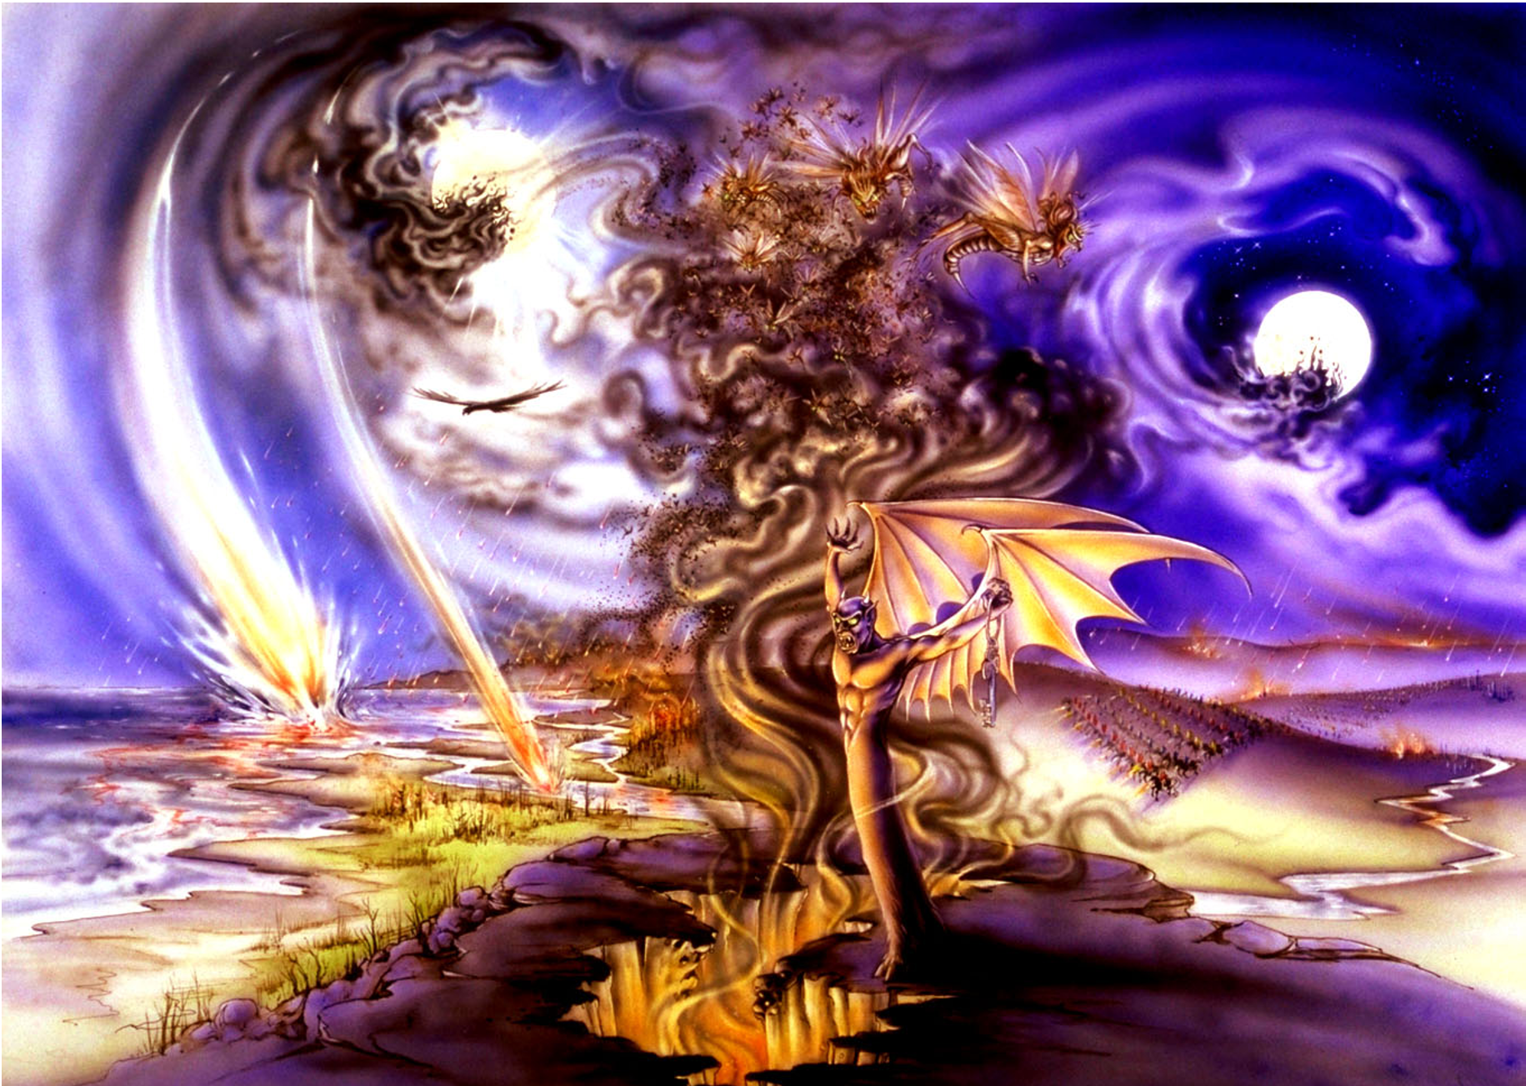
^{9:3} Then from the smoke came locusts on the earth, and they were given power like the power of scorpions of the earth. (ESV)
Pat Marvenko Smith. Revelation Illustrated: An Artist's View of the Bible's Last Book (1982)

Slide 12
^{9:4} They were told not to harm the grass of the earth or any green plant or any tree, but only those people who do not have the seal of God on their foreheads. (ESV)
Unlike natural locusts, these locusts are forbidden to harm “the grass of the earth or any green plant or any tree”.
They are permitted to attack only those who do not have “the seal of God on their foreheads”.
This is, of course, a reference to the 144,000 of God’s servants who were sealed in Revelation 7:3–8.
When we looked at that passage, I suggested that this symbolic number symbolizes the large number of believing Jews living in Jerusalem.
Because these sealed believers trusted Jesus, they heeded his warning to leave town when they saw the Roman armies.
Therefore they were spared from much of the devastating “harm” that came to the unbelieving Jews who remained – including the kinds of “harm” inflicted by these locusts with “the power of scorpions ”.

Slide 13
^{9:5} They were allowed to torment them for five months, but not to kill them, and their torment was like the torment of a scorpion when it stings someone. (ESV)
The locusts are permitted to “torment” people but “not to kill them”.
The fifth trumpet therefore emphasizes spiritual, emotional, and social agony rather than immediate death.
Their torment resembles the intense pain of a scorpion’s sting.
Historically this painful period took place during Rome’s final siege of Jerusalem, which lasted approximately “five months” in AD 70.
It is interesting to note that the normal locust season in that part of the world lasts from May to September – about “five months”!
The torment of the locusts most likely symbolizes the madness and paranoia experienced by the population of Judea as this horde of demonic spirits (symbolized by the “locusts”) are released into the city.
As Jerusalem’s citizens became hopelessly trapped inside the walls of their holy city, enduring their own radical compatriots tormenting them, the city became a hell on earth.

Slide 14
^{9:6} And in those days people will seek death and will not find it. They will long to die, but death will flee from them. (ESV)
Here we see the suffering becomes so unbearable that people begin to wish they could “die”, though they are unable to do so.
This brings to mind the description of the kind of people Job talks about in Job 3:21 – “They long for death, and it won't come. They search for death more eagerly than for hidden treasure.” (NLT)
Jesus, when speaking of “this generation” in the Olivet Discourse predicted the kind despair being described here.
He said people would call upon the mountains to fall on them and the hills to cover them (Luke 23:27–30 cf. Revelation 6:16).
Josephus’s descriptions of starvation, torture, robbery, factional violence, murder, suicide, and hopelessness during Jerusalem’s siege vividly illustrate this misery.

Slide 15
^{9:6} And in those days people will seek death and will not find it. They will long to die, but death will flee from them. (ESV)
The civilian population was caught between bloodthirsty internal rebel factions (led by three rebel leaders whose names were Simon, John, and Eleazar).
Josephus describes the city as a “great body torn in pieces”.
The domestic terror, rampant plundering, and factional slaughter were so severe that the elderly men and women began to actively pray for the Roman army to arrive!
They viewed an external war (with Rome) as their only hope of delivery from the horrible infighting that was taking place within the city.
Regular citizens were paralyzed by fear.
Trapped inside, they couldn’t flee because guards blocked every exit.
While the rebel factions violently disagreed on everything else, they unanimously agreed on executing anyone suspected of wanting peace or desertion.
As Josephus famously notes, “They agreed in nothing but this, to kill those that were innocent.”

Slide 16
^{9:6} And in those days people will seek death and will not find it. They will long to die, but death will flee from them. (ESV)
In their madness, two of the rebel Jewish leaders (John and Simon) began intentionally burning granaries and storehouses filled with corn and provisions simply to deny them to the other side.
Josephus laments that they single-handedly destroyed the very food supply that could have helped the city survive years of siege, effectively starving themselves before the Romans even breached a wall.
When Titus originally arrived and observed the city from afar, he recognized that the factions were doing the Roman’s work for them.
Rather than rushing in blindly, he allowed the Jewish factions to exhaust their manpower, burn their own food, and slaughter each other.

Slide 17
^{9:6} And in those days people will seek death and will not find it. They will long to die, but death will flee from them. (ESV)
When Titus finally did press the siege, he combined brutal force with psychological tactics.
He ordered the crucifixion of captured Jewish fighters outside the walls to terrorize those inside into surrendering.
Conversely, he also periodically halted the siege to offer peace terms via Josephus, hoping the starving, terrified civilian population would revolt against the tyrants.
The tragic irony Josephus emphasizes throughout Book 5 of his Jewish Wars is that the rebel leaders were completely unyielding; they brutally executed any citizen who advocated for Titus's peace terms, preferring total civic self-destruction over submission.
https://en.wikisource.org/wiki/The_War_of_the_Jews/Book_V

Slide 18
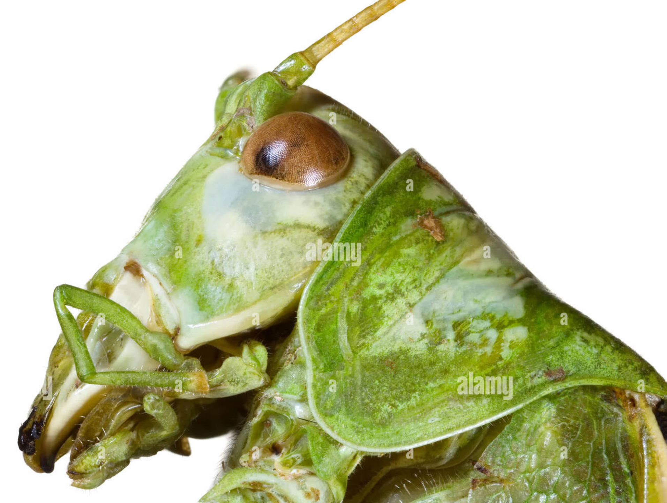
^{9:7} In appearance the locusts were like horses prepared for battle : on their heads were what looked like crowns of gold; their faces were like human faces, ⁸ their hair like women's hair, and their teeth like lions' teeth; ⁹ they had breastplates like breastplates of iron, and the noise of their wings was like the noise of many chariots with horses rushing into battle. (ESV) (ESV)
https://www.alamy.com/stock-photo-locust-head-cutout-93373986.html

Slide 19
^{9:7} In appearance the locusts were like horses prepared for battle: on their heads were what looked like crowns of gold; their faces were like human faces, ⁸ their hair like women's hair, and their teeth like lions' teeth; ⁹ they had breastplates like breastplates of iron, and the noise of their wings was like the noise of many chariots with horses rushing into battle. (ESV)
John’s description here would have been especially fearsome in antiquity, because in that day war horses were among the most powerful and feared military weapons – “horses prepared for battle” are fast, strong, and virtually unstoppable.
“on their heads were what looked like crowns of gold” – in this context, “crowns” are an emblem of their victorious conquering.
Thus “crowns of gold” on these on locusts who symbolize demonic beings, probably signify that these locusts are demonic rulers and powers of darkness (Eph 6:12; cp. Col 2:15).

Slide 20
^{9:7} In appearance the locusts were like horses prepared for battle: on their heads were what looked like crowns of gold; their faces were like human faces, ⁸ their hair like women's hair, and their teeth like lions' teeth; ⁹ they had breastplates like breastplates of iron, and the noise of their wings was like the noise of many chariots with horses rushing into battle. (ESV)
Next the narrative shifts to their human-like features: “their faces were like human faces”
This probably suggests their intelligence, as man’s intelligence is an important attribute making him the highest of all creatures (Ps 8:4-8).
These demon-locusts also had “hair like women's hair”.
This additional human-like feature may be a reference to the demonically-induced, shameful crimes committed within Jerusalem of this period.
Josephus writes concerning some of the rebels:
  they decked their hair, and put on women’s garments, and were besmeared over with ointments; and that they might appear very comely, they had paints under their eyes, and imitated not only the ornaments, but also the lusts of women, and were guilty of such intolerable uncleanness, that they invented unlawful pleasures of that sort. And thus did they roll themselves up and down the city, as in a brothel-house, and defiled it entirely with their impure actions; nay, while their faces looked like the faces of women, they killed with their right hands; and when their gait was effeminate, they presently attacked men. (J.W. 4:9:10 §561-563)

Slide 21
^{9:7} In appearance the locusts were like horses prepared for battle: on their heads were what looked like crowns of gold; their faces were like human faces, ⁸ their hair like women's hair, and their teeth like lions' teeth; ⁹ they had breastplates like breastplates of iron, and the noise of their wings was like the noise of many chariots with horses rushing into battle. (ESV)
Next the narrative shifts to their animal-like features: “their teeth like lions' teeth”.
This is a proverbial image denoting the frightening and destructive power of lions (Job 4:10; Ps 7:2; 57:4; 58:6; Jer 2:30; Joel 1:6) from whom none can deliver (Isa 5:29; cf. Pr 30:30; Hos 5:14).
Though the attacking demon-locusts torment their victims for five months (9:5), they themselves cannot be hurt (or thwarted) for they had “breastplates like breastplates of iron”.
This is a part of their look as “horses prepared for battle” (9:7a): fully dressed for battle in their protective plated armor.
“the noise of their wings was like the noise of many chariots with horses rushing into battle” – this audible element is designed to impart fear, for in antiquity the attack of war horses and chariots was a signal of approaching devastation (1Sam 13:5; 1Ki 20:1; Isa 2:7).

Slide 22
^{9:10} They have tails and stings like scorpions, and their power to hurt people for five months is in their tails. (ESV)
John again emphasizes their scorpion-like tails, painful stingers, as well as the five-month limit.
This is not a just a repeat of John’s previous statements (9:3, 5), for here John adds a new feature: the locusts have “tails” that are the source of pain.
Interestingly and perhaps significantly, when Isaiah delivered God’s message of doom to Old Testament Israel he made this statement: “the prophet who teaches lies [i.e. the false prophet] is the tail” (Isa 9:15)
During the Jewish War, there were many false prophets who repeatedly promised that God would miraculously deliver Jerusalem.
These assurances persuaded people to remain in the city and continue resisting Rome, thereby increasing and prolonging their suffering.
The locusts’ torment therefore included spiritual deception and false hope, as well as cruelty, fear, and social chaos.

Slide 23
^{9:11} They have as king over them the angel of the bottomless pit. His name in Hebrew is Abaddon, and in Greek he is called Apollyon. (ESV)
Natural locusts have no king (Prov. 30:27), but these demonic locusts are ruled by “the angel of the bottomless pit.”
His Hebrew name, “Abaddon”, and Greek name, “Apollyon”, mean “Destruction” and “Destroyer.”
Most commentators identify this ruler as Satan—the ruler of demons (Matt. 12:24–27), the prince of the power of the air (Eph. 2:2), and the one possessing the power of death (Heb. 2:14).
“Apollyon” may also be a wordplay on “Apollo”, the pagan god with whom Nero associated himself.
This is significant in that Nero is the one who initially commissioned Vespasian to suppress the Jewish revolt after Jewish rebels defeated and expelled the Roman forces from Jerusalem in A.D. 66.

Slide 24
^{9:12} The first woe has passed; behold, two woes are still to come. (ESV)
This verse signals that the internal judgment of spiritual insanity and civil war inside Jerusalem that accompany the fifth trumpet has run its course.
The city has destroyed itself from within.
The stage was now set for the sixth trumpet (the second woe), where judgment shifted from the internal strife taking place within the city to the external Roman legions advancing to tear down the city walls and temple.

Slide 25

Class Discussion Time
In today’s lesson (and in last week’s lesson), I used the Book of 1 Enoch to flesh in some details and give clarification concerning ideas spoken of in scripture (such as the “bottomless pit” and the evil spirits who came out of that pit)
What do you think about the idea of using extra-biblical literature (like the book of 1 Enoch or even the writings of Josephus) in this way?
While it is not something directly addressed in today’s text in Revelation, what did you think about the picture that emerged when, as a result of wanting to better understand the nature of the “bottomless pit”, we compared some passages in 1 Enoch with Genesis 6, 2 Pet 2:4, and Jude 1:6 that talked about a group of angels who had relations with human women prior to the flood (resulting in the birth of giants on the earth) and were subsequently imprisoned by God?
Have you heard of this idea before?
Do you believe it actually happened?

Slide 26
Class Discussion Time
When we looked at the behavior of the Jews living in Jerusalem while under siege, brought on, in part, by demonic influence (symbolized by the locusts) we saw:
  The people segmented into various factions that began warring with one another and treating one another with inhumane cruelty
  Their infighting made them ripe for defeat at the hands of their external military foes (the Romans)
Do you think it is possible that something like this could happen in our country if the right series of stressful events were to occur?
Do you think such a thing could happen in our lifetime?

Slide 27
Class Discussion Time
Did it surprise you to learn there were transgender women (men pretending to be women) roaming the streets of Jerusalem in A.D. 70?
As Solomon says, “there is nothing new under the sun” (Ecc 1:9)!

