Slide 1
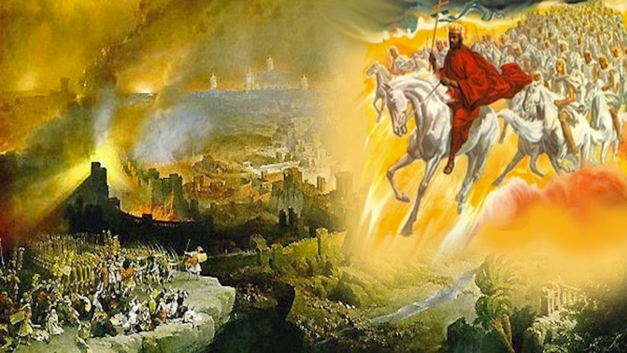
The Book of Revelation
Image credit – https://www.bible.com/events/84698
“The kingdom of the world has become the kingdom of our Lord and of His Christ,
and He shall reign forever and ever.” (Revelation 11:15)
Class Recording and Notes Will Be Available on https://www.purifiedbyfaith.com/

Slide 2
High Level Outline of the Book of Revelation
Introduction (1:1-8)
Jesus Among the Seven Churches (1:9-20)
Letters to the Seven Churches: (Chapters 2-3)
The Throne of God and the Lamb (Chapters 4-5)
Three Sets of Divine Judgments (6:1-16:21)
  Seven Seals (6:1-17; 8:1)
  Interlude: Sealing of the 144,000 (7:1-8); and Great Multitude Before the Throne (7:9-17)
  Seven Trumpets (8:2-11:19)
  Interlude: Persecution, Deliverance and Judgment (Chapters 12–14)
  Seven Bowls (Chapters 15–16)
The Fall of Babylon (17:1-19:10)
The Last Battle (19:11-20:15)
The Marriage of Heaven and Earth (21:1-22:5)
Epilogue (22:6-21)

Slide 3
The Sixth Trumpet – The Horsemen of Judgment (9:13-21)
^{9:13} The sixth angel sounded his trumpet, and I heard a voice coming from the horns of the golden altar that is before God. ¹⁴ It said to the sixth angel who had the trumpet, “Release the four angels who are bound at the great river Euphrates.” ¹⁵ And the four angels who had been kept ready for this very hour and day and month and year were released to kill a third of mankind. ¹⁶ The number of the mounted troops was two hundred million. I heard their number. ¹⁷ The horses and riders I saw in my vision looked like this: Their breastplates were fiery red, dark blue, and yellow as sulfur. The heads of the horses resembled the heads of lions, and out of their mouths came fire, smoke and sulfur.

Slide 4
The Sixth Trumpet – The Horsemen of Judgment (9:13-21)
^{9:18} A third of mankind was killed by the three plagues of fire, smoke and sulfur that came out of their mouths. ¹⁹ The power of the horses was in their mouths and in their tails; for their tails were like snakes, having heads with which they inflict injury. ²⁰ The rest of mankind that were not killed by these plagues still did not repent of the work of their hands; they did not stop worshiping demons, and idols of gold, silver, bronze, stone and wood--idols that cannot see or hear or walk. ²¹ Nor did they repent of their murders, their magic arts, their sexual immorality or their thefts. (NIV)

Slide 5
^{9:13} Then the sixth angel blew his trumpet, and I heard a voice from the four horns of the golden altar before God, ¹⁴ saying to the sixth angel who had the trumpet, "Release the four angels who are bound at the great river Euphrates." (ESV)
When the “sixth angel” sounds his “trumpet”, John hears a “voice” coming from the “the four horns of the golden altar before God”.
The “voice” that John hears is said to come from “the four horns of the golden altar”, which is poetically personified as speaking – as it does again in Revelation 16:7.
Once again, we have a vision focusing on the “golden altar” of incense as had in 6:9-10 and 8:3-5.
This altar is the heavenly counterpart to the one in the earthly temple, as we should expect from God’s instructions to Moses: “Exactly as I show you concerning the pattern of the [heavenly] tabernacle, and of all its furniture, so you shall make [the earthly tabernacle].” (Ex 25:9).

Slide 6
^{9:13} Then the sixth angel blew his trumpet, and I heard a voice from the four horns of the golden altar before God, ¹⁴ saying to the sixth angel who had the trumpet, "Release the four angels who are bound at the great river Euphrates." (ESV)
This heavenly altar of incense was associated earlier with the prayers of the persecuted saints (Rev. 6:9–10; cf. 8:3–5).
Therefore, this judgment that is about to fall on Jerusalem is probably being presented as a part of God’s answer to His people’s prayers for vindication.
The mention of this point is undoubtably intended to encourage God’s people in worship and prayer, by assuring them that God’s actions in history proceed from his “altar”, where He has received their prayers.
We’re told here that this altar is “before God” who sits on his judicial throne (cf. 8:3c).
From this we see that it is ultimately God who is judging – even though he uses demons (9:3-6) and the Romans (9:16-19) to carry out those judgments

Slide 7
^{9:13} Then the sixth angel blew his trumpet, and I heard a voice from the four horns of the golden altar before God, ¹⁴ saying to the sixth angel who had the trumpet, “Release the four angels who are bound at the great river Euphrates.” (ESV)
The voice commands the “sixth angel ” to “Release the four angels who are bound at the great river Euphrates.”
These are probably not the same “four angels” we saw earlier in Revelation 7:1.
Those earlier “four angels” stood “at the four corners of the earth, holding back the four winds of the earth”; whereas these angels are “bound at the great river Euphrates”.
These are probably evil angels – their being “bound” suggests that they have been restrained against their will, much as Satan is later bound and then released (Rev. 20:2–3; cf. 2 Pet. 2:4; Jude 6).
Their destructive work also resembles that of the demonic locusts in Revelation 9:1–11.

Slide 8
^{9:13} Then the sixth angel blew his trumpet, and I heard a voice from the four horns of the golden altar before God, ¹⁴ saying to the sixth angel who had the trumpet, "Release the four angels who are bound at the great river Euphrates." (ESV)
The “great river Euphrates” was the ideal northern boundary of Israel’s Promised Land (Gen. 15:18; Deut. 11:24; Josh. 1:4).
It also marked the extent of the kingdoms of David and Solomon (2 Sam. 8:3; 1 Chron. 18:3; 2 Chron. 9:26).
More ominously, Israel’s most dangerous enemies—Assyria and Babylon—had come from the region beyond the “Euphrates”.
The prophets therefore often referred to this region as the direction from which covenant judgment invaded Israel (Isa. 7:20; 8:7–8; Jer. 1:14–15; 6:1, 22; 10:22; Ezek. 38:6, 15; Joel 2:20–25).

Slide 9
^{9:13} Then the sixth angel blew his trumpet, and I heard a voice from the four horns of the golden altar before God, ¹⁴ saying to the sixth angel who had the trumpet, "Release the four angels who are bound at the great river Euphrates." (ESV)
The “great river Euphrates” also had a direct connection with the Jewish War.
It formed the eastern boundary of the Roman Empire, and four Roman legions were normally stationed in Syria between that region and the river.
When Vespasian and Titus organized the military campaign to crush the Jewish Revolt in A.D. 66–70, four legions (the 5th, 10th, 12th, and 15th) were dispatched directly from the Euphrates region to invade Judea.
While we can’t be certain, the spiritual powers (“the four angels”) who are “bound at the great river Euphrates” may represent the supernatural forces operating behind those four Roman legions who had been dispatched from that region.

Slide 10
^{9:15} So the four angels, who had been prepared for the hour, the day, the month, and the year, were released to kill a third of mankind. (ESV)
We’re told here that the “four angels” had been prepared “for the hour, the day, the month, and the year.”
The wording does not mean that they would operate for a total period of one year, one month, one day, and one hour.
The single Greek article unites all four expressions and points to one specific moment: an appointed hour occurring on the appointed day, month, and year.
Their release therefore demonstrates God’s exact sovereignty over history.
The saints had asked, “How long?” before God avenged their blood (Rev. 6:10).
The answer is that God had already chosen the precise moment.
The apparent delay was neither forgetfulness nor indifference.
The destructive angels were restrained until His appointed time.
Notice this trumpet intensifies the judgment of the previous trumpet.
The demonic locusts of the fifth trumpet could only “torment” (cf. 9:5;10) – here these angels coming with the sixth trumpet are “released to kill ”

Slide 11
^{9:15} So the four angels, who had been prepared for the hour, the day, the month, and the year, were released to kill a third of mankind [literally, “the men”]. (ESV)
The ESV translation tells us here that “the four angels… were released to kill a third of mankind”
The Greek phrase translated “mankind” here (ton anthropon = “the men”), describes the group from which “a third” is taken.
But the Greek grammar do not tell us who that group is.
Context must determine whether the group being spoken of here is:
  “a third” of humanity universally
  or “a third” of a particular population, such as those living in the land of Israel.
By translating the Greek (ton anthropon) here as “mankind” (rather than “the men”) the ESV makes it sound like a “third” of the entire earth’s population was killed by “the four angels” – even though the Greek grammar here does not necessarily mean that.
This is similar to way the ESV consistently translates Greek word ge throughout the book of Revelation as “earth” rather than “the Land” (6:8, 10; 7:1; 8:5, 7, 13; 9:1).

Slide 12
^{9:15} So the four angels, who had been prepared for the hour, the day, the month, and the year, were released to kill a third of mankind [literally, “the men”]. (ESV)
In this context, I believe “the men” being spoken of here are the Jews of first-century Israel, not the human race at large.
All of the preceding judgments up to this point have been directed against the Jews living in “the Land”:
  The six seals which describe the judgments Jesus warned (in the Olivet Discourse) would come upon “this generation” of Jews living in Palestine.
  The first four “trumpet” judgments which took place after an angel sprinkled hot coals from the heavenly alter on “the Land” (Rev 8:5, 6-12)
  The preceding fifth trumpet protected the sealed Jewish Christians from the internal “torment” inflicted upon “the Land” by Satan and his demons during the Roman siege (Rev. 7:4–8; 9:1-12).
  The “four angels” bringing this sixth trumpet judgment are “bound at the great river Euphrates” which is just northeast of “the Land” of Israel.
Therefore, in light of the context, I believe this verse should be translated: “the four angels… were released to kill a third of the men [in the Land]”.

Slide 13
^{9:16} The number of the troops of cavalry was twice ten thousand times ten thousand; I heard their number. (ESV)
John hears that the mounted troops number “twice ten thousand times ten thousand,” commonly translated as two hundred million.
Nearly all the commentators agree that the number should not be treated as a literal head count
In biblical language, “ten thousand” frequently represents an incalculably large multitude rather than an exact total (Gen. 24:60; Deut. 32:30; 33:2, 17; Dan. 7:10).
The expression probably draws upon Psalm 68:17, which describes God’s chariots as “twice ten thousand, thousands upon thousands”
The number is intended to create psychological terror.
It portrays a complete, colossal, and irresistible military host.
Similar biblical descriptions compare armies to the innumerable sands of the seashore (Josh. 11:4; Judg. 7:12; 1 Sam. 13:5; 2 Sam. 17:11).

Slide 14
^{9:16} The number of the troops of cavalry was twice ten thousand times ten thousand; I heard their number. (ESV)
The Roman army that attacked Jerusalem was not literally two hundred million strong.
Josephus places its combined force of legionaries, auxiliaries, archers, and cavalry at approximately sixty thousand.
Nevertheless, this army represented the whole power of the Roman Empire.
Soldiers from various provinces and client kingdoms joined the campaign.
Tiny Judea was confronting the world’s most highly trained and successful military force.
Four of Rome’s approximately thirty legions were deployed against Jerusalem, together with numerous auxiliaries.
Thus, the number symbolizes the overwhelming power that Rome could bring against the rebellious city.
Jerusalem’s defenders would have felt as though the entire world had gathered against them.

Slide 15
^{9:17} And this is how I saw the horses in my vision and those who rode them: they wore breastplates the color of fire and of sapphire and of sulfur, and the heads of the horses were like lions' heads, and fire and smoke and sulfur came out of their mouths. (ESV)
John here tells us that he saw “in [his] vision” the horses and those who sat on them.
John is reminding his readers the horses, lionlike heads, and fire-breathing mouths are symbolic images in a “vision”, not literal creatures.
John reports that the rider’s breastplates are three colors:
  “fire” means fiery red.
  “sapphire” means dark or smoky blue.
  “sulfur” means sulfurous yellow.
These colors are probably meant to metaphorically represent the “fire”, “smoke”, and “sulfur” that come from the horses’ mouths.

Slide 16
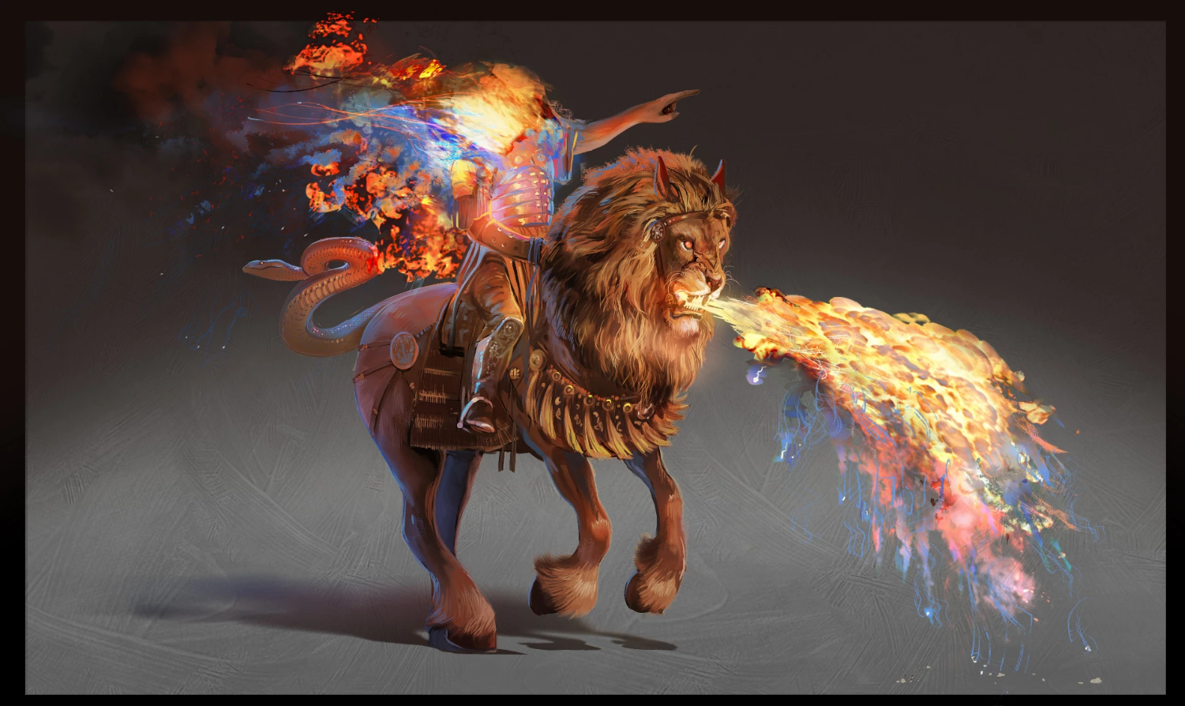
^{9:17} And this is how I saw the horses in my vision and those who rode them: they wore breastplates the color of fire and of sapphire and of sulfur, and the heads of the horses were like lions' heads, and fire and smoke and sulfur came out of their mouths. (ESV)
https://www.biblicaltoolbelt.com/l/horse-and-rider-revelation-9/

Slide 17
^{9:17} And this is how I saw the horses in my vision and those who rode them: they wore breastplates the color of fire and of sapphire and of sulfur, and the heads of the horses were like lions' heads, and fire and smoke and sulfur came out of their mouths. (ESV)
The “fire and smoke and sulfur” imagery draws upon several biblical pictures of judgment:
  Joel’s advancing army spreads “fire” before and behind it (Joel 2:1–11).
  Leviathan breathes “fire” and “smoke” (Job 41:18–21).
  “fire” and “sulfur” destroyed Sodom and Gomorrah (Gen. 19:24, 28).
  “fire”, “smoke”, and “sulfur” anticipate final judgment (Rev. 14:10–11; 19:20; 20:10; 21:8).
These riders are a symbolic representation of Rome’s military power during the siege of Jerusalem in A.D. 70.
The cavalry was one of the most feared weapons of ancient warfare.

Slide 18
^{9:17} And this is how I saw the horses in my vision and those who rode them: they wore breastplates the color of fire and of sapphire and of sulfur, and the heads of the horses were like lions' heads, and fire and smoke and sulfur came out of their mouths. (ESV)
Roman horsemen repeatedly scattered, trampled, and killed Jewish fighters.
Behind them stood Rome’s formidable siege machinery: battering rams, catapults, mobile towers, archers, missiles, and other engines of destruction.
John compresses these destructive forces into one horrifying image of fire-breathing horses.
The demonic torment inside Jerusalem and the Roman army outside its walls operated simultaneously.
While rebellious factions terrorized the city internally, Rome surrounded it with legions, cavalry, siege engines, missiles, and fire.

Slide 19
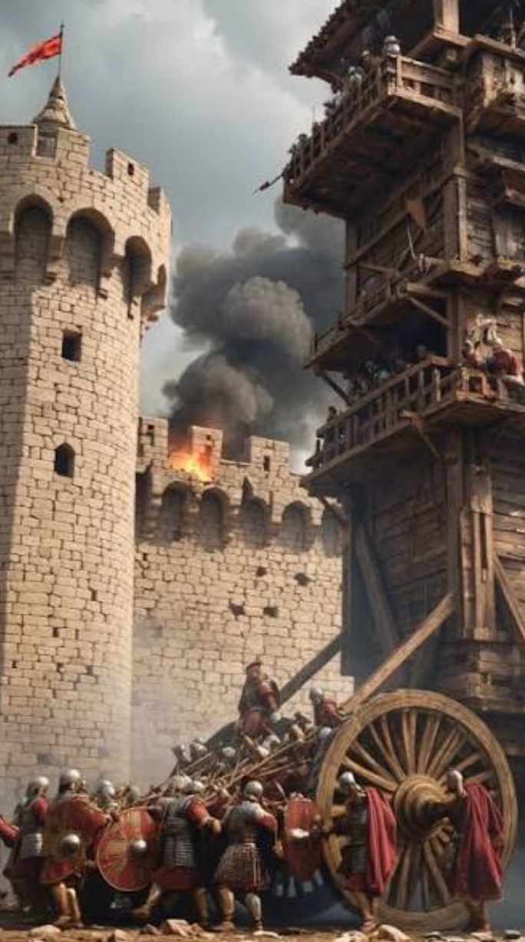
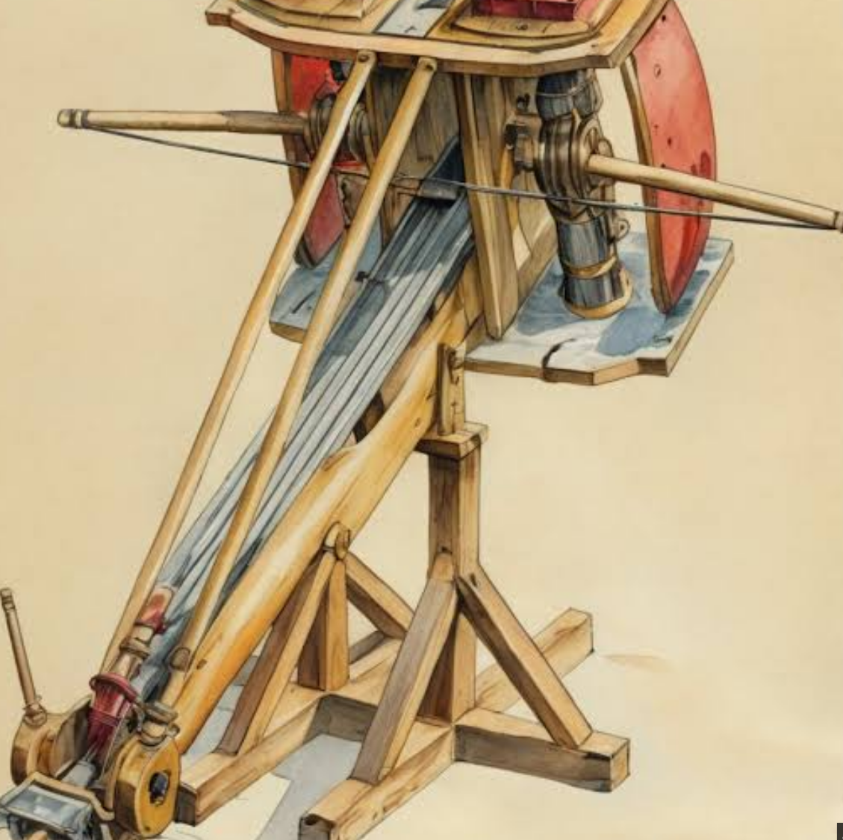
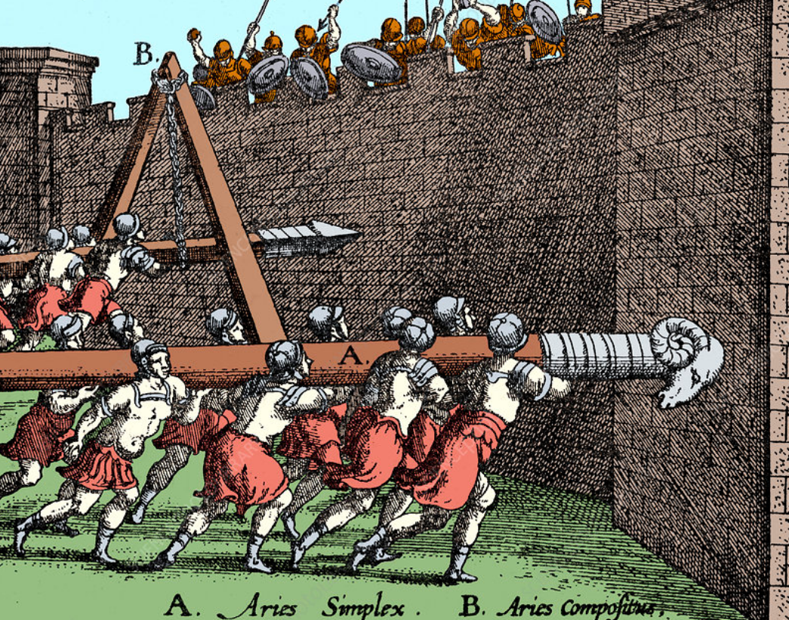
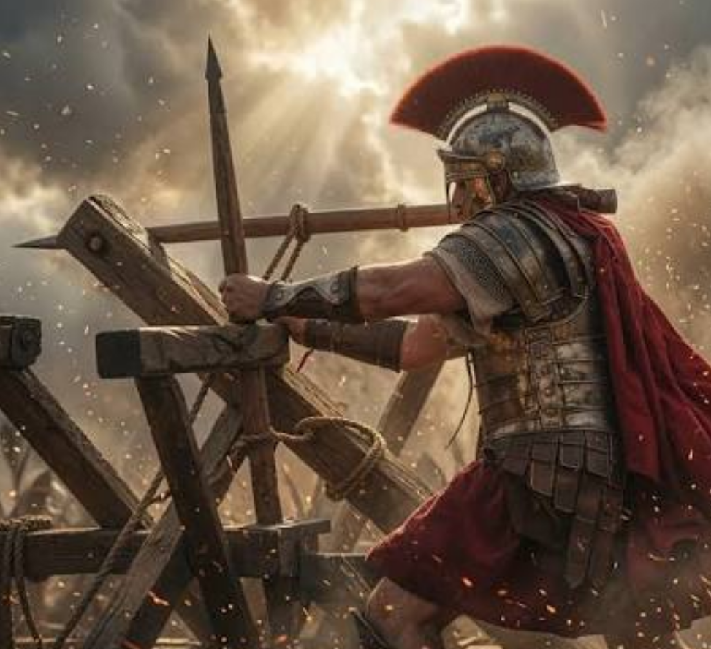
Rome’s formidable siege machinery: battering rams, catapults, mobile towers, archers, missiles, and other engines of destruction:
https://www.sciencephoto.com/media/1194185/view/battering-rams-ancient-roman-warfare
https://www.facebook.com/Romanhistoryold/posts/the-roman-army-conquered-vast-territories-not-through-courage-alone-but-through-/1009405361998278/
https://www.facebook.com/groups/2077090212683898/posts/2387637424962507/
https://www.facebook.com/reel/1946814142894374

Slide 20
^{9:18} By these three plagues a third of mankind [the men] was killed, by the fire and smoke and sulfur coming out of their mouths. (ESV)
As in verse 15 “a third of mankind” is better translated in this context “a third of the men [in Israel]”.
The “third” killed here is the same group mentioned in verse 15 – a large but limited portion of the Jewish population caught in the judgment.
Jesus had warned the Jews about this in His parable of the wedding feast:
  Jesus spoke to them in parables, saying, “The kingdom of heaven may be compared to a king who gave a wedding feast for his son, and sent his servants to call those who were invited to the wedding feast, but they would not come. Again he sent other servants, saying, ‘Tell those who are invited, “See, I have prepared my dinner, my oxen and my fat calves have been slaughtered, and everything is ready. Come to the wedding feast.”’ But they paid no attention and went off, one to his farm, another to his business, while the rest seized his servants, treated them shamefully, and killed them. The king was angry, and he sent his troops and destroyed those murderers and burned their city.” (Matt. 22:1–7)

Slide 21
^{9:19} For the power of the horses is in their mouths and in their tails, for their tails are like serpents with heads, and by means of them they wound. (ESV)
The horsemen possess power to destroy both from the front (“mouths”) and from behind (“tails”).
The “tails” with serpent-like “heads” symbolize stealth, venomous injury, and total entrapment.
This is a fulfillment of the double-edged judgment prophesied in Joel 2:2–5:
  …a day of darkness and gloom, a day of clouds and thick darkness! Like blackness there is spread upon the mountains a great and powerful people; their like has never been before, nor will be again after them through the years of all generations. Fire devours before them, and behind them a flame burns. The land is like the garden of Eden before them, but behind them a desolate wilderness, and nothing escapes them. Their appearance is like the appearance of horses, and like war horses they run. As with the rumbling of chariots, they leap on the tops of the mountains, like the crackling of a flame of fire devouring the stubble, like a powerful army drawn up for battle.

Slide 22
^{9:20} The rest of mankind [the men], who were not killed by these plagues, did not repent of the works of their hands nor give up worshiping demons and idols of gold and silver and bronze and stone and wood, which cannot see or hear or walk, ²¹ nor did they repent of their murders or their sorceries or their sexual immorality or their thefts. (ESV)
As in verse 15 and 18 “The rest of mankind” in this context is better translated “The rest of the men [in Israel]” – that is, Jews in Jerusalem who survived the previously mentioned “plagues” (i.e., judgments of the Jewish War).
Despite everything these Jews suffered, they still refused to “repent”.
Their stubbornness resembles Pharaoh’s response to the Egyptian “plagues”.
Although first-century Jews generally rejected literal pagan idols, by rejecting Christ, persecuting His followers, and declaring, “We have no king but Caesar” (John 19:15), Israel abandoned faithfulness to God.
Jesus even told certain Jewish leaders, “You are of your father the devil” (John 8:44).
Thus, their outward religion concealed a deeper allegiance to satanic opposition.

Slide 23
^{9:20} The rest of mankind [the men], who were not killed by these plagues, did not repent of the works of their hands nor give up worshiping demons and idols of gold and silver and bronze and stone and wood, which cannot see or hear or walk, ²¹ nor did they repent of their murders or their sorceries or their sexual immorality or their thefts. (ESV)
The “works of their hands”—“idols of gold and silver and bronze and stone and wood” – may point to the Jerusalem temple itself.
The temple contained all these materials and had become an object of misplaced Jewish trust and confidence.
The Jews trusted the magnificent building and its ceremonies while rejecting the Messiah to whom the temple pointed.
This is a repeat of the sin condemned in Jeremiah 7:4: “Do not trust in these deceptive words: ‘This is the temple of the Lord.’”
The lifeless earthly temple “cannot see or hear or walk”, while the alter in the heavenly temple spoke God’s judgment against it.

Slide 24
^{9:20} The rest of mankind [the men], who were not killed by these plagues, did not repent of the works of their hands nor give up worshiping demons and idols of gold and silver and bronze and stone and wood, which cannot see or hear or walk, ²¹ nor did they repent of their murders or their sorceries or their sexual immorality or their thefts. (ESV)
While Verse 20 focuses on spiritual apostasy, Verse 21 details the moral collapse in human relationships.
The four specific sins mentioned here were characteristic of Jewish society leading up to A.D. 70:
  “murders” – The assassination campaigns by the Zealots and Sicarii, in addition to the murder of the Christian prophets and apostles (Matt 23:34–37).
  “sorceries”, “sexual immorality”, and “thefts”: Josephus explicitly records that during the inner-city war inside Jerusalem, the rival Jewish factions degenerated into rampant theft, sexual depravity, violent extortion, and reliance on false, deceptive prophets (J.W. 5.9.4 §402; 5.13.6 §566).

Slide 25

Class Discussion Time
One of the astounding outcomes of today’s lesson is that while God continues to turn up the heat, brining on more and more judgment, the Jews remain stubbornly steadfast in their rebellion.
What does this tell you about the evil nature of the rebellious human heart, apart from its being changed from within by the Spirit of God?

Slide 26
Class Discussion Time
In today’s lesson, I spent a couple of slides explaining the Greek grammar behind the ESV’s translation of “the four angels… were released to kill a third of mankind” (Rev 9:15)
Does anyone have any questions about why I believe this is better translated “the four angels… were released to kill a third of the men [in the Land]”
Do you agree with my thinking on this?
Did stepping through this argument help you see the value of knowing the original languages?

Slide 27
Class Discussion Time
In today’s lesson I suggested concerning Rev 9:14 that, while we can’t be certain, the spiritual powers (“the four angels”) who are “bound at the great river Euphrates” may represent the supernatural forces operating behind those four Roman legions who had been dispatched from that region.
Do you think that is the case?
Remember we saw in our Daniel study references to angelic beings identified as “the Prince of Persia” and the “Prince of Greece”, which I suggested were behind events happening in the world back in that day.
Do you think angelic beings play this kind of role behind the scenes in our day?

Slide 28
Class Discussion Time
The judgment of Jerusalem by the Roman army is obviously a special case of God’s Judgment upon the Jews for their rejection of the Messiah.
That being said, do you think that God brings judgment on nations today for their sinful behavior?
Why or Why not?

