Slide 1
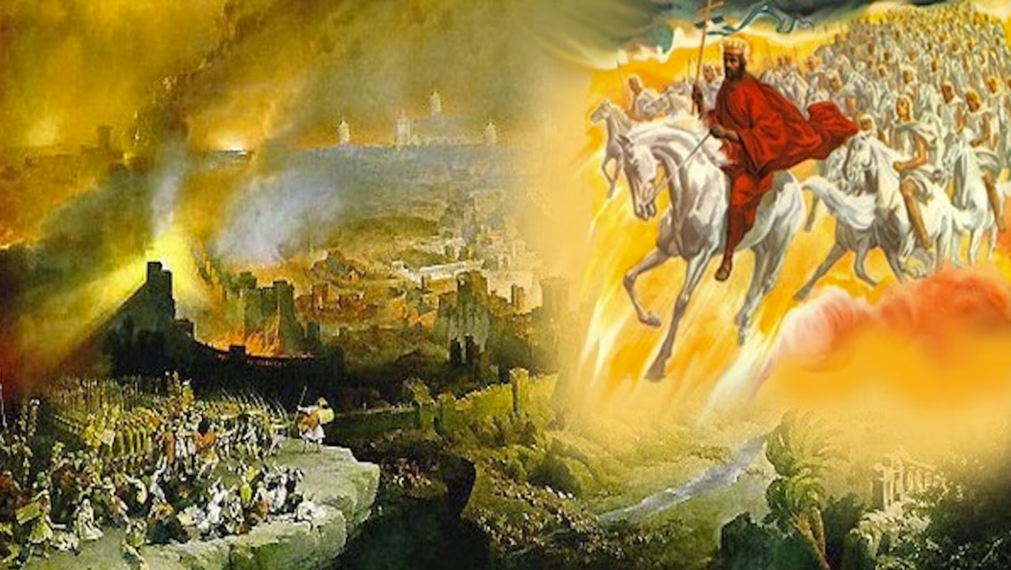
The Book of Revelation
Image credit – https://www.bible.com/events/84698
“The kingdom of the world has become the kingdom of our Lord and of His Christ,
and He shall reign forever and ever.” (Revelation 11:15)
Class Recording and Notes Will Be Available on https://www.purifiedbyfaith.com/

Slide 2
High Level Outline of the Book of Revelation
Introduction (1:1-8)
Jesus Among the Seven Churches (1:9-20)
Letters to the Seven Churches: (2-3)
The Throne of God and the Lamb (4-5)
Three Sets of Divine Judgments (6:1-16:21)
  Seven Seals (6:1-17; 8:1)
    Interlude Between Seal 6 and 7: Sealing of the 144,000 (7:1-8); Great Multitude Before the Throne (7:9-17)
  Seven Trumpets (8:2-9:21; 11:15-19)
    Interlude Between Trumpet 6 and 7: Angel and the Scroll (10:1-11); The Two Witnesses (11:1-14)
  Interlude Between Trumpets and Bowls: Persecution, Deliverance and Judgment (12–14)
  Seven Bowls (15–16)
The Fall of Babylon (17:1-19:10)
The Last Battle (19:11-20:15)
The Marriage of Heaven and Earth (21:1-22:5)
Epilogue (22:6-21)

Slide 3
Introduction to the Interlude Between the Sixth and Seventh Trumpet (Revelation 10:1-11:14)
The interlude between the sixth and seventh trumpets (Revelation 10:1–11:14) temporarily interrupts the description of the trumpet judgments to explain more fully why the destruction of Jerusalem and the Old Covenant system was about to take place.
Specifically, the trumpet interlude focuses on:
  The basis of God’s covenantal lawsuit against apostate Israel (Lev 26:14ff)
  The resulting global expansion of the New Covenant Church (cf. Ephesians 3:4-6; 2:11-14)
This interlude provides the crucial historical context to reassure first-century Christians that Christ is orchestrating this agonizing transition of replacing apostate Jerusalem with His eternal Kingdom.

Slide 4
The Angel and the Little Scroll (10:1-11)
^{10:1} Then I saw another mighty angel coming down from heaven. He was robed in a cloud, with a rainbow above his head; his face was like the sun, and his legs were like fiery pillars. ² He was holding a little scroll, which lay open in his hand. He planted his right foot on the sea and his left foot on the land, ³ and he gave a loud shout like the roar of a lion. When he shouted, the voices of the seven thunders spoke. ⁴ And when the seven thunders spoke, I was about to write; but I heard a voice from heaven say, “Seal up what the seven thunders have said and do not write it down.”

Slide 5
The Angel and the Little Scroll (10:1-11)
^{10:5} Then the angel I had seen standing on the sea and on the land raised his right hand to heaven. ⁶ And he swore by him who lives for ever and ever, who created the heavens and all that is in them, the earth and all that is in it, and the sea and all that is in it, and said, “There will be no more delay! ⁷ But in the days when the seventh angel is about to sound his trumpet, the mystery of God will be accomplished, just as he announced to his servants the prophets.”

Slide 6
The Angel and the Little Scroll (10:1-11)
^{10:8} Then the voice that I had heard from heaven spoke to me once more: “Go, take the scroll that lies open in the hand of the angel who is standing on the sea and on the land.” ⁹ So I went to the angel and asked him to give me the little scroll. He said to me, “Take it and eat it. It will turn your stomach sour, but in your mouth it will be as sweet as honey.” ¹⁰ I took the little scroll from the angel's hand and ate it. It tasted as sweet as honey in my mouth, but when I had eaten it, my stomach turned sour. ¹¹ Then I was told, “You must prophesy again about many peoples, nations, languages and kings.” (NIV)

Slide 7
^{10:1} Then I saw another mighty angel coming down from heaven, wrapped in a cloud, with a rainbow over his head, and his face was like the sun, and his legs like pillars of fire. (ESV)
Here John tells us he saw “another mighty angel coming down from heaven”.
There is a big disagreement among commentaries as to the identity of this “mighty angel”
One group of commentaries (Terry, Gentry, Chilton, Clark, Russell, Beeke, and Beale) say the “mighty angel” is Christ, appearing as an “Angel of the Lord” (Gen 16:7–13; 22:11–18; Ex 3:2–6; Judges 6:11–24; 13:3–22; Zechariah 3:1–2).
Others (Stewart, Paul, Schreiner, Mounce, and Carson) understand the “mighty angel” to be a powerful angel representing God or Christ.
The main arguments against this angel being Christ are:
  John calls him “another mighty angel,” naturally placing him alongside other angels, especially the “mighty angel” mentioned in Revelation 5:2.
  Some argue that Revelation does not otherwise clearly call Jesus an angel.
  Later in the passage (10:5–6) this angel takes an oath to “by him who lives forever and ever”– some consider this oath more fitting for God’s messenger than for Christ himself.

Slide 8
^{10:1} Then I saw another mighty angel coming down from heaven, wrapped in a cloud, with a rainbow over his head, and his face was like the sun, and his legs like pillars of fire. (ESV)
The main arguments for this angel being Christ are:
  “coming down from heaven” echoes the many references in the Gospel of John where Christ is repeatedly described as the one who “comes down from heaven” (John 3:13; 6:33, 38, 41, 42, 50, 51, 58)
  “wrapped in a cloud” is an echo of Rev 1:7 where Christ is seen “coming with the clouds [in divine judgment], and every eye will see him, even those who pierced him”
  The “rainbow” points back to the rainbow of God's throne (Ezek. 1:28; Rev. 4:3)
  “face… like the sun” and “legs like pillars of fire” almost exactly matches the description given of Christ as he appears in Revelation 1:12–18 (“face was like the sun”, “feet were like burnished bronze”)
  His taking an oath is no obstacle, since God swears by himself (Gen. 22:16; Heb. 6:13–18) – not only that, but an almost identical oath is made by “the man clothed in linen” (Dan 12:7) who I believe to be a reference to the preincarnate Christ.
I believe the evidence for this “mighty angel” being Christ is significantly stronger than the evidence against it – so I will interpret the remaining text with this assumption in mind.

Slide 9
^{10:2} He had a little scroll open in his hand. And he set his right foot on the sea, and his left foot on the land, ³ and called out with a loud voice, like a lion roaring. When he called out, the seven thunders sounded. (ESV)
Here we see that the “mighty angel” (Christ) has a “little scroll” in his hand.
Because it is called a “little scroll” and is not sealed with seven seals like the one in chapter 5, but “open” – many commentaries (Matthewson, Paul, Aune, Schreiner, Mounce, Carson) believe this is a different scroll than the scroll mentioned in chapter 5.
But I, along with a number of other commentaries (Terry, Gentry, Chilton, Clark, Stewart, Beale ), believe the “scroll” mentioned here (in chapter 10) is the same “scroll” that John saw chapter 5

Slide 10
^{10:2} He had a little scroll open in his hand. And he set his right foot on the sea, and his left foot on the land, ³ and called out with a loud voice, like a lion roaring. When he called out, the seven thunders sounded. (ESV)
My reasons for thinking this is the same “scroll” that John saw chapter 5 are:
  The earlier heavenly scene presents a “scroll” with seven seals (5:1,5).
  With each of the seven seals having been opened (6:1-17; 8:1), the “scroll” itself would be “open” at this point.
  John states twice that this “scroll” is “open” (10:2,8), apparently for emphasis.
  Previously we learned that only the “Lamb” (Christ) can take the scroll to open it (5:3-8)
  Here the “mighty angel” (Christ) descends from heaven holding it “open in his hand”.
  Thus, in both chapters Christ is in control of the heavenly scroll.
  In fact, the last time we saw this scroll, Christ still had the scroll in his hand as he opened its seventh and final seal (8:1).

Slide 11
^{10:2} He had a little scroll open in his hand. And he set his right foot on the sea, and his left foot on the land, ³ and called out with a loud voice, like a lion roaring. When he called out, the seven thunders sounded. (ESV)
  Another reason for thinking that chapters 5 and 10 are referring to the same “scroll” is that both chapters set their scenery with many of the same images:
    a “mighty angel ” (though the previous one is not Christ) who cries out with a “loud voice” (5:2; 10:3)
    a “lion” is mentioned (5:5; 10:3),
    the prominent taking of “the scroll” from a heavenly hand (5:7; 10:8-9)
    references to “heaven”, “earth”, and “sea” (5:13a; 10:6b) and to God’s eternality (5:13b; 10:6a).

Slide 12
^{10:2} He had a little scroll open in his hand. And he set his right foot on the sea, and his left foot on the land, ³ and called out with a loud voice, like a lion roaring. When he called out, the seven thunders sounded. (ESV)
  Also, both chapters (5 and 10) make an obvious allusion to Ezekiel 2:9–3:3 in relation to the scroll:
Ezekiel | Revelation
A hand holds out a scroll written on both sides (2:9–10). | John sees a scroll written on both sides in God’s hand (5:1).
Ezekiel is told to eat the scroll, and it tastes sweet as honey (3:1–3). | John is told to eat the (open) scroll and eats it; it tastes sweet as honey, then makes his stomach bitter (10:8–10).
So, Revelation 5 echoes the appearance of Ezekiel’s scroll, while Revelation 10 echoes the prophet receiving and eating it.
Taken together, these echoes strengthen the case that John is seeing the same scroll both in chapters 5 and 10.
Also, Ezekiel’s scroll contains “lamentation and mourning and woe” (2:10), which fits the message of judgment associated with both chapters.

Slide 13
^{10:2} He had a little scroll open in his hand. And he set his right foot on the sea, and his left foot on the land, ³ and called out with a loud voice, like a lion roaring. When he called out, the seven thunders sounded. (ESV)
We should also note that calling it a “little scroll” does not mean it must be a different scroll.
In fact, in Revelation 10:8, John refers to this “little scroll” as simply “the scroll”.
John’s reason for calling it a “little scroll” may be to emphasize how large the angel is in comparison as he stands over the land and sea.
So, why bring the scroll back into view now?
By bringing the scroll mentioned in Revelation 5 back into view, we learn of the theological consequences of its opening, i.e., the redemptive-historical results of the judgments upon Israel.

Slide 14
^{10:2} He had a little scroll open in his hand. And he set his right foot on the sea, and his left foot on the land, ³ and called out with a loud voice, like a lion roaring. When he called out, the seven thunders sounded. (ESV)
In the preceding context (9:20-21), John notes that Israel does “not repent” under God’s judgments, even after the Lamb unseals the book.
Nevertheless, the larger purpose of God is not thereby thwarted.
As Revelation will ultimately demonstrate, John would agree with Paul: “…did [the Jews] stumble in order that they might fall? By no means! Rather through their trespass salvation has come to the Gentiles, so as to make Israel jealous” (Rom 11:11).
We will discover in the following verses in this chapter and in later chapters (chs. 20-22) that the devastation of Israel in AD 70 leads to the full, permanent, and final inclusion of the Gentiles into the kingdom of God.
With this judgmental affirmation, the debates of Acts 11 and 15 and of Galatians are dramatically and resoundingly resolved forever: The Gentiles are now numbered among the people of God and are not subject to the old covenant.

Slide 15
^{10:2} He had a little scroll open in his hand. And he set his right foot on the sea, and his left foot on the land, ³ and called out with a loud voice, like a lion roaring. When he called out, the seven thunders sounded. (ESV)
Besides having a scroll in his hand, the “mighty angel” (Christ) prominently straddles “sea” and “land”: he placed his “right foot on the sea” and “his left on the land”.
In the Bible planting a foot is often used as a picture of dominion (Rev 11:2; 1Ki 5:3; Pss 8:6; 18:38; Mal 4:3; Rom 16:20).
Planting His “right foot on the sea” (Gentile nations) and “left foot on the land” (gē, the Land of Israel) signifies Christ's absolute legal claim and cosmic dominion over all earthly realms (cf. Matt. 28:18).
This is further confirmation that the “mighty angel” here is Christ – not a regular angel – because only he has dominion over all things (Mt 28:18; Php 2:9-11; Col 1:16-17; Rev 17:14; 19:16).
The reference to Christ’s dominion over sea and land also anticipates the two beasts that will later appear in the book: one from the “sea” (13:1) and the other from the “land” (13:11).
Those beasts portray the Roman emperor (who rules the nations, Lk 2:1) and apostate Judaism (headquartered in “the Land”).

Slide 16
^{10:2} He had a little scroll open in his hand. And he set his right foot on the sea, and his left foot on the land, ³ and called out with a loud voice, like a lion roaring. When he called out, the seven thunders sounded. (ESV)
The might angel “called out with a loud voice, like a lion roaring” – here Christ’s sovereignty is effectively emphasized in yet another way:
The lion’s powerful roar is the terrifying sound of victory (Isa 5:29; Jer 2:15; Eze 22:25; Am 3:4).
Many commentators also connect the lion's roar to Christ being the “the Lion of the tribe of Judah” announced in Revelation 5:5.
“the seven thunders sounded” flow naturally from the imagery of the “cloud” surrounding Christ (10:1; cf. Ex 19:16; 2Sam 22:12- 14; Job 36:29; Ps 18:11-13; 77:17-18).
Nearly all commentators believe that John draws this imagery from Psalm 29, where “the voice of the LORD” is mentioned seven times and is associated there with “thunder” (Ps 29:3).

Slide 17
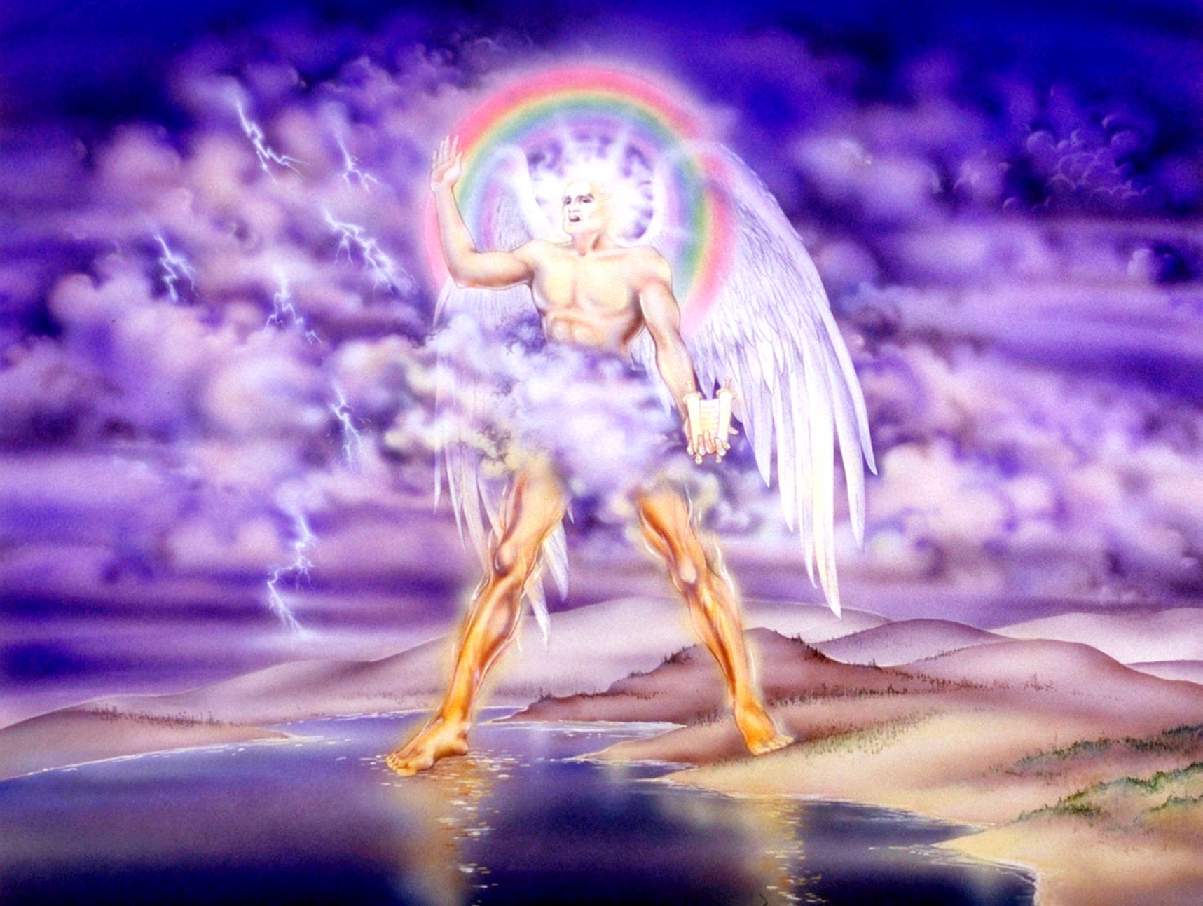
^{10:1} Then I saw another mighty angel coming down from heaven, wrapped in a cloud, with a rainbow over his head, and his face was like the sun, and his legs like pillars of fire. ^{10:2} He had a little scroll open in his hand. And he set his right foot on the sea, and his left foot on the land, ³ and called out with a loud voice, like a lion roaring. When he called out, the seven thunders sounded. (ESV)
Pat Marvenko Smith. Revelation Illustrated: An Artist's View of the Bible's Last Book (1982)

Slide 18
^{10:4} And when the seven thunders had sounded, I was about to write, but I heard a voice from heaven saying, “Seal up what the seven thunders have said, and do not write it down.” (ESV)
Here we read with disappointment that when the seven peals of thunder had “sounded”, and John was about to write, he heard a voice from heaven saying, “Seal up what the seven thunders have said, and do not write it down”.
Since John does not reveal what the seven thunders said, what can we conclude about this?
Thunder elsewhere in Revelation signals God’s judgment, so the thunders likely announced further judgments.
The command to suppress their message suggests that God will not add another series of judgments before the end.
The seals have led to the trumpets, but the bowls will be the last series.
God is bringing the judgment to its conclusion without further delay.
This answers the martyrs’ cry for justice and reinforces Revelation’s promise that these events will happen soon (cf. Rev 1:1, 3; 22:6, 10).

Slide 19
^{10:5} And the angel whom I saw standing on the sea and on the land raised his right hand to heaven ⁶ and swore by him who lives forever and ever, who created heaven and what is in it, the earth and what is in it, and the sea and what is in it, that there would be no more delay, ⁷ but that in the days of the trumpet call to be sounded by the seventh angel, the mystery of God would be fulfilled, just as he announced to his servants the prophets. (ESV)
The mighty angel (Christ) raises “his right hand to heaven” and swears that there will be “no more delay.”
This oath is an echo of two Old Testament passages:
  Daniel 12:7 – where the Christ figure (called the “man clothed in linen”) “raised his right hand and his left hand toward heaven and swore by him who lives forever ” that at “the time of the end” (cf. Dan 12:4) after a three and a half year period “when the shattering of the power of the holy people [i.e. The Jews in Jerusalem] comes to an end all these things [the daily sacrifices in the temple] would be finished”
  Deuteronomy 32:40-41 : is a passage where God raises his hand to heaven and swears by his own eternal life that he will judge his enemies: “As I live forever, if I sharpen my flashing sword and my hand takes hold on judgment, I will take vengeance on my adversaries and repay those who hate me”

Slide 20
^{10:5} And the angel whom I saw standing on the sea and on the land raised his right hand to heaven ⁶ and swore by him who lives forever and ever, who created heaven and what is in it, the earth and what is in it, and the sea and what is in it, that there would be no more delay, ⁷ but that in the days of the trumpet call to be sounded by the seventh angel, the mystery of God would be fulfilled, just as he announced to his servants the prophets. (ESV)
The oath’s appeal to the Creator stresses that God has the power to carry out his judgment.
In his oath he swears there will be “no more delay” – a warning that the time for judgment on Israel is near.
This connects the oath to the martyrs’ earlier question, “How long?” (Revelation 6:10).
When the seventh trumpet sounds (“the trumpet call to be sounded by the seventh angel”), their wait for vindication will be over.

Slide 21
^{10:5} And the angel whom I saw standing on the sea and on the land raised his right hand to heaven ⁶ and swore by him who lives forever and ever, who created heaven and what is in it, the earth and what is in it, and the sea and what is in it, that there would be no more delay, ⁷ but that in the days of the trumpet call to be sounded by the seventh angel, the mystery of God would be fulfilled, just as he announced to his servants the prophets. (ESV)
Both the oath in Daniel’s vision (Dan 12:7) and the oath being sworn here point to the crisis culminating in Jerusalem’s destruction in AD 70.
Daniel was told in Daniel 12:4 to seal the words of his prophesy “until the time of the end”.
John is told here that “the end” of the Jewish age is fast approaching (“there would be no more delay”) and that when that age ended, the “mystery of God would be fulfilled”.
The “mystery of God” is the full inclusion of Gentiles alongside Jews in Christ’s kingdom, a promise “announced to his servants the prophets”.

Slide 22
^{10:5} And the angel whom I saw standing on the sea and on the land raised his right hand to heaven ⁶ and swore by him who lives forever and ever, who created heaven and what is in it, the earth and what is in it, and the sea and what is in it, that there would be no more delay, ⁷ but that in the days of the trumpet call to be sounded by the seventh angel, the mystery of God would be fulfilled, just as he announced to his servants the prophets. (ESV)
The Apostle Paul refers to his same “mystery” in Ephesians 3:4-6:
  When you read this, you can perceive my insight into the mystery of Christ, which was not made known to the sons of men in other generations as it has now been revealed to his holy apostles and prophets by the Spirit. This mystery is that the Gentiles are fellow heirs, members of the same body, and partakers of the promise in Christ Jesus through the gospel.
Christ secured that access through his death:
  Therefore remember that at one time you Gentiles …were …separated from Christ, alienated from the commonwealth of Israel and strangers to the covenants of promise, having no hope and without God in the world. But now in Christ Jesus you who once were far off have been brought near by the blood of Christ. (Eph 2:11-13)
The destruction of the temple in A.D. 70 publicly confirmed that the old covenant temple system had ended, making way for this “mystery” to take place.
Revelation 10 announces under oath that there will be “no more delay” – this change is coming soon (cf. Rev 1:1, 3; 22:6, 10)!

Slide 23
^{10:8} Then the voice that I had heard from heaven spoke to me again, saying, "Go, take the scroll that is open in the hand of the angel who is standing on the sea and on the land." ⁹ So I went to the angel and told him to give me the little scroll. And he said to me, "Take and eat it; it will make your stomach bitter, but in your mouth it will be sweet as honey." ¹⁰ And I took the little scroll from the hand of the angel and ate it. It was sweet as honey in my mouth, but when I had eaten it my stomach was made bitter. (ESV)
As we have already pointed out, John's eating of the scroll is modeled on Ezekiel's eating of the scroll of lamentation (Ezek. 2:9–3:14), with the same sweet-then-bitter experience.
The judgments listed in the scroll are both “sweet” and “bitter”:
  “sweet” because God vindicated the martyrs, judged their persecutors, and brought about the church's triumph.
  “bitter” because the temple, city, and nation had to be destroyed for their unrepentance, and John, no doubt feels genuine grief for the judgment and condemnation his fellow kinsmen are about to experience, much like the Apostle Paul expresses in Rom 9:2-3 where he says, “I have great sorrow and unceasing anguish in my heart. For I could wish that I myself were accursed and cut off from Christ for the sake of my brothers, my kinsmen according to the flesh.”

Slide 24
^{10:11} And I was told, "You must again prophesy about many peoples and nations and languages and kings." (ESV)
John is told to prophesy again to “many peoples and nations and languages and kings”.
It does not specifically tell us who is speaking here, but the command clearly comes from heaven.
The Lord here renews John’s commission and signals that his work will continue even though the seventh trumpet is near.
John’s message will now extend beyond judgment on Jerusalem and Israel to judgment on Rome, which is allied with Jerusalem in its persecution of Christians.
The command to prophesy [judgment] “about” the nations, the bitterness of the scroll John has eaten, and the example of Ezekiel all point to a message of judgment.
The coming chapters will show both Jerusalem’s downfall and Rome’s role in the conflict.

Slide 25

Class Discussion Time
Early on in the lesson I made you aware that there is a big divide among commentaries as to the identity of this “mighty angel” in Rev 10:1:
  One group of commentaries (Terry, Gentry, Chilton, Clark, Russell, Beeke, and Beale) say the “mighty angel” is Christ, appearing as an “Angel of the Lord” (Gen 16:7–13; 22:11–18; Ex 3:2–6; Judges 6:11–24; 13:3–22; Zechariah 3:1–2).
  Others (Stewart, Paul, Schreiner, Mounce, and Carson) understand the “mighty angel” to be a powerful angel representing God or Christ.
I went with the first view for the remainder of the lesson.
Which view makes the most sense to you and why?

Slide 26
Class Discussion Time
Another big divide among commentaries is whether or not the “little scroll” in Rev 10:2 is the same scroll as the one mentioned in chapter 5:
  Terry, Gentry, Chilton, Clark, Stewart, Beale say it is
  Matthewson, Paul, Aune, Schreiner, Mounce, Carson say it is not
I taught that they were the same scroll, giving several reasons why I thought so – mainly that there are a remarkable number of parallels between scrolls in chapter 5 and chapter 10, and that John actually refers to what he starts out calling the “little scroll” as just “the scroll” in Rev 10:8.
What do you think? Do you think both chapter 5 and chapter 10 are referring to the same scroll? Why or why not?

Slide 27
Class Discussion Time
Were you surprised to learn that the book of Revelation, in harmony with the rest of the New Testament, provides support for the idea that with the coming of Christ, we are no longer under the Old Covenant?
All the necessary “equipment” for the Old Covenant (i.e. the temple and all of it’s furnishings) were destroyed in A.D 70, paving the way for the Gentiles to be included on equal footing with the Jews under the New Covenant.
Can you see how this understanding of Revelation makes the things that happen in this book very relevant to its readers and to us, as opposed to the dispensationalist, futurist view which almost makes Revelation like a scary movie about a bunch of weird scary things that happen sometime in the distant future after we’ve all been raptured and won’t even be here to see it?

