Slide 1
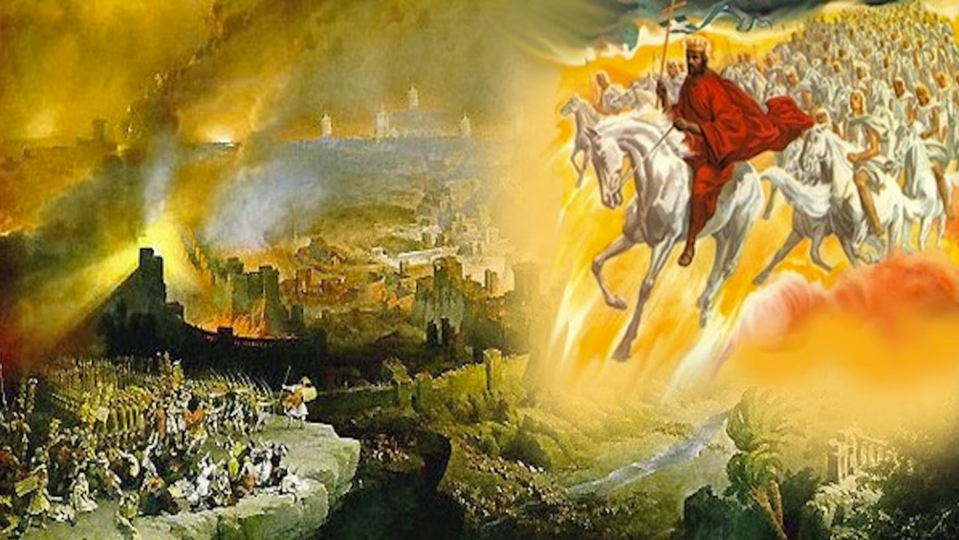
The Book of Revelation
Image credit – https://www.bible.com/events/84698
“The kingdom of the world has become the kingdom of our Lord and of His Christ,
and He shall reign forever and ever.” (Revelation 11:15)
Class Recording and Notes Will Be Available on https://www.purifiedbyfaith.com/

Slide 2
High Level Outline of the Book of Revelation
Introduction (1:1-8)
Jesus Among the Seven Churches (1:9-20)
Letters to the Seven Churches: (2-3)
The Throne of God and the Lamb (4-5)
Three Sets of Divine Judgments (6:1-16:21)
  Seven Seals (6:1-17; 8:1)
    Interlude Between Seal 6 and 7: Sealing of the 144,000 (7:1-8); Great Multitude Before the Throne (7:9-17)
  Seven Trumpets (8:2-9:21; 11:15-19)
    Interlude Between Trumpet 6 and 7: Angel and the Scroll (10:1-11); Measuring the Temple (11:1-2); The Two Witnesses (11:3-14)
  Interlude Between Trumpets and Bowls: Persecution, Deliverance and Judgment (12–14)
  Seven Bowls (15–16)
The Fall of Babylon (17:1-19:10)
The Last Battle (19:11-20:15)
The Marriage of Heaven and Earth (21:1-22:5)
Epilogue (22:6-21)

Slide 3
Introduction to Revelation Chapter 11:1-14
In chapter 11, John continues his interlude between the sixth and seventh trumpets, which began at 10:1 and will end with the declaration that “the second woe is past” (11:14) and the sounding of the seventh trumpet (11:15).
It is broken into two sections:
  The temple measurement (11:1–2)
  The two witnesses (11:3–13).
It parallels the interlude in Revelation 7, between the sixth and seventh seals.
Both interludes give a pair pictures:
  7:9–17 – Sealed Jewish believers, then heaven’s countless multinational multitude
  11:1–12 – Jewish Christians preserved during the temple destruction, then the witnesses’ ministry and heavenly ascent.
The temple worshipers (mentioned in 11:1–2) and the 144,000 Jewish Christians (mentioned in 7:4–8) represent the same group.
Thus, both of these interludes reveal God’s protection of Christianity’s Jewish beginnings followed by the heavenly destiny of the new covenant community that grows out of it.

Slide 4
The Temple Measured (11:1-2)
^{11:1} I was given a reed like a measuring rod and was told, “Go and measure the temple of God and the altar, and count the worshipers there. ² But exclude the outer court; do not measure it, because it has been given to the Gentiles. They will trample on the holy city for 42 months.

Slide 5
^{11:1} Then I was given a measuring rod like a staff, and I was told, “Rise and measure the temple of God and the altar and those who worship there, ² but do not measure the court outside the temple; leave that out, for it is given over to the nations, and they will trample the holy city for forty-two months. (ESV)
John receives a “measuring rod” and is told to measure “the temple of God and the altar and those who worship there”, but he is told not to measure “the court outside the temple”.
Clearly the command John receives here involves a symbolic action, since no literal purpose would be served by his measuring the temple and the altar and its worshippers.
John is a prophet, not an architect!
And why would the things he measures include the worshipers themselves?
Their presence in the temple does not increase its dimensions!
And why would he not include the whole temple complex rather than omitting “the court outside the temple” – which is certainly is an important part of the massive temple complex?
And how could we expect the “nations” to “trample” down the exterior portions of the temple but leave the interior untouched?

Slide 6
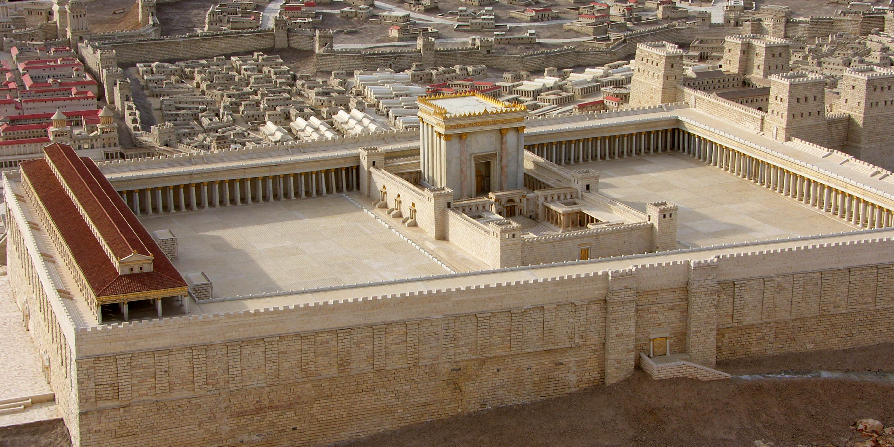
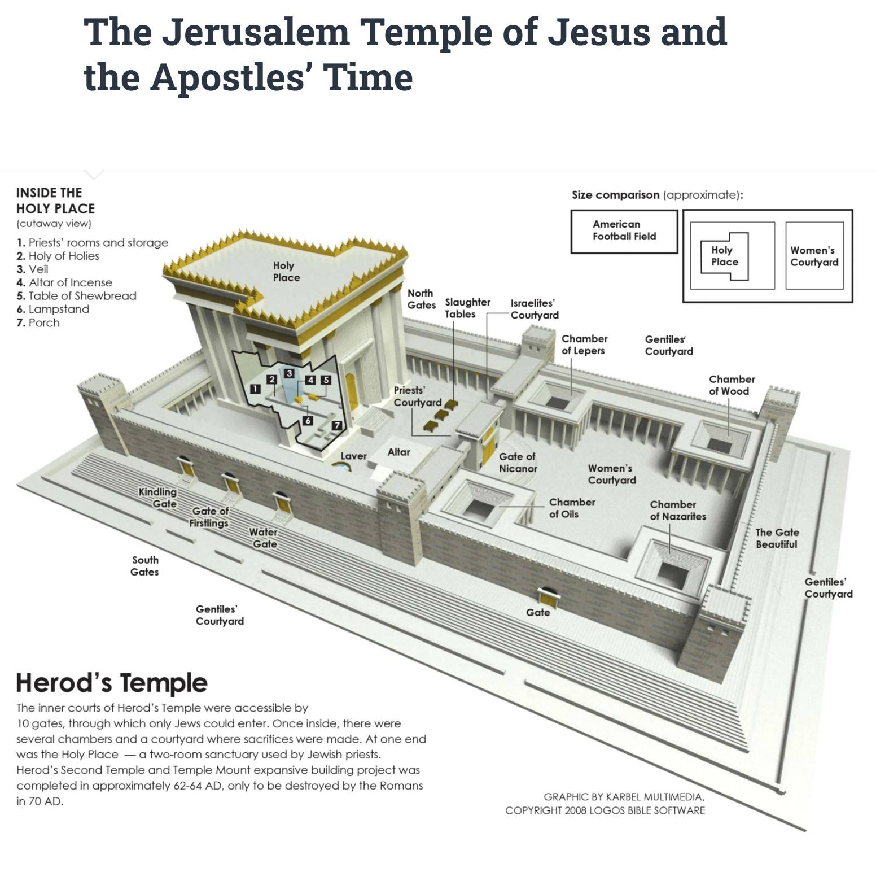
^{11:1} Then I was given a measuring rod like a staff, and I was told, “Rise and measure the temple of God and the altar and those who worship there, ² but do not measure the court outside the temple; leave that out, for it is given over to the nations, and they will trample the holy city for forty-two months. (ESV)
https://en.wikipedia.org/wiki/Temple_Mount#/media/File:19_Shrine_of_the_Book_005.jpg
https://christianpublishinghouse.co/2024/04/18/the-jerusalem-temple-of-jesus-and-the-apostles-time/

Slide 7
^{11:1} Then I was given a measuring rod like a staff, and I was told, “Rise and measure the temple of God and the altar and those who worship there, ² but do not measure the court outside the temple; leave that out, for it is given over to the nations, and they will trample the holy city for forty-two months. (ESV)
So, what is going on here?
Borrowing heavily from the imagery of Ezekiel 40–43 and Zechariah 2 as well as other Old Testament passages, John is called to participate directly in a symbolic act of prophetic theater or enacted prophesy.
In these acts, the physical performance itself becomes the prophecy.
The action serves as a living, visual sign that both illustrates and guarantees the divine truth being declared.
In Old Testament prophetic tradition, the “measuring line” (qav) or “measuring rod” (qaneh) is a dual-edged symbol.
The use of these terms in the Old Testament help explain why John is told here to measure the inner temple (“the temple of God and the altar and those who worship there”) while leaving “the court outside the temple” unmeasured.

Slide 8
^{11:1} Then I was given a measuring rod like a staff, and I was told, “Rise and measure the temple of God and the altar and those who worship there, ² but do not measure the court outside the temple; leave that out, for it is given over to the nations, and they will trample the holy city for forty-two months. (ESV)
The first thing to keep in mind is that a “measuring line” or “measuring rod” implies exactness – nothing is left to chance.
When God “measures” something in order to protect or restore it, the measurement acts as an official decree of ownership, establishing sacred boundaries and guaranteeing that what lies inside is set apart and preserved from destruction.
Examples of the use of the “measuring line” for protection or restoration:
  Zechariah’s Surveyor (Zechariah 1:16; 2:1–5):
    A man with a “measuring line” goes out to measure Jerusalem.
    The action seals God’s promise to rebuild the ruined city, claim it as His own, and act as a “wall of fire around it”.
  Ezekiel’s Temple (Ezekiel 40–48):
    After the fall of Jerusalem to the Babylonians in 586 B.C., Ezekiel has a vision of a temple in which he sees a divine guide with a “measuring rod ” (40:5) survey every wall, gate, and altar.
    The precise measurements taken guarantee the restoration of God’s glory and create a firm boundary between the holy sanctuary and the common world.

Slide 9
^{11:1} Then I was given a measuring rod like a staff, and I was told, “Rise and measure the temple of God and the altar and those who worship there, ² but do not measure the court outside the temple; leave that out, for it is given over to the nations, and they will trample the holy city for forty-two months. (ESV)
In contrast, stretching a measuring line over a person, city, or nation can also be used to foreshadow an upcoming execution of destruction and divine judgment.
Just as a builder uses a “measuring line” to build straight, God uses a “measuring line” to ensure an absolute, exacting destruction that leaves nothing unpunished.
Examples of the use of the “measuring line” for destruction or judgment:
  Lamentations 2:8:
    Describing the devastation of Jerusalem by Babylon, Jeremiah writes: “The LORD determined to destroy the wall of Daughter Zion. He stretched out a measuring line and did not withdraw His hand from destroying.”
    The measuring line highlights that the ruin was deliberate, calculated, and thorough.
  2 Kings 21:13:
    Announcing judgment on apostate Jerusalem under King Manasseh, God declares: “I will stretch over Jerusalem the measuring line used against Samaria and the plumb line used against the house of Ahab.”
    Samaria had been completely demolished by Assyria; applying the same “measuring line” to Jerusalem meant identical, total annihilation.

Slide 10
^{11:1} Then I was given a measuring rod like a staff, and I was told, “Rise and measure the temple of God and the altar and those who worship there, ² but do not measure the court outside the temple; leave that out, for it is given over to the nations, and they will trample the holy city for forty-two months. (ESV)
In our present passage (Rev 11:1-2) John uses both Old Testament meanings of the “measuring rod” (protection and destruction) at the same time:
  The Measured Sanctuary (Protection): By measuring the inner temple and worshipers, God uses the “measuring rod” in its Zechariah/Ezekiel sense – marking out the Jewish-Christian worshipers (the true Church) for spiritual protection and preservation so they do not perish in the coming wrath.
  The Unmeasured Outer Court (Destruction): By commanding John not to measure the outer court, God uses the “measuring rod” in its Lamentations/2 Kings sense – abandoning physical, apostate Jerusalem to the Roman legions to be trampled for “forty-two months”.

Slide 11
^{11:1} Then I was given a measuring rod like a staff, and I was told, “Rise and measure the temple of God and the altar and those who worship there, 2 but do not measure the court outside the temple; leave that out, for it is given over to the nations, and they will trample the holy city for forty-two months. (ESV)
Next, we read: “it is given over to the nations, and they will trample the holy city” – This fulfills Jesus' prophecy in Luke 21:24: “Jerusalem [the holy city] will be trampled underfoot by the Gentiles [the nations].”
“for forty-two months” – The Roman military campaign in Judea – from Vespasian's invasion in early AD 67 to the destruction of the Temple in August AD 70 – lasted about 42 months (3 ½ years)!
This is also a remarkable fulfillment of Daniel 12:1-12 which prophesies this future destruction of the temple by the Romans:
  In Daniel 12:7, the Christ figure (called the “man clothed in linen”) “raised his right hand and his left hand toward heaven and swore” that “the time of the end” (cf. Dan 12:4) will come after a 3 ½ year period (“time, times, and half a time”)
  Then in Daniel 12:11, it describes the time period between the arrival of the Roman army (referred to there as “the abomination that makes desolate” – cf. Mat 24:15 and Luke 21:20) and the destruction of the temple (which it describes as the time when “the regular burnt offering is taken away”) as 1290 days, which is a period of about 3 ½ years, or, in the words of our present text, “forty-two months”.

Slide 12
The Two Witnesses (11:3-6)
^{11:3} And I will give power to my two witnesses, and they will prophesy for 1,260 days, clothed in sackcloth." ⁴ These are the two olive trees and the two lampstands that stand before the Lord of the earth. ⁵ If anyone tries to harm them, fire comes from their mouths and devours their enemies. This is how anyone who wants to harm them must die. ⁶ These men have power to shut up the sky so that it will not rain during the time they are prophesying; and they have power to turn the waters into blood and to strike the earth with every kind of plague as often as they want.

Slide 13
^{11:3} And I will grant authority to my two witnesses, and they will prophesy for 1,260 days, clothed in sackcloth. ⁴ These are the two olive trees and the two lampstands that stand before the Lord of the earth. (ESV)
Here John rather abruptly introduces “two witnesses” whom he has not previously mentioned.
We’re told that God authorizes these “two witnesses” to “prophesy for 1,260 days , clothed in sackcloth”
  “two witnesses” – Represents the minimum legal requirement of witnesses needed to establish truth under biblical law (Deut 17:6; 19:15; Matt 18:16; 2 Cor 13:1)
  “for 1,260 days” – the equivalent of “forty-two” idealized thirty-day “months” (see the previous verse), which, as we have already observed, is how long the Roman siege of Jerusalem lasted.
  “clothed in sackcloth” – a sign of mourning and repentance (Jonah 3:5; Jer. 4:8); also, the traditional attire of Old Testament prophets warning of covenantal curses and impending doom (Isaiah 20:2; Jer 4:8)

Slide 14
^{11:3} And I will grant authority to my two witnesses, and they will prophesy for 1,260 days, clothed in sackcloth. ⁴ These are the two olive trees and the two lampstands that stand before the Lord of the earth. (ESV)
So, what is happening here?
As we think back over what has been presented so far in the Book of Revelation, what we basically see is a courtroom drama:
  God sits as judge
  A sealed scroll announces judgment
  Christ swears an oath (Rev 4–6; 10:1–11:14).
  John, Jesus, and persecuted believers bear witness (Rev 1:2,5,9; 2:13; 3:14; 6:9)
Now John here introduces “two witnesses” standing before God, satisfying the legal requirement for testimony in a capital case against murderous Jerusalem.
Their message, which we’re not given, probably has to do, not with evangelism, but Christ’s judgment against Jerusalem and its temple.
Commentaries have made numerous suggestions as to who these two witnesses might represent, but I do not believe we are given enough information to determine who they are with certainty.

Slide 15
^{11:3} And I will grant authority to my two witnesses, and they will prophesy for 1,260 days, clothed in sackcloth. ⁴ These are the two olive trees and the two lampstands that stand before the Lord of the earth. (ESV)
In my opinion, the three most plausible suggestions for who these “two witnesses” represent are:
  The witnesses represent the Old Testament’s testimony:
    On this interpretation, the two witnesses symbolize the Law and the Prophets, represented by Moses and Elijah.
    The whole Old Testament bears witness that Jesus is the Messiah—and therefore stands as a witness against Israel’s rejection of him.
  The witnesses represent first-century Christianity:
    Here the witnesses symbolize the Christian community, especially Jewish Christians.
    They could represent the “apostles and prophets” who form the foundation of God’s new temple (Eph 2:19–20; 1 Pet 2:5–9).
  The witnesses are two actual Christian prophets in Jerusalem:
    Gentry proposes that two Jewish Christian prophets may have remained in Jerusalem during the Jewish War, warning its inhabitants that Christ was bringing judgment upon the city and temple.
    Most Jewish Christians fled to Pella.
    Gentry suggests that two may have stayed behind specifically to bear this final testimony.
    The biggest downside for this view is there is that there is no surviving historical evidence to support the idea that men such as these really existed.

Slide 16
^{11:3} And I will grant authority to my two witnesses, and they will prophesy for 1,260 days, clothed in sackcloth. ⁴ These are the two olive trees and the two lampstands that stand before the Lord of the earth. (ESV)
Drawing on an Old Testament metaphor, John goes on to say that the witnesses are “the two olive trees and the two lampstands”.
This imagery comes from Zechariah 4, where olive trees supply oil to a lampstand.
The two anointed figures in that passage are associated with Joshua the high priest and Zerubbabel the governor – leaders in rebuilding God’s temple at that time.
Oil points to the Spirit’s power: “Not by might nor by power, but by my Spirit” (Zechariah 4:6).
As such, John is saying that the two witnesses serve through divine strength as they receive an uninterrupted supply of the Holy Spirit to shine light in a spiritually darkened, apostate city.

Slide 17
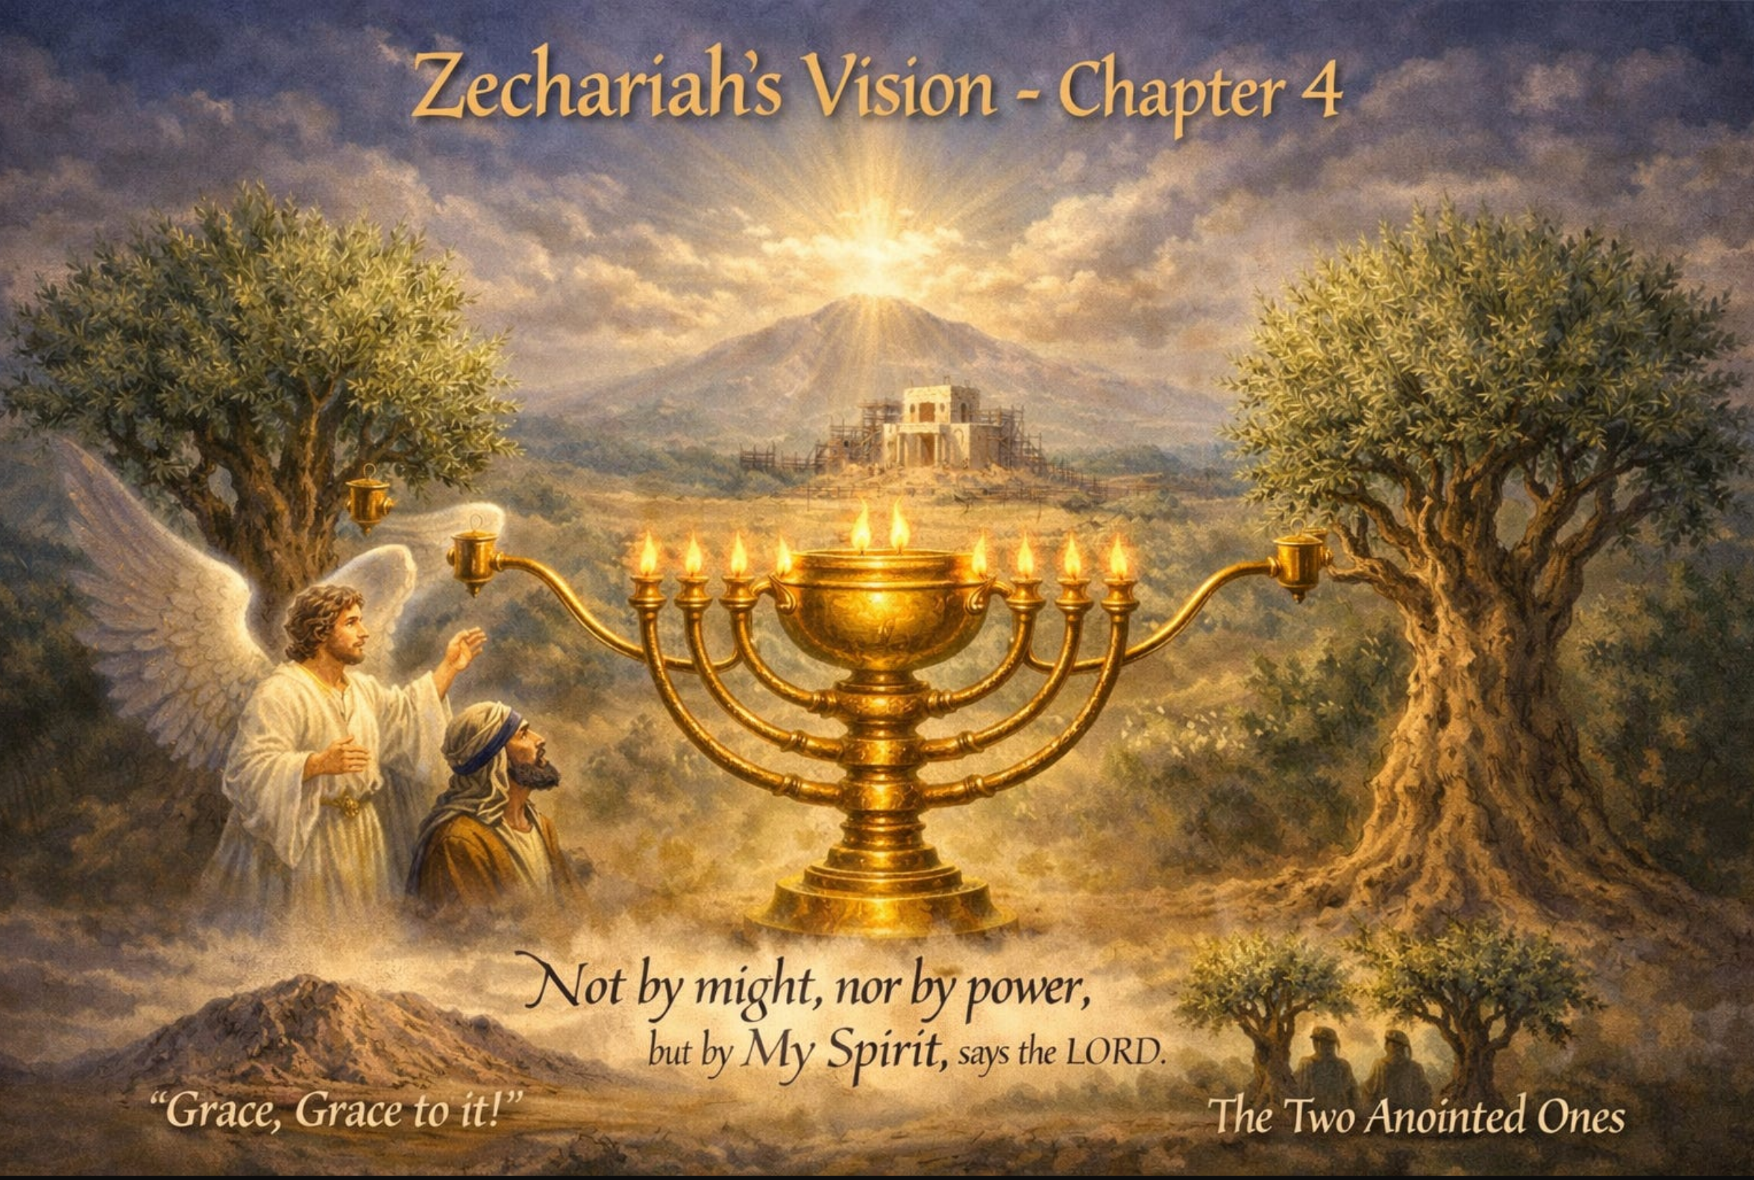
^{11:3} And I will grant authority to my two witnesses, and they will prophesy for 1,260 days, clothed in sackcloth. ⁴ These are the two olive trees and the two lampstands that stand before the Lord of the earth. (ESV)
https://centeredonchrist.substack.com/p/the-vision-of-a-golden-lampstand

Slide 18
^{11:5} And if anyone would harm them, fire pours from their mouth and consumes their foes. If anyone would harm them, this is how he is doomed to be killed. ⁶ They have the power to shut the sky, that no rain may fall during the days of their prophesying, and they have power over the waters to turn them into blood and to strike the earth with every kind of plague, as often as they desire. (ESV)
Here we see the ministry of the two witnesses mirrors the power and authority of the prophets of old.
The “fire” that “pours from their mouth and consumes their foes” echoes Jeremiah 5:14 – “I will make my words in your mouth a fire, and this people wood, and it shall devour them”.
This signifies the invincible power of God's proclaimed judgment.
No power in Judea or Rome could silence the witnesses’ message until their testimony was fully completed.
“the power to shut the sky” brings to mind Elijah’s 3 ½ year drought during the reign of Ahab (1 Kings 17:1).
Spiritual drought and famine gripped apostate Judea during the 3 ½ years of the Jewish War.
The “power over the waters to turn them into blood” and “to strike the earth with every kind of plague” brings to mind Moses’ judgment on Pharaoh's Egypt (Exodus 7–11).
The plague imagery presents Jerusalem as another Egypt – resisting God while facing his judgments.

Slide 19
The Defeat of the Witnesses by the Beast (11:7-10)
^{11:7} Now when they have finished their testimony, the beast that comes up from the Abyss will attack them, and overpower and kill them. ⁸ Their bodies will lie in the street of the great city, which is figuratively called Sodom and Egypt, where also their Lord was crucified. ⁹ For three and a half days men from every people, tribe, language and nation will gaze on their bodies and refuse them burial. ¹⁰ The inhabitants of the earth will gloat over them and will celebrate by sending each other gifts, because these two prophets had tormented those who live on the earth.

Slide 20
^{11:7} And when they have finished their testimony, the beast that rises from the bottomless pit will make war on them and conquer them and kill them, ⁸ and their dead bodies will lie in the street of the great city that symbolically is called Sodom and Egypt, where their Lord was crucified. (ESV)
The witnesses die only “when they have finished their testimony”.
God controls the timing, just as Jesus’ enemies could not seize him before his hour arrived (John 7:30; 8:20).
The “beast” is the Roman imperial power, described more fully in Revelation 13.
Its emergence from the “bottomless pit” reveals its evil spiritual character; its “war on them” brings to mind Daniel’s beast that made war with the saints – “this horn made war with the saints and prevailed over them” (Daniel 7:21).
These prophets were most likely killed by Roman forces near the end of the war, possibly from a catapult stone, as Josephus reports happened to Jesus son of Ananus.
But the historical details concerning these witnesses are unknown.
Their deaths complete their testimony through martyrdom and associate them with the other servants whose blood cries for vindication (Revelation 6:9–11).

Slide 21
^{11:7} And when they have finished their testimony, the beast that rises from the bottomless pit will make war on them and conquer them and kill them, ⁸ and their dead bodies will lie in the street of the great city that symbolically is called Sodom and Egypt, where their Lord was crucified. (ESV)
The city being spoken of here is unmistakably Jerusalem: the place “where their Lord was crucified”.
Its spiritual names expose its moral condition. “Sodom” signifies corruption; “Egypt” signifies oppression of God’s people.
The Old Testament prophets had already compared Jerusalem with “Sodom” (Isaiah 1:10; Jeremiah 23:14; Ezekiel 16:46).
Jerusalem’s treatment of the witnesses continues its history of persecuting God’s messengers.
You’ll recall, Jesus, in his Olivet Discourse, charged it with responsibility for righteous blood and announced judgment upon his generation (Matthew 23:34–38).
“their dead bodies” that “lie in the street” display the apparent defeat of those who proclaimed the truth about Christ.

Slide 22
^{11:9} For three and a half days some from the peoples and tribes and languages and nations will gaze at their dead bodies and refuse to let them be placed in a tomb, ¹⁰ and those who dwell on the earth [“in the Land”] will rejoice over them and make merry and exchange presents, because these two prophets had been a torment to those who dwell on the earth. (ESV)
People from different nations observe the bodies and refuse them burial.
The international observers are people from among the nations, present in Jerusalem, much like the diverse gathering on the Day of Pentecost (Acts 2:5,9–11,19–20,32; 19:21; 20:16).
Denied burial expresses exceptional contempt (Psalm 79:2–3; Jeremiah 16:4).
The witnesses are treated as people whose message deserves disgrace.
Their humiliation lasts only “three and a half days”.
This short interval stands in contrast with their extended ministry (“1,260 days” – see verse 3) and anticipates the reversal of their apparent defeat.
Their experience follows the pattern of Christ’s suffering, death, and vindication – 3 days in the grave after 3 years of ministry.

Slide 23
^{11:9} For three and a half days some from the peoples and tribes and languages and nations will gaze at their dead bodies and refuse to let them be placed in a tomb, ¹⁰ and those who dwell on the earth [“in the Land”] will rejoice over them and make merry and exchange presents, because these two prophets had been a torment to those who dwell on the earth [“in the Land”]. (ESV)
The inhabitants “who dwell in the Land” “rejoice” and “exchange presents” because “these two prophets had been a torment to those who dwell in the Land”.
Their warnings of the two witnesses disturbed the confidence of the Jews under siege that Jerusalem and its temple would receive unconditional divine protection.
With the witnesses dead, their opponents imagine that their threatening testimony has been defeated.
Their celebration reveals their rejection of God’s message.
Yet silencing the messengers cannot cancel the judgment they announced.
The apparent victory prepares the way for God’s public vindication of their testimony.

Slide 24
The Vindication of the Two Witnesses (11:11-13)
^{11:11} But after the three and a half days a breath of life from God entered them, and they stood on their feet, and terror struck those who saw them. ¹² Then they heard a loud voice from heaven saying to them, “Come up here.” And they went up to heaven in a cloud, while their enemies looked on. ¹³ At that very hour there was a severe earthquake and a tenth of the city collapsed. Seven thousand people were killed in the earthquake, and the survivors were terrified and gave glory to the God of heaven. (NIV)

Slide 25
^{11:11} But after the three and a half days a breath of life from God entered them, and they stood up on their feet, and great fear fell on those who saw them. ¹² Then they heard a loud voice from heaven saying to them, "Come up here!" And they went up to heaven in a cloud, and their enemies watched them. (ESV)
The resurrection probably symbolizes Christianity’s survival and renewal, rather than a literal visible bodily resurrection of the two witnesses.
John borrows Ezekiel’s language about breath entering “dry bones” and “they stood up on their feet” – a picture of Israel’s restoration after the Babylonian judgment (Ezek 37:5,10).
Although the witnesses are individuals, they represent Christianity emerging as a living, new covenant Israel rising from the condemned old covenant order (Rev 2:9; 3:9).
Other passages similarly use resurrection imagery for restoration or vindication (Isa 26:13–19; Dan 12:2; Rom 11:16–21; Luke 2:34).
Jerusalem’s collapse does not destroy the Christian faith.
Instead, it confirms the prophets’ warnings and reveals the living new covenant community.

Slide 26
^{11:11} But after the three and a half days a breath of life from God entered them, and they stood up on their feet, and great fear fell on those who saw them. ¹² Then they heard a loud voice from heaven saying to them, "Come up here!" And they went up to heaven in a cloud, and their enemies watched them. (ESV)
The witnesses’ ascent “in a cloud” signifies God’s acceptance and vindication.
Heaven’s command, “Come up here,” brings to mind John’s summons (Rev 4:1; 11:12).
God receives the witnesses, approves their testimony, and rewards their faithfulness (Rev 6:10–11; 14:13; 20:4–6).
Their victory fulfills Jesus’ assurances to persecuted disciples (Matt 10:16–32; 24:9–13; Luke 21:12–19).
Earthly death does not prevent heavenly life and reward (Rev 3:21; 6:9–11; 7:9–17; 14:3; 2 Tim 4:6–8; Col 1:5; 1 Pet 1:4).
Rome destroys neither these martyrs’ life with God nor the Christianity they represent.

Slide 27
^{11:13} And at that hour there was a great earthquake, and a tenth of the city fell. Seven thousand people were killed in the earthquake, and the rest were terrified and gave glory to the God of heaven. (ESV)
The “great earthquake” represents divine judgment.
Whether literal or figurative, it vindicates the murdered witnesses.
The fallen “tenth of the city” and “seven thousand” deaths need not be mathematically exact.
Nevertheless, seven thousand was approximately a tenth of Jerusalem’s estimated 70,000–75,000 permanent residents.
More than likely, the “tenth” is an initial installment of greater destruction, since the seventh trumpet remains ahead.
It may represent the casualties that occurred when the Romans first entered the temple, but it does not represent the total number of deaths that resulted from the siege.
The survivors’ giving “glory to the God of heaven” probably expresses terrified acknowledgment rather than saving repentance (Rev 11:13).
Fear and acknowledgment do not necessarily prove genuine faith (Josh 7:19; 1 Sam 6:5; Jonah 1:9–10,16; Phil 2:11).

Slide 28

Class Discussion Time
Were you surprised to see how many times in scripture God uses a “measuring rod” as a means of foreshadowing sometimes judgment and sometimes protection?
Perhaps you’ve come a across a passage in your daily reading where God was “taking measure” of some person or thing and wondered what that was all about.
Do you think today’s lesson will prove helpful when looking at those kind of passages in the future?

Slide 29
Class Discussion Time
The witnesses gave a message of warning and judgment to the people of the Land (of Israel). Was that a good thing or a bad thing?
How did the people of the Land (of Israel) view their warning and judgment – as a good thing or a bad thing?
Given this example, what kind of response can we expect when we evangelize unbelievers and warn them that they are in danger of judgment?
Have you ever tried to talk to someone about the Gospel and their need for salvation and then felt bad about it later because they had a bad response? And if so, did you let it discourage you from evangelizing others?

Slide 30
Class Discussion Time
The section of Revelation that we covered today is considered by almost all the commentaries on the book of Revelation (regardless of their theological approach to the book) as one of the most difficult sections to understand.
After looking at this portion in class today, how confident do you feel that I have gotten it right?
Does what I have laid out make sense? Does it seem to fit well with the context that we have covered so far?

