Slide 1
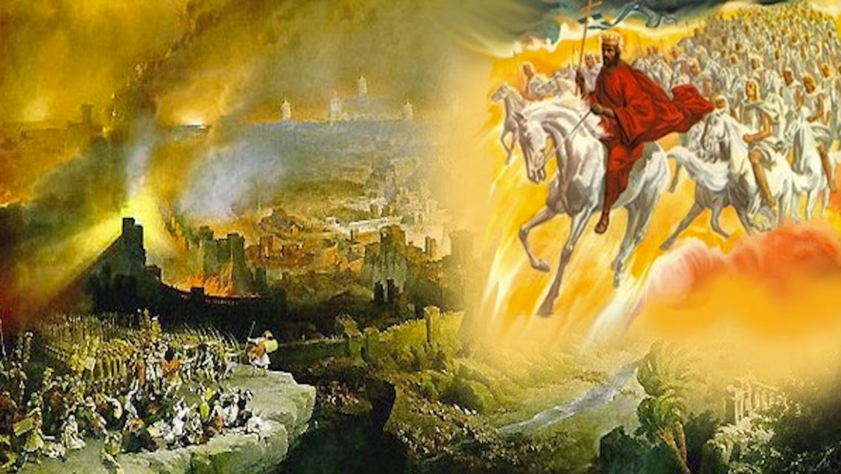
The Book of Revelation
Image credit – https://www.bible.com/events/84698
“The kingdom of the world has become the kingdom of our Lord and of His Christ,
and He shall reign forever and ever.” (Revelation 11:15)
Class recording and notes will be available on https://www.purifiedbyfaith.com/

Slide 2
High Level Outline of the Book of Revelation
Introduction (1:1-8)
Jesus Among the Seven Churches (1:9-20)
Letters to the Seven Churches: (2-3)
The Throne of God and the Lamb (4-5)
Three Sets of Divine Judgments (6:1-16:21)
  Seven Seals (6:1-17; 8:1)
    Interlude Between Seal 6 and 7: Sealing of the 144,000 (7:1-8); Great Multitude Before the Throne (7:9-17)
  Seven Trumpets (8:2-9:21; 11:14-19)
    Interlude Between Trumpet 6 and 7: Angel and the Scroll (10:1-11); Measuring the Temple (11:1-2); The Two Witnesses (11:3-13)
  Interlude Between Trumpets and Bowls: Persecution, Deliverance and Judgment (12–14)
  Seven Bowls (15–16)
The Fall of Babylon (17:1-19:10)
The Last Battle (19:11-20:15)
The Marriage of Heaven and Earth (21:1-22:5)
Epilogue (22:6-21)

Slide 3
Introduction to Revelation Chapter 12
Revelation 12 explains the spiritual conflict behind the suffering of the first-century church.
Enemies of the first-century church included unbelieving Israel initially, and then eventually, Rome – but behind these earthly opponents stood Satan and his forces (Ephesians 6:12).
Chapter 12 reaches back in time to explain the origin of the conflict portrayed by the visions that unfold in the book of Revelation.
The woman, her offspring, and the dragon bring to mind the promise made to Adam and Eve all the way back in the book of Genesis, that the woman’s seed would defeat the serpent (Genesis 3:15).
As in the previous sections, the primary concern in chapter 12 continues to be the events that would “soon” take place in John’s own time (Revelation 1:1, 3; 22:6, 10).
By showing Christ as victorious and enthroned, John encourages Christians to remain faithful through the persecution that lies ahead.

Slide 4
The Woman and the Dragon (12:1-6)
^{12:1} A great and wondrous sign appeared in heaven: a woman clothed with the sun, with the moon under her feet and a crown of twelve stars on her head. ² She was pregnant and cried out in pain as she was about to give birth. ³ Then another sign appeared in heaven: an enormous red dragon with seven heads and ten horns and seven crowns on his heads. ⁴ His tail swept a third of the stars out of the sky and flung them to the earth. The dragon stood in front of the woman who was about to give birth, so that he might devour her child the moment it was born. ⁵ She gave birth to a son, a male child, who will rule all the nations with an iron scepter. And her child was snatched up to God and to his throne. ⁶ The woman fled into the desert to a place prepared for her by God, where she might be taken care of for 1,260 days. (NIV)

Slide 5
^{12:1} And a great sign appeared in heaven: a woman clothed with the sun, with the moon under her feet, and on her head a crown of twelve stars. (ESV)
The word “sign” appears here for the first time in the book of Revelation, where it appears a total of seven times:
  three in the singular (12:1, 3; 15:1)
  four in the plural (13:13, 14; 16:14; 19:20).
A “sign” is something remarkable that captures attention, often a miracle –the Gospel of John uses it frequently.
“appeared” is an unusual way for John to introduce a vision, since he normally uses “after these things” or “I saw”.
Consequently, the use of the word “appeared” here draws even more attention to this important sign.
The “woman” and her adversary (“great red dragon”) are signs that alert readers to the book’s key conflict.
The woman here is called a “great sign,” while the dragon, who first appears in verse 3, is called only “another sign,” even though he is “great” (or, as the NIV translates it, “enormous”) in size.

Slide 6
^{12:1} And a great sign appeared in heaven: a woman clothed with the sun, with the moon under her feet, and on her head a crown of twelve stars. (ESV)
“in heaven” refers to the abode of God where these things take place:
  The preceding verse talks about the temple “in heaven” (11:19).
  Later Michael and his angels are said to be “in heaven” (12:7)
  After that we are told that Satan is cast out of “heaven” so he can no longer accuse the saints before God’s throne (12:8–9; cf. Job 1:6–12; 2:1–7)
  Then after that we’re told that a “loud voice in heaven” speaks of God and Christ (12:10).
  John here continues to gives us the heavenly view of earthly events, as he himself has been caught up to “heaven” (4:1–2).
From heaven’s perspective the “woman” is not only “great”, but she is also glorious:
For she is “clothed with the sun, with the moon under her feet, and on her head a crown of twelve stars”.

Slide 7
^{12:1} And a great sign appeared in heaven: a woman clothed with the sun, with the moon under her feet, and on her head a crown of twelve stars. (ESV)
“sun”, “moon” and “stars” are the complete biblical description of light-bearing heavenly bodies going all the way back to Genesis (Gen 1:16).
In fact, these light-bearing heavenly bodies are set in the heavens by God at the beginning of Creation for the purpose of giving light to the earth (Gen 1:17),
And now we see here that the “woman” is arrayed in light from her head to her feet!
The description given here of the woman uses imagery drawn from Genesis 37:9—Joseph's dream of the sun, moon, and eleven stars bowing to him:
  Then [Joseph] dreamed another dream and told it to his brothers and said, ‘Behold, I have dreamed another dream. Behold, the sun, the moon, and eleven stars were bowing down to me.’ But when he told it to his father and to his brothers, his father rebuked him and said to him, "What is this dream that you have dreamed? Shall I and your mother and your brothers indeed come to bow ourselves to the ground before you?" And his brothers were jealous of him, but his father kept the saying in mind. (Gen 37:9-11).

Slide 8
^{12:1} And a great sign appeared in heaven: a woman clothed with the sun, with the moon under her feet, and on her head a crown of twelve stars. (ESV)
In that dream, the sun, moon and stars represented Jacob's entire family: the patriarchs and the twelve tribes of Israel:
Genesis 37:9-11 | Revelation 12:1
The sun = Joseph’s father, Jacob | Clothed with the sun
The moon = Joseph’s mother | Moon under her feet
Eleven stars (plus Joseph) = twelve brothers | Crown of twelve stars
Joseph's family = the origin of the nation of Israel | Implication: The woman represents Israel?
In other words, the apparent allusion in Revelation 12:1 to Genesis 37:9 might suggest that the woman represents the nation of Israel – i.e., the covenant people of God.
But before we can fully confirm the identity of this “woman”, we need to take a look at some of the other important descriptive information given to us about her in the next few verses.

Slide 9
^{12:2} She was pregnant and was crying out in birth pains and the agony of giving birth…⁵ She gave birth to a male child, one who is to rule all the nations with a rod of iron, but her child was caught up to God and to his throne, ⁶ and the woman fled into the wilderness, where she has a place prepared by God, in which she is to be nourished for 1,260 days. (ESV)
We’re told here that the woman:
  “was pregnant ”
  “was crying out in birth pains and the agony of giving birth”.
  “She gave birth to a male child , one who”:
    “is to rule all the nations with a rod of iron”
    “was caught up to God and to his throne”
  “[she] fled into the wilderness, where she has a place prepared by God, in which she is to be nourished for 1,260 days”
I believe we can easily identify the “male child” to whom she gives birth as Jesus, by matching the descriptions given of him here with two Old Testament passages that we looked at last week concerning Jesus:
  In Ps 2:9, which ultimately applies to Jesus as God’s anointed king, it says “[he] shall break [the nations] with a rod of iron” – a description which Rev 2:27 and 19:15 also apply to Jesus.
  In Dan 7:13-14 it tells us that Jesus (the “son of man”) was given this authority over the nations when he came before the “Ancient of Days” at his ascension.

Slide 10
^{12:2} She was pregnant and was crying out in birth pains and the agony of giving birth…⁵ She gave birth to a male child, one who is to rule all the nations with a rod of iron, but her child was caught up to God and to his throne, ⁶ and the woman fled into the wilderness, where she has a place prepared by God, in which she is to be nourished for 1,260 days. (ESV)
The Roman Catholics want to identify the “woman” here as Mary, since she is the one who physically gave birth to Jesus – but I believe that is too narrow.
For example, later in this chapter (verse 17), it tells us that the “offspring” of the “woman” are “those who keep the commandments of God and hold to the testimony of Jesus” – a statement that is obviously too broad to be true of just Mary.
Also, here in verse 6 she is said to flee “into the wilderness” for “1,260 days” – something for which there is no historical parallel in the life of Mary.
On the other hand, as we saw earlier, the connection of the woman being clothed with the sun, moon, and stars with Joseph’s dream in Genesis 37:9 would suggest that the woman represents the entire family of Israel – the covenant people of God.
And furthermore, it can be said that the family of Israel “gave birth to” Christ in the sense that Christ, in his humanity, was birthed from the Israelite community (Rom 9:4-5)

Slide 11
^{12:2} She was pregnant and was crying out in birth pains and the agony of giving birth…⁵ She gave birth to a male child, one who is to rule all the nations with a rod of iron, but her child was caught up to God and to his throne, ⁶ and the woman fled into the wilderness, where she has a place prepared by God, in which she is to be nourished for 1,260 days. (ESV)
In addition to these reasons, it turns out that the wording in this passage also seems to have roots in two passages (found in the book of Isaiah) which corporately portray the nation of Israel as a “woman” giving birth:
  Isaiah 26:17-18 – Like a pregnant woman who writhes and cries out in her pangs when she is near to giving birth, so were we [Israelites] because of you, O LORD; we were pregnant, we writhed, but we have given birth to wind. We have accomplished no deliverance in the earth, and the inhabitants of the world have not fallen.
  Isaiah 66:7-9 – “Before she was in labor she gave birth; before her pain came upon her she delivered a son. Who has heard such a thing? Who has seen such things? Shall a land be born in one day? Shall a nation be brought forth in one moment? For as soon as Zion was in labor she brought forth her children. Shall I bring to the point of birth and not cause to bring forth?” says the LORD; “shall I, who cause to bring forth, shut the womb?” says your God.

Slide 12
^{Isaiah 26:17} Like a pregnant woman who writhes and cries out in her pangs when she is near to giving birth, so were we because of you, O LORD; ¹⁸ we were pregnant, we writhed, but we have given birth to wind. We have accomplished no deliverance in the earth, and the inhabitants of the world have not fallen. (ESV)
Isaiah 26:17–18 is a confession of Israel’s complete helplessness, using the metaphor of a woman in labor whose pain produces nothing.
Israel confesses that all her own efforts to produce “deliverance” have failed.
The labor metaphor is deliberately ironic:
  The imagery of labor: A woman in labor endures intense pain, but normally with the hope that the pain leads to a child. What is being metaphorically portrayed here is the nation’s anticipation of relief while suffering under judgment.
  The tragic twist: But instead of a child, she gives birth to “wind” – a figure for an abortive, empty effort. All the pain of childbirth produced nothing!
  The point: “We have accomplished no deliverance” – Israel cannot save herself. Her own strength, alliances, and plans have yielded only exhaustion and futility.

Slide 13
^{Isaiah 66:7} “Before she was in labor she gave birth; before her pain came upon her she delivered a son. ⁸ Who has heard such a thing? Who has seen such things? Shall a land be born in one day? Shall a nation be brought forth in one moment? For as soon as Zion was in labor she brought forth her children. ⁹ Shall I bring to the point of birth and not cause to bring forth?" says the LORD; "shall I, who cause to bring forth, shut the womb?" says your God. (ESV)
There is a strong and widely recognized connection between the woman who gives birth in Revelation 12 and the woman (“Zion”) who gives birth in Isaiah 66:7-9.
The scholarly consensus is that Revelation 12 deliberately draws on the imagery of Isaiah 66, which then provides us with essential background for understanding who the woman is and what her birth represents.
The primary contribution of Isaiah 66 is clarifying the identity of the woman and her child.
In Isaiah 66, we are explicitly told that the mother is “Zion” (v. 8).
In other words, the nation itself is the one giving birth.
This seems to confirm the tentative conclusion that we reached when comparing the description of the woman in Revelation 12 with the imagery drawn from Joseph's dream in Genesis 37:9-10 – that the woman described in Revelation 12 is corporate, representing Israel as a whole.

Slide 14
^{Isaiah 66:7} “Before she was in labor she gave birth; before her pain came upon her she delivered a son. ⁸ Who has heard such a thing? Who has seen such things? Shall a land be born in one day? Shall a nation be brought forth in one moment? For as soon as Zion was in labor she brought forth her children. ⁹ Shall I bring to the point of birth and not cause to bring forth?" says the LORD; "shall I, who cause to bring forth, shut the womb?" says your God. (ESV)
Furthermore, in this passage (Isaiah 66:7-9) we also see that “Zion” gives birth, not just to an individual, but to a “land/nation” – terms that I believe, in this context, refer to the new covenant community of God's people.
So, in other words, not only is the woman corporate, but she gives birth to a corporate offspring.
And yet Revelation 12:5 describes the child to whom the woman gives birth as a “male child” who “will rule all the nations with an iron scepter,” which, as we have already seen, is a clear reference to the Jesus (Psalm 2:9; Revelation 2:27; 19:15).
So, how do these two ideas fit together?
Isaiah 66 helps us see that the woman's birth in Revelation 12 is not merely the historical birth of Jesus in Bethlehem.
Rather, it is the messianic community coming to full expression through Christ.

Slide 15
^{Isaiah 66:7} “Before she was in labor she gave birth; before her pain came upon her she delivered a son. ⁸ Who has heard such a thing? Who has seen such things? Shall a land be born in one day? Shall a nation be brought forth in one moment? For as soon as Zion was in labor she brought forth her children. ⁹ Shall I bring to the point of birth and not cause to bring forth?" says the LORD; "shall I, who cause to bring forth, shut the womb?" says your God. (ESV)
In other words, the “male child” of Revelation 12:5 ultimately encompasses both Christ and the Church in union with Him.
So that the birth that Zion experiences here metaphorically describes the entire redemptive process: the Messiah is brought forth from Israel, and through His victory, the new Israel – the Church – is born.
And indeed, as I mentioned earlier, a little further on in chapter 12 (which we will not get to today) it confirms this very idea when it describes the “offspring” of the woman as “those [plural] who keep the commandments of God and hold to the testimony of Jesus”, i.e. New Covenant believers. (Rev 12:17)

Slide 16
^{Isaiah 66:7} “Before she was in labor she gave birth; before her pain came upon her she delivered a son. ⁸ Who has heard such a thing? Who has seen such things? Shall a land be born in one day? Shall a nation be brought forth in one moment? For as soon as Zion was in labor she brought forth her children. ⁹ Shall I bring to the point of birth and not cause to bring forth?" says the LORD; "shall I, who cause to bring forth, shut the womb?" says your God. (ESV)
Recognizing this connection guards against a purely individualistic reading of Revelation 12.
The “woman” in Revelation 12 is not just Mary (though in one sense it includes her).
The “woman” in Revelation 12 represents the corporate people of Israel from whom and through whom the Messiah comes.
The birth pangs in Isaiah 66 (and Revelation 12) represent the long, painful history of Israel's longing and suffering as she awaited the fulfillment of God's promises.
The “sudden” birth in Isaiah 66:7 (“before her pain came upon her she delivered a son”) finds its ultimate fulfillment in the resurrection and exaltation of Christ, when the Messiah is “caught up to God and to his throne” (Revelation 12:5), and a large portion of the new covenant community is born in “one day” on the day of Pentecost.

Slide 17
^{Isaiah 26:17} Like a pregnant woman who writhes and cries out in her pangs when she is near to giving birth, so were we because of you, O LORD; ¹⁸ we were pregnant, we writhed, but we have given birth to wind. We have accomplished no deliverance in the earth, and the inhabitants of the world have not fallen. (ESV)
Going back now to Isaiah 26:17 – this verse serves as the necessary backdrop for the sudden, painless birth of Isaiah 66:7-9 that we just looked at:
Isaiah 26 declares that human effort produces nothing (“wind”).
Isaiah 66 declares that God produces a nation in a single moment, “before she was in labor.”
Isaiah 26 sets up the nation’s impossibility; Isaiah 66 announces God’s solution.
Same woman; different outcome:
The woman is “Zion”/Israel in both texts.

Slide 18
^{Isaiah 26:17} Like a pregnant woman who writhes and cries out in her pangs when she is near to giving birth, so were we because of you, O LORD; ¹⁸ we were pregnant, we writhed, but we have given birth to wind. We have accomplished no deliverance in the earth, and the inhabitants of the world have not fallen. (ESV)
In Isaiah 26, she goes into labor but fails to deliver a child.
In Isaiah 66, she delivers suddenly and successfully – because the birth is God’s work, not hers.
Isaiah 26 ends with “wind”, the very breath of emptiness.
Isaiah 66 promises that God will not “shut the womb” – the labor will not be in vain.
Both of these texts teaches the same theological truth from a different angle: salvation is not something human beings can produce; it is something that God must cause to be born.

Slide 19
^{Revelation 12:6} and the woman fled into the wilderness, where she has a place prepared by God, in which she is to be nourished for 1,260 days. (ESV)
Gentry argues that the “woman” represents, not physical Israel, but ideal Israel: God’s faithful covenant people, through whom the Messiah and the Christian church emerged.
In his mind, she is to be distinguished from unbelieving Israel, which rejected Christ and faced judgment.
Here verse 6 seems to bear that out.
After the child is born and caught up to the throne of God, the woman flees “into the wilderness” where she has a place prepared by God to be nourished for “1,260 days” (three and a half years) – the period of time that Jerusalem was under seige.
I believe this is a metaphorical picture of the Jewish Christian remnant (especially the mother church in Jerusalem) fleeing to safety during the Jewish War.
They did this in response to Christ's explicit warnings in the Olivet Discourse to flee when Jerusalem is surrounded by Roman armies.
Historically, the believers in the Jerusalem church heeded Christ’s warning and escaped to Pella in Perea – an area described by Josephus as mostly desert and rough “wilderness” – just before the total destruction of unrepentant Jerusalem by the Roman armies under Vespasian and Titus.

Slide 20
Summary of what we have learned about the “woman” of Revelation 12
The “woman” of Revelation 12 does not represent a single person (like Mary), but she represents a corporate entity represented by the “sun”, “moon” and “twelve stars”: the covenant people of Israel.
And not just physical Israel but ideal Israel: God’s faithful covenant people, through whom the Messiah and the Christian church emerged.
The “male child” to whom the “woman” gives birth is (primarily) Jesus – who ascends into heaven to the “Ancient of Days” (the Father), to sit at his right hand where he has been given dominion by the Father to “rule the nations with an iron rod”.
As a part of that dominion, a new corporate “nation” (Isaiah 66:8) or “kingdom” (Daniel 2:44) has formed, that is: the new covenant community through whom Jesus carries out his conquest (Psalm 110:3).
During the Roman siege of Jerusalem, the “woman” as she was constituted at that time, was delivered from the ravages of the siege by obeying Jesus’ command (given in the Olivet Discourse) to flee Jerusalem as she fled to Pella, which Josephus tells us is in “the wilderness”.
This concludes our discussion of the “woman” in Rev 12:1-6; Now for the remainder of our time we will look at the “great red dragon” in verses 3-4.

Slide 21
^{12:3} And another sign appeared in heaven: behold, a great red dragon, with seven heads and ten horns, and on his heads seven diadems. (ESV)
The second heavenly “sign” introduces the ultimate enemy of ideal Israel and the church in his most potent form: the dragon, who will be explicitly identified as Satan in verse 9.
“behold” directs our attention to this negative image, emphasizing his “great” size.
The dragon is “red” (purros, fiery red from fire), signifying blood and depicting his bellicose, murderous, and bloodthirsty character as a murderer from the beginning who holds the power of death.
The dragon possesses “seven heads”, “ten horns”, and “seven diadems” on his heads.
The “seven heads” indicate complete rule, the “ten horns” symbolize aggressive and full power, and the “seven diadems” speak of political authority and rule.
This imagery is drawn from the oppressive Pharaoh of the Exodus (portrayed as a great dragon in Ezekiel 29:3) and the terrible beast-empires of Daniel 7.
It prepares the reader for Rome's association with Satan, as the “beast” in chapter 13 likewise has seven heads and ten horns.
This represents a demonic parody of true deity, as Satan operates as the god and ruler of this world (2 Corinthians 4:4; John 12:31; 1 John 5:19).

Slide 22
^{12:4} His tail swept down a third of the stars of heaven and cast them to the earth [Land]. And the dragon stood before the woman who was about to give birth, so that when she bore her child he might devour it. (ESV)
The dragon’s “tail swept down a third of the stars of heaven and cast them to the [Land] ” of Israel.
The stars represent supernatural spiritual beings (angels), as we see in other passages where “stars” symbolize angels (Job 38:7; Judges 5:20; 1 Enoch 43:2; 80:6).
The “third of the stars” continues the pattern of partial, one-third destruction seen under the trumpet judgments, showing that Satan marshals a sizeable portion of his demonic hordes for this evil work.
“to the earth” is better rendered “into the Land”, meaning Israel, the central battleground of Satan’s assault on the kingdom.

Slide 23
^{12:4} His tail swept down a third of the stars of heaven and cast them to the earth [Land]. And the dragon stood before the woman who was about to give birth, so that when she bore her child he might devour it. (ESV)
That assault produced an enormous surge of demonic activity during Christ’s earthly ministry:
  Exorcisms as a sign that “the kingdom of God has come upon you” (Matt 12:28),
  The temptation of Christ in the wilderness (Mark 1:12),
  Disciples authorized to cast out demons (Matt 10:8)
  Satan entering Judas to betray Jesus (John 13:2, 27).
The dragon stands before the woman to devour her child.
Since Eden, when the curse was pronounced (Gen 3:15), Satan has known a coming seed would crush him.
The seed line narrowed from the human race through Abraham’s seed and the faithful remnant down to one person: Christ (Gal 3:16; Matt 1:1).
With the seed having arrived, Satan bargained desperately with Christ (Luke 4:5–7), knew his time was up (Matt 8:29) and moved the Jewish leaders to condemn him: “But this is your hour--when darkness reigns.” (Luke 22:53 NIV)

Slide 24
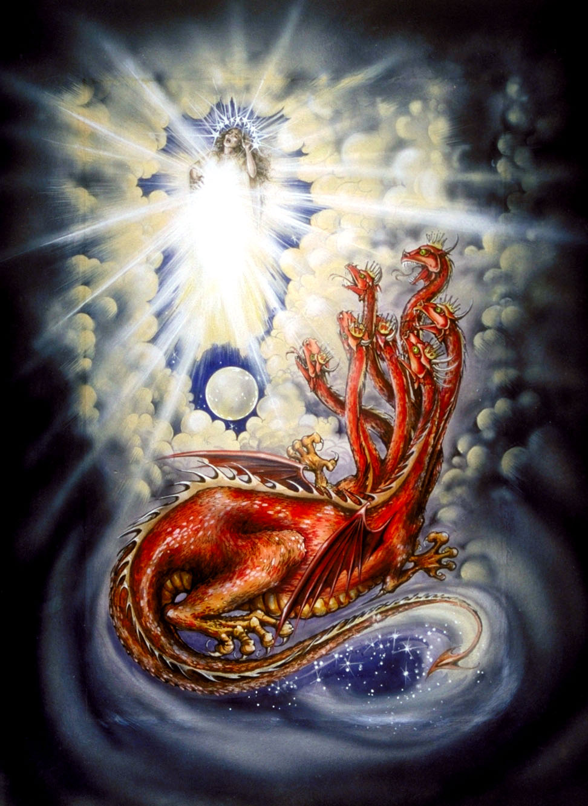
^{12:3} And another sign appeared in heaven: behold, a great red dragon, with seven heads and ten horns, and on his heads seven diadems. ⁴ His tail swept down a third of the stars of heaven and cast them to the earth. And the dragon stood before the woman who was about to give birth, so that when she bore her child he might devour it. (ESV)
Pat Marvenko Smith. Revelation Illustrated: An Artist's View of the Bible's Last Book (1982)

Slide 25

Class Discussion Time
In today’s lesson we examined two texts out of Isaiah that served as background material for John’s description of the woman giving birth: Isaiah 26:17–18 and Isaiah 66:7-9.
And we saw for instance that:
  In Isaiah 26, the woman goes into labor but fails to deliver a child.
  In Isaiah 66, the woman delivers suddenly and successfully – because the birth is God’s work, not hers.
I then concluded by saying that both of these texts teaches the same theological truth from a different angle: salvation is not something human beings can produce; it is something that God must cause to be born.
This is a broad biblical principle which lies behind the all that we do in our Christian life, and even the very Gospel itself.
What are some practical out workings of this principal the you have seen in your life, or perhaps in the lives of others around you?

Slide 26
Class Discussion Time
In today’s lesson we saw a couple of instances where symbol of a single person becomes the symbol of a corporate entity:
  The “woman” becomes a corporate symbol of ideal Israel
  Her “male child” ends up representing not just Jesus but the new covenant church that is in union with him.
Did you find this difficult to understand?
This is not the only time we see this kind of thing in scripture.
For example, in Gal 3:16, the Apostle Paul makes a big point that when scripture speaks of Abraham’s “offspring”, it is singular: “Now the promises were made to Abraham and to his offspring. It does not say, ‘And to offsprings,’ referring to many, but referring to one, ‘And to your offspring,’ who is Christ.”
And yet we know that there is a sense in which the promises to Abraham’s “offspring” do refer to a corporate group, as is evident in many other passages (even those written by the Apostle Paul):
  “For the promise to Abraham and his offspring that he would be heir of the world did not come through the law but through the righteousness of faith.” (Rom 4:13)
  “not all are children of Abraham because they are his offspring, but "Through Isaac shall your offspring be named." This means that it is not the children of the flesh who are the children of God, but the children of the promise are counted as offspring.” (Rom 9:7-8)

